Slide 1
Size enlargement
Size enlargement by agglomeration as a unit operation of mechanical process technology is characterized by the structure of the enlarged particles in which, contrary to, for example, crystals or particles obtained by solidification of melt droplets, the shape and size of the original particles are still distinguishable.
Strength of agglomerates derives from the action of binding forces, acting either at the coordination points between the particles or the interfaces between a matrix binder and the particulate solids or, respectively, by the negative capillary pressure of a liquid filling the pore volume.

Slide 2
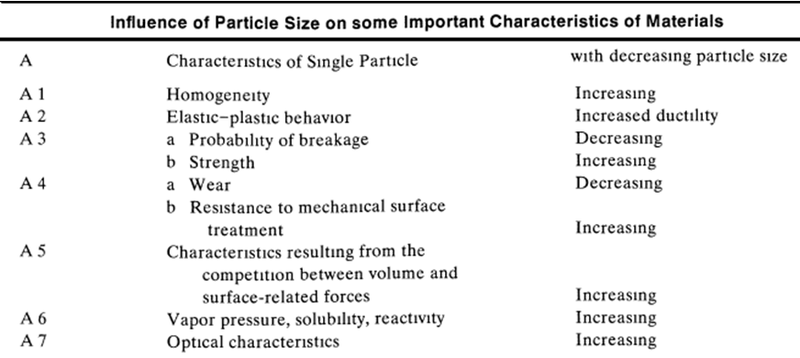

Slide 3
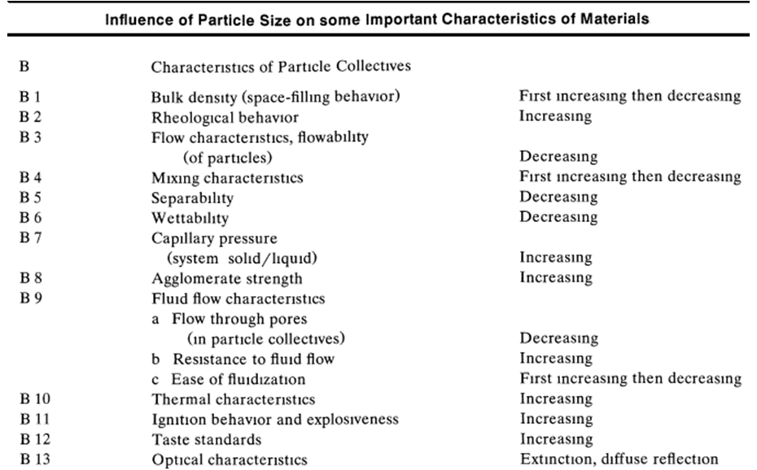

Slide 4
Desired and Undesired Agglomeration
During production and processing of solid matter in disperse systems, adhesion phenomena become more and more important with decreasing particle size, causing aggregation, agglomeration, coating, caking, and build-up.
Adhesion of finely divided material takes place during all operations of mechanical process engineering and can be either desired or undesired.
Adhesion during grinding is always undesirable because it diminishes the grinding effect, lengthens the grinding time, and increases the energy requirement. In some mills an equilibrium between size reduction and size enlargement sets in at a certain fineness and can be avoided only by the addition of dispersion agents or the application of another comminution
method.

Slide 5
Powder mixtures often tend to segregate during handling and storage; then, a controlled agglomeration of the final mix may be desirable prior to further processing.
Because fine powders possess a large bulk volume, generate dust, and exhibit unfavorable transport, storage, and feeding characteristics,
their particle size is sometimes enlarged by agglomeration
In some cases it is necessary to further treat the agglomerate with "anticaking" compounds to avoid clustering during storage.
Agglomeration and adhesion of fine particles are particularly annoying during Transport, Storage, and feeding. Conglomerates can result in clogging of feeders, prevent discharge from silos, and cause incorrect metering. The prevention or destruction of such conglomerates often requires considerable technical efforts.

Slide 6
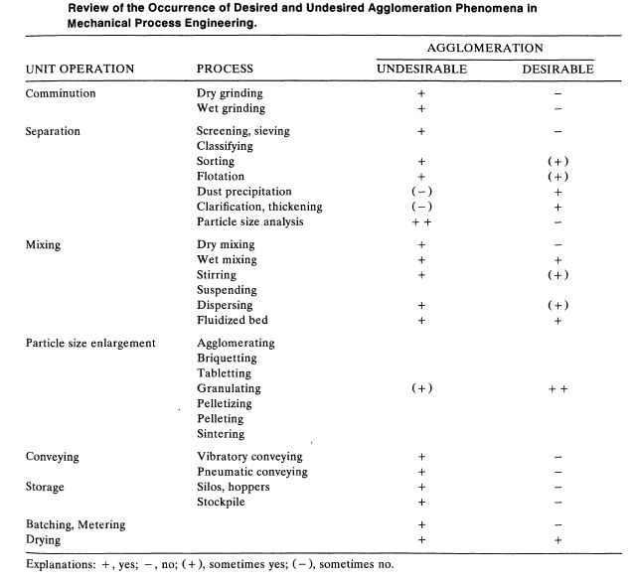

Slide 7
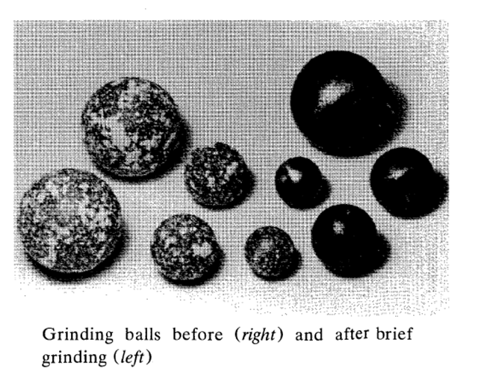

Slide 8
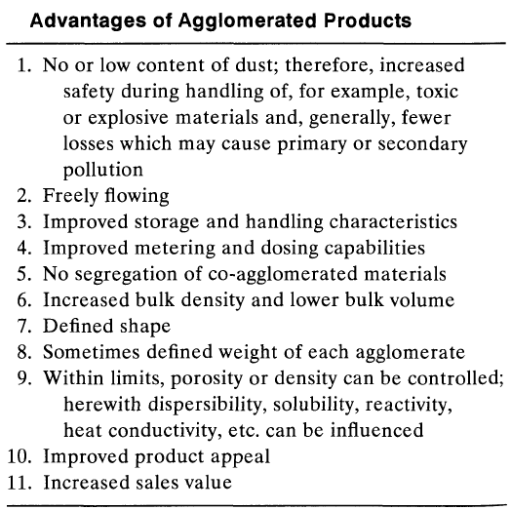

Slide 9
Reasons For Agglomeration
Minimize or eliminate dust
Improve flowability
Improve storage and handling characteristics
Improve metering and dosing characteristics
Formulation stability, prevent segregation

Slide 10
Reasons For Agglomeration
Increase or control bulk density
Defined shape, size, or weight
Solubility control, dispersability
Improved appearance
Increased product value

Slide 11
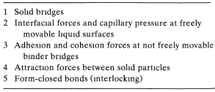
AGGLOMERATE BONDING AND STRENGTH
Binding Mechanisms
To obtain agglomerates from particular matter, binding forces must act between the individual particles. According to Rumpf who
first published a classification, the possible mechanisms can be divided into five major groups.

Slide 12
Binding Mechanisms
(According To Pietsch)
- Solid Bridges - Chemical Reactions - Liquid Bridges
- Sintering - Adhesion Forces -Capillary Pressure
-Crystallization of Soluble - Highly Viscous Binders - Interfacial Forces
Substances - Adsorption Layers
-Hardening of melted subs. -Cohesion Forces
- Matrix Binder - Interlocking - Molecular Forces
- Capillary Forces -Form Closed Bonds - Electrical Forces
(conglomerates saturated - Magnetic Forces
with liquid)

Slide 13
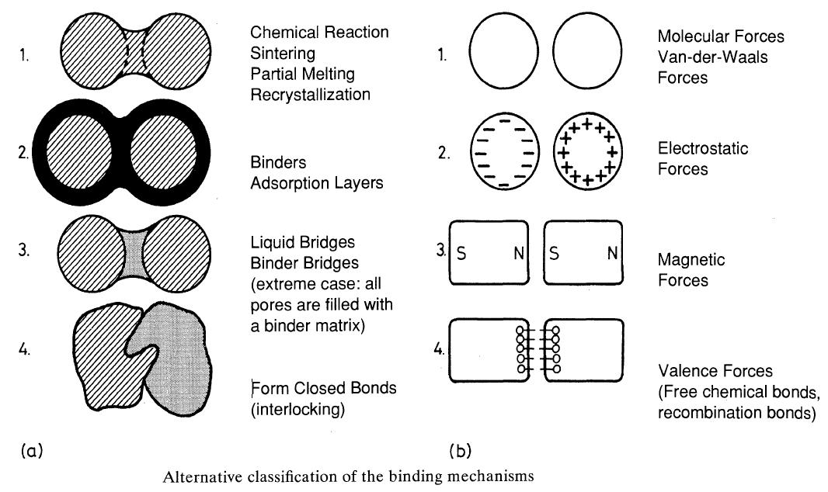

Slide 14
Theory of Agglomerate Bonding and Strength
The most important characteristic of all forms of the agglomerates is their strength. For the determination of agglomerate strength, real stresses are often simulated experimentally.
In addition to the usually applied crushing, drop, and abrasion tests, methods for the determination of impact, bending, cutting, or shear strength are employed. All values obtained by these methods are strictly empirical and cannot be predicted by theory, since it is not known which stress component causes the agglomerate to fail.

Slide 15
Methods of Size Enlargement by agglomeration
A common classification of methods for the size enlargement of particulate matter distinguishes between two types of processes:
Growth/tumble agglomeration (no external forces)
Pressure/agglomeration (low, medium, and high external forces)
Two techniques:
• Binder-less agglomeration
• Agglomeration with the addition of binders.

Slide 16
Growth/tumble agglomeration
The mechanism of growth/tumble agglomeration is similar to that of natural agglomeration
Because the particles to be agglomerated are larger, the particle-to-particle adhesion must be enhanced by the addition of binders (mostly water and other liquids) and the collision probability must be increased by providing a high particle concentration. Such conditions can be obtained in inclined discs, rotating drums, any kind of powder mixers,
and fluidized beds.
These wet agglomerates are temporarily bonded by the effects
of surface tension and capillary forces of the liquid binder.
With increasing size and mass of the particles to be agglomerated by growth/tumble methods, the forces trying to separate newly created bonds during agglomerate growth become larger until size enlargement by tumbling is no longer possible.

Slide 17
GROWTH/TUMBLE AGGLOMERATION METHODS — AGITATION METHODS
Theoretically, no specific piece of equipment is necessary for this phenomenon to occur; as long as the solid particles are kept in irregular, stochastic motion, the probability for collision and coalescence exists.
Micron and sub-micron particles (approx. <5 to 10 μm) will adhere to form an agglomerate even if they are dry. van der Waals forces are
high enough to cause coalescence. Agglomeration of larger particles necessitates the addition of binders.
Drawbacks of all tumble agglomeration methods are the limitation to small dimensions of the particles forming the agglomerate and that, in most cases, only temporarily bonded conglomerates are formed.
If very large amounts of solids must be agglomerated and the fine particulate form is also required for other reasons, for example, the concentration of valuable constituents of ores, tumble agglomeration is a preferred technology. In those cases the main binder is normally water.
Other reasons for the application of tumble agglomeration, even at small capacities, may be the high porosity of the agglomerates with other attendant beneficial characteristics such as large surface area (e.g., for catalyst carriers)
and easy solubility [e.g., for food (drink) and pharmaceutical products].

Slide 18
Wet Agglomeration Process
Dry Particles
Wet Particles
Effective Collision
Forming of Liquid Bridge
Notes:
23

Slide 19
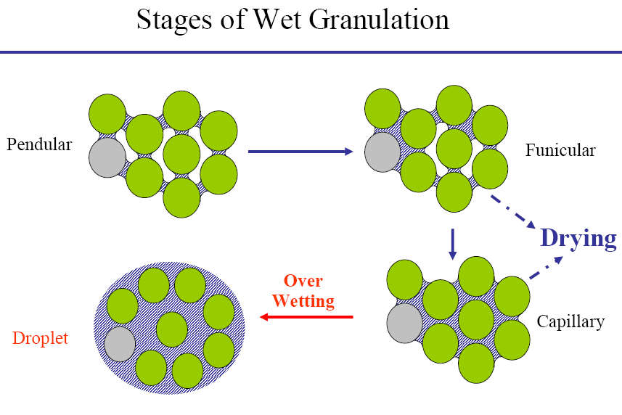

Slide 20
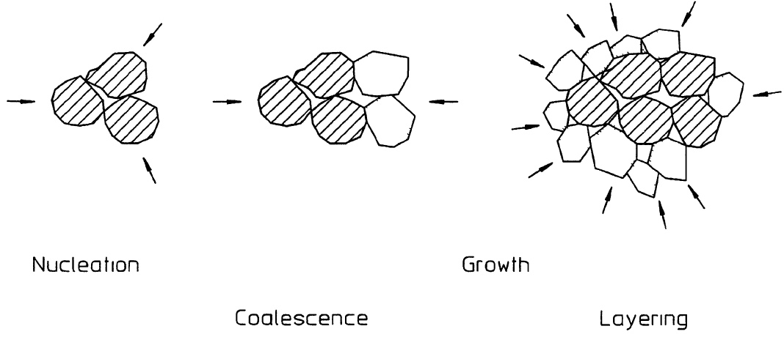
Major mechanisms of growth tumble agglomeration

Slide 21
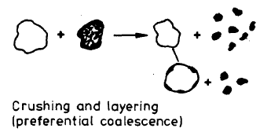
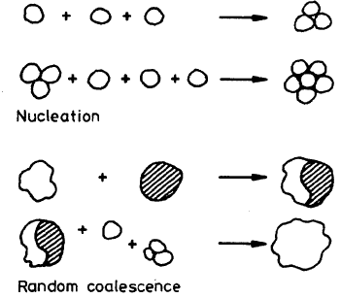
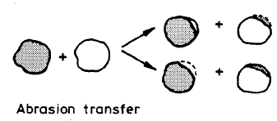
Diagram explaining the different processes taking place during tumble agglomeration

Slide 22
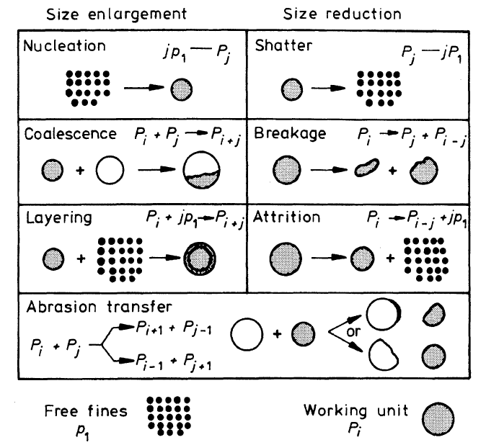
Formal representation of mechanisms of size change in size enlargement by agglomerate growth

Slide 23
Selection of an Agglomeration System
End Product Characteristics
Dispersability
Dissolution rate
Flowability
Compressibility
Density
Strength
Shape
Size
Size Distribution
Formulation

Slide 24
In a broad sense, equipment for tumble agglomeration itself can be divided into:
Apparatus producing movement of a densely dispersed bulk mass of particulate solids—dense phase agglomeration.
Apparatus keeping solid particulate matter suspended and loosely dispersed in a suitable fluid—suspended solids agglomeration.
In both cases, binder is sprayed into the turbulently agitated bed of particles.

Slide 25
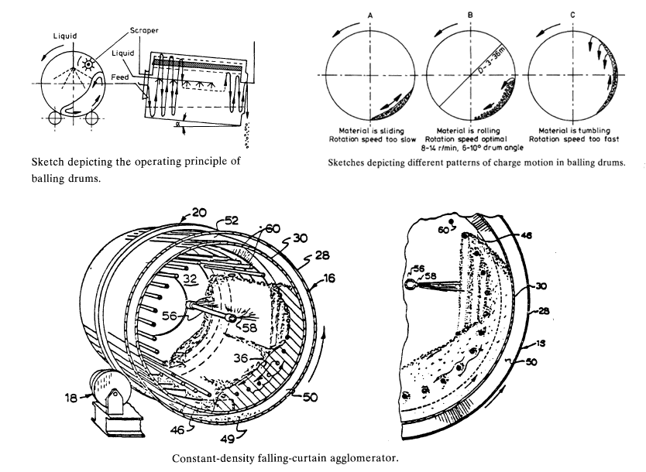

Slide 26
Agglomeration Methods
Tumbling Agglomeration
- Mechanical - Tumbling
High/Low Speed - Pneumatic

Slide 27

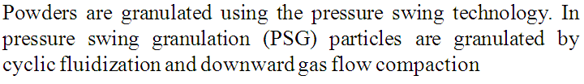
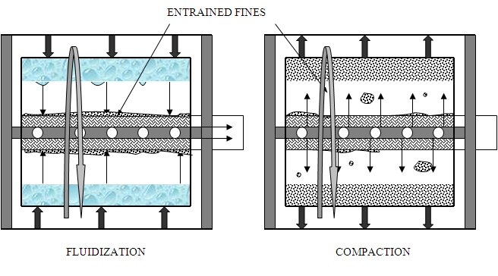

Slide 28
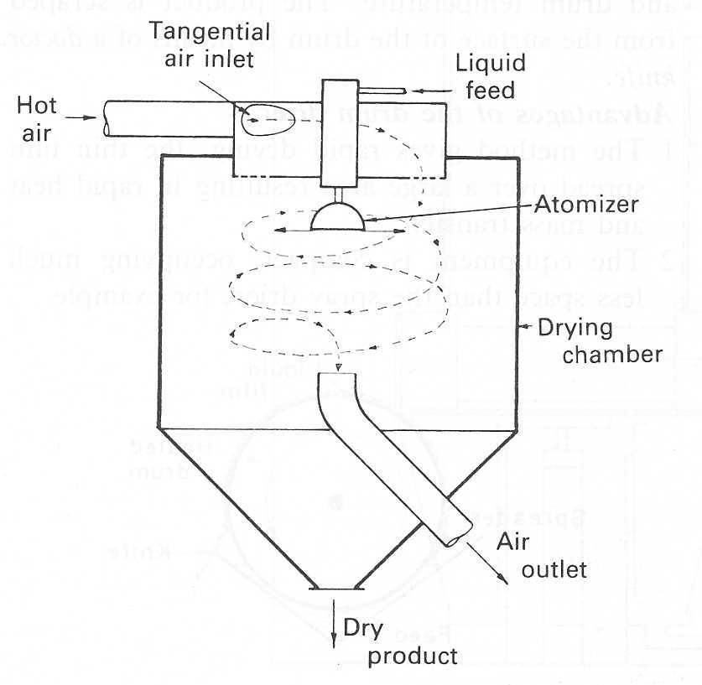
Wet Granulation
  spray granulation

Slide 29
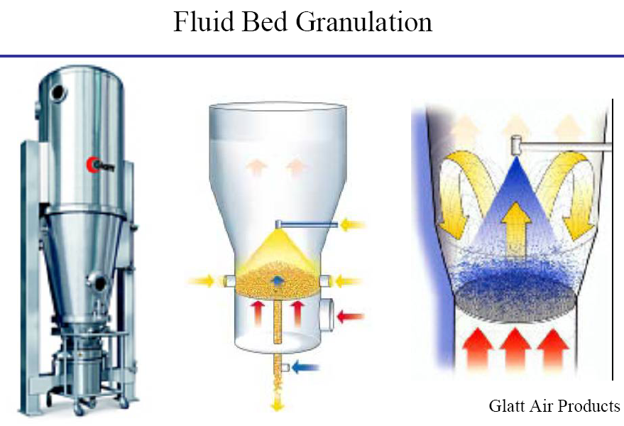

Slide 30
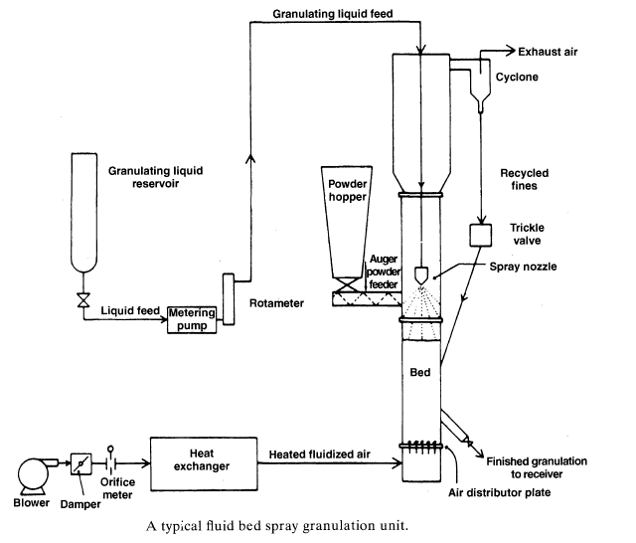

Slide 31
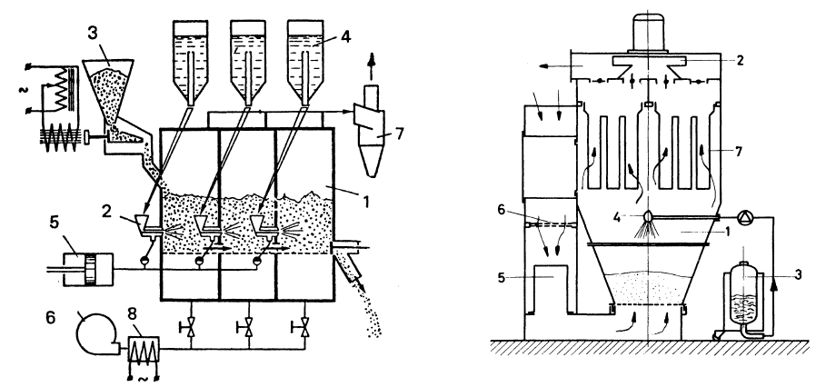
Batch fluid bed spray granulator used to produce tablet granulations in the pharmaceutical industry. Air flow necessary for fluidization is generated by a suction fan (2) mounted in the top portion of the
unit, directly driven by an electric motor. The air being used is heated to the desired temperature by an air heater (5). Pre-filters remove all impurities at the air inlet (6). The material to be processed has been loaded into the material container (1). The container bottom consists of a perforated plate above which a fine mesh stainless steel retaining screen is fitted. Exhaust filters (7) mounted above the product container retain fines and dust. The granulating liquid (3) is sprayed as a fine mist through a mechanical or pneumatically actuated nozzle onto the finely dispersed, fluidized material to form the desired agglomerates.
A multi-compartment fluid bed granulator: (1) fluid beds;
(2) compressed air-operated injectors for introducing solution into the fluid bed; (3) vibratory feeder for introducing the solid phase; (4) solution tanks; (5) compressor; (6) blower; (7) cyclone; and (8) heater.

Slide 32
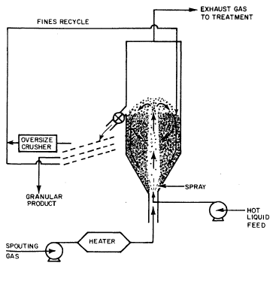
A typical spouted bed granulator

Slide 33
Increasing Solid:Liquid Ratio
Very little liquid → powder coating
More liquid → agglomerates
A lot of liquid → paste
Mainly liquid → slurry
Notes:
17
SEHR WENIG FLÜSSIGKEIT
ZWECK : ANFEUCHTUNG DES PULVERS
RESULTAT : TROCKENES ENDPRODUKT
MODERIERTE FLÜSSIGKEIT MENGE
ZWECK : AGGLOMERATION
RESULTAT : NASSES GROBERES PULVER
VIEL FLÜSSIGKEIT
PASTA FORMUNG
ÜBERMAß AN FLÜSSIGKEIT
SLURRY FORMUNG

Slide 34
Influence of Moisture on Particle Size
Mixing
Agglomeration
Particle Size
% Liquid
Notes:
19
KURVE VERLOOP ?

Slide 35
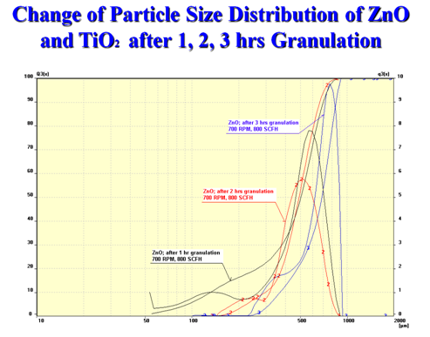

Slide 36
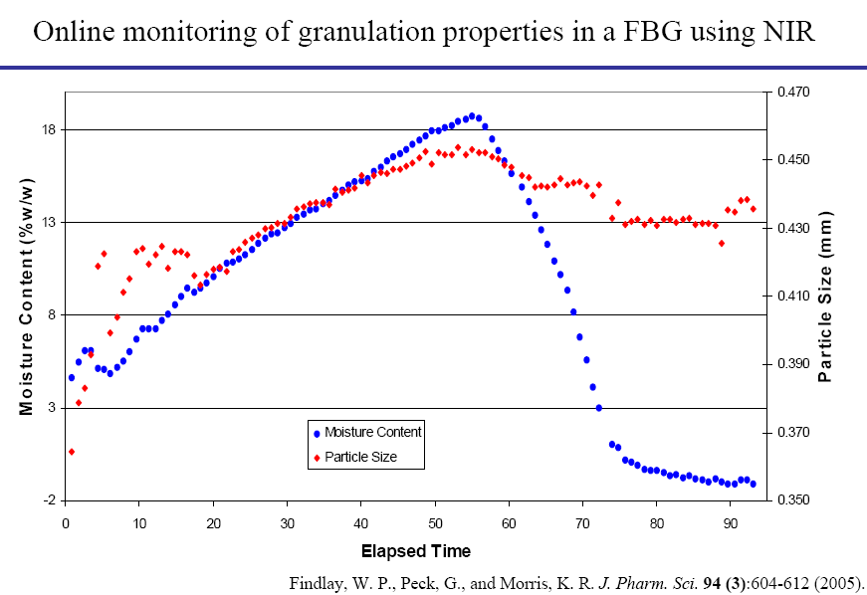

Slide 37
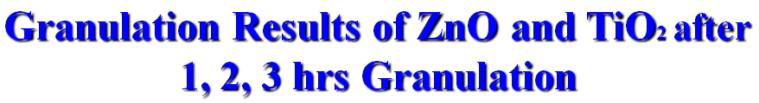
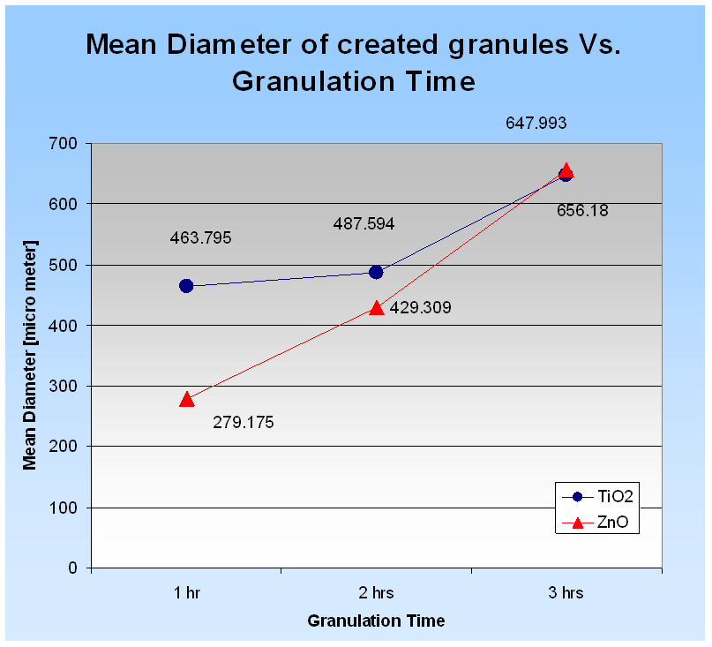

Slide 38
Wet Agglomeration
General Flow Sheet
  Solids Feed
Liquid Feed
Pre-Mix
Agglomeration
Conditioning
Size
Reduction
Oversize
Sizing
Final Product

Slide 39
Pressure agglomeration methods
Relatively uniformly shaped and sized agglomerates can be obtained by low- to medium-pressure agglomeration whereby the feed mixture must still be made up of fine particles and binders.
The moist, often sticky mass of particulate solids and a liquid binder
is extruded through holes in differently shaped screens or perforated dies.
Agglomeration and shaping occur by the pressure forcing the material through the holes and by frictional forces during passage of the mass.
Depending on the plasticity of the feed mix, short "crumbly," elongated "spaghetti-like," or cylindrical "green extrudates" are produced.
In most cases a post treatment (typically drying and cooling) is required to obtain final, permanent strength.

Slide 40
Pressure Agglomeration
Application of High Pressure to:
  Densify powder feed material
  Partially crush incoming particles
  Force particles into close proximity
  Rely on inter-particle forces
  Rely on particle molding

Slide 41
Advantages of
Pressure Agglomeration
Little or no binders required
Drying or curing post treatment not required
High capacity with low energy input
Wide range of feed sizes acceptable
High product density achieved
Robust design promotes extended equipment life

Slide 42
Pressure Agglomeration
Product Characteristics
Densify powder feed material
High density products
High strength
Uniform shape and size
Large product size possible
Possibility for no binder addition
Limited dispersability

Slide 43
Agglomeration Methods
Pressure Agglomeration
- Briquetting - Tableting
- Compacting - Piston Press

Slide 44
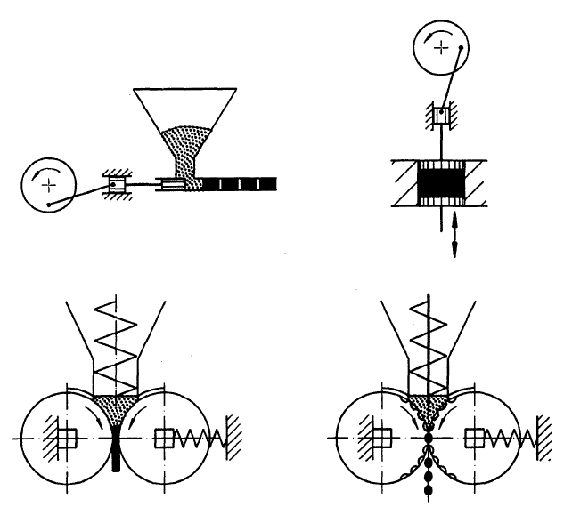
Schematic representation of
equipment for high-pressure
agglomeration

Slide 45
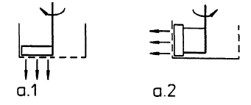
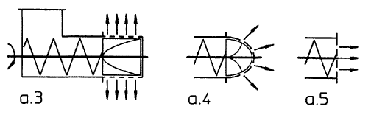
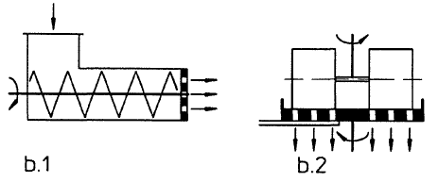
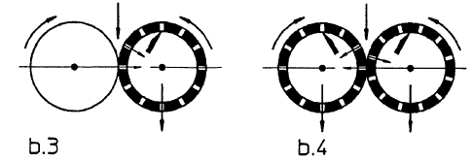
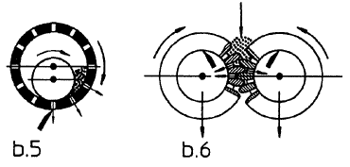
Schematic representation of equipment for low (a)- and medium (b)-pressure agglomeration

Slide 46
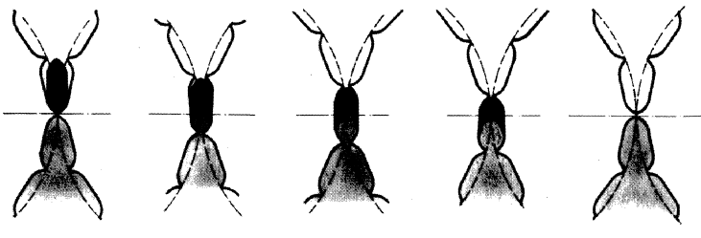
Five successive momentary conditions of briquetting between two counter currently rotating rollers with matching pockets

Slide 47
Double Roll Compaction
Material drawn between counter rotating rolls
Force feeders usually used
High pressure applied in the nip
Roll surface dictates product shape
End product: Briquettes, or sheets for granulation

Slide 48
Feed Limitations for
Double Roll Compaction
Aerated feed materials require special features to deaerate or minimize vibration
Only “dry” feed acceptable
Abrasiveness, elasticity, plasticity, and brittleness need to be considered
Heat and pressure sensitive materials not compatible
Toxic materials are difficult to contain

Slide 49
Extrusion Agglomeration
- Low Pressure Extruder
- Gear Pelletizing
- Pellet Mill
- High Pressure Extruder

Slide 50
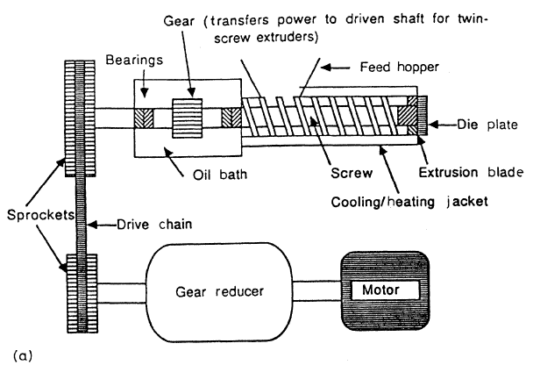
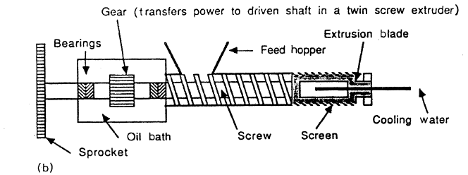
Schematic representation of (a) axial and (b) radial screw extruders.

Slide 51
Extrusion Agglomeration
Product Characteristics
Medium density product
Medium dispersability
Good for time release dispersion
Product is cylindrical, with constant cross section
Typical diameter 1 to 10 mm
Uniform particle size and shape
Product very resistant to breakdown
Binder may need to be added

Slide 52
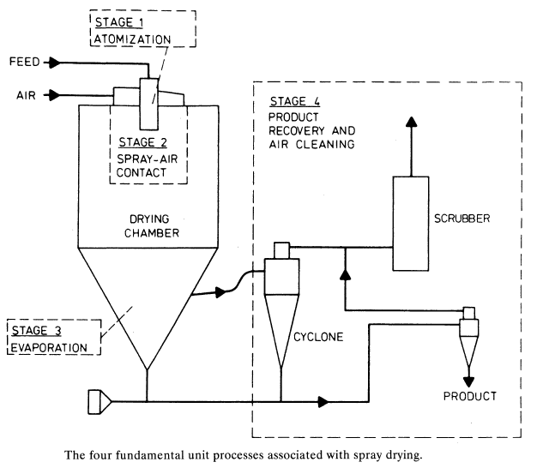

Slide 53
