Slide 1
Mechanical Micro-process in a fluid

Slide 2
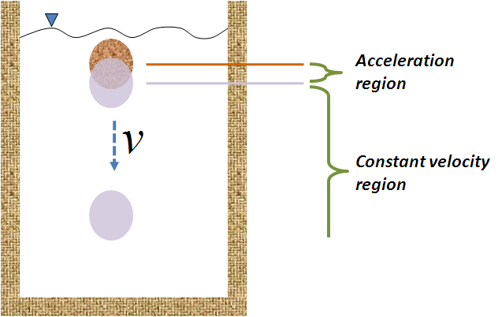
Motion of particles in a fluid

Slide 3
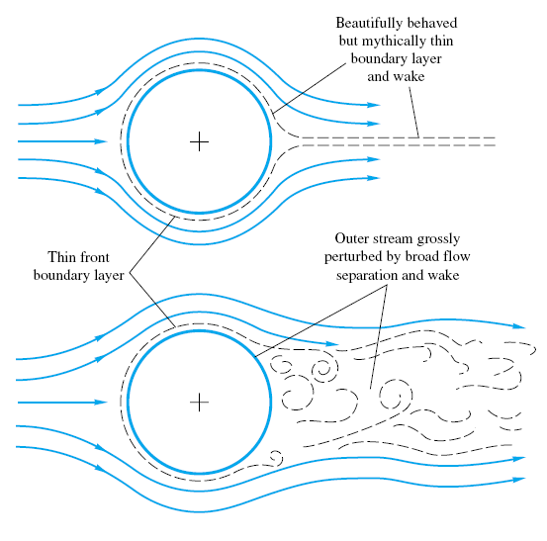
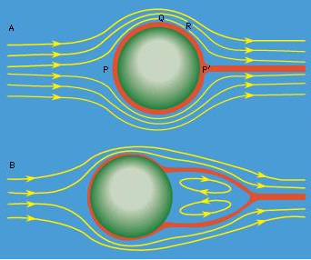

Slide 4
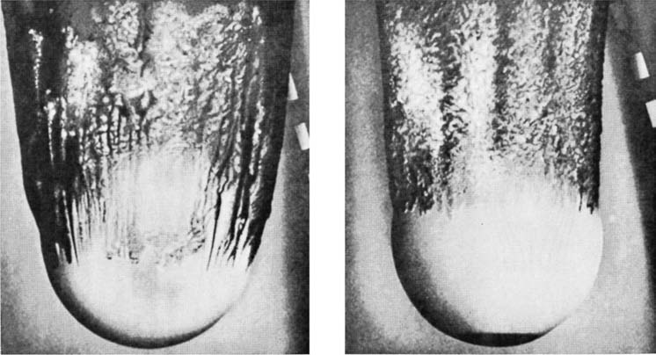

Slide 5
Motion of particles in a fluid
F_{B}
F_{d}
v
W
Notes:
Processes for the separation of particles of various sizes and shapes often depend on the variation in the behavior of the particles when they are subjected to the action of a moving fluid.
Further, many of the methods for the determination of the sizes of particles in the sub-sieve ranges involve relative motion between the particles and a fluid.
All bodies immersed in a fluid are subject to a buoyancy force. In a flowing fluid, there is an additional force which is made up of two components: the skin friction (or viscous drag) and the form drag (due to the pressure distribution).

Slide 6
Motion of particles in a fluid
When the net force is zero the particle moves with constant velocity known as
terminal velocity.

Slide 7
Motion of particles in a fluid
(Δ)
The value of C_{d} is determined by the flow regime;
the majority of sedimentation phenomena involve
laminar flow conditions.

Slide 8
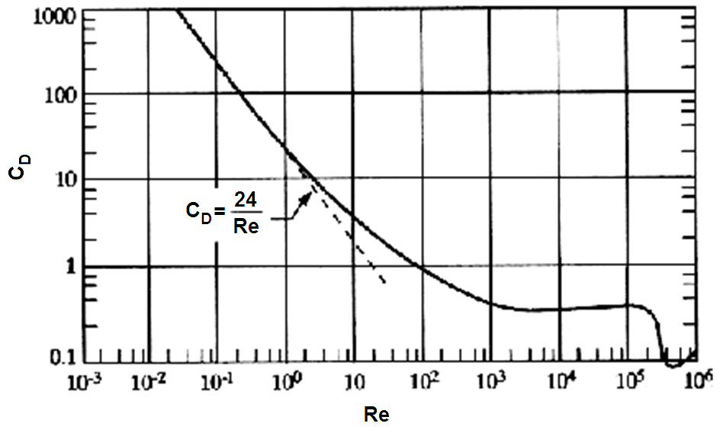
C_{d} = f (Re)

Slide 9
Motion of particles in a fluid
Laminar flow: stokes’ region: Re ≤ 2 and C_{d} ≈ C_{fd} = 24/Re
For accelerating particle
For steady rate of fall:

Slide 10
Motion of particles in a fluid
The stoke’s region has an upper limit: Re = 2 and C_{d} = 24/Re = 12
From Re:
From equation (Δ):

Slide 11
Motion of particles in a fluid
Transient regime: 2 < Re < 500 and C_{d} = 18.5/Re^{0.6}
Substituting C_{d} in equation (Δ) gives:

Slide 12
Motion of particles in a fluid
The upper boundary of the transient region: Re = 500 and C_{d} = 18.5/500^{0.6}
From Re:
From equation (Δ):

Slide 13
Motion of particles in a fluid
Turbulent regime: 500 < Re < 2e5 and C_{d} = 0.44

Slide 14
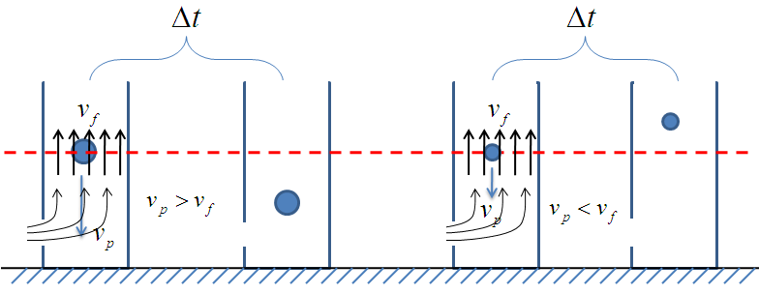
Motion of particles in a fluid
Applications
  Separation of particles of a given material according to size

Slide 15
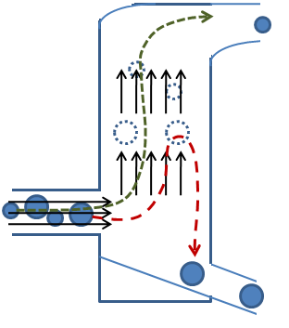
Motion of particles in a fluid

Slide 16
Motion of particles in a fluid
Applications
  Separation of particles of the same size, but of different composition (materials A and B with ρ_{A}> ρ_{B})
    In a liquid of intermediary density (ρ_{B} < ρ_{f} < ρ_{A})
    In a liquid whose density approaches that of the lightest particles (ρ_{f} ≈ ρ_{B} < ρ_{A})

Slide 17
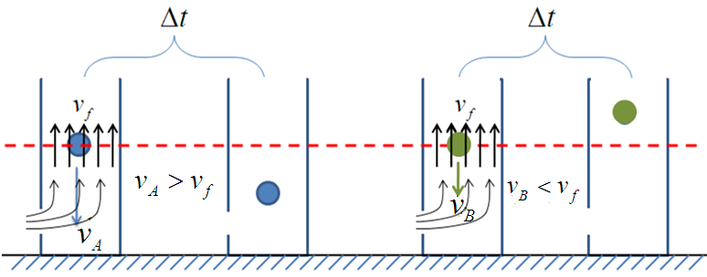
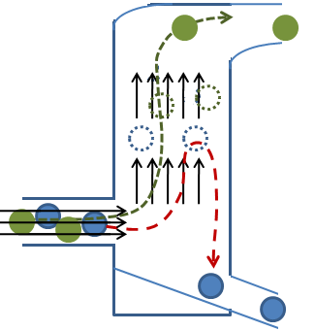

Slide 18
Motion of particles in a fluid
The sedimentation velocity of the heavier particles are bigger than that of lighter ones according to the ratio:
Laminar flow
Transient
Turbulent

Slide 19
Motion of particles in a fluid
Applications
  Separation of particles differing both in composition and size
    In a liquid with (ρ_{f} < ρ_{B} < ρ_{A})
m = 0.5 in laminar
m = 0.625 in transient
m = 1.0 in turbulent

Slide 20
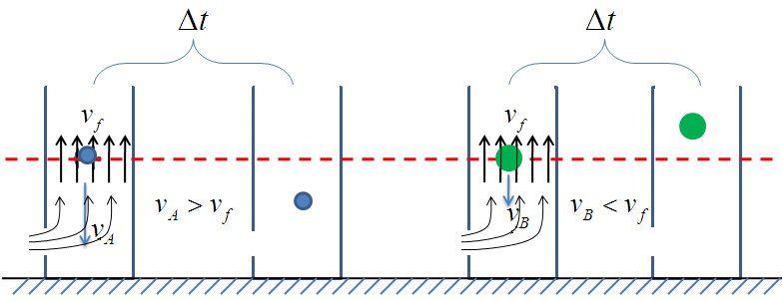
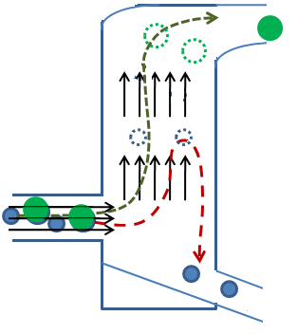

Slide 21
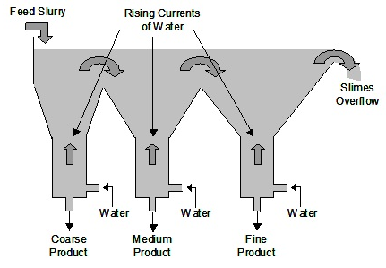
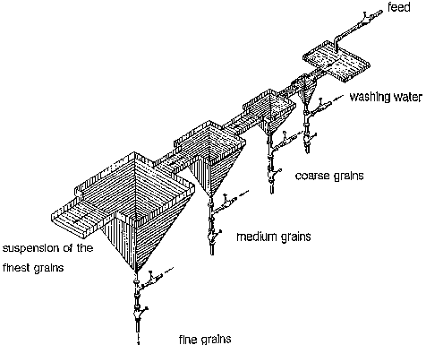
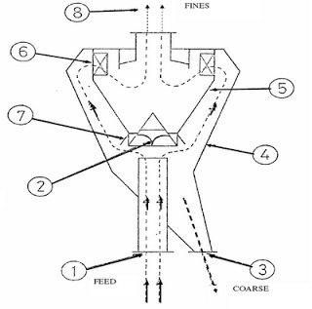
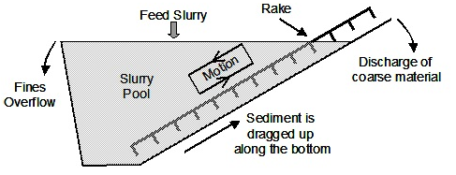
Double cone classifier

Slide 22
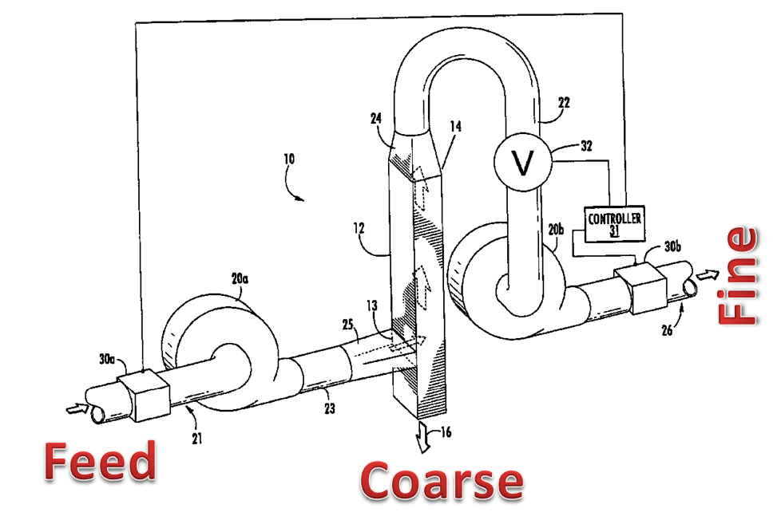

Slide 23
Example 1: Estimate the terminal velocity for 0.08mm particles of limestone (ρ_{s}=2450 kg/m³) falling in water at 30ºC.
Given : ρ_{water} = 995.7kg/m³, μ_{water} = 0.801x10⁻³ kg/m-s

Slide 24
Example 2: Find the size of a spherical particle of glass that has a terminal settling velocity of 7.4mm/s in a fluid of density 982kg/m³ and viscosity 0.0013kg/ms. Density of glass is 2800kg/m³.

Slide 25
Example 3: Calculate the minimum density of the fluid, viscosity
μ = 0.005 Pa-s, needed to separate lead ore particles (ρ_{Pb} = 7500 kg/m³)
completely from a matrix of quartz particles (ρ_{qu} = 2650 kg/m³); both
minerals are characterized by a particle size distribution ranging from
0.015mm to 0.065mm.
In laminar flow:
In turbulent flow:

Slide 26
Calculate and for the largest and the smallest particles in the two
different fluids of density 1195 and 2377 kg/m³ respectively.
 | Lead |  | Quartz
Diameter
0.015e-3 | 1.26e-4 | 8.96e-4 | 6.70e-6 | 4.77e-5
0.065e-3 | 2.36e-3 | 7.29e-2 | 1.26e-4 | 3.89e-3
In all cases under consideration laminar flow prevails. Thus the density
of the fluid is:

Slide 27
Example 3.1 (Coulson)
What is the terminal velocity of a spherical steel particle, 0.40 mm in diameter, settling in an oil of density 820 kg/m³ and viscosity 10 mN s/m²? The density of steel is 7870 kg/m³.
Example 3.2 (Coulson)
A finely ground mixture of galena and limestone in the proportion of 1 to 4 by mass is subjected to elutriation by an upward-flowing stream of water flowing at a velocity of 5 mm/s. Assuming that the size distribution for each material is the same, and is as shown in the following table, estimate the percentage of galena in the material carried away and in the material left behind. The viscosity of water is 1 mN s/m² and Stokes’ equation may be used. The densities of galena and limestone are 7500 and 2700 kg/m³, respectively.
Diameter (μm) | 20 | 30 | 40 | 50 | 60 | 70 | 80 | 100
Undersize (per cent by mass) | 15 | 28 | 48 | 54 | 64 | 72 | 78 | 88

Slide 28
Exercise : Polyethylene spheres, density = 910 kg/m³ and diameter
3.4mm, settle in air of density = 1.218kg/m³ and viscosity = 1.73e-5
pa-s. calculate:
  Their steady rate of fall;
  The time needed to settle over a distance of 2m at steady rate of fall

