Slide 1
Mechanical and Hydro –Mechanical Separations

Slide 2
Sedimentation
Most wastewaters and waters contain solids, and in many treatment processes solids are generated e.g., phosphate precipitation, coagulation and activated sludge bioxidation.
Particles in water and wastewater that will settle by gravity within a reasonable period of time can be removed by "sedimentation" in sedimentation basins (also known as "clarifiers").

Slide 3
Sedimentation
“Settleable” doesn’t necessarily mean that these particles will settle easily by gravity. In many cases they must be coaxed out of suspension or “solution” by the addition of chemicals or increased gravity (centrifugation or filtration).
Because of the high volumetric flow rates associated with water and wastewater treatment systems, gravity sedimentation is the only practical, economical method to remove these solids. i.e., processes such as centrifugation are not economical, in most cases.

Slide 4
Sedimentation
Goals of gravity sedimentation:
1) Produce a clarified (free of suspended solids) effluent.
2) Produce a highly concentrated solid sludge stream.
Two important functions of sedimentation tanks are : clarification and thickening.

Slide 5
Sedimentation
Thickening and/or clarification
Concentrated suspension
Gravity is the driving force
Hindered settling

Slide 6
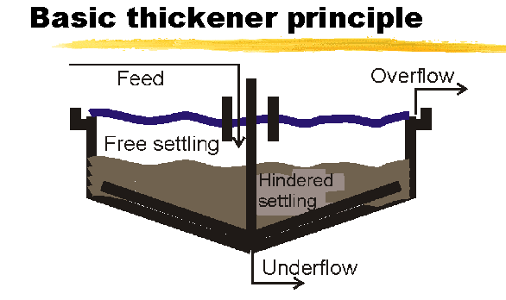
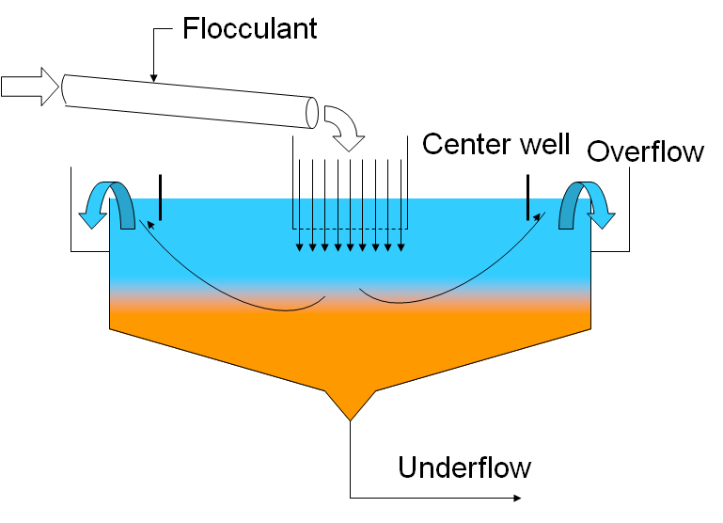
Feed added gently just below surface
Upward velocity of liquid must be less than v_{T}
Capacity depends on area: big area = low velocity (Q = vA)
Degree of thickening depends on residence time which depends on height

Slide 7
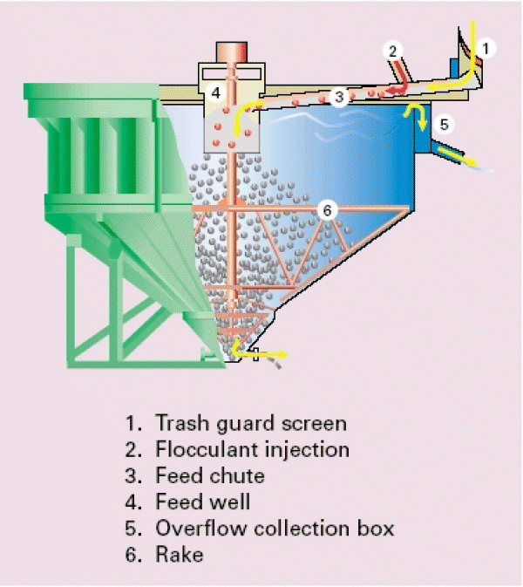
Thickener
The thickened solids are pumped from the bottom of the cone as an underflow
The overflow is (relatively) clear which is piped to the next process step
Conventional thickener main objective is maximizing tonnage or underflow density

Slide 8
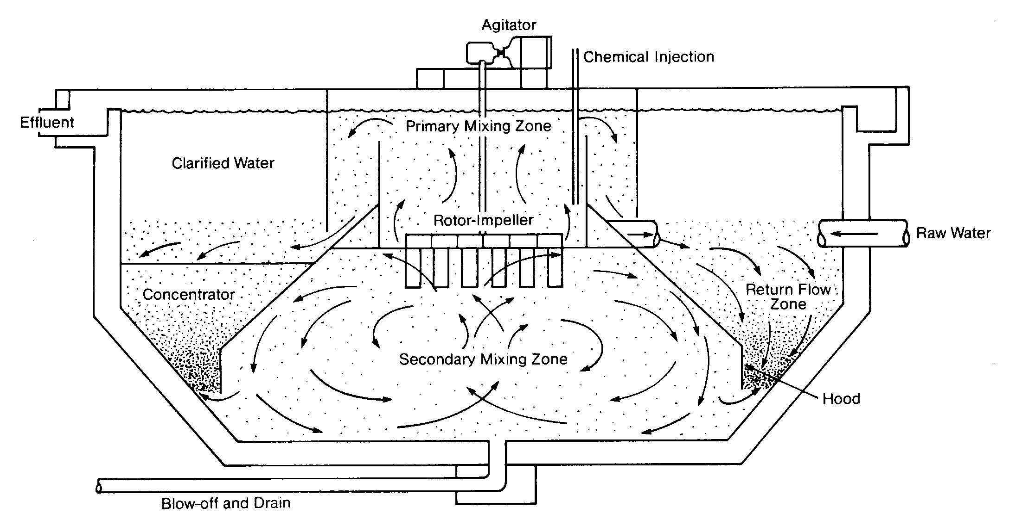
Clarifier
Clarifiers look like thickeners
Main objective is O/F clarity, not U/F density
Generally lower density feed
Rise rate critical for difficult-to-settle feed

Slide 9
Sedimentation tanks
Generally, two types of sedimentation basins (also called tanks, or clarifiers) are used:
  Rectangular and
  Circular.
Rectangular settling, basins or clarifiers, are basins that are rectangular in plans and cross sections. In plan, the length may vary from two to four times the width.
The length may also vary from ten to 20 times the depth. The depth of the basin may vary from 2 to 6 m. The influent is introduced at one end and allowed to flow through the length of the clarifier toward the other end.

Slide 10
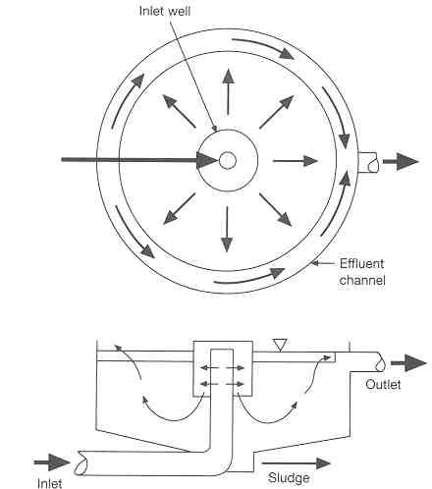
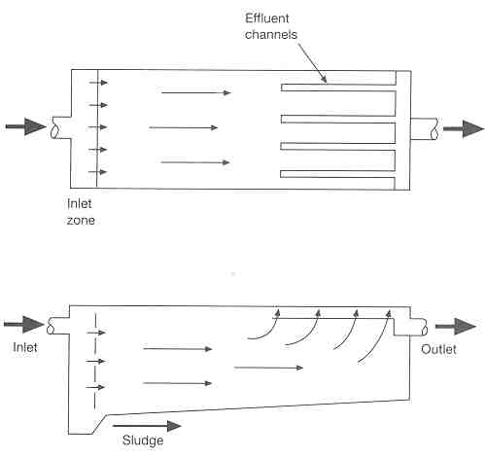
Circular Basin
Rectangular Basin

Slide 11
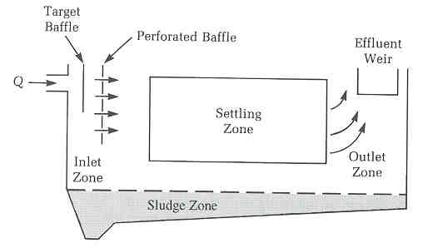
Basin Model

Slide 12
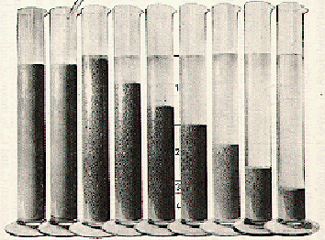
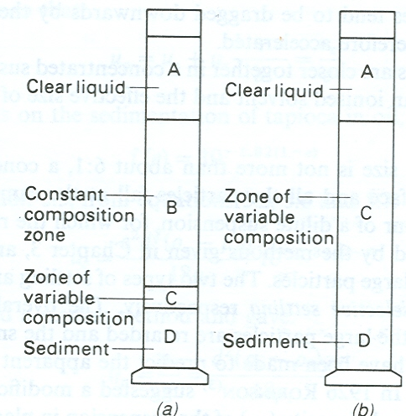
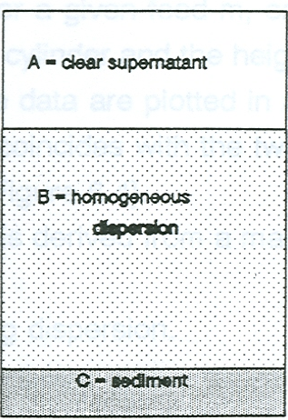
For large particle
size range
Sedimentation of concentrated
Suspensions
Type 1 settling
Type 2 settling

Slide 13
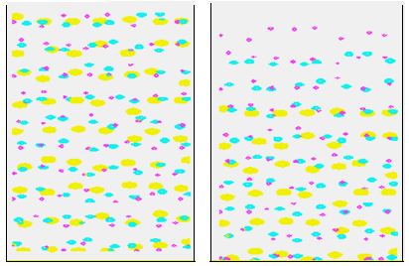
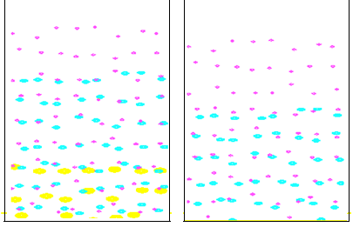
MUO (Sedimentation)
Sedimentation of particles in a suspension
Type 2 settling

Slide 14
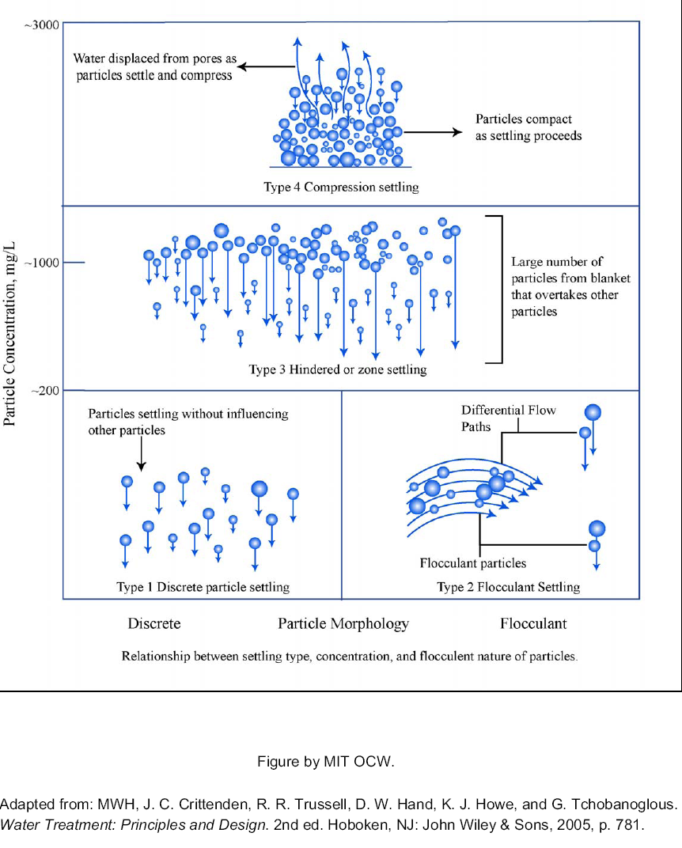

Slide 15
For the range of particle sizes not more than about 6:1, a concentrated suspension settles with a sharp interface and all the particles fall at the same velocity.
Some attempts to predict the apparent settling velocity of a concentrated suspension:

Slide 17
MUO (Sedimentation)
For a given suspension, the main factors which affect the sedimentation process are:
    Height of suspension
    Diameter of the vessel { for vessel (φ)/Particle (φ) < 100}
    Volumetric concentration
    Shape of vessel

Slide 18
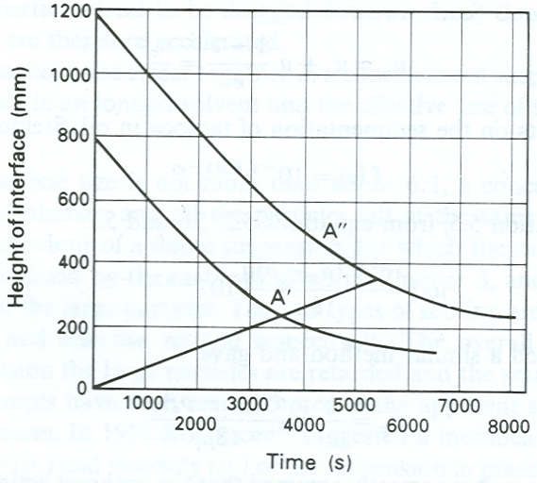
Effect of height of the suspension
Height of suspension
(OA’/OA”) is constant
If the curve is found for
one initial height, then the
curves can be drawn for
any other height
Height of the interface vs. time for two different initial heights of the slurry

Slide 19
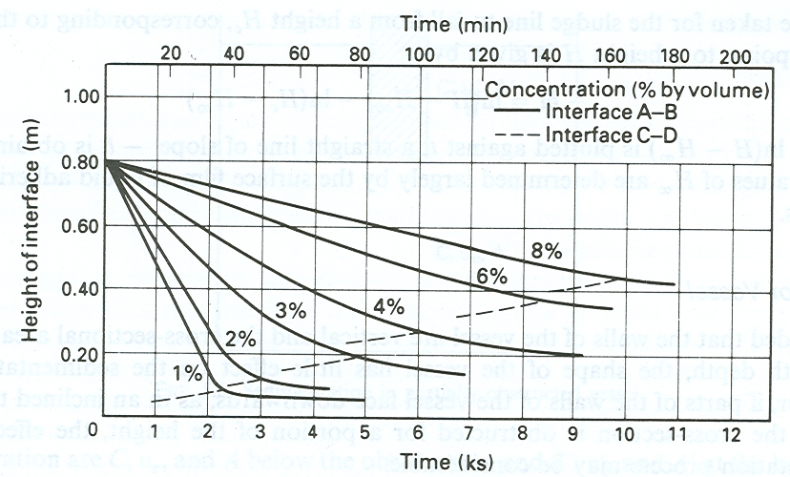
Effect of concentration
The higher the concentration the lower is the rate of fall because:
  The upward velocity of the displaced fluid is high
  The velocity gradient in the fluid is steeper

Slide 20
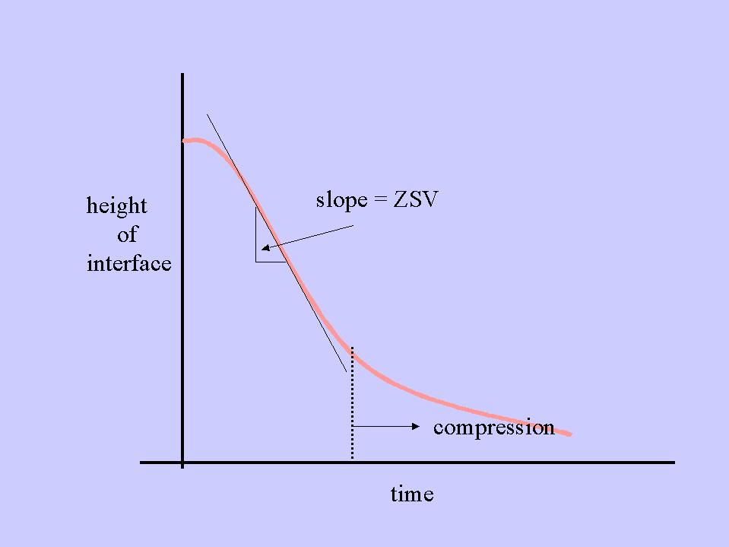
The slope of the steady interface subsidence rate represents zone settling velocity.

Slide 21
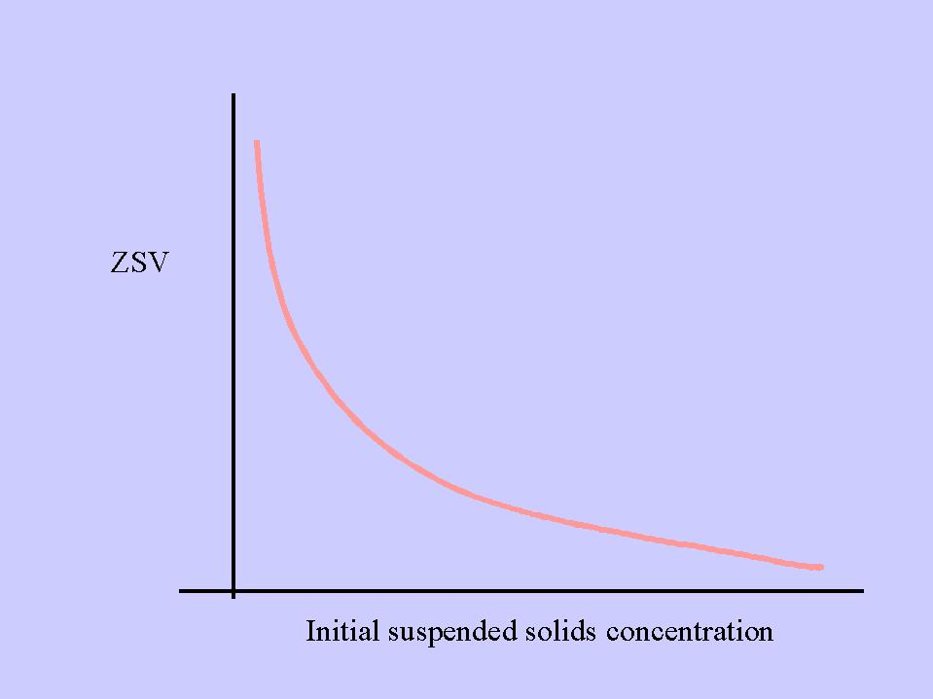
A typical relationship between initial suspended solids and ZSV

Slide 22
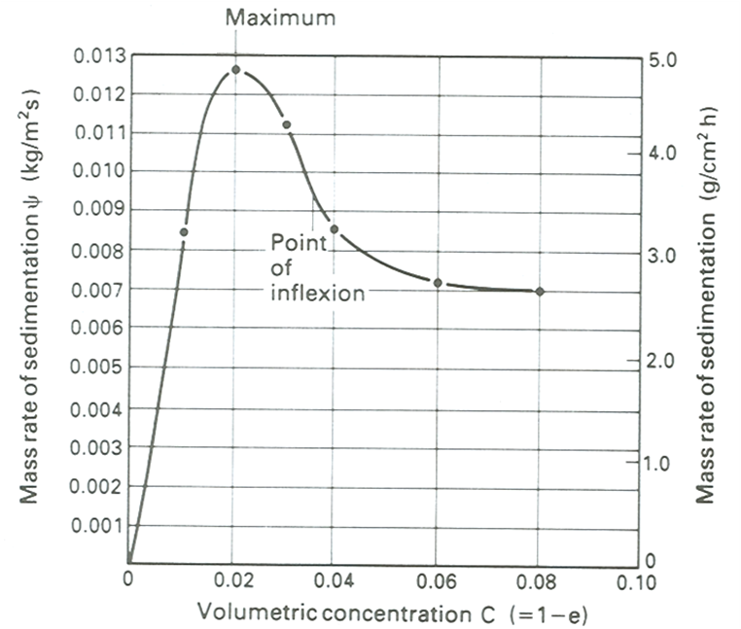
This is plotted from the previous height of the interface vs time data
C_{i}

Slide 23
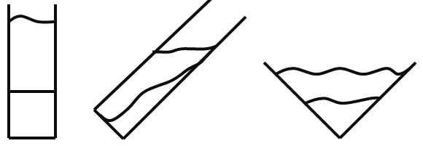
Effect of shape of the vessel
Shape of the vessel
  If the walls are vertical and the cross-sectional area does not vary with depth, the shape of the vessel has little effect on the rate of sedimentation.

Slide 24
Kynch theory of sedimentation
  Basic assumptions
    Particle concentration is uniform across any horizontal layer
    Wall effects can be ignored
    No differential settling of particles as a result of differences in shape, size, or composition
    The velocity of particles depends only on the local concentration of particles
    The initial concentration is either uniform or increases towards the bottom of the suspension
    The sedimentation velocity tends to zero as the concentration approaches a limiting value corresponding to that of the sediment layer deposited at the bottom of the vessel.

Slide 25
dH
H

Slide 26
In general, the concentration of particles will be a function of position
and time and thus:
For constant concentration:

Slide 27
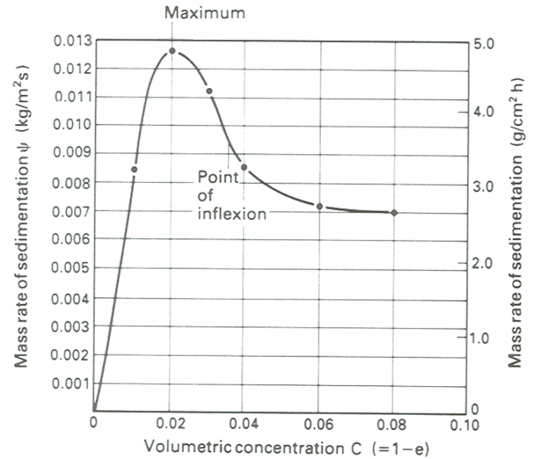
Substituting in the previous equation:
Since concentration is constant, dψ/dC is constant and
v_{w}(=dH/dt) is therefore constant for a given concentration
(v_{w} is the propagation velocity of a zone of constant concentration)
  ⇒lines of constant slope, on a plot of H versus t, will refer to
  Zones of constant concentration.
  ⇒when dψ/dC is negative (for C > C_{max}); v_{w} is positive and the
  wave of constant concentration will propagate upwards.

Slide 28
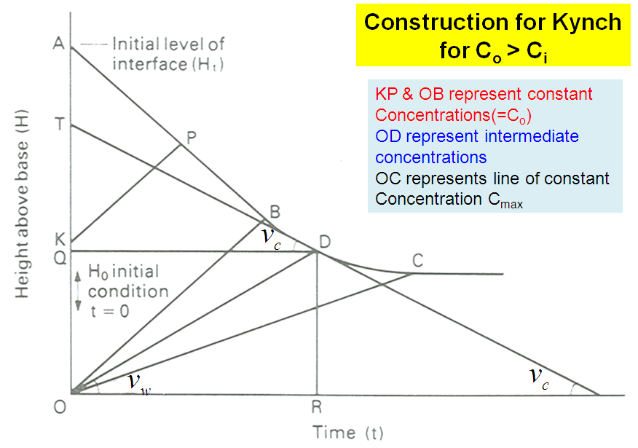

Slide 29
MUO (Sedimentation)
Line KP refers to the propagation of a wave corresponding to the initial uniform composition from an initial position K in the suspension.
Line KP terminates on the curve ABDC at P which is the position of the top interface of the suspension at time t.
In the upward propagation of a wave of the constant composition at a velocity v_{w}(=dH/dt), particles are falling at a sedimentation velocity v_{c}.

Slide 30
MUO (Sedimentation)
The total volume of particles passing per unit area through the plane in time t is given by:
Since P corresponds to the surface of the suspension, V must be equal to the total volume of particles which was originally above the level indicated by K.

Slide 31
MUO (Sedimentation)
Line APB is straight line with slope (-dH/dt) equal to v_{c}.
After point B, the sedimentation curve has a decreasing negative slope, reflecting the increasing concentration of solids at the interface.
Line OD corresponds to the propagation of a wave at a velocity v_{w}, from the bottom of the suspension. Thus when the wave reaches the interface , point D, all the particles in the suspension must have passed through the plane of the wave.

Slide 32
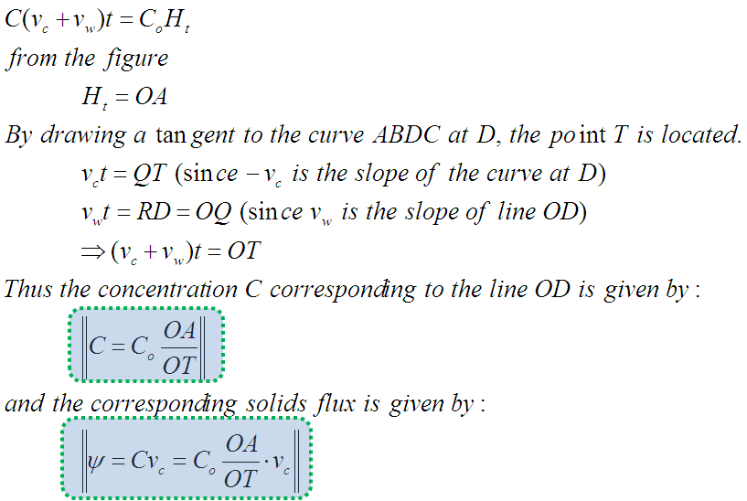
Thus, by drawing the tangent at a series of points on the curve BDC and
measuring the corresponding slope –v_{c} and intercept OT, it is possible to
establish the solids flux ψ for any concentration C (C_{i} < C < C_{max}).

Slide 33
Thickener
  The thickener is the industrial plant in which the concentration of a suspension is increased by sedimentation, with the formation of a clear liquid.
  The thickener has twofold function:
    Must produce a clarified liquid, therefore upward velocity of the liquid must at all times be less than the settling velocity of the particles.
      Thus, for a given throughput, the clarifying capacity is determined by the diameter of the tank
    It is required to produce a given degree of thickening of the suspension.
      This is controlled by the residence time of particles in the tank, and hence by the depth below the feed inlet.

Slide 34
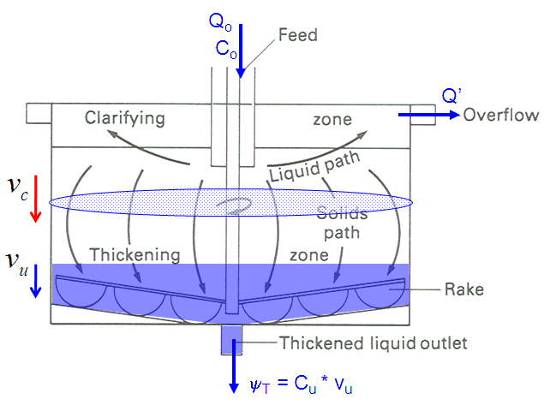
In a continuous thickener, the area required for thickening must be such that the total solids flux (volumetric flow rate per unit area) at any level does not exceed the rate at which the solids can be transmitted downwards.
Q_{o}............is the volumetric feed
rate of the suspension
A…………is area of the thickener
C_{o}………..is the volumetric
concentration of solids in the feed

Slide 35
The solids flux leaving in the underflow must be equal to the volumetric rate per unit area at which solids are fed to the container.
At any horizontal plane in a continuous thickener operating under steady-state conditions, the total flux of solids ψ_{T} is made up of two components:
    Sedimentation of solids in the liquid – as measured in batch sedimentation
    That arising from the bulk downward flow of the suspension which is drawn off as underflow from the base of the thickener

Slide 36
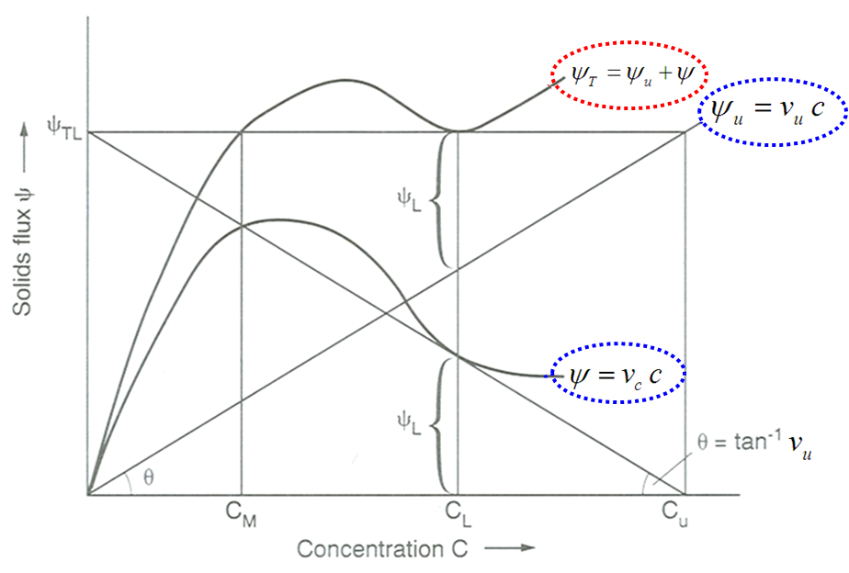

Slide 37
For all concentrations exceeding C_{M}, ψ_{TL} is the parameter which determines the capacity of the thickener operating at v_{u}.
Thus the required area of the thickener is calculated based on ψ_{TL}.

Slide 38
♣
If a tangent is drawn from the point on the abscissa corresponding
to the required underflow concentration C_{u}, it will meet the ψ curve at
a concentration value C_{L} at which ψ_{T} has the minimum value ψ_{TL} and
will intersect the ordinate axis at a value equal to ψ_{TL}
♣
Thus, in order to determine both C_{L} and ψ_{TL}, it is not necessary to plot
the total flux curve (ψ_{T}), but only to draw the tangent to the batch sedimentation (ψ) curve.
From the geometry of the ψ = f (C) curve

Slide 39
Thus, the minimum necessary area of the thickener may be obtained from the maximum value of:
Overflow:
  The liquid flow rate in the overflow (Q’) is the difference between that in the feed and in the underflow.

Slide 40
♣
At any depth below the feed point, the upward velocity of the liquid
must not exceed the settling velocity of the particles v_{c} where the
concentration is C
Thus the required area is:
♣
It is therefore necessary to calculate the maximum value of A for all
the values of C which may be encountered.
♣
Equation (∗) can be rewritten in terms of the mass ratio of liquid to solid
in the feed (Y) and in the underflow (U):

Slide 41
♣
The values of A should be calculated for the whole range of concentrations present in the thickener, and the design should be based on the maximum value so obtained.
  where A = area (m²)
  Q₀ = feed rate of suspension (m³/s)
  Y = mass ratio liquid to solid in feed
  U = mass ratio liquid to solid in underflow
  C = particle volume fraction (1-ε)
  ρ_{s} = density of solid (kg/m³)
  v_{c} = terminal velocity at conc. C (m/s)
  ρ_{f} = density of liquid (kg/m³)

Slide 42
Example1: A slurry containing 5kg of water per kg of solids is to be
thickened to a sludge containing 1.5kg of water per kg of solids in a
continuous operation. Laboratory tests using five different
concentrations of the slurry yielded the following results:
Concentration (kg water/kg solid) | 5.0 4.2 3.7 3.1 2.5
Rate of sedimentation (mm/s) | 0.20 0.12 0.094 0.070 0.050
Calculate the minimum area of the thickener to effect the
separation of 1.33 kg of solids per second.

Slide 43
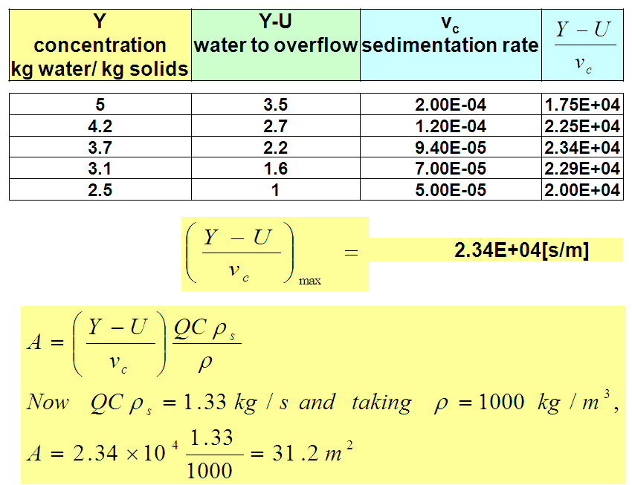

Slide 44
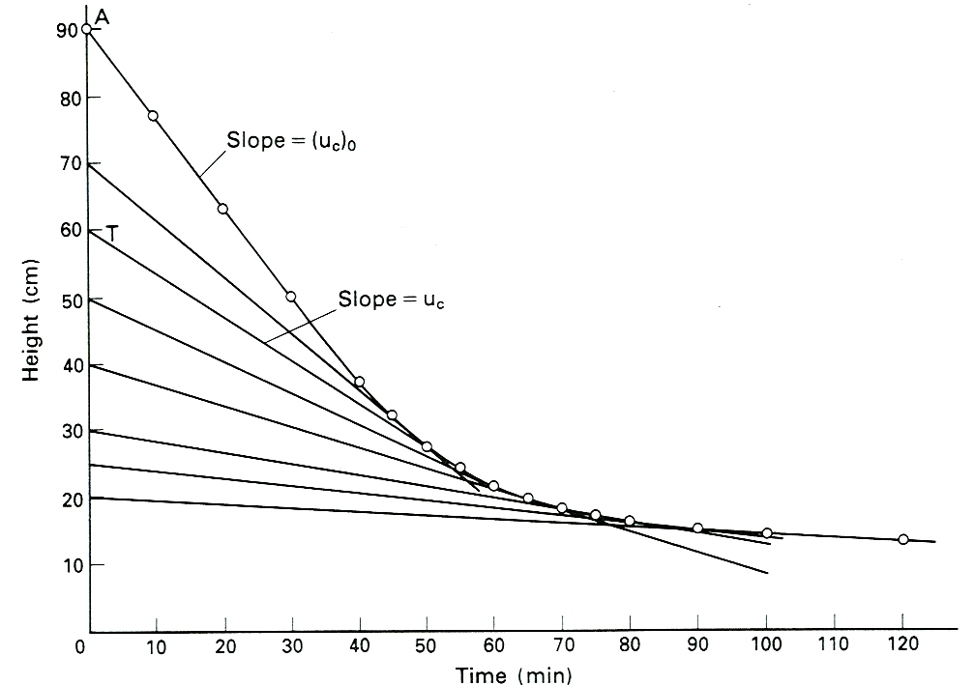
Example2: A batch test on the sedimentation of a slurry containing 200 kg solids/m³ gave the results shown in the figure for the position of the interface between slurry and clear liquid as a function of time.
Using the Kynch theory, tabulate the sedimentation velocity and solids flux due to sedimentation as a function of concentration. What area of tank will be required to give an underflow concentration of 1200 kg/m³ for a feed rate of 2 m³/min of slurry?

Slide 45
Solution
On the diagram the height H above the base is plotted against time. The initial height is given by OA (90 cm) and the initial constant slope of the curve gives the sedimentation velocity (u_{c})₀ for a concentration of 200 kg/m³ (c₀).
For some other height, such as OT (60 cm), the slope of the tangent gives the sedimentation velocity u_{c} for a concentration of:
Thus, for each height, the corresponding concentration may be calculated and the slope of the tangent measured to give the sedimentation velocity. The solids flux in kg/m²s is then:

Slide 46
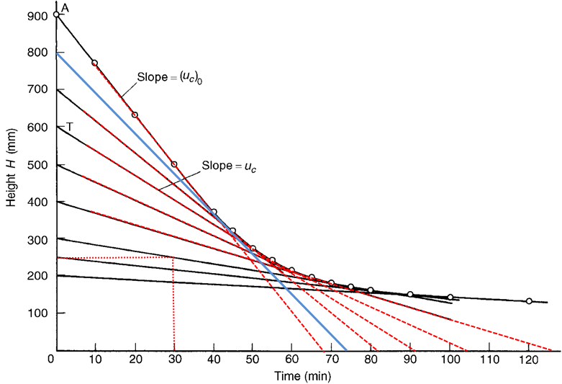
Slope calculation: to estimate the
settling velocity for each concentration

Slide 47
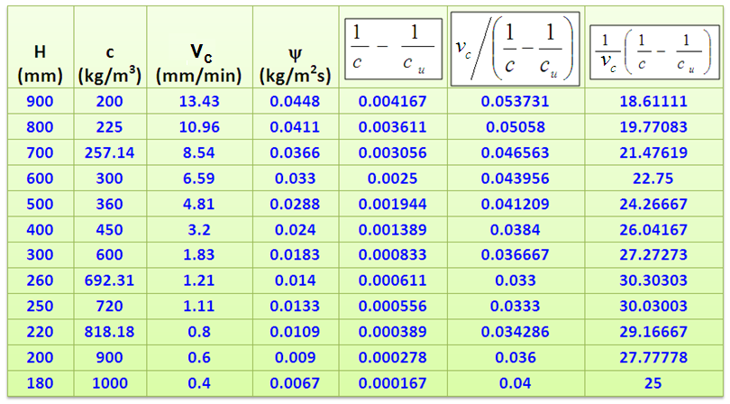

Slide 48
Sedimentation
  Thickening or clarifying
  Small particles tends to have very slow settling velocity
    The settling velocity can be increased by
      Flocculation or coagulation
        By changing PH
        By stirring
        By heating
        By addition of flocculants (lime, Al- or Fe-sulphate or polyelectrolyte)
      reducing the viscosity
        By heating
        By reducing the concentration of thickeners (e.g. by enzymatic degradation of pectin)

Slide 49
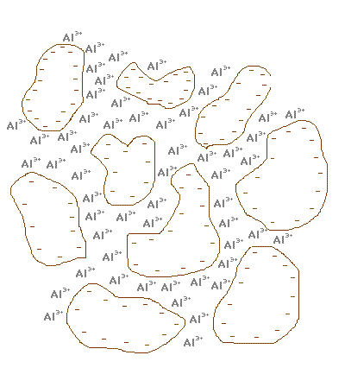
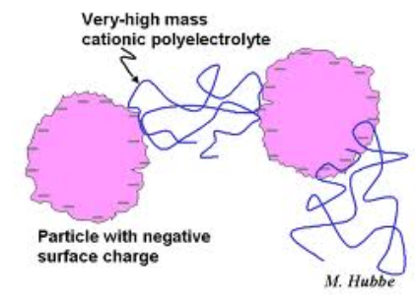
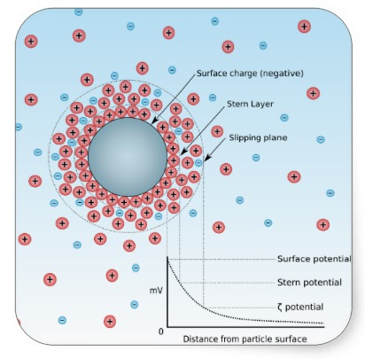
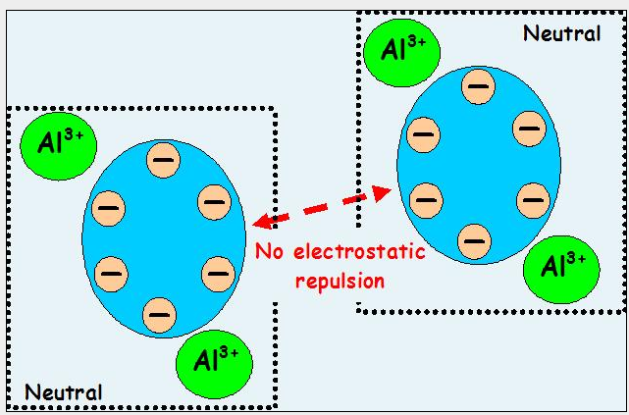
Flocculation

Slide 50
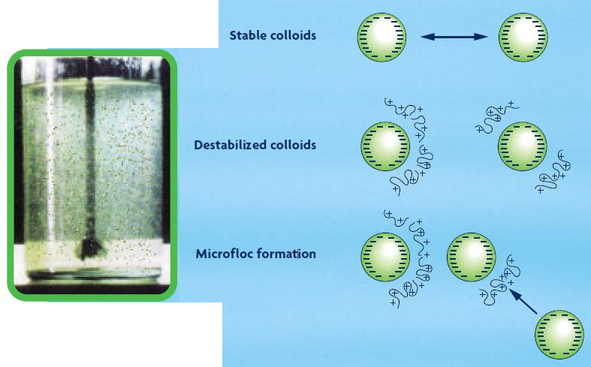
Flocculation

Slide 51
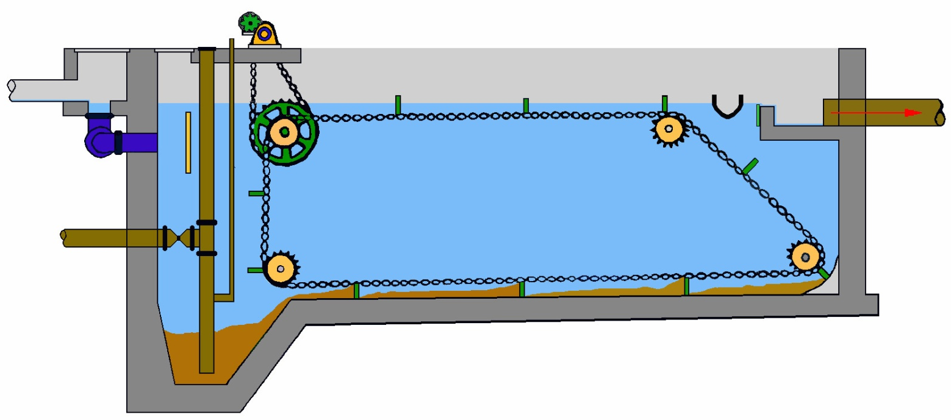
Types of Clarifiers – Rectangular
Effluent
Weir
Inlet
Baffle
Drive
Unit
Flights
Scum
Trough
Effluent
Launder
Inlet
Drive
Gear
Idler
Sprockets
Sludge
Trough
Drive
Chain
Sludge Withdrawal
Pipe

Slide 52
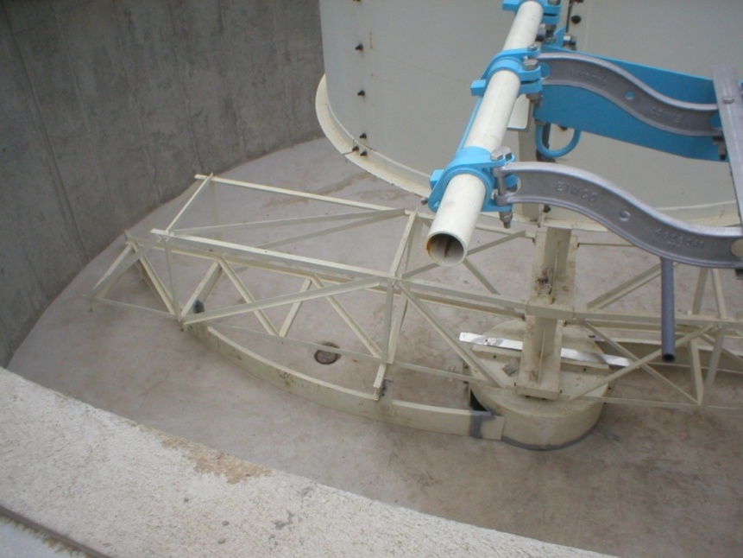
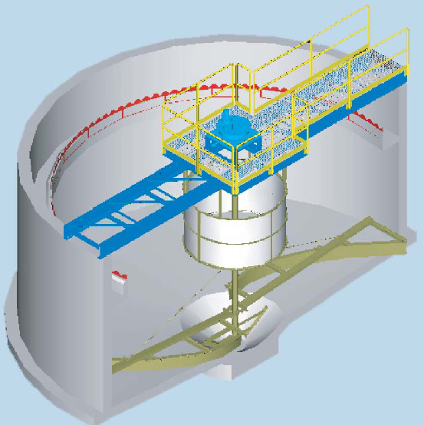
Clarifier Variations
Spiral Sludge Collector

Slide 53
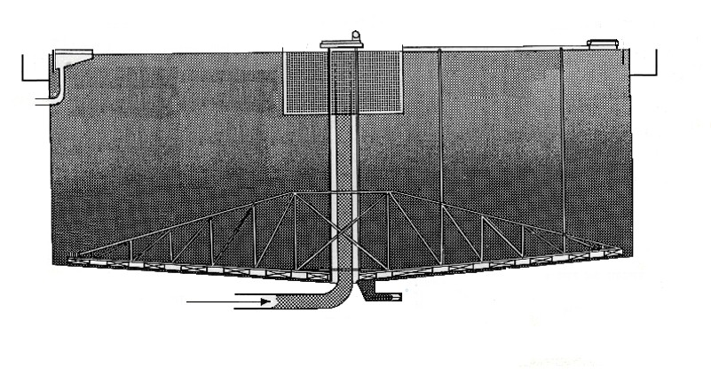
Circular Clarifier
Drive Mechanism Also Drives Skimmer Arm to Remove Floating Scum
Scum
Baffle
Drive Unit
Skimmer Arm
Influent

Slide 54
Circular Clarifier
Solids Settle
Scraped to Sump
Removed by Pumping
Center Baffle
Influent
Sludge Plow
Sludge Sump

Slide 55
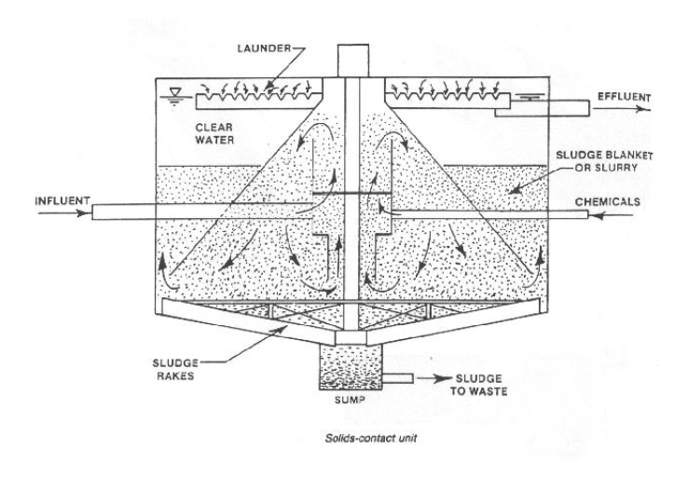
SOLID CONTACT UNITS

Slide 56
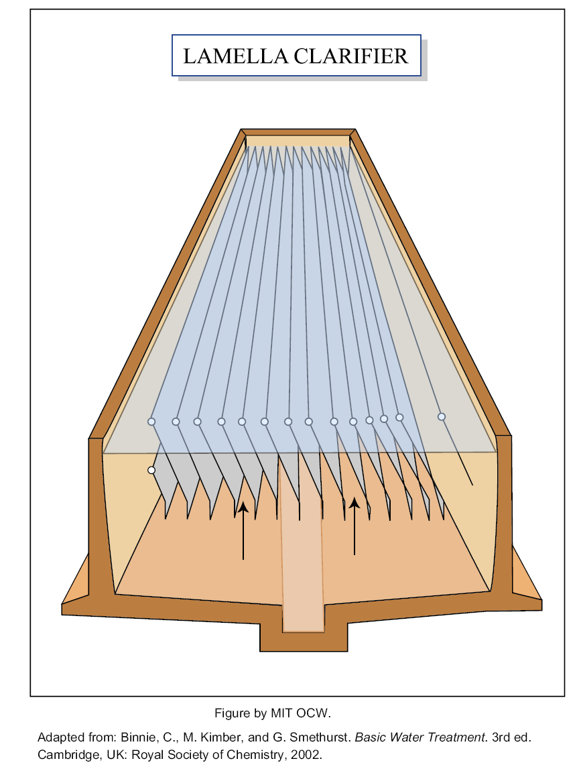

Slide 57
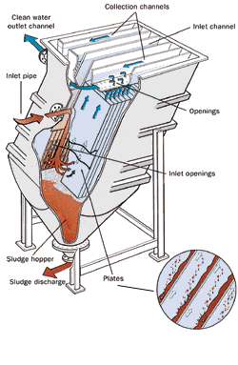
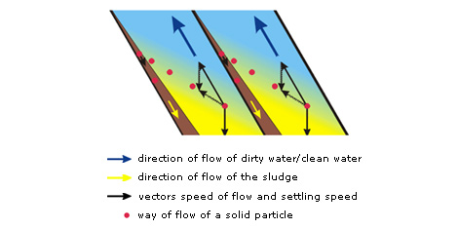
Types of Clarifiers – Inclined Plate (Lamella)

Slide 58
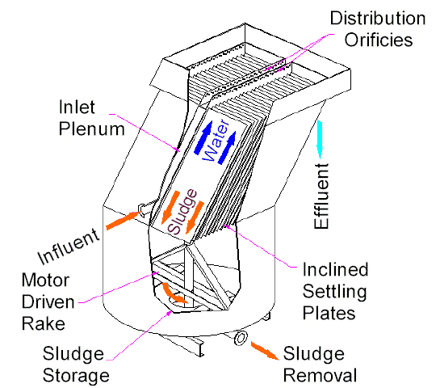
Types of Clarifiers – Inclined Plate (Lamella)
Increased settling efficiency due to increased surface area
Smaller Area Needed for Installation

Slide 60
Filtration in solid-liquid separation
Filtration may be defined as the separation of solids from liquids by passing a suspension through a permeable medium which retains the particles.

Slide 61

Liquid-Solid Separation
Filtration
Physical separation of solid particles from liquid or gas.
  A porous medium: allow fluid to pass through and solid particles to be retained.
Filter cake
Filter medium
Slurry flow
Filtrate

Slide 62
Classification of Filters
Filters are classified on following three different basis:
Mechanism
The driving force
Operation

Slide 63
On the basis of mechanism
Cake filters
Cross flow filters
depth filters
On the basis of driving force
Pressure Filters
Vacuum filters
Centrifugal filters
On the basis of operation
Continuous filters
Batch or discontinuous filters

Slide 64
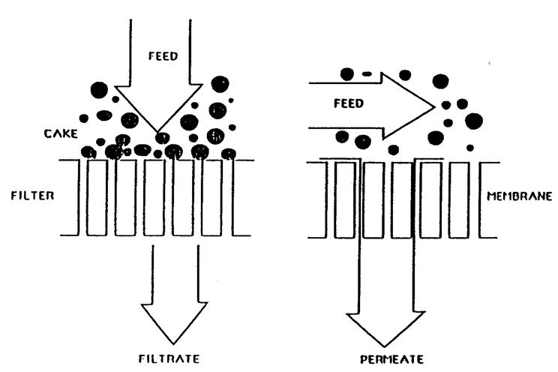
Cake filtration
Cross-flow filtration

Slide 65
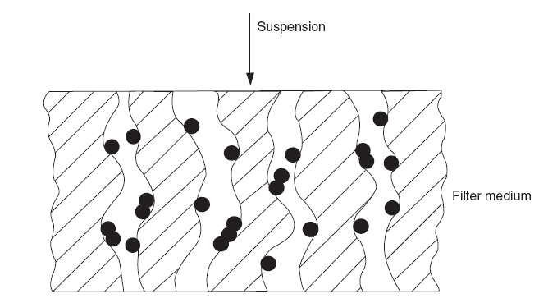
Depth filters
Used for deep bed filtration in which particle deposition takes place inside the medium and cake deposition on the surface is undesirable.
Mechanism of deep bed filtration
* The particles of solid are trapped inside the filter medium.

Slide 66
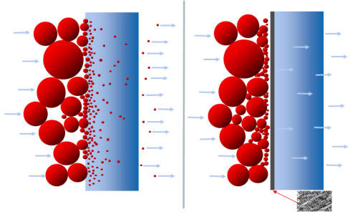
Cake Vs Depth filtration

Slide 67

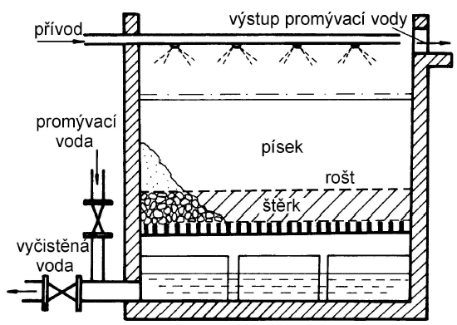
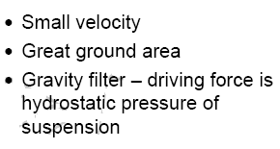
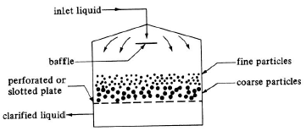

Slide 68
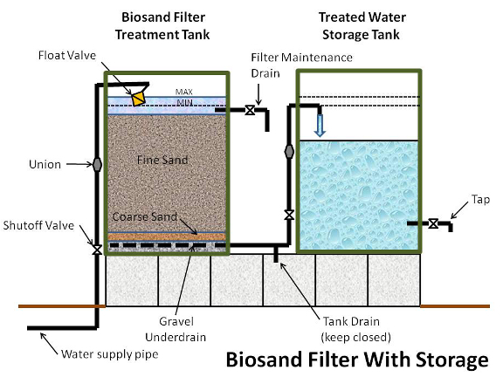

Slide 69
Driving force (Pressure difference)
  Vacuum filters: The pressure below the filter medium may be reduced below atmospheric pressure by connecting the filtrate receiver to a vacuum pump and creating a pressure difference across the filter.
  Pressure filters: The simplest method being to pump the slurry into the filter under pressure.
  Centrifugal filters: The gravitational force could be replaced by centrifugal force in particle separation.

Slide 70
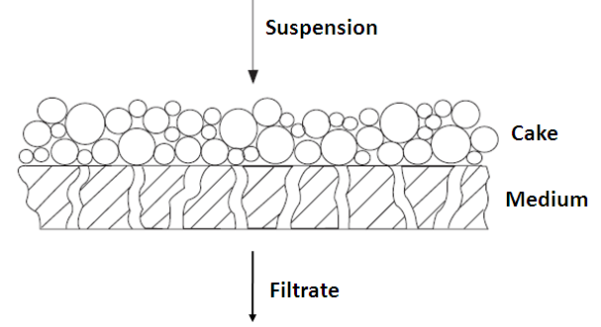
Cake filtration
Used for cake filtration in which the solids are deposited in the form of a cake on the up-stream side of a relatively thin filter medium.
A visible cake of appreciable thickness builds up on the surface and must be periodically removed.

Slide 71
Filtration Equipment
The basic requirements for filtration equipment are:
    mechanical support for the filter medium
    flow accesses to and from the filter medium
    provision for removing excess filter cake.
    In some instances, washing of the filter cake to remove traces of the solution may be necessary.
    Pressure can be provided on the upstream side of the filter, or a vacuum can be drawn downstream, or both can be used to drive the wash fluid through.

Slide 72


Slide 73


Slide 74


Slide 75


Slide 76
Filtration in solid liquid separation
Filter media
  Filter media selection are based on
    The nature of the dispersion, e.g. concentration, φ, T…
    The operating conditions, e.g. under pressure or over pressure
    Type of filtration, e.g. continuous or batch wise
    The cost

Slide 77
  The following filter media may be used:
    Loosely packed bulk materials such as sand, coke, charcoal, lime, ground ceramic materials, cotton and gravel
      Used mainly in water and waste water purification
    Porous plates made of ceramic materials, sintered glass, sintered metals, porous rubber or polymers, perforated metal
    Fiber plates (non-woven) made of cellulose, cotton fibers, asbestos fibers and synthetic fibers
    Fabrics (woven textiles) made of metals, textile fibers or polymer fibers
    Membranes

Slide 78
Material of construction of filter media
Woven Materials (Cotton, Wool, Silk etc)
Perforated Metal Sheeting
Granular Materials (Sand, Asbestos etc)
Porous Solid
Felted-Fiber materials (Porous Paper)

Slide 79
Septum or Filtering Media
Filter Paper
Membrane

Slide 80
Filter Media Structure
Cloth
Metal

Slide 81


  screens and grids (coarse-granied suspense, supporting frame)
  polymeric clothes –PA, acryl, Teflon

Slide 82

Filtration theory
  The flow of filtrate through the pores of the filter cake is laminar and may be described by the Kozeny-Carman-equation

Slide 83
Dispersion
dispersion
Cake
L
Filter medium
Filtrate

Slide 84
Dispersion
P_{s}
-ΔP_{m}
-ΔP_{c}
P_{f}
P_{s}-P_{f} = -ΔP_{f}
Filtrate

Slide 85
The driving force, which is the total pressure difference between the added suspension and the removed filtrate, is given by:
The parameters of the filter medium are constant during the
filtration. However, the thickness of the cake L increases.
If the particles are compressible, the porosity ε of the filter
cake decreases with increasing pressure.

Slide 86
Incompressible cake: porosity ε is constant
Mass of filtered dispersion m_{d} = mass of filtrate m_{f} + mass of wet cake m_{c}

Slide 89
Constant rate filtration

Slide 90
The pressure drop will increase linearly with time or with the filtrate volume
This requires either to increase the pressure in the feed side (for pressure filtration) or decrease in the filtrate side (for vacuum filtration) so that the filtrate rate can be constant

Slide 91
Constant pressure drop [(dV/dt) changes];
  The question is how the volume of filtrate changes as a function of
the filtration time.

Slide 92


Slide 93
Operating Mode
Constant pressure filtration
  Vacuum pumps, compressed gas
Constant rate filtration
  Positive displacement pumps
Variable pressure, variable rate filtration
  Centrifugal pumps

Slide 94
Example: An aqueous dispersion containing 8.76% of solids with a particle density of 3470 kg/m³, is filtered through a flat filter of 650 cm² surface area. The cake is incompressible. At a constant pressure drop of 12kPa, 33.8dm³ of filtrate is obtained after 3 min, and an additional 23.25dm³ after 8min of filtration. A plate/frame filter press containing the same filter medium and consisting of nine 70X70 cm square chambers of 11 cm thickness is used to filter the dispersion, initially at a rate of 16 dm³/s up to a pressure drop of 15kPa, and subsequently at a constant pressure of 15kPa until the distance between the cake is reduced to only 1cm.
Given: ρ_{f} = 999 kg/m³ , μ = 1.12e-3 pa-s ,
bulk density of the dry cake = 1922 kg/m³
Calculate:
    The cake equivalent thickness of the medium
    Total volume of filtrate recovered with plate/frame filter
    Total time of the operation
    The average particle diameter of the particles in the slurry

Slide 95


Slide 96

Plate and Frame Press

Slide 97





Slide 98

Filtration

Slide 99

Cake washing

Slide 100

0.01
0.11
0.7
0.7
Slurry

Slide 102
x= | 0.0876
ρ | 999
μ = | 1.12E-03
ρ_{p} = | 3470
A = | 6.50E-02
ΔP = | 1.20E+04 | t₁ | t₂ | t/V | 5.33E+03 | 8.41E+03
 |  | 180 | 480
 |  | V₁ | V₂ | V | 3.38E-02 | 5.71E-02
 |  | 3.38E-02 | 5.71E-02
 |  |  |  | slope = | 132827 |  | K1 = | 3.19E+09 | kg/m⁷-s
 |  |  |  | intercept = | 835.89 |  | K2 = | 1.00E+07 | kg/m⁴-s

Slide 108

Factors affecting rate of filtration

Slide 109
Cake Compressibility
Incompressible
Filtrate Flowrate
Highly compressible
Pressure Drop
Incompressible solids - R is independent of pressure

Slide 110
Filter medium resistance; R_{m}
Normally is constant but may vary with time (as a result of some penetration of solid into the medium) and sometimes may also change with applied pressure (because of the compression of fiber in the medium).

Slide 111
Filter Aids
  Added before filtration
  This increases the porosity of the cake and reduces resistance of the cake during filtration.
  As a pre-coat
  They can be used as a precoat before the slurry is filtered. This will prevent solids from plugging the filter medium and also give a clearer filtrate.
  Use of filter aids is usually limited to cases where the cake is discarded.

Slide 112

Filter Aids
Filter aids are granular solids which are used in combination with filtration to enhance rate of filtration. For example, Diatomaceous silica, perlite, purified wood cellulose etc.
Filter aids are used in two
different ways:
  Added before filtration
  As a pre-coat

Slide 113


Slide 114




Slide 115


Slide 116


Slide 117


Slide 118


Slide 119


Slide 120
Vacuum Belt Filter
Belt movement by pneumatic cylinders only

Slide 121


Slide 122

Vacuum Filtration P & ID

Slide 123

Vacuum Filtration for Lignin, Cellulose and Biomass with Eleven (11) Wash Stages and 24 m² of Filter Area

Slide 124

BHS Rotary Pressure Filter
Typical Operation
Wash Inlet
Drum
Drying Gas
Inlet
Housing
Outlets
& Vents
Sealing
Element
Solids
Discharge
Cloth
Rinse
Slurry Inlet

Slide 125


Slide 126


Slide 127


Slide 128






Slide 129


Leaf filters (vacuum, pressure)
Leaf with cloth in shape of sack, suspension outside, filtrate removed from hollow wire framework
Limited cake thickness-small concentrations

Slide 130

Vacuum leaf filter
Time cycle of vacuum leaf filter 1 – collecting tube, 2 – connection of vacuum, 3 – tank for slurry (suspension), 4 – Tank for washing liquid, 5 – tank for removed filter cake, 6 – feed screw

Slide 131


Slide 132




Slide 133


Slide 134
Rate = f (t)
t/V = f (V, P)
e = f (P)

Slide 136
Ex1. Constant pressure
Filtration area = 0.01 m² A
Solution density = 1,062 kg/m² ρ
Solution viscosity = 1.6×10⁻³ Pa.s μ
Filtration pressure = 200 kPa ΔP
Solid concentration = 3 kg/m³ C_{s}
Determine specific filter cake resistance and filter medium resistance
Time (sec) | Volume (cm³)
0 | 0
14 | 400
32 | 800
55 | 1200
80 | 1600
107 | 2000

Slide 137

Y = aX + C
Y axis = tA/V
X axis = V/A
Slope = μαCs/2ΔP
Y intercept = μR_{m}/ΔP

Slide 138
Time (sec) | Volume (cm³) | Volume (m³) | tA/V | V/A
0 | 0 | 0 | 0 | 0
14 | 400 | 0.0004 | 350 | 0.04
32 | 800 | 0.0008 | 400 | 0.08
55 | 1200 | 0.0012 | 458.33 | 0.12
80 | 1600 | 0.0016 | 500 | 0.16
107 | 2000 | 0.0020 | 535 | 0.20

Slide 140
Ex2. Constant rate
A slurry containing 25.7 kg dry solids/m³ of filtrate across the filter medium area 2.15 m² at a constant rate of 0.00118 m³/s. If the pressure drop was observed 4,000 and 8,500 Pa after 150 and 450 seconds of filtration, respectively. The viscosity of filtrate was 0.001 Pa.s
Determine the specific cake resistance and filter medium resistance.

Slide 141
The solution
(1)
ΔP (Pa)
t (sec)
(2)
(3)
(4)

Slide 142
ΔP (Pa) | t (sec)
4,000 | 150
8,500 | 450

Slide 144
[Example] A suspension containing 225 g of carbonyl iron powder, Grade E, per liter of a solution of 0.01 N NaOH is to be filtered, using a leaf filter. Estimate the size (area) of the filter needed to obtain 100 lb of dry cake in 1 h of filtration at a constant pressure drop of 20 psi. The cake is incompressible. The specific cake resistance is 10¹¹ ft/lb. The resistance of the medium is taken as 0.1 in⁻¹.
Solution:
(To be continued)

Slide 145
[Example] A suspension containing 225 g of carbonyl iron powder, Grade E, per liter of a solution of 0.01 N NaOH is to be filtered, using a leaf filter. Estimate the size (area) of the filter needed to obtain 100 lb of dry cake in 1 h of filtration at a constant pressure drop of 20 psi. The cake is incompressible. The specific cake resistance is 10¹¹ ft/lb. The resistance of the medium is taken as 0.1 in⁻¹.
Solution (cont’d):
t = filtration time = 1 h
= 1.2 × 10¹² lb/ft-h²
α = specific cake resistance = 10¹¹ ft/lb
R_{M} = resistance of the medium = 0.1 in⁻¹ = 1.2 ft⁻¹
μ = viscosity of the liquid = 1 cp = 2.42 lb/ft-h (assumed)
(To be continued)

Slide 146
[Example] A suspension containing 225 g of carbonyl iron powder, Grade E, per liter of a solution of 0.01 N NaOH is to be filtered, using a leaf filter. Estimate the size (area) of the filter needed to obtain 100 lb of dry cake in 1 h of filtration at a constant pressure drop of 20 psi. The cake is incompressible. The specific cake resistance is 10¹¹ ft/lb. The resistance of the medium is taken as 0.1 in⁻¹.
Solution (cont’d):

A² − 1.7 × 10⁻¹¹A − 71.2 = 0
A = 8.4 ft²
#

Slide 147

[Example] Streptomyces Filtration from an Erythromycin Broth. Using a test filter, we find the following data for a broth containing the antibiotic erythromycin and added filter aid:
The filter leaf has a total area of 0.1 ft² and the filtrate has a viscosity of 1.1 cp. The pressure drop is 20 in. of mercury and the feed contains 0.015 kg dry cake per liter. Determine the specific cake resistance α and the medium resistance R_{M}.
Solution:
(To be continued)

Slide 148

Example: Streptomyces Filtration from an Erythromycin Broth (cont’d)

Slide 149

Example: Streptomyces Filtration from an Erythromycin Broth (cont’d)
#

Slide 150

[Example] We have filtered a slurry of sitosterol at constant pressure through a filtration medium consisting of a screen support mounted across the end of a Pyrex pipe. We find that the resistance of the filtration medium is negligible. We also find the following data in a laboratory test:
On the basis of this laboratory test, predict the number of frames (30 in × 30 in × 1 in thick) needed for a plate-and-frame press. Estimate the time required for filtering a 63 kg batch of steroid. In these calculations, assume that the feed pump will deliver 10 psi and that the filtrate from the press must be raised against the equivalent of 15 ft head.
(To be continued)

Slide 151
Example: filtering a slurry of sitosterol
Solution (cont’d):
(a) Predict the number of frames needed
Cake volume of 63 kg steroid =
Number of frames needed =
 18 frames are needed.
(To be continued)

Slide 152
Example: filtering a slurry of sitosterol
Solution (cont’d):
(b) Time required for filtering a 63 kg batch of steroid
For incompressible cake with a negligible filter medium resistance,
In the laboratory test:

(To be continued)

Slide 153
Example: filtering a slurry of sitosterol
Solution:
(b) Time required for filtering a 63 kg batch of steroid (cont’d)
In the laboratory test:
In the large-scale operation:
#

Slide 154
GENERAL THEORY FOR FILTRATION: Compressible Cakes (1/3)
Compressible Cakes
“Almost all cakes formed of biological materials are compressible. As these cakes compress, filtration rates drop.”
To estimate the effects of compressibility, we assume that the cake resistance α is a function of the pressure drop.
Recall:
where R’ = a constant related largely to the size and shape of the particles forming the cake
s = the cake compressibility

Slide 155

GENERAL THEORY FOR FILTRATION: Compressible Cakes (2/3)
⇨
 Plot logR versus logΔP, slope = s, intercept = logR’.

Slide 156
EXAMPLE:
Plate-and-frame press has 25 frame with inside dimensions 600 x600x40mm. Volumetric concentration of particles in slurry is 6% and volumetric content of filtrate in cake is 20%. Determine volumetric capacity of this filter. Volume of washing water is 10% from total volume of filtrate and total operating time is 30min. Filtration and washing is realized for same and constant value of pressure. Viscosity of filtrate is 1.5 mPa•s and washing water is 1mPa•s. Following values of filtration constants were obtained on experimental filter for identical condition: a=66.7h•m², b=0.67h•m⁻¹

Slide 157
Parabolic Data Analysis
Rearranging:
Plot t/V vs V – Linear
Slope – proportional to average specific cake resistance
Intercept – proportional to medium resistance
Notes:
157

Slide 158
Cake Compressibility
ln α
ln ΔP
Where usually, 0.1 < s < 0.8
Sometimes expressed as:
Where R_{o}, P_{o}, and s are empirical constants
Notes:
158

Slide 159
Example (ex.11.1 in the textbook for solution)
The following data were obtained in a constant-pressure unit for filtration of a yeast suspension:
t(min) 4 20 48 76 120
V(L) 115 365 680 850 1130
Characteristics of the filter are as follows:
A=0.28m², C=1920kg/m³, μ=2.9X10⁻³ kg/m-s, α=4m/kg
Determine:
a) The pressure drop across the filter.
b) The filter medium resistance.
c) The size of the filter for the same pressure drop to process 4000L of cell suspension in 20 min.

Slide 160
Example:
Filtration of Mycelial Broth:
A 30 ml sample of broth from penicillin fermentation is filtered in the laboratory on a 3 cm² filter at a pressure drop of 5 psi.
The filtration time is 4.5 min. Previous studies have shown that filter cake of Penicillium chrysogenium is significantly compressible with s = 0.5.
If 500 liters of broth from a pilot-scale fermenter must be filtered in one hour, what size filter is required if the pressure drop is 10 psi.

Slide 161


Slide 162
In other words:
To optimize the flow rate
Increase the area of the filter
Increase the driving pressure
Reduce the viscosity of the fluid (usually by heating or addition of water)
Reduce the Cake resistance
Reduce the resistance of filter medium

Slide 163

The basic design is a series of filter screens that alternately allow the filtrate and permeate to flow through the screens and filter cake

Slide 164

Theory of Filtration
In filtration, solid particles are separated from solid-liquid mixtures by forcing the fluid through a filter medium or filter cloth that retains the particles.
The Filtration rate can be improved either by using a vacuum or pressure.
Filter aides such as Diatomaceous Earth which are highly porous also improve the filtration rate.
Filtration theory is used to estimate the rate of filtration.

Slide 165
Difference b/n cross flow & Conventional filtration
Cross Flow Filtration
Flow of fluid is parallel to the surface
Majority of the feed travels across the surface of the filter
Process feed remains in the form of a mobile slurry, suitable for further processing
It is possible to fractionate particles by size
Conventional Filtration
Flow of fluid is perpendicular to the surface
Solids in the feed trap inside the filter or retain on the filter
Process feed is transformed into solid cake & filtrate
It is simply the separation of solids from liquids, no fractionation

Slide 166
EXAMPLE:Plate-and-framepress
Plate-and- Frame press has 25 frame with inside dimensions 600 60040mm. Volumetric concentration of particles in slurry is 6% and volumetric content of filtrate in cake is 20%. Determinate volumetric capacity of this filter. Volume of washing water is 10% from total volume of filtrate and total operating time is 30min. Filtration and washing is realized for same and constant value of pressure. Viscosity of filtrate is 1.5mPa• sand washing water is 1mPa•s. Following values of filtration constants were obtained on experimental filter for identical condition: a = 66.7h•m-2, b = 0.67h•m-1

Slide 167
The fluid passes through the filter medium, which offers resistance to its passage, under the influence of a force which is the pressure differential across the filter.
rate of filtration = driving force/resistance

Slide 168
The filter-cake resistance is obtained by multiplying the specific resistance of the filter cake, that is its resistance per unit thickness, by the thickness of the cake.
The resistances of the filter material and pre-coat are combined into a single resistance called the filter resistance.
It is convenient to express the filter resistance in terms of a fictitious thickness of filter cake.
This thickness is multiplied by the specific resistance of the filter cake to give the filter resistance.

Slide 169
Air filters
Filters are used quite extensively to remove suspended dust or particles from air streams.
The air or gas moves through a fabric and the dust is left behind. These filters are particularly useful for the removal of fine particles.
The air passing through the bags in parallel. Air bearing the dust enters the bags, usually at the bottom and the air passes out through the cloth
A familiar example of a bag filter for dust is to be found in the domestic vacuum cleaner. Some designs of bag filters provide for the mechanical removal of the accumulated dust.

Slide 170
Plate and Frame Filter Press
This press is made up of two units, known respectively as plates and frames, with a filter medium, usually filter cloth, between the two.
The frame is open, with an inlet for the slurry, while the plate has grooved surface to support the filter cloth, and with an outlet for the filtrate.
The operation
The slurry enters the frame from the feed channel,
The filtrate passes through the filter medium on to the surface of the plate while the solids form a filter cake in the frame.
The filtrate then drained down the surface of the plate , between the projections on the surface and escapes from the outlet.
Filtration is continued until the frame is filled with filter cake, when the process is stopped , the frame emptied, and the cycle re-started.

Slide 171
Channels for the slurry inlet and the filtrate outlet can be arranged by fitting eyes to the plates and frames. This has the advantages that the filtrate from each plate can be seen and, in the event of a broken cloth, the faulty plate can be isolated and the filtration continued with one plate less.
The thickness of the cake can be varied by using frames of different thickness and, in general, there will be an optimum thickness of filter cake for any slurry, depending on the solids content of the slurry and the resistance of the filter cake.
As filtration proceeds, the resistance of the cake increases and the filtration rate will decrease. At a certain point it will be preferable in terms of the overall output of the process, to stop and empty the press rather than to continue filtration at a very low flow rate.
Plates and frames may be made in various metals to provide resistance to corrosion or prevent metallic contamination of the product. Non-metals e.g. plastics is lighter, also varieties of wood are satisfactory materials of construction.
Plates and frames may be of considerable size, of about 1m square

Slide 172
Advantages &disadvantages
Advantages:
1- Construction is very simple and a wide variety of materials can be used.
2- It provides a large filtering area in a relatively small floor space.
3- It is versatile, the capacity being variable according to the thickness of the frames and the number used.
4- The construction permits the use of considerable pressure difference.
5- Efficient washing of the cake is possible.
6- Operation and maintenance is straightforward , because there no moving parts, filter cloths are easily renewable and, because all joints are external, any leaks are visible and do not contaminate the filtrate.

Slide 173
Disadvantages
1- It is a batch filter, so it is a time consuming.
2- The filter press is an expensive filter, the emptying time, the labour involved, and the wear and tear on the cloths resulting in high costs.
3- Operation is critical, as the frames should be full, otherwise washing is inefficient and the cake is difficult to remove.
4- The filter press is used for slurries containing less about 5 % solids
5- In view of the high labour costs , it is most suitable for expensive materials.e.g.the removal of precipitated proteins from insulin liquors.

Slide 174
[Example] Filtration of Beer Containing Protease. We have a suspension of Bacillus subtilis fermented to produce the enzyme protease. To separate the biomass, we have added 1.3 times the biomass of a Celatom filter aid, yielding a beer containing 3.6 wt% solid, with a viscosity of 6.6 cp. With a Buchner funnel 5 cm in diameter attached to an aspirator, we have found that we can filter 100 cm³ of this beer in 24 min. However, previous studies with this type of beer have had a compressible cake with s equal to 2/3.
We now need to filter 3000 L of this material in a pilot plant’s plate-and-frame press. This press has 15 frames, each of area 3520 cm². The spacing between these frames can be made large, so that we can filter all the beer in one single run. The resistance of the filter medium is much smaller than the filter cake, and the total pressure drop that can be used is 65 psi. How long will it take to filter this beer at 50 psi?
(To be continued)

Slide 175
Example: Filtration of Beer Containing Protease
Solution (cont’d):
Negligible R_{M} 
Compressible cake,

Laboratory test:
ΔP = 14.7 psi (a Buchner funnel attached to an aspirator)
A = ;V = 100 cm³; t = 24 min; s = 2/3

 μα’ρ₀ = 4.53 min psi^{1/3} cm⁻²
(To be continued)

Slide 176
Example: Filtration of Beer Containing Protease
Solution (cont’d):
;
μα’ρ₀ = 4.53 min psi^{1/3} cm⁻²
Pilot-plant operation:
V = 3000 L = 3 × 10⁶ cm³
A = 15 × 2 × 3520 cm² (Filtration occurs on both sides of the frame.)
= 496 min = 8.3 h
#

Slide 177

ANALYSIS OF CONTINUOUS ROTARY VACUUM FILTERS
There are three stages involved in the operation:
(1) cake formation
(2) cake washing
(3) cake discharge
(not affecting the filter size and the cycle time)

Slide 178
ANALYSIS OF CONTINUOUS ROTARY VACUUM FILTERS (2/8)
Cake Formation
For compressible cake and negligible medium resistance,
where t_{f} = cake formation time
V_{f} = volume of filtrate collected during the period of t_{f}
A = filtration area (submerged area of filter)

Slide 179
ANALYSIS OF CONTINUOUS ROTARY VACUUM FILTERS (3/8)
Cake Formation (cont’d)
Let t_{f} = βt_{c} and A = βA_{T}

where t_{c} = cycle time
A_{T} = total filter area
β = fraction of the drum submerged

Slide 180
ANALYSIS OF CONTINUOUS ROTARY VACUUM FILTERS (4/8)
Cake Washing
Two factors involved in the stage of cake washing:
(1) The fraction of soluble material remained after the wash
 Governing the volume of wash liquid required.
(2) The rate of wash liquid passes through the cake
 Controlling the fraction of cycle time for cake
washing.

Slide 181
ANALYSIS OF CONTINUOUS ROTARY VACUUM FILTERS (5/8)
Two factors involved in the stage of cake washing:
(1) The fraction of soluble material remained after the wash
 Governing the volume of wash liquid required.
An empirical equation for the fraction of soluble material remained:
where r = ratio of soluble material remained after the wash to that originally present in the cake
n = volume of wash liquid divided by the volume of retained liquid
ε = washing efficiency of the cake

Slide 182
ANALYSIS OF CONTINUOUS ROTARY VACUUM FILTERS (6/8)
Two factors involved in the stage of cake washing:
(2) The rate of wash liquid passes through the cake
 Controlling the fraction of cycle time for cake washing.
The wash liquid contains no additional solids.
 (1) The cake thickness is constant.
 The flow of wash liquid is constant.
(2) Wash rate
= filtration rate at the end of cake formation

Slide 183
ANALYSIS OF CONTINUOUS ROTARY VACUUM FILTERS (7/8)
where V_{w} = volume of wash water required, and t_{w} = time required for washing.
Filtration rate at the end of cake formation =

Slide 184
ANALYSIS OF CONTINUOUS ROTARY VACUUM FILTERS (8/8)
A useful expression:


where V_{r} = volume of liquid retained
f = ratio of the volume of retained liquid (V_{r}) to the volume of filtrate (V_{f})

Slide 185
[Example] It is desired to filter a cell broth at a rate of 2000 L/h on a rotary vacuum filter at a vacuum pressure of 70 kPa. The cycle time for the drum is 60 s, and the cake formation time is 15 s. The broth to be filtered has a viscosity of 2.0 cp and a cake solid per volume of filtrate of 10 g/L. From laboratory tests, the specific cake resistance has been determined to be 9 × 10¹⁰ cm/g. Determine the area of the filter that is required.
Solution:
For incompressible cake,
(To be continued)

Slide 186
Example: Determine the area of a rotary vacuum filter
Solution (cont’d):
;
;
 A = 7715 cm² = 0.7715 m²

#

Slide 187
[Example] We want to filter 15,000 L/h of a beer containing erythromycin using a rotary vacuum filter originally purchased for another product. Our filter has a cycle time of 50 s and an area of 37.2 m². It operates under a vacuum of 20 in Hg. The pretreated broth forms an incompressible cake with the resistance:
We want to wash the cake until only 1% of the retained solubles is left, and we expect that the washing efficiency will be 70% and that 1% of the filtrate is retained. (a) Calculate the filtration time per cycle. (b) Find the washing time.
Solution:
For incompressible cake,
(To be continued)

Slide 188
Example: Filtration of erythromycin using rotary vacuum filter
Solution (cont’d):
For incompressible cake,
t_{c} = 50 s
A_{T} = 37.2 m² = 37.2 × 10⁴ cm²

(To be continued)

Slide 189
Example: Filtration of erythromycin using rotary vacuum filter
(b) Find the washing time.
Solution (cont’d):
Fraction of retained solubles, r = 0.01
Washing efficiency, ε = 0.7
Fraction of filtrate retained, f = 0.01
r = 0.01 = (1 − 0.7)^{n}  n = 3.82
t_{w} = 2nf × t_{f} = 2 × 3.82 × 0.01 × 9.1 = 0.7 s
#

Slide 190
Application of Rotary Vacuum Filter
* It is commonly used to recover yeast and mycelia.
* Filtration of bacterial fermentation broth will usually require a precoat of filter aid.
* The separation of cell debris is performed by adding filter aid to the feed liquor.

Slide 191
Experimental Method and Analysis
Laboratory Pressure Filtration
Factory or Pilot Plant Filtration
Representative Slurry
Volume vs Time Data
Cake Size and dry weight
Three-Four Runs at various P’s
Various Medium Types
Sample slurry for laboratory
Volume vs Time data
Cake size and dry weight
Different pressures (if possible)
Different medium types (if possible)
Parabolic Data Analysis
Scale Up Calculations
Ave. Specific Cake Resistance
Medium Resistance
Porosity (bulk density)
Liquor viscosity and density
Compute α_{ave}, R_{m}
Understand geometric
considerations
Develop a working model
Understand equipment specific
issues
Optimize operational strategy
Notes:
191

Slide 192
Filtration Analysis Example
Three pressures, same crystal
slurry
Notes:
192

Slide 193
Filtration Analysis Example
Cake Filtration
Cake Deliquoring
Start up Effects
Notes:
193

Slide 194
Filtration Analysis Example
Notes:
194

Slide 195
Filtration Analysis Example
Cake Deliquoring
Start up Effects
Notes:
195

Slide 196
Filtration Analysis Example
Slope
Intercept
Slope
Intercept
Notes:
196

Slide 197
Filtration Analysis Example
Slope | 0.0031 | s/g2
Viscosity | 8.94E-04 | kg/m-s
c | 61.12 | kg/m3
A | 0.002 | m2
ΔP | 34474 | N/m2 | (5 psi)
Density | 1.0 | g/cm3 |  | Alpha = | 0.782E+10
Notes:
197

Slide 198
Filtration Analysis Compressibility
ln α
ln ΔP
ΔP | alpha | ln(p) | ln(α)
5 | 0.785E+10 | 1.609438 | 22.78378
15 | 1.06E+10 | 2.70805 | 23.08412
25 | 1.39E+10 | 3.218876 | 23.35515
Notes:
198

Slide 199
Filtration Analysis Compressibility
Slightly compressible
Expect:
Some effect of
pressure on
filtration flux
Likely acceptable
filtration in
centrifuge
Notes:
199

Slide 201
Centrifugation
A process used to separate or concentrate materials suspended in a liquid medium.
Centrifugation separates on the basis of the particle size and density difference between the liquid and solid phases.

Slide 202
Centrifuge rotors
axis of rotation
Swinging-bucket
At rest
Spinning
g
g
Fixed-angle
Notes:
There are two traditional types of rotor: swinging-bucket and fixed-angle
1 In the swinging-bucket rotor, at rest, the tube and bucket are vertical and the meniscus of the liquid is at 90° to the earth’s vertical centrifugal field.
2 During acceleration of the rotor the bucket, tube and meniscus reorient through 90° in the spinning rotor’s radial centrifugal field.
3 In the fixed-angle rotor only the meniscus is free to reorient – one of the reasons why open-topped tubes in particular must not be filled beyond the recommended level in a fixed-angle rotor, if spillage is to be avoided.

Slide 203
Geometry of rotors
r_{max}
r_{av}
r_{min}
axis of rotation
a
r_{min}
r_{min}
r_{av}
r_{av}
r_{max}
r_{max}
b
c
Sedimentation path length
Notes:
The g-force or relative centrifugal force (RCF) in a rotor tube increases linearly with the radius, so the geometry of the tube with respect to the axis of rotation is important in determining the suitability of a rotor for a particular particle separation.
1 The rotor (or tube) of the swinging-bucket rotor (a) is routinely described by three parameters, the r_{min}, r_{av} and r_{max} (the distance from the axis of rotation to the top, midpoint and bottom of the tube) and the RCF at each point is described as g_{min}, g_{av} and g_{max}.
2 In a fixed angle rotor the value of r_{min}, r_{av} and r_{max} (and the corresponding RCFs) is modulated by the angle of the tube to the vertical; the difference between r_{min} and r_{max} being greater in a rotor whose tubes are held at a wide angle to the vertical (b) than in one with a narrow angle (c).
3 The sedimentation path length of the rotor (or tube) is r_{max} – r_{min}. For tubes of equal volume and dimensions, the sedimentation path length is longest for a swinging-bucket rotor and shortest for a narrow-angle fixed-angle rotor, although in Training File 2 rotors are described, which have even shorter sedimentation path lengths.

Slide 204


Slide 205


Slide 206


Slide 207


Slide 208


Slide 209


CENTRIFUGAL
FILTRATION
* A combination of a centrifuge and a filter.
* Accumulated solids can be washed.

Slide 210

Bowl
Basket

Slide 211


Centrifugal Filtration
Filtration is achieved by creating a pressure difference across a filter cloth.
The pressure difference forces the liquid through the cloth while leaving behind a cake (the solid) behind.
This force is usually done using gravity or a vacuum on the other side of the cloth but centrifugal force can be used as an alternative to creating a pressure difference across the cloth.

Slide 212

Centrifuge

Slide 213

Centrifugal Settling
When the density of particles suspended in a solution is greater than the density of the liquid then settling will occur.
This does not always happen in a practical length of time, making centrifuges necessary.
Several forces are important when settling occurs:
  Gravitational forces
  Buoyancy
  Centrifugal force
  Particle drag

Slide 214
Centrifugal separations
Used either to thicken or filter suspensions
Types:
  Sedimenting centrifuge
  Filtering centrifuge
Centrifugal force
  Density (particle and liquid)
  Particle size
  Radius
  Angular speed
  viscosity
ω
F_{D}
F_{B}
F_{c}
r

Slide 215
Centrifugal separation process
Settling: acceleration from gravity (F_{g})
Centrifuge:
  acceleration from centrifugal force (F_{c})
    a_{c} = acceleration from centrifugal force (m/s²)
    r = radial distance (m)
    ω = angular velocity (rad/s)

Slide 216
The steady-state velocity of particles moving in a streamline flow under the action of an accelerating force
Where v_{t}=terminal velocity of particle; ρ_{s} and ρ_{f} = density of solid and fluid ; r = distance of the particle from center of rotation; µ_{f} = viscosity of fluid.

Slide 217
Centrifugation time
Time taken by the particle to move through the liquid layer is called residence time (t_{r}).

Slide 219

Calculation of flow rate for continuous centrifuge
flow rate (Q)

Slide 220
r₁ = inside radius (m)
r₂ = outside radius (m)
b = height of centrifuge(m)
µ_{f} = viscosity (Pa.s)
ω = an angular velocity (rad s⁻¹)
ρ_{p} = density of solid (kg/m³)
ρ_{f} = density of liquid (kg/m³)
φ_{p}= diameter of particle(m)

Slide 221

Hydrostatic Equilibrium in a Centrifugal Field
In a rotating centrifuge, a layer of liquid is thrown outward from the axis of rotation and is held against the wall of the bowl by centrifugal force.

Slide 222

Consider a volume element of thickness dr at a radius r,
;
dF = centrifugal force
dm = mass of liquid in the element
ω = angular velocity
ρ = density of the liquid
h = height of the ring
Integration 

Slide 223

Liquid separation
Neutral zone

Slide 224
where: ρ_{A} is the density of the heavier liquid
ρ_{B} is the density of the lighter liquid
This equation shows that as the discharge radius for the heavier liquid is made smaller, then the radius of the neutral zone must also decrease

Slide 225
Example 1
Find centrifugation time t_{r} of a particle φ=1mm. In a centrifuge
Given
r_{i}
r_{o}

Slide 226
Find ω

Slide 227
Find time
t_{r} of particle φ=1mm. in centrifuge≥3.25x10⁻³sec

Slide 228
Example2
A bowl centrifuge is used to break an oil-in-water emulsion. Determine the radius of the neutral zone in order to position the feed pipe correctly. (Assume that the density of the continuous phase is 1000 kg/m³ and the density of the oil is 870 kg/m³. the outlet radius from the centrifuge are 3 cm and 4.5 cm).

Slide 229
Solution

Slide 230
Example 3
Beer with a specific gravity of 1.042 and a viscosity
of 1.04x10⁻³ N s/m² contains 1.5% solids which
have a density of 1160kg/m³. It is clarified at a rate
of 240 l/h in a bowl centrifuge which has and
operating volume of 0.09 m³ and a speed of 10000
rev/min. The bowl has a diameter of 5.5 cm and is
fitted with a 4 cm outlet. Calculate the effect on
feed rate of an increase in bowl speed to 15000
rev/min and the minimum particle size that can be
removed at the higher speed.

Slide 231
Solution
Initial flow rate
new flow rate

Slide 232
As all conditions except the bowl speed
remain the same,
Therefore,
Q₂ = 0.15 l/s

Slide 233
To find the minimum particle size

Slide 234

Basket

Slide 235

CENTRIFUGAL FILTRATION (2/8)

Slide 236


Slide 238


Slide 239


Slide 240


Slide 241


Slide 242


Slide 243


Slide 244


Slide 245


Slide 246


Slide 247

Principles of Centrifugal Filtration
Darcy’s law:
Set

For centrifugal filtration, the pressure drop varies with the radius, thus
R₁ = radius of the surface of feed solution
R_{c} = radius of the cake’s interface

Slide 248
(Note: v varies with r.)
The total volumetric flow rate, Q = (2πrh)v; or
Integration 
* Note: R_{c} is a function of time, and so is Q; however, Q is not a function of r.
The pressure drop (−ΔP) is due to the centrifugal force on the liquid.


Slide 249
Mass balance for the solids:
(where ρ_{c} = cake density)

I. C.: t = 0, R_{c} = R₀

Slide 250
I. C.: t = 0, R_{c} = R₀
The integrated expression is complex, and can be approximated as:
 This is the desired result to find the time needed for obtaining a cake of thickness (R₀ − R_{c}).
* Recalling that for a flat cake,

Slide 251
Centrifugal Separations
Constant Pressure Filtration
Centrifugal Filtration
R₃
R_{c}
R₁ =R_{o}
P₃
Fluid
P_{c}
Cake + Fluid
P₁
Filter Media
P_{o}
Notes:
251

Slide 252
Centrifugal Separations
Constant Pressure Filtration
Centrifugal Filtration
Driving force and surface area are functions of time, feed profile
Filtration equation can be integrated numerically
Notes:
252

Slide 253
[Example] We can filter 250 cm³ of a slurry, containing 0.016 g progesterone (黃體激素) per cm³, in 32 min. Our filter has a surface area of 8.3 cm², a pressure drop of 1 atm, and a filter medium of negligible resistance. The solids in the cake have a density of 1.09 g/cm³, and the slurry density is that of water.
We want to use this experiment to estimate the time to filter 1,600 liters of this slurry through a centrifugal filter. The filter has a basket of 51 cm radius and 45 cm height. It rotates at 530 rpm. When it is spinning, the liquid and cake together are 5.5 cm thick. How long will this filtration take?
Solution:
 Need data of μα and R_{c}.

Slide 254
[Example] We can filter 250 cm³ of a slurry, containing 0.016 g progesterone (黃體激素) per cm³, in 32 min. Our filter has a surface area of 8.3 cm², a pressure drop of 1 atm, and a filter medium of negligible resistance. The solids in the cake have a density of 1.09 g/cm³, and the slurry density is that of water.
Solution (cont’d):
In the laboratory test,
t = 32 min = 1920 s; ρ₀ = 0.016 g/cm³
V = 250 cm³; A = 8.3 cm²

 μα = 2.67 × 10⁸ s⁻¹

Slide 255
Solution (cont’d):
Using centrifugal filtration,
μα = 2.67 × 10⁸ s⁻¹ ; ρ_{c} = 1.09 g/cm³ ; ρ = 1.0 g/cm³
ω = 530 rpm = 55.47 s⁻¹ ; R₀ = 51 cm ;
R₁ = 51 − 5.5 = 45.5 cm
Mass balance for solids:
 (0.016)(1,600 × 10³) = (1.09)π[(51)² − R_{c}²](45)
 R_{c} = 49.3 cm

Slide 257


Cyclone

Slide 259

CYCLONES and HYDROCYCLONES

Slide 260


Slide 261


Slide 262


Slide 263


Slide 264


Slide 265


Slide 266


Slide 267


Slide 268



Slide 269


Slide 270


Slide 271


Slide 272


Slide 273



Slide 274



Slide 275


Slide 276
Problem
A cyclone with a flow rate of 150 m³/min has an efficiency of 80%. Estimate the efficiency if the flow rate is doubled.
Step 1
Q1 = 150 m³/min
Q2 = 300 m³/min
Pt₁ = 100% - 80% = 20%
Pt₂/Pt₁ = (Q₁/Q₂)^{0.5}
Step 2
Final Efficiency = 1- Pt₂
= 86%

Slide 277

Dimensions of a Standard Cyclone

Slide 278


Slide 279
Problem
Design of Cyclone
Body diameter = 0.75 m
Flow rate = 2.75 m³/s
ρ_{p} = 1600 kg/m³
ρ_{g} = 1.1 kg/m³
µ = 2.5*10-5 kg/m-s
High throughput
H = 0.8 * body diameter
W = 0.35 * body diameter
Lb = 1.7 * body diameter
Lc = 2.0 * body diameter
Calculate the diameter of particle with 50% efficiency

Slide 280
Solution
Step 1:
Inlet Velocity = Q/A
= 17.46 m/s
Step 2:
Number of effective turns
N_{e} = (L_{b} + L_{c}/2)/H
N_{e} = 3.375
Step 3: Diameter of particle
d_{pc} = 10 µm

Slide 281
Consider a particle of diameter x and density ρ_{p} following an orbit of radius r in a gas of density ρ_{f} and viscosity μ
Let the tangential velocity of the particle be U_{θ} and the radial inward velocity of the gas be U_{r}
If we assume that Stokes’ law applies under these conditions then the drag force is given by:
The centrifugal and buoyancy forces acting on the particle moving with a tangential velocity component U_{θ} at radius r are,
Under the action of these forces, the particle moves inwards or outwards until the forces are balanced and the particle assumes its equilibrium orbit

Slide 282
A relationship between U_{θ} and the radius r for the vortex in a cyclone is needed
For a rotating solid body, U_{θ} = rω, where ω is the angular velocity and for a free vortex U_{θ}r = constant
For the confined vortex inside the cyclone body, it has been found experimentally that the following holds approximately:
If we also assume uniform flow of gas towards the central outlet,
Combining,
Where r is the radius of the equilibrium orbit for a particle of diameter x

Slide 283
If we assume that all particles with an equilibrium orbit radius greater than or equal to the cyclone body radius will be collected,
Then substituting r = R, we derive the expression below for the critical particle diameter for separation, x_{crit}:
Values of the radial and tangential velocity components at the cyclone wall, U_{R} and U_{θR}, may be found from a knowledge of cyclone geometry and gas flow rate
This analysis predicts an ideal grade efficiency curve
All particles of diameter x_{crit} and greater are collected
All particles of size less than x_{crit} are not collected

Slide 284
In practice, gas velocity fluctuations and particle-particle interactions result in some particles larger than x_{crit} being lost and some particles smaller than x_{crit} being collected
Consequently, the cyclone does not achieve such a sharp cut-off as predicted by the theoretical analysis
Grade efficiency curve for gas cyclones is usually S-shaped
Particle size for which the grade efficiency is 50%, x₅₀, is often used as a single number measurement of the efficiency of the cyclone
x₅₀ is also known as the equiprobable size since it is that size of particle which as a 50% probability of appearing in the coarse product
In a large population, 50% of the particles of this size will appear in the coarse product
x₅₀ is sometimes simply referred to as the cut size of the cyclone

Slide 285
Scale-Up of Cyclones
Scale-up of cyclones is based on a dimensionless group, the Stokes number
Characterizes the separation performance of a family of geometrically similar cyclones
Stokes number Stk₅₀ is defined as:
Where μ is gas viscosity, ρ_{p} is solids density, v is the characteristic velocity and D is the diameter of the cyclone body
Physical significance of the Stokes number is that it is a ratio of the centrifugal force (less buoyancy) to the drag force, both acting on a particle of size x₅₀
For large industrial cyclones the Stokes number, like the Euler number, is independent of Reynolds number

Slide 286
Range of Operation
For a particular cyclone and inlet particle concentration, total efficiency of separation and pressure drop vary with gas flow rate as follows:
Theory predicts that efficiency increases with increasing gas flow rate
In practice, total efficiency curve falls away at high flow rates because re-entrainment of separated solids increases with increased turbulence at high velocities

Slide 287
Optimum operation is achieved somewhere between points A and B, where maximum total separation efficiency is achieved with reasonable pressure loss
Position of point B changes only slightly for different dusts
Correctly designed and operated cyclones should operate at pressure drops within a recommended range
For most cyclone designs operated at ambient conditions, this is between 500 to 1500 Pa
Within this range, total separation efficiency E_{T} increases with applied pressure drop
Above the top limit the total efficiency no longer increases with increasing pressure drop and it may actually decline due to re-entrainment of dust from the dust outlet orifice
It is therefore wasteful of energy to operate cyclones above the limit

Slide 293

Trommel

Slide 294
Cake Compressibility
ΔP₃, α₃
ΔP₂, α₂
ΔP₁, α₁
t / V
V
Compressible solids - α varies with pressure
Notes:
294

