Slide 1
Introduction
Relation between motion and forces causing is a fascinating subject. This study is a generally referred as dynamics.
Modern Engineering aims at analyzing and predicting dynamics behavior of physical systems
Theory of Mechanisms & Machines is used to understand the relationships between the geometry and motions of the parts of a machine or mechanism and forces which produce motion.

Slide 2
TOM&M is divided into two
1. Kinematics of Machinery:
Study of motion of the components and basic geometry of
the mechanism and is not concerned with the forces which cause or affect motion. Study includes the determination of velocity and acceleration of the machine members
2. Dynamics of machinery
Analyses the forces and couples on the members of the
machine due to external forces (static force analysis) also analyses the forces and couples due to accelerations of machine members ( Dynamic force analysis)

Slide 3
Deflections of the machine members are neglected in general by treating machine members as rigid bodies (also called rigid body dynamics).
In other words the link must be properly designed to withstand the forces without undue deformation to facilitate proper functioning of the system.

Slide 4
In order to design the parts of a machine or mechanism for strength, it is necessary to determine the forces and torques acting on individual links.
Each component however small, should be
carefully analyzed for its role in transmitting force.

Slide 5
Forces in machines and mechanisms
The general function of any machine is to transmit motion and forces from an actuator to the components that perform the desired task.
Example:
Escalator used in many commercial building
Electrical power is fed into motors, which drive mechanisms that move and fold the stairs. The task is to safely and efficiently move people up and down at multilevel buildings.

Slide 6
A critical task in the design of machines is to ensure that the strength of the links and joints is sufficient to withstand the forces imposed on them. Therefore, a full understanding of the forces in the various components of a machine is vital.

Slide 7
Forces in machines and mechanisms
The forces associated with the principal function of the machine are usually known or assumed.
For example:
Piston type of engine: gas force on the piston is known or assumed
QRM (quick return mechanism_ – Resistance of the cutting tool is assumed.
Above two forces are examples of static forces

Slide 8
Example of other static forces are:
Energy transmitted
Forces due to assembly
Forces due to applied loads
Forces due to changes in temperature
Impact forces
Spring forces
Belt and pulley
Weights of different parts

Slide 9
Dynamic forces
Apart from static forces, mechanism also experiences inertia forces when subjected to acceleration, called dynamic forces.
Static forces are predominant at lower speeds and dynamic forces are predominant at higher speeds.

Slide 10
Force analysis:
A mechanism is a device that transmits/ transform motion and in doing so transmits power by means of forces and torques in its elements.
In designing a mechanism it is necessary to know the manner in which forces (force or torque) are transmitted from input to output so that components of the mechanism can be properly sized to withstand the stresses developed.

Slide 11
Force analysis:
The analysis is aimed at determining the forces transmitted from one point to another, essentially from input point to out put point.
This would be the starting point for strength design of a component/ system, basically to decide the dimensions of the components
Force analysis is essential to avoid either overestimation or under estimation of forces on machine member.

Slide 12
Under estimation: leads to design of insufficient strength and to early failure.
Overestimation: machine component would have more strength than required.
Over design leads to heavier machines, costlier and becomes not competitive

Slide 13
The first part of this chapter deal with the force analysis in mechanisms without accelerations, or where the accelerations can neglected. This condition is termed static equilibrium.
Static equilibrium is applicable in many machines where movement is relatively slow.
Examples: clamps, latches, support linkages, and many hand-operated tools, such as pliers and cutters.

Slide 14
STATIC FORCE ANALYSIS OF MACHINERY

Slide 15
Introduction
When the inertia forces are neglected in comparison to the externally applied load, one may go for static force analysis.
If the body is under equilibrium condition, then this equilibrium is known as static equilibrium and this condition is applicable in many machines where the movement is relatively slow.
These include clamps, latches, support linkages, and many hand operated tools, such as pliers and cutters.
In case of lifting cranes also, the bucket load and the static weight loads may be quite high relative to any dynamic loads due to accelerating masses and hence one may go for static force analysis.

Slide 16
Applied and Constraint forces:
When two or more bodies are connected together to form a group or system, the pair of action and reaction forces between any two of the connecting bodies is called constrained forces.
These forces constrain the connected bodies to behave in a specific manner defined by the nature of the connection.
Forces acting on this system of bodies from outside the system are called applied forces.

Slide 17
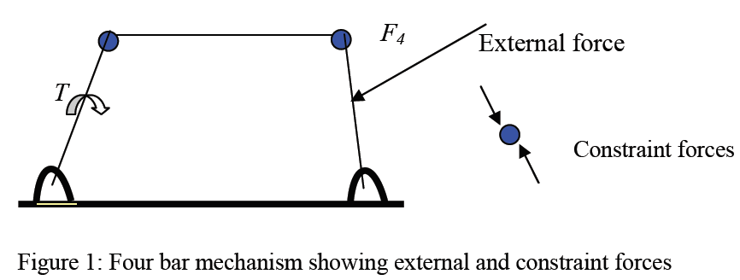
Examples of external forces
Electric, Magnetic and gravitational forces are example of forces that may be applied without actual physical contact.
But most of the forces we are concerned in mechanical equipment occur through direct physical or mechanical contact.

Slide 18
Constraint forces of action and reaction at a mechanical contact occur in pairs and thus have no net force effect on the system of bodies being considered.
When a part of the body is considered in isolation the effect of such force is considered by using the freebody diagram.
Characteristics of a force are its magnitude, its direction and its point of application

Slide 19
Two equal and opposite forces along two parallel but noncollinear straight lines in a body cannot be combined to constitute a single force and they constitute a couple. The arm of the couple is the perpendicular distance between their lines of action and the plane of the couple is the plane containing the two lines of action.
The moment of the couple M is a vector directed normal to the plane of the couple and the sense of M is in accordance to the right-hand rule for rotation

Slide 20
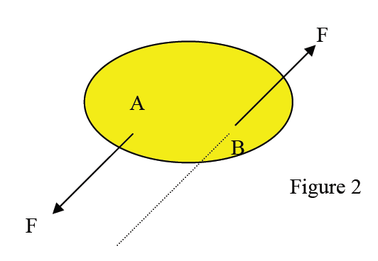
M=RBA x F
The value of M is independent of the choice of the reference point about which the moments are taken, because the vector RBA is the same for all positions of the origin.
As the moment vector M is independent of any particular origin or line of application, hence it is a free vector.

Slide 21
Static force analysis procedures
Consider a planar (2D) mechanism:
Given input motion (displacements, velocities and accelerations)
Find:
      Motion of the rest of the mechanism
      The forces necessary to generate the motion of the mechanism ,(# independent forces required to generate the motion of the mechanism is equal to the DOF of that mechanism)
      Joint (reaction) forces
ASSUMPTIONS
Rigid body assumptions of the components are used
Gravity may or may not be considered
Frictional forces at the joints will be assumed to be negligible

Slide 22
Free-Body Diagrams
FBD is the best method to represent all the known and unknown forces in a system.
FBD is a sketch of the outlined shape of the body, which represents it being isolated or free from its surroundings.
Necessary to show all the forces and couple moments that the surroundings exert on the body so that these effects can be accounted for when equations of equilibrium are applied

Slide 23
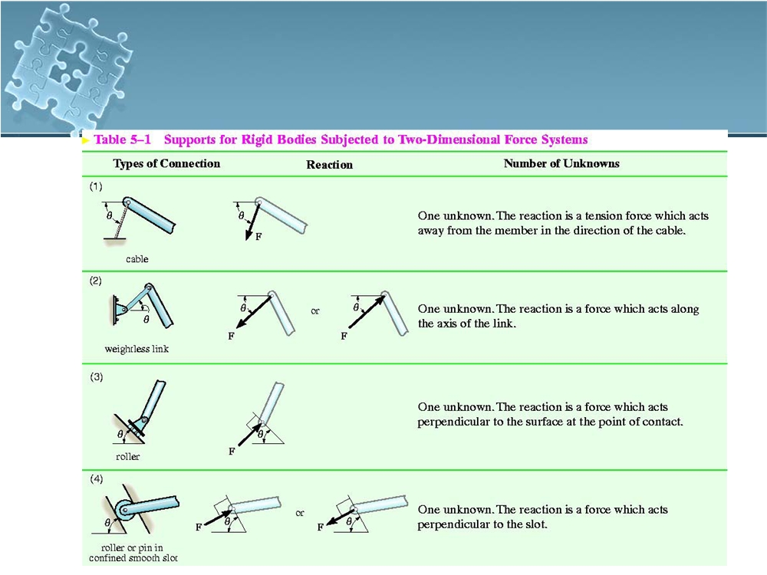
Free-Body Diagrams
4

Slide 24
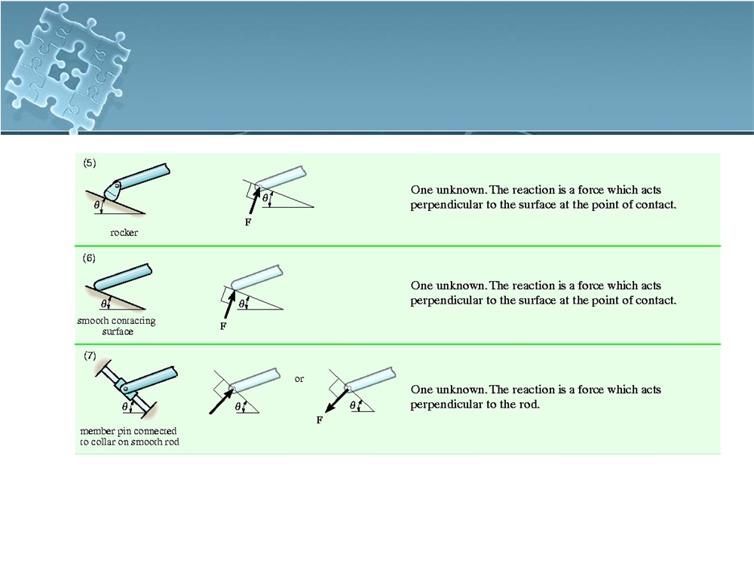
Free-Body Diagrams
50
50
(50)

Slide 25
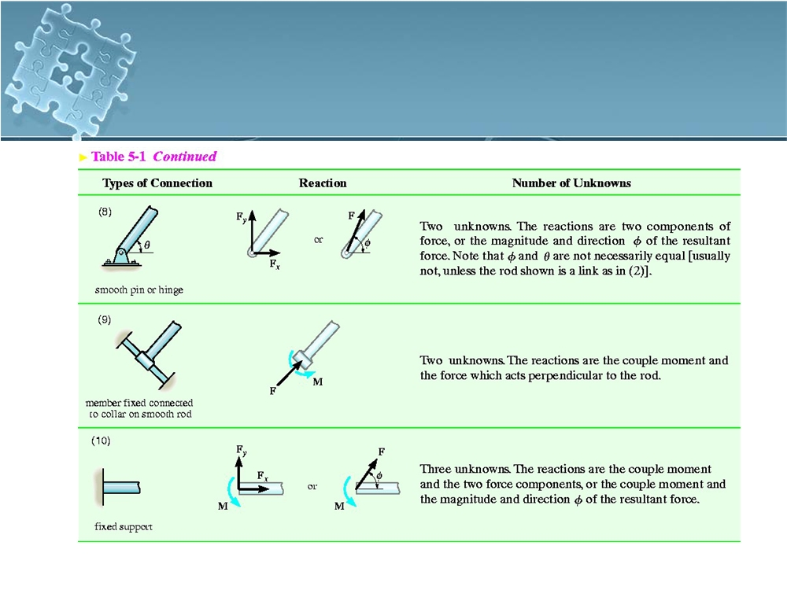
Free-Body Diagrams
51
(51)

Slide 26
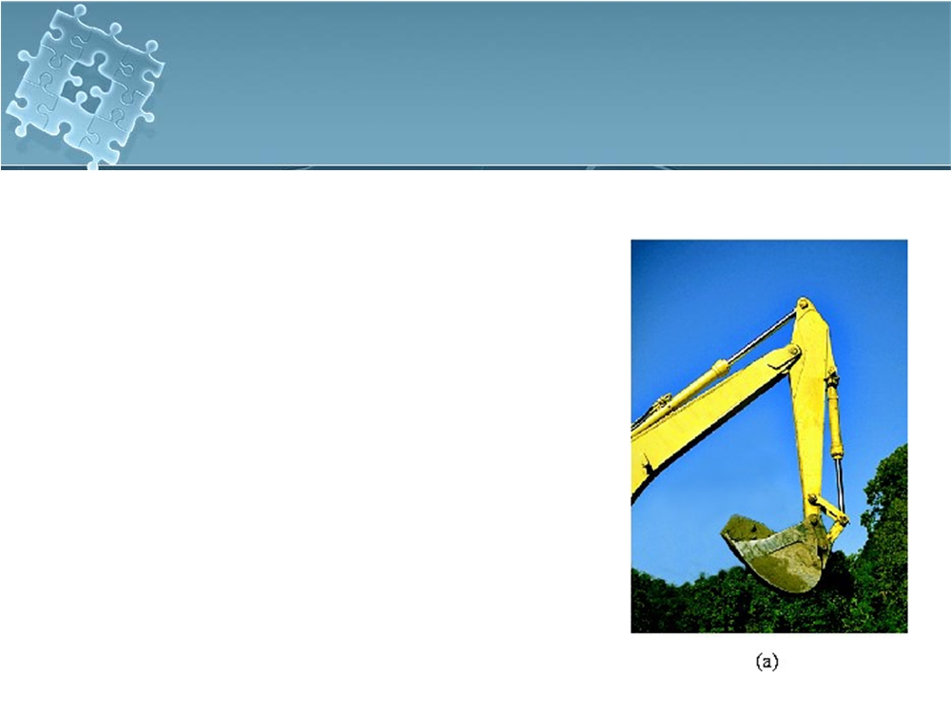
Free-Body Diagrams
Example
Draw the free-body
diagrams of the bucket and the vertical boom of the back hoe. The bucket and its content has a weight W. Neglect the weight of the members.
7

Slide 27
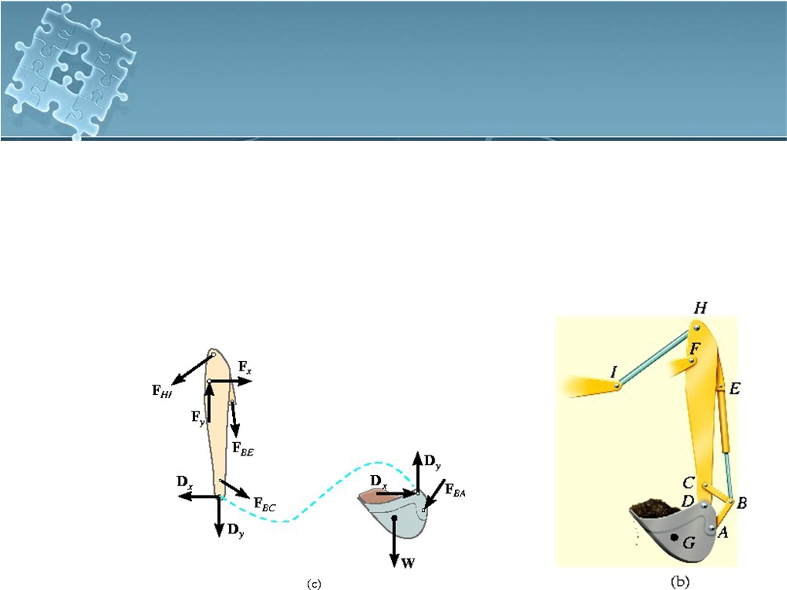
Free-Body Diagrams
Solution
●
Idealized model of the assembly
●
Members AB, BC, BE and HI are two
force members
7

Slide 28
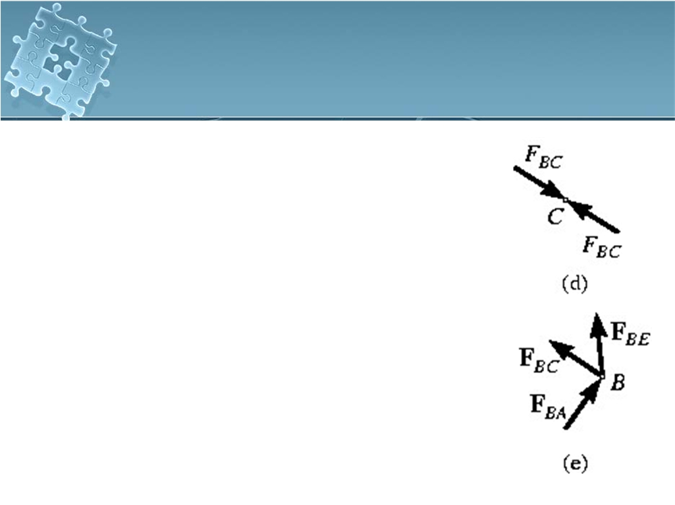
Free-Body Diagrams
Solution
●
FBD of the bucket and boom
●
Pin C subjected to 2 forces, force
of the link BC and force of the boom
Pin at B subjected to three forces, force by the hydraulic cylinder and the forces caused by the link
These forces are related by equation of force equilibrium
75

Slide 29

Static Equilibrium
Static Equilibrium - all links that are at rest or moving at constant velocity.
●
Conditions for an object to be in static
equilibrium:
1.The resultant, of all external forces acting on the object is equivalent to zero and does not cause it to translate.
2.The moment due to any external force is cancelled by the moments of the other forces
acting on the object and do not cause it to
76
rotate about any point.
76

Slide 30
Static Equilibrium
●
For equilibrium of an object in 2D,
∑Fx
= 0; ∑Fy
= 0;
∑MO
= 0
●
∑Fx
and ∑Fy
represent the algebraic sums of the
x and y components of all the forces acting on
the object.
●
presents the algebraic sum of the couple moments and moments of the force components about an axis perpendicular to x-yplane and passing through arbitrary point O, which may lie on or off the object.
77

Slide 31
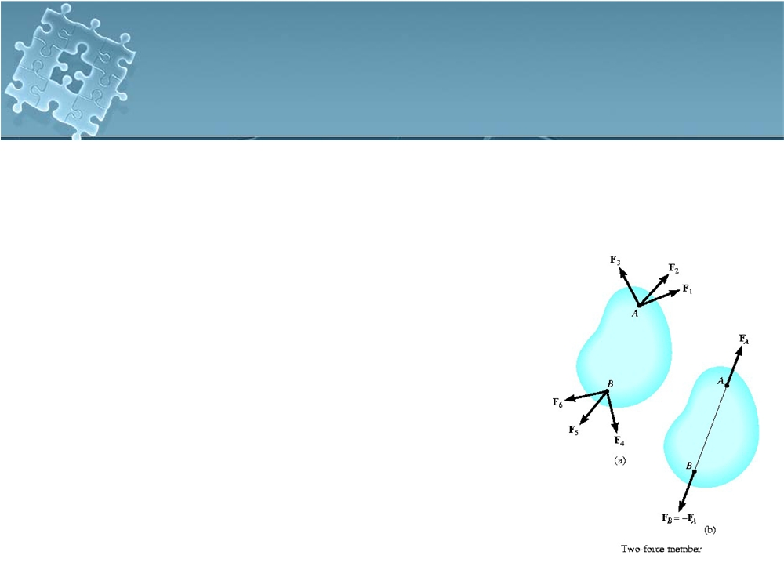
Two- and Three-Force Members
●
Simplify some equilibrium problems by
recognizing members that are subjected to only
2 or 3 forces
Two-Force Members
Then a member is subject to no couple moments and forces are applied at only two points on a member, the member is called a two-force member
7

Slide 32
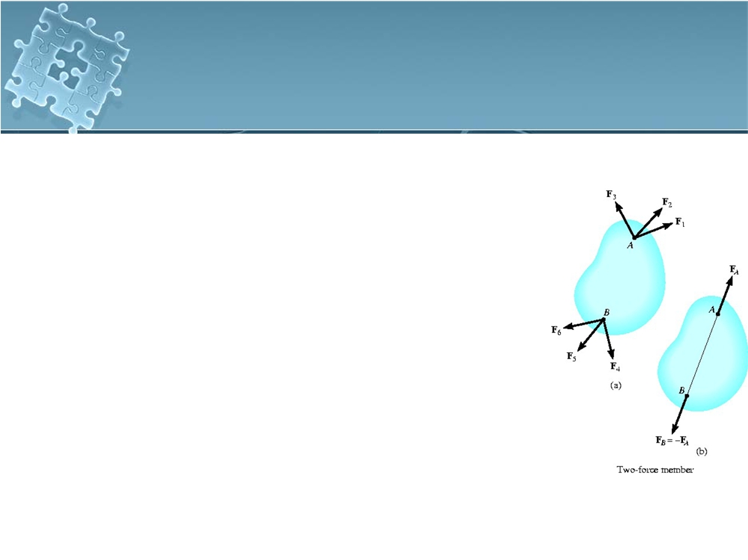
5.6 Two- and Three-Force Members
Two-Force Members
Example
Forces at A and B are summed to obtain their respective resultants FA and FB
These two forces will maintain translational and force equilibrium provided FA is of equal magnitude and opposite direction to FB
line of action of both forces is known and passes through A and B
79
(79)

Slide 33
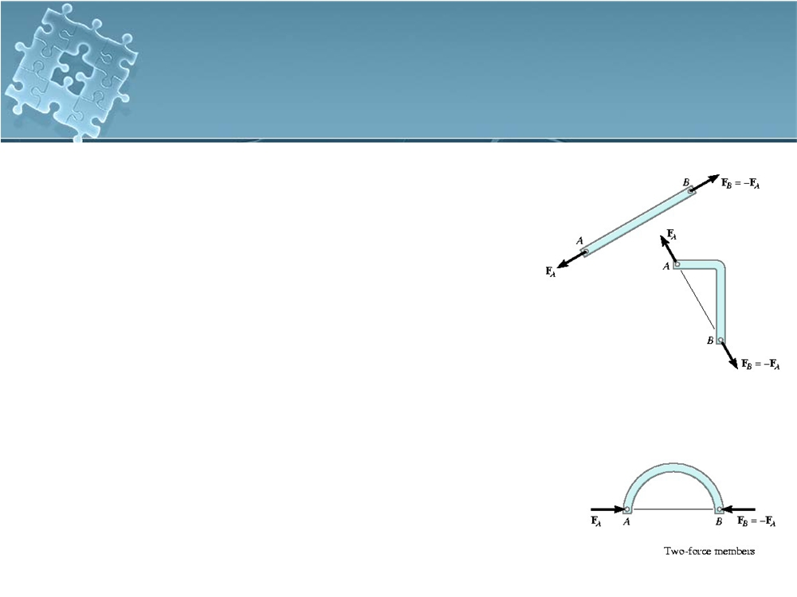
Two- and Three-Force Members
Two-Force Members
hence, only the force
magnitude must be determined or stated
Other examples of the two- force members held in equilibrium are shown in the figures to the right
80

Slide 34
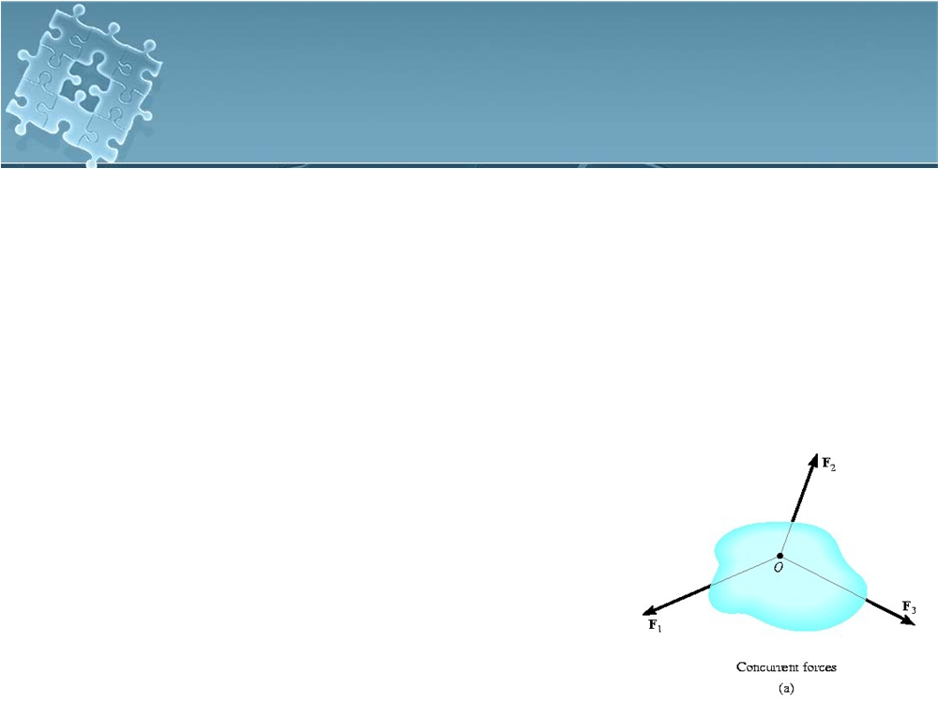
Two- and Three-Force Members
Three-Force Members
If a member is subjected to only three forces, it is necessary that the forces be either concurrent or parallel for the member to be in equilibrium
To show the concurrency
requirement, consider a body with any two of the three forces acting on it, to have line of actions that intersect at point O
8

Slide 35
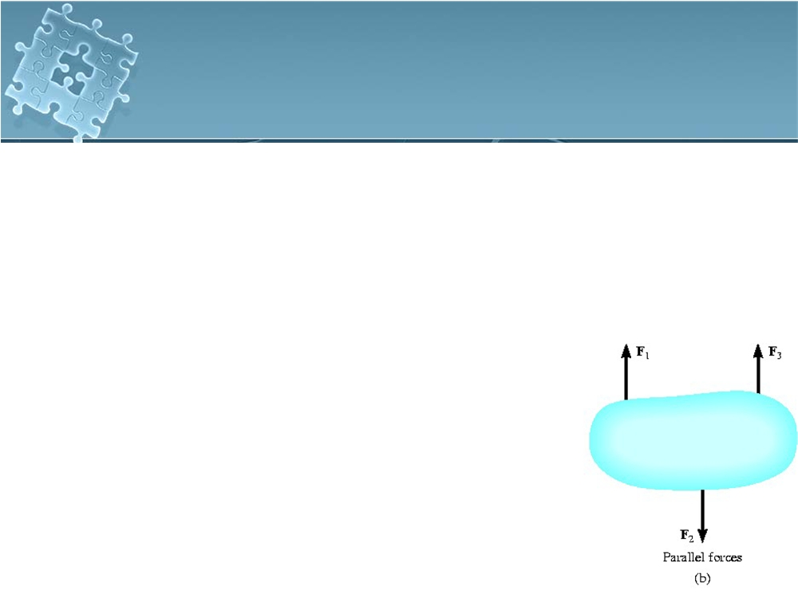
Two- and Three-Force Members
Three-Force Members
To satisfy moment equilibrium about O, the third force must also pass through O, which then makes the force concurrent
If two of the three forces parallel, the point of currency O, is
considered at “infinity”
Third force must parallel to the other two forces to insect
at this “point”
8

Slide 36
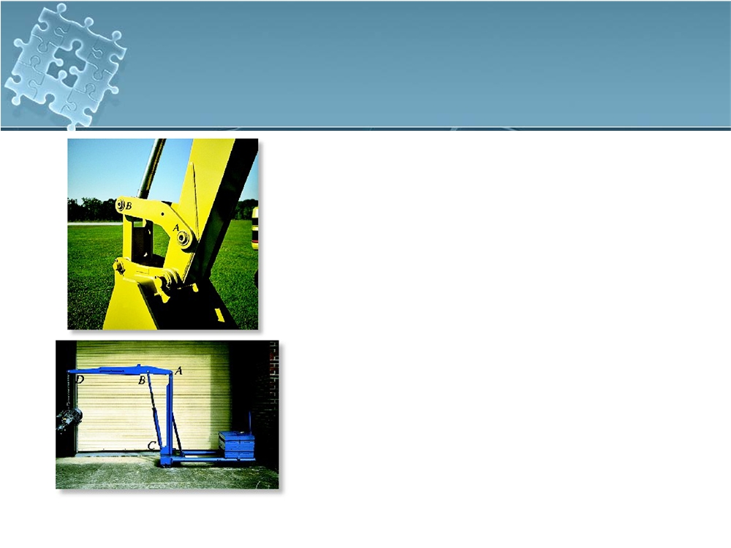
Two- and Three-Force Members
bucket link AB on the back hoe is a typical example of a two-force member since it is pin connected at its end provided its weight is neglected, no other force acts on this member
the hydraulic cylinder BC is pin connected at its ends,
being a two-force member.
83
83

Slide 37
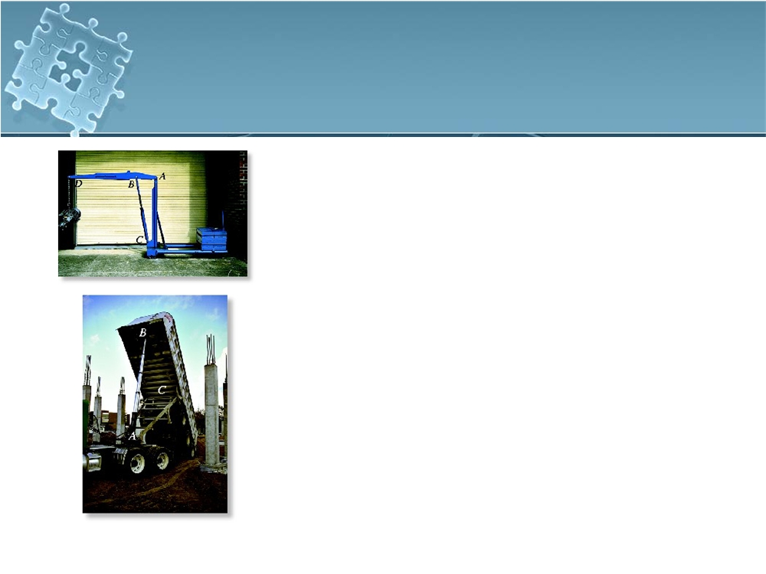
Two- and Three-Force Members
The boom ABD is subjected to the weight of the suspended motor at D, the forces of the hydraulic cylinder at B, and the force of the pin at A. If the boom’s weight is neglected, it is a three-force member
The dump bed of the truck operates by extending the hydraulic cylinder AB. If the weight of AB is neglected,
it is a two-force member since it is
pin-connected at its end points
84
84
(84)

Slide 38
Superposition:
The principle of superposition of forces is an extremely useful concept, particularly in graphical force analysis. Basically, the principle states that, for linear systems, the net effect of multiple loads on a system is equal to the superposition (i.e., vector summation) of the effects of the individual loads considered one at a time

Slide 39
. Physically, linearity refers to a direct proportionality between input force and output force.
Generally, in the absence of Coulomb or dry friction, most mechanisms are linear for force analysis purposes, despite the fact that many of these mechanisms exhibit very nonlinear motions. Examples and further discussion in later sections will demonstrate the application of this principle

Slide 40
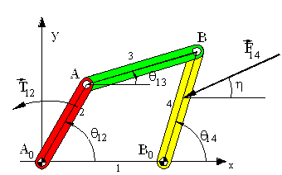
Static Force Analysis
Consider the simple four-bar system shown:
The system is in equilibrium under the action of the external force F₁₄ and T₁₂.
The magnitude and direction (η) of the force F₁₄ are known.
We are to determine T₁₂ and the forces acting at the joints. In free-body diagrams of the moving links are shown.

Slide 41
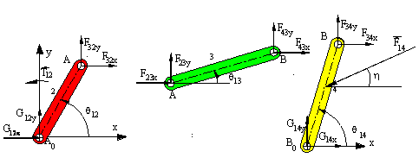
Free Body Diagram
On the free-body diagrams the unknown joint force components (F_{ijx} and F_{ijy}) are all shown acting in the positive x and y directions. a negative value is obtained in the result, it means that force component is in the opposite direction.

Slide 42
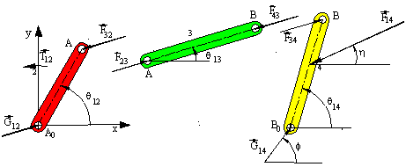
FBD if direction of forces is known

Slide 43
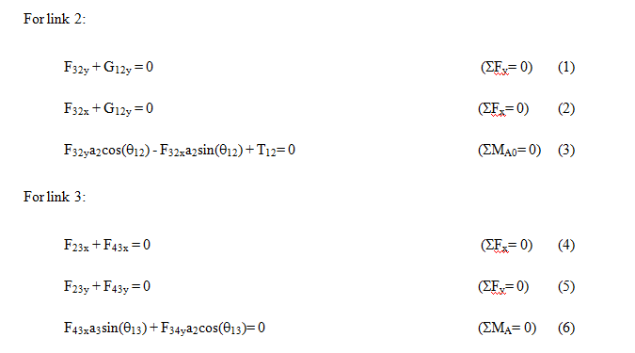
Analysis

Slide 44
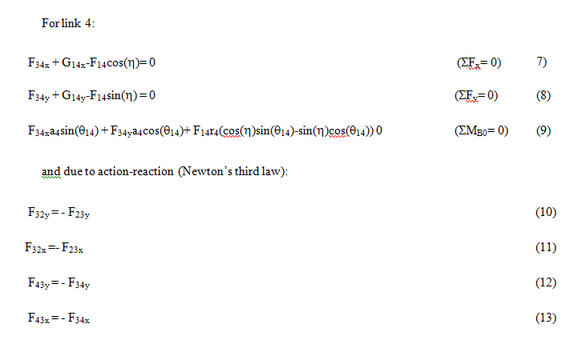

Slide 45
If the displacement analysis is performed beforehand, e.g. if Ɵ₁₃, Ɵ₁₄ values are determined for different Ɵ₁₂ values, the above equations can be used for every position of the mechanism.
Another important point is that this formulation is very general. It can be used for mechanisms where there are several external forces acting on the same or different links and in cases where we have resisting forces at the joints. However, the resulting number of equations is usually too large (if there are l links in the mechanism there will be 3(l-1) equilibrium equations).

Slide 46
If we generalise the above result, we can see that:
a) For two-force members you don't have to write the equilibrium equations. You can simply state that the forces are equal and opposite and their line of action coincides with the line joining the points of applications.
b) For two-force plus a moment members you must write the moment equilibrium equation only. The two forces are equal and opposite and they form a couple equal and opposite to the moment applied.
c) In case of three or four force members, the three equilibrium equations (∑F_{x} = 0, ∑ F_{y} = 0, ∑ M= 0) must be written.

Slide 47
example
Figure shows Whithworth quick-return motion mechanism. We want to determine driving torque and the joint forces when the system is assumed to be in static equilibrium when the input crank angle q₁₂=30⁰. After performing the kinematic analysis (either graphically or analytically) at the position shown, the position variables have the following values:
B₀A = 158.75 mm; q₁₄= 49.11⁰ B₀C = 285.13 mm; q₁₅ = 169.55⁰

Slide 48
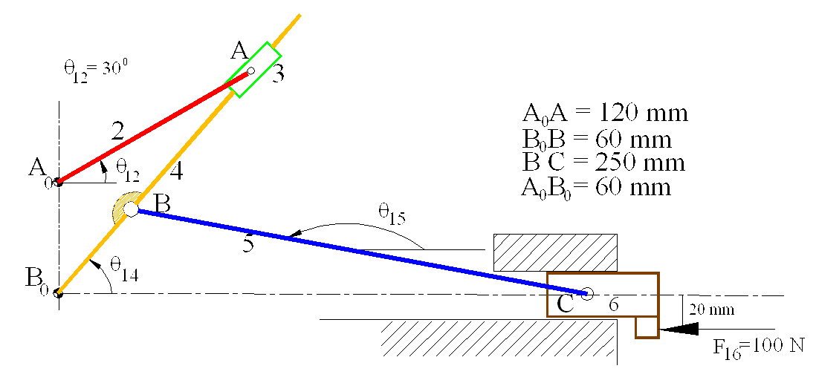

Slide 49
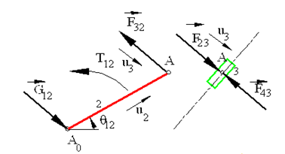
FBD

Slide 50
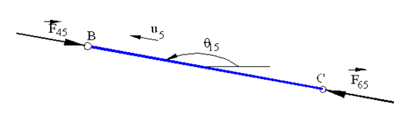
FBD

Slide 51
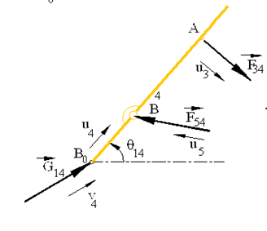
FBD

Slide 52
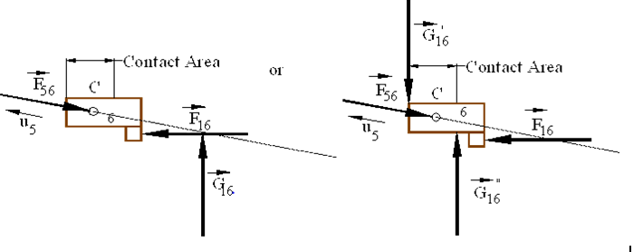
FBD

Slide 54
F₅₆ = - F₆₅ = F₄₅ = -F₅₄
F₃₄ = - F₄₃ = F₂₃ = -F₃₂ = G₁₂
F₅₆ = - F₅₆ u₅ where u₅= 1 < 169.95⁰ = cos(169.95⁰)i +sin(169.95⁰)j
F₁₆ = -100 i (N)
G”₁₆ = G”₁₆j and G’₁₆ = -G’₁₆j
Force equilibrium of link 6 results:
(G”₁₆- G’₁₆)j - F₅₆ u₅ - 100 j = 0
or
(G”₁₆- G’₁₆)- F₅₆ sin(169.95⁰) = 0
- F₅₆ cos(169.95⁰) -100 = 0

Slide 55
The moment equilibrium equation (SM_{C}= 0) yields (the distance from point B to the two boundaries are 70 and 30 mm respectively. These distances will be a function of the mechanism position):
G’₁₆*70 +G”₁₆*30 -100*20=0
We obtain:
F₅₆ = 101.56 N <-10.05⁰; G’₁₆= 14.68 N < 90⁰; G”₁₆= 32.41 N < 90⁰

Slide 56
Since link 5 is a two force member F₅₄=-F₄₅=F₆₅=-F₅₆=107.56 N < 169.95⁰.
The force equilibrium equation for link 4 is:
F₅₄u₅ + G₁₄v₄ + F₃₄u₃ = 0
Where
v₄ = 1 < f= cosf i + sinf j
u₃ = 1 <(q14 -90⁰) = cos 40.89⁰ i - sin 40.89⁰ j

Slide 57
The force equilibrium equations can also be written as:
F₅₄ cos 169.95⁰ + G₁₄ cosf + F₃₄ cos 40.89⁰ = 0
F₅₄ sin l69.95⁰ + G₁₄ sin f-F₃₄ sin 40.89⁰ = 0
The moment equilibrium equation (SM_{B} = 0) is:
a₄u₄x F₅₄ u₅ + r₄u₄x F₃₄ u₃ = 0
Where:
u₄ = 1 < q₁₄ = cos 49.11⁰ i + sin49.11⁰ j
and
B₀B = a₄ = 60 mm , B₀A = r₄ = 158.75 mm

Slide 58
When the moment equilibrium equation is simplified:
a₄ F₅₄ sin(q₁₅-q₁₄ + r₄ F₃₄ sin(q₁₄-90⁰ -q₁₄) =0
or:
a₄ F₅₄ sin(120.44⁰) - r₄ F₃₄ = 0
Which yield:
F₃₄ = 33.14 N < -40.89⁰ , G₁₄ = 75.02 N < 2.48⁰

Slide 59
For link 2 :
F₃₂ = 33.14 N < 139.11⁰
G₁₂ = 33.14 N <40.89⁰
And the moment equilibrium equation yields:
T₁₂ + 120 * 33.14 sin(139.11⁰ -30⁰ ) = 0
or
T₁₂ = -3757.65 N-mm
or
T₁₂ = 3.76 N-m (CW)

Slide 60
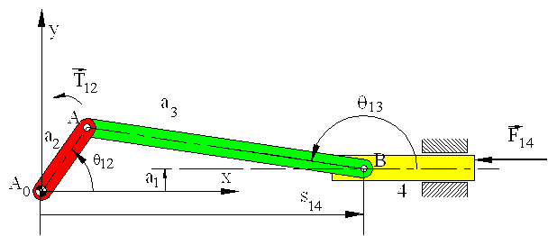
consider the slider-crank mechanism shown

Slide 61
The system is in static equilibrium for all crank angles under the action of a known force F₁₄ acting on link 4 and unknown torque T₁₂ acting on link 2. We are to determine the joint forces and the input torque, T₁₂ .

Slide 62
Note that link 3 is a two force, link 2 is a two force and a moment member. In case of link 4, there is a known external force F₁₄ , a joint force F₃₄ whose direction is known (along AB). There must be a joint force G₁₄ (perpendicular to the slider axis) and moment M₁₄ (perpendicular to the plane) due to the action of link 1 on link 4 . The rigid body is in equilibrium under the action of three forces and a moment.

Slide 63
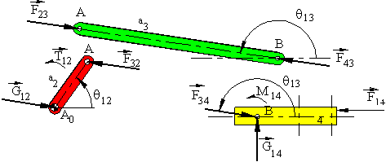
FBD

Slide 64
The force G₁₄ can be placed anywhere on link 4.
Since link 4 is in static equilibrium, this will change the magnitude of the moment M₁₄ .
If the line of action of G₁₄ passes through the point of intersection of F₁₄ and F₃₄ , the moment M₁₄ will be zero and rigid body will be in equilibrium under the action of three forces.
If the point of concurrency, O, of the three forces lie within the physical boundaries of the sliding joint, there will be surface contact between links 1 and 4.

Slide 66
STATIC FORCE ANALYSIS OF MACHINERY
Method of Superposition
Dr. Sadettin KAPUCU

Slide 67
METHOD of SUPERPOSITION
Sometimes the number external forces and inertial forces acting on a mechanism is too much for graphical solution.
F3
F1
τ1
F2
In this case we apply the method of superposition. Using superposition the entire system is broken up into (n-1) problems, where n is the number of forces, by considering the external and inertial forces of each link individually.

Slide 68
METHOD of SUPERPOSITION
Response of a linear system to several forces acting simultaneously is equal to the sum of responses of the system to the forces individually.
F1
τ1
F3
F1
τ
τ2
F2
F2
F3
τ3

Slide 69
Example 1
Onto crank CD of the mechanism shown, a CCW torque of 100 N.m is acting. Onto the slider of link 6 a 50 N force is acting horizontally rightward. Calculate the amount of torque required on crank AB to keep the mechanism in static equilibrium using the method of “superposition”. AB = BE=CE = 7 cm. CD = EF = 6 cm.AD = 10 cm.e = 8 cm.

Slide 70
Example 1
This problem can not be solved graphically. We have to use the method of superposition.
Assume, only 50 N force is acting onto mechanism. Then,
Link 6, 3 are three force member.
Link 5, 4 are two force member.

Slide 71
Example 1
N
FF
Link 6, 3 are three force member.
Link 5, 4 are two force member.
FF
FE
N
FF=59.8N
FE
FC
FC
FB
FB
d=37.5 mm
FB=49N
FA
FF=59.8N
FC
FD

Slide 72
Example 1
Assume, only 100 N.m torque is acting onto mechanism. Then,
Link 3 is two force member.
There is no force and torque on link 5 and 6.

Slide 73
Example 1
N
FF
Link 3 is two force member.
There is no force and torque on link 5 and 6.
FF
FE
100 Nm

Slide 74
Example 1
N
FF
Link 3 is two force member.
There is no force and torque on link 5 and 6.
FF
FE
FC
FB
FC
FB
100 Nm
d2=58 mm
d3=26.7 mm
FA
FD

