Slide 1
MENG 3071 Chapter 3 Velocity Analysis
All figures taken from Design of Machinery, 3rd ed. Robert Norton 2003

Slide 2
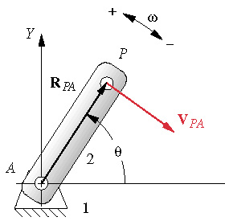
Velocity Analysis
Definitions
Linear Velocity
Angular Velocity
Velocity of a point
Link in pure rotation
Multiplying by i rotates the vector by 90°
Velocity is perpendicular to radius of rotation & tangent to path of motion

Slide 3
Velocity Analysis
Vector r can be written as:
Imaginary
Multiplying by i gives:
Multiplying by i rotates a vector 90°
r
θ
Real

Slide 4
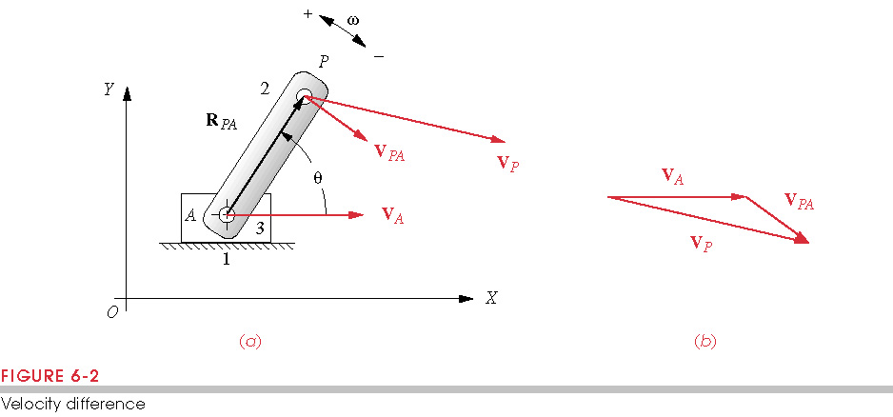
Velocity Analysis
If point A is moving
Graphical solution:

Slide 5
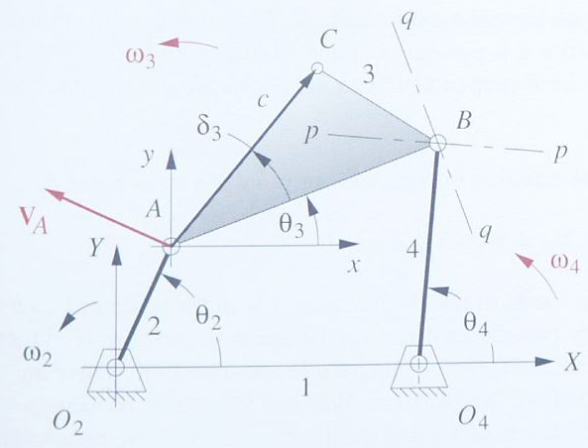
Graphical Velocity Analysis (ω₃ & ω₄)
V_{BA}
V_{BA} Direction
V_{BA}
V_{A}
V_{B}
V_{B}
V_{B} Direction
Given linkage configuration & ω₂. Find ω₃ and ω₄
We know V_{A} and direction of V_{B} and V_{BA} (perpendicular to AB)
Draw vector triangle. V=ωr.

Slide 6
Graphical Velocity Analysis (V_{C})
Double Scale
V_{C}
V_{CA}
V_{A}
V_{CA}
V_{C}
After finding ω₃ and ω₄, find V_{C}
V_{C}=V_{A}+V_{CA}
Recall that ω₃ was in the opposite direction as ω₂

Slide 7
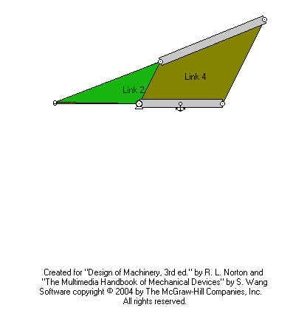
Instant Center
A point common to two bodies in plane motion, which has the same instantaneous velocity in each body.
In ENGR 214 we found the instant center between links 1 and 3 (point on link 3 with no velocity)
Now we also have an instant center between links 2 and 4

Slide 8
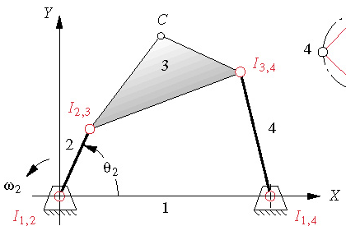
Instant Centers
Kennedy’s rule: any three links will have three instant centers and they will lie on a straight line
The pins are instant centers
I₁₃ is from links 1,2,3 and 1,3,4
I₂₄ is from links 1,2,4 and 2,3,4
I₁₃
1 2 3
1 3 4
1 2 4
2 3 4
Links
I₁₂
I₂₃
I₁₃
I₁₃
I₃₄
I₁₄
I₁₂
I₂₄
I₁₄
I₂₃
I₃₄
I₂₄
IC’s
I₂₄

Slide 9
Instant Centers
I₁₃ has zero velocity since link 1 is ground
ω₃ is the same all over link 3
Velocity relative to ground=rω, perpendicular to r
V_{A2}=aω₂=V_{A3}=pω₃
From this, ω₃ must be in the opposite direction as ω₂, and smaller in magnitude since p>a
I₁₃
ω₃
p
V_{A2}
ω₃
A
V_{A3}
a

Slide 10
Instant Centers
I₂₄ has the same velocity on link 2 and link 4
V_{I2}=l₂w₂=V_{I4}=l₄w₄
From this, w₄ is in the same direction as w₂ and smaller in magnitude since l₄>l₂
l₄
ω₄
I₂₄
V_{I4}
V_{I2}
l₂

Slide 11
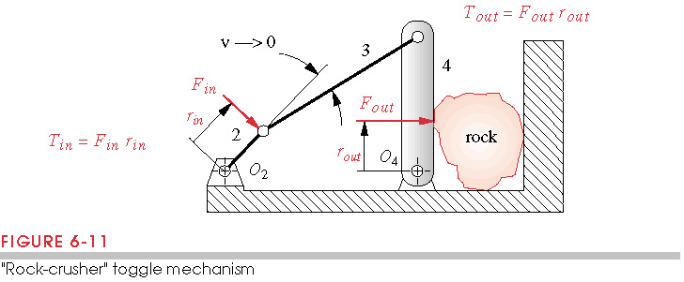
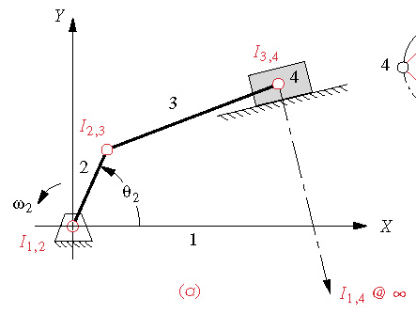
Instant Centers Practice Problems
A
B
O₂
O₄
Power=T_{in}ω_{in}=T_{out}ω_{out}
A
O₄
O₂
B

Slide 12
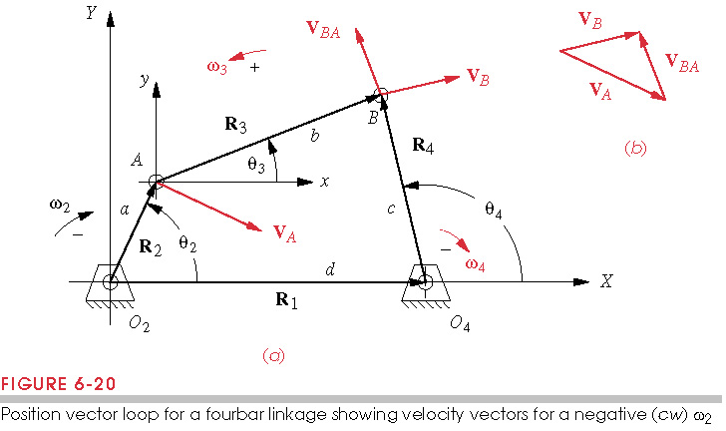
Velocity Analysis of a 4-Bar Linkage
Given ω₂. Find ω₃ and ω₄

Slide 13
Velocity Analysis of a 4-Bar Linkage
Write the vector loop equation
After solving the position analysis, take the derivative
or
where

Slide 14
Velocity Analysis of a 4-Bar Linkage
Take knowns to one side:
Take conjugate to get 2nd equation:
Put in matrix form:
Invert matrix:

Slide 15
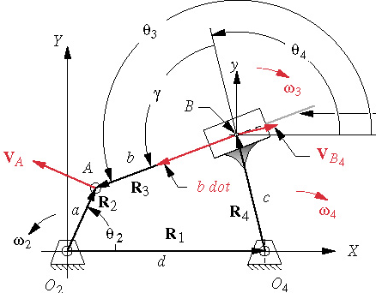
Inverted Crank Slider
Link 3 is a slider link: its effective length, b, changes
Given ω₂. Find ω₃ and

Slide 16
Inverted Crank Slider
Given ω₂. Find ω₃ and
Write the vector loop equation:
After solving the position analysis, take the derivative:
To get another equation:
or
so

Slide 17
Inverted Crank Slider
Take conjugate to get second equation:
Put in matrix form:
Invert:

Slide 18
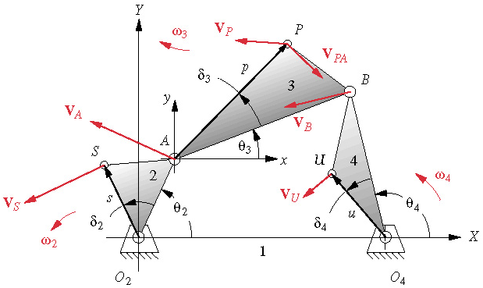
Velocity of any Point on a Linkage
Write the vector for R_{P}
Take the derivative
Similarly
R_{P}

Slide 19
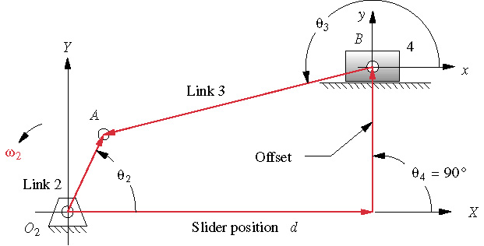
Offset Crank Slider
b
c
a
Given ω₂. Find ω₃ and

