Slide 1
Chapter 5 Meng 3071
INTRODUTION TO COMPUTER METHODS FOR KINEMATIC MULTI BODY SYSTEM ANALYSIS

Slide 2
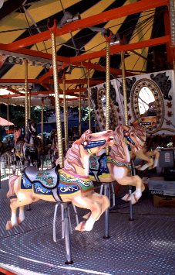
INTRODUCTION T0 COMPUTER METHODS FOR KINEMATICS ANALYSIS OF MULTBODY SYSTEM

Slide 3
INTRODUCTION
The displacement, velocity and acceleration of a point in mechanism or link can be determined by graphical method for very few positions say one or two of the crank .moreover the accuracy of this method is limited also if these quantities are required for more positions or for their several configurations diagrams are required it will be very convenient to use desk calculator or a digital computer know for our discussion we see the expression for displacement ,velocity and acceleration shall be derived in terms of general parameters of the mechanisms it facilitates forming computer program thereby desired quantities can be determined by using a computer

Slide 4
There are three computer methods for kinematic analysis for multi body system
Mat lab program
Program cam design
Working 2D model, version 5.0

Slide 5
1.MATLAB PROGRAM
INTRODUCTION TO MAT LAB
1.1 Programs Available
The programs address the following types of problems.
MATLAB program for cam design with axial cylindrical-faced follower, axial flat faced follower, oscillating cylindrical-faced follower, and oscillating flat-faced follower, oscillating cylindrical-faced follower, and oscillating flat-faced follower.
Crank Rocker Design: MATLAB program for crank rocker design

Slide 6
When we use mat lab program we enter the given input data on the program and the required data or out put data will given by the math lab program

Slide 7
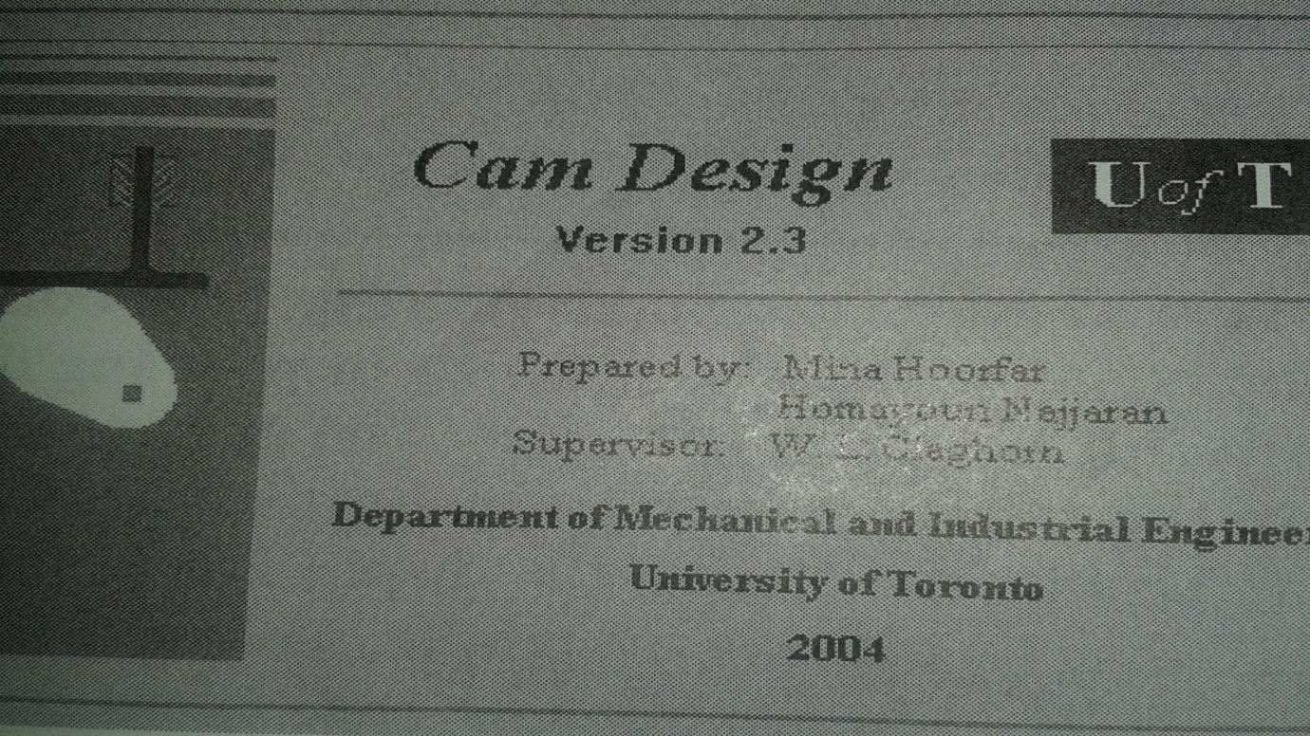
PROGRAM CAM DESIGN

Slide 8
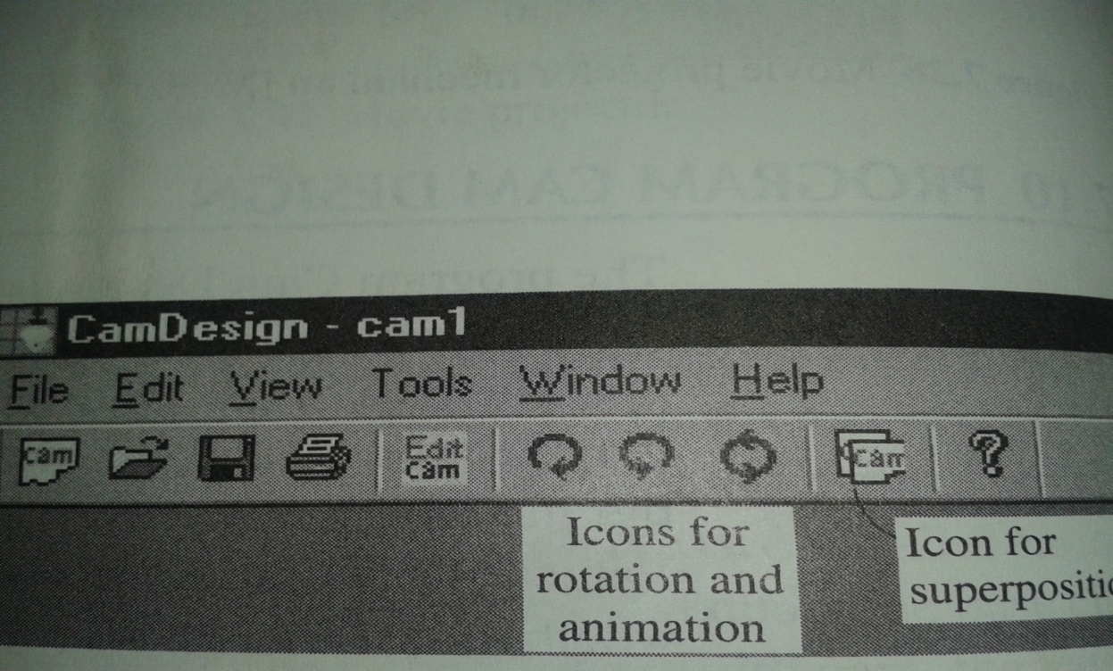
RUNING CAM DESIGEN PROGRAM
First step is to initiate the program
Press the cam icon on above diagram and design page is appeared as shown below

Slide 9
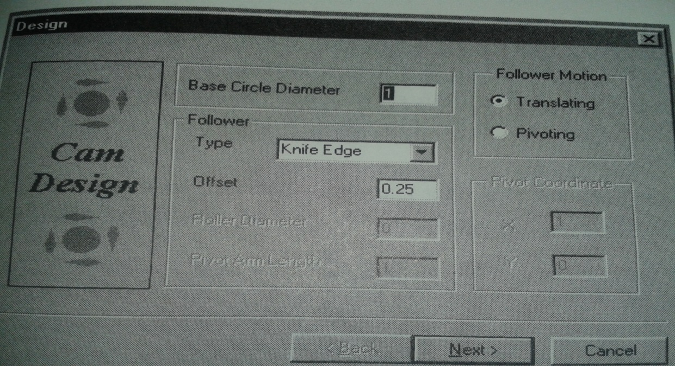
The second step is design page it is shown bellow
Entering our data we get the next page bellow

Slide 10
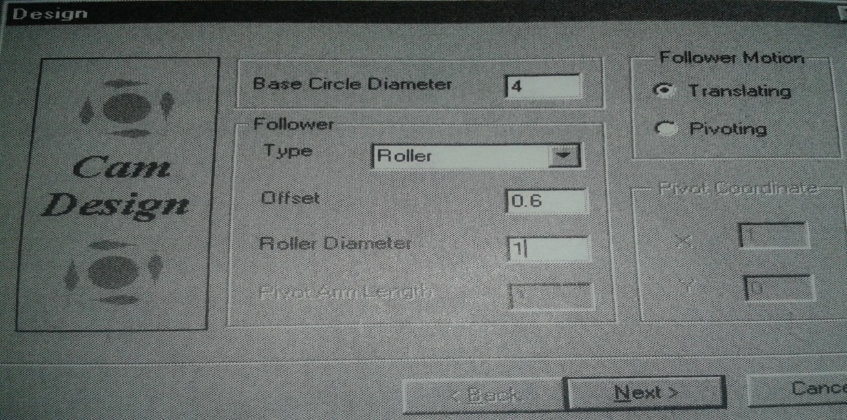
Parameter interval | Initial angel For interval | Final angle For interval | Type of motion | Rise(+) or return(_)cm
1 | 0 | 100 | parabolic | 0.8
2 | 100 | 260 | dwell | 0
3 | 260 | 360 | harmonic | _0.8
Then by selecting next button we obtain the motion page

Slide 11
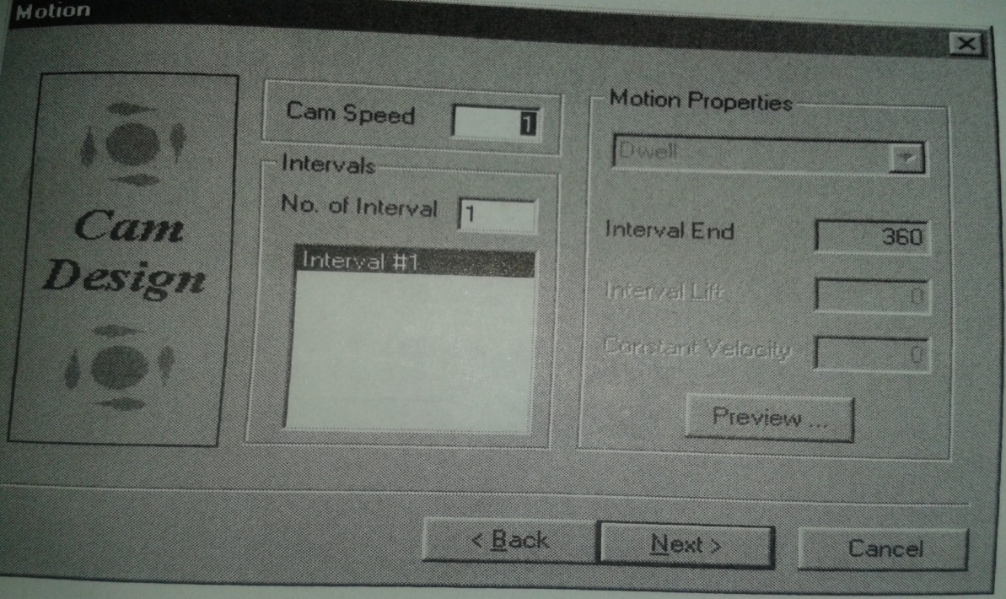
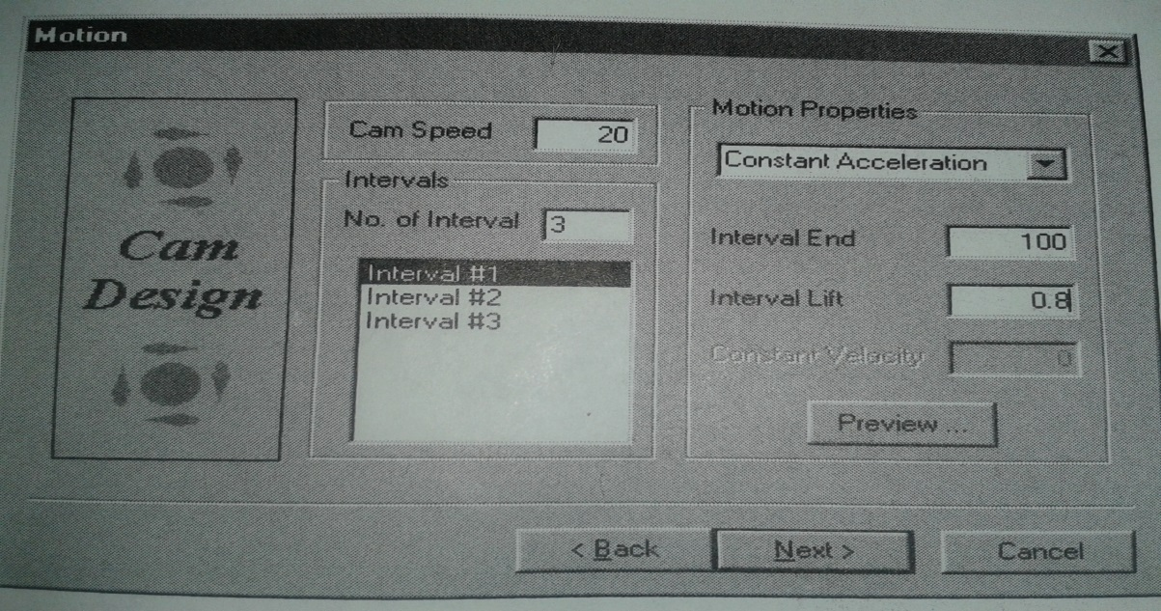
Inter the number of interval

Slide 12
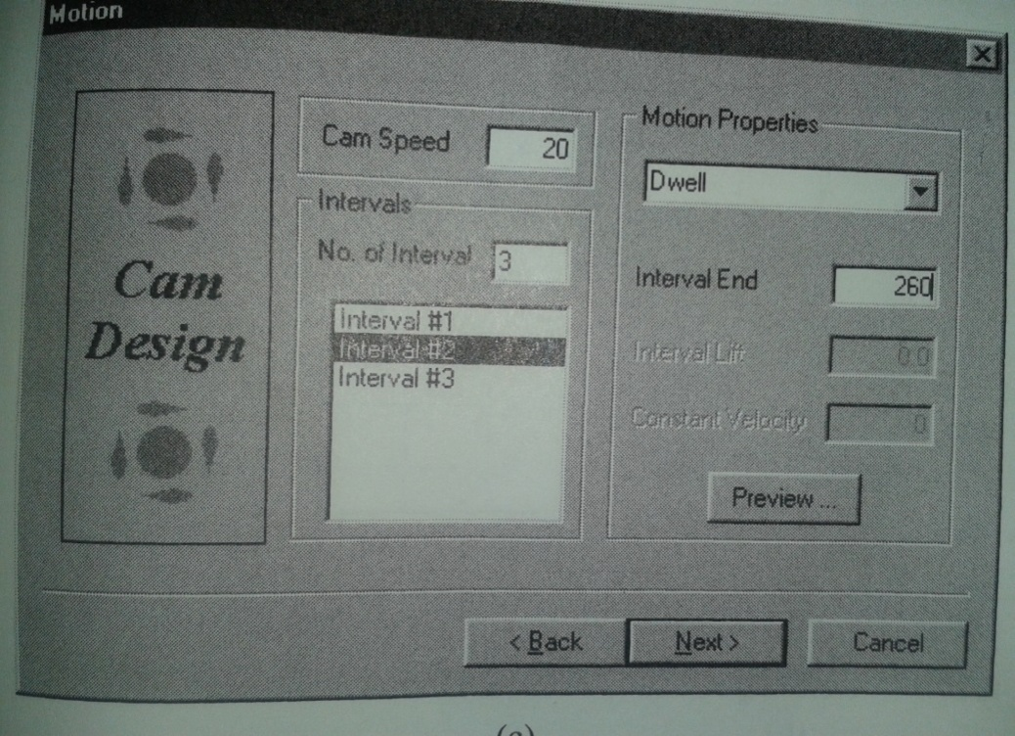
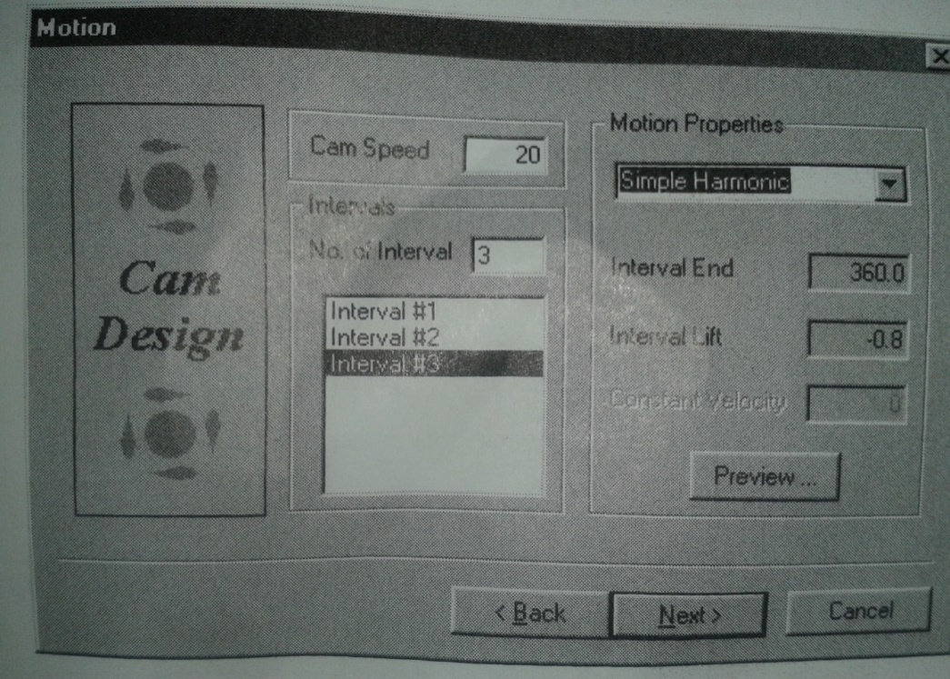
Interning the interval values we get the folloing

Slide 13
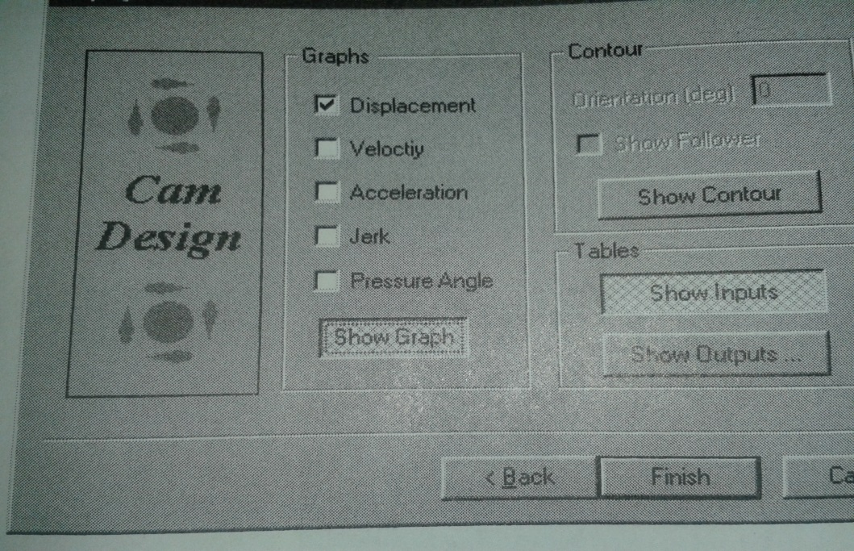
By selecting next button we obtain the display page as shown below:
Display page:

Slide 14
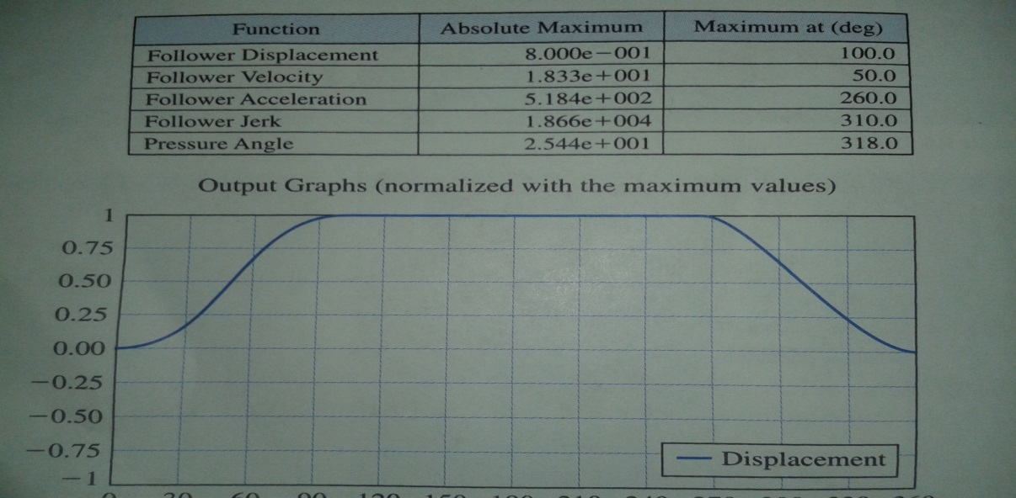
If we want to see only the displacement graph we only click displacement graph and by clicking finish we obtain the data below:

Slide 15
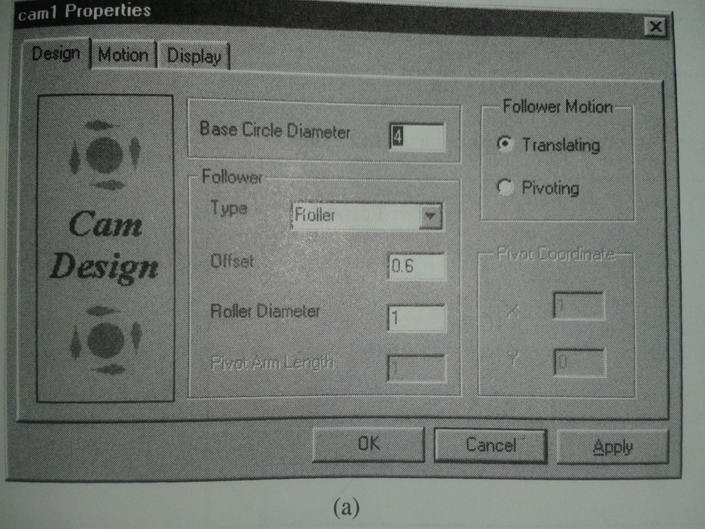
By clicking the edit cam icon the property sheet appears as shown below:

Slide 16
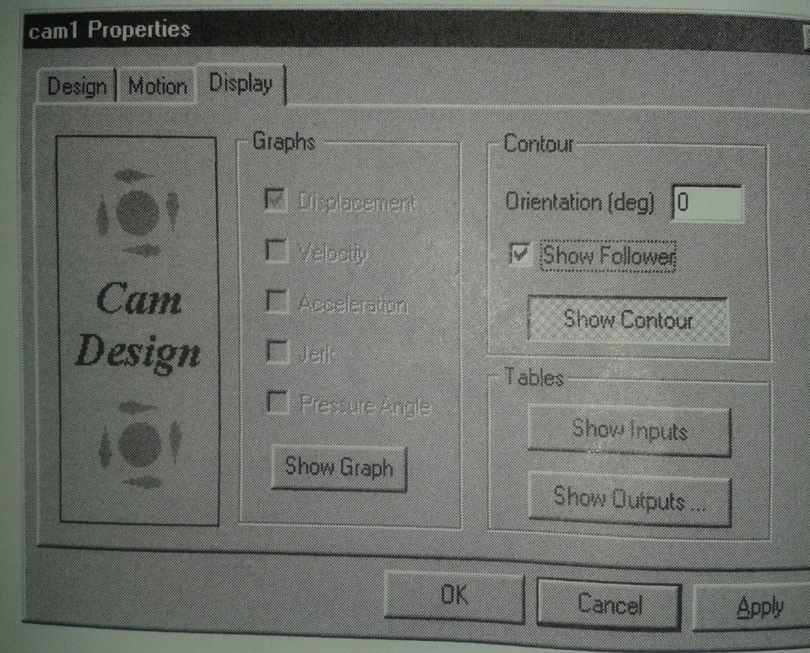

Slide 17
In the display page it is possible to modify the parameters or repeat the displays.
We have options to change the type and dimensions of the cam mechanism through the design page. a further option is to select the display page and either review select out puts. We may go to the display page, deselect the show graph button and select show contour button. then by clicking apply gives the result shown below:

Slide 18
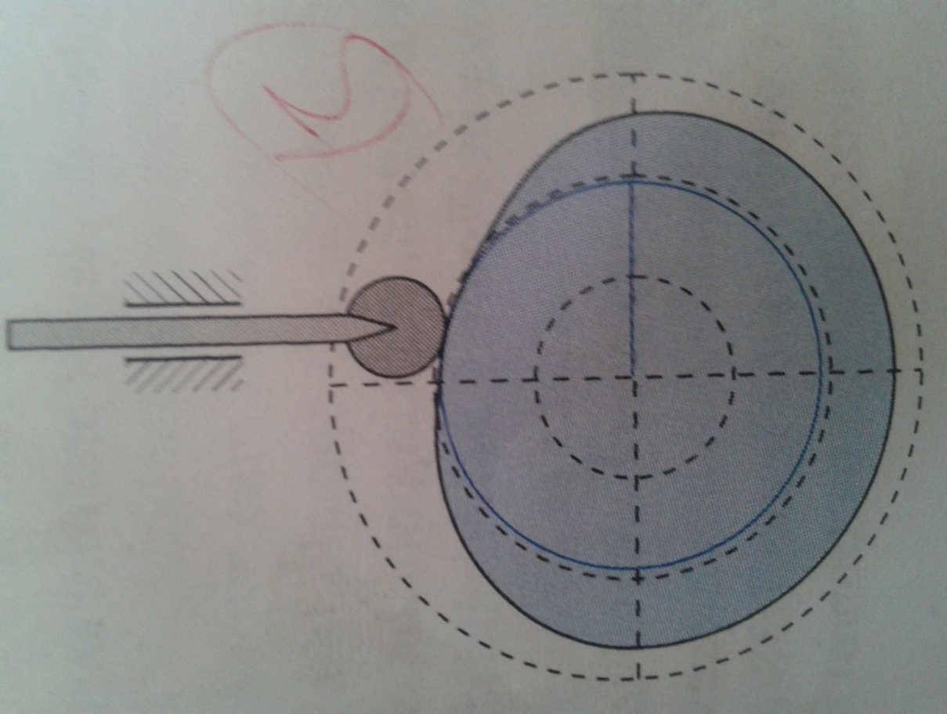

Slide 19
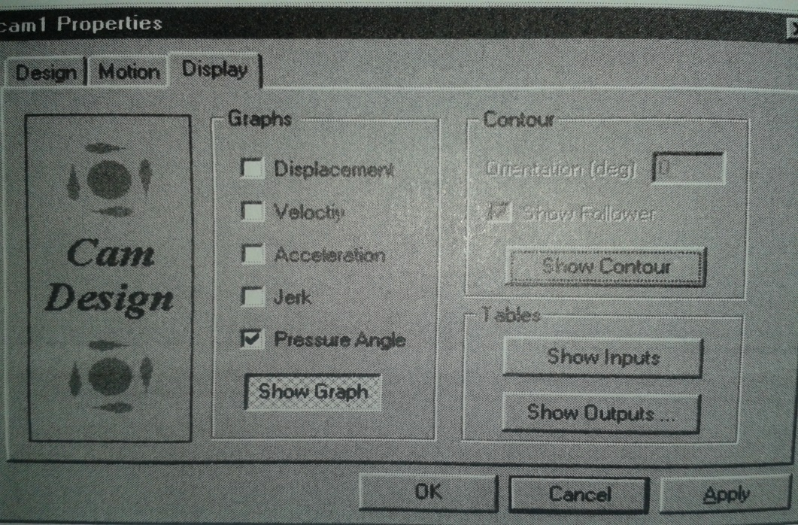
Once again by clicking edit cam icon, then the display page button deselecting the show contour button clicking on the show graph button selecting the pressure angle graph and clicking apply gives a result below

Slide 20
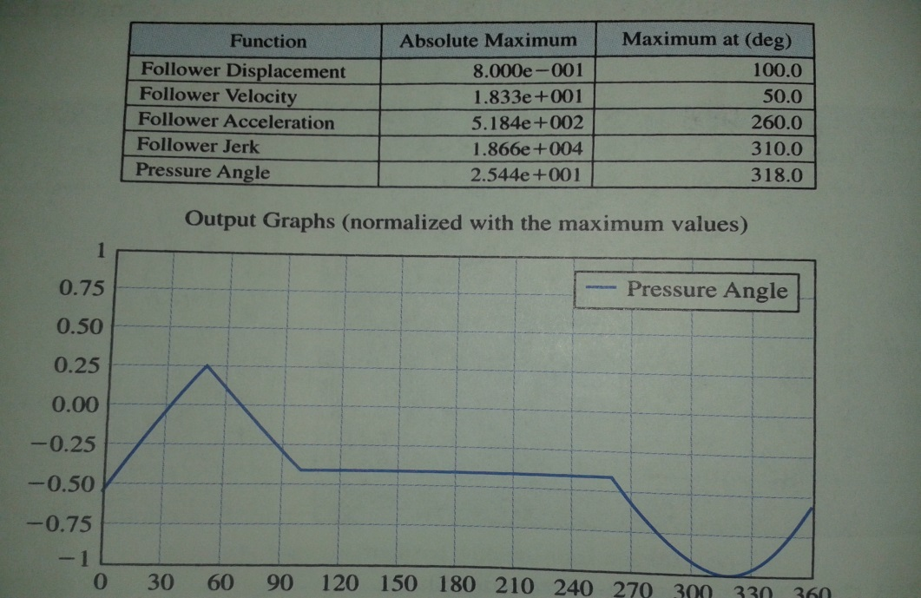
An animated motion of the mechanism may also be obtained .animation may be generated with or with out the follower .for animation it is necessary to de select other input s and other out puts, except show contour .t hen using the icon below then clicking apply then ok we obtain the following result or animation

Slide 22
An animated motion of follower.for animation it is necessary to de select othr input s and other outputs,except show contour.then using the icon belowthen clicking apply then ok we obtain the following result or animation

Slide 23
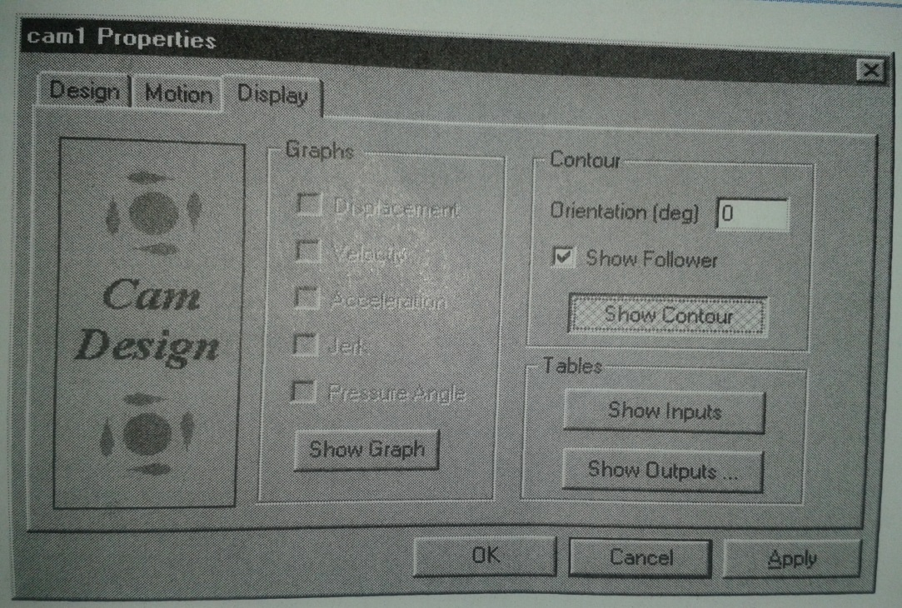

Slide 24
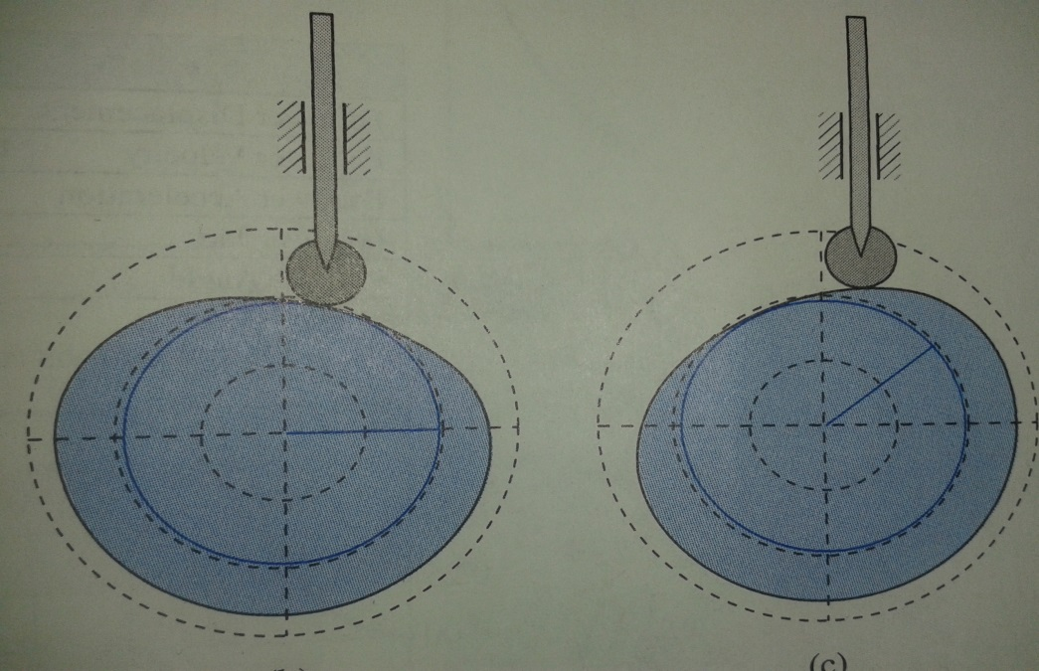
mechanism may also be obtained.animation may be generated with or with out the

Slide 25
Under the file menu, we may savethe above parameter using a desired file name. The above mechanism is saved as cams1 then we procced to return to the motion page and change the displacement diagram of the rotaion of the cam dividing the second and third interval is altered from 260⁰ to 300⁰ this modified cam mechanism and displacement diagram are showin in figuer

Slide 26
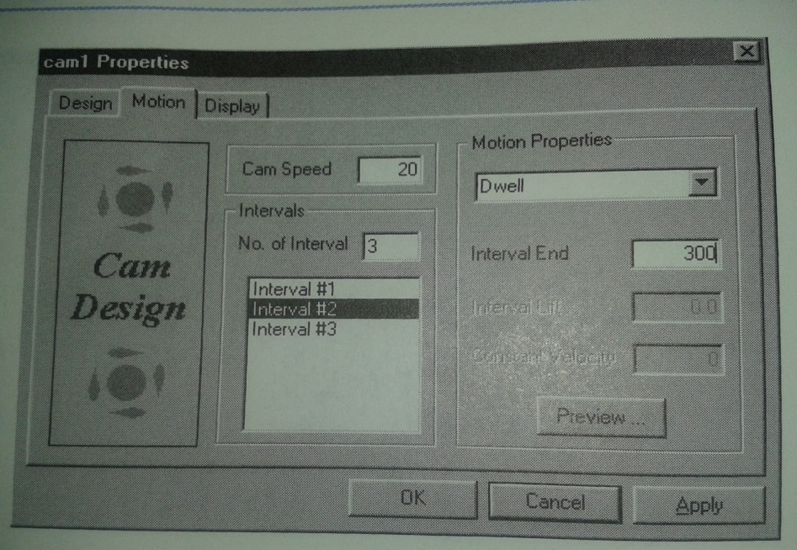

Slide 27
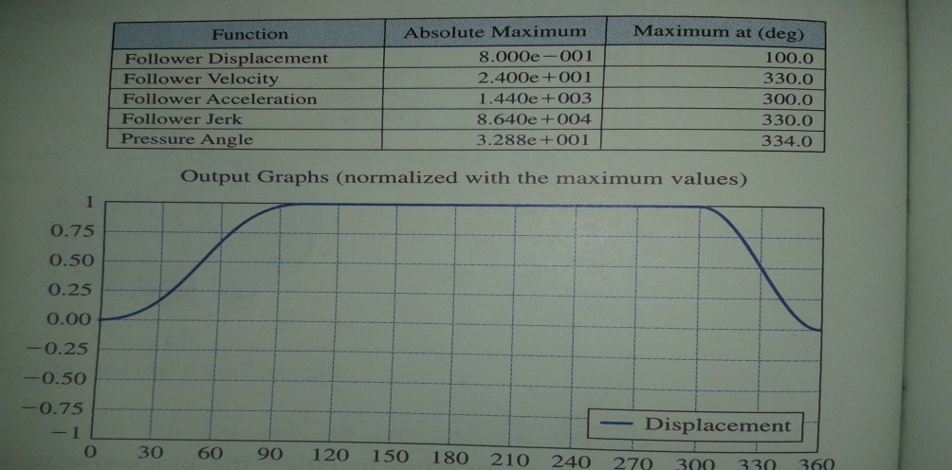
It then saved as cam 2
Two or more files may be opened simulutsly the figure below shows the cause
When both cam 1 and cam 2 are opened at the same time when more than one five is opened it is possible to super impose graphs of displacement and the time derivative of displacement jests hown as the cam contours.

Slide 28
3.WORKING 2D MODEL VERSION 5.0 This soft ware is used to visualise or to see tnhe mechanism in working condition.after starting the soft ware the main dialogue box is shown below:

Slide 29
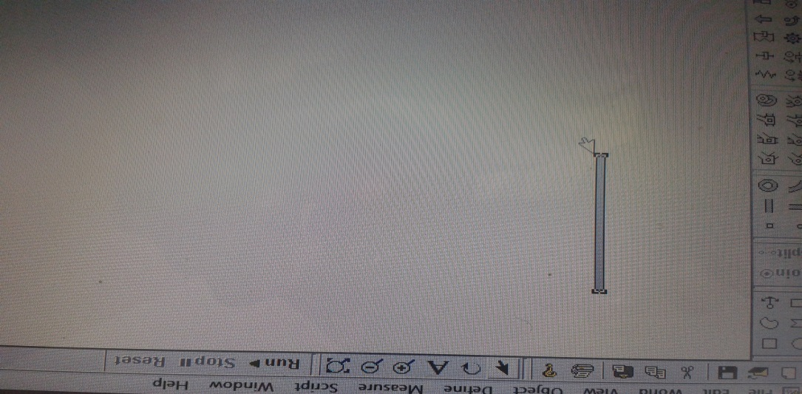
Steps to use working 2D model:
First step:to select any shape we need to draw:we the select shape tool bar
e.g select rectangle it appears as shown below

Slide 30
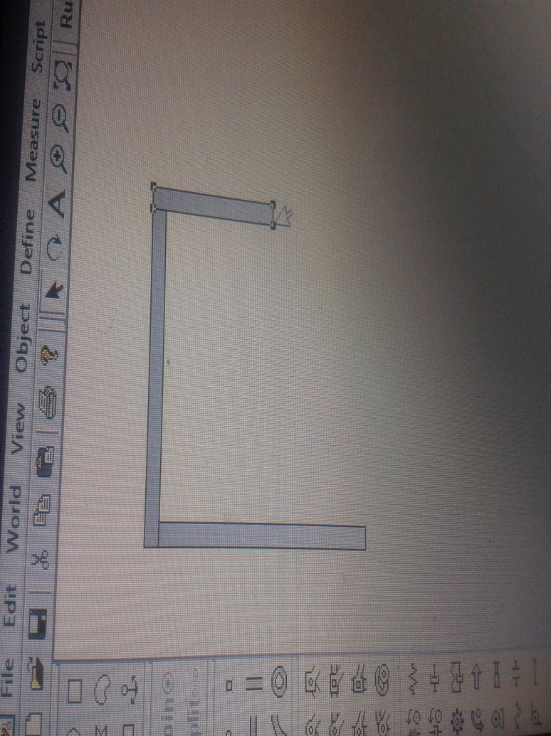
Second step :to draw the other links like the first step we select the shape we want to be a link from the shape tool bar

Slide 31
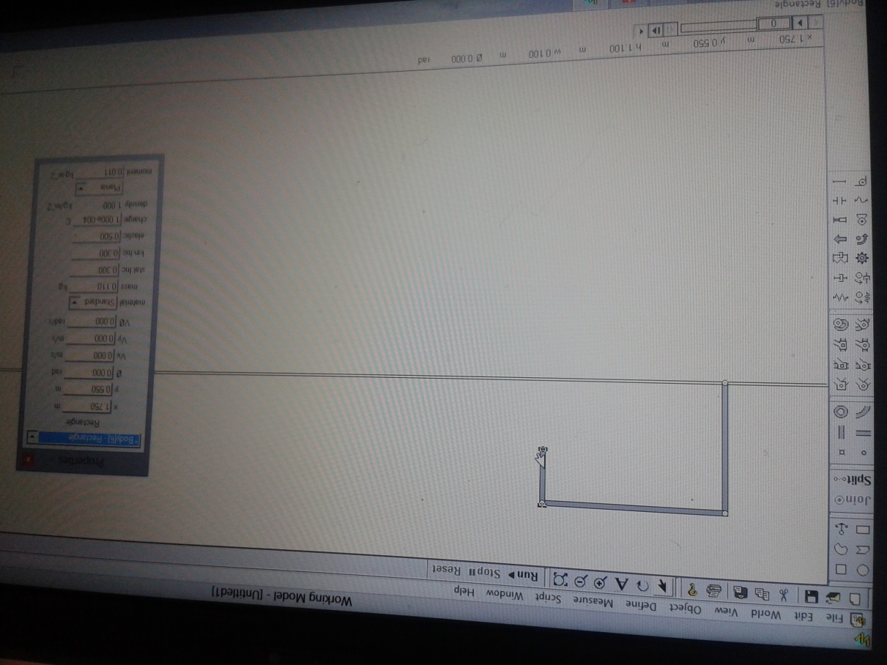
Fourth step: double clicking on one of the links we can input any of the parameter we want to inter

Slide 32
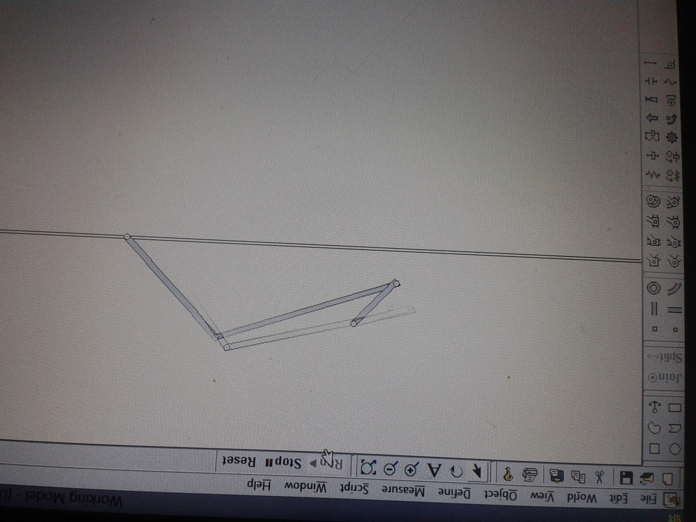
The fifth step: by clicking the run icon we can see the animation of the mechanism

Slide 34
SAM 7.0
The ultimate mechanism designer

Slide 35
What is SAM?
SAM (Synthesis and Analysis of Mechanisms) is an interactive PC-software package for the design, analysis (motion and force) and optimization of arbitrary planar mechanisms.
. SAM integrates pre-processing, numerical analysis and post processing, such as animation and x y-plots, in an easy to-use environment offering pull-down menus, mouse support and help facilities.

Slide 36
Chapter 2 Overview
Basic objectives:-
2.1 The Design Process
2.2 Capabilities 2.2.1 Design
2.2.2 Modeling
2.2.3 Input Motion
2.2.4 CAD Interface
2.2.5 Analysis Results
2.2.6 Post-Processing
2.2.7 Optimization

Slide 37
2.1 The Design Process
The process of designing mechanisms, basically can be divided into two distinct phases.
the first step in the design cycle consists of the synthesis phase, in which the designer attempts to find the type of mechanism and its dimensions.
Once a mechanism has been chosen, its motion and force behavior can be analyzed. And is called analyzed phase.

Slide 38
2.2 Capabilities
2.2.1 Design
SAM offers a set of design wizards which will help you to synthesize mechanisms for specific tasks, such as : Angle function generation.
The user has to rely on his experience, previous design, handbooks or trial & error to invent the mechanism, which can then be modeled and analyzed in SAM.

Slide 39
2.2.2 Modeling
SAM is equipped with a large library of basic elements, including: beam, slider belt, gear sensor, spring, damper and friction element , non-linear spring . The unique mathematical foundation of the program, Open loop, closed loop and even multiple loop mechanisms are treated in the same way and even the most complex mechanisms, including planetary gear trains, can be modeled within minutes.

Slide 40
2.2.3 Input Motion
SAM allows the definition of multiple inputs, which can either be defined in terms of absolute displacements or in terms of elemental change of shape to model relative inputs (e.g. elongation of a hydraulic cylinder or relative rotation of a robot elbow).

Slide 41
2.2.4 CAD Interface
The DXF import/export facility lets you export your conceptual mechanism design to any CAD program to work out the details and it lets you import CAD data to easily set-up the mechanism in SAM or to perform animation of the final mechanism.

Slide 42
2.2.5 Analysis Results
once the mechanism has been constructed and the inputs have been defined any of the following kinematic quantities can be calculated (all relative or absolute): nodal position, displacement, velocity, acceleration - angles, angular velocity and acceleration
Furthermore SAM can perform force-analysis.

Slide 43
2.2.6 Post-Processing
the analysis results can be displayed either in tabular or graphical form. The tabular listing can be viewed on the screen, send to a printer or stored in a readable formatted list file.
It is possible to output selected data to an external file (ASCII format) for customized post-processing.

Slide 44
2.2.7 Optimization
The goal for optimization can be the minimization or maximization of a variety of properties (peak, RMS, average, ...) of the difference between the actual and the target behaviour of a mechanism,
The optimization process in SAM is based on a two-step approach, consisting of: Exploration of the design space and Optimization of a specific solution.

Slide 45
Chapter 3 /Examples/
3.1 Motion Analysis examples :- 3.1.1 Crank Rocker Mechanism
3.1.2 Quick-Return Mechanism 3.1.3 Slider Driven Gear Transmission
3.1.4 Double Crank Mechanism
3.1.5 Planetary Mechanism (Hypo-Cyclic)

Slide 46
3.2 Force Analysis
3.2.1 Transfer Mechanism (incl. gravity effects) The transfer mechanism can be used to transfer products without introducing any rotation. Due to the mass of the transfer linkage, which is modeled as discrete masses at the end nodes of that linkage, a certain static driving torque is required.

Slide 47
3.2.2 Belt drive with external force
the force analysis of a belt drive without pretension that is loaded by an external force. Depending on the rotation of the wheel the vertical force acting in node 3 leads to positive or a negative torque on the second wheel. This torque needs to be counteracted by either a positive force (tension) in the upper or a positive force in the lower part of the belt drive, since a non-loaded belt drive can not transfer negative forces (pressure).

Slide 48
3.3 Optimization
3.3.1 Driving Torque Minimization
This is achieved by the addition of one single mass in the coupler plane. The mechanism is driven by a constant angular velocity at the crank and gravity effects are excluded from the study. The optimization algorithm must search for the optimal location and value of the compensating mass.
3.3.2 Constrained Optimization
The optimization algorithm must search for the optimal value and location of the compensating mass. In this example, we want to add the extra constraint, that the length of the extra element, that is added to support the compensating mass.

Slide 49
Cont.
3.3.3 Optimization of trajectory
This mechanism is used as a starting point for an optimization in which the RMS-value of the deviation of the actual trajectory from the target curve is chosen as optimization objective function and the positions of the nodes of the mechanism are the design parameters. All moving nodes can be chosen arbitrarily, whereas the support points are limited in their range, as indicated. As can be seen the mechanism that resulted from the optimization process shows significantly better correspondence with the requested target path.

Slide 50
Chapter 4 /elements/
4.1 Beam The beam element is the most basic element that is available in SAM. It is used to model any type of linkage.
The user can define inertia properties of a beam, such as :-
>> length, elongation, elongation speed, elongation acceleration >> absolute and relative angle, angular velocity, angular acceleration

Slide 51
Slider AND Gear
The slider element is basically nothing more than a beam element, with a non-fixed length. In order to achieve better graphical visualization, the user can specify the length of the slider.
The gear element is used to describe various gear configurations, ranging from standard gear configurations to gears with inner toothing and even planetary gear trains.

Slide 52
4.4 Belt
The belt element is used to describe various sorts of belt configurations, ranging from standard belt to crossed belts or a belt that passes several wheels. It is important to note, that the distance between the nodes of a belt element needs to be fixed, by constraining the nodes or - in case of a non-stationary belt - by defining a beam element between these nodes.

Slide 53
4.5 Sensor
Their sole purpose is to extract certain data from a model (like the distance between two points or the relative angle between two elements).They have no influence on the kinematics or kinetostatics of a mechanism.

Slide 54
4.6 Non-linear spring
The non-linear spring is very similar to the linear spring in terms of functionality; however one can specify a non-linear relation between spring force and elongation of the spring. This non-linear characteristic is defined in the following way: - Unloaded length (length of the spring in the absence of any load).

Slide 55
Chapter 5 /use full shortcuts and display setting
DEL pressing the <DEL> key invokes the deletion mode. Any element or graphical item that is selected will be removed.
ESC the <ESC> key can be used to cancel any activity.
TAB the <TAB> key can be used to step through the list of elements while in the element selection mode.
ENTER 1. Finalizes an element selection that is initiated by the <TAB> key. 2. Finalizes a group modification (graphics) when adding/removing items.
Ctrl+C Copies the active SAM window to the clipboard.
Ctrl+M Shortcut for Input/Modify. Let’s you modify the input motion definition.

Slide 56
CON’T
Ctrl>+P Shortcut for File/Print.... Prior to printing you can enable printing of the graph and/or the mechanism.
Ctrl + mouse move Horizontal of vertical alignment of element.
F2 Shortcut for Display/Animation. Start the animation.
F3 Shortcut for Build/Element Properties.
F4 Shortcut for File/Preferences
F5 Shortcut for Optimization/Run.
F8 Shortcut to return to Design Wizard
F9 Shortcut for Analysis.
F10 Shortcut for Display/Options

Slide 57
5.2 Toolbar
The toolbar contains a number of icons that represent short-cuts for menu items. New Open a new mechanism project. Open Open an existing mechanism project. Save Save current mechanism project. Print Print the current mechanism/graph. Beam Enter a beam element. Slider Enter a slider element. Gear Enter a gear element. Belt Enter a belt element. Support Apply support in x and/or y direction. Fix Rel. Angle Fix relative angle between two elements.. Input Define input (translational and rotational). ETC……….

Slide 58
THANK YOU

