Slide 1
MENG 3071
Chapter 6
Cam Design
All figures taken from Design of Machinery, 3rd ed. Robert Norton 2003

Slide 2
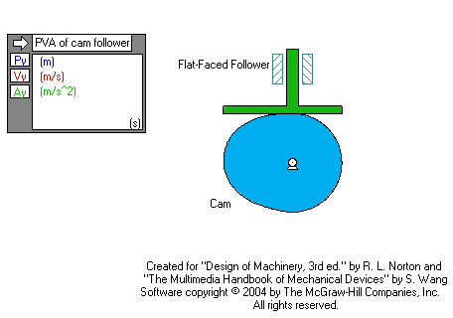
Cams
Function generator
Can generate a true dwell

Slide 3
Cam Terminology
Type of follower motion (rotation, translation)
Type of joint closure (force, form)
Type of follower (roller, mushroom, flat)
Direction of follower motion (radial, axial)
Type of motion constraints (critical extreme position(CEP) and critical path motion (CPM))
Type of motion program (rise-fall (RF), rise-fall-dwell (RFD), rise-dwell-fall-dwell (RDFD)

Slide 4
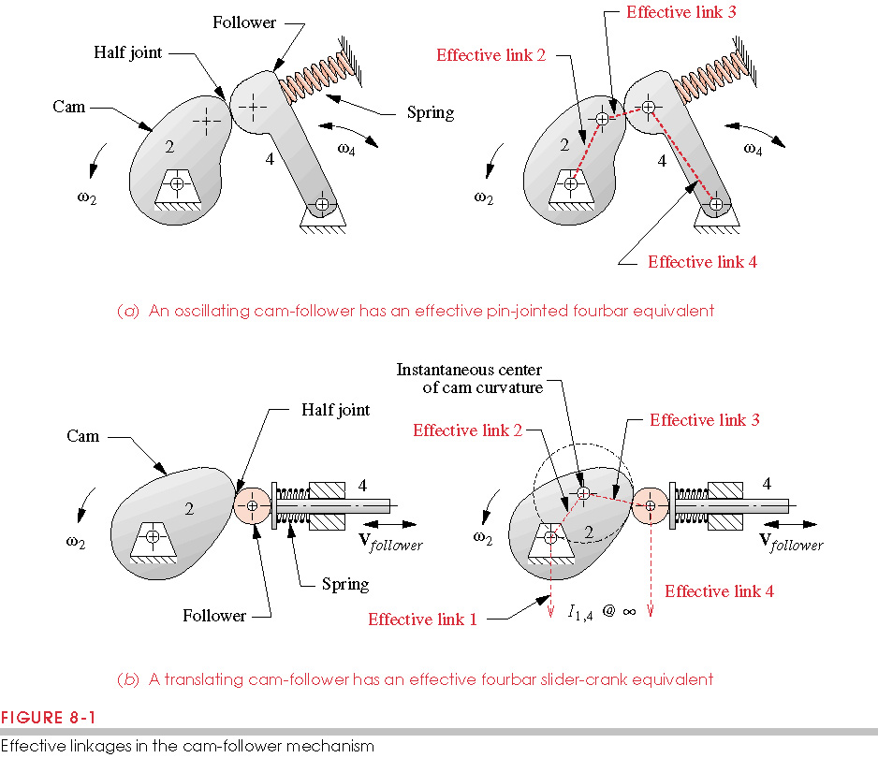
Type of Follower Motion
Oscillating follower
Translating follower

Slide 5
Type of Joint Closure
Force and form closed cams
Force closed cams require an external force to keep the cam in contact with the follower
A spring usually provides this force

Slide 6
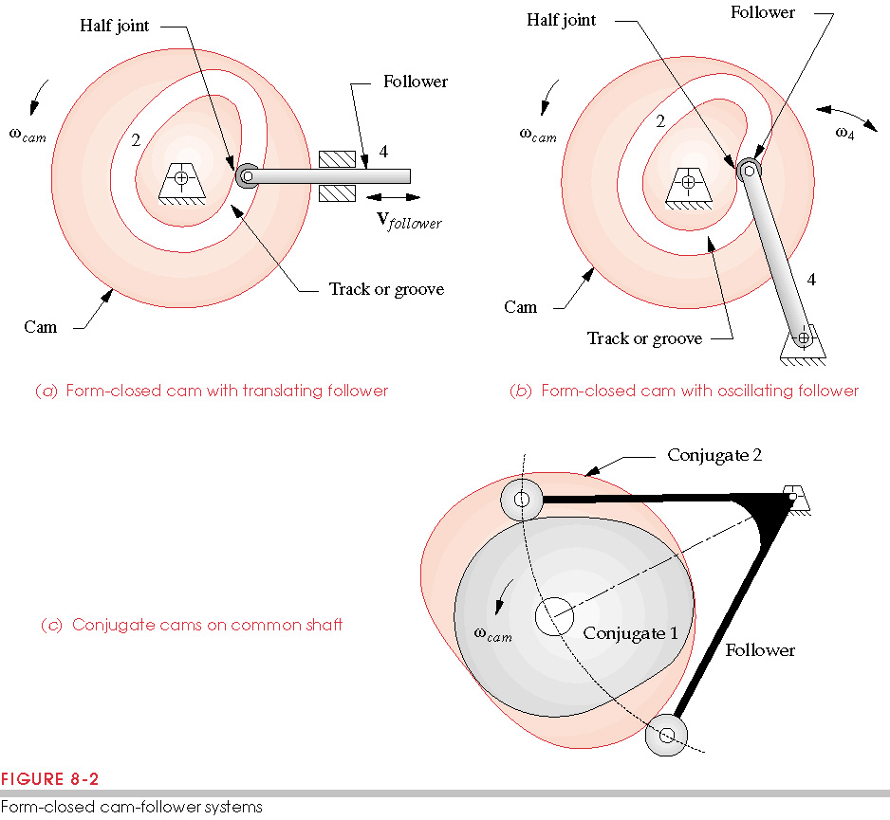
Type of Joint Closure
Form closed cams are closed by joint geometry
Slot milled out of the cam

Slide 7
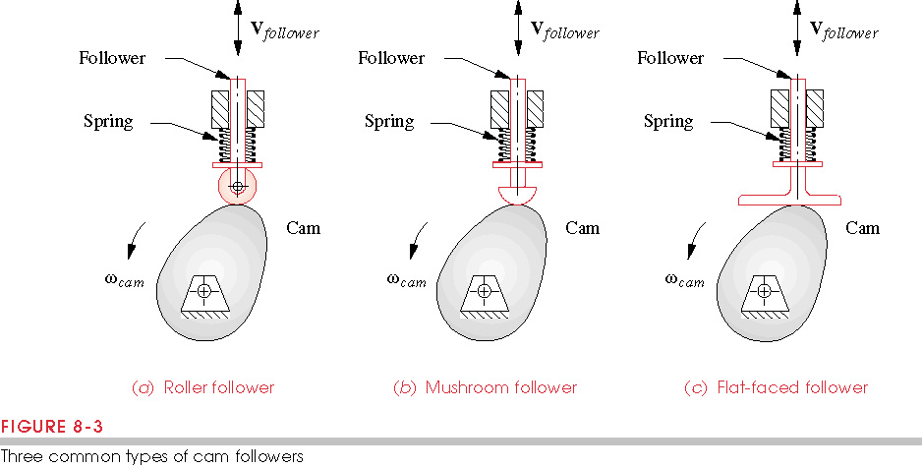
Types of Followers
Flat-Faced Follower
Roller Follower
Mushroom Follower
Roller Follower
Mushroom Follower
Flat-Faced Follower

Slide 8
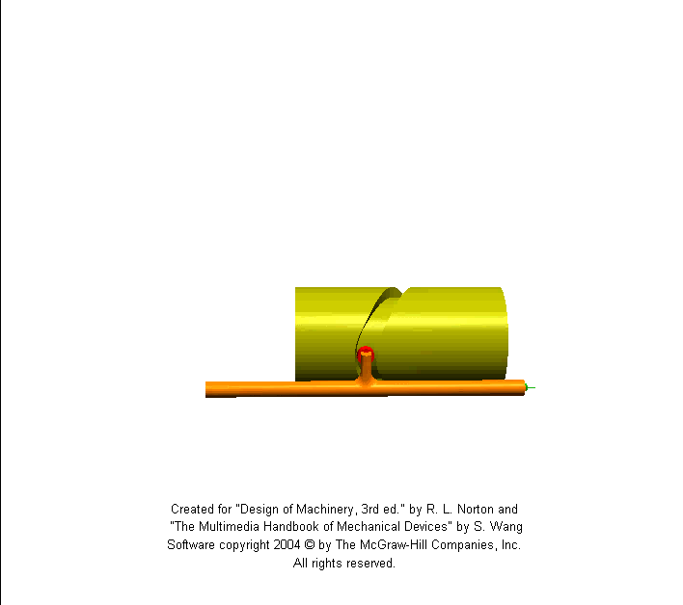
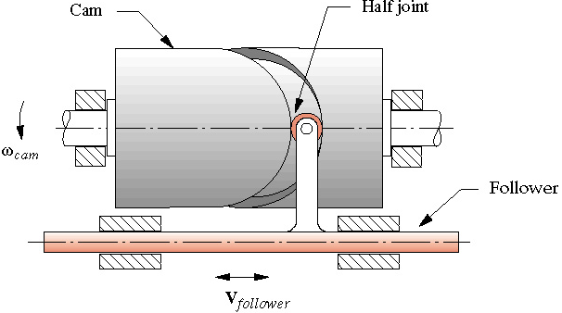
Direction of Follower Motion
Radial or Axial
Radial Cam
Axial Cam

Slide 9
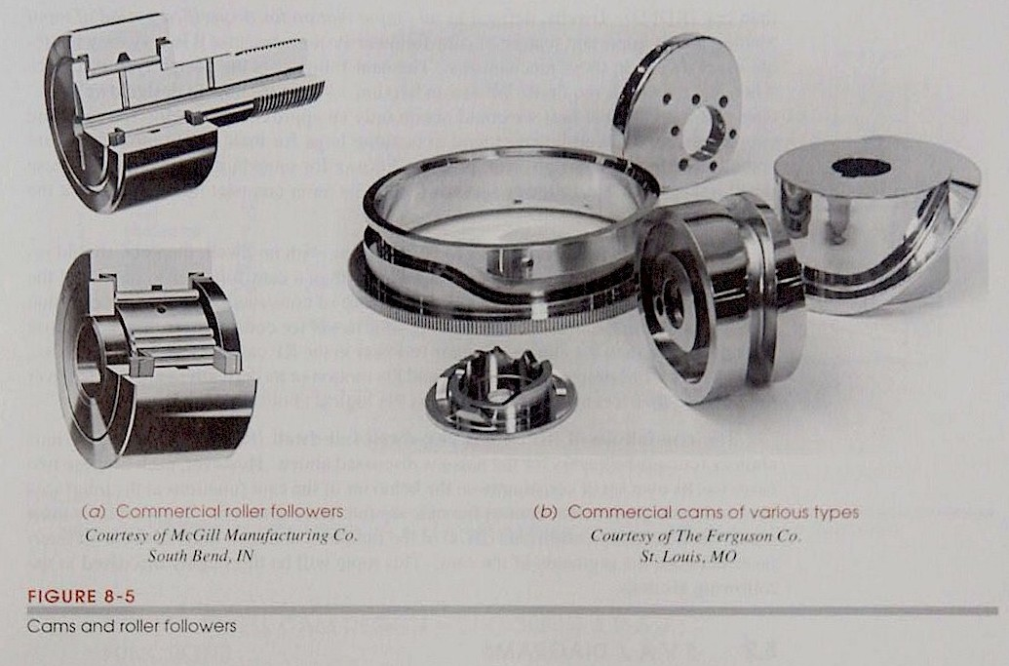
Cam Terminology (review)
Type of follower motion (rotation, translation)
Type of joint closure (force, form)
Type of follower (roller, mushroom, flat)
Direction of follower motion (radial, axial)

Slide 10
Type of Motion Constraints
Critical Extreme Position (CEP) – start and end positions are specified but not the path between
Critical Path Motion (CPM) – path or derivative is defined over all or part of the cam

Slide 11
Type of Motion Program
From the CEP cam profile
Dwell – period with no output motion with input motion.
Rise-Fall (RF) – no dwell (think about using a crank-rocker)
Rise-Fall-Dwell (RFD) – one dwell
Rise-Dwell-Fall-Dwell (RDFD) – two dwells

Slide 12
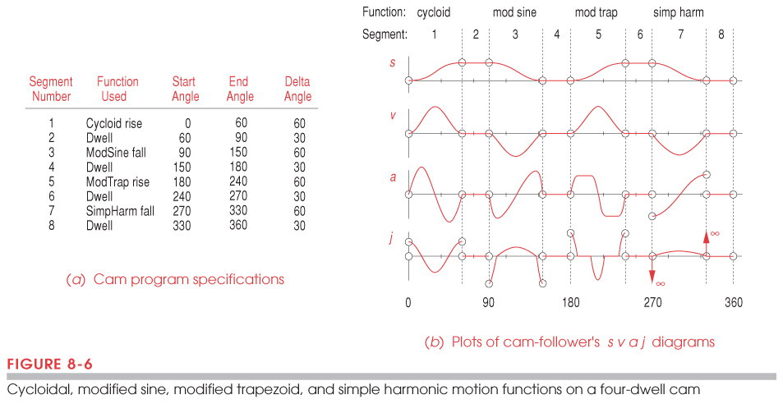
SVAJ Diagrams
Unwrap the cam
Plot position (s), velocity (v), acceleration (a) and jerk (j) versus cam angle
Basis for cam design

Slide 13
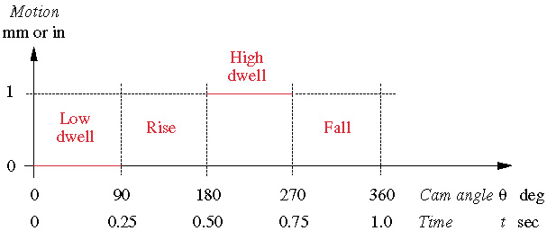
RDFD Cam Design
Motion is between two dwells

Slide 14
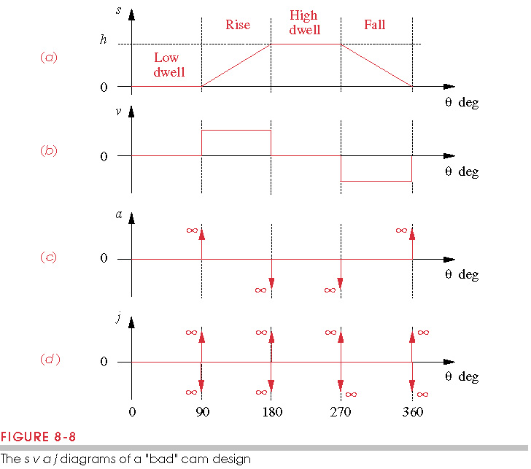
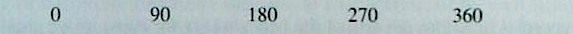
RDFD Cam, Naïve Cam Design
Connect points using straight lines
Constant velocity
Infinite acceleration and jerk
Not an acceptable cam program

Slide 15
Fundamental Law of Cam Design
Any cam designed for operation at other than very low speeds must be designed with the following constraints:
The cam function must be continuous through the first and second derivatives of displacement across the entire interval (360°).
Corollary:
The jerk must be finite across the entire interval (360°).

Slide 16
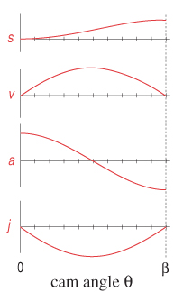
RDFD Cam Sophomore Design
Simple Harmonic Motion
Sine function has continuous derivatives
h
∞
∞
Acceleration is discontinuous
Jerk is infinite (bad cam design)

Slide 17
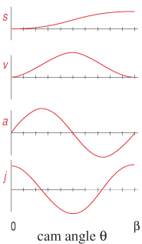
RDFD Cam, Cycloidal
h
Start with acceleration & integrate:
Since
at
then:

Slide 18
RDFD Cam, Cycloidal
h
Since s=0 at θ=0, k₂=0
Since s=h at θ=β,

Slide 19
RDFD Cam, Cycloidal
h
Equation for a cycloid.
Cam has a cycloidal displacement or sinusoidal acceleration
Valid cam design (follows fundamental law of cam design)
Acceleration and velocity are higher than other functions
General procedure for design is to start with a continuous curve for acceleration and integrate.

Slide 20
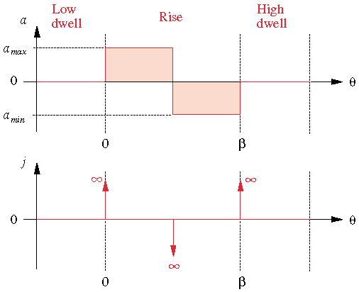
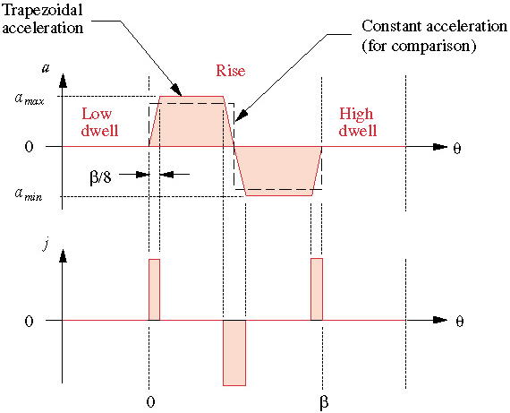
RDFD Cam, Trapezoidal
Constant acceleration gives infinite jerk
Trapezoidal acceleration gives finite jerk, but the acceleration is higher

Slide 21
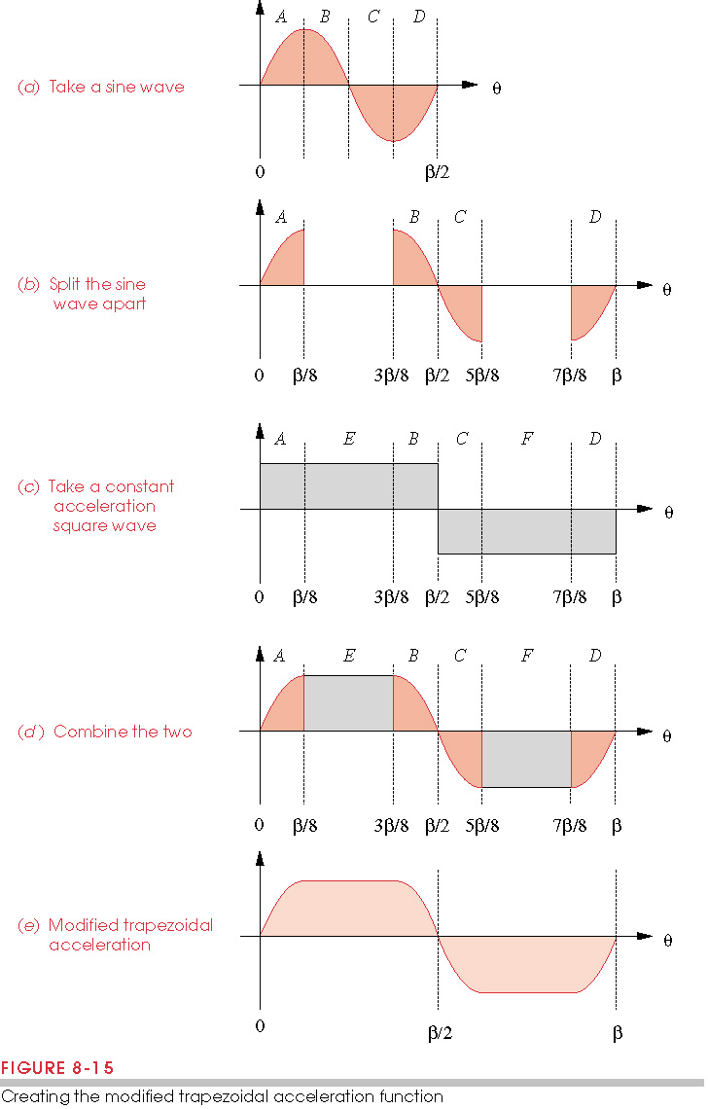
RDFD Cam, Modified Trapezoidal
Combination of sinusoidal and constant acceleration
Need to integrate to get the magnitude

Slide 22
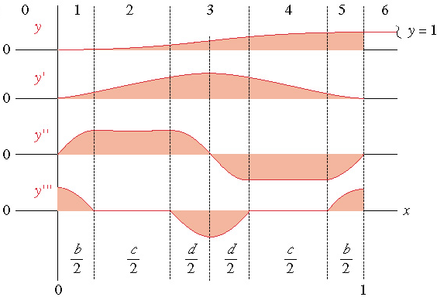
RDFD Cam, Modified Trapezoidal
After integrating, we get the following curves
Has lowest magnitude of peak acceleration of standard cam functions
(lowest forces)

Slide 23
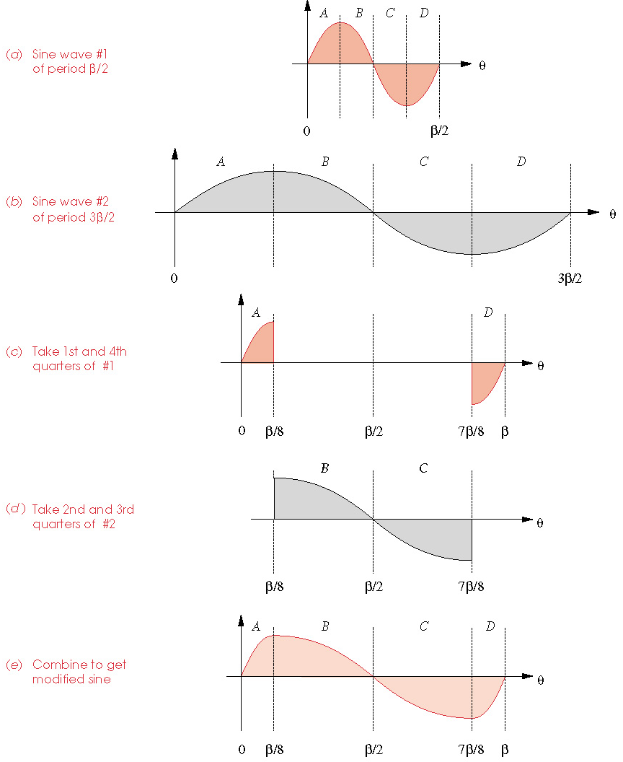
RDFD Cam, Modified Sine
Combination of a low and high frequency sine function
Has lowest peak velocity (lowest kinetic energy)

Slide 24
RDFD Cam, SCCA Family
The cam functions discussed so far belong to the SCCA family (Sine-Constant-Cosine-Acceleration)

Slide 25
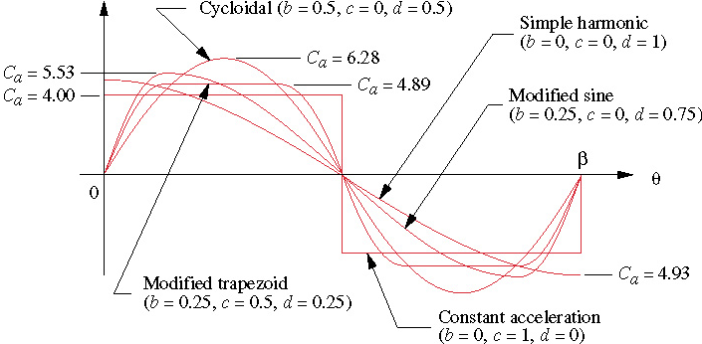
RDFD Cam, SCCA Family
Comparison of accelerations in SCCA family
All are combination of sine, constant, cosine family

Slide 26
Polynomial Functions
We can also choose polynomials for cam functions
General form:
where x=θ/β or t
Choose the number of boundary conditions (BC’s) to satisfy the fundamental law of cam design

Slide 27
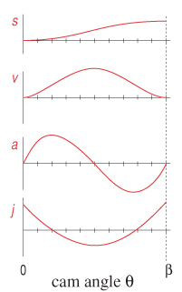
3-4-5 Polynomial
Boundary conditions
  @θ=0, s=0,v=0,a=0
  @θ=β, s=h,v=0,a=0
Six boundary conditions, so order 5 since C₀ term

Slide 28
3-4-5 Polynomial
@θ=0, s=0=C₀ v=0=C₁/β a=0=2C₂/β²
  C₀=0 C₁=0 C₂=0
@θ=β, s=h= C₃+C₄+C₅, v=0=2C₃+3C₄+5C₅ a=0= 6C₃+12C₄+20C₅
Solve the 3 equations to get

Slide 29
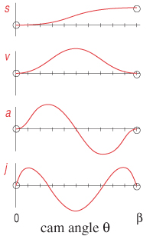
3-4-5 and 4-5-6-7 Polynomial
3-4-5 polynomial
  Similar in shape to cycloidal
  Discontinuous jerk
4-5-6-7 polynomial: set the jerk to be zero at 0 and β
Has continuous jerk, but everything else is larger
4-5-6-7 Polynomial

Slide 30
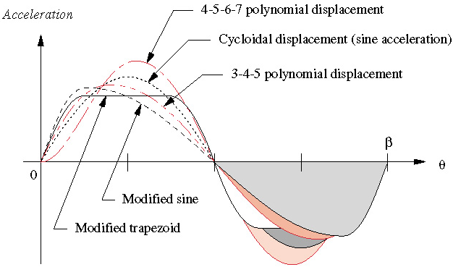
Acceleration Comparisons
Modified trapezoid is the best, followed by modified sine and 3-4-5
Low accelerations imply low forces

Slide 31
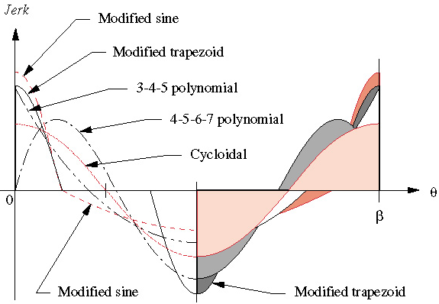
Jerk Comparison
Cycloidal is lowest, followed by 4-5-6-7 polynomial and 3-4-5 polynomial
Low jerk implies lower vibrations

Slide 32
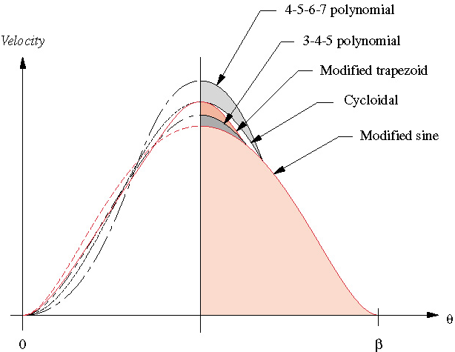
Velocity Comparison
Modified sine is best, followed by 3-4-5 polynomial
Low velocity means low kinetic energy

Slide 33
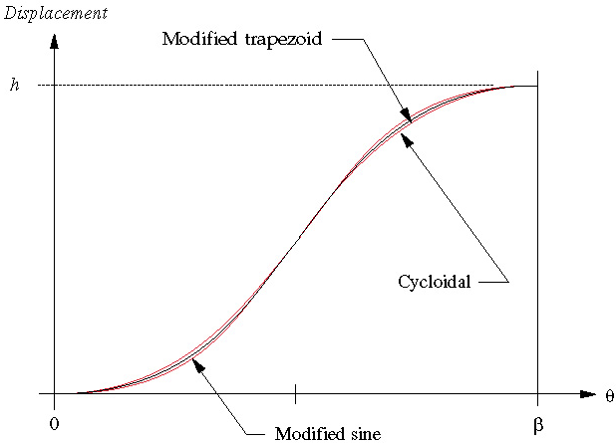
Position Comparison
There is not much difference in the position curves
Small position changes can lead to large acceleration changes

Slide 34
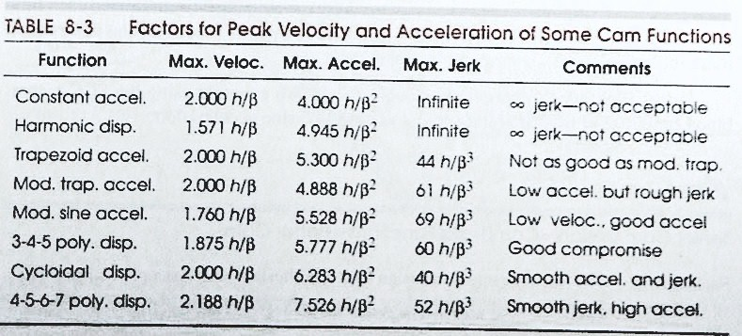
Table for Peak VAJ for Cam Functions
Velocity is in m/rad, Acceleration is in m/rad², Jerk is in m/rad³.

Slide 35
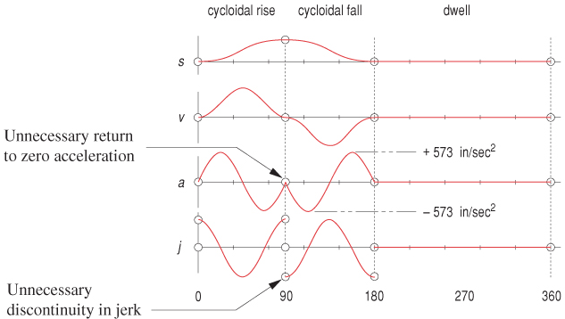
Single Dwell Cam Design, Using Double Dwell Functions
The double dwell cam functions have an unnecessary return to zero in the acceleration, causing the acceleration to be higher elsewhere.

Slide 36
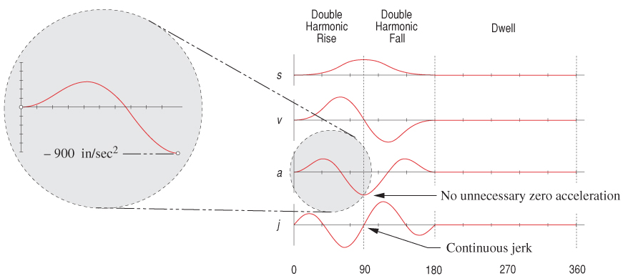
Single Dwell Cam Design, Double Harmonic function
Large negative acceleration

Slide 37
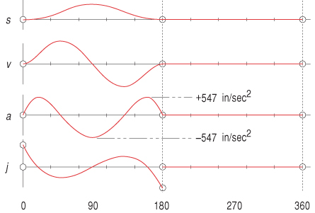
Single Dwell Cam Design, 3-4-5-6 Polynomial
Boundary conditions @θ=0 s=v=a=0
@θ=β s=v=a=0 @θ=β/2 s=h
Has lower peak acceleration (547) than cycloidal (573) or double harmonic (900)

Slide 38
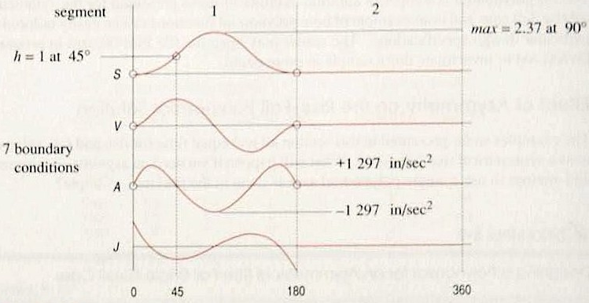
Unsymmetrical RFD Cams
If the rise has different time than the fall, need more boundary conditions.
With 7BC’s

Slide 39
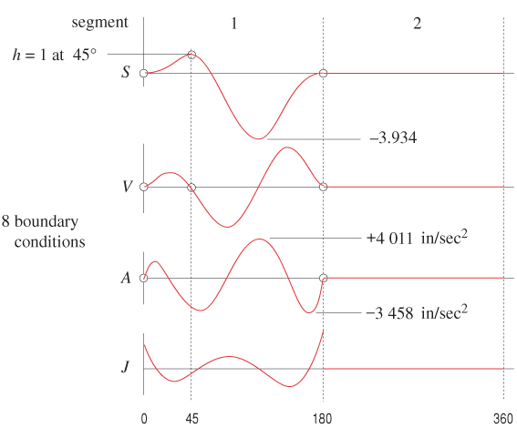
Unsymmetrical RFD Cams
If you set the velocity to zero at the peak:

Slide 40
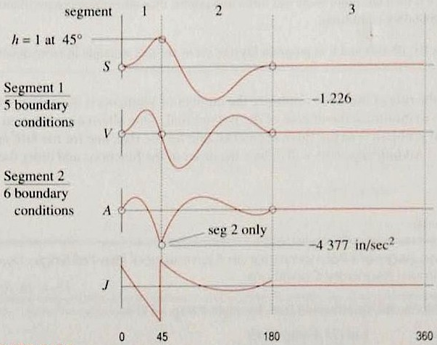
Unsymmetrical RFD Cams
With 3 segments, segment 1 with 5BC’s, segment 2 with 6BC’s get a large peak acceleration

Slide 41
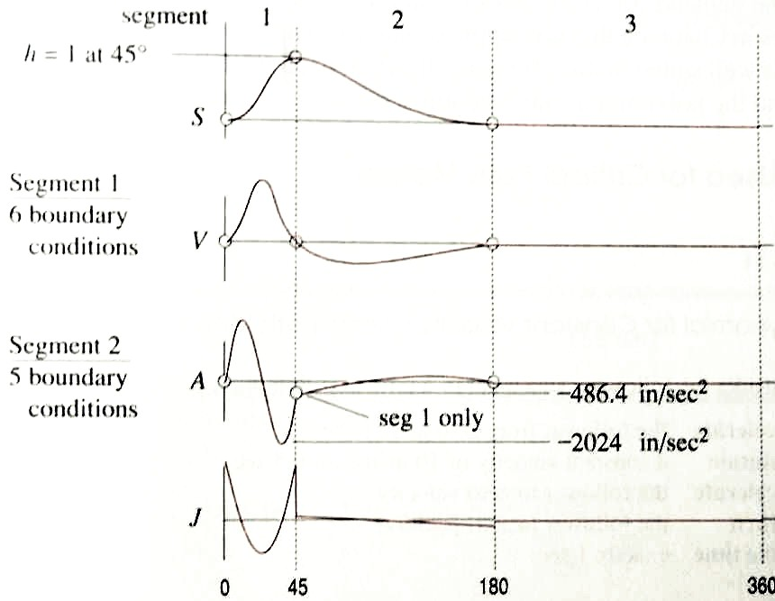
Unsymmetrical RFD Cams
Best to start with segment with lowest acceleration with 5BC’s then do the other segment with 6BC’s

Slide 42
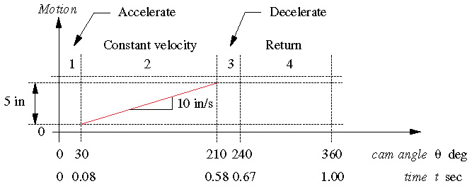
Critical Path Motion (CPM)
Position or one of its derivatives is specified
Ex: Constant velocity for half the rotation
Break the motion into the following parts:

Slide 43
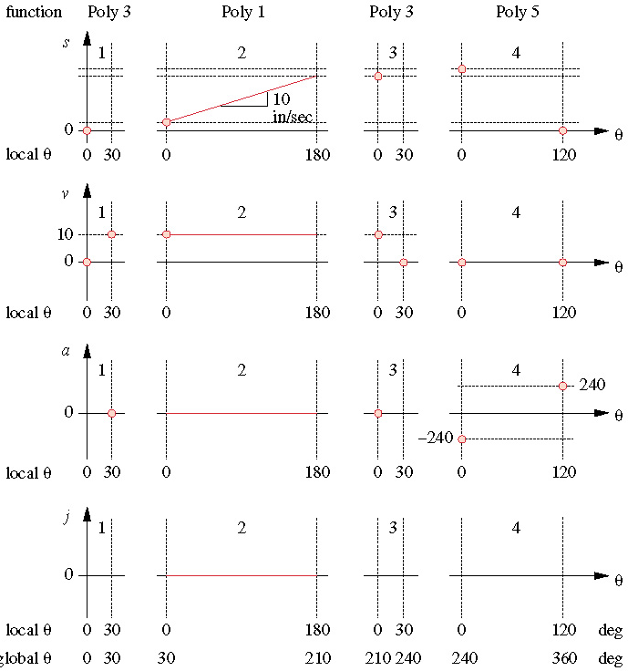
Critical Path Motion (CPM)
Segment 1 has 4BC’s
Segment 2 has 2BC’s (constant V)
Segment 3 has 4BC’s
Last segment has 6BC’s (almost always)

Slide 44
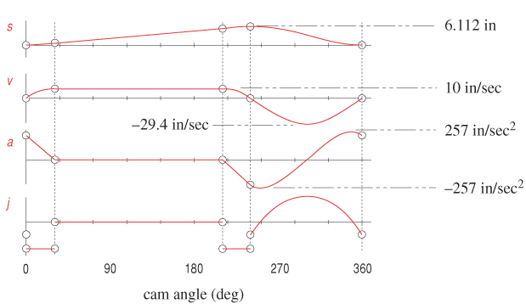
Resulting Curves

Slide 45
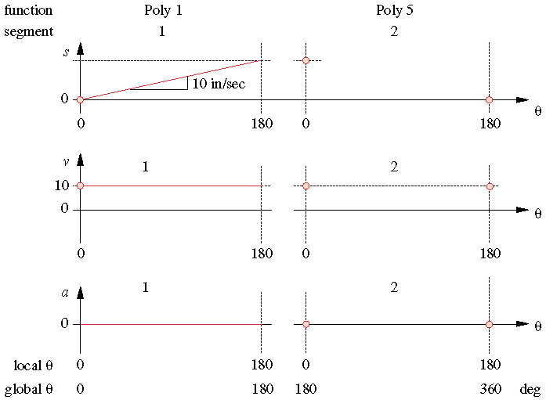
Constant Velocity, 2 Segments
The divisions on the previous approach are not given, only one segment of constant velocity

Slide 46
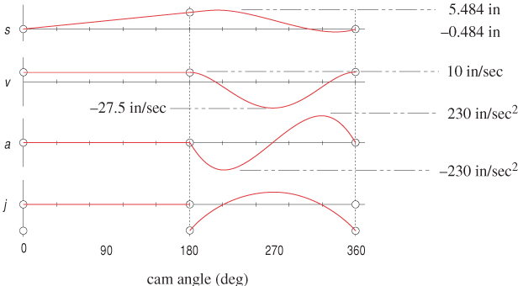
Resulting SVAJ diagram
2 segment design has better properties
4 segment design had Δs=6.112, v=-29.4, a=257

Slide 47
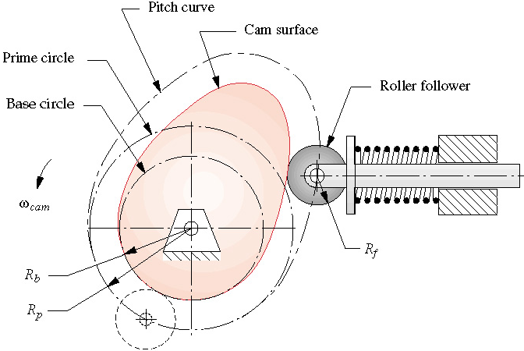
Sizing the Cam, Terminology
Base circle (R_{b}) – smallest circle that can be drawn tangent to the physical cam surface
Prime circle (R_{p}) – smallest circle that can be drawn tangent to the locus of the centerline of the follower
Pitch curve – locus of the centerline of the follower

Slide 48
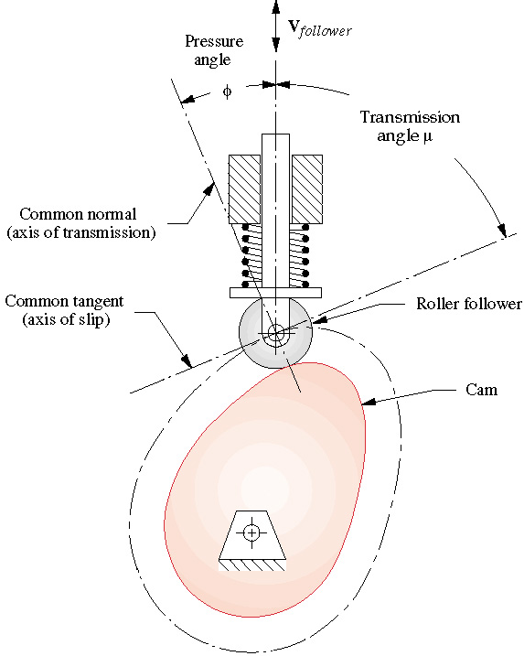
Cam Pressure Angle
Pressure Angle (φ)
  the angle between the direction of motion (velocity) of the follower and the direction of the axis of transmission
Want φ<30 for translating and φ<35 for oscillating followers
φ

Slide 49
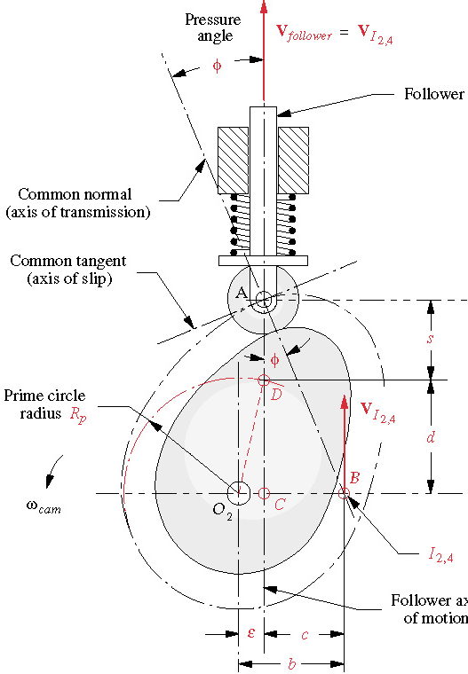
Cam Eccentricity
Eccentricty (ε) – the perpendicular distance between the follower’s axis of motion and the center of the cam
Aligned follower: ε=0
ε
b

Slide 50
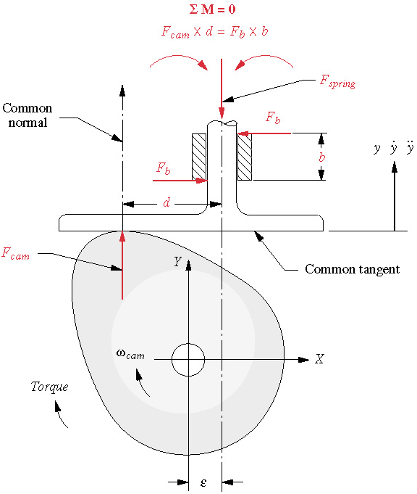
Overturning Moment
For flat faced follower, the pressure angle is zero
There is a moment on the follower since the force is not aligned with the direction of follower motion. This is called the overturning moment

Slide 51
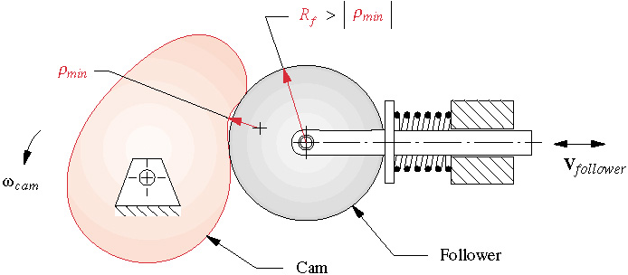
Radius of Curvature
Every point on the cam has an associated radius of curvature
If the radius of curvature is smaller than the radius of the follower the follower doesn’t move properly
Rule of thumb: ρ_{min} =(2→3) x R_{f}

Slide 52
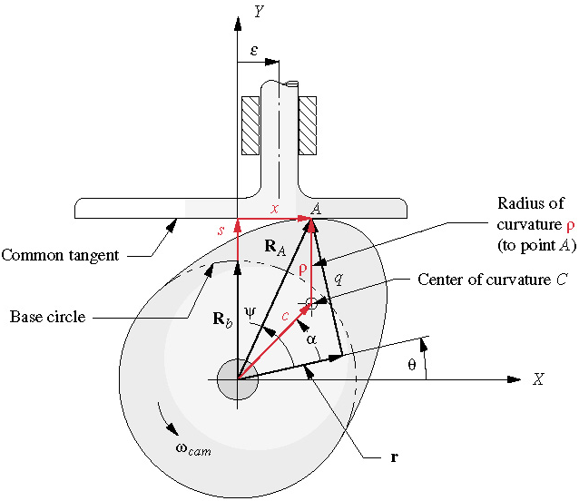
Radius of Curvature – Flat Faced Follower
We can’t have a negative radius of curvature

Slide 53
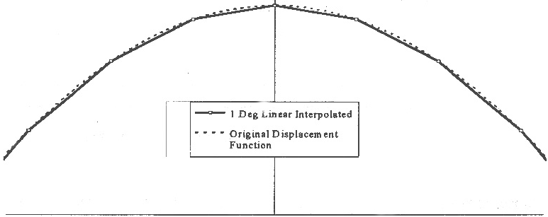
Cam Manufacturing Considerations
Medium to high carbon steels, or cast ductile iron
Milled or ground
Heat treated for hardness (Rockwell HRC 50-55)
CNC machines often use linear interpolation (larger accelerations)

Slide 54
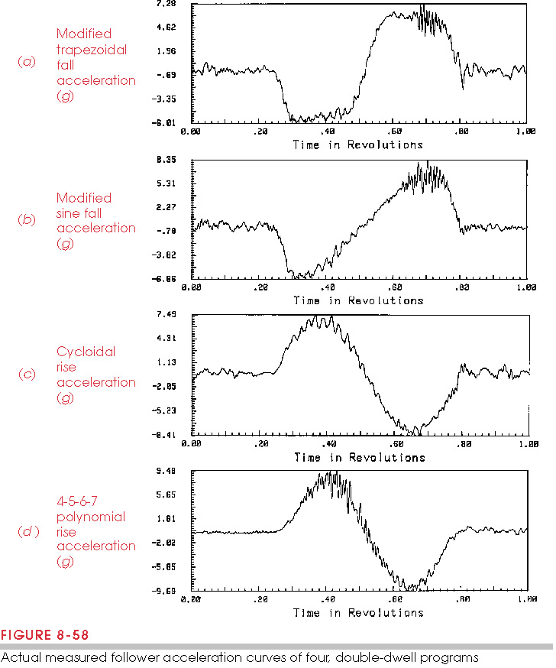
Actual vs. Theoretical Cam Performance
Larger acceleration due to manufacturing errors, and vibrations from jerk

Slide 55
Practical Design Considerations
Translating or oscillating follower?
Force or Form-Closed?
  Follower Jump vs. Crossover Shock
Radial or Axial Cam?
Roller or Flat-Faced Follower?
To Dwell or Not to Dwell?
To Grind or not to Grind?
To Lubricate or Not to Lubricate?

