Slide 1
UNIVERSAL JOINTS

Slide 2
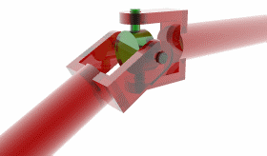

Slide 3
Chapter Objectives
Understand and describe the purpose and construction of common RWD drive shaft designs.
Understand and describe the purposes and construction of common Universal joint designs.
Explain the importance of drive shaft balance.
Explain the natural speed variations inherent to a drive shaft.
Describe the effects of canceling Universal joint angles.

Slide 4
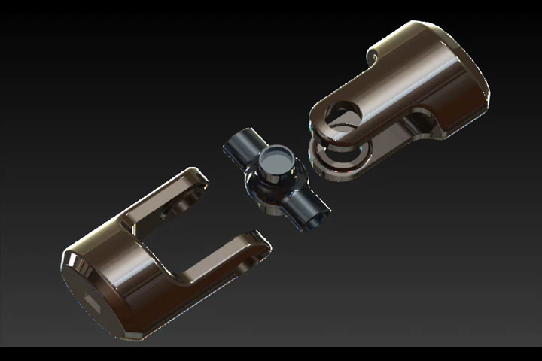
Definition
Universal joint:- is a connection between two intersecting rotating shafts which are coplanar and are inclined at an angle,δ with respect to each other.
It is also a positive, mechanical connection between two . .. …….. rotating shafts A and B. And is used to transmit both motion and power from shaft A to shaft B.
Shaft B
Shaft A
U-joint

Slide 5
Applications of U-joint
U-joints have many applications in:- aircraft, Control mechanisms, electronics, instrumentation, textile machinery tool drives etc.
Uses of U-joint
to carry maximum load-capacity for a given size.
universal joints with thermoplastic body members are used in light industrial applications by their Self-lubricating feature, light weight, corrosion resistance and capability for high-speed operation are significant advantages.
Disadvantage:- its expensiveness…
(From http://en.wikipedia.org/wiki/Universal_joint

Slide 6
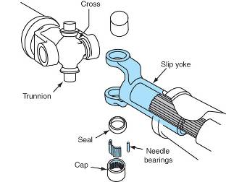

Universal Joints
Are sometimes referred to as Cardan Joints, Spicer Joins , or Hooke joints
Allow for angle changes between the drive shaft, the transmission output shaft, and the rear axle housing

Slide 7
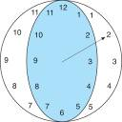
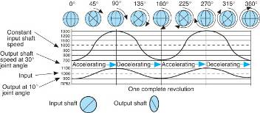
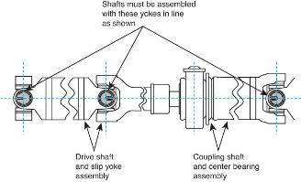
Universal Joint Characteristics
Speed variations
  While operating at an
  angle, U-joints speed
  up and slow down
  twice per revolution
Joint phasing
  The vibrations caused
  by one U-joint are transmitted to the other one

Slide 8
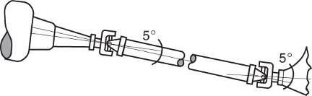
Universal Joint Characteristics (cont’d)
Canceling angles
  The angle of the front U-joint is offset by the rear one
  The correct angle must be maintained to minimize vibration

Slide 9
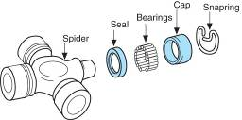
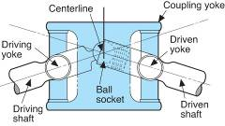
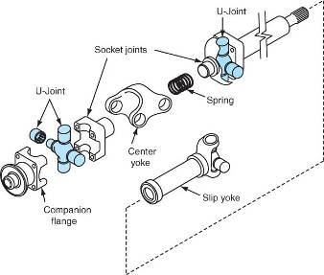
Universal Joint Designs
Single universal joint
  Sometimes known as
  single Cardan/Spicer Universal joint
  Consists of a cross and
  four needle bearings
Double Cardan joint
  Consists of two single
  U-joints joined by a center yoke and a ball and socket

Slide 10
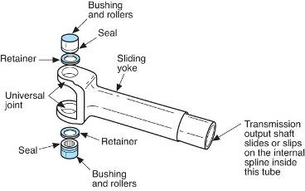
Universal Joint Designs (cont’d)
Slip joint
  Allows for changes in driveshaft length caused by suspension travel
  Components include:
    Transmission output shaft
    The slip joint
    A yoke and U-joint
    The driveshaft

Slide 11
Universal Joint
Allows non-parallel shafts to be coupled.
Considered to be a variation of a solid coupling.
Generally, requires lubrication.

Slide 12
Industrial applications operate continuously and with high torque loads. This demands maximum strength and long life of the universal joint components. The modern universal joint has become much more complex than its simple ancestor. The universal joints manufactured by Ameridrives are made for demanding industrial applications.
Universal joints have several unique features that make them ideal for a variety of applications. Most significant is the ability of the universal joint to operate at high misalignment angles. Operating angles up to 25 degrees are not uncommon.
Another feature of the universal joint is the bearing and seal design that resists lubrication loss and contamination. This makes Ameridrives Universal Joints suitable for applications where severe atmospheric conditions would put other couplings at a distinct disadvantage.
When compared to other high misalignment couplings, universal joints operate with negligible backlash or radial clearance. The difference can be significant on applications where backlash is critical.
Ameridrives Universal Joint yokes are precisely engineered using the latest design technologies. They are manufactured as a onepiece, closed bearing eye design, assuring the highest degree of strength and minimum distortion under load.

Slide 13
Industrial applications operate continuously and with high torque loads. This demands maximum strength and long life of the universal joint components. The modern universal joint has become much more complex than its simple ancestor. The universal joints manufactured by Ameridrives are made for demanding industrial applications.
Universal joints have several unique features that make them ideal for a variety of applications. Most significant is the ability of the universal joint to operate at high misalignment angles. Operating angles up to 25 degrees are not uncommon.
Another feature of the universal joint is the bearing and seal design that resists lubrication loss and contamination. This makes Ameridrives Universal Joints suitable for applications where severe atmospheric conditions would put other couplings at a distinct disadvantage.
When compared to other high misalignment couplings, universal joints operate with negligible backlash or radial clearance. The difference can be significant on applications where backlash is critical.
Ameridrives Universal Joint yokes are precisely engineered using the latest design technologies. They are manufactured as a onepiece, closed bearing eye design, assuring the highest degree of strength and minimum distortion under load.

Slide 14
The universal joint can be used as a single joint or it can be used in pairs. When used as a single joint, only angular misalignment is accommodated. Since nearly every installation requires the coupling to also accommodate offset misalignment, universal joints should be used in pairs. Using universal joints in pairs also corrects for non-uniform angular velocity caused by the rotational characteristics of a single joint.

Slide 15
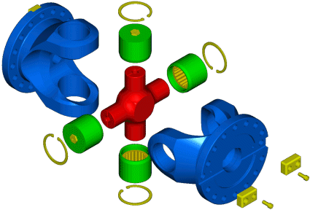

Slide 16
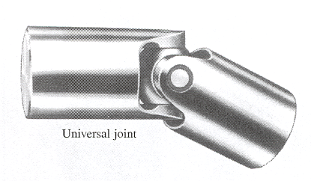
U-joint

Slide 17
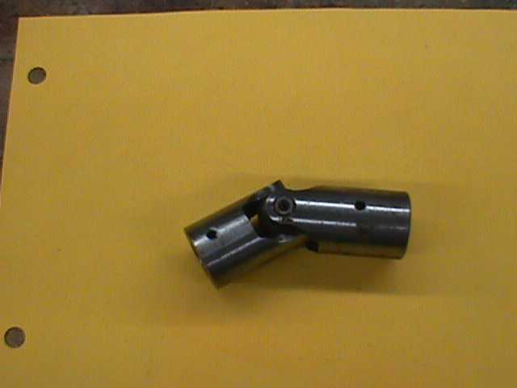

Slide 18

Amerigear® Spindles
Americardan™ U-Joints
VL Mill Spindles

Slide 19
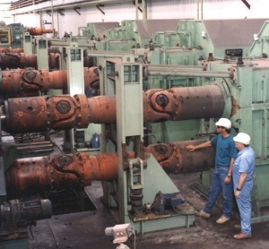
Ameridrives U3600 FT Universal Joints on a large section mill

Slide 20


Slide 21
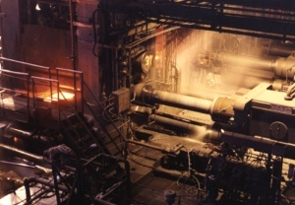

Slide 22


Slide 23
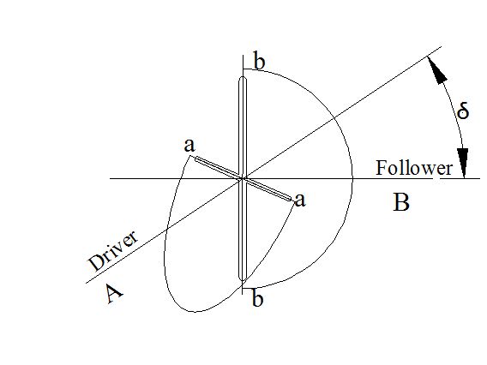
VELOCITY RATIO OF SHAFTS
Consider the two shafts A and B which are the driver and follower respectively. The axes of the two shafts are inclined at angle δ from the plan view of the designer. When the shafts A and B rotate A-A traces a circle(shown by b-b) while B-B traces an ellipse(shown by a-a).
A schematic representation of a universal joint
From Alem Bazezew
Text book series

Slide 24
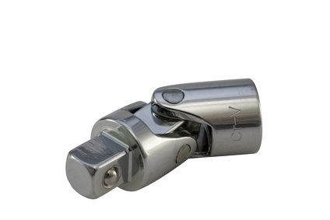
Universal joint
From http://www.ehow.com/info_8181311_types-ujoints.html
In reality
Follower
.
Driver
δ
Follower
Universal joint
From http://en.wikipedia.org/wiki/Universal_joint.
Driver

Slide 25
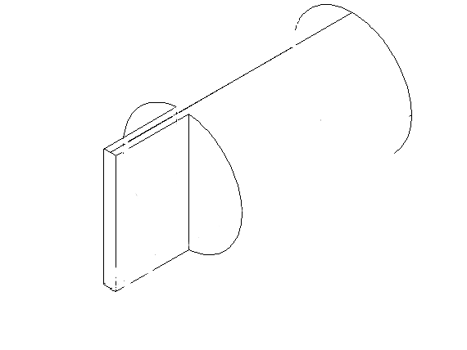
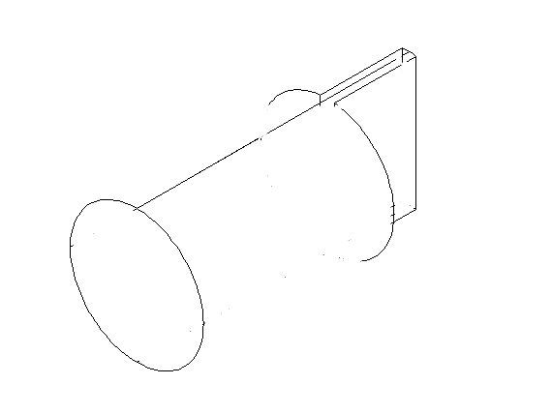
.
When the two shafts are cross sectioned
A
B
B
.
Follower
A
B
Driver
Driver
A
B
B
A

Slide 26
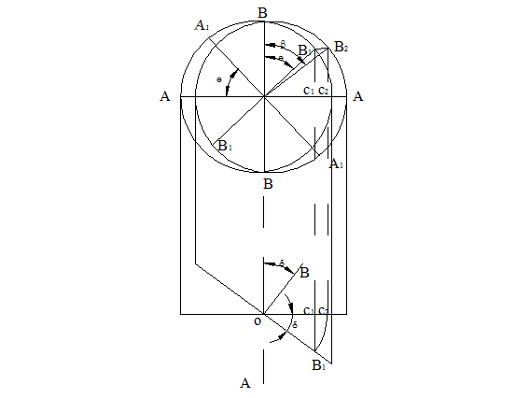
If shaft A turns through an angle θ from AA to A1A1 , then the projection of
BB will also turn through angle θ to B1B1. During this time the angle turned by shaft B is β as observed from the axis of shaft B. The projections of B1 and B2 on AA are C1 and C2.
θ
B1
O
C1
Note: θ and β shows
the fluctuation of shaft B
o
B
B2
β
O
C2
O
C1
δ
B1
C1B1=C2B2
OC2=OB1
Plan and elevation of a cross-shaped universal joint
From Alem Bazezew
Text book series
Notes:
.

Slide 27
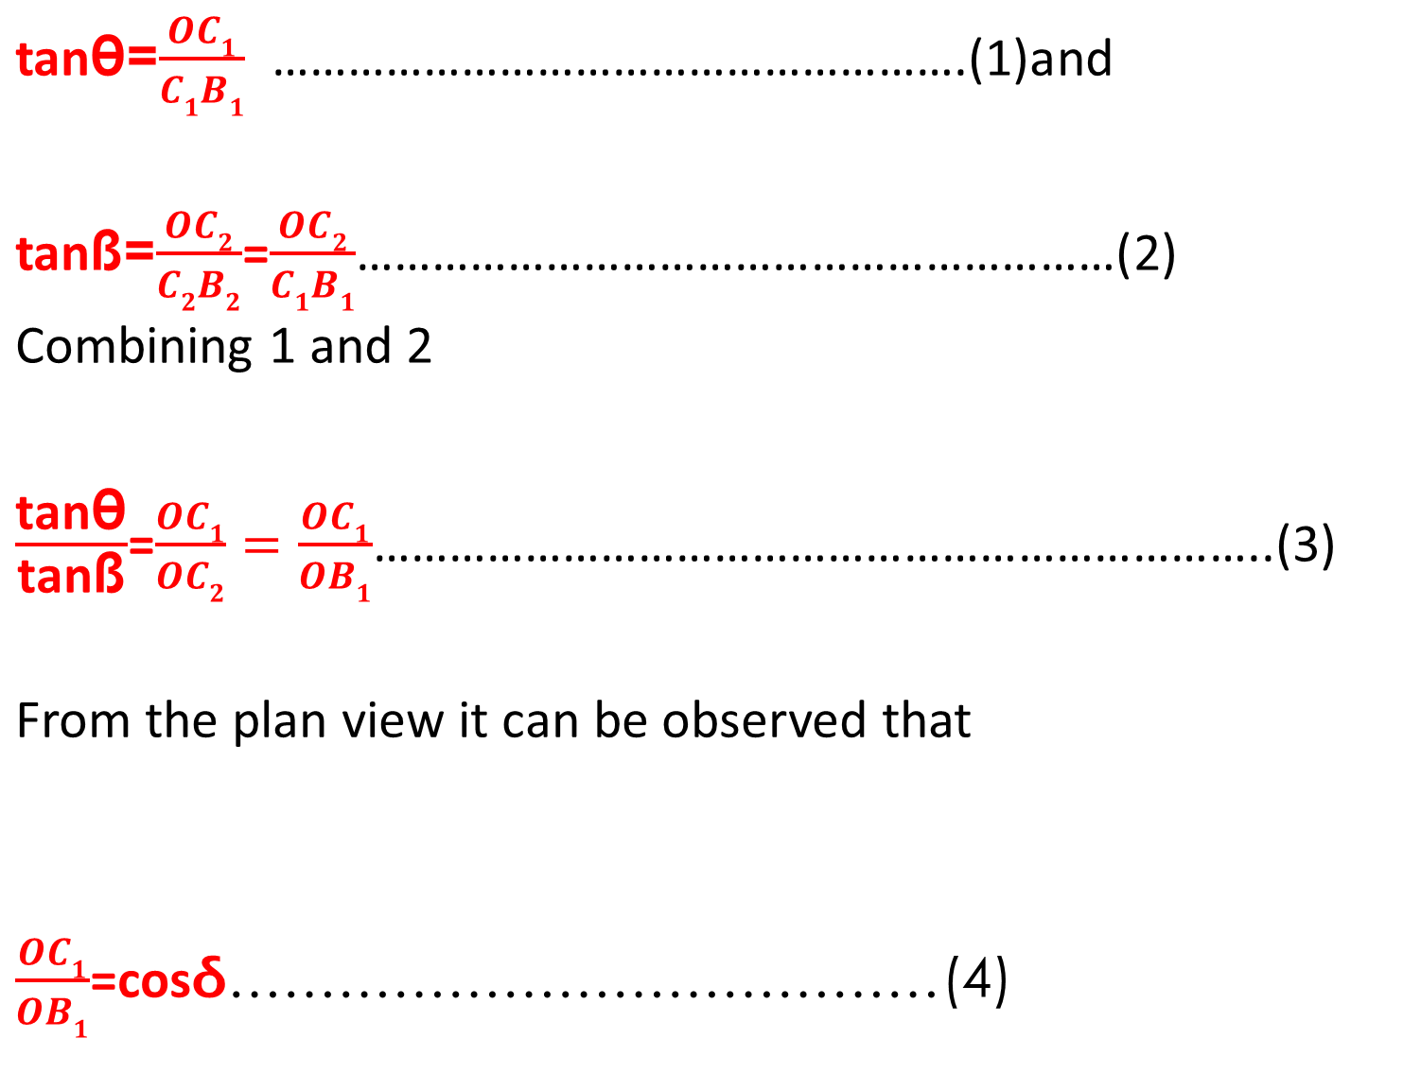
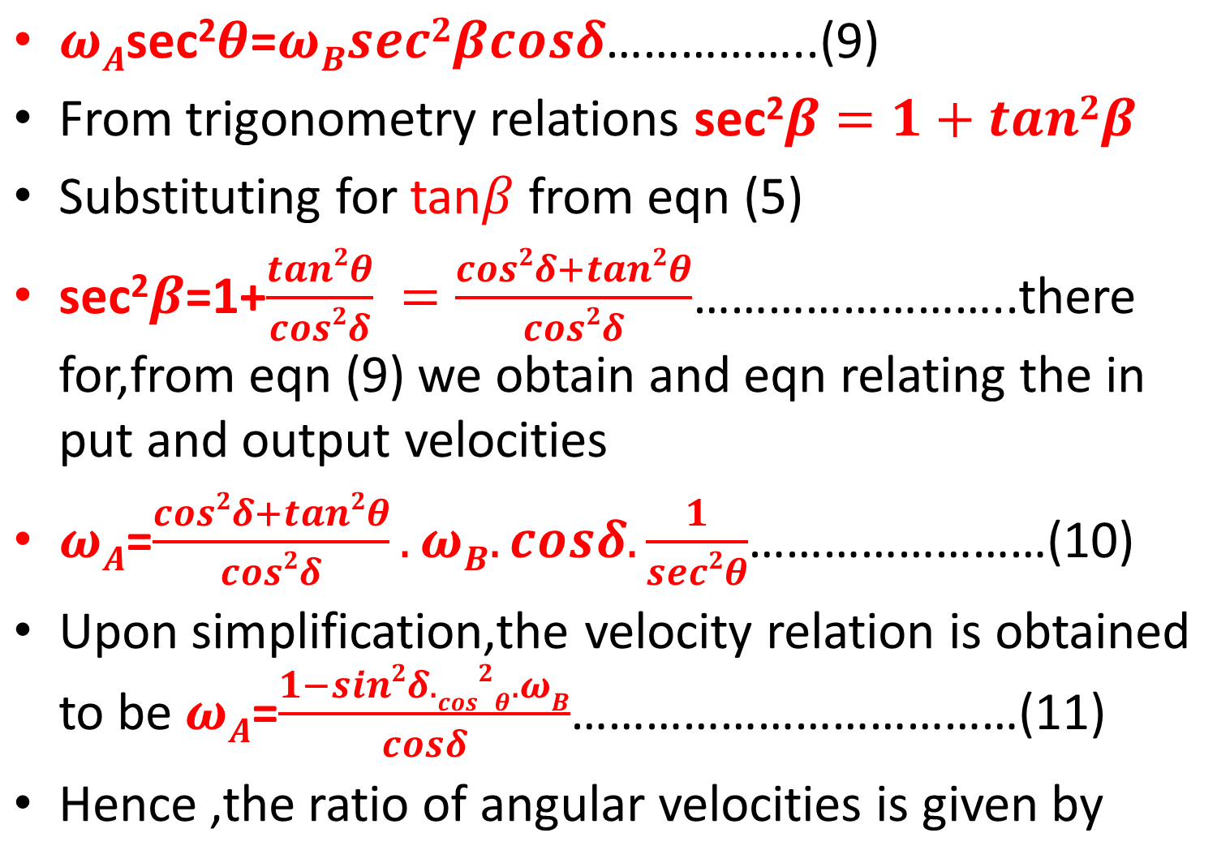
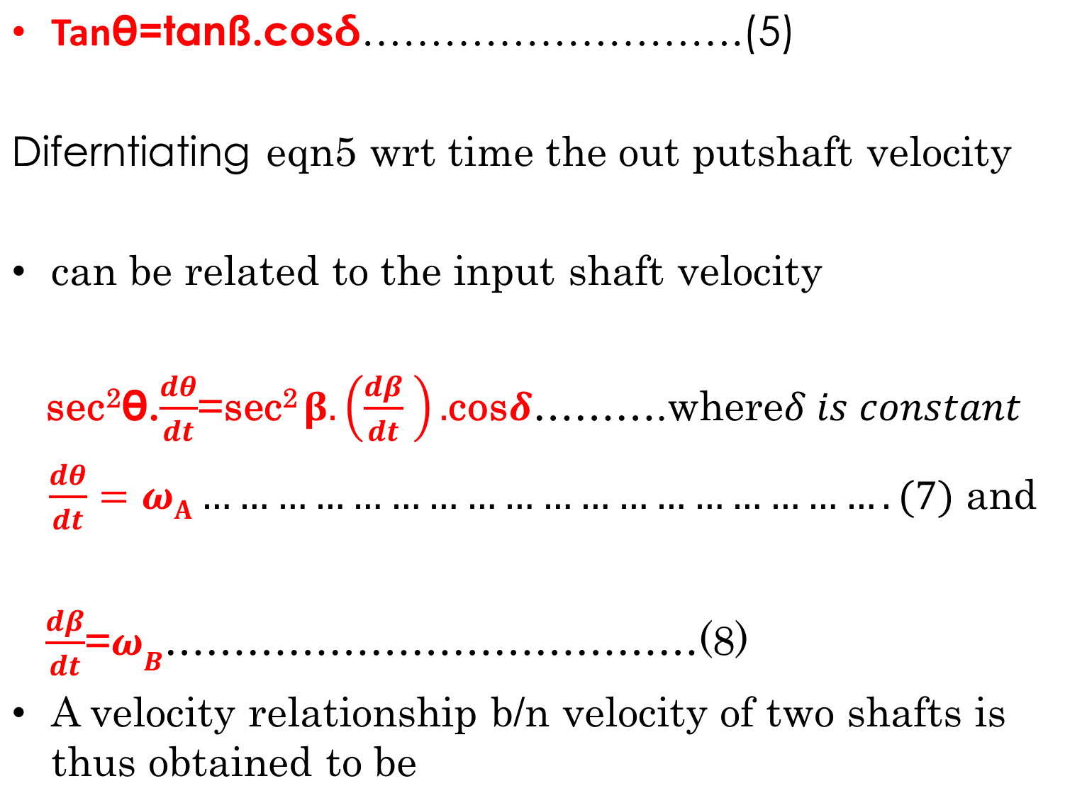
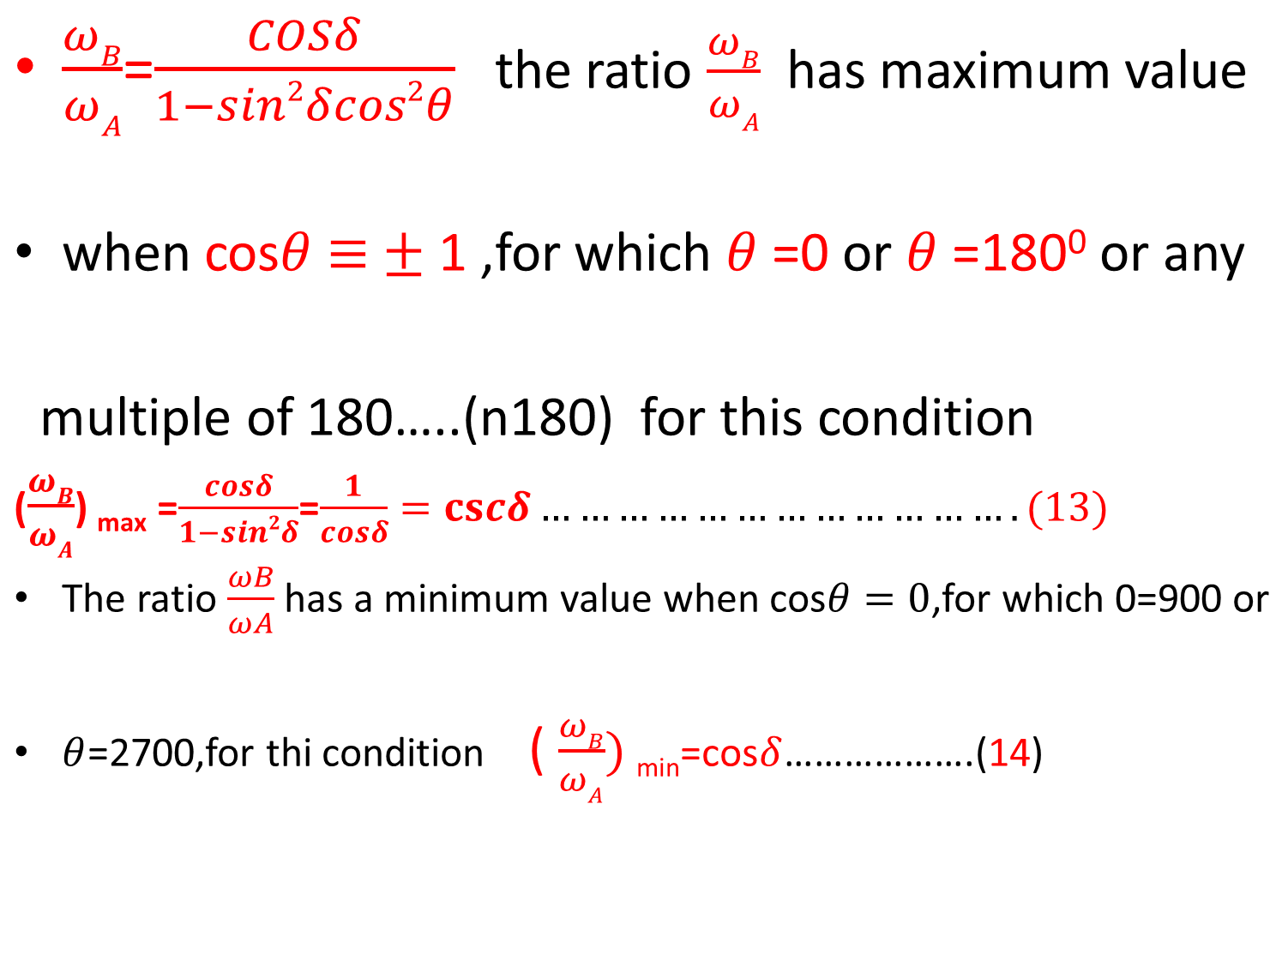
.
.
sec
θ

Slide 28
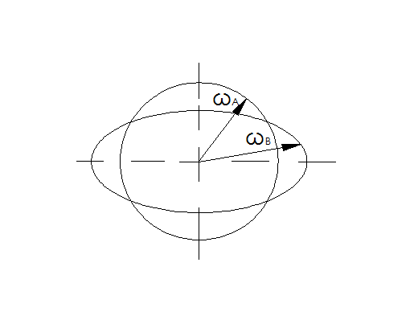
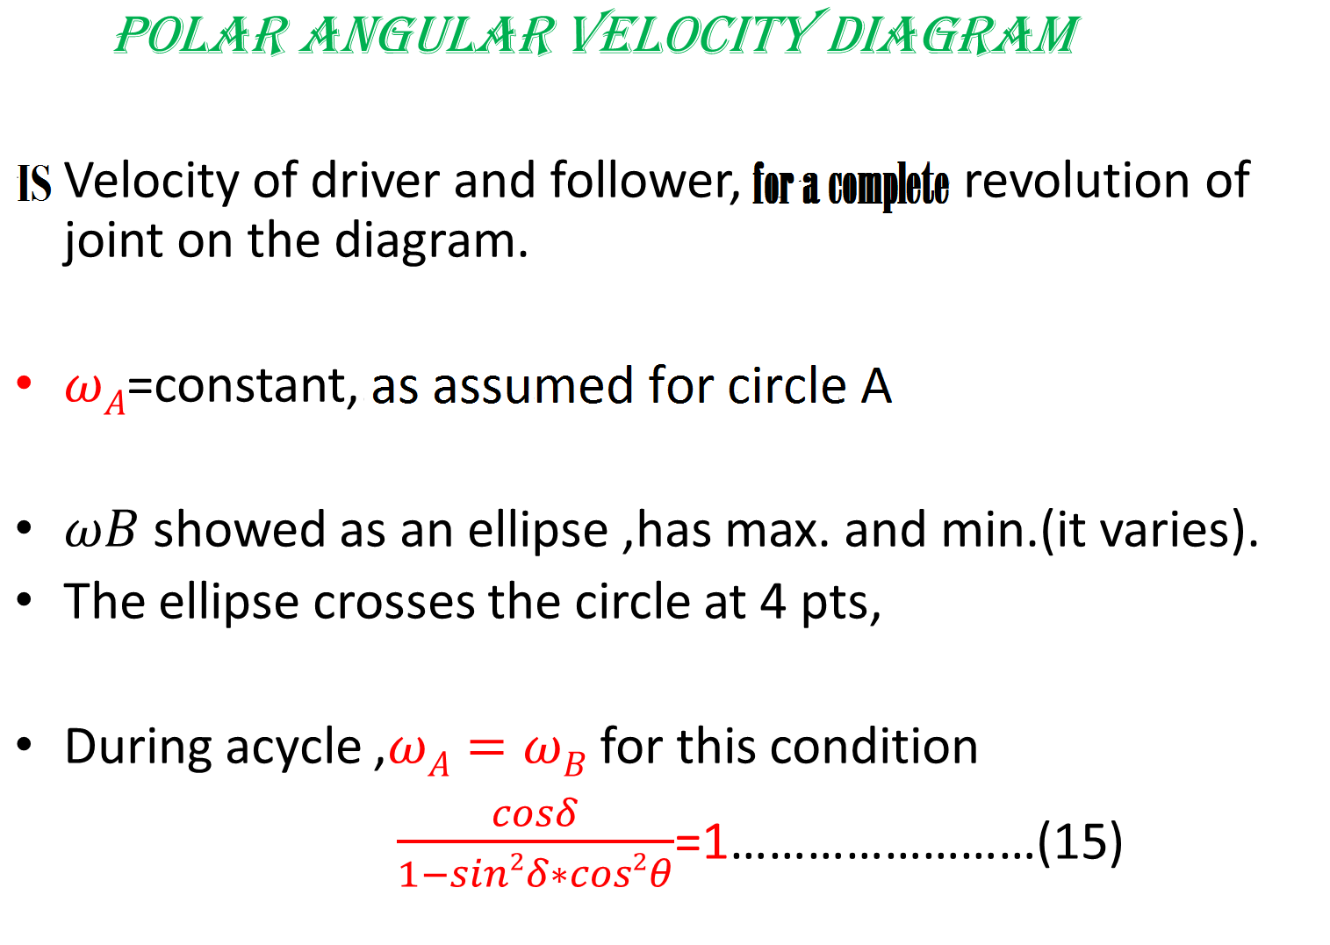
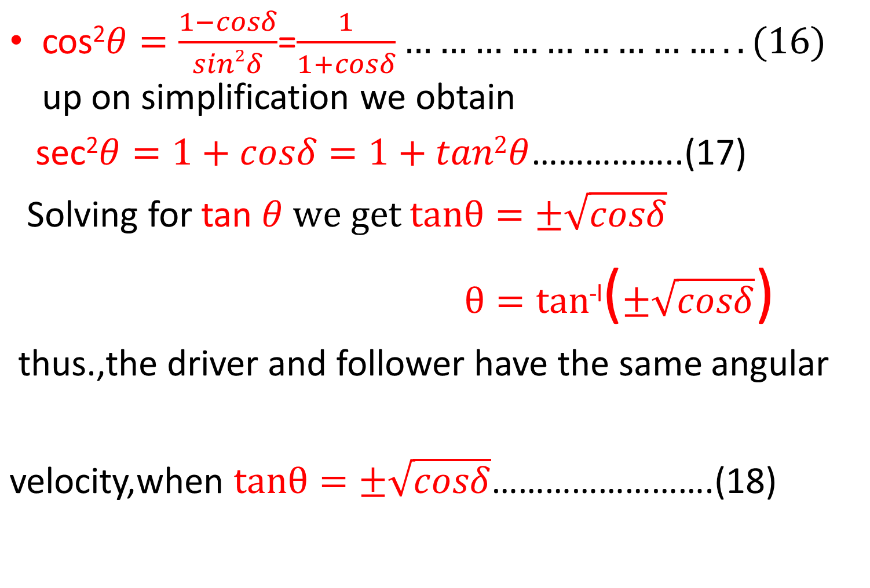
.
P2 P1
P3 P4
.
Polar angular velocity diagram
From Alem Bazezew
Text book series
Conclusion:1) At P1,P2,P3,P4
ωA =ω B.
2) B/n (P1 up to P2) & . . (P3 up to P4)
=> ωA >ω B.
3) B/n (P1 up to P4) & . . (P2 up to P3)
ωA <ω B.

Slide 29
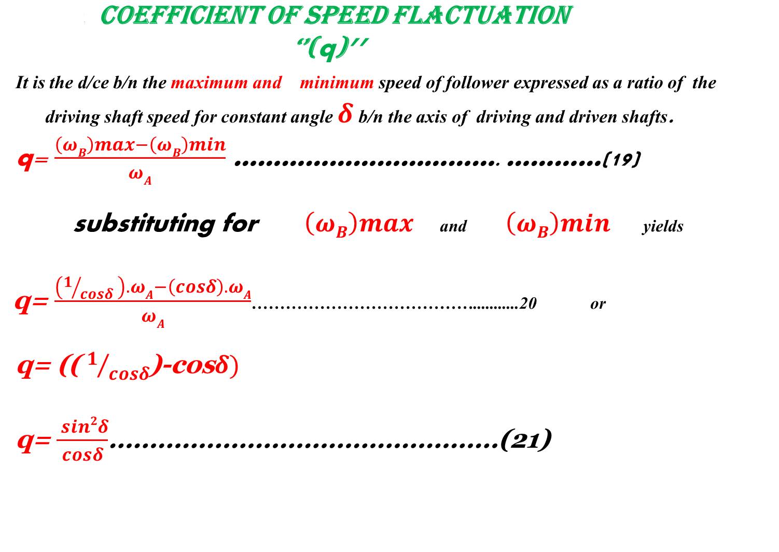
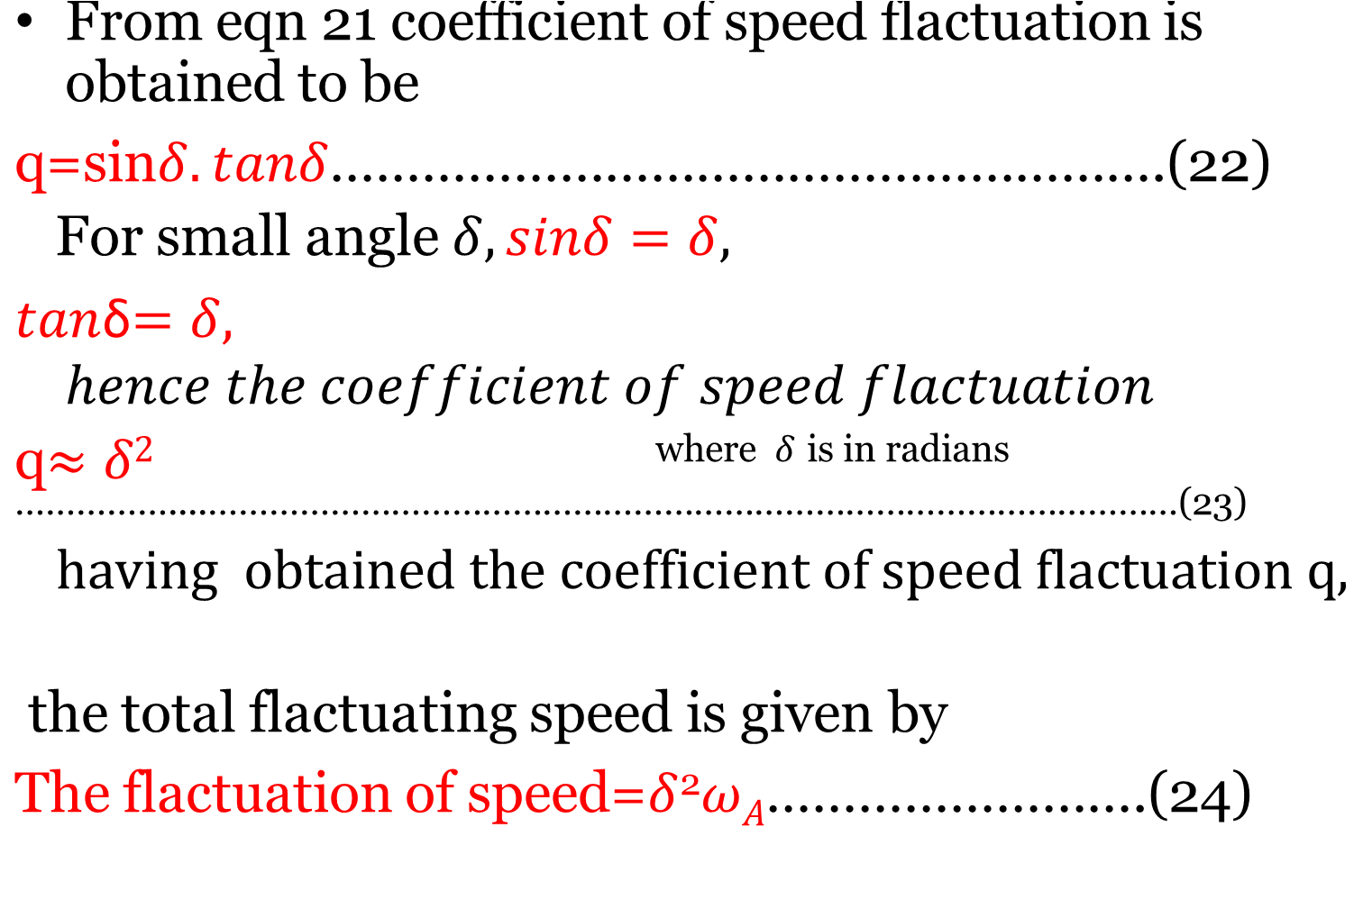
.
.

Slide 30
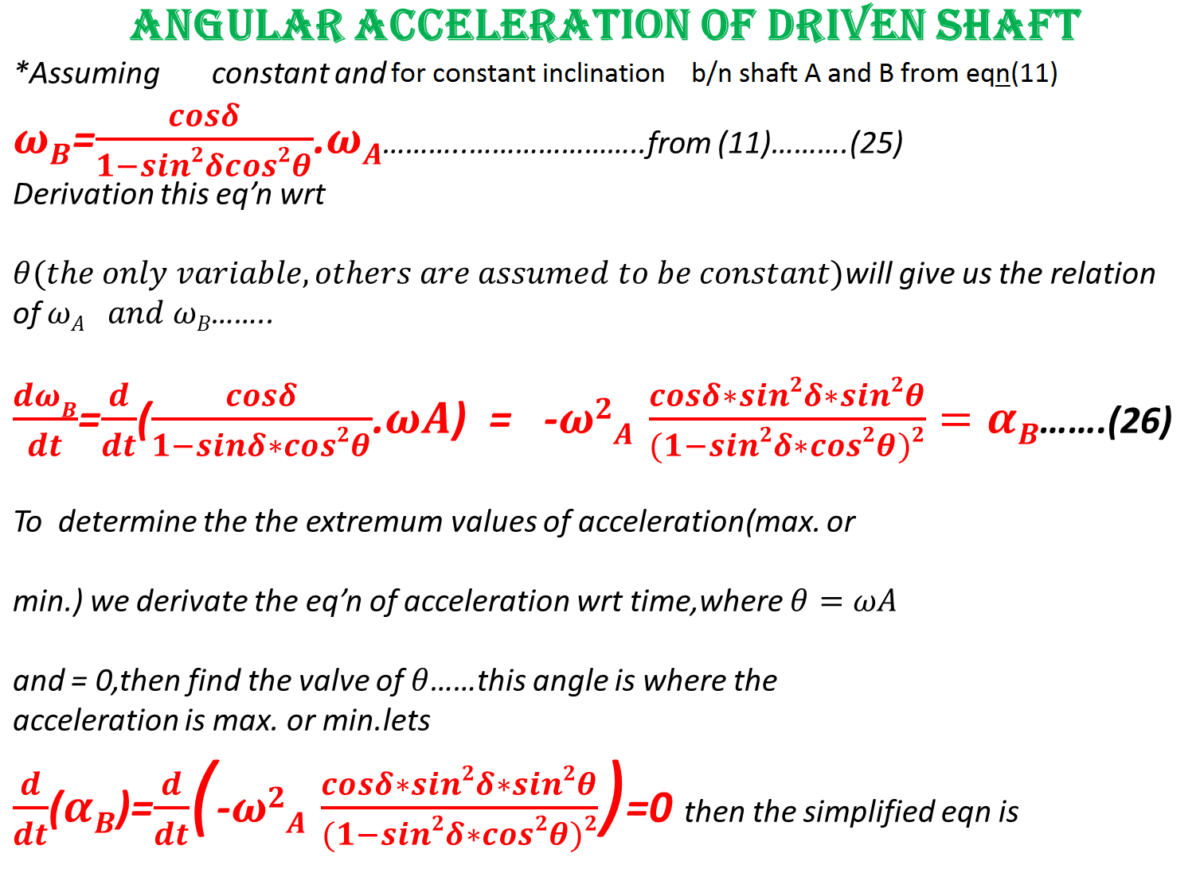
.
ωA
ωA
.
.

Slide 31
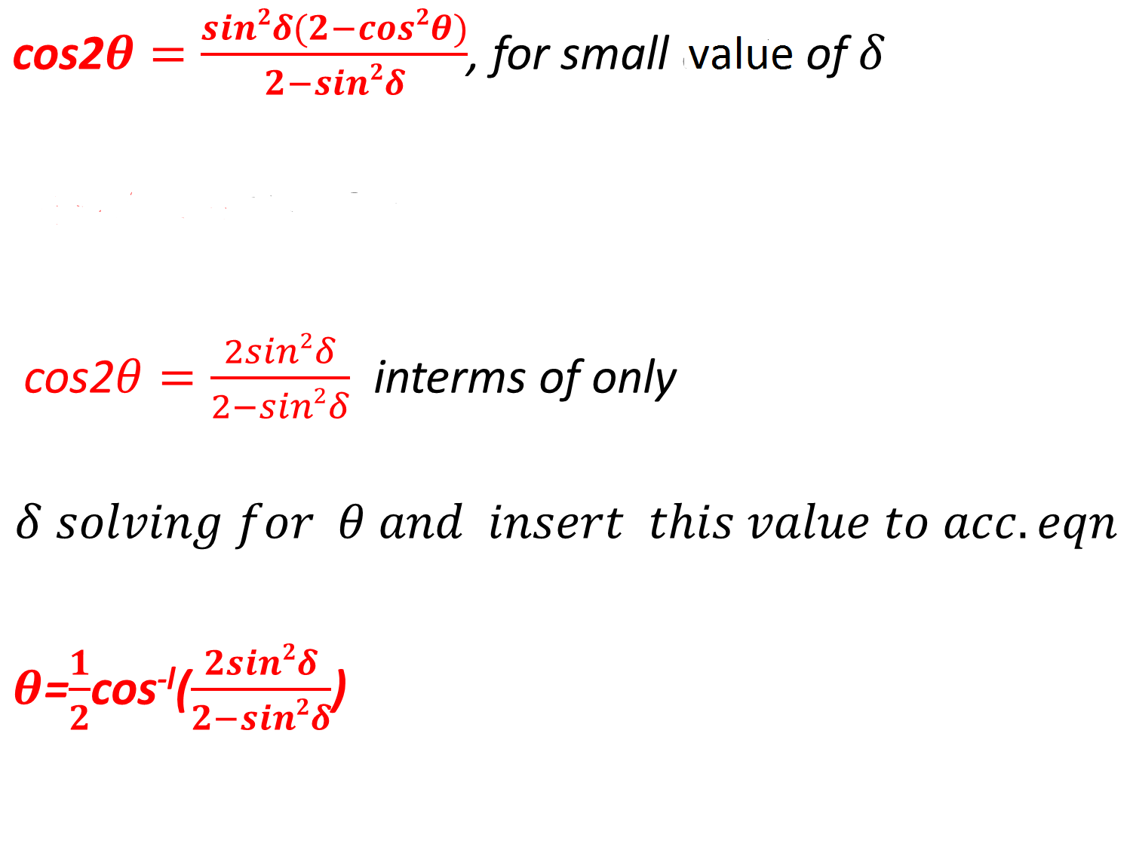
Thus, having obtained the angular position for which the angular acceleration is maximum, the angular acceleration is obtained by substituting forθ in the equation of the acceleration.

Slide 32
DOUBLE HOOK’S JOINT
using single Hooke’s joint in automobile would vary the speed of either
car or engine during each revolution of the driver shaft.
-*this occurs high stresses on shaft and slippage on the tires.
-*so the best solution for this is to use double Hooke’s joint.
-*it provides uniformity of speed b/n input and output ends by limiting
the variation of speed to the intermediate shaft.
-*If the driver and follower shafts are inclined equally relative to the intermediate shaft the fluctuation of speed is confined to the intermediate Shaft alone. To reduce the inertia due to fluctuation in transmission, the intermediate shaft can be made short and light.

Slide 33
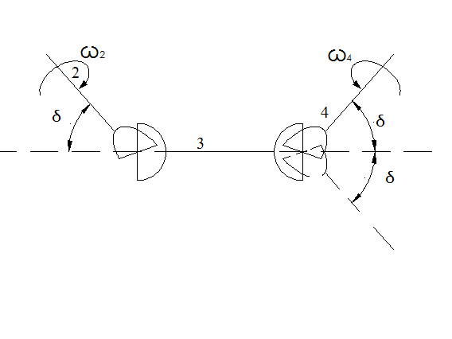
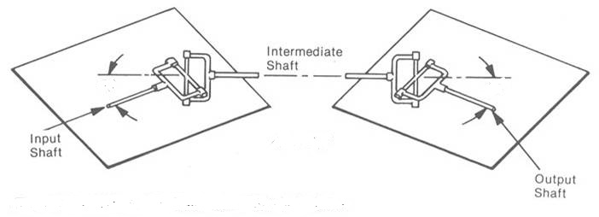
Double universal joint
From Alem Bazezew
Text book series
Double Hooke’s joint
From http://en.wikipedia.org/wiki/Universal_joint

Slide 34
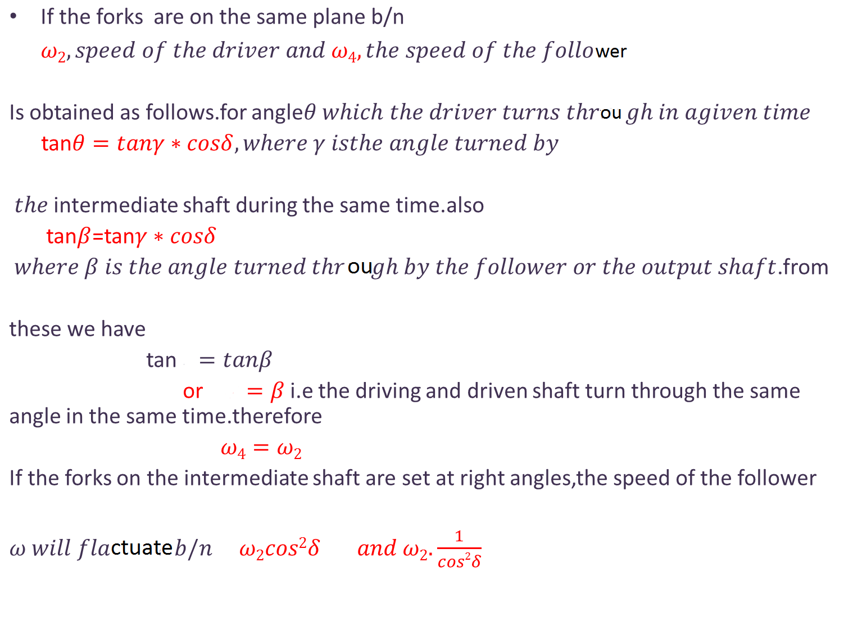
θ
θ

Slide 35
THANK YOU !!!
1
From Group
Jun 4 /2 013

