Slide 1
MANUFACTURING Engineering II
CHAPTER 1
Casting I
AAiT
Lecture By: Abrha M.

Slide 2
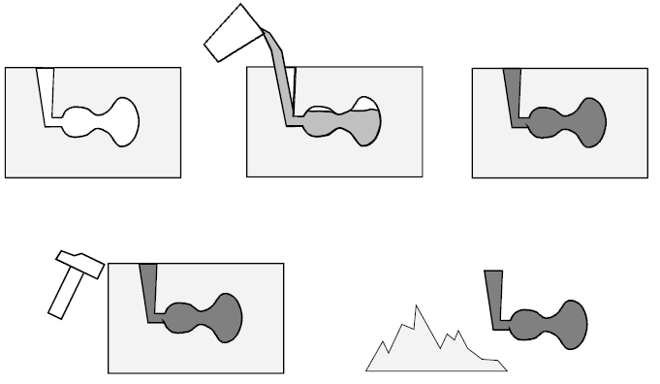
Foundry
Metal casting
Meta casting – ancient
Process of forming metallic object
Melting metal
Pouring in to shaped cavity
Allow it to solidify
Foundry is a factory for making molds
Melting & handling molten metals
Perform casting process
Cleaning the finished casting
Foundrymen workers who perform casting

Slide 3
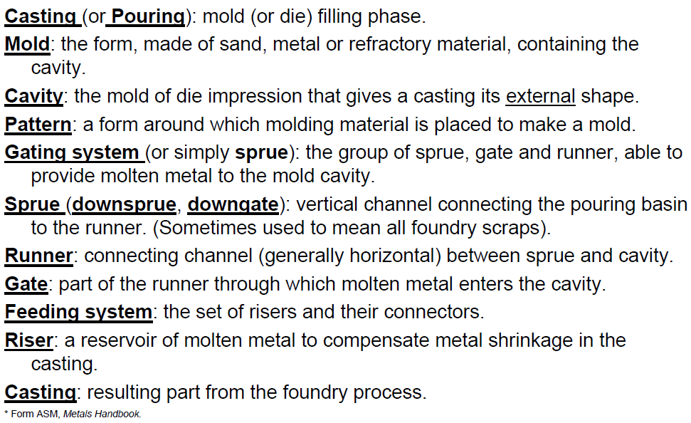
GLOSSARY
Notes:
Manufacturing Engineering

Slide 4
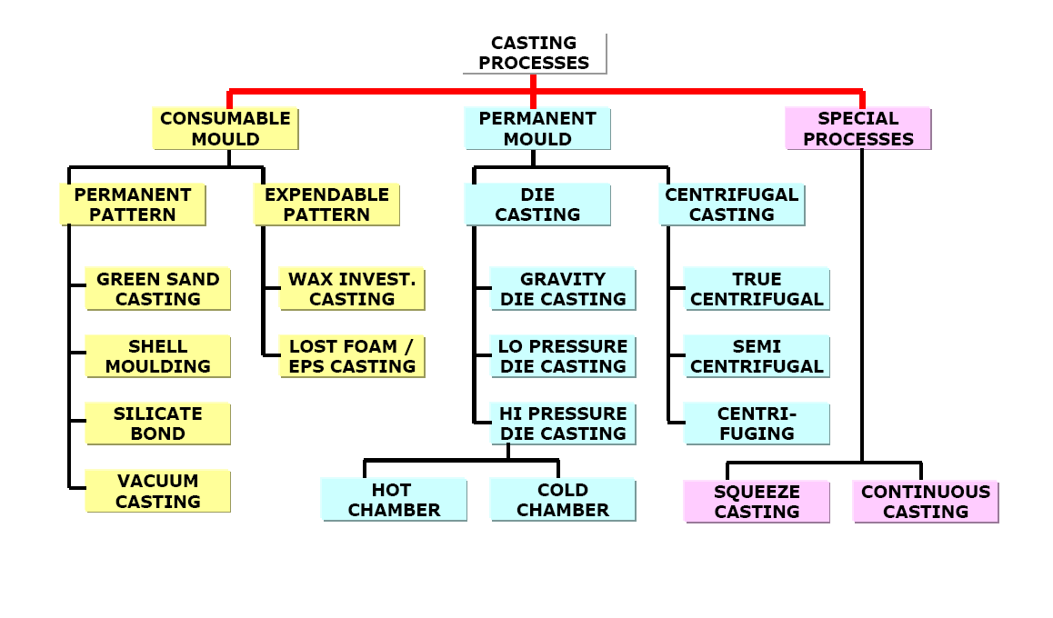
CASTING PROCESSES

Slide 5
MATERIALS Typical foundry materials are:
Aluminum alloys: automotive, house appliances, electronics, furniture, etc.
Ferrous alloys (iron & steel): automotive, plant components (pumps, valves), tools, house appliances, etc.
Zinc alloys: suitable for hot chamber pressure casting (Zn-Al-Mg: “Zama”): automotive, furniture, electronics, house appliances,
Titanium alloys: aerospace, automotive, sport, etc.
Copper alloys (bronze, brass, cupronickel…): piping, tools, house appliances, naval, etc.
Magnesium alloys: automotive, aerospace, electronics, sport,
Nickel alloys (difficult to machine, often made by investment casting): aerospace, automotive, power plants, etc.
Each material has specific problems for melting, refining, die/mold filling, metallurgy…

Slide 6
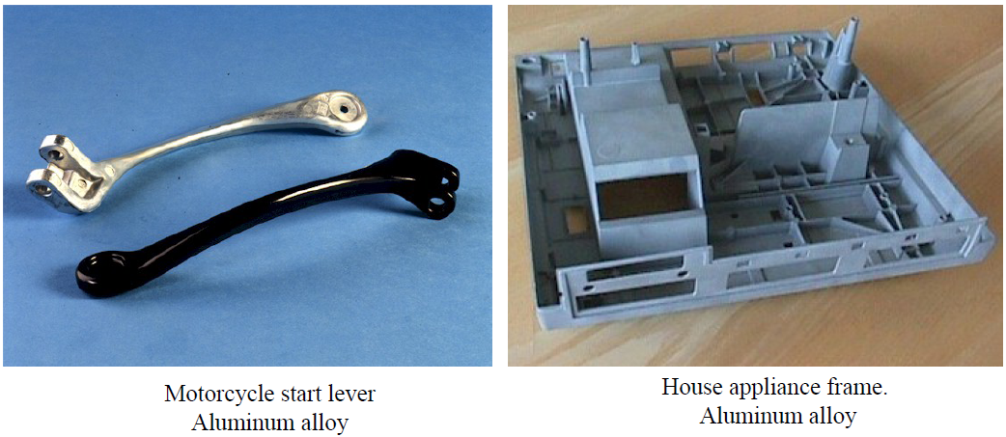
PRODUCTS –Aluminum alloys

Slide 7
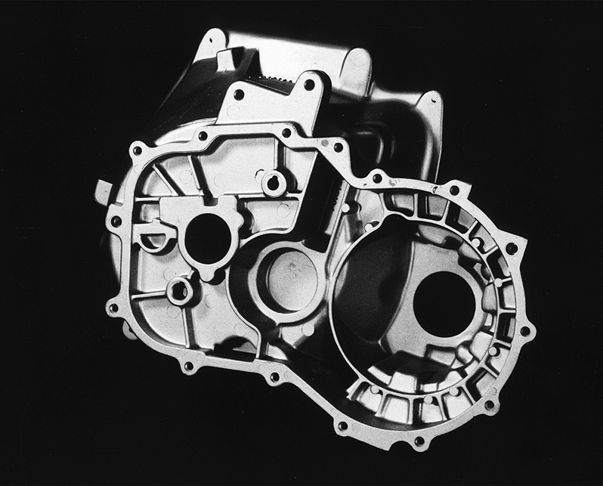
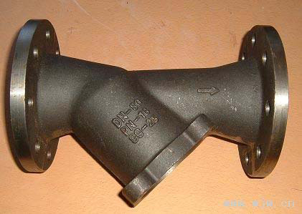
PRODUCTS –Ferrous
Piping valve Steel
Automotive transmission case Cast Iron

Slide 8
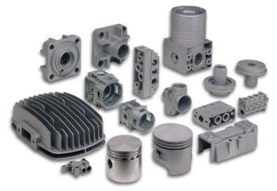
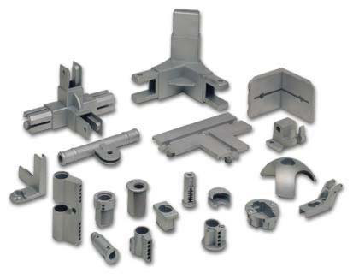
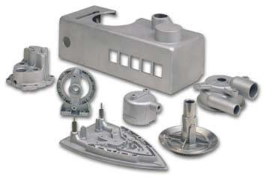
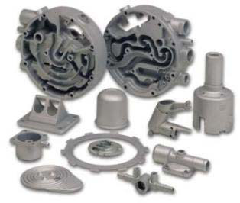
PRODUCTS –Zn alloys (Zamak, Zama)
Pneumatics parts
Furniture parts
House appliances
Automotive parts

Slide 9
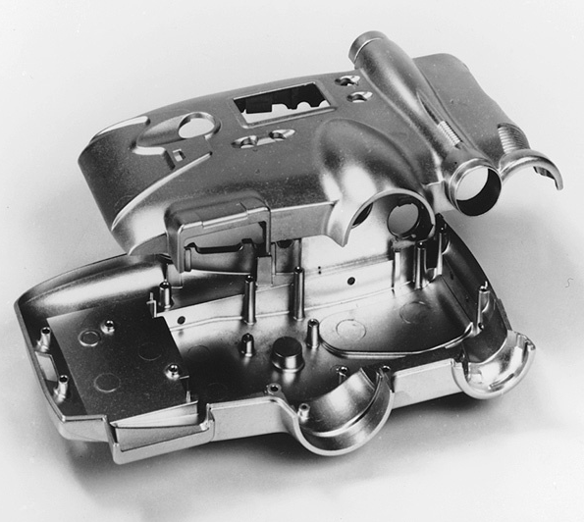
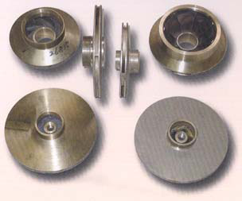
PRODUCTS –Cu and Mg alloys
Pulleys Copper alloy
Camera body Magnesium alloy

Slide 10
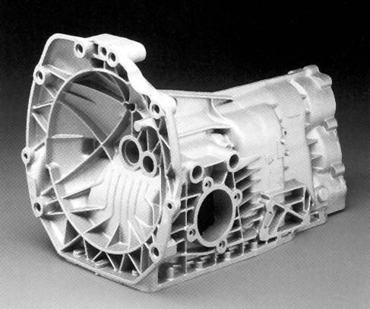
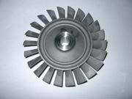
PRODUCTS –Ti Ni
Turbine Nickel alloy
Automotive gearbox case Titanium alloy

Slide 11
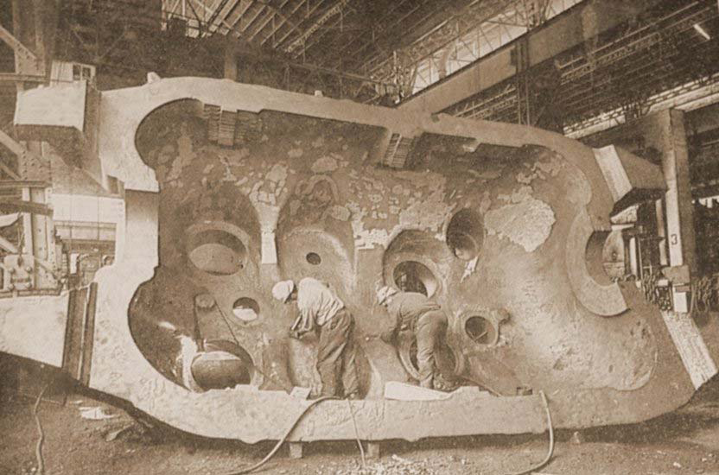
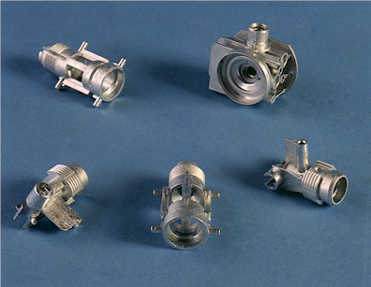
PRODUCTS
Foundry is very flexible about size:

Slide 12
PRODUCTS Casting is profitable when:
Part shape is complex: thickness is important, but a complex shape is cast as easily as a simple one (especially for internal cavities);
Batch size ranges from medium (sand casting)
To very large (die casting): there is an initial cost for equipment (pattern, match plates, dies, core boxes…) that should be divided on a number of produced parts;
Part size is a problem: in theory there is no limit to the casting size, casting is mandatory for very large complex parts (e.g. big machine tool frames, naval engine bodies);
The workpiece material has low machinability: some materials are more easily cast (ferrous, copper alloys), other less (Al, Ti), yet castability should be compared with alternative techniques (e.g.: Nickel alloys are often cast, they are difficult to cast but even more difficult to machine…).

Slide 13
SAND CASTING
With the sand casting technique, metal castings are produced in sand molds(to be precise, a special foundry sand mixed with a number of binders and additives) and molten metal is poured in by gravity, that is, poured without an external pressure.
Thus molds are disposable and metals are poured in by gravity.
Almost all metals are suitable for sand casting. Ferrous materials are most commonly manufactured using this technique.
Generally, sand is placed around a pattern (usually made of wood, metal or polymers), then rammed or chemically hardened. Once the mold is made, it is necessary to extract the pattern from the mold.

Slide 14
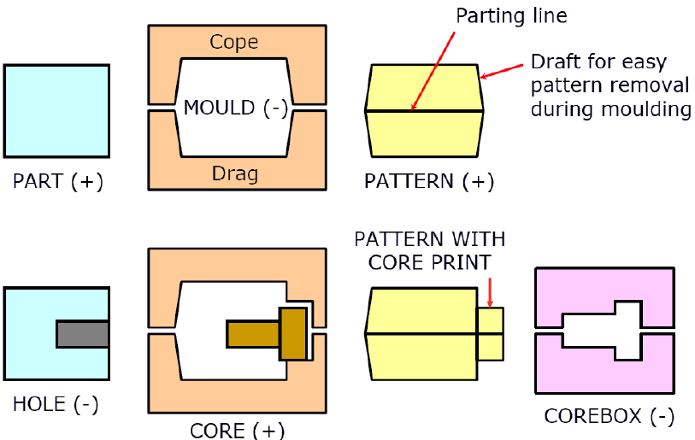
SAND CASTING

Slide 15
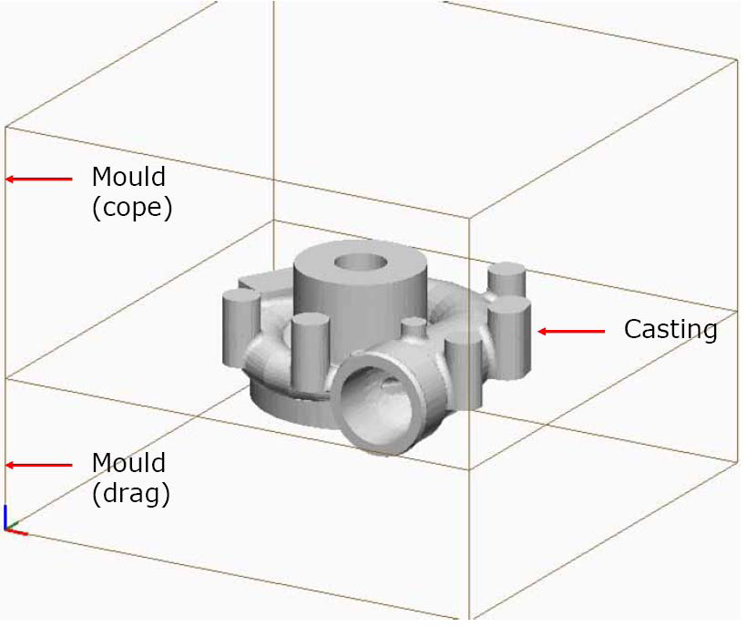
SAND CASTING

Slide 16
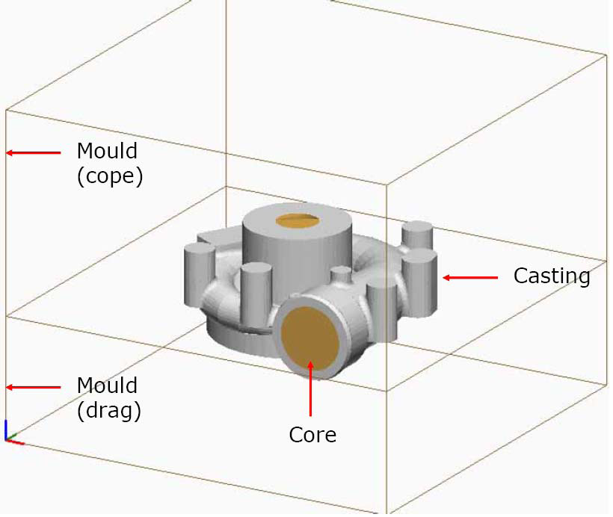
SAND CASTING

Slide 17
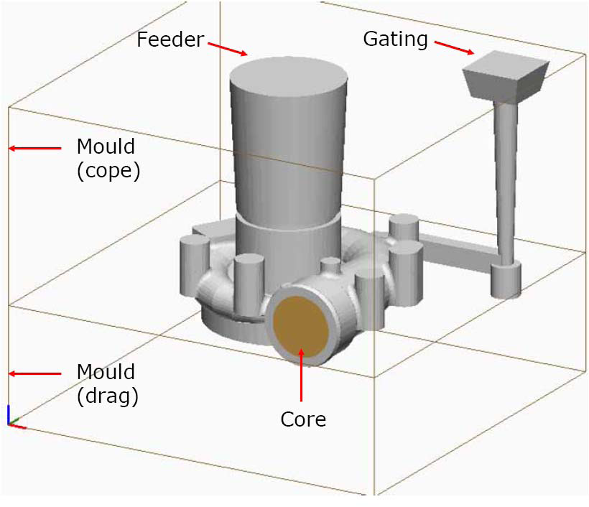
SAND CASTING

Slide 18
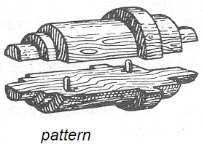
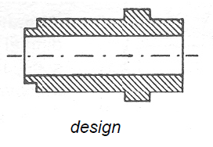
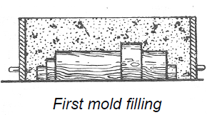
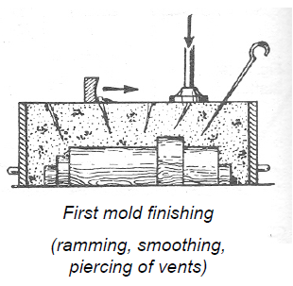
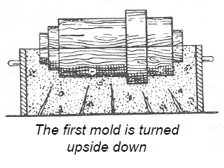
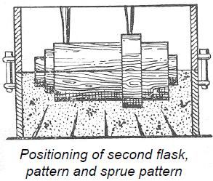
SAND CASTING –Sequence (manual mold-making)

Slide 19
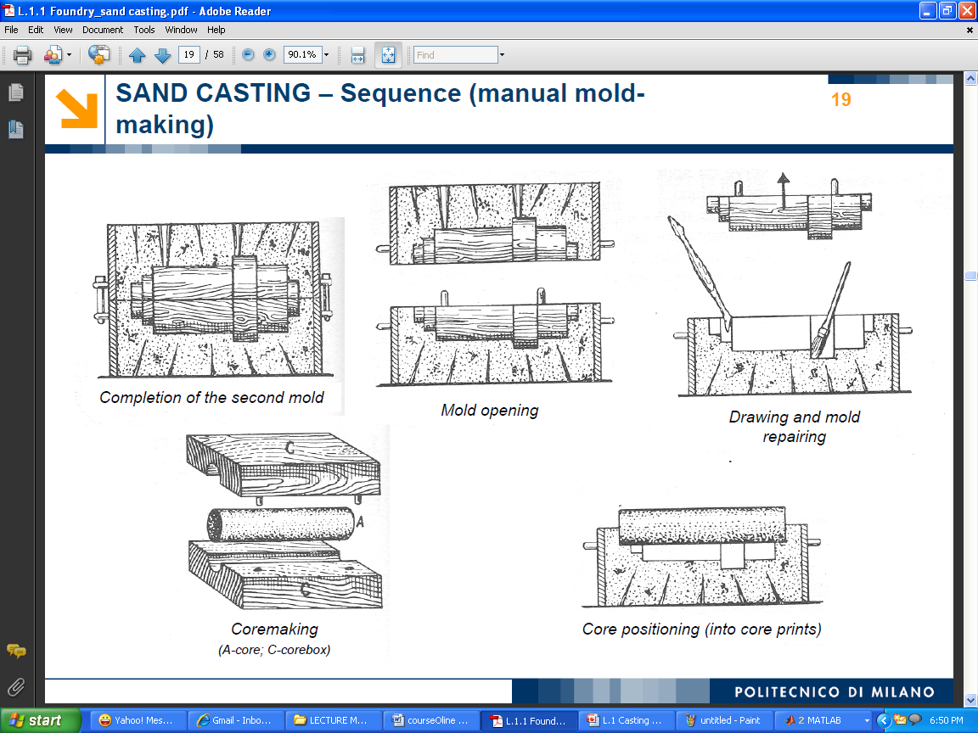
SAND CASTING –Sequence (manual mold-making)

Slide 20
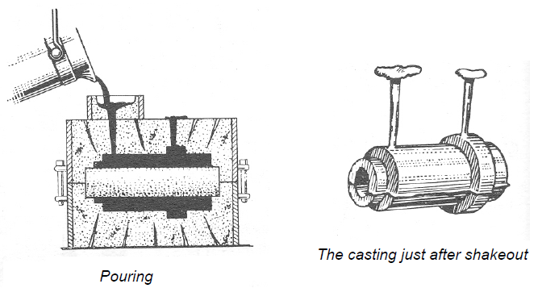
SAND CASTING –Sequence (manual mold-making)

Slide 21
SAND CASTING Patterns
Pattern requirements:
Easy to extract from the mold (no undercuts, divided into two or more parts);
Easy to machine (often wood, but also metal or plastics);
Wear resistant (in contact with sand).
Pattern features:
Core prints (when present);
Modified dimensions (for both allowances and shrinkage);
Modified geometry (fillets, drafts).

Slide 22
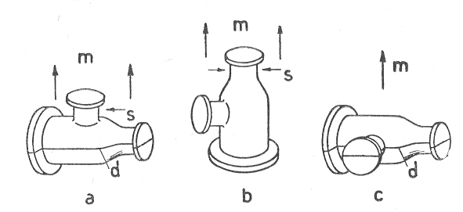
SAND CASTING –Patterns
Pattern extraction is made possible by:
1) Correct positioning between
cope & drag (i.e. upper & lower mold);
m –mold extraction direction
s –Undercut

Slide 23
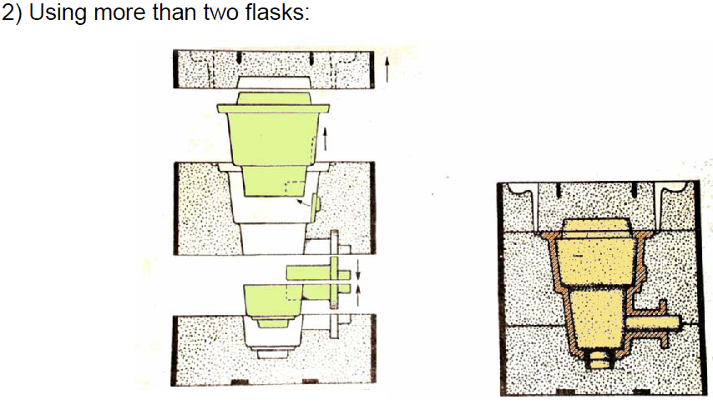
SAND CASTING –Patterns

Slide 24
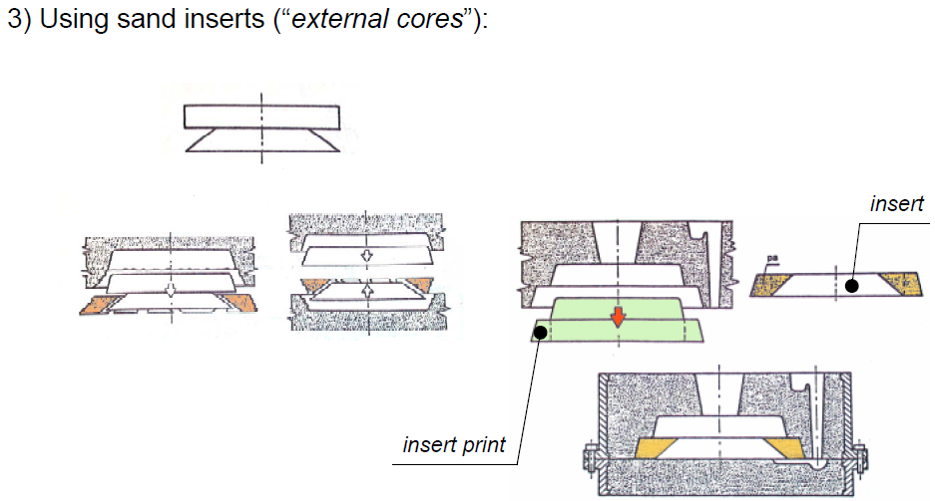
SAND CASTING –Patterns

Slide 25
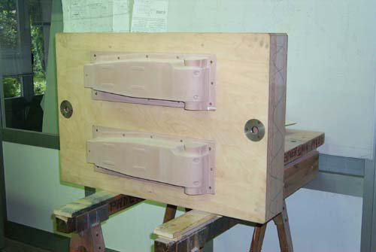
SAND CASTING –Patterns
Wooden patterns are very common: they are produced easily with carpentry techniques.

Slide 26
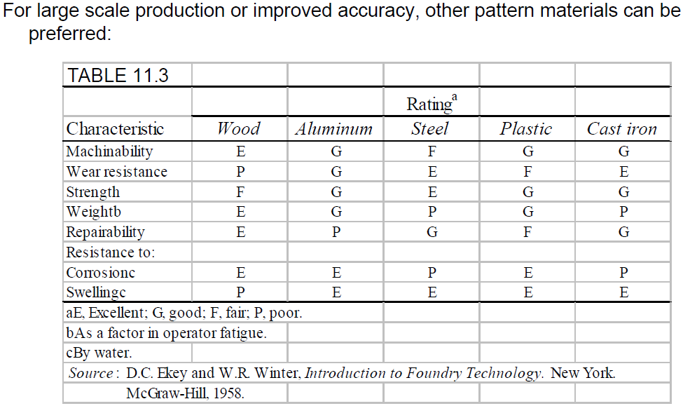
SAND CASTING –Patterns

Slide 27
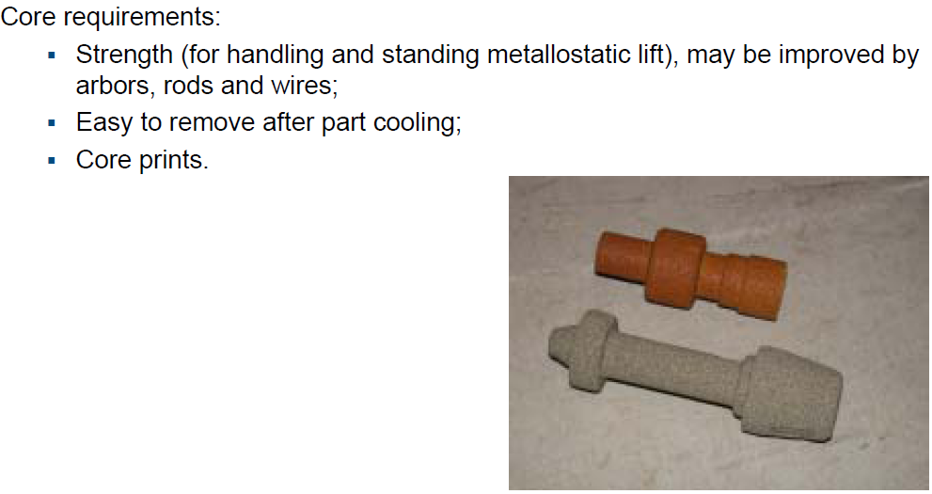
SAND CASTING –Cores

Slide 28
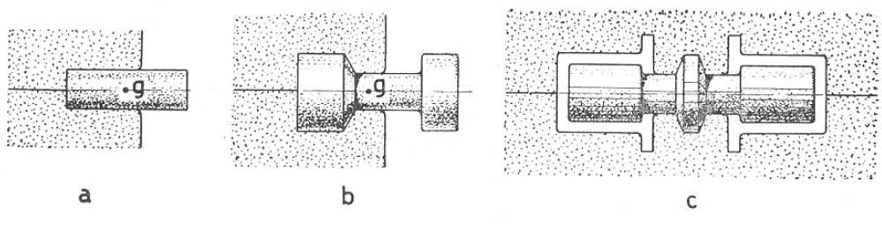
SAND CASTING –Cores
While using blind cores, avoid core shift. Cores should keep their position both before closing the flasks and after pouring: their center of gravity should fall inside the print.

Slide 29
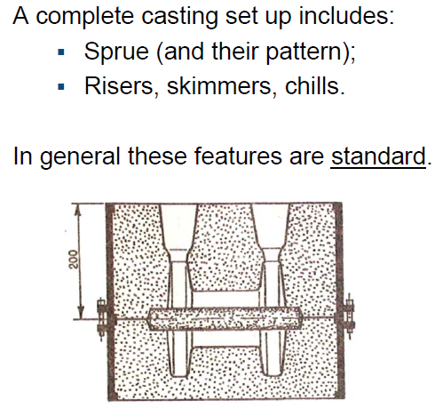
SAND CASTING –Other devices

Slide 30
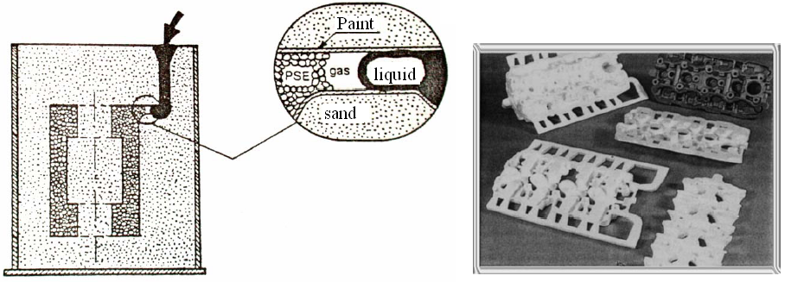
SAND CASTING –“Lost Foam”
It is a special molding technique using patterns made by polystyrene foam. During casting (just in sand, without binders) this pattern is destroyed by the heat. Therefore, in this process both pattern and mold are expendable and casting is by gravity.

Slide 31
SAND CASTING –“Lost Foam”
Advantages:
no problems with undercuts;
in most cases, cores are not required, even for through holes;
molding and shakeout are very simple;
special freedom of choice in gate positioning;
one flask.
Disadvantages.
in general more expensive;
requires a pattern for each casting;
venting is critical;
a trial and error process is needed, before a sound part can be produced (good for large scale production);
risers are critical: effective only for thin walls.

Slide 32
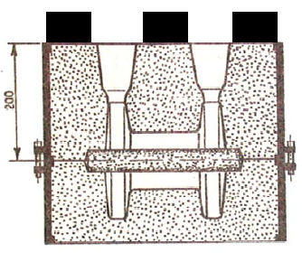
SAND CASTING –Metallostatic lift
Once poured, the molten metal exerts a pressure on cavity walls. As a result, the cope may be lifted. To prevent this, some weight may be set on the mold. DO NOT OVERLOAD thin copes: they may be deformed (sags)!
Metallostatic pressure can result also in either core shift or core deformation, especially for horizontal cores.

Slide 33
SAND CASTING –Sands
Silica: most widely available, economical
Zircon: lower expansion, high refractoriness, higher thermal conductivity, but more expensive
Olivine, Chromite: intermediate properties
Desired features for a disposable mold material:
Flowability(good flow, good contact with all surfaces of the pattern), for better reproduction of details
refractoriness (heat resistance to stand contact with molten metal)
permeability (ability to permit gases to pass through)
strength (to keep the desired shape, against shocks and metallostatic pressure)
collapsibility (to allow an easy shakeout)
These features are given by a mix of:
sand (esp. silica = SiO2)
binders (esp. clay = 2SiO2.Al2O3.2H2O)
moisture
additives

Slide 34
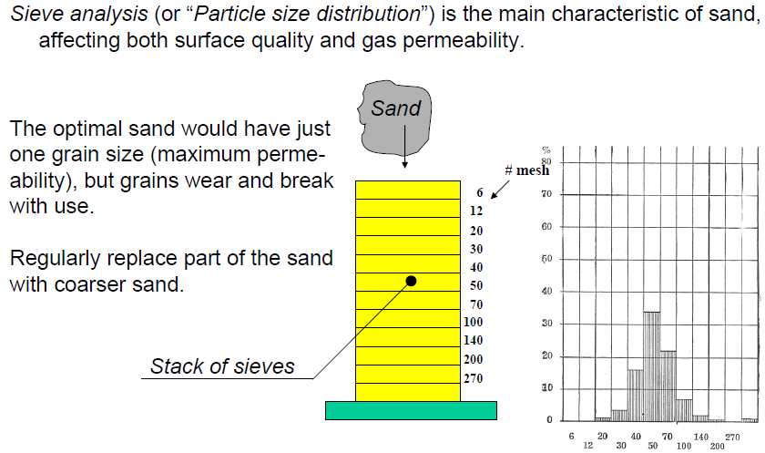
SAND CASTING –Sands

Slide 35
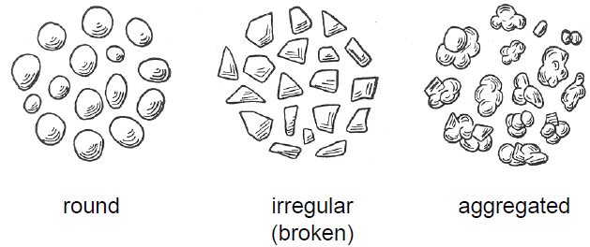
SAND CASTING –Sands
Sand grain shape has effect on mold permeability too: the optimal shape is round (with lower apparent density, since a higher amount of void is left).
Here is a sketch of possible grain shapes.

Slide 36
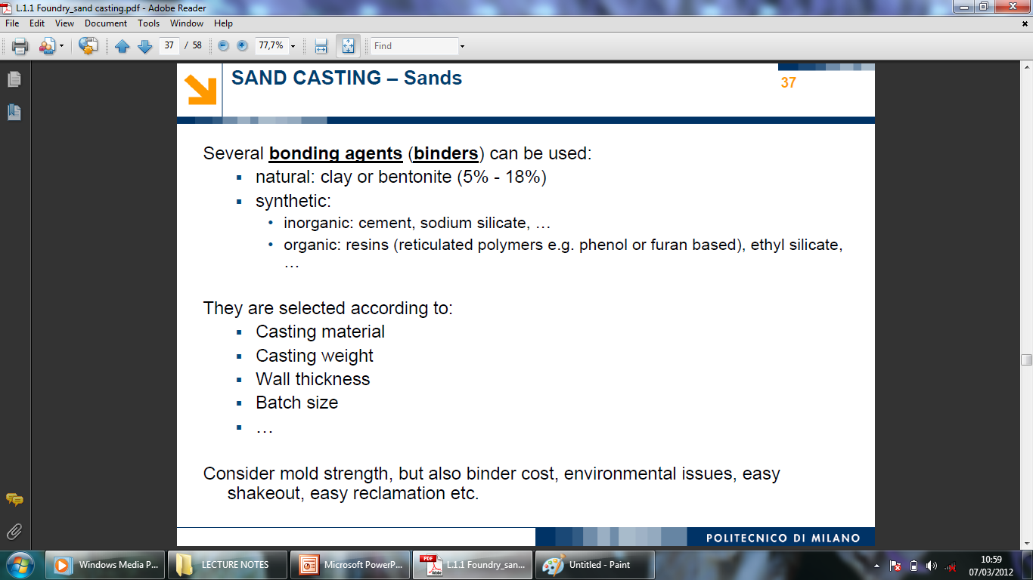
SAND CASTING –Sands

Slide 37
SAND CASTING –Molding techniques
Molding is compacting sand around the pattern to reach the required mold strength. Both manual and mechanical molding (mold making) are possible, depending on:
batch size,
required level of repeatability,
lack of skilled crew.
Manual mold making may be done with flasks, slip or snap flasks (& mold jackets), ground molding.
Mechanical mold making may be done either with flasks or flask-less. Even fully automated processes are possible (molding, pouring and knockout).

Slide 38
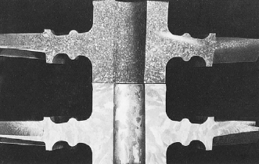
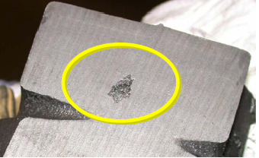
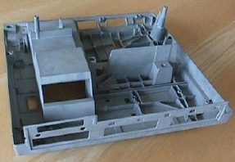
CAST MATERIALS
To select a good material, we require the following properties:
Low melting point: not really necessary in all casting processes, but always useful;
Castability: a complex mix of properties able to give accurate and sound castings:
•high fluidity of liquid phase, to easily fill “difficult” cavities;
•phase-diagram properties, esp. to reduce dendrite formation;
•low shrinkage, during both solidification and cooling;
•chemical properties, to control compounds inclusions (esp. with O, Si, S).

Slide 39
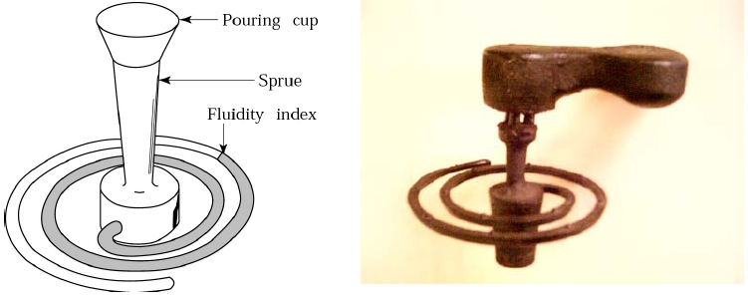
FLUIDITY TEST
Test for the ability of the metal to fill thin cavities. The fluidity index is the length of the filled part, under “standard” testing condition.
NOTE: most thermal properties of molten alloy (specific and latent heat, heat flux…) strongly affect the test results as well.

Slide 40
SAND CASTING Materials
Most materials are suitable for sand casting:
steel: fair;
iron: very good, because of its lower melting point (compared to steel) ,high fluidity and limited shrinkage;
aluminum: fair, some problems from gas inclusions (gas porosity, blisters, blows);
copper alloys: very good for bronze and brass (e.g.: artistic castings).

Slide 41
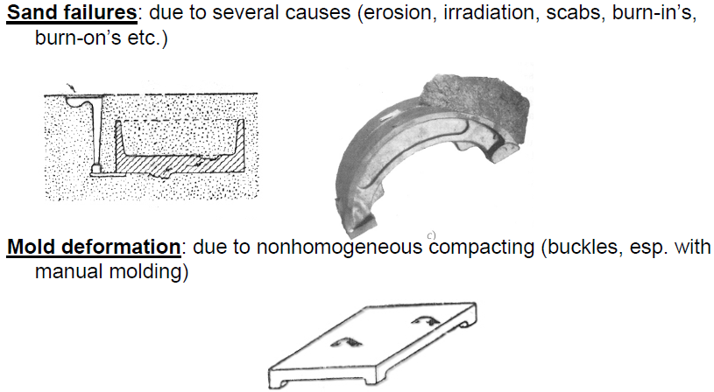
SAND CASTING Defects

Slide 42
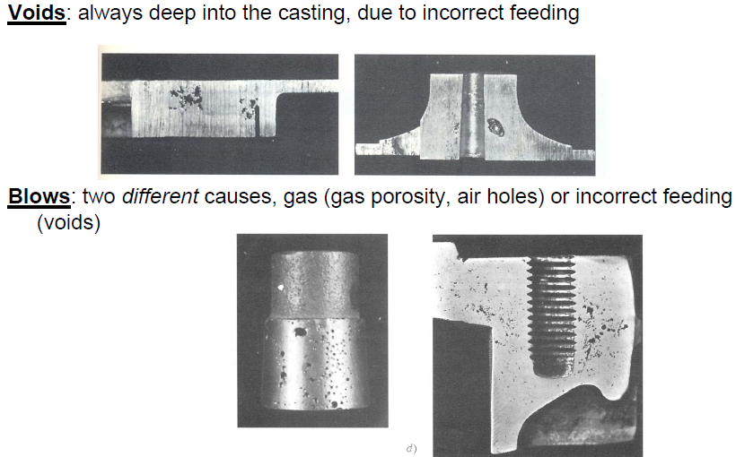
SAND CASTING Defects

Slide 43
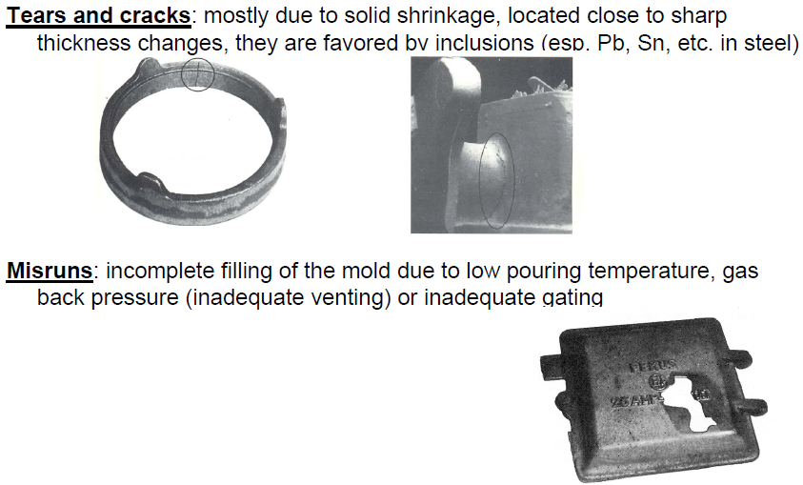
SAND CASTING Defects

Slide 44
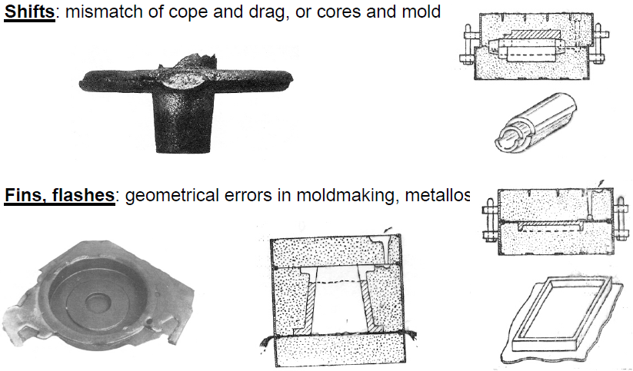
SAND CASTING Defects

Slide 45
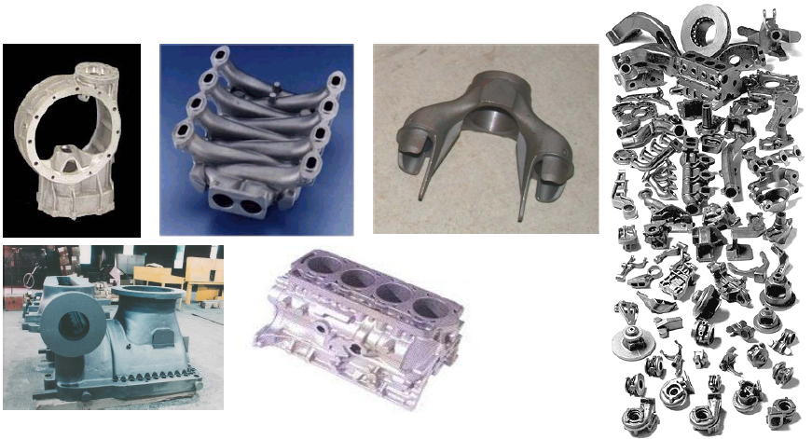
SAND CASTING –Products
A big variety of complex shapes is possible:

Slide 46
PRODUCTS
Particularly suitable for sand casting:
Complex geometries, thin walls are desirable but not necessary;
Rather broad tolerances, +/-0.5% –2% of dimensions;
Surface finish ra = 12 –24 μm for “as cast” surfaces;
Medium-heavy part weight (the bigger, the more interesting with respect to alternative solutions);
Wide range of batch sizes, from single to very large (automated process is often used for automotive parts);
Need for production flexibility (small pattern modifications are relatively easy).

