Slide 1
The aircraft engines are manufactured by metal casting, the turbine blades, the turbine housings, and the machine tool structures and many more are manufactured by metal casting.

Slide 2
Principle of metal casting

Slide 4
Cross section of Cylinder head

Slide 5
V6Engine

Slide 7
Engine Head

Slide 8
Crank Case

Slide 9
Car Rims

Slide 10
Transmission Components

Slide 11
Aircraft Engine parts Aircraft engine used by Wright brothers in 1903

Slide 12
Modern aircraft Engine

Slide 13
Lathe Bed

Slide 14
Lathe Carriage

Slide 15
Grinding machine housing

Slide 16
Machine Parts

Slide 19
Steam Engine Flywheel

Slide 20
Railway wagon components

Slide 22
Pump Housing

Slide 23
Pump Casting

Slide 24
Francis Turbine runner

Slide 25
Pelton wheel runner

Slide 39
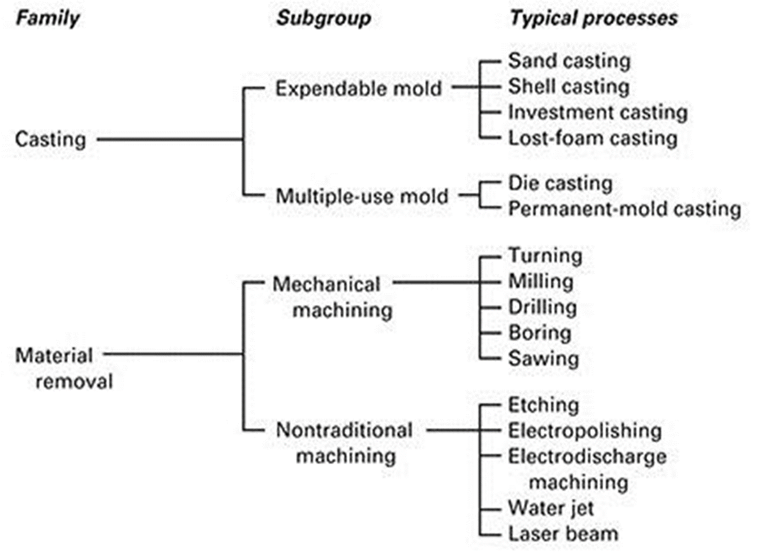

Slide 41
Casting processes developed over the years can be classified into:
1. Expendable mold: sand, shell, expandable pattern, plaster, ceramic and investment.
2. Permanent mold: slush, pressure, die, centrifugal, squeeze, and semisolid.
3. Single crystal growing: single crystals for microelectronics, single-crystal turbine blades,
and directional solidification.
As in all manufacturing, each casting process has its own characteristics, applications, advantages limitations, and costs.

Slide 44
Fundamental of metal casting
Casting processes are most often selected over other manufacturing methods, for the following reasons:
1. Casting can produce complex shapes with internal cavities or hollow sections.
2. Very large parts can be produced in one piece.
3. It can utilize materials that are difficult or uneconomical to process by other means.
4. Casting is competitive with other processes.
Almost all metals can be cast in the final shape desired (net-shape mfg), often with only minor finishing operations required.
Important considerations in casting operations:
1. Flow of the molten metal into the mold cavity.
2. Solidification and cooling of the metal in the mold.
3. The influence of the type of mold material.

Slide 45
Typical sand mould with nomenclature
pattern attached with gating and risering system

Slide 46
Mould Section and casting nomenclature, (a) top view, (b) front view

Slide 48
STEPS IN THE PRODUCTION SEQUENCE IN SAND CASTING

Slide 53
Desirable Mold Properties and Characteristics
•Strength - to maintain shape and resist erosion
•Permeability - to allow hot air and gases to pass through voids in sand
•Thermal stability - to resist cracking on contact with molten metal
•Collapsibility - ability to give way and allow casting to shrink without cracking the casting
•Reusability - can sand from broken mold be reused to make other molds?

Slide 54
Foundry Sands
Silica (SiO2) or silica mixed with other minerals
•Good refractory properties - capacity to endure high temperatures
•Small grain size yields better surface finish on the cast part
•Large grain size is more permeable, to allow escape of gases during pouring
• Irregular grain shapes tend to strengthen molds due to interlocking, compared to round grains
Disadvantage: interlocking tends to reduce permeability

Slide 55
Binders Used with Foundry Sands
•Sand is held together by a mixture of water and bonding clay
Typical mix: 90% sand, 3% water, and 7% clay
•Other bonding agents also used in sand molds:
Organic resins (e g , phenolic resins)
Inorganic binders (e g , sodium silicate and phosphate)
•Additives are sometimes combined with the mixture to enhance strength and/or permeability

Slide 56
Types of Sand Mold
•Green-sand molds - mixture of sand, clay, and water; “Green" means mold contains moisture at time of pouring
•Dry-sand mold - organic binders rather than clay and mold is baked to improve strength
•Skin-dried mold - drying mold cavity surface of a green-sand mold to a depth of 10 to 25 mm, using torches or heating lamps

Slide 59
