Slide 1
Manufacturing Engineering II
CHAPTER 2.1
FUNDAMENTAL OF METAL FORMING
(AAiT)
Instructor : Dr Shanthakumar G C

Slide 2
Metal Forming
Large group of manufacturing processes in plastic deformation is used to change the shape of metal workpiece.
The tool, usually called a die, applies stresses that exceed the yield strength of the metal .
The metal takes a shape determined by the geometry of the die

Slide 3
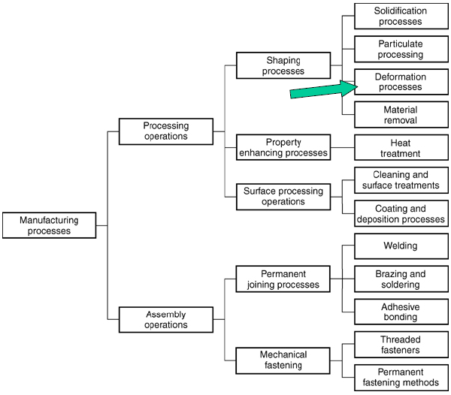
Metal Forming
Metal forming dominates the class of shaping operations identified as the deformation process.

Slide 4
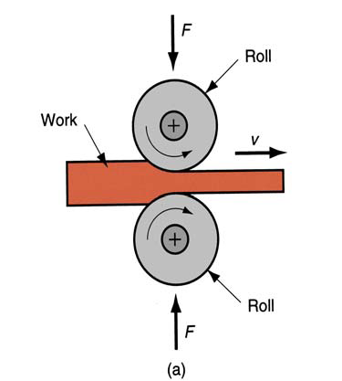
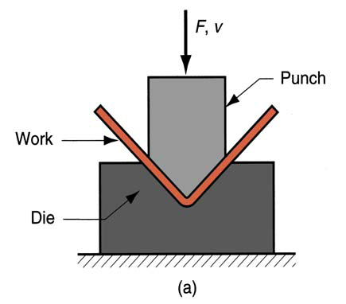
Stresses in Metal Forming
Stresses to plastically deform the metal are usually compressive
  Examples: rolling, forging, extrusion
However, some forming processes
  Stretch the metal [tensile stresses]
  Others bend the metal [tensile and compressive]
  Still others apply shear stresses

Slide 5
Material Properties in Metal Forming
Desirable material properties:
  Low yield strength
  High ductility
These properties are affected by temperature:
  Ductility increases and yield strength decreases when work temperature is raised
  The effect of temperature gives rise to distinctions between cold, warm and hot working
Other factors:
  Strain rate and friction

Slide 6
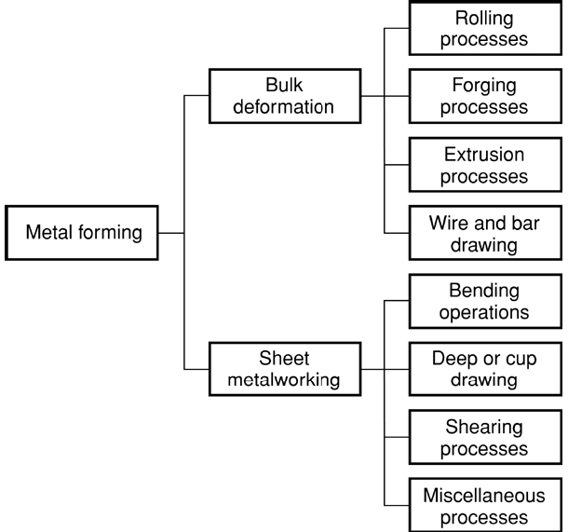
Metal Forming
Metal forming processes con be classified into two basic categories: bulk deformation process and sheet metalworking processes.
Each category includes several major classes of shaping operations

Slide 7

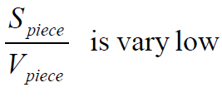
Bulk Deformation Processes
Characterized by significant deformations and massive shape changes
"Bulk" refers to work parts with relatively low surface area-to-volume ratios
Starting work shapes include cylindrical billets and rectangular bars

Slide 8
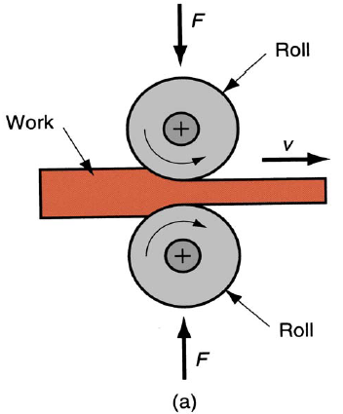
Rolling
This is a compressive deformation process in which the thickness of a slab or plate is reduced by two opposing cylindrical tools called rolls. The rolls rotate so as to draw the workpiece into the gap between them and squeeze it.

Slide 9
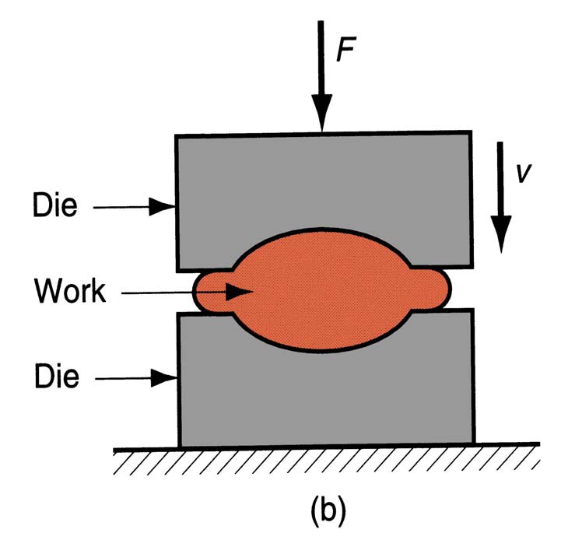
Forging
In forging, a workpiece is compressed between two opposing dies, so that the die shapes are imparted to the work. Forging is traditionally a hot working process, but many types of forging are performed cold.

Slide 10
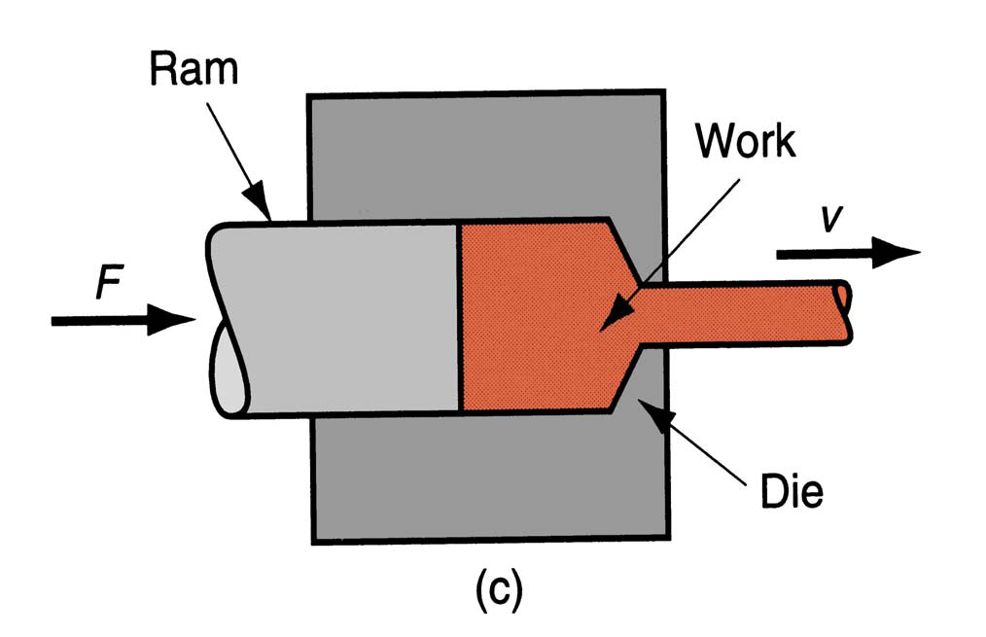
Extrusion
This is a compression process in which the work metal is forced to flow through a die opening, thereby taking the shape of the opening as its own cross section.

Slide 11
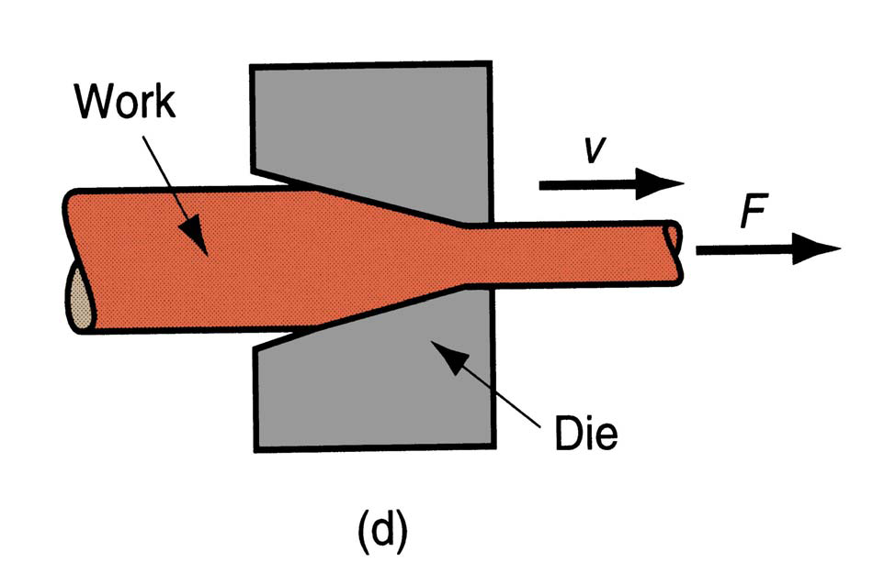
Wire and Bar Drawing
In this forming process, the diameter of a round wire or bar is reduced by pulling it through a die opening.

Slide 12
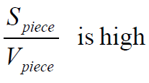

Sheet Metal Working
Forming and related operations performed on metal sheets, strips, and coils
High surface area-to-volume ratio of starting metal, which distinguishes them from bulk deformation
Often called press working because presses perform these operations
Parts are called stampings
Usual tooling: punch and die (the punch is the positive portion and the die is the negative portion of the tool set)

Slide 13

Sheet Metal Bending
Bending involves straining of a metal sheet or plate to take an angle along (usually) straight axis

Slide 14
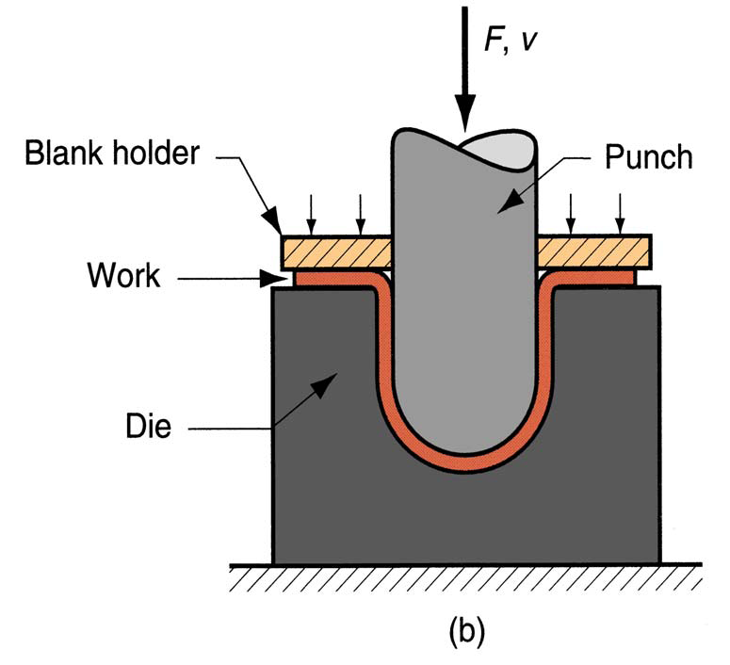
Drawing
In sheet metal working, drawing refers to the forming of a flat metal sheet into a hollow or concave shape, such as a cup, by stretching the metal. A blank holder is used to hold down the blank while the punch pushes into the sheet metal.

Slide 15
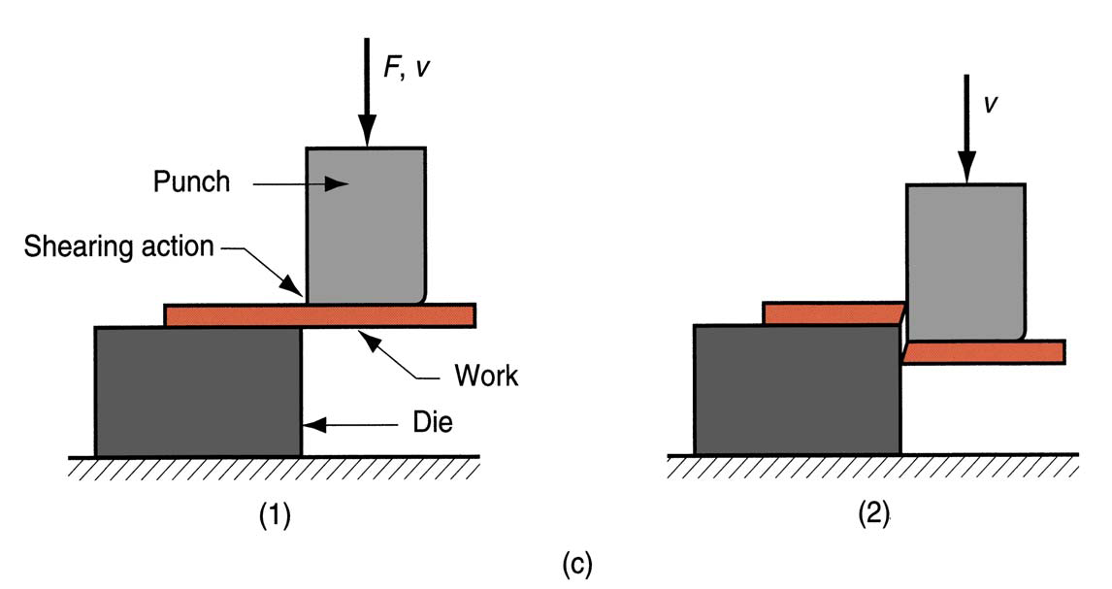
Sheet Metal Shearing
This process is somewhat out-of-place in our list of deformation processes, because it involves cutting rather than forming. A shearing operation cuts the workpiece using a punch and a die. Although it is not a forming process, it is included here because it is necessary and very common operation in sheet metal working.

Slide 16
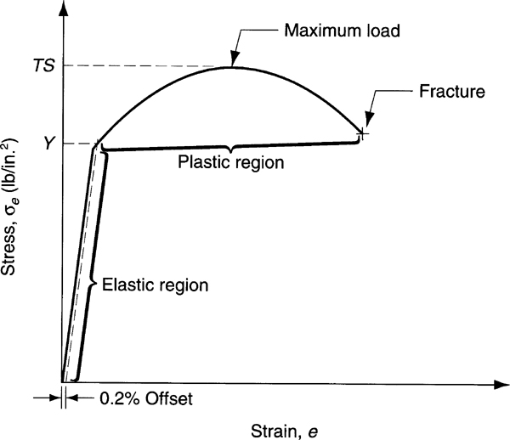
Material Behavior in Metal Forming
Considerable insight about the behavior of metals during forming can be obtained from the stress and strain curve. The typical stress-strain curve from the most metals is divided into an elastic region and a plastic region. In metal forming, the plastic region is of primary interest because the material is plastically and permanently deformed in these processes

Slide 17
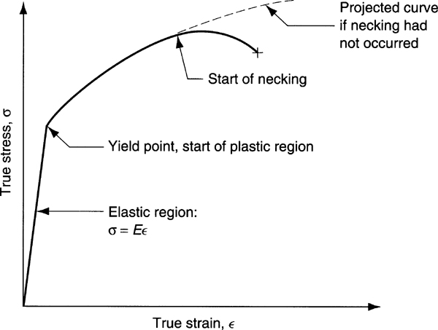
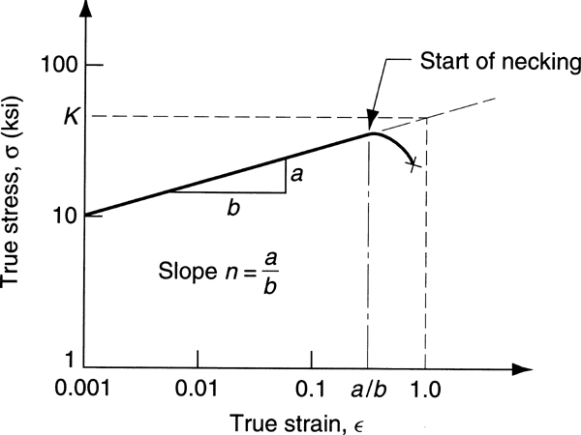
Material Behavior in Metal Forming
The typical stress strain relationship for a metal exhibits elasticity below the yield point and strain hardening above it. Figures below indicate this behavior in linear and logarithmic axes.

Slide 18

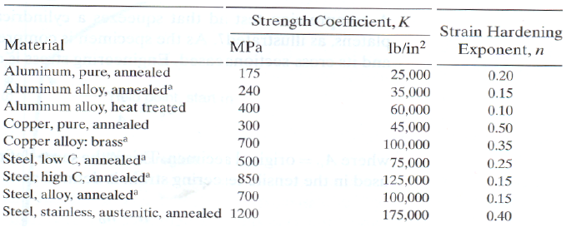
Material Behavior in Metal Forming
In the plastic region, the metal’s behavior is expressed by the flow curve:
where K= strength coefficient; and n= strain hardening exponent
The stress and the strain in the flow curve are true stress and true strain. The flow curve is generally valid as a relationship that defines a metal’s plastic behavior in cold working

Slide 19
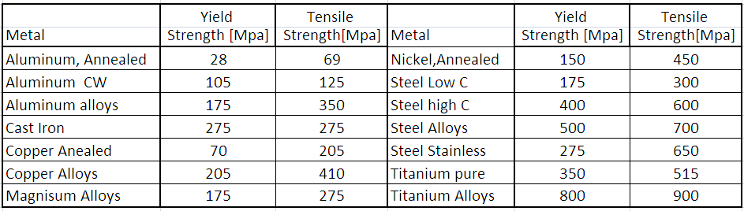
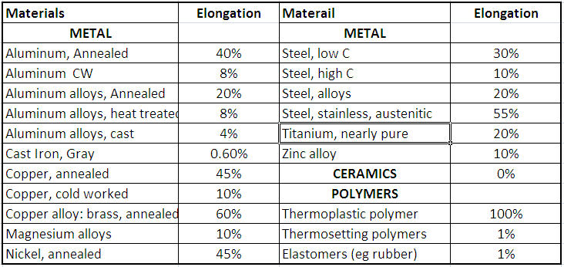
Material Behavior in Metal Forming

Slide 20
Flow Stress
The flow curve describes the stress strain relationship in the region in which metal forming takes place. Thanks to this curve, it is possible to determinate forces and power required to accomplish a particular forming operation. For most metal at room temperature, the stress strain plot indicates that as the metal is deformed, its strength increases due to the strain hardening.
The stress required to continue deformation must be increased to match this increase in strength

Slide 21
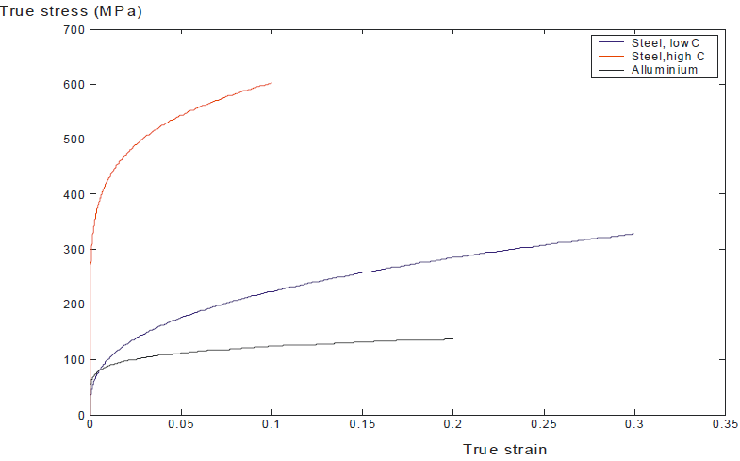
Flow Stress

Slide 22
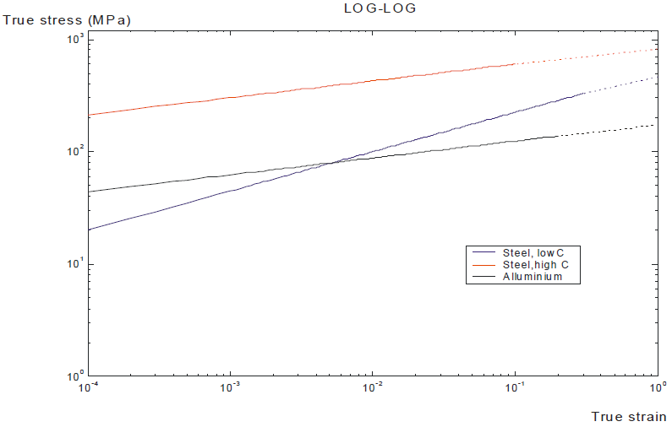
Flow Stress

Slide 23

Flow Stress
The flow stress is defined as the instantaneous value of stress required to continue deforming material. It is the yield strength of the metal as a function of strain, which can be expressed as:
where Y_{f} = flow stress, that is, the yield strength as a function of strain
In the individual forming operations discussed forward, the instantaneous flow stress can be used to analyze the process as it is occurring.

Slide 24
Flow Stress
For example, in certain forging operations, the instantaneous force during compression can be determined from the flow stress value. Maximum force can be calculated based on the flow stress that results from the final strain at the end of the forging stroke.

Slide 25

Flow Stress
In other cases, the analysis is based on the average stresses and strain that occur during deformation rather than instantaneous values
Extrusion represents this case. As the billet is reduced in cross section to pass through the extrusion die opening, the metal gradually strain hardens to reach maximum value. In this case it is more useful to analyze the process based on the average flow stress during deformation

Slide 26
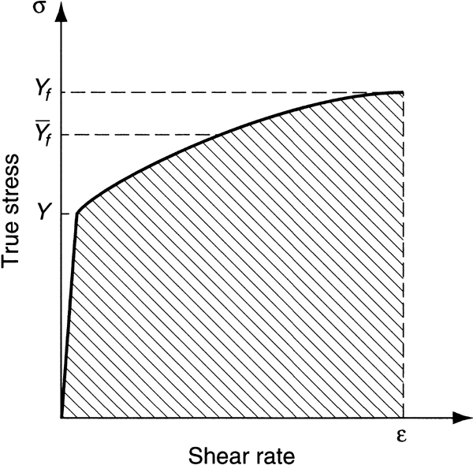



Average Flow Stress
The average flow stress is the average value of stress over the stress strain curve from the beginning of strain to the final (maximum) value that occurs during deformation process.
= Average Flow Stress
= Maximum strain during deformation process

Slide 27
Temperature in Metal Forming
The flow curve is a valid representation of stress and strain behavior of a metal during plastic deformation, particularly for cold working operations.
For any metal, K and n in the flow curve depend on temperature
Both strength (K) and strain hardening (n) are reduced at higher temperatures
In addition, ductility is increased at higher temperatures

Slide 28
Temperature in Metal Forming
These property changes are important because any deformation operation can be accomplished with lower forces and power at elevated temperature.
There are three temperature ranges in metal forming:
Cold working
Warm working
Hot working

Slide 29
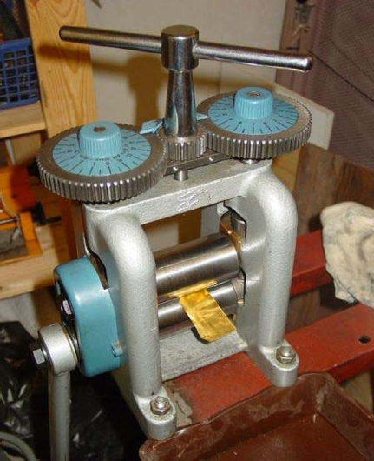
Cold Working
Performed at room temperature or slightly above
Many cold forming processes are important mass production operations
Minimum or no machining usually required
These operations are near net shape or net shape processes

Slide 30
Cold Forming
Advantages
Better accuracy, closer tolerances
Better surface finish
Strain hardening increases strength and hardness
Grain flow during deformation can cause desirable directional properties in product
No heating of work required
Owing to this combination of advantages, many cold forming processes have developed into important mass-production
Disadvantages
Higher forces and power required in the deformation operation
Ductility and strain hardening limit the amount of forming that can be done
In some cases, metal must be annealed to allow further deformation
In other cases, metal is simply not ductile enough to be cold worked

Slide 31
Warm Working
Because plastic deformation properties are normally enhanced by increasing workpiece temperature, forming operations are sometimes performed at temperatures above room temperature but below the recrystallization temperature.
Working Temperature ≈ 0.3 T_{m}
Where Tm is the melting temperature
  Advantages over cold working:
lower forces and power
more intricate work geometries possible
need for annealing could be reduced or eliminated

Slide 32
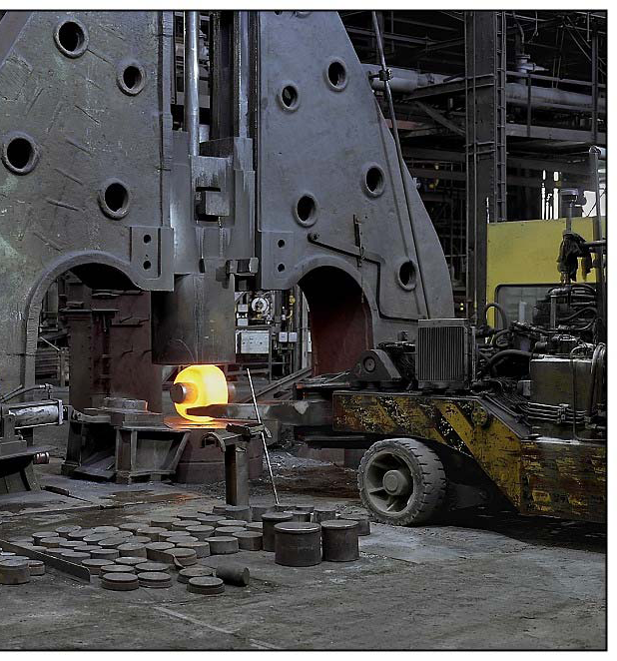
Hot Working

Slide 33
Hot Working
Deformation at temperatures above the recrystallization temperature.
Recrystallization temperature = about one-half of melting point on absolute scale.
In practice, hot working usually performed somewhat above 0.5T_{m.}
Metal continues to soften as temperature increases above 0.5T_{m}, enhancing advantage of hot working above this level .

Slide 34
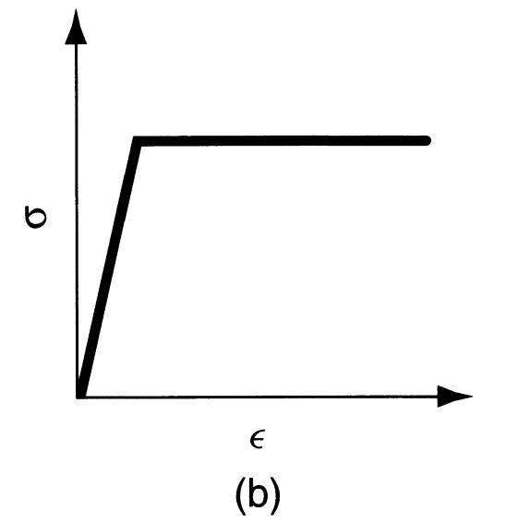
Why Hot Working?
Capability for substantial plastic deformation of the metal-far more than possible with cold working or warm working.
Why?
Strength coefficient (K) is substantially less than at room temperature.
Strain hardening exponent (n) is zero (theoretically)
Ductility is significantly increased.

Slide 35
Hot Working
Advantages
Work part shape can be significantly altered
Lower forces and power required
Metals that usually fracture in cold working can be hot formed
Strength properties of product are generally isotropic
Disadvantages
Lower dimensional accuracy
Higher total energy required (due to the thermal energy to heat the workpiece)
Work surface oxidation (scale), poorer surface finish
Shorter tool life

Slide 36
Strain Rate Sensitivity
Theoretically, a metal in hot working behaves like a perfectly plastic material, with strain hardening exponent n= 0
The metal should continue to flow at the same flow stress, once that stress is reached
However, an additional phenomenon occurs during deformation, especially at elevated temperatures: Strain rate sensitivity

Slide 37


What is Strain Rate?
The rate at which the metal is strained in a forming process is directly related to the speed deformation v. in many forming operation, deformation speed is equal to the velocity of the ram or other moving element of the equipment. Given the deformation speed, strain rate is defined as:
If the deformation speed is constant during the operation, strain rate will change as h changes.

Slide 38
Evaluation of Strain Rate
In most practical operations, valuation of strain rate is complicated by:
Work part geometry
Variations in strain rate in different regions of the part
Usually strain rate can reach 1000 s⁻¹ or more for some metal forming operations

Slide 39
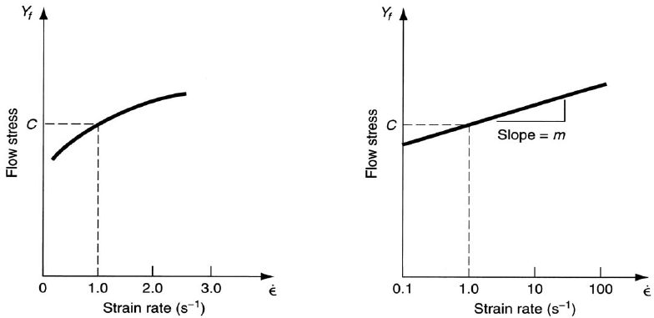
Effect of Strain Rate on Flow Stress
We have already observed that the flow stress of a metal is a function of temperature. At the temperature of hot working, flow stress depends on strain rate. The effect of strain rate on strength properties is know as strain rate sensitivity.
As the strain rate is increased, resistance to deformation increases

Slide 40
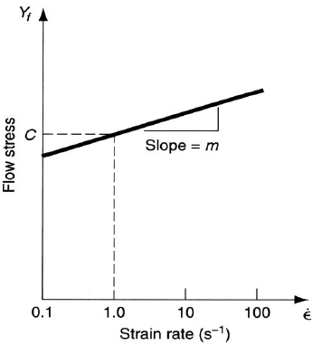

Strain Rate Sensitivity Equation
where C= strength constant (similar but not equal to strength coefficient in flow curve equation), and m= strain-rate sensitivity exponent
where
C= strength constant (similar but not equal to strength coefficient in flow curve equation), and m= strain-rate sensitivity exponent
The value of C is determined at a strain rate of 1.0, and m is the slope of the curve

Slide 41
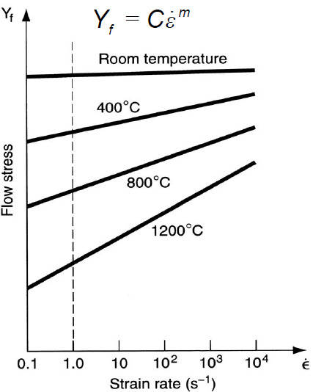
Effect of Temperature on Flow Stress
The effect of temperature is pronounced. Increasing temperature decreases the value of C and increases the value of m
At room temperature, the effect of strain rate is almost negligible, indicating that the flow curve is a good representation of the material behavior

Slide 42
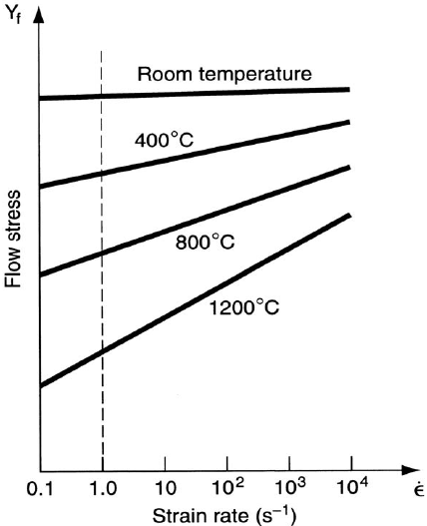
Effect of Temperature on Flow Stress
As the temperature increased, strain rate plays a more important role in determining flow stress. This is important in hot working because deformation resistance of the material increases so dramatically as the strain rate is increased

Slide 43


Effect of Temperature on Flow Stress
It is notice that even in cold working, also if small, strain rate can have effect.
So a more complete expression for flow stress as a function of both strain and strain rate must be introduced.
Where A is the strength coefficient, combining the effects of the previous K and C values. Of course A, n, m would all be function of temperature.

Slide 44
Friction in Metal Forming
Friction in metal forming arises because of the close contact between the tool and work surfaces and the high pressures that drive the surface together in these operation

Slide 45
Friction in Metal Forming
In most metal forming processes, friction is undesirable:
Metal flow is retarded
Forces and power are increased
Tooling wears faster
Since tools wear are generally expensive, tool wear is a major concern

Slide 46
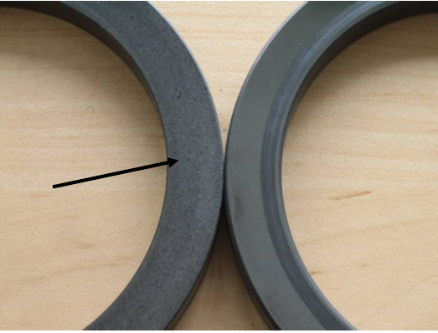
Friction in Metal Forming
If the coefficient friction becomes large enough, a condition know as sticking occurs. Sticking in metalworking is the tendency for the two surfaces in relative motion to adhere to each other rather than slide

Slide 47
Lubrication in Metal Forming
Metalworking lubricants are applied to tool-work interface in many forming operations to reduce harmful effects of friction
Benefits:
Reduced sticking, forces, power, tool wear
Better surface finish
Removes heat from the tooling

Slide 48
Considerations in Choosing a Lubricant
    Type of forming process (rolling, forging, sheet metal drawing, etc.)
    Hot working or cold working
    Work material
    Chemical reactivity with tool and work metals
    Ease of application
    Toxicity
    Cost
Lubricants used for cold working operation include mineral oil, water based emulsion, soaps, other coating. Hot working is sometimes performed dry (as hot rolling) if not, as in hot extrusion, mineral oils, molten glass, graphite are used.

Slide 49
QUESTIOB AND ANSWERS
1.What are the differences between bulk deformation processes and sheet metal processes?
Answer. In bulk deformation, the shape changes are significant, and the work parts have a low area-to-volume ratio. In sheet metal processes, the area-to-volume ratio is high.
2.Extrusion is a fundamental shaping process. Describe it.
Answer. Extrusion is a compression process in which the work material is forced to flow through a die orifice, thereby forcing its cross section to assume the profile of the orifice.
3.Why is the term pressworking often used for sheet metal processes?
Answer. The term press working is used because most sheet metal operations are performed on presses.
4. What is the difference between deep drawing and bar drawing?
Answer. Deep drawing is a sheet metal forming process used to fabricate cup-shaped parts; bar drawing is a bulk deformation process used to reduce the diameter of a cylindrical workpart.

Slide 50
5.Indicate the mathematical equation for the flow curve.
Answer. The flow curve is defined as Y_{f} = Kε^{n}
where Y _{f} flow stress, MPa
6 How does increasing temperature affect the parameters in the flow curve equation?
Answer. Increasing temperature decreases both K and n in the flow curve equation.
7 Indicate some of the advantages of cold working relative to warm and hot working.
Answer. Advantages of cold working are (1) better accuracy, (2) better surface finish, (3) increased strength due to work hardening, (4) possible directional properties due to grain flow, and (5) no heating of work required.
8 What is isothermal forming?
Answer. An isothermal forming operation is performed in such a way as to eliminate surface cooling and thermal gradients in the work part. This is accomplished by preheating the forming tools.
9 Describe the effect of strain rate in metal forming.
Answer. Increasing strain rate tends to increase the resistance to deformation. The tendency is especially prominent in hot forming operations.

