Slide 1
ManufacturingEngineering II
CHAPTER 2.4
FORGING (Bulk deformation Process)
(AAiT)
LECTURER :Dr Shanthakumar G C

Slide 2
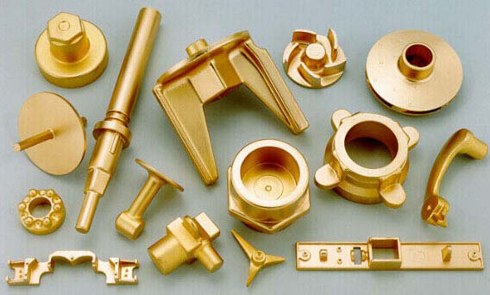
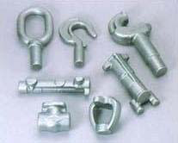
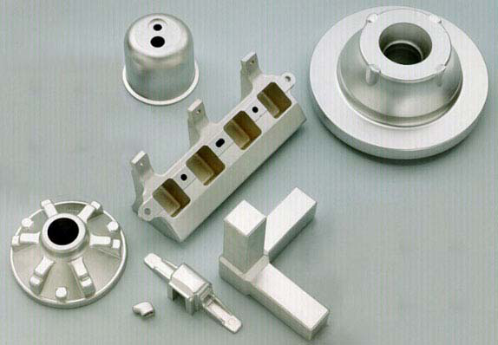
Forging
Forging is a deformation process in which the workpiece is compressed between two dies, using either impact or gradual pressure to form the part.
Oldest of the metal forming operations.
Components: engine crankshafts, connecting rods, gears, aircraft structural components, jet engine turbine parts.
Also, basic metals industries use forging to establish basic form of large parts that are subsequently machined to final shape and size.

Slide 3
Classification of forging process
Forging is carried out in many different ways. One way to classify it is by working temperature. Most forging operations are performed hot or warm. However, cold forging is also vary common for certain product in order to increase the strength.
Either impact or gradual pressure is used in forging. The distinction derives more from the type of equipment used than differences technology:
    Forge hammer -applies an impact load
    Forge press -applies gradual pressure
Another difference among forging operations is the degree to which the flow of the workpiece metal is constrained by the dies:
    Open-die forging
    Impression-die forging
    Flashless

Slide 4
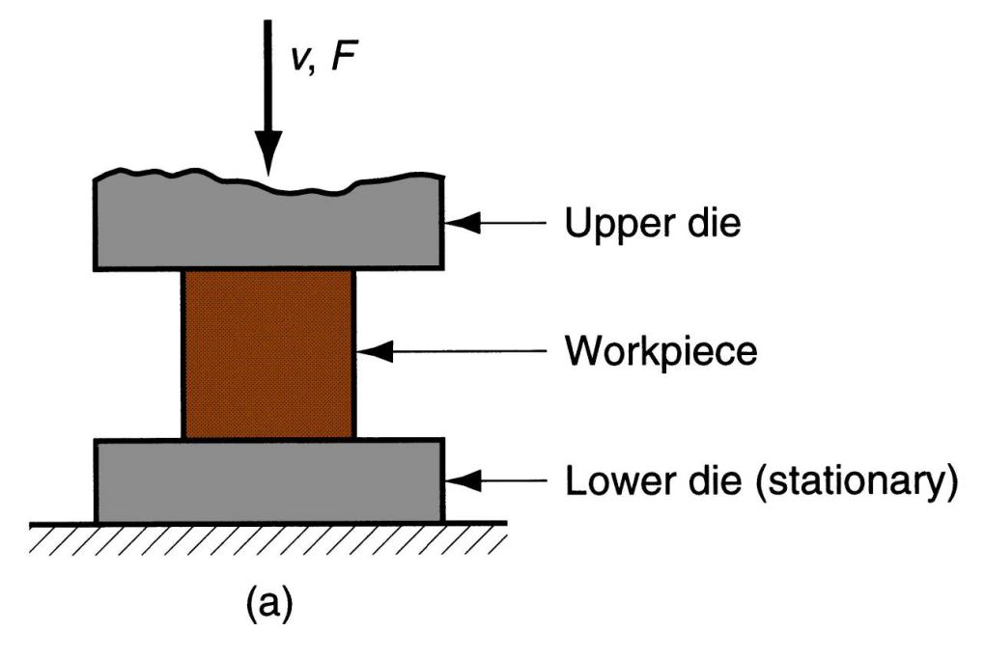
Open Die Forging
Compression of workpiece between two flat dies.
Similar to compression test when work part has cylindrical cross section and is compressed along its axis.
Deformation operation reduces height and increases diameter of work.
Common names include upsetting or upset forging.

Slide 5

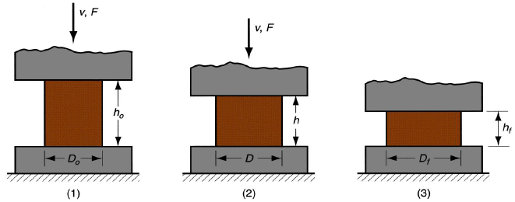
Open die forging with no friction
no friction occurs between work and die surfaces
homogeneous deformation
radial flow is uniform throughout workpiece height

Slide 6


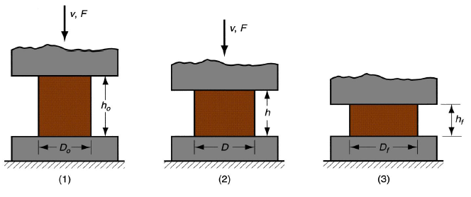
Open die forging with no friction-Force

Slide 7
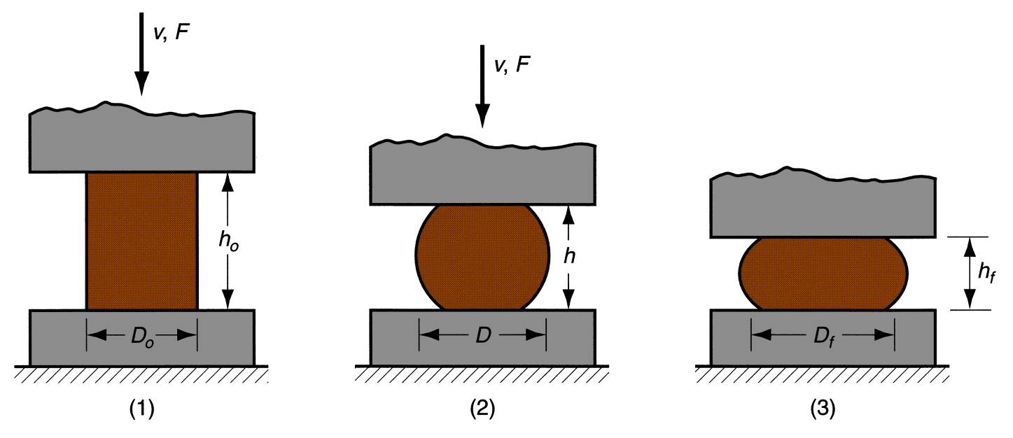
Open die forging with friction
An actual upsetting operation does not occur quite as shown before because friction opposes the flow of workpiece metal at the die surface. This creates the barreling effect
In hot open-die forging, barreling effect is even more pronounced due to heat transfer. This result from a higher coefficient of friction typical in hot working at and near die surfaces, which cools the metal and increases its resistance to deformation.

Slide 8
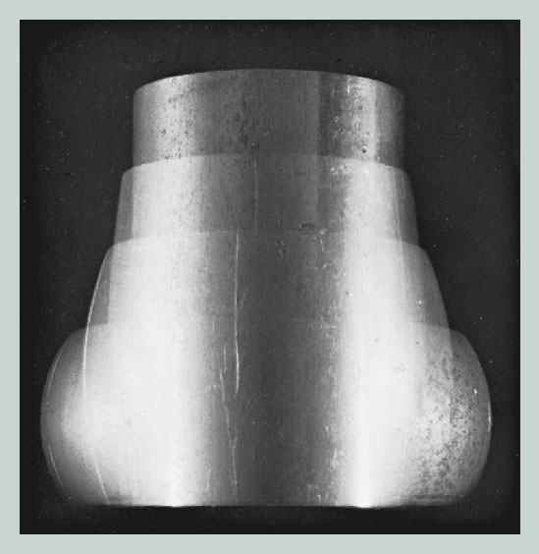
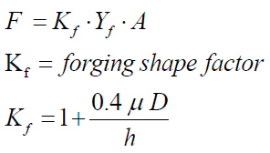
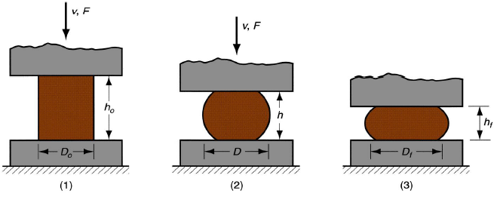
Open die forging with friction-Force
This factor cause the actual upsetting force to be greater than what is predicted. As an approximation we can apply a shape factor to account for effects of the D/h ratio and friction.

Slide 9
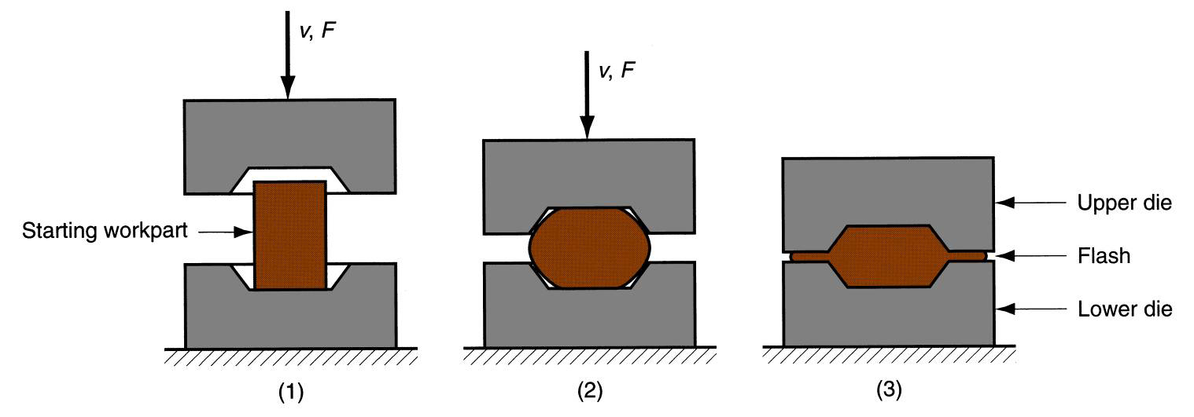
Impression die forging
Impression die forging is performed with dies that contain the inverse of the desired shape of the part.
As the die closes to its final position, flash is formed by metal that flows beyond the die cavity and into the small gap between the die plates.
Flash must be later trimmed, but it serves an important function during compression:
  constraining material to fill die cavity (friction)
  cooling against die plates

Slide 10
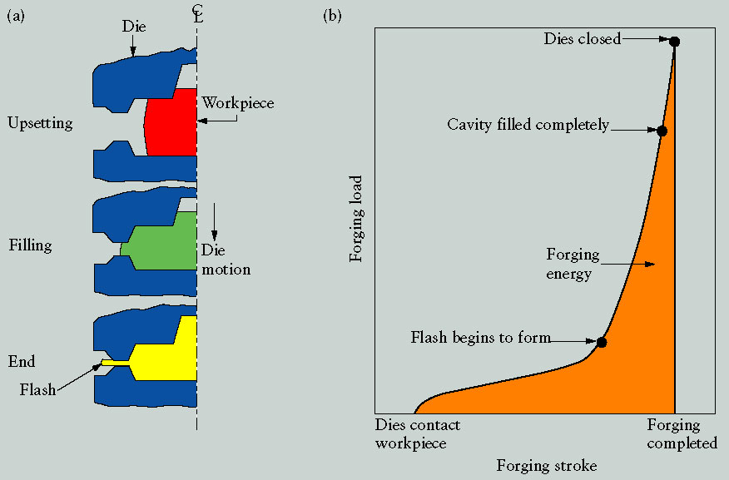

Impression die forging - Force
because of flash formation in impression die forging the forces are significantly greater and more difficult to analyze than in open die forging.
Part shape | K_{fi} | Part shape | K_{ff}
Impression die forging |  | Flashless forging
Simple shapes with flash | 6 | Coining (Top and bottom surface) | 6
Complex shapes with flash | 8 | Complex shapes | 5
Very complex shapes with flash | 10

Slide 11
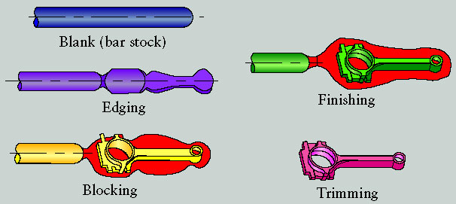
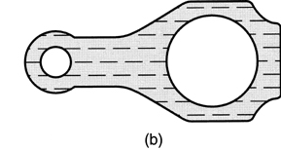
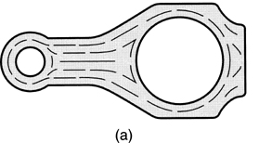
Impression die forging – connecting rod
machining
forging + machining

Slide 12
Advantages and limitations
Advantages of forging compared to machining the part completely:
Higher production rates.
Less waste of metal.
Greater strength.
Favorable grain orientation in the metal.
Limitations:
Not capable of close tolerances.
Machining often required to achieve accuracies and features needed.

Slide 13
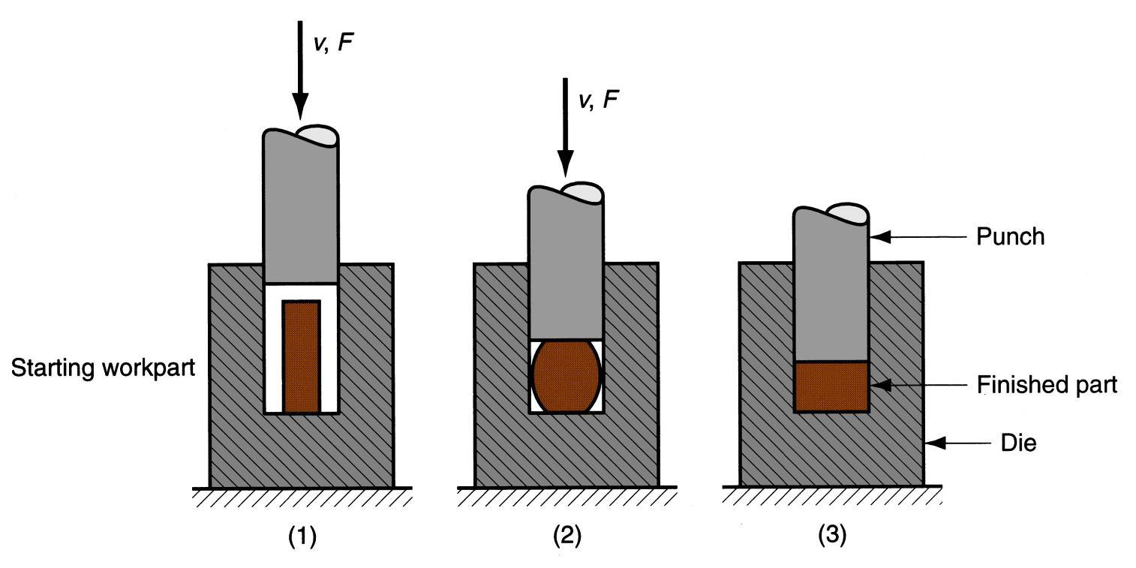
Flashless forging
Compression of work in punch and die tooling whose cavity does not allow for flash.
Starting workpart volume must equal die cavity volume within very close tolerance.
Process control more demanding than impression-die forging.
Best suited to part geometries that are simple and symmetrical.
Often classified as a precision forging process.

Slide 14
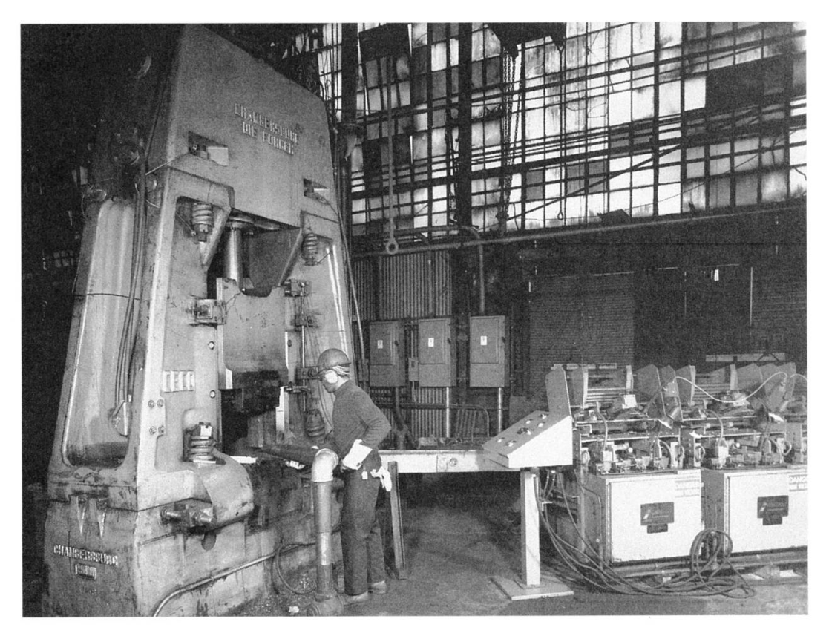
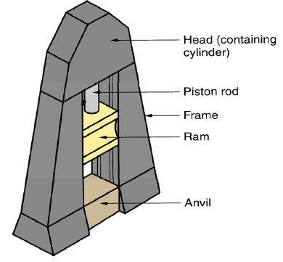
Forging Hammers (Drop Hammer)
Apply impact load against workpart
Two types: Gravity drop hammers and Power drop hammers
Disadvantage: impact energy transmitted through anvil into floor of building
Commonly used for impression-die forging

Slide 15
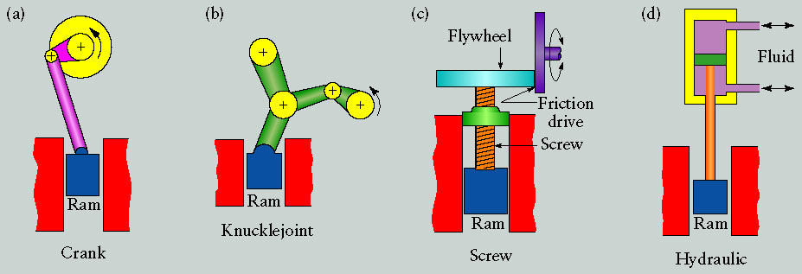
Forging presses
Apply gradual pressure to accomplish compression operation
Types:-
Mechanical press -converts rotation of drive motor into linear motion of ram.
Hydraulic press -hydraulic piston actuates ram.
Screw press -screw mechanism drives ram.

Slide 16
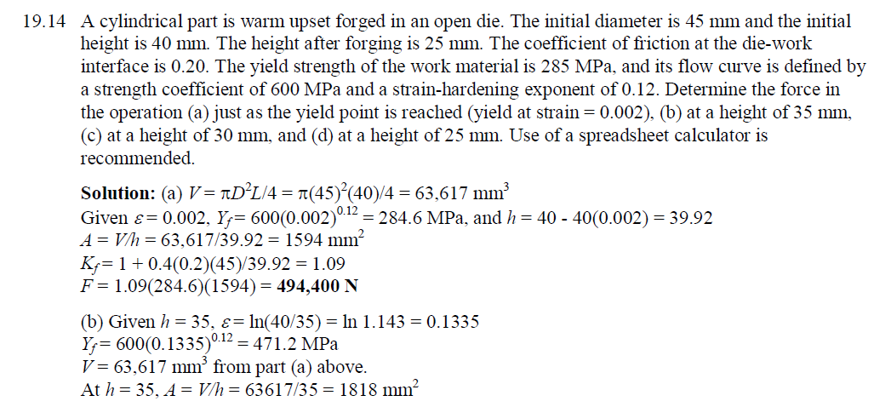

Slide 17
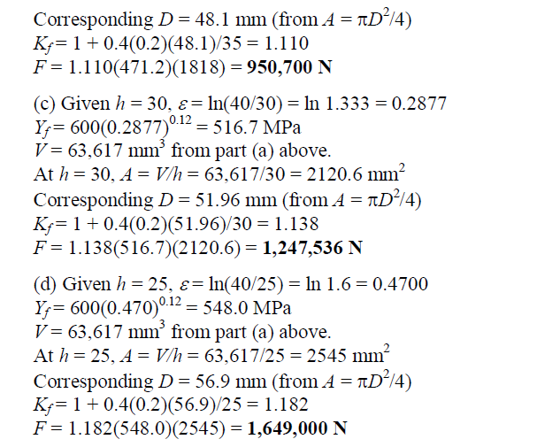

Slide 18
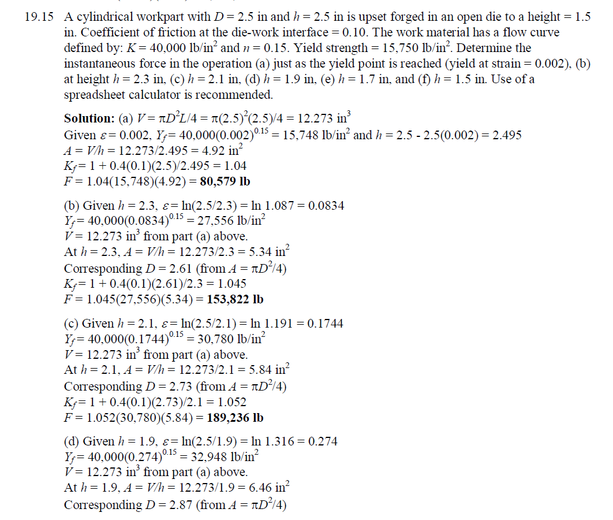

Slide 19
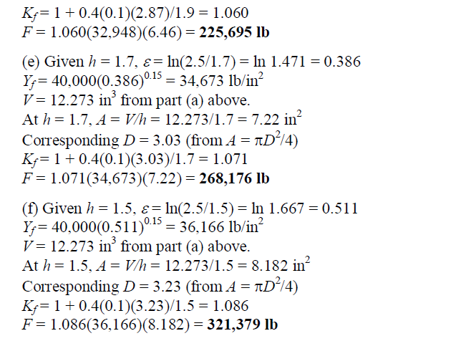

Slide 20
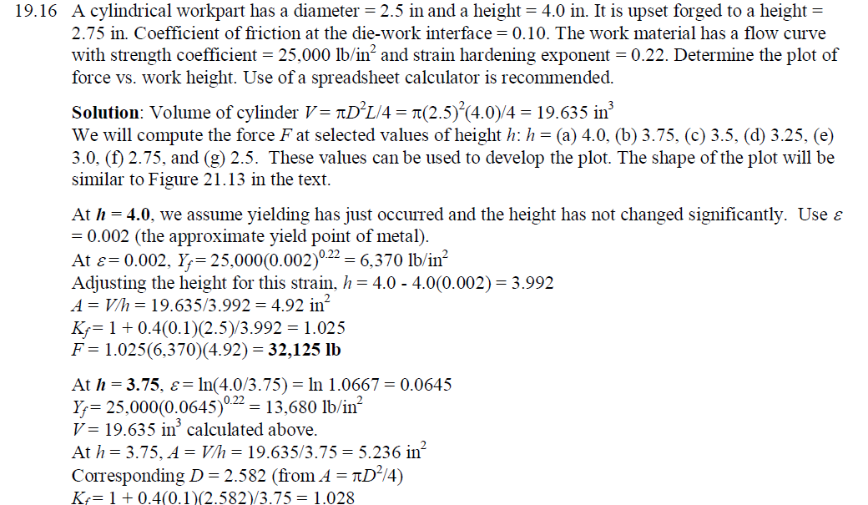

Slide 21
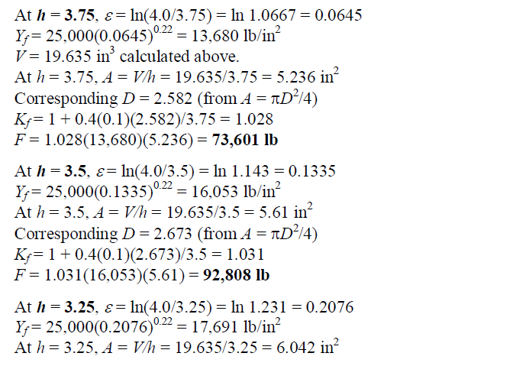

Slide 22
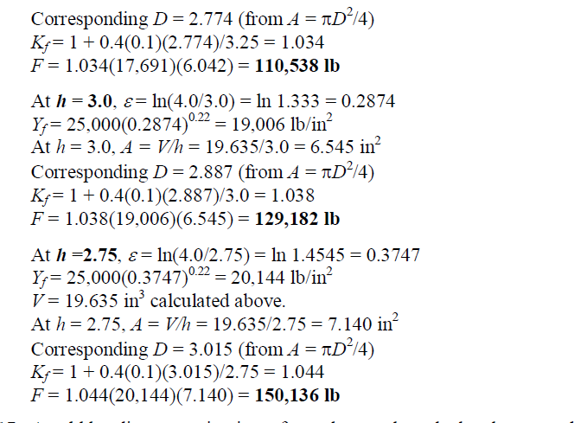

Slide 23
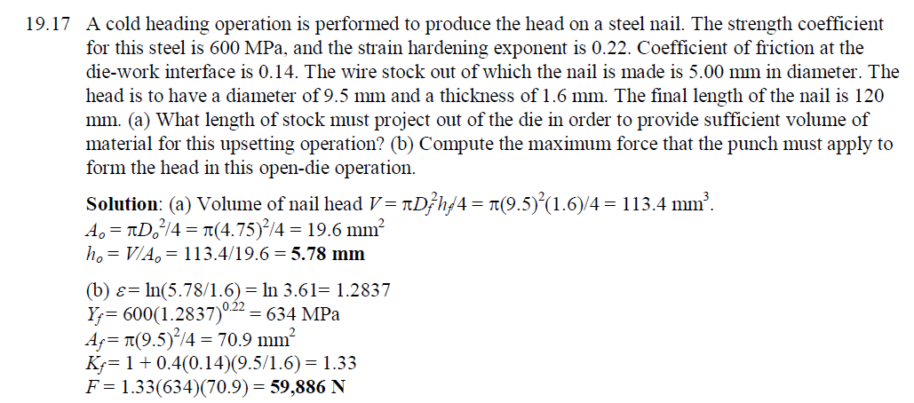

Slide 24
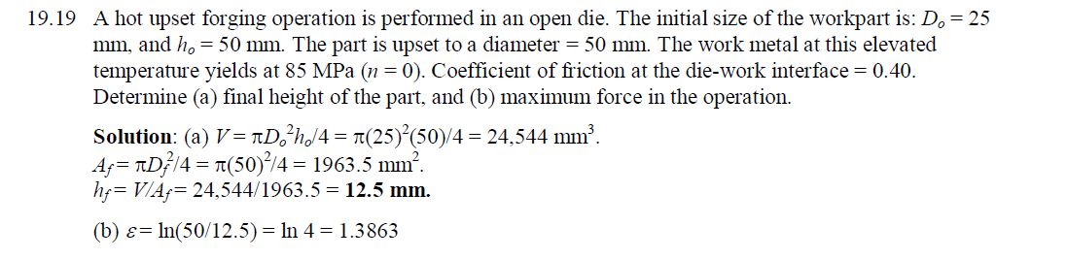

Slide 25
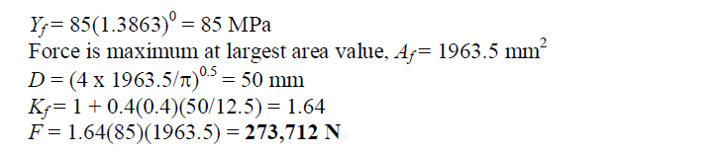

Slide 26
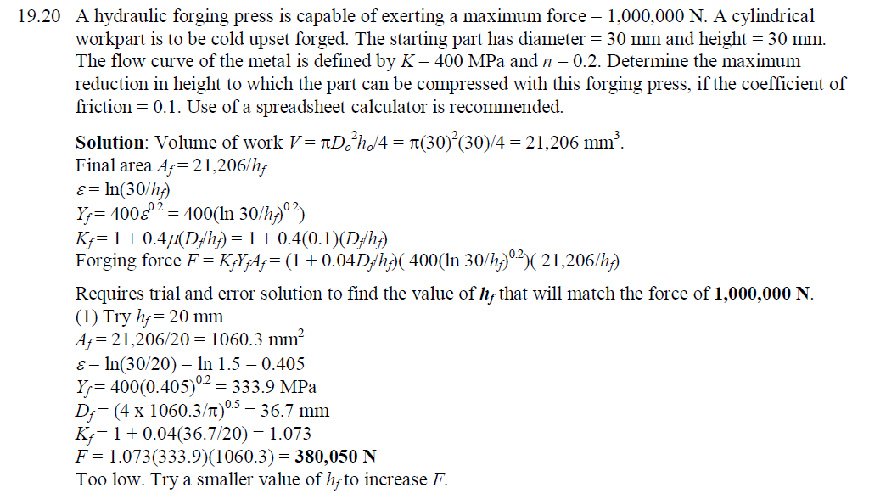

Slide 27
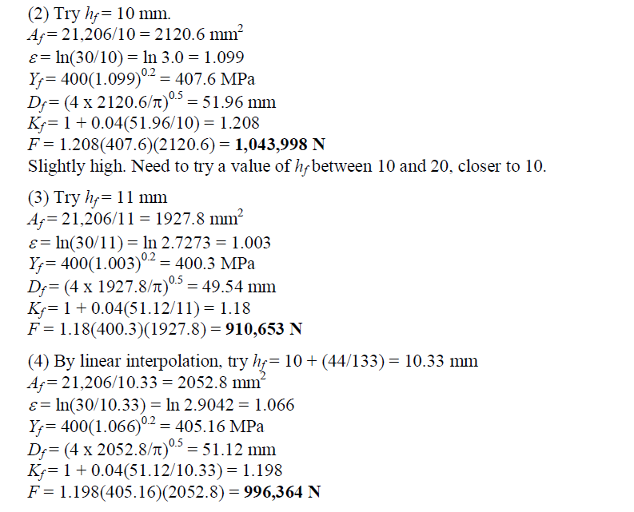

Slide 28
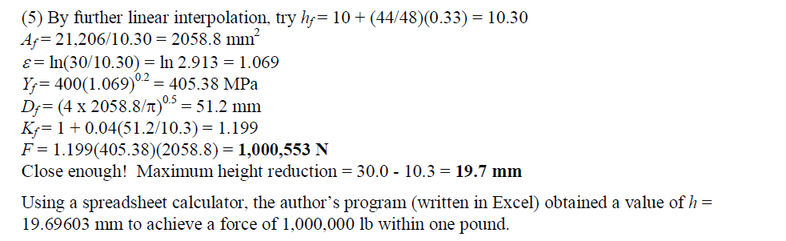

Slide 29
