Slide 1
Manufacturing Engineering II
CHAPTER 2.5
Extrusion (Bulk deformation Process)
(AAiT)
LECTURER :DR Shanthakumar G C

Slide 2
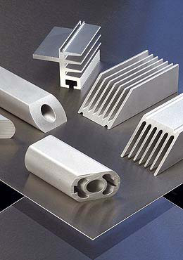
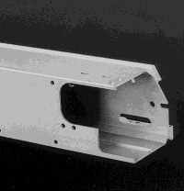
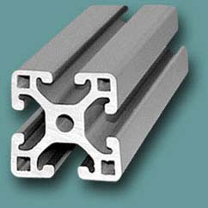
Extrusion
Compression forming process in which work metal is forced to flow through a die opening to produce a desired cross-sectional shape
In general, extrusion is used to produce long parts of uniform cross sections
Two basic types:
Direct extrusion
Indirect extrusion

Slide 3
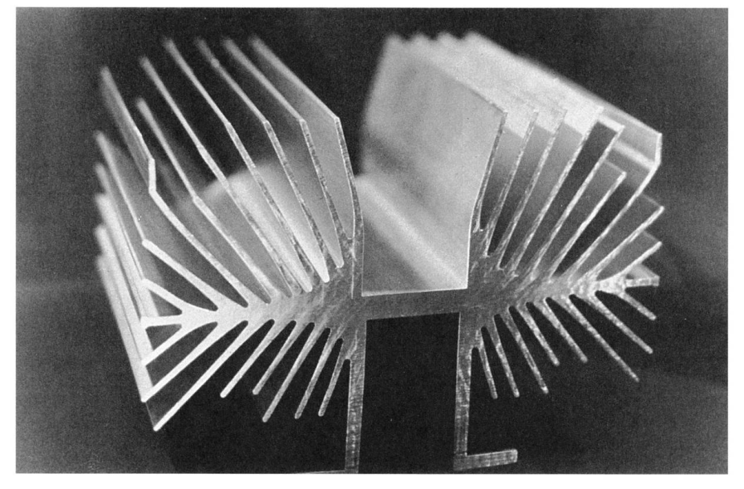
Extrusion
Advantages:
a variety of shapes are possible, especially with hot extrusion; however a limitation of the geometry is that thee cross section of the part must be uniform throughout its extruded length;
grain structure and strength properties are enhanced in cold and warm extrusion;
fairly close tolerances are possible, especially in cold extrusion;
in some extrusion operations, little or no wasted material is created
A complex extruded cross section for a heat sink.

Slide 4
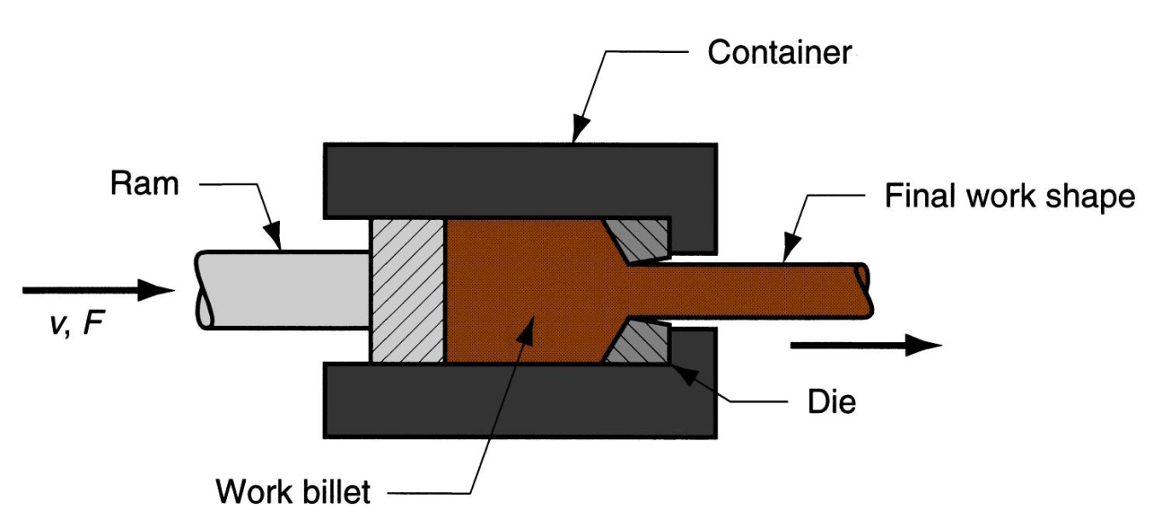
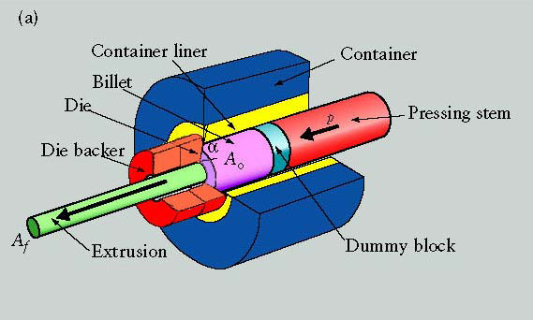
Direct Extrusion
A metal billet is loaded into a container, and a ram compresses the material, forcing to flow through one or more openings in a die at the opposite end of the container. At the ram, a small portion of the billet remains that cannot be forced through the die opening.
In direct extrusion significant friction exists between the work surface and the walls of the container as the billet is forced to slide toward the die opening. This friction causes a substantial increase in the ram force required in direct extrusion.

Slide 5
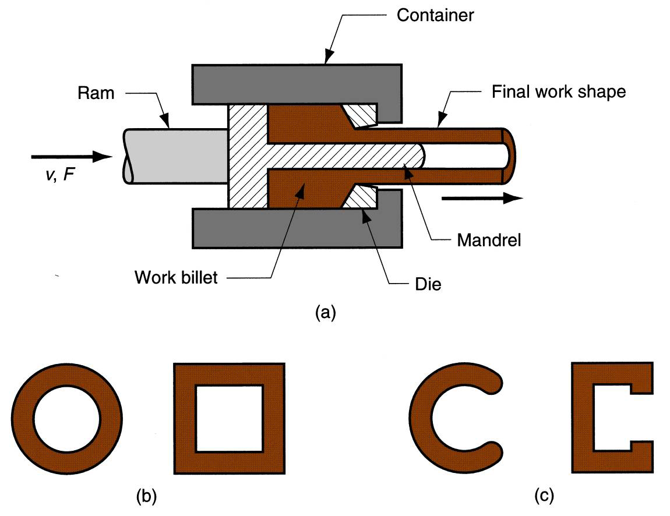
Hollow and semi hollow shapes
Hollow sections (tubes) are possible in direct extrusion by the process setup. The starting billet is prepared with a hole parallel to its axis. This allows passage of a mandrel and the die opening. The resulting cross section is tubular. Semi hollow cross-sectional shapes are usually extruded in the same way.

Slide 6
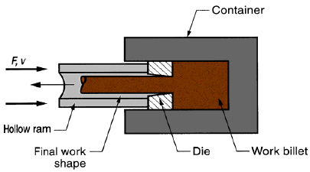
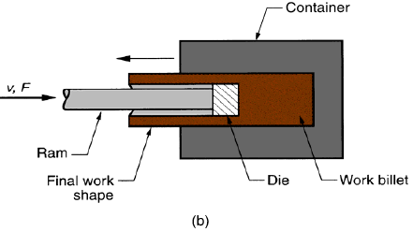
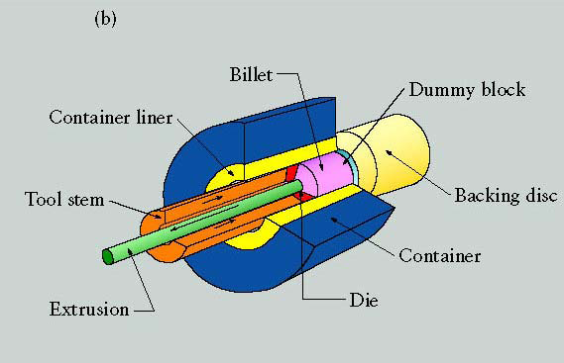
Indirect Extrusion
The die is mounted to the ram rather than at the opposite end of the container. As the ram penetrates into the workpiece, the metal is forced to flow through the clearance in a direction opposite to the motion of the ram.
Since the billet is not forced to move relative to the container, there is no friction at the container walls, and the ram force is therefore lower than in direct extrusion.

Slide 7
Comments on Indirect Extrusion
Limitations of indirect extrusion process are imposed by the lower rigidity of the ram and the difficulty in supporting the extruded product as it exist in the die.

Slide 8
Hot vs. Cold Extrusion
Extrusion can be performed either hot or cold, depending on work metal and amount of strain to which it is subjected during deformation.
Metals that are typically extruded hot included:
aluminum, copper, magnesium, zing and their alloy. These metals are sometimes extruded cold.
Steel alloy are usually extruded hot.
Hot extrusion - prior heating of billet to above its recrystallization temperature:
• reduces strength and increases ductility of the metal, permitting more size reductions and more complex shapes, reduction of ram forces, increased ram speed.
Cold extrusion - generally used to produce discrete parts
• increased strength due to strain hardening, closed tolerances, improved surface finish, absence of oxide layers, high production rates.

Slide 9
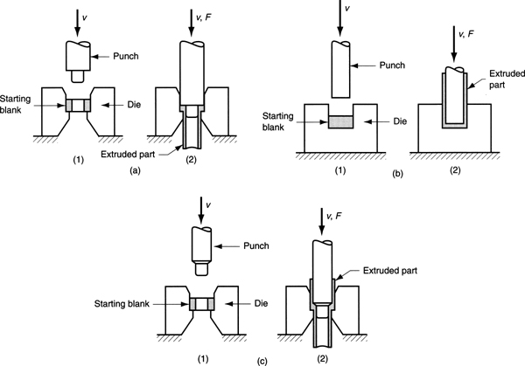
Other extrusion process: Impact extrusion
Impact extrusion is performed at higher speeds and shorter strokes than conventional process. It is used to make individual components.
Impact can be carried out as forward extrusion, backward extrusion or combinations of these.

Slide 10
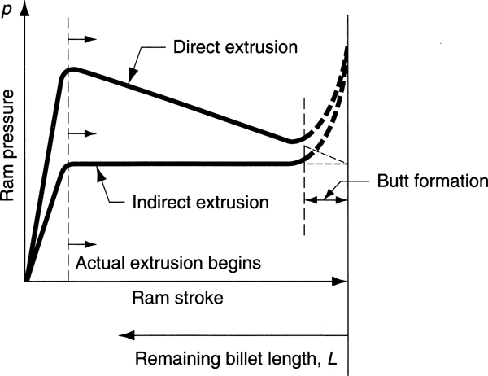
Direct or Indirect Extrusion Pressure with friction
In the second part for direct extrusion process the pressure decrease because decrease the contact surface (and so the friction) between the part and the container walls
In the first part the pressure increase until the whole container cavity s filled by the workpiece

Slide 11
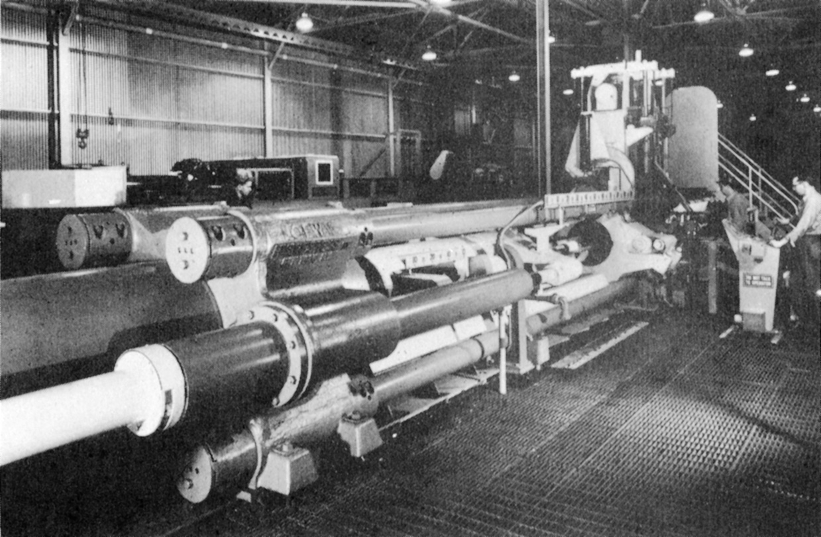
Hydraulic Extrusion Presses

Slide 12
ANALYSIS OF EXTRUSION

Slide 20
Our previous equations for ram pressure, Eqs. (19.23a), p =Yf ex apply to a circular die orifice. The shape of the die orifice affects the ram pressure required to perform an extrusion operation.
A complex cross section, such as the one shown in Figure 19.36,
requires a higher pressure and greater force than a circular shape. The effect of the die orifice shape can be assessed by the die shape factor,
defined as the ratio of the pressure required to extrude a cross section of a given shape relative to the extrusion pressure for a round cross section of the same area.
We can express the shape factor as follows:

Slide 23
FIGURE 19.36 A complex extruded cross section for a heat sink. (Photo courtesy of Aluminum Company of America, Pittsburg, Pennsylvania.)

Slide 26
Example 2. A cylindrical billet that is 100 mm long and 50 mm in diameter is reduced by indirect (backward) extrusion to a 20 mm diameter. The die angle is 90°. The Johnson equation has a = 0.8 and b = 1.4, and the flow curve for the work metal has a strength coefficient of 800 MPa and strain hardening exponent of 0.13. Determine (a) extrusion ratio, (b) true strain (homogeneous deformation), (c) extrusion strain, (d) ram pressure, and (e) ram force.
Solution:
(a)Extrusion Ratio= rx = Ao/Af = Do²/Df² = (50)²/(20)² = 6.25
(b) True strain ε = ln rx = ln 6.25 = 1.833
(c) True strain=Homogeneous deformation=εx = a + b ln rx = 0.8 + 1.4(1.833) = 3.366
(d) Ram Pressure=Y f = Kε^{n}/(1+n) 800(1.833)^{0.13}/1.13 = 766.0 MPa
p = (Ram Pressure ) x (True strain)=766.0(3.366) = 2578 MPa
(e) Ao = πDo²/4 = π(50)²/4 = 1963.5 mm²
F = (Ram Pressure)x( Ao)=2578(1963.5) = 5,062,000 N

Slide 27
Example 3.A billet that is 75 mm long with diameter = 35 mm is direct extruded to a diameter of 20 mm. The extrusion die has a die angle = 75°. For the work metal, K = 600 MPa and n = 0.25. In the Johnson extrusion strain equation, a = 0.8 and b = 1.4. Determine (a) extrusion ratio, (b) true strain (homogeneous deformation), (c) extrusion strain, and (d) ram pressure and force at L = 70, 60, 50, 40, 30, 20, and 10 mm. Use of a spreadsheet calculator is recommended for part (d).
Solution: (a) rx = Ao/Af = Do 2/Df 2 = (35)2/(20)2 = 3.0625
(b) ε = ln rx = ln 3.0625 = 1.119
(c) εx = a + b ln rx = 0.8 + 1.4(1.119) = 2.367
d) Y f = 600(1.119)0.25/1.25 = 493.7 MPa
Ao = π(35)²/4 = 962.1 mm²

Slide 28
It is appropriate to determine the volume of metal contained in the cone of the die at the start of the extrusion operation, to assess whether metal has been forced through the die opening by the time the billet has been reduced from L = 75 mm to L = 70 mm.
For a cone-shaped die with angle = 75°, the height h of the frustum is formed by metal being compressed into the die opening:
The two radii are: R1 = 0.5Do = 17.5 mm and R2 = 0.5Df = 10 mm, and h = (R1 - R2)/tan 75 = 7.5/tan 75 = 2.01 mm
Frustum volume V = 0.333πh(R1 ² + R1R2 + R2²) = 0.333π(2.01)(17.52 + 10 x 17.5 + 102) = 1223.4 mm³.
Compare this with the volume of the portion of the cylindrical billet between L = 75 mm and L = 70 mm.
V = πDo² h/4 = 0.25π(35)²(75 - 70) = 4810.6 mm³
Since this volume is greater than the volume of the frustum, this means that the metal has extruded through the die opening by the time the ram has moved forward by 5 mm.

Slide 29
L = 70 mm: pressure p = 493.7(2.367 + 2 x 70/35) = 3143.4 MPa
Force F = 3143.4(962.1) = 3,024, 321 N
L = 60 mm: pressure p = 493.7(2.367 + 2 x 60/35) = 2861.3 MPa
Force F = 2861.3(962.1) = 2,752,890 N
L = 50 mm: pressure p = 493.7(2.367 + 2 x 50/35) = 2579.2 MPa
Force F = 2579.2(962.1) = 2,481,458 N
L = 40 mm: pressure p = 493.7(2.367 + 2 x 40/35) = 2297.1 MPa
Force F = 2297.1(962.1) = 2,210,027 N
L = 30 mm: pressure p = 493.7(2.367 + 2 x 30/35) = 2014.9 MPa
Force F = 2014.9(962.1) = 1,938,595 N
L = 20 mm: pressure p = 493.7(2.367 + 2 x 20/35) = 1732.8 MPa
Force F = 1732.8(962.1) = 1,667,164 N
L = 10 mm: pressure p = 493.7(2.367 + 2 x 10/35) = 1450.7 MPa
Force F = 1450.7(962.1) = 1,395,732 N

Slide 30
Example 4.A 3.0-in-long cylindrical billet whose diameter = 1.5 in is reduced by indirect extrusion to a diameter = 0.375 in. Die angle = 90°. In the Johnson equation, a = 0.8 and b = 1.5. In the flow curve for the work metal, K = 75,000 lb/in² and n = 0.25. Determine (a) extrusion ratio, (b) true strain (homogeneous deformation), (c) extrusion strain, (d) ram pressure, (e) ram force, and (f) power if the ram speed = 20 in/min
Solution: (a) rx = Ao/Af = Do²/Df² = (1.5)²/(0.375)² = 42 = 16.0
(b) ε = ln rx = ln 16 = 2.773
(c) εx = a + b ln rx = 0.8 + 1.5(2.773) = 4.959
(d) Y f = 75,000(2.773)0.25/1.25 = 77,423 lb/in²
p = 77,423(4.959) = 383,934 lb/in²
(e) Ao = πDo²/4 = π(1.5)²/4 = 1.767 in²
F = (383,934)(1.767) = 678,411 lb.
(f) P = 678,411(20) = 13,568,228 in-lb/min
HP = 13,568,228/396,000 = 34.26 hp

Slide 31
Example 5.An L-shaped structural section is direct extruded from an aluminum billet in which Lo = 500 mm and Do = 100 mm. Dimensions of the cross section are given in Figure 19.29. Die angle = 90°. Determine (a) extrusion ratio, (b) shape factor, and (c) length of the extruded section if the butt remaining in the container at the end of the ram stroke is 25 mm.

Slide 32
Solution:
(a) Extrusion Ratio=rx = Ao/Af
Ao = π(100)²/4 = 7854 mm²
Af = 2(12 x 50) = 1200 mm²
rx = 7854/1200= 6.545
(b) To determine the die shape factor we need to determine the perimeter of a circle whose area is equal to that of the extruded cross section, A = 1200 mm². The radius of the circle is R = (1200/π)0.5
= 19.54 mm, Cc = 2π(19.54) = 122.8 mm.
The perimeter of the extruded cross section Cx = 62 + 50 + 12 + 38 + 50 + 12 = 224 mm
Kx = 0.98 + 0.02(224/122.8)2.25 = 1.057
(c) Total original volume V = 0.25π(100)2(500) = 3,926,991 mm3

Slide 33
The final volume consists of two sections: (1) butt, and (2) extrudate.
The butt volume V1 = 0.25π(100)²(25) = 196,350 mm³.
The extrudate has a cross-sectional area Af = 1200 mm².
Its volume V2 = LAf = 3,926,991 - 196,350 = 3,730,641 mm3.
Thus, length L = 3,730,641/1200 = 3108.9 mm = 3.109 m
Example 6:A cup-shaped part is backward extruded from an aluminum slug that is 50 mm in diameter. The final dimensions of the cup are: OD = 50 mm, ID = 40 mm, height = 100 mm, and thickness of base = 5 mm. Determine (a) extrusion ratio, (b) shape factor, and (c) height of starting slug required to achieve the final dimensions. (d) If the metal has flow curve parameters K = 400 MPa and n = 0.25, and the constants in the Johnson extrusion strain equation are: a = 0.8 and b = 1.5, determine the extrusion force.

Slide 34
Solution: (a) rx = Ao/Af
Ao = 0.25π(50)² = 1963.75 mm²
Af = 0.25π(50² - 40²) = 706.86 mm2
rx = 1963.75/706.86 = 2.778
(b) To determine the die shape factor we need to determine the perimeter of a circle whose area is equal to that of the extruded cross section, A = 706.86 mm². The radius of the circle is R = (706.86/π)0.5 = 15 mm, Cc = 2π(15) = 94.25 mm.
The perimeter of the extruded cross section Cx = π(50 + 40) = 90π = 282.74 mm.
Kx = 0.98 + 0.02(282.74/94.25)2.25 = 1.217

Slide 36
Example 7. The flow curve parameters for the aluminum alloy of Problem 19.29 are: K = 240 MPa and n = 0.16. If the die angle in this operation = 90°, and the corresponding Johnson strain equation has constants a = 0.8 and b = 1.5, compute the maximum force required to drive the ram forward at the start of extrusion.
Solution: From Example 6 above , rx = 5.068

Slide 39
Example 8. The following structural section is indirect extruded from an aluminium billet with initial length Lo of 100 mm and diameter Do 0f 120 mm Dimensions of the cross section are given in figure and die opening angle is 90⁰.Consider the Johnson equation (For extrusion strain εx = [a+b ln(Rx)] has the constants a and b of 0.8 and 1.4 respectively and the flow curve for the work metal has strength coefficient of 400 Mpa and strain hardening exponent of 0.13.Evaluate
a) Extrusion ratio
b) True strain (Homogeneous deformation)
c) Extrusion strain( Johnsons equation
Average Ram Force
Extrusion Ratio Rx= Ao/Af
Therefore,
Ao=πDo²/4 =(π x120²)/4=11309.7 mm²

Slide 40
Af=2x (80+10)+(60x10)+2x (5x10)+2X[π(10²-5²)]/4=
Af=1600+600+100+235.6 mm2
Extrusion Ratio=Rx= Ao/Af=11309.7/2535.6=4.46
B. True Strain (Homogeneous deformation
ε = ln Rx =ln 4.46=1.49
εx=Extrusion strain (Johnsons Equation )=(a+blnRx)
εx =0.8+1.4(1.49)=2.89
Y f = Kε^{n}/(1+n) =400X1.49 ^{0.13}/(1+0.13)=372.8 Mpa
Ram Pressure P=Y f(εx )= 372.8(2.89)=1077.4Mpa
C Average Ram Force=P Ao=1077.4+11309.7=12MN
D.Length of the Extruded sections if the butt remaining in the container at end of the ram stroke is 25mm
Volume of the initial=Volume of the Final
AoLo=AfLf+(AoLo)
11309.7x100=2535.6xLf+11309.7x25
1130970=2535.6Lf+28740
Lf=848230/2535.6=334.4 mm

