Slide 1
Examples
Chapter Three – Compressible Flow
By Dawit M.

Slide 2
Outline
Example 1: Mach Number of Air Entering a Diffuser
Example 2: Gas Flow through a C-D Nozzle
Example 3: Critical P and T in a Gas Flow
Example 4: Effect of Back Pressure on Mass Flow Rate
Example 5: Airflow through C-N Nozzle
Example 6: Shock Wave in C-D Nozzle

Slide 3
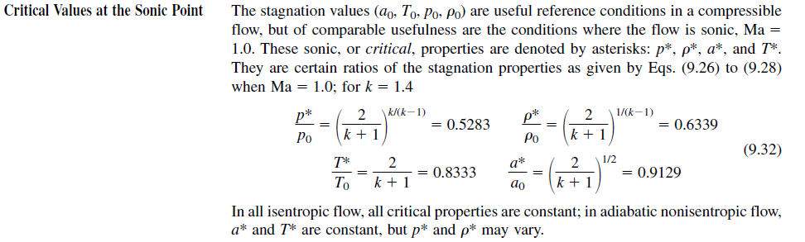
Important Relations

Slide 4
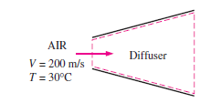
Example 1: Mach Number of Air Entering a Diffuser
1. Air enters a diffuser shown in Fig. with a velocity of 200 m/s. Determine:
the speed of sound and
the Mach number at the diffuser inlet when the air temperature is 30°C.

Slide 5
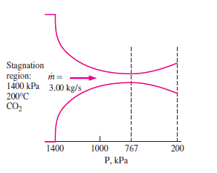
Example 2: Gas Flow through a C-D Nozzle
2. Carbon dioxide flows steadily through a varying cross-sectional area duct such as a nozzle shown in Fig. at a mass flow rate of 3 kg/s. The carbon dioxide enters the duct at a pressure of 1400 kPa and 200°C with a low velocity, and it expands in the nozzle to a pressure of 200 kPa. The duct is designed so that the flow can be approximated as isentropic. Determine the density, velocity, flow area, and Mach number at each location along the duct that corresponds to a pressure drop of 200 kPa.
Cp = 0.846kJ/kgK
k = 1.289
R = 0.1889kJ/kgK

Slide 6
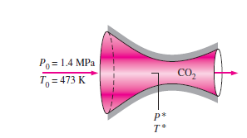
Example 3: Critical P and T in a Gas Flow
3. Calculate the critical pressure and temperature of carbon dioxide for the flow conditions described in Example 2.

Slide 7
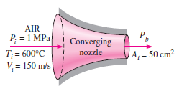
Example 4: Effect of Back Pressure on Mass Flow Rate
4. Air at 1 MPa and 600°C enters a converging nozzle, shown in Fig., with a velocity of 150 m/s. Determine the mass flow rate through the nozzle for a nozzle throat area of 50 cm² when the back pressure is:
0.7 Mpa and
0.4 MPa.

Slide 8
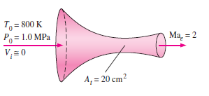
Example 5: Airflow through C-D Nozzle
5. Air enters a converging–diverging nozzle, shown in Fig., at 1.0 Mpa and 800 K with a negligible velocity. The flow is steady, one-dimensional, and isentropic with k = 1.4. For an exit Mach number of Ma = 2 and a throat area of 20 cm², determine:
(a) the throat conditions,
(b) the exit plane conditions, including the exit area, and
(c) the mass flow rate through the nozzle.

Slide 9
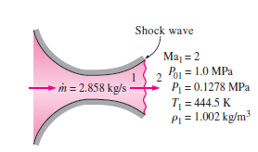
Example 6: Shock Wave in C-D Nozzle
6. If the air flowing through the converging–diverging nozzle of Example 5 experiences a normal shock wave at the nozzle exit plane, determine the following after the shock:
the stagnation pressure, static pressure, static temperature, and static density;
the entropy change across the shock;
the exit velocity; and
(d) the mass flow rate through the nozzle.
Assume steady, one-dimensional, and isentropic flow with k = 1.4 from the nozzle inlet to the shock location.

Slide 10
Thank You!
Any Questions?

