Slide 1
2-D Potential Flow Theory
Introduction, def., some basic concepts
General governing Eqns; reduced forms,
Solving the Potential Flow
Velocity potential function, Laplace eqn
Stream function, Laplace eqn
Superposition of elementary potential flow models;
Examples:
Uniform Flow and Source Flow
Uniform Flow and Source / Sink Pair: The Rankine Oval
Uniform Flow and Doublet: Non-lifting flow over a circular cylinder
Uniform Flow, Doublet and Free Vortex: Lifting flow over a circular cylinder
Conclusion : The Kutta – Joukowski Thm

Slide 2
The General Eqns of Fluid Dynamics

Slide 3
Recall that: The General Eqns of Fluid Dynamics
… were developed based on conservation laws:
mass conservation:
→ continuity eqn.
momentum conservation /Newton’s 2nd Law:
→ momentum eqn.
angular momentum conservation
→ angular momentum eqn.
energy conservation /1st Law of Thermo:
→ energy eqn.

Slide 4
Recall the Two Approaches used to Develop the Eqns.
Integral Approach
in which the size of the CV is finite
Differential Approach
in which the size of the CV is infinitesimally small

Slide 5
Recall the Two Approaches used to Develop the Eqns…
the integral approach is used when we seek an estimate of ‘gross’ effects over a finite flow region (e.g., estimates of mass flow, induced force, energy/power involved).
whereas, …

Slide 6
Recall the Two Approaches used to Develop the Eqns…
….
The differential approach is used when we seek the point-by-point details of a flow pattern by analyzing an infinitesimal region of a flow, i.e., when we seek ‘local’ values

Slide 7
General
Integral Governing Eqns

Slide 8

General Continuity Eqn. - integral form

Slide 9

General Linear Momentum Eqn - integral form
where
V is fluid velocity relative to an inertial (non-accelerating coordinate system,
ΣF is the vector sum of all forces acting on the CV material considered as a free body
ΣF = ΣF_{body forces} + ΣF_{surface forces}

Slide 10
General ……… Eqn - integral form
etc …
Please refer to e.g., Frank M. White, for the remaining integral eqns

Slide 11
General
Differential Governing Eqns.

Slide 12



kinematics aspect of a flow (in Cartesian co-ord.)
The velocity field:
The acceleration field
x-component
i.e.,
The total acc. field

Slide 13

The total time derivative may also be applied to any other dependent variable; e.g., the pressure:
N.B.
Wherever convective effects occur, the differential eqns. become non-linear, thus making them too complicated to solve them.

Slide 14
General Differential Continuity Eqn

Slide 15
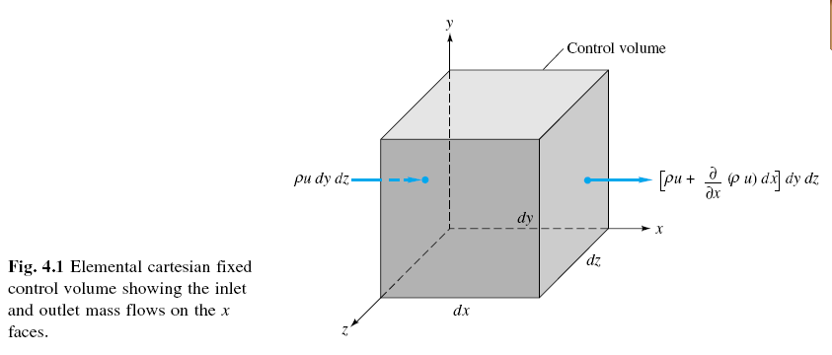
General Continuity Eqn. – diff approach
(Ref., Frank W. White)
Consider:

Slide 16


General Continuity Eqn. – diff approach…
Calculating the net mass flux across all the six faces of the fixed diff. CV, and
applying mass conservation principle, we get the following continuity eqn.:
It is named ‘continuity’ eqn. because there is no underlying assumption except the continuum concept.
The same eqn. can be written in compact form as follows:

Slide 17
General Continuity Eqn. – diff approach…
Alternatively,
Integral continuity eqn. written for finite CV: ⇒
Applying Gauss Divergence Thm to the convective term: ⇒
Substitute this for the convective term ⇒
Let the size of the finite control volume approach infinitesimal, ⇒
which is the same as the previous expression ⇒

Slide 18
General Continuity Eqn. – diff approach…
Please refer to, e.g., Frank M. White for the rest of the eqns, including when other coordinate systems are used to describe the flow.

Slide 19
General Linear Momentum Eqn. – differential form

Slide 20
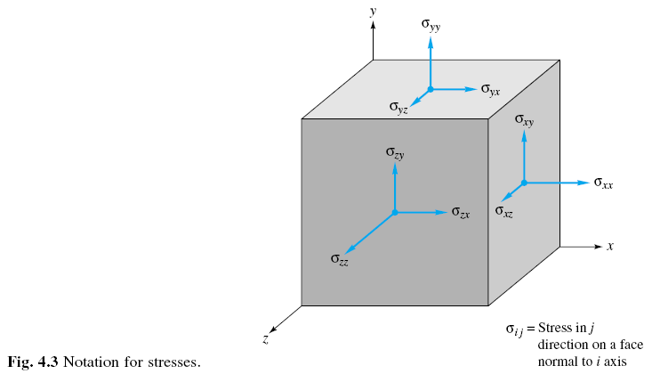
General Linear Momentum Eqn.. – diff. form
Consider:

Slide 21
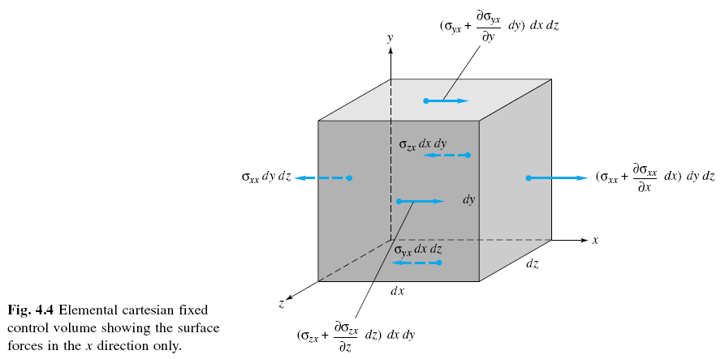
General Linear Momentum Eqn.. – diff. form
and this fig.:-

Slide 22

General Linear Momentum Eqn.– diff. form
Ref. to the fixed CV, with inlet and outlet momentum fluxes as shown in the last slides, and remembering Newton’s 2nd Law:
Net force = rate of change of linear momentum of the system instantly located in the CV, i.e.,

Slide 23
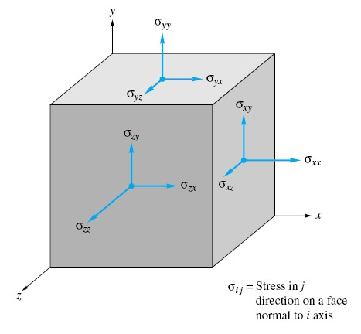
General Linear Momentum Eqn.. – diff. form …
∑ F : is the sum of body force and surface forces.
the body force,
dF_{grav} =ρg (dx dy dz)
In general, the surface forces are due to pressure (p) and due to viscous stresses (τ_{ij}) which arise from motion with velocity gradients on the sides of the CV.

Slide 24
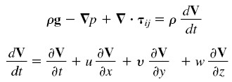
General Linear Momentum Eqn.. – diff. form …
substituting for ΣF in the Newton’s eqn, we obtain the basic momentum eqn. for a general flow., in compact form:
where,
In words, the vector eqn. says:-
Gravity force/unit volume - pressure force/unit volume + viscous force/unit volume = density X acc.,i.e., inertia force/unit volume.

Slide 25
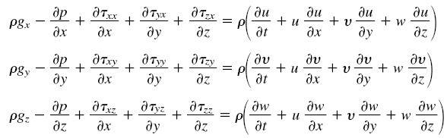
General Linear Momentum Eqn.. – diff. form …
The three components of the momentum eqn. are:
Note the mathematical complexity of the eqn. It is valid for any fluid undergoing through any type of motion.
The last three “convective” terms on the RHS of each component eqn. are non-linear, and this complicates the mathematical analysis.

Slide 26
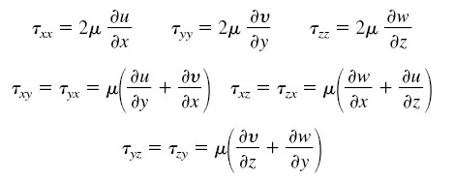
Linear momentum eqn. …
For incompressible flow of Newtonian fluids, the viscous stresses are approximated by:

Slide 27
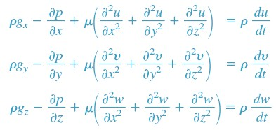
General Linear Momentum Eqn.. – diff. form …
Substituting the preceding expressions of viscous stresses into the general momentum eqn., we obtain the following reduced form, valid for an incompressible flow of Newtonian fluid with constant viscosity:
These are named Navier-Stokes eqn. (2nd order, non-linear)

Slide 28
General ……. Eqn.. – diff. form …
etc …
Please refer to e.g., Frank M. White, for the remaining idifferential eqns

Slide 29

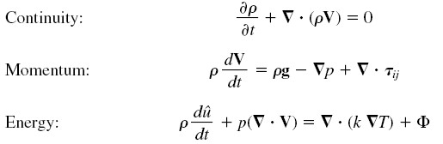


Summary of the General Forms of Differential Governing Eqns.
They contain the unknowns: ρ, V, p, T
and so - one additional relation is needed to close the system of eqns.:
Plus the necessary boundary conditions!!!

Slide 30
Summary of the Reduced Forms of Diff Eqns. for 2-D Potential Flow
Continuity ……….
Linear Momentum …
(Euler’s eqn.)

