Slide 1
2-D Potential Flow Theory
- continued
Reference:
    Frank M. White, Chapter 4, Sections 4.6 & 4.7;
    Frank M. White, Chapter 8, Sections 8.1 to 8.4

Slide 2
2-D Potential Flow Theory ….
Introduction, def., some basic concepts
General governing Eqns; reduced forms,
Solving the Potential Flow
      Velocity potential function, Laplace eqn
      Stream function, Laplace eqn
  Superposition of elementary potential flow models;
  Examples:
        Uniform Flow and Source Flow
        Uniform Flow and Source / Sink Pair: The Rankine Oval
        Uniform Flow and Doublet: Non-lifting flow over a circular cylinder
        Uniform Flow, Doublet and Free Vortex: Lifting flow over a circular cylinder
Conclusion : The Kutta – Joukowski Thm

Slide 3
2-D Potential Flow Theory
  Potential flow is
    an inviscid, incompressible, irrotational, steady flow
  Potential Flow Theory is
    a mathematical method developed to solve flow problems that can be closely approximated as a potential flow

Slide 4
2-D Potential Flow Theory
Question
What do we mean by ‘solve’ ?

Slide 5
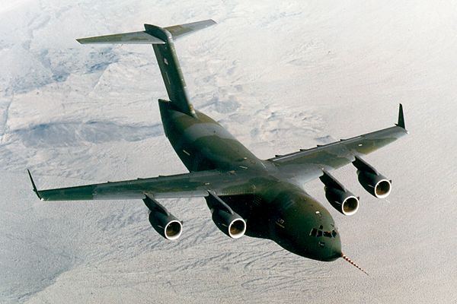
Questions?
  Why doesn't it fall down ? (What keeps it floating in air?
  Why/How does it move forward?
Consider an air craft moving in air:
air
body

Slide 6
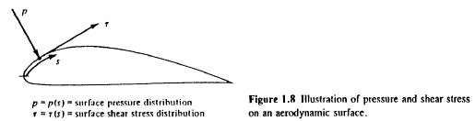

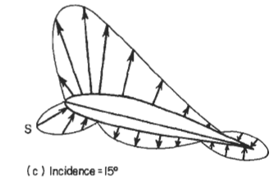
Airfoil :

Slide 7
Known:
  The forces exerted on bodies moving through a fluid are caused only by two reasons:
    Pressure distribution ( p ) over the body surface,
    Shear-stress distribution (τ ) over the body surface.
    i.e., pressure and Shear-stress are the only two mechanisms nature has for ‘communication’ of force & moment between the body and the moving fluid.

Slide 8
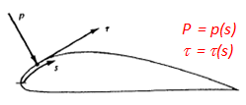
In general,
  the net effect of the p- and τ distributions integrated over the entire body surface constitutes a resultant force, R, b/n the fluid and the body; and is given by:
In particular,
  For a potential flow,
  there is no τ ; we have only p
  A good e.g. for ‘solve’ is determining the velocity and pressure distribution, from which R could be determined (i.e., solving an eng’g problem).

Slide 9
2-D Potential Flow Theory …
The starting point for solving a potential flow problem is the set of eqns governing the flow.

Slide 10
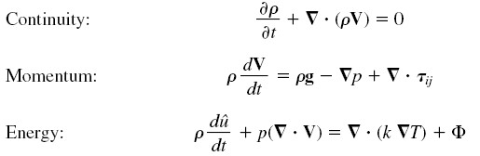

2-D Potential Flow Theory …
Recall the set of Differential Eqns for a (general) fluid flow:
The flow is steady. Therefore, the non-steady term of the continuity eqn can be left out. (Friction does not affect continuity eqn).
The flow is inviscid & incompressible. Therefore, the momentum eqn reduces to:
We know, the energy eqn is not required for the study /analysis of incompressible flow. So, forget the 3rd eqn.

Slide 11
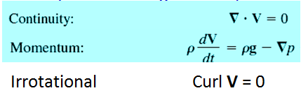
2-D Potential Flow Theory …
Thus, our Potential Flow problem can be fully described by the following set of eqns :
  integral ?
The next task is: find U and p from these eqns;
    The momentum eqn can be integrated; however,
    the continuity eqn, as it is, can not be integrated;
      It can, however, be integrated through use of velocity potential- and stream functions
So, let us define these functions first:

Slide 12
2-D Potential Flow Theory …
Velocity Potential Function (symbol, Φ )
Known – Potential flow is irrotational flow ➔ Curl U = 0;
Known:
if Curl U = 0, then, there exists a scalar
function Φ(x, y) such that:
U = ∇Φ , where:
    Comparing
  &
we note that the following relationship exists b/n the velocity components of the flow and the function Φ:
and

Slide 13
2-D Potential Flow Theory …
(Repeated),
  and
  where Φ = Φ(x,y) represents the scalar function, named ‘velocity potential function’ .
Now, these velocity components computed from Φ must of course satisfy the continuity eqn:
∇ ⋅ U = 0 ,
i.e., ,

Slide 14
2-D Potential Flow Theory …
The eqn. is the well known Laplace eqn.
  Laplace eqn is a widely studied eqn in mathematical physics; and its characteristics is well known.
Thus, (CONCLUSION)
  The pair of continuity and momentum eqns, governing a potential flow, can now been replaced by Laplace Eqn (whose solution is well known) & by Bernoulli eqn:
  i.e.,
  Continuity: …………………………….
  Momentum: → Bernoulli eqn:

Slide 15
2-D Potential Flow Theory …
and therefore,
  the problem of solving the potential flow is now reduced to that of solving simultaneously Laplace and Bernoulli eqns.

Slide 16
2-D Potential Flow Theory …
Another Laplace eqn can be obtained in a similar way, using stream function as follows:
Stream Function (symbol, ψ)
  is defined based on a 2D continuity eqn and a simple (but clever) mathematical manipulation.

Slide 17

2-D Potential Flow Theory …
Stream Function …
  We start with continuity eqn:
  We can find a function, ψ = ψ(x, y) such that
  (a true statement)
    i.e., letting and
and, for irrotational flow in x-y plane,
since Curl U = 0, (Laplace eqn)

Slide 18
2-D Potential Flow Theory …
Again,
  the problem of solving the potential flow is reduced to that of solving simultaneously another Laplace and Bernoulli eqns.

Slide 19
2-D Potential Flow Theory …
Geometric interpretation of velocity potential
function and stream function:
  Const-ψ lines represent stream lines of the flow; no flow across the stream lines; flow is along these lines.
  const-Φ lines represent equipotential lines; no flow along equipotential lines; flow is across these lines.
  Const-ψ and const-Φ lines are perpendicular to each other.

Slide 20
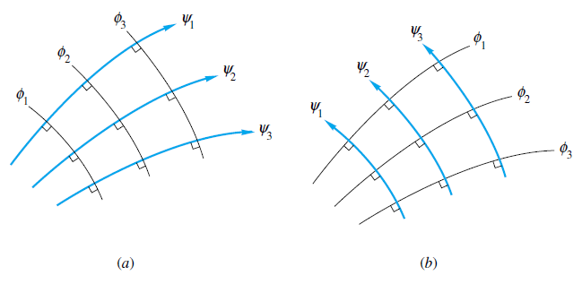
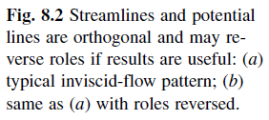
2-D Potential Flow Theory …
  Const-ψ and const-Φ lines are perpendicular to each other.

Slide 21
2-D Potential Flow Theory …
Note that:
  if ψ = ψ(x, y) and/or φ(x, y) functions of a flow field are known, one can determine the velocity field, and then use Bernoulli eqn to find p
  If, on the other hand, the velocity field is known, the velocity potential and/or stream function of the field can be determined as illustrated next:
  ψ = ψ(x, y) ⇒
  ⇒

Slide 22
2-D Potential Flow Theory …
Similarly,
  for velocity potential function,
  ⇒
  ⇒
Now, returning back to the issue of solving the Potential Flow problem:
  There are different methods of finding φ and/or ψ of the flow, …..

Slide 23
2-D Potential Flow Theory …
… solving the Potential Flow ….
  There are different methods of finding φ and/or ψ of the flow, from which the velocity field could be determined:
  These methods are:
      Superposition of known elementary potential flow models,
      Numerical panel techniques, and
      Conformal mapping.
  The scope of this course is limited to no.1

Slide 24
2-D Potential Flow Theory …
Concept behind the superposition principle:
  If φ₁ and φ₂ are two separate solutions of a
  Laplace eqn , their sum, φ₁+φ₂ is also another solution of the same eqn.
  The same is true for the stream function; ψ₁+ψ₂ is also the solution of if ψ₁ and ψ₂ are known separate solutions of the Laplace eqn.
  The superposition principle is based on this well established characteristic feature of a Laplace Eqn.

Slide 25
2-D Potential Flow Theory …
Steps to apply the superposition principle:
Start with known elementary potential flow models like:-
        Uniform flow,
        Source/sink flow,
        Doublet,
        Vortex, etc
    Note The velocity potential / stream functions of these flow models are known.

Slide 26
2-D Potential Flow Theory …
Steps to apply the superposition principle: …
Superimpose/combine linearly a number of the elementary flow models that together simulate the actual flow pattern, and then,
    Determine the stream function of the combined flow from the sum of the stream functions of the individual elementary flows.
    Determine the velocity components of the combined flow from the combined stream/velocity potential function
    Determine the pressure distribution of the flow field from Bernoulli eqn.
    Determine the eng’g parameter (e.g. aerodynamic force /moment) by integrating the diff. pressure force over the entire surface

Slide 27
2-D Potential Flow Theory …
  The Elementary Flow Models

Slide 28
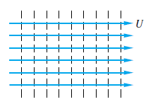


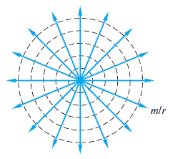



2-D Potential Flow Theory …
Elementary Flow Models
Uniform Flow
Line Source/sink
m – source strength

Slide 29
2-D Potential Flow Theory …
Superposition of the Elementary Flows
  We can form a variety of flow patterns of practical interest by linearly combining these elementary flow models (and others).
  The streamlines of the combined flow could be obtained, e.g., graphically (i.e., by summing up the constant-ψ lines of the elementary flow models).
Examples:-
Source – Sink pair (PTO)

Slide 30
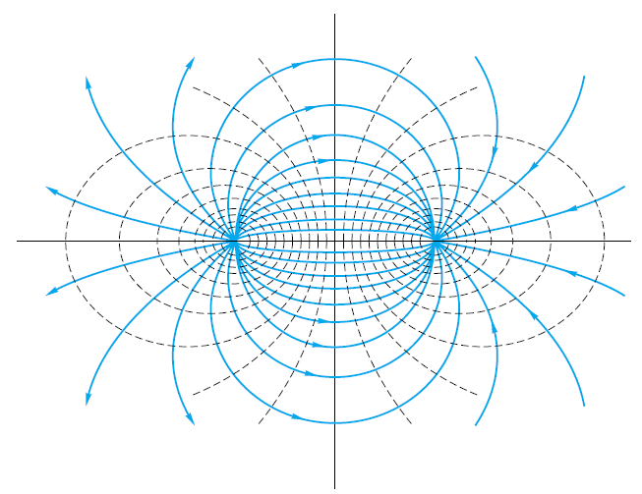

2-D Potential Flow Theory …
Superposition of the Elementary Flows …
Examples:-
Source – Sink pair
y
x
+s
-s

Slide 31

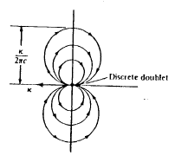

2-D Potential Flow Theory …
Superposition of the Elementary Flows …
Examples:-
Doublet

Slide 32
2-D Potential Flow Theory …
Examples of
superposition of elementary flows
to simulate practical flow problems

Slide 33
2-D Potential Flow Theory …
Example 1
superposition of
Uniform Flow and Source Flow

Slide 34
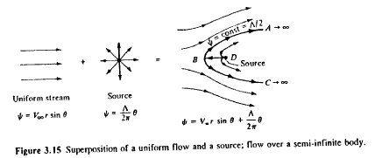
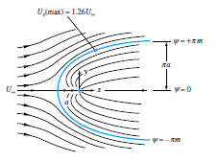


2-D Potential Flow Theory …
Uniform Flow and Source Flow
The stream function of the combined flow,
The velocity components of the comb. flow

Slide 35

2-D Potential Flow Theory …
Superposition of the Elementary Flows …
Uniform Flow and Source Flow …
The velocity components of
the combined flow:
The stagnation pt of the
combined flow:
Solving the eqns, the stagnation pt, S(r,θ) = S(Λ/2πV∞ ,π)

Slide 36
Potential Flow Theory …
Uniform Flow and Source Flow …
Subst. the coordinates of the
stagnation pt in the expression
of ψ of the comb flow, we get
ψ_{-cont} = Λ/2 - an expression
of the dividing stream line (see fig.);
it separates the free stream and
the source flow.
The entire region inside the const ψ_{-cont} = Λ/2
can be replaced with a solid surface of the same shape;
and, the flow outside can be described by:

Slide 37

Potential Flow Theory …
Uniform Flow and Source Flow …
This illustrates the practicality of
adding elementary flows to obtain
a more complex flow over a body
of interest.
The velocity field can then be calculated
from the ψ of the combined flow.
Then, we can calculate the pressure
coeff. from:
And then, the aerodynamic force coeff. can be calculated.

Slide 38
Potential Flow Theory …
Example 2
superposition of
Uniform Flow and Source / Sink Pair:
- The Rankine Oval

Slide 39
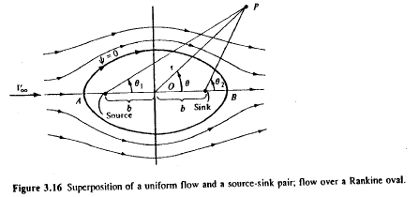

Potential Flow Theory …
Uniform Flow + Source / Sink Pair (Rankine Oval)
The stream function of the combined flow at any arbitrary point P (see Fig) is:

Slide 40
Potential Flow Theory …
Uniform Flow + Source / Sink Pair (Rankine Oval)
The stream function of the combined flow at P:
from which the velocity components at P:
u_{r} = ….. u_{θ} = …..
The stagnation pts in the cobined flow field ……..
The particular const-ψ line that passes thru the stagnation pts, ψ = 0, is the dividing stream line.
All the flow from the source is ‘consumed’ by the sink; and so, the source-sink pair is entirely contained inside the oval curve defined by the dividing stream line , ψ = 0.

Slide 41
Potential Flow Theory …
Uniform Flow + Source / Sink Pair (Rankine Oval)
Therefore, the region inside the oval can be replaced with the shape given by ψ = 0, where:
And the region outside the oval closed
curve can be interpreted as an inviscid,
irrot. incomp. steady flow past the solid surface.
The velocity field can be calculated from:
The pressure coeff. ….
The aerodynamic coeff. ……

Slide 42
Potential Flow Theory …
Example 3
superposition of
Uniform Flow and Doublet:
Non-lifting flow over a circular cylinder

Slide 43
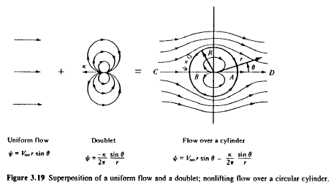


Potential Flow Theory …
Uniform Flow and Doublet
(Non-lifting flow over a circular cylinder)
The stream function of the comb flow is:
  R : radius of cylinder; k : Doublet strength

Slide 44
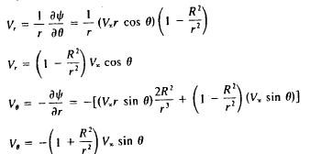


Potential Flow Theory …
Uniform Flow and Doublet
(Non-lifting flow)
The velocity field can then be determined by differentiating the stream function of the combined flow:
Equating V_{r} and V_{θ} to zero, we determine the stagnation pts:
On surface,

Slide 45

Potential Flow Theory …
Uniform Flow and Doublet
(Non-lifting flow)
Substituting the co-ord. of the stagnation pts into the expression of the stream function for the comb flow, we get the eqn of the dividing stream line:
The velocity distribution on the surface of the cylinder is:

Slide 46

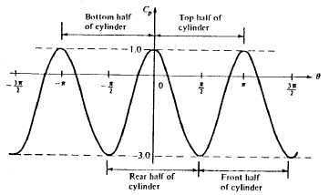

Potential Flow Theory …
Uniform Flow and Doublet
(Non-lifting flow)
Thus, the distribution of pressure coeff on the surface of the cylinder,
The normal- and axial
force coeffs are each zero.

Slide 47
Potential Flow Theory …
One More Elementary Flow Model:
Line Vortex

Slide 48
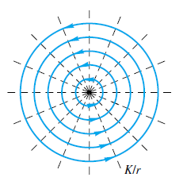
Potential Flow Theory …
Line Vortex (Ref: See, e.g., Section 3.14, Anderson)
is an elementary potential flow model where:
  the stream lines are concentric circles,
  v_{θ} is const for a given streamline;
  however, it varies from one streamline to
  another according to:
  r v_{θ} = const, or, v_{θ} = - Γ/(2πr)
  where Γ = the vortex strength = - 2 π (const)
  The radial velocity comp, v_{r} = 0

Slide 49



Potential Flow Theory …
Line Vortex …
Vortex flow is a physically possible model
and so, it obeys continuity eqn for incomp
flow; ie, ∇ ⋅ V = 0.
and, it is an irrotational flow, i.e.,
Curl V = 0
at every pt except at the origin;
  at the origin,
    Curl V → ∞.

Slide 50
Potential Flow Theory …
Line Vortex …
Since the velocity field is known,
one can determine the velocity
potential and stream functions
of the model by integration, using:
The results: , and

Slide 51
Potential Flow Theory …
Example 4
superposition of
Uniform Flow, Doublet and Free Vortex:
Lifting flow over a circular cylinder
Ref. See, e.g., Sec 3.15, Anderson

Slide 52
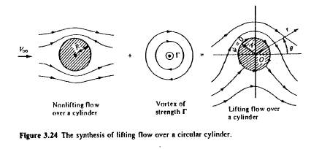

Potential Flow Theory …
Superposition of Uniform Flow, Doublet and Free Vortex: Lifting flow over a circular cylinder
The Doublet and free vortex are located at the same pt.
The stream function of the combined flow is:
The comb flow is:
. Symm about the y-axis; but
. Not symm about the x-axis,
(hence, lift exists)

Slide 53

Potential Flow Theory …
Lifting flow over a circular cylinder …
Stream function of the comb flow …
Radius of the cylinder, k – Doublet strength
Since ψ = a const is the eqn of a streamline,
ψ = 0 represents a streamline; in fact it represents the dividing streamline of the comb flow.
At r = R, ψ = 0 for all values of θ.

Slide 54


Potential Flow Theory …
Lifting flow over a circular cylinder …
The stream function of the comb flow …
The velocity field of the comb flow can be calculated from this expression of ψ :
Stagnation pts can be obtained from:
Result : at r = R and,
θ = arcsin(- Γ/4πV∞R)

Slide 55
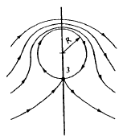
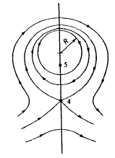
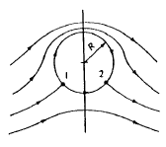
Potential Flow Theory …
Lifting flow over a circular cylinder …
The flow pattern of the comb flow:
Note: In the sketch, the vortex strength, Γ is freely chosen.
There are infinite no. of possible potential flow solutions (corresponding to the infinite choices for values of Γ).

Slide 56

Potential Flow Theory …
Lifting flow over a circular cylinder …
The velocity components on the surface of the cylinder:
v_{r} = 0 ; v_{θ} = -2V∞sin θ - Γ/2πR
Therefore, the velocity on the surface,
V = v_{θ} = -2V∞sin θ - Γ/2πR
The pressure coeff at any pt on the surface of the cylinder:

Slide 57
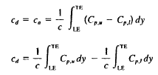

Potential Flow Theory …
Lifting flow over a circular cylinder …
The drag coeff ,
The lift coeff: The Lift per unit span:
  Very important relation in theoretical aerodynamics!!!
  The eqn is named Kutta - Joukowski Thm

Slide 58
Potential Flow Theory …
Lifting flow over a circular cylinder …
Concluding Remarks on the results :
  The drag coeff :
  The Lift per unit span:
Agreement b/n the results and the real life ???
  The prediction of zero drag is erroneous ; the error is due to the (inviscid) assumption underlying the Theory.
  In reality, there is:
  skin friction --> flow separation --> finite drag.
  The prediction of Lift, however, is realistic !!!! The result is used extensively in the theory of aerodynamics

Slide 59
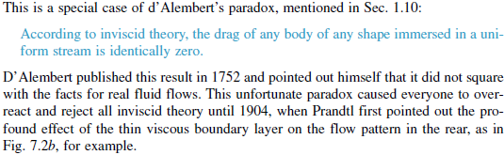
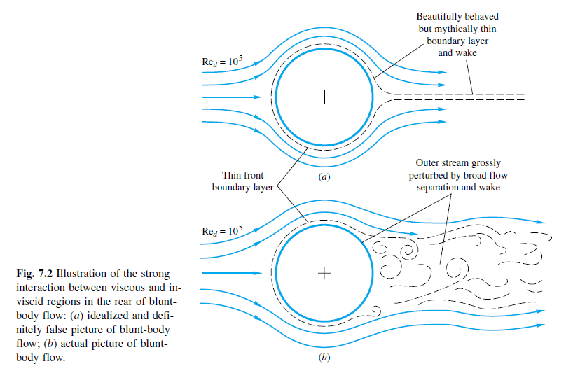

Slide 60
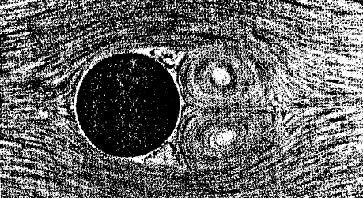
Potential Flow Theory …
Concluding Remarks on the results ….
  The following pictures were obtained in water tunnel, where aluminum filings were scattered on the surface of the cylinder to show the directions of the streamlines.
Case (a) Non-spinning cylinder in the tunnel

Slide 61
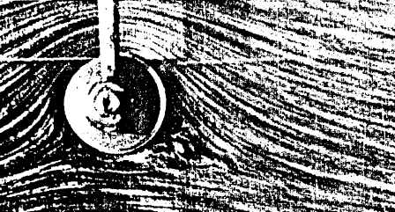
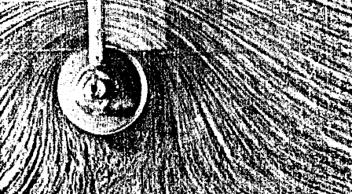
Potential Flow Theory …
Concluding Remarks on the results ….
Case (b) Spinning cylinder – peripheral velocity of the surface = 3V∞
Case (c) Spinning cylinder – peripheral velocity of the surface = 6V∞

Slide 62
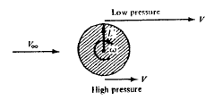
Potential Flow Theory …
Concluding Remarks on the results ….
  The physics of creation of lift on the spinning cylinder: (see the sketch)
  The spinning cylinder transfers its angular momentum to the fluid due to:
        (1) the no-slip condition and (2) viscosity.
  hence, generating the vortex flow Γ required for the lift:

Slide 63

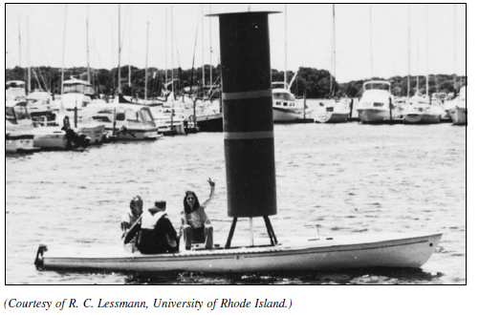
The Kutta – Joukowski Thm

Slide 64
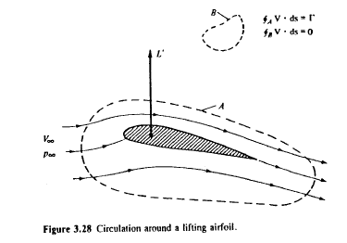
Potential Flow Theory …
The Kutta – Joukowski Thm, and
The Generation of Lift
The eqn is applicable also to cylindrical bodies of any cross-section, including airfoils.
Consider a uniform flow past an
airfoil (see sketch:
Let A be any curve enclosing the airfoil.
For the airfoil to produce Lift, the velocity field around the airfoil must be such that the circulation,
and, the lift,

Slide 65
Potential Flow Theory …
Conclusion
  The def of Γ and the use of the eqn
  to calculate L’ is the core concept of the circulation theory of lift in aerodynamics.
  the development of the theory (turn of the 20th century) was a breakthrough in aerodynamics.
  Remember, however, that
      The circulation theory of lift is simply an alternative way of thinking about the generation of lift;
      the physical source of the force is the p- (and τ ) distribution on the body surface.

Slide 66
Potential Flow Theory …
Conclusion …
  Thus, Kutta-Joukowski Thm is simply an alternative way of expressing the consequences of the p- and τ distribution;
      So, take the Thm is a mathematical tool that is consistent with the physical situation for the inviscid incomp flow over airfoils.
  How can we determine the Γ of a given flow problem?
  Possible ways are:
      The thin airfoil theory
      The Vortex Panel Method
      etc

