Slide 1
Examples
Chapter Two – 2D Potential Flow Theory
By Dawit M.

Slide 2
Outline
Example 1: Irrotationality
Example 2: Circulation
Example 3: Flow over Rankine Half Body
Example 4: Non – lifting Flow over a Circular Cylinder
Example 5: Lifting Flow over a Circular Cylinder
Example 6: Kutta – Jowkoweski Theorem
Example 7: Superposition of Elementary Flows

Slide 3
Example 1: Irrotationality
The velocity components for 2D Incompressible fluid flow field is expressed as:
u = y³/3 + 2x – x²y
v = xy² – 2y – x³/3
Is the flow irrotational?
Find the steam function, ψ.

Slide 4
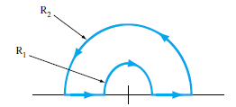
Example 2: Circulation
2. The steady plane flow in fig has the polar velocity components, V_{ɵ} = Ωr and v_{r} = o. Determine the circulation Γ around the path shown.

Slide 5
Example 3: Flow over Rankine Half Body
3. Obtain and expression of the dividing streamline for a flow resulting from a superposition of a free stream at 20m/s on a two dimensional source with a strength (˄) of 10m²/s. Sketch the flow pattern.

Slide 6
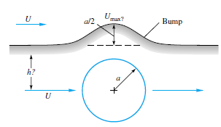
Example 4: Non – lifting Flow over a Circular Cylinder
4. It is desired to simulate the flow past a two dimensional bump by using stream line which passes above the flow over a circular cylinder as shown in the figure below. The bump is a/2 high, where a is the cylinder radius. What is the elevation h of this streamline (ψ = U͚ h)? What is U_{max} on the bump compared with the free stream velocity U.

Slide 7
Example 5: Lifting Flow over a Circular Cylinder
5. A circular cylinder 0.5m diameter rotates at 600 rpm clockwise in a uniform stream of 15m/s.
Locate the stagnation points
Calculate the maximum rotational speed (the stagnation point has to be relocated)

Slide 8
Example 6: Kutta – Jowkoweski Theorem
6. Consider a lifting flow over a circular cylinder with diameter of 0.5m. The free stream velocity is 25m/s, the maximum velocity on the surface of the cylinder is 75 m/s. Calculate the lift per unit span on the cylinder. (Take ρ ͚ = 0.91kg/m³)

Slide 9
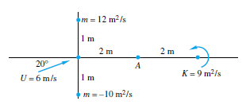
Example 7: Superposition of Elementary Flows
7. Find the resultant velocity vector induced at point A in fig. by uniform stream, line source, line sink and vortex.

Slide 10
Thank You!
Any Questions?

