Slide 1
2.1 THE CONDUCTION RATE EQUATION
Conduction heat transfer obeys Fourier law which was derived from actual observation. Consider the object given in fig-chp2\fig2.1.pptx . As it is insulated on the lateral side, conduction heat transfer will occur along the axial direction only. This heat transfer is due to the temperature difference of the two faces (T₁>T₂). The heat transfer q_{x} will depend on A, Δx and ΔT. It is observed that the conduction heat transfer is proportional to A and ΔT, while it is inversely proportional to Δx.

Slide 2
The collective effect can be represented by
The above can be written as an equation using a proportionality constant k, thermal conductivity (W/m.K) which is a property of the substance
To evaluate the heat transfer at any location x, needs an imposition

Slide 3
limit Δx→0 which gives
The negative sign is necessary as the slope dT/dx is negative since heat is always transferred in the direction of decreasing temperature.
is directional and normal to the isothermal surface having a positive value.

Slide 4
Fourier’s law can be generalized in three dimensional representation as
Where is del operator
The heat flux vector is in a direction normal to the isothermal fig-chp2\fig2.2.pptx .
As an alternative fig-chp2\fig2.3.pptx

Slide 5
The heat flux vector can be resolved as
All the above require the assumption that the thermal conductivity k does not vary with x, y, or z. Such substances are called isotropic.

Slide 6
2.2 THERMAL PROPERTIES OF MATTER
Thermal conductivity is a transport property on which energy transfer by diffusion depends on.
From Fourier’s law
Similar definitions follow for k_{y} and k_{z}. For isotropic materials k_{x} = k_{y} = k_{z} = k. fig-chp2\fig2.4.pptx gives the ranges of k values. In general, the thermal conductivity of a solid is larger than that of a liquid, which is larger than that of a gas.

Slide 7
2.2.1 The Solid State
Solids-comprised of electrons and atoms bound in a lattice. Transport of thermal energy due to a) migration of free electrons 2) lattice vibrational waves when quantized are termed as phonons analogous to photons of electromagnetic waves.
Pure metals-electron contribution to conduction heat transfer dominates.
Non-conductors-the phonon contribution is dominant.
According to kinetic theory

Slide 8
For conducting materials C≡C_{e}, electron specific heat per unit volume, , mean electron velocity, λ_{mfp} ≡λ_{e}, electron mean free path. Collision is either with an imperfection or with a phonon. In non-conducting solids C≡C_{ph}, phonon specific heat, -average speed of sound and λ_{mfp} ≡ λ_{ph} , phonon mean free path. Thermal conductivity increases as the mean free path of the energy carriers (electrons and phonons) is increased.
When both (electrons and phonons) are considered
k=k_{e} + k_{ph} (2.8)
Pure metals-low ρ_{e}, k_{e} is much larger than k_{ph}.

Slide 9
Non-metallic solids-k is determined primarily by k_{ph}.
Crystalline (well ordered) materials like quartz have high k_{ph}.
Temperature dependence of k for some selected solids is shown in fig-chp2\fig2.5.pptx . The analysis becomes more complex when the material’s characteristic dimensions are of the order of microscale and nanoscale.
2.2.2 The Fluid State
Includes both liquids and gases.
Intermolecular spacing is much larger
Motion of molecules is more random

Slide 10
Due to the above reasons thermal energy transport is less effective.
k for gases and liquids is lower. According to kinetic theory of gases
For gases k increases with increasing temperature and decreasing molecular weight (same as )as shown in fig-chp2\fig2.6.pptx .
Because ρ and λ_{mfp} are directly and inversely proportional to the gas pressure, k is independent of pressure except in extreme cases (perfect vacuum).

Slide 11
Physical mechanisms for explaining thermal conductivity in liquids are not well understood.
fig-chp2\fig2.7.pptx shows the dependence of k on temperature on selected nonmetallic liquid.
2.2.3 Insulation Systems
Consist of low thermal conductivity materials combined to achieve an even lower system thermal conductivity. Conventional forms are fiber-, powder-, and flake-type insulations, where the solid material is finely dispersed throughout the air space.
If small voids or hollow spaces are formed by bonding portions of the solid material, a rigid matrix is formed. Foamed systems are typical examples.

Slide 12
Reflective insulations are composed of multilayered, parallel, thin sheets or foils of high reflectivity.
2.2.4 Other Relevant Properties
These are in general called thermophysical properties classified as transport and thermodynamic properties. The transport properties are the ones that have direct effect on momentum, heat and mass transfer. These are thermal conductivity, k (for heat transfer), kinematic viscosity, υ(for momentum transfer), and diffusion coefficient, D(for mass transfer).
Extensively used thermodynamic properties are the density, ρ, and specific heat, c_{p}. The product ρc_{p}

Slide 13
(J/m³) is the volumetric heat capacity. It measures the ability of a material to store thermal energy.
A very important property termed as thermal diffusivity and designated by α is given by
It measures the ability of a material to conduct thermal energy relative to its ability to store thermal energy.
Large α has quick response to environmental temperature change.

Slide 14
2.3 HEAT DIFFUSION EQUATION
2.3.1 Rectangular Coordinates
Major objective in conduction analysis is to determine the temperature field T(x,y,z) in a medium resulting from conditions imposed within or on its boundary. This can help to determine
heat flux
Magnitude of temperature at locations of interest for determination of thermal stresses, expansions, and deflections etc..
A differential approach is used to derive the

Slide 15
governing differential equations by using a homogeneous differential control volume shown in fig-chp2\fig2.8.pptx .
Neglecting higher order terms in Taylor series, heat transfers across opposite faces can be approximated by

Slide 16
energy generated due to internal energy source:
where is energy generation rate per unit volume, W/m³.
Energy storage rate in the differential volume is
Applying conservation of energy requirement

Slide 17
Substituting the corresponding expressions
Using Taylor’s approximation
Substitution in 2.13 gives

Slide 18
Using Fourier’s law
After substitution in the energy balance equation will result in

Slide 19
Division by dV=dx dy dz gives

Slide 20
In vector form, the above equation becomes
The above is the heat diffusion equation whose solution gives T(x,y,z,t)
For constant k, the equation simplifies to
thermal diffusivity

Slide 21
Under steady state condition (∂T/∂t=0), the general equation (2.15) reduces to
For a one-dimensional heat transfer with no heat generation the above equation reduces to
With no heat generation, steady state assumption gives

Slide 22
EXAMPLE 2.1
The temperature distribution across a wall 1 m thick at a certain instant of time is given as
T(x) = a + bx + cx²
Where T is in ºC and x is in meters, while a=- 900ºC, b= -300ºC/m, and c = -50ºC/m². A uniform heat generation, is present in the wall of area 10 m² having the properties ρ = 1600 kg/m³, k = 40 W/m.K, and c_{P} = 4 kJ/kg.K.
Determine the rate of heat transfer entering the wall (x=0) and leaving the wall (x=1m).
Determine the rate of change of energy storage in the wall

Slide 23
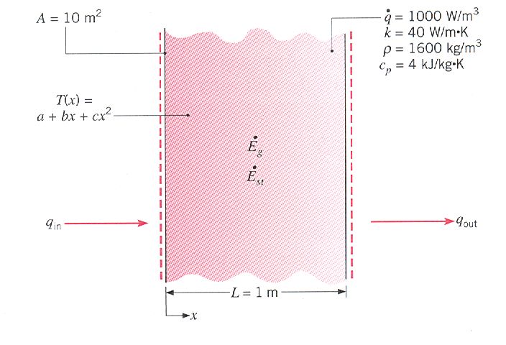
Figure for example 2.1

Slide 24
Determine the time rate of temperature change at x = 0, 0.25, and 0.5 m.
SOLUTION
1. Incoming and outgoing heat transfer rate

Slide 25
Rate of change of energy storage can be determined from
Rate of temperature change at any location

Slide 26
From the given temperature distribution
which is a constant (independent of location).
This temperature decrease rate is the same at any location.

Slide 27
2.3.2 Cylindrical Coordinates
When the heat transfer problem involves cylindrical objects such as pipes, the equation in cylindrical coordinates will be more convenient for analysis.
Referring to fig-chp2\fig2.9.pptx

Slide 28
Using the energy balance equation

Slide 29
Substitution of Fourier’s law
After substitution and division by will give

Slide 30
For constant k, the equation becomes
The same result would have been achieved if the del operator expressed in cylindrical coordinates had been used

Slide 31
2.3.3 Spherical Coordinates
If heat transfer involves spherical shapes then the conduction heat transfer equations in spherical coordinates will be convenient for analysis.
The spherical differential control volume is shown in fig-chp2\fig2.10.pptx.
If we directly use the Laplacian in spherical coordinates as

Slide 32
For constant k, the conduction equation in spherical coordinates becomes

Slide 33
Example 2.2
Passage of an electric current through a long conducting rod of radius r_{i} and thermal conductivity k_{r} results in uniform volumetric heating at a rate of
. The conducting rod is wrapped in an electrically nonconducting cladding material of outer radius r_{o} and thermal conductivity k_{c}, and convection cooling provided by an adjoining fluid. For steady state conditions, write appropriate forms of the heat equations for the rod and cladding. Express appropriate boundary conditions for the solution of these equations.

Slide 34
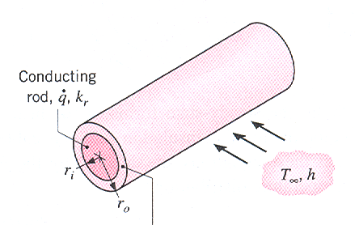
Figure for example 2.2

Slide 35
Solution
Appropriate equation for the rod in cylindrical coordinates is given by
For the cladding

Slide 36
Boundary conditions
By simple observation, the temperature distribution is symmetric in the rod.
T_{r}(r_{i}) = T_{c}(r_{i}) (intermediate temperature)
3.
4.

Slide 37
2.4 BOUNDARY AND INITIAL CONDITIONS
The complete solution of the heat equation requires the state at the boundaries and if the situation is time dependent, initial condition will be required.
Since the heat equation is a second order in spatial coordinates, two boundary conditions must be expressed for each coordinate needed to describe the system. As the equation is also first order in time, one initial condition must be satisfied.
Three kinds of boundary conditions commonly encountered in heat transfer are:

Slide 38
1. Constant Surface Temperature:- The surface is maintained at a fixed temperature at any time.
T(0,t) = T_{s} ( fig-chp2\fig2.11.pptx )
This is termed as Dirichlet condition or boundary condition of the first kind. This is closely approximated by surfaces in contact with phase changing fluids.
Constant Surface Heat Flux:- This heat flux related to the temperature gradient at the surface is expressed as

Slide 39
This is termed as Neumann condition or boundary condition of the second kind. This may be realized by bonding a thin film electric heater to the surface or allowing solar radiation on the surface.
A special case is a perfectly insulated surface, or adiabatic surface where (∂T/∂x)_{x=0} = 0.
Boundary condition of the third kind involves convective heat transfer at the surface (cooling or heating) expressed as

Slide 40
Example 2.3
A long copper bar of rectangular cross-section, whose width w is much greater than its thickness L, is maintained in contact with a heat sink at its lower surface, and the temperature throughout the bar is approximately equal to that of the sink, T_{o}. Suddenly, an electric current is passed through the bar and an airstream of temperature T∞ is passed over the top surface, while the bottom surface continues to be maintained at T_{o}. Obtain the differential equation and the boundary and initial conditions that could be solved to determine the temperature as a function of position and time in the bar.

Slide 41
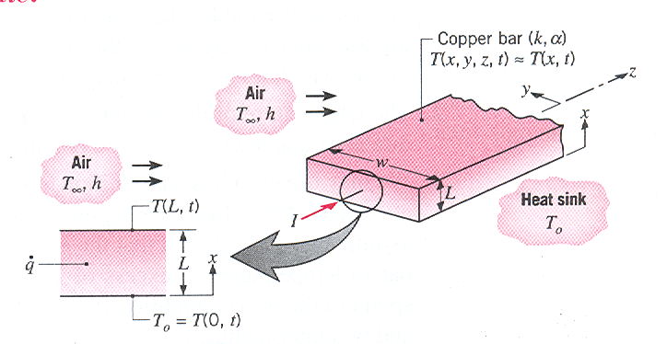
Figure for example 2.3

Slide 42
Solution
The appropriate equation is
One initial condition and two boundary conditions are required to solve this PDE.
IC: T(x,0) = T_{o}
BC: 1) T(0,t) = T_{o}
2)

Slide 43
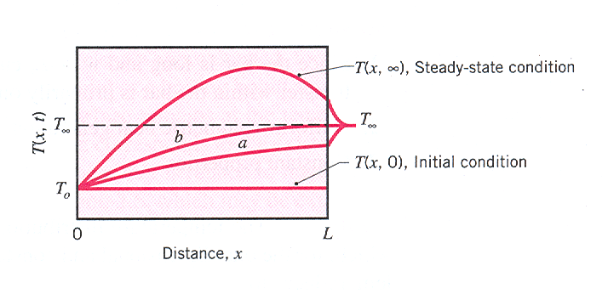

Slide 44
