Slide 1
Examples – Part I
Chapter Four
2D – Steady State Conduction
Prepared By: Dawit M.

Slide 2
Outline
Example 1: Exact Solution Method for S.S, 2D Conduction Heat Transfer
Example 2: Use of Shape Factor

Slide 3
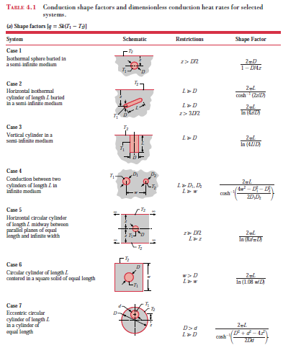

Slide 4
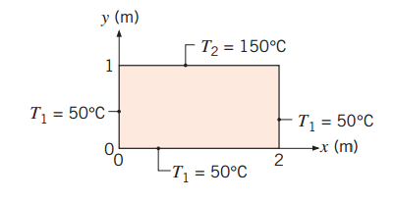
Example 1: Exact Solution Method for S.S, 2D Conduction Heat Transfer
A two-dimensional rectangular plate is subjected to prescribed boundary conditions. Using the results of the exact solution for the heat equation presented in Section 4.2, calculate the temperature at the midpoint (1, 0.5) by considering the first five nonzero terms of the infinite series that must be evaluated. Assess the error resulting from using only the first three terms of the infinite series

Slide 5
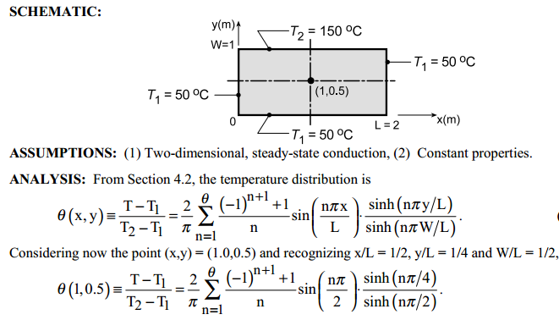
Solution

Slide 6
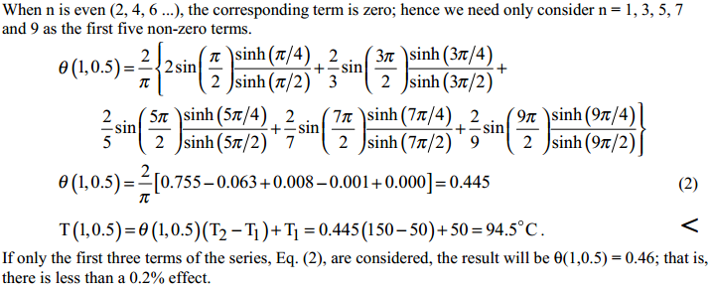
Cont’d …

Slide 7
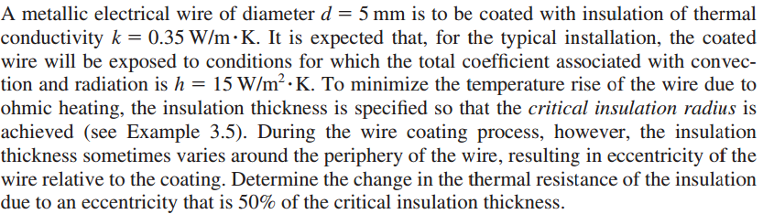
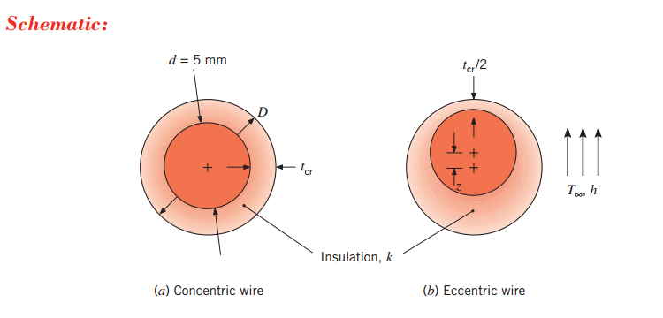
Example 2: Use of Shape Factor
2.

Slide 8
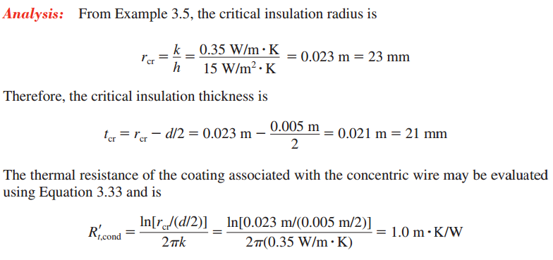
Solution

Slide 9
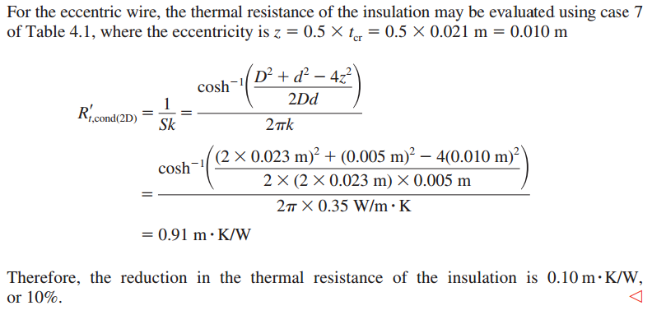
Cont’d …
Table 4.1

Slide 10
Any Question? Thank You!

