Slide 1
Chapter 6
Introduction to Convection/Heat transfer coefficients

Slide 2
Energy
Conservation
Problems involving conduction:
Chapters 2-3
Transient problems: Chapter 5
Obtained temperature as a function of time for cases where resistance to conduction was negligible
Chapter 3:
Obtained temperature profiles for 1-D, SS conduction, with and without generation
We wrote the 1-D, SS problems in terms of resistances in series
We defined an overall heat transfer coefficient, as the inverse of the total resistance

Slide 3
In Chapters 1-5 we used Newton’s law of convection:
h was provided
we did not consider any temperature variations within the fluid

Slide 4
Chapter 6:
We will use dimensional parameters to the boundary layer to find a functional dependence of h
In subsequent chapters we will use this information to obtain temperature distributions within the fluid.

Slide 5
Introduction to Convection
Convection denotes energy transfer between a surface and a fluid moving over the surface.
The dominant contribution is due to the bulk (or gross) motion of fluid particles.
In this chapter we will
  Discuss the physical mechanisms underlying convection
  Discuss physical origins and introduce relevant dimensionless parameters that can help us to perform convection transfer calculations

Slide 6
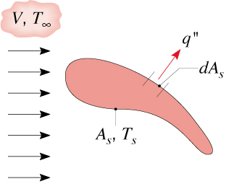
Heat Transfer Coefficient
Recall Newton’s law of cooling for heat transfer between a surface of arbitrary shape, area A_{s} and temperature T_{s} and a fluid:
(6.1)
Generally flow conditions will vary along the surface, so q” is a local heat flux and h a local convection coefficient.
The total heat transfer rate is
where
(6.2)
average heat transfer coefficient

Slide 7
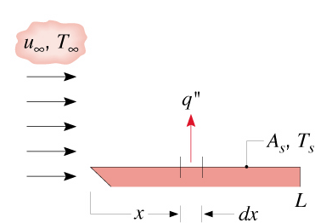
Heat Transfer Coefficient
For flow over a flat plate:
(6.3)
How can we estimate the heat transfer coefficient?

Slide 8
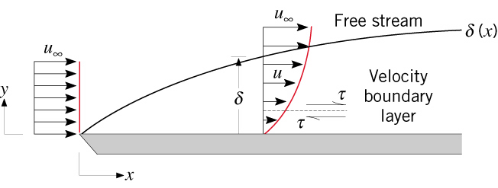
The Velocity Boundary Layer
Consider flow of a fluid over a flat plate:
The flow is characterized by two regions:
  A thin fluid layer (boundary layer) in which velocity gradients and shear stresses are large. Its thickness δ is defined as the value of y for which u = 0.99
  An outer region in which velocity gradients and shear stresses are negligible
For Newtonian fluids:
where C_{f} is the local friction coefficient
and

Slide 9
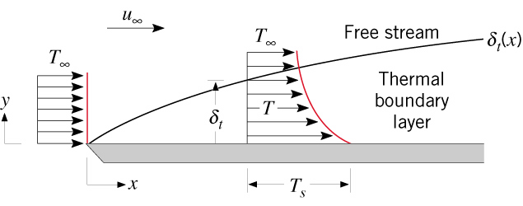
The Thermal Boundary Layer
Consider flow of a fluid over an isothermal flat plate:
The thermal boundary layer is the region of the fluid in which temperature gradients exist
Its thickness is defined as the value of y for which the ratio:
At the plate surface (y=0) there is no fluid motion – The local heat flux is:
(6.4)
and
(6.5)

Slide 10
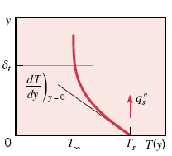
The Thermal Boundary Layer

Slide 11
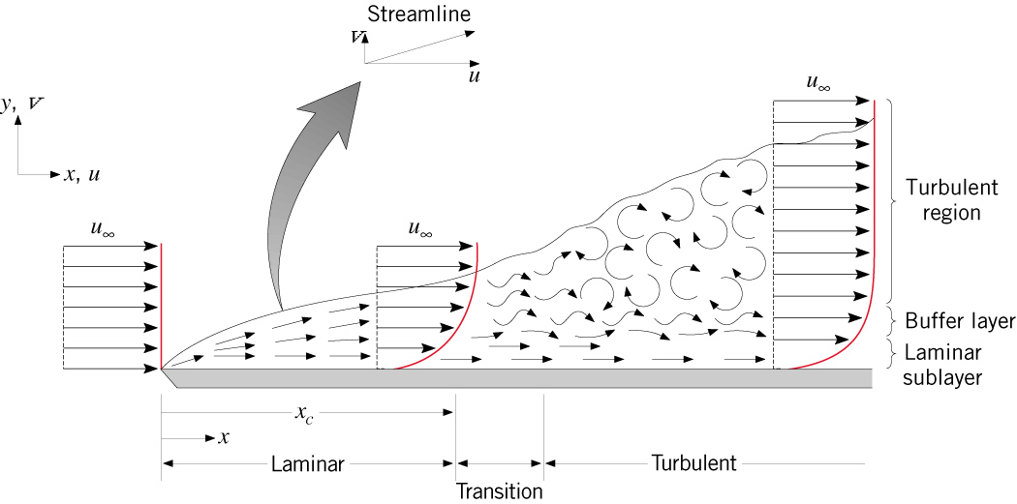
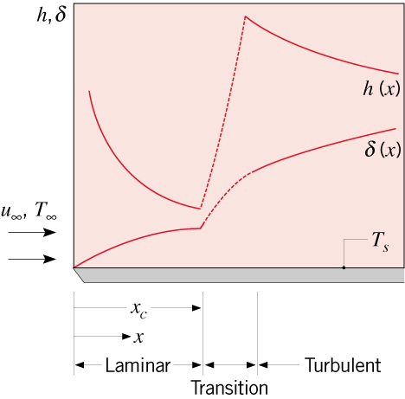
Laminar and Turbulent Flow
Transition criterion at Re_{critical}:
Transition criterion at Re_{critical}:

Slide 12
Boundary Layers - Summary
Velocity boundary layer (thickness δ(x)) characterized by the presence of velocity gradients and shear stresses - Surface friction, C_{f}
Thermal boundary layer (thickness δ_{t}(x)) characterized by temperature gradients – Convection heat transfer coefficient, h

Slide 13
Need to determine the heat transfer coefficient, h
Must know T(x,y), which depends on velocity field

Slide 14
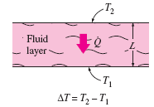

Nusselt Number
Consider the following
Heat transfer through the fluid layer will be by convection, when the fluid involves some motion, and by conduction when the fluid layer is motionless
Taking the ratio of convection to conduction heat transfer through the fluid layer

Slide 15
Nusselt Number
So the nusselt number represents the enhancement of the heat transfer through a fluid layer as a result of convection relative to conduction across the same fluid layer
If Nu=1, heat transfer through the layer is by pure conduction

Slide 16


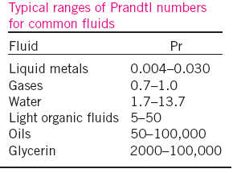
Prandtl number
The relative thickness of the velocity and thermal boundary layer,
The prandtl number of gases are about 1, which indicates that both momentum and heat dissipate through the fluid at about the same rate.
For laminar flow the boundary layer thickness is given by. n=1/3
Consequently the thermal boundary layer is much thicker for liquid metals and much thinner for oil relative to the velocity boundary layer

Slide 17

Reynolds number
The transition from laminar to turbulent flow depends on surface geometry, surface roughness, free stream velocity, surface temperature and type of fluid
The flow regimes depends mainly on the ratio of the inertia forces to viscous forces in the fluid, dimensionless quantity
At large reynold numbers, the inertia forces are large relative to the viscous forces and thus the viscous forces cannot prevent the random and rapid fluctuation of the fluid
At small reynolds number the visous forces are large enough to overcome the inertia forces and to keep the fluid line

Slide 18
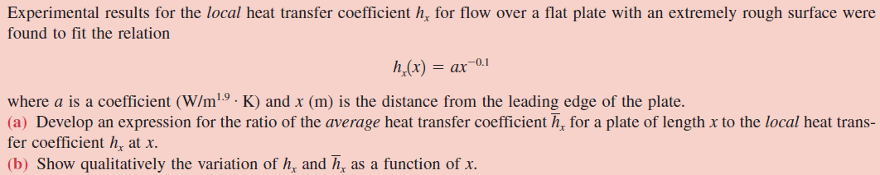
Example

Slide 19
Example 6.1
Experimental results for the local heat transfer coefficient h_{x} for flow over a flat plate with an extremely rough surface were found to fit the relation
h_{x}(x) = ax^{-0.1}
where a is a coefficient (W/m^{1.9}.K) and x(m) is the distance from the leading edge of the plate.

Slide 20
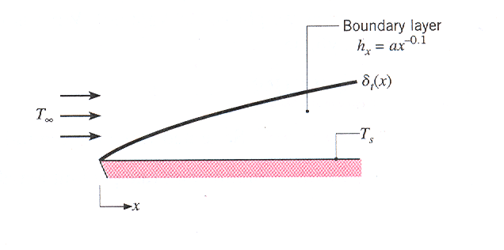
Develop an expression for the ratio of the average heat transfer coefficient for a plate of length x to the local heat transfer coefficient
Sketch the variation of h_{x} and
Figure for example 6.1

Slide 21
Solution
The average value of the convection heat transfer coefficient over the region from 0 to x is
Substituting the given value for the local heat transfer coefficient gives
or
2. The variation of h_{x} and with x is as follows.

Slide 22
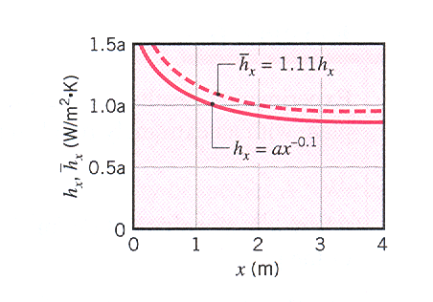
Variation of h_{x} and with x.

Slide 23

Empirical Correlation
Empirical correlations are needed based on surface geomentry and flow conditions. The most general correlation for forced convection.
Where C, m,n are independent of the fluid, but dependent on the surface geometry and flow conditions (laminar Vs Turbulent)

Slide 24
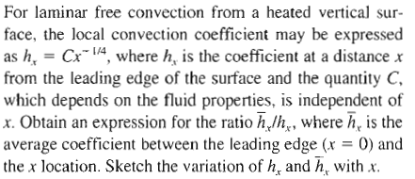
Tutorial Q1

Slide 25
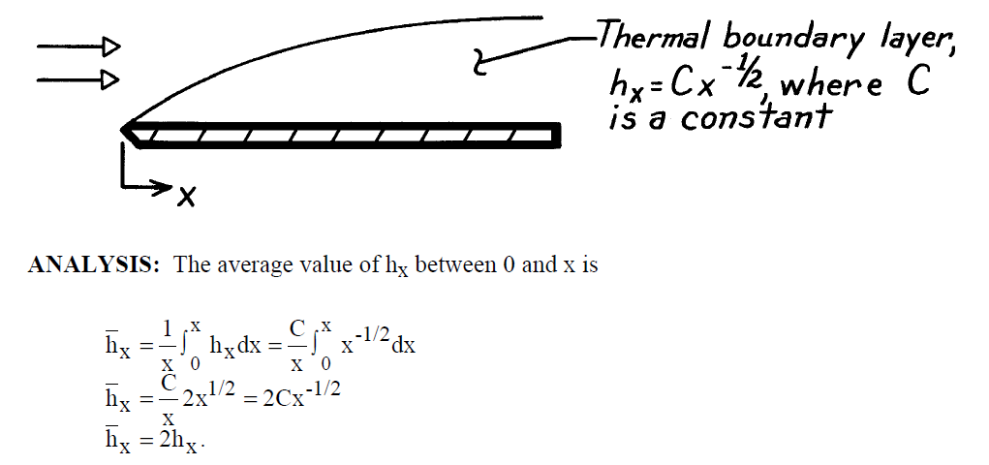
solution

Slide 26
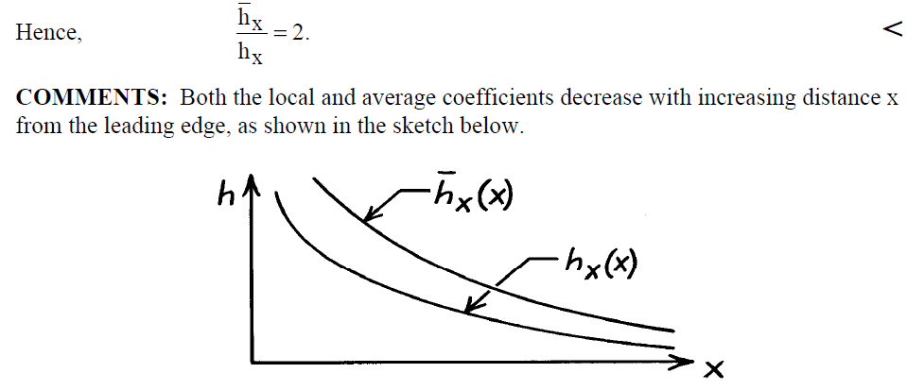
solution

Slide 27
Chapter 7
Forced Convection
External Flow

Slide 28
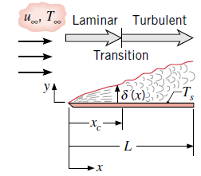
Forced Convection (External flow)
In this section, we will introduce correlations useful for estimating coefficients over a flat plate and curved surfaces of a cylinder and illustrated to compute convection heat rate.
Flat plate Laminar flow
In the absence of upstream disturbances, laminar boundary layer development begins at the leading edge (x=0),
Transition to turbulence may occur at a
downstream location (xc) for which the critical
Reynold number is Rexc=500000
for laminar flow,
Where the charactersitc length in the reynolds number is x, the distance from the leading edge

Slide 29
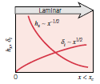

The local Nusselt number is
The expression for the average convection coefficient for any surface shorter than xc

Slide 30

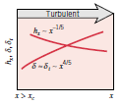
Turbulent flow
For turbulent flows, the hydrodynamic boundary layer thickness will be
The local nusselt number is

Slide 31


Mixed boundary Layer conditions
If transition occurs towards the trailing edge of the plate, within the range 0.95<=(Xc/L)<=1, this equation will provide the reasonable approximation which will be influenced by conditions in both laminar and turbulent boundary layers
If representative transtion reynold number of Rex,c=500000 is assumed , the equation will reduce to

Slide 32

Sometimes, there are many practical applications where it is desirable to use turbulence promoters to trip the boundary layer at the leading edge, Rex,c=0.
Where the boundary layer is assumed to be fully turbulent

Slide 33
The cylinder in a cross flow
Free stream fluid is brought to rest at the forward stagnation point, and the thin hydrodynamic boundary layer begins to grow as the fluid moves toward the rear of the cylinder
Depending upon the reynolds no , a transition from laminar to turbulent condition can occur
Correlations are available for average nusselt number. The Hilpers correlation is one of the most widely used
The churchill-Bernstein correlation is a single comprehensive equation with a wide range of reynolds and prandtl no

Slide 34

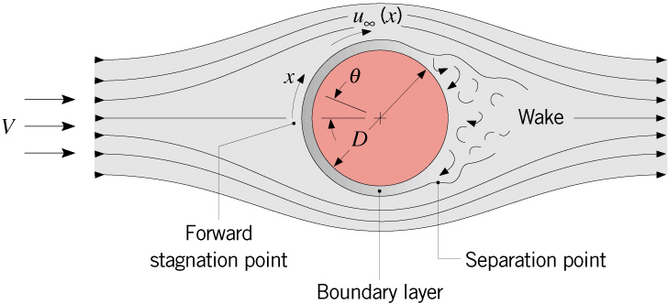
Cylinder in cross flow
Laminar boundary layer for

Slide 35
Summary of Correlations ccf
Zhukauskas correlation:
(7.9)
where C and m are listed in Table 7.4, (n=0.37 for 10≥Pr) and (n=0.36 for 10<Pr). Properties evaluated at , except Pr_{s} which is evaluated at T_{s}.
Churchill and Bernstein correlation, for all Re_{D} and Pr>0.2
(7.10)
Properties evaluated at film temperature
Hilpert correlation, can be used for cross flow around other non-circular shapes – see Table 7.2 for values of C and m

Slide 36
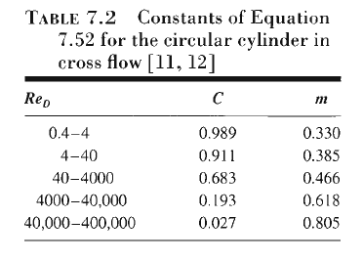
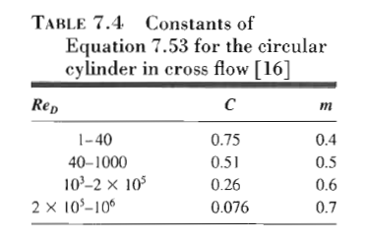

Slide 37
The sphere
Whitaker correlation:
(7.12)
where properties are evaluated at , except μ_{s} which is evaluated at T_{s}
Correlation by Ranz and Marshall for heat transfer from freely falling liquid drops:
(7.13)
At Re_{D}=0, equations (7.12) and (7.13) reduce to:
Applicable for heat transfer to a stationary infinite medium around the surface

Slide 38
Procedures for calculation
Begin by recognizing the flow geometry (i.e. flat plate, sphere, cylinder etc.)
Specify appropriate reference temperature for evaluation of fluid properties (usually film temperature, equation 7.2)
Calculate Reynolds number – determine whether flow is laminar or turbulent
  Reminder: Transition criteria:
Flat plates
Decide whether a local or average heat transfer coefficient is required
Use appropriate correlation to determine heat transfer coefficient
Proceed with other calculations, such as determination of heating or cooling rate

Slide 39
Examples

Slide 40
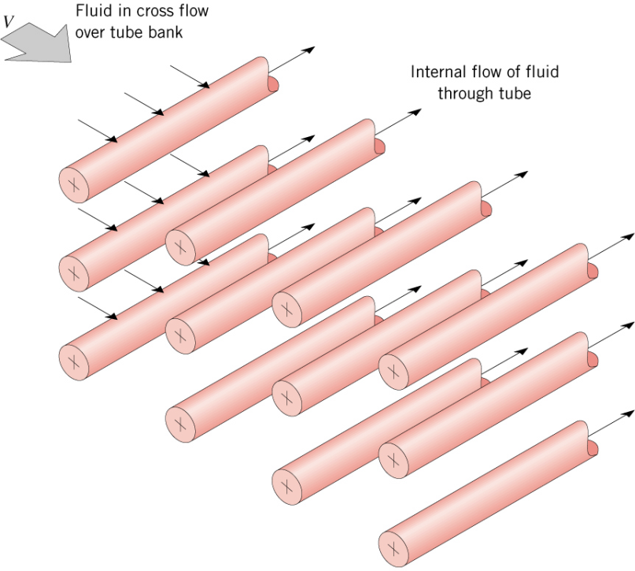
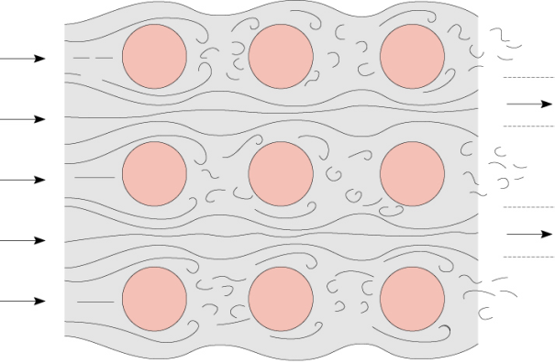
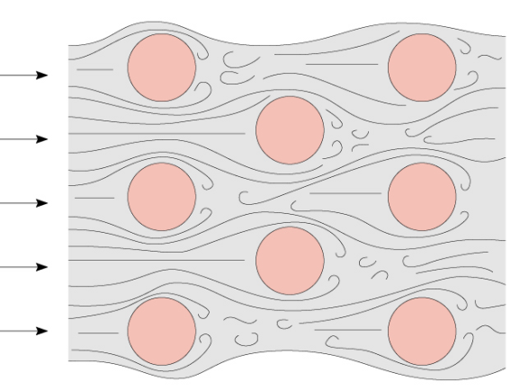
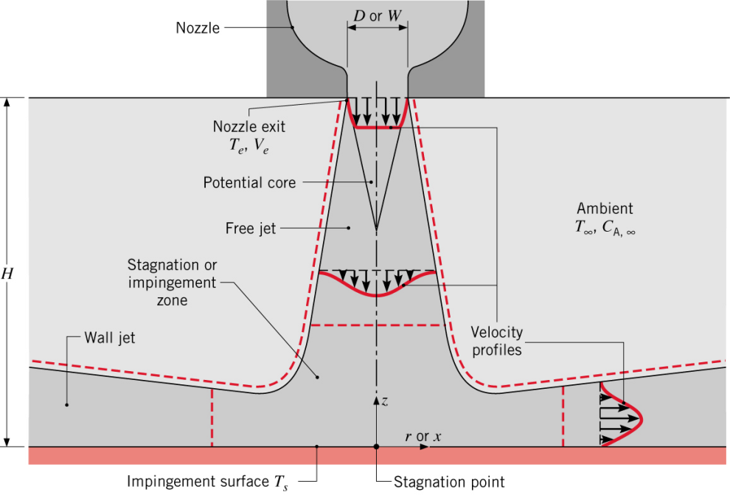
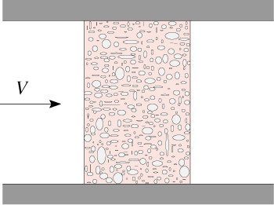
Other Applications
Flow around tube banks
Packed beds
Impinging jets

Slide 41
Flow across Banks of Tubes
Several correlations exist (textbook section 7.6)
Usually of the form
where C and m can be found in tables

Slide 42
Summary
In addition to heat transfer due to conduction, we considered for the first time heat transfer due to bulk motion of the fluid
We discussed the concept of the boundary layer
We defined the local and average heat transfer coefficients and obtained a general expression, in the form of dimensionless groups to describe them.
we obtain expressions to determine the heat transfer coefficient for specific geometries

Slide 43
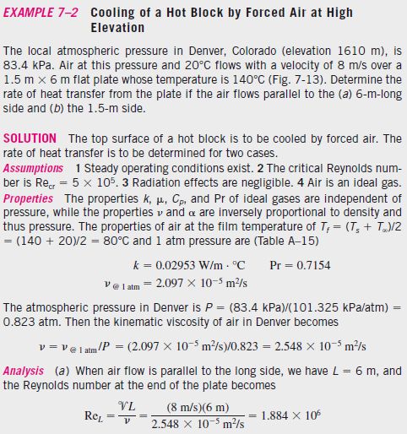
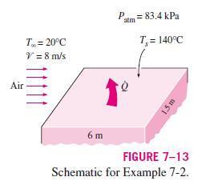
Tutorial Q

Slide 44
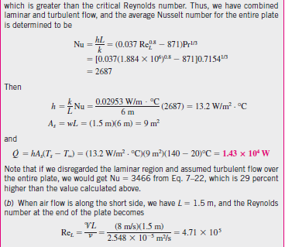

Slide 45
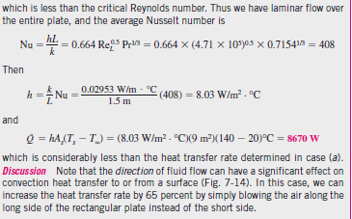

Slide 46
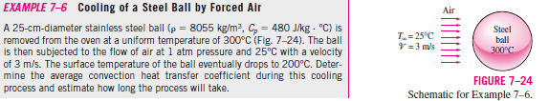

Slide 47
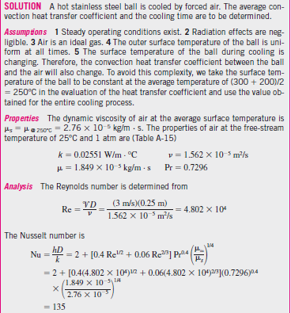

Slide 48
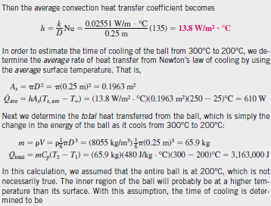
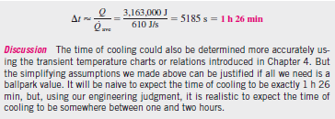

Slide 49
Chapter 7
Forced Convection
Internal Flow

Slide 50
Introduction
When flow enters a tube, a hydrodynamic boundary layer forms in the entrance region, growing in thickness to eventually fill the tube.
Beyond this location, referred to as the fully developed region, the velocity profile no longer changes in the flow direction.
We begin by considering thermal boundary layer formation in the entrance and fully developed regions, and how the convection coefficient is determined from the resulting temperature profile.
We will introduce empirical correlations to estimate convection coefficients for laminar and turbulent flows in the fully developed region, deferring consideration of correlations for the entrance region.

Slide 51
Hydrodynamic and Thermal Considerations
The development of the boundary layer for laminar flow in a circular tube is represented in Fig 1
Because of viscous effects, the uniform velocity profile at the entrance will gradually change to a parabolic distribution as the boundary layer begins to fill the tube in the entrance region.

Slide 52

Beyond the hydrodynamic entrance length, Xfd,h, the velocity profile no longer changes, and we speak of the flow as hydrodynamically fully developed.
The extent of the entrance region, as well as the shape of the velocity profile, depends upon Reynolds number, which for internal flow has the form

Slide 53


In a fully developed flow, the critical Reynolds number corresponding to the onset of turbulence is
For laminar flow (ReD≤2300), the hydrodynamic entry length has the form
While for turbulent flow, the entry length is approximately independent of Reynolds number and that, as a first approximation

Slide 54


For laminar flow, the thermal entry length may be expressed as:-
For turbulent flow, conditions are nearly independent of Prandtl number, and to a first approximation the thermal entrance length is:-

Slide 55

The Mean Temperature
As shown in Fig.c, the temperature and velocity profiles at a particular location in the flow direction x each depend on radius, r.
The mean temperature of the fluid, also referred to as the average or bulk temperature, shown on the figure as Tm(x), is defined in terms of the energy transported by the fluid as it moves past location x.
For incompressible flow, with constant specific heat Cp, the mean temperature is found from

Slide 56


The mean temperature is the fluid reference temperature used for determining the convection heat rate with Newton’s law of cooling and the overall energy balance.
Newton’s law of cooling, also referred to as the convection rate equation, is expressed as

Slide 57

Fully Developed Conditions.
The temperature profile can be conveniently represented as the dimensionless ratio
(Ts-T )/(Ts -Tm).
Literatures indicate that although the temperature profile T(r) continues to change with x, the relative shape of the profile given by this temperature ratio is independent of x for fully developed conditions.
The requirement for such a condition is mathematically stated as:-

Slide 58
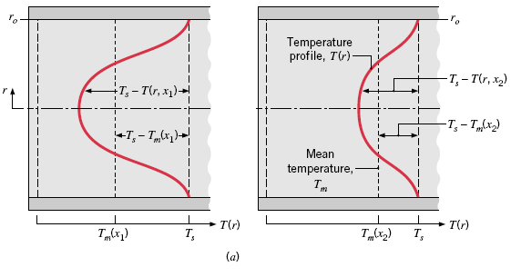
Where Ts is the tube surface temperature, T is the local fluid temperature, and Tm is the mean temperature as shown in Fig. 2a.

Slide 59
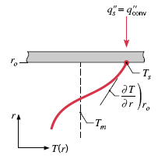



Since the temperature ratio is independent of x, the derivative of this ratio with respect to r must also be independent of x.
Evaluating this derivative at the tube surface (note that Ts and Tm are constants in sofar as differentiation with respect to r is concerned), we obtain
Substituting for from Fourier’s law,
and for from Newton’s law of cooling, we obtain

Slide 60
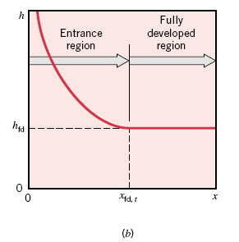
Hence, in the thermally fully developed flow of a fluid with constant properties, the local convection coefficient is a constant, independent of x.

Slide 61
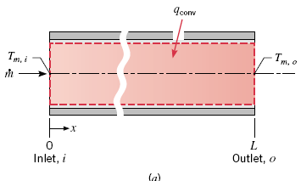

Energy Balances and Methods of Heating
Overall Tube Energy Balance:-Consider the tube flow of Fig.4a. Fluid moves at a constant flow rate and convection heat transfer occurs along the wall surface. Assuming that fluid kinetic and potential energy changes are negligible, there is no shaft work, and regarding cp as constant, the energy rate balance yields:-

Slide 62
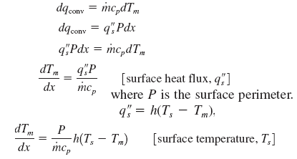
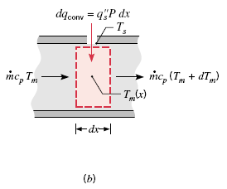
Energy Balance on a Differential Control Volume.
The solutions to the last eqn. for Tm(x) depend upon the surface thermal condition.
We will now consider two special cases of interest: constant surface heat flux (qs) and constant surface temperature (Ts). It is common to find one of these conditions existing in practical applications to a reasonable approximation.

Slide 63
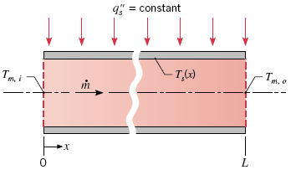

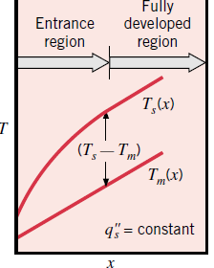

Thermal Condition: Constant Surface Heat Flux
Integrating from x= 0 to some axial position-x, we obtain the mean temperature distribution, Tm(x)

Slide 64
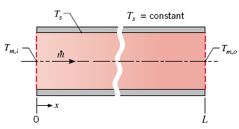






Thermal Condition: Constant Surface Temperature, Ts
Defining ΔT as (Ts - Tm),
Where is now the average value of h from the tube inlet to x.
If we had integrated from x = 0 to some axial position, we obtain the mean temperature distribution,
Tm(x)

Slide 65


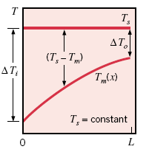
Determination of an expression for the total heat transfer rate qconv. is complicated by the exponential nature of the temperature decrease.
Inserting mcp in the above equation we will obtain

Slide 66

Convection Correlations for Tubes:
Fully Developed Region
In this section we present correlations for estimating the coefficients for fully developed laminar and turbulent flows in circular and noncircular tubes.
Laminar Flow
The problem of laminar flow (ReD <2300) in tubes has been treated theoretically, and the results can be used to determine the convection coefficients.
For flow in a circular tube characterized by uniform surface heat flux and laminar, fully developed conditions, the Nusselt number is a constant, independent of ReD, Pr, and axial location.

Slide 67

When the thermal surface condition is characterized by a constant surface temperature, the results are of similar form, but with a smaller value for the Nusselt number
In using these equations to determine h, the thermal conductivity should be evaluated at Tm.

Slide 68
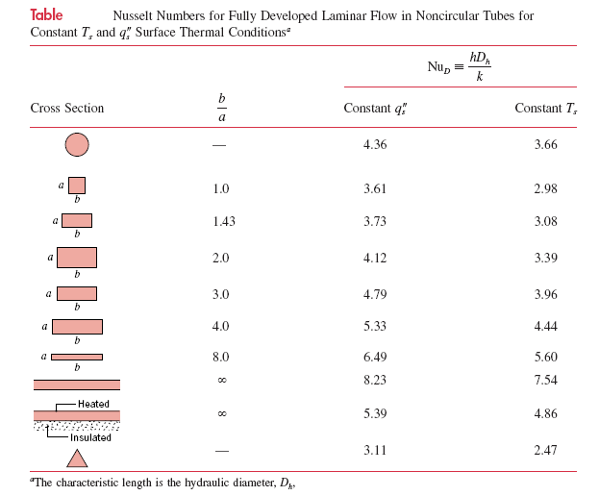

Slide 69

For applications involving convection transport in noncircular tubes, to at least a first approximation, the foregoing correlations can be applied by using the hydraulic diameter as the characteristic length
Where Ac and P are the flow cross-sectional area and the wetted perimeter, respectively. It is this diameter that should be used in calculating the Reynolds and Nusselt numbers.

Slide 70

Turbulent Flow
A commonly used expression for computing the local Nusselt number for fully developed (hydrodynamically and thermally) turbulent flow in a smooth circular tube is the Dittus-Boelter correlation of the form
where n=0.4 for heating (Ts>Tm) and 0.3 for cooling (Ts<Tm). These correlations have been confirmed experimentally for the range of conditions shown in the brackets. The correlations can be used for small to moderate temperature differences, (Ts-Tm) with all properties evaluated at Tm.

Slide 71

For flows characterized by large property variations, the Sieder-Tate correlation is recommended
where all properties except s are evaluated at

Slide 72
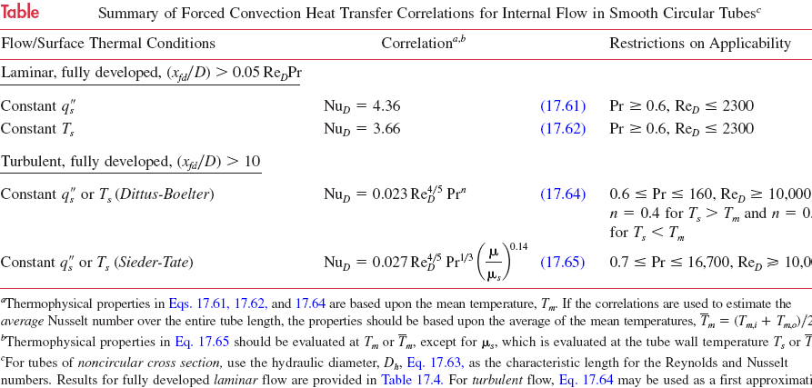

Slide 73
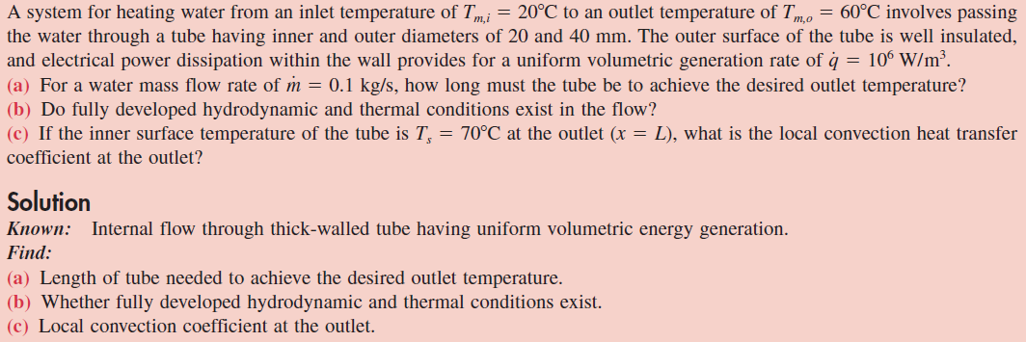
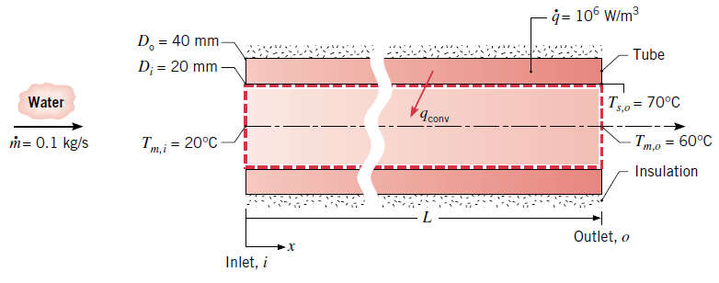

Slide 74
