Slide 1

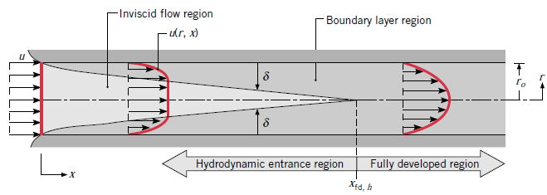
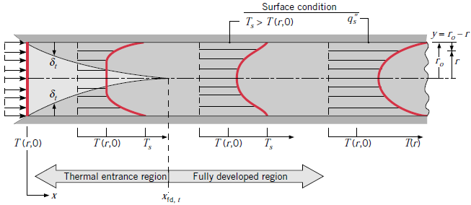
Addis Ababa University
Addis Ababa Institute of Technology
School of Mechanical & Industrial Engineering
Forced Convection – Internal Flow
Prepared by: Dawit M. (M.Sc.)
Office: 314 - C
E-mail: dwtmus@gmail.com

Slide 2
Outline
  Introduction
  Objectives
  Hydrodynamic Considerations
  Thermal Considerations
  Empirical Convection Correlations – Internal Flow
  Examples
AAiT
School of Mechanical and Industrial Engineering - SMiE

Slide 3
Introduction
Recall that an external flow is one for which boundary layer development on a surface is allowed to continue without external constraints, as for the flat plate.
In contrast, an internal flow, such as flow in a pipe, is one for which the fluid is confined by a surface. Hence the boundary layer is unable to develop without eventually being constrained.
The internal flow configuration represents a convenient geometry for heating and cooling fluids used in chemical processing, environmental control, and energy conversion technologies.
AAiT
School of Mechanical and Industrial Engineering - SMiE

Slide 4
Objectives
After completion of this lecture and tutorial on internal flow – forced convection students will be able to:
Consider velocity (hydrodynamic) and Thermal effects pertinent to internal flows, focusing on certain unique features of boundary layer development.
Apply overall energy balance to determine fluid temperature variations in the flow direction.
Develop an appreciation for the physical phenomena associated with internal flow and to obtain convection coefficients for flow conditions of practical importance.
(Correlations for estimating the convection heat transfer coefficient are presented for a variety of internal flow conditions.)
AAiT
School of Mechanical and Industrial Engineering - SMiE

Slide 5
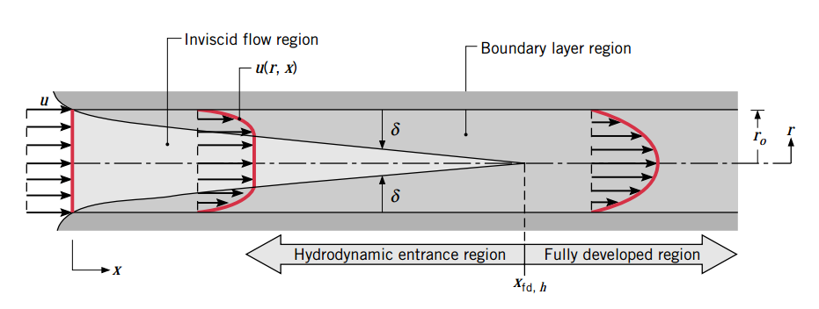


Hydrodynamic Considerations
When considering external flow, it is necessary to ask only whether the flow is laminar or turbulent. However, for an internal flow we must also be concerned with the existence of entrance and fully developed regions.
Flow Conditions:
Where U_{m} is the mean fluid velocity over the cross section and D is the diameter.
Critical Reynod’s number to the onset of turbulence is:
AAiT
School of Mechanical and Industrial Engineering - SMiE

Slide 6


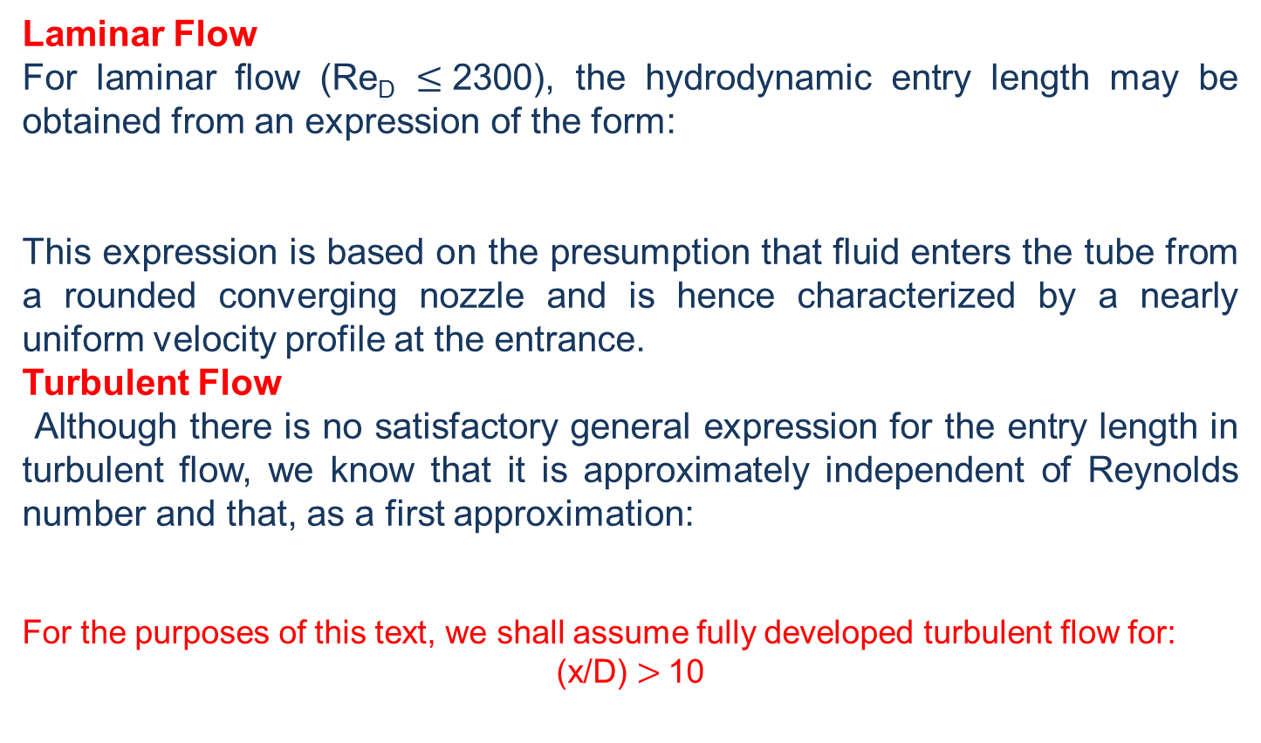
Cont’d …
Laminar Flow
For laminar flow (Re_{D} $≤$2300), the hydrodynamic entry length may be obtained from an expression of the form:
This expression is based on the presumption that fluid enters the tube from a rounded converging nozzle and is hence characterized by a nearly uniform velocity profile at the entrance.
Turbulent Flow
Although there is no satisfactory general expression for the entry length in turbulent flow, we know that it is approximately independent of Reynolds number and that, as a first approximation:
For the purposes of this text, we shall assume fully developed turbulent flow for:
(x/D) $>$10
AAiT
School of Mechanical and Industrial Engineering - SMiE

Slide 7



Cont’d …
The Mean Velocity
For steady, incompressible flow in a tube of uniform cross-sectional area,
The Velocity Profile in the Fully Developed Region
The form of the velocity profile may readily be determined for the laminar flow of an incompressible, constant property fluid in the fully developed region of a circular tube.
AAiT
School of Mechanical and Industrial Engineering - SMiE

Slide 8

Cont’d …
The Pressure Drop
The engineer is frequently interested in the pressure drop needed to sustain an internal flow because this parameter determines pump or fan power requirements.
Friction factor (f) for Fully Developed Laminar Flow:
Friction factor (f) for Fully Developed Turbulent Flow:
For fully developed turbulent flow, the analysis is much more complicated; and we must ultimately rely on experimental results.
Friction factors for a wide Reynolds number range are presented in the Moody diagram. In addition to depending on the Reynolds number, the friction factor is a function of the tube surface condition, e.
AAiT
School of Mechanical and Industrial Engineering - SMiE

Slide 9




Cont’d …
Correlations that reasonably approximate the smooth surface condition are of the form:
Alternatively, a single correlation that encompasses a large Reynolds number range has been developed by Petukhov and is of the form:
The Pressure Drop (ΔP):
The Pump or Fan Power Requirement:
Where the volumetric flow rate may, in turn, be expressed as for an incompressible fluid.
AAiT
School of Mechanical and Industrial Engineering - SMiE

Slide 10
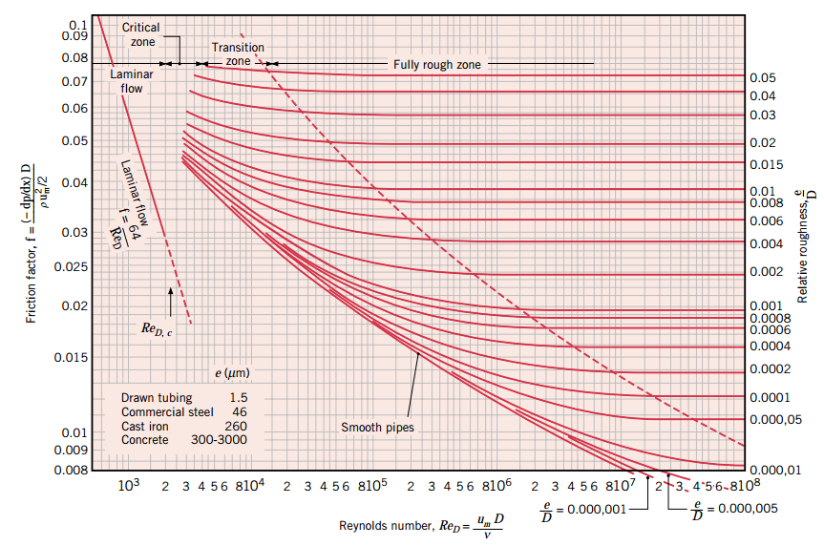
Cont’d …
Moody Chart
AAiT
School of Mechanical and Industrial Engineering - SMiE

Slide 11

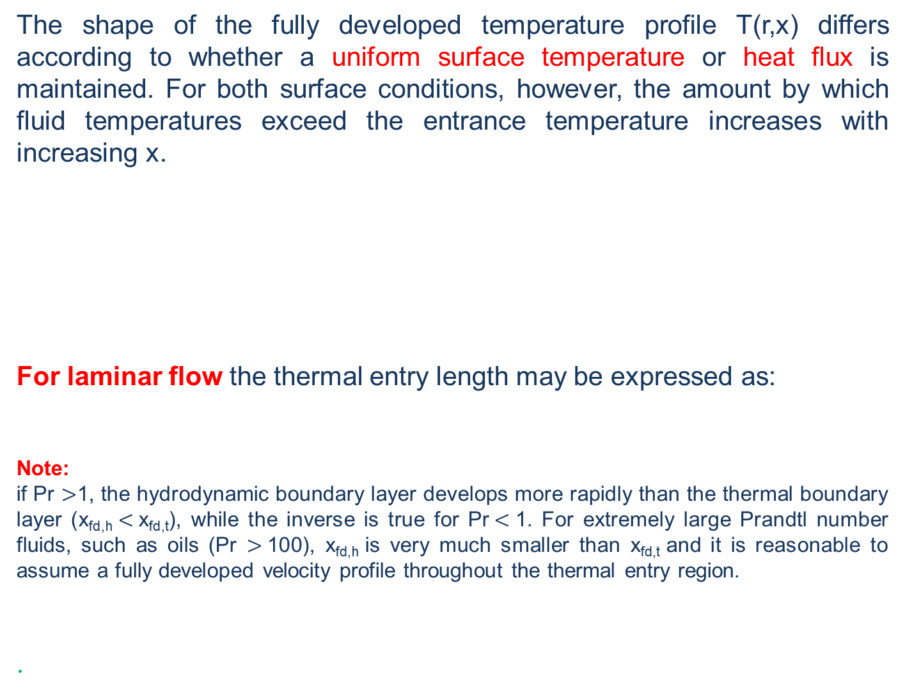
Thermal Considerations
The shape of the fully developed temperature profile T(r,x) differs according to whether a uniform surface temperature or heat flux is maintained. For both surface conditions, however, the amount by which fluid temperatures exceed the entrance temperature increases with increasing x.
For laminar flow the thermal entry length may be expressed as:
Note:
if Pr $>$1, the hydrodynamic boundary layer develops more rapidly than the thermal boundary layer (x_{fd,h} $<$x_{fd,t}), while the inverse is true for Pr$<$1. For extremely large Prandtl number fluids, such as oils (Pr $>$100), x_{fd,h} is very much smaller than x_{fd,t} and it is reasonable to assume a fully developed velocity profile throughout the thermal entry region.
.
AAiT
School of Mechanical and Industrial Engineering - SMiE

Slide 12


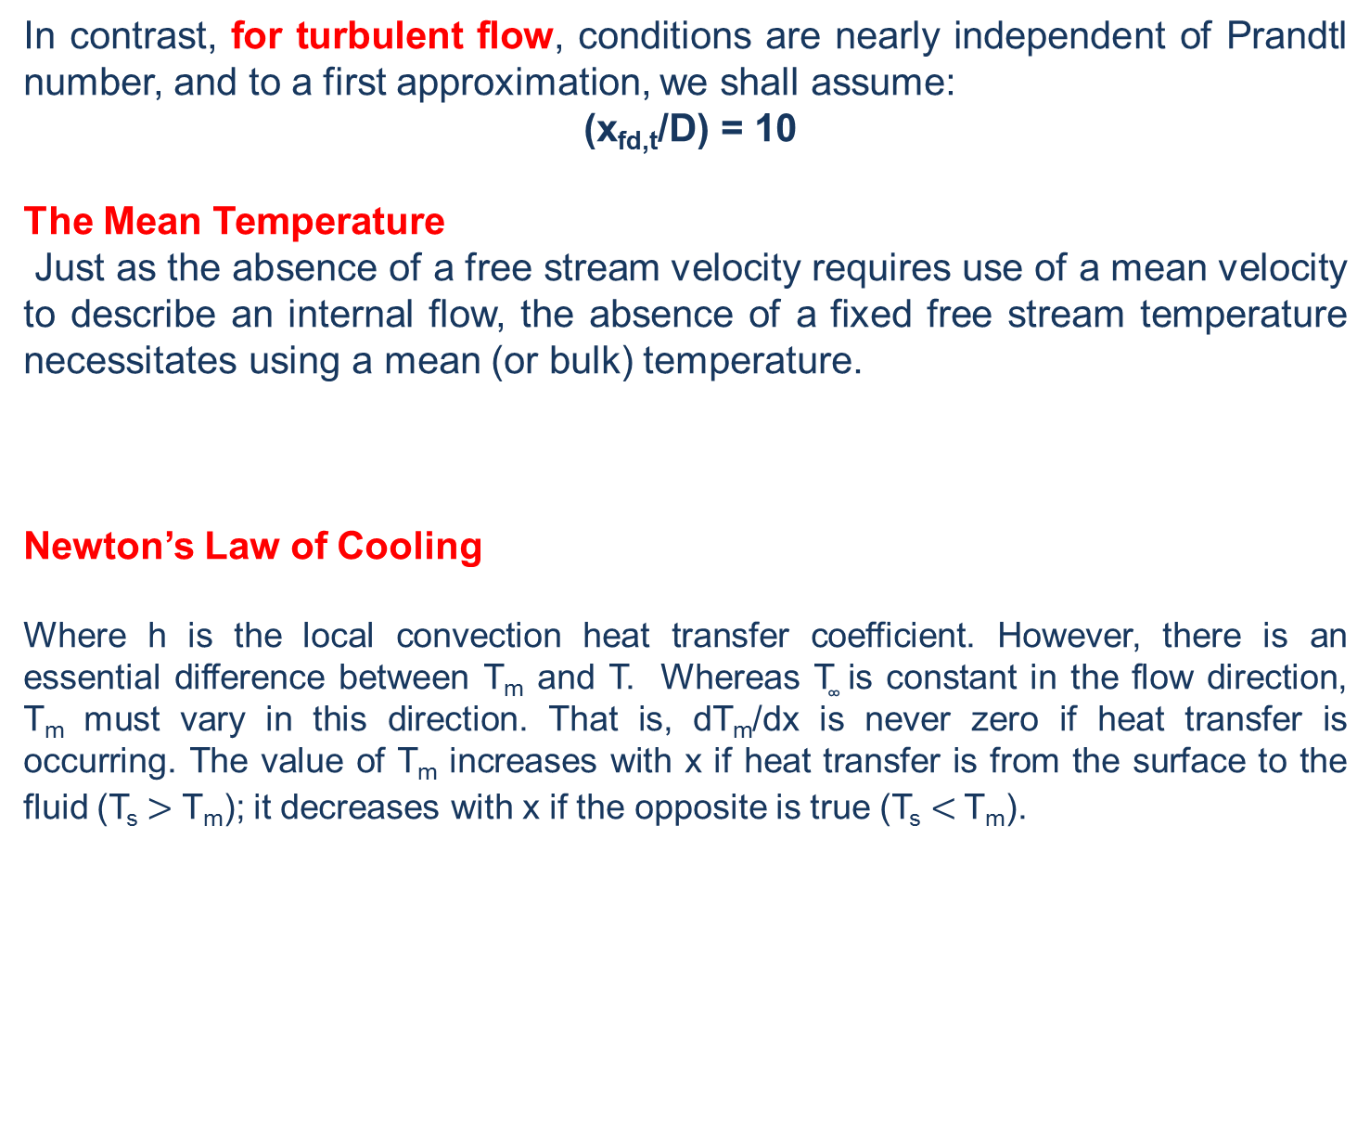
Cont’d …
In contrast, for turbulent flow, conditions are nearly independent of Prandtl number, and to a first approximation, we shall assume:
(x_{fd,t}/D) = 10
The Mean Temperature
Just as the absence of a free stream velocity requires use of a mean velocity to describe an internal flow, the absence of a fixed free stream temperature necessitates using a mean (or bulk) temperature.
Newton’s Law of Cooling
Where h is the local convection heat transfer coefficient. However, there is an essential difference between T_{m} and T. Whereas T͚ is constant in the flow direction, T_{m} must vary in this direction. That is, dT_{m}/dx is never zero if heat transfer is occurring. The value of T_{m} increases with x if heat transfer is from the surface to the fluid (T_{s} $>$ T_{m}); it decreases with x if the opposite is true (T_{s} $<$T_{m}).
AAiT
School of Mechanical and Industrial Engineering - SMiE

Slide 13
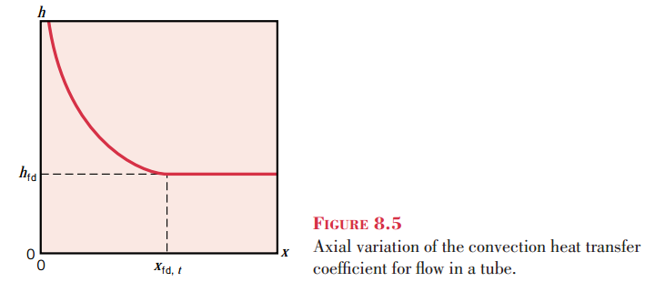
Cont’d …
Note:
Hence in the thermally fully developed flow of a fluid with constant properties, the local convection coefficient is a constant, independent of x.
In the entrance region, where h varies with x, as shown in Figure. Because the thermal boundary layer thickness is zero at the tube entrance, the convection coefficient is extremely large at x = 0. However, h decays rapidly as the thermal boundary layer develops, until the constant value associated with fully developed conditions is reached
AAiT
School of Mechanical and Industrial Engineering - SMiE

Slide 14

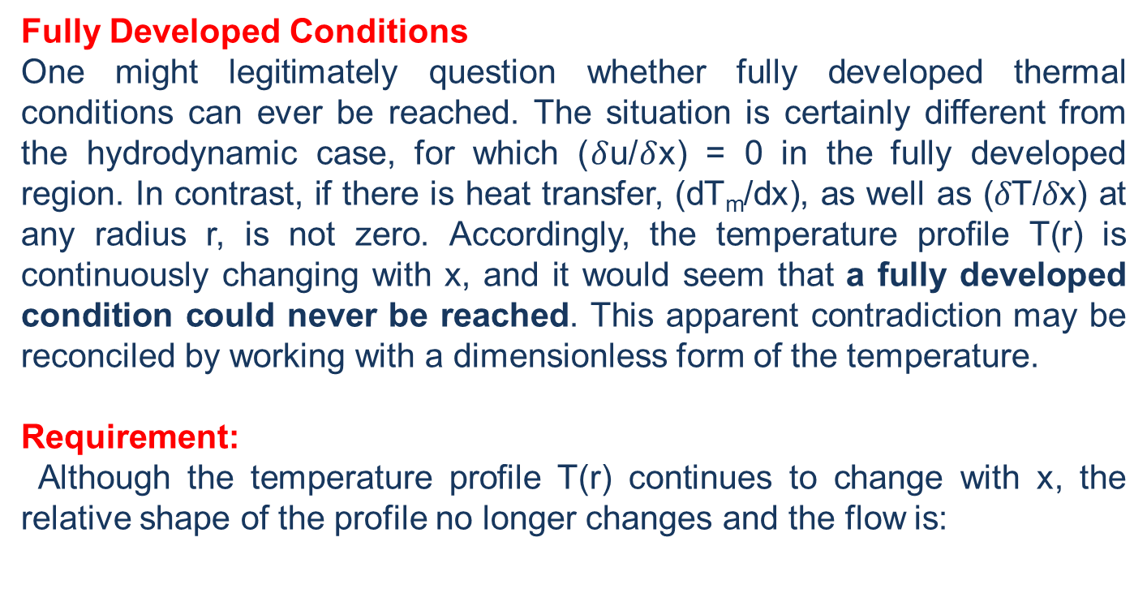
Cont’d …
Fully Developed Conditions
One might legitimately question whether fully developed thermal conditions can ever be reached. The situation is certainly different from the hydrodynamic case, for which ($δ$u/$δ$x) = 0 in the fully developed region. In contrast, if there is heat transfer, (dT_{m}/dx), as well as ($δ$T/$δ$x) at any radius r, is not zero. Accordingly, the temperature profile T(r) is continuously changing with x, and it would seem that a fully developed condition could never be reached. This apparent contradiction may be reconciled by working with a dimensionless form of the temperature.
Requirement:
Although the temperature profile T(r) continues to change with x, the relative shape of the profile no longer changes and the flow is:
AAiT
School of Mechanical and Industrial Engineering - SMiE

Slide 15

Cont’d …
The condition given by the equation above is eventually reached in a tube for which there is either a uniform surface heat flux (q’’ is constant) or a uniform surface temperature (T_{s} is constant).
Note that it is impossible to simultaneously impose the conditions of constant surface heat flux and constant surface temperature. If q’’ is constant, T_{s} must vary with x; conversely, if T_{s} is constant, q’’ must vary with x.
The Energy Balance
Because the flow in a tube is completely enclosed, an energy balance may be applied to determine how the mean temperature T_{m}(x) varies with position along the tube and how the total convection heat transfer q_{conv} is related to the difference in temperatures at the tube inlet and outlet.
AAiT
School of Mechanical and Industrial Engineering - SMiE

Slide 16
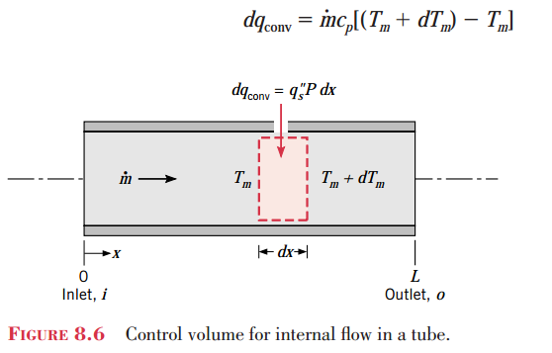

Cont’d …
The solution to the above equation for T_{m}(x) depends on the surface thermal condition. Recall that the two special cases of interest are constant surface heat flux and constant surface temperature.
AAiT
School of Mechanical and Industrial Engineering - SMiE

Slide 17


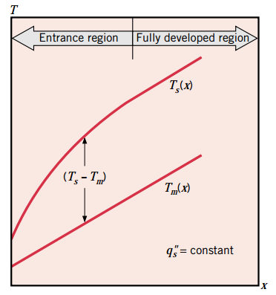
Cont’d …
Case – Constant Surface Heat Flux
AAiT
School of Mechanical and Industrial Engineering - SMiE

Slide 18
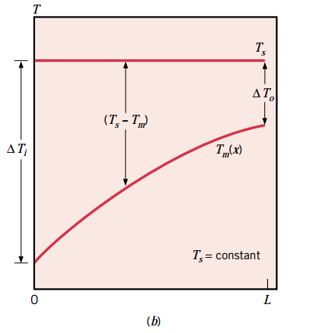

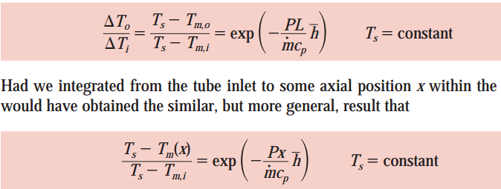
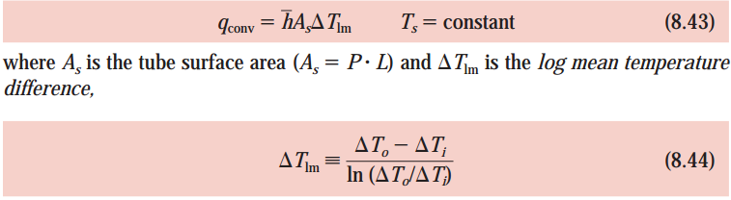
Cont’d …
Case – Constant Surface Temperature
Let ΔT = T_{s} - T_{m}
AAiT
School of Mechanical and Industrial Engineering - SMiE

Slide 19
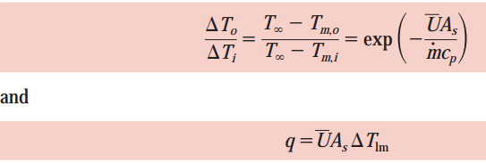
Cont’d …
It is readily shown that the results of this section may still be used if T_{s} is replaced by T͚ (the free stream temperature of the external fluid) and h (avg.) is replaced by (the average overall heat transfer coefficient). For such cases, it follows that:
AAiT
School of Mechanical and Industrial Engineering - SMiE

Slide 20


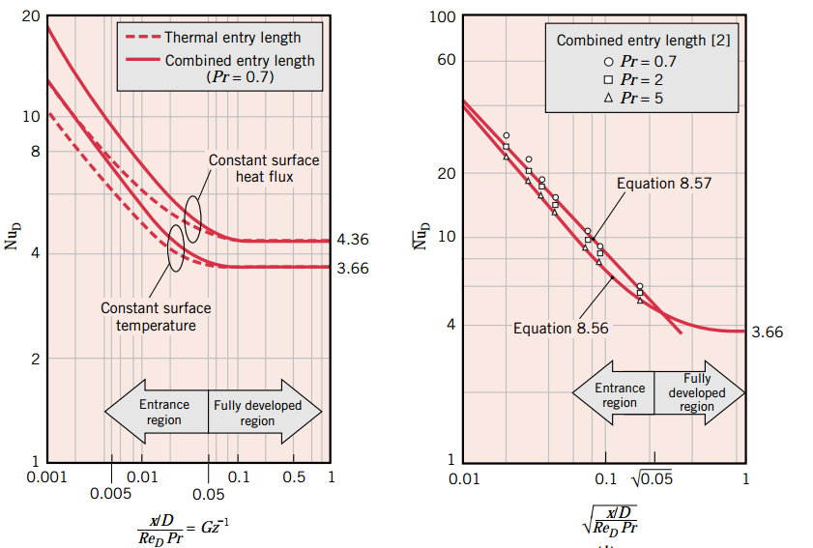
Empirical Convection Correlations – Internal Flow
Laminar Flow in Circular Tubes: Convection Correlations
The Fully Developed Region:
Hence in a circular tube characterized by uniform surface heat flux and laminar, fully developed conditions, the Nusselt number is a constant, independent of Re_{D}, Pr, and axial location. The thermal conductivity should be evaluated at T_{m}.
The Entry
Region:
AAiT
School of Mechanical and Industrial Engineering - SMiE

Slide 21
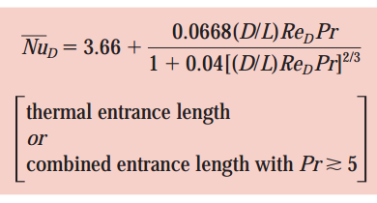
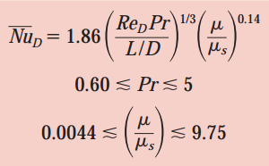
Cont’d …
For the constant surface temperature condition, it is desirable to know the average convection coefficient, presents a correlation attributed to Hausen, which is of the form:
Because this result is for the thermal entry length problem, it is applicable to all situations where the velocity profile is already fully developed.
For the combined entry length, a suitable correlation for use at moderate Prandtl numbers, due to Sieder and Tate
… *
AAiT
School of Mechanical and Industrial Engineering - SMiE

Slide 22

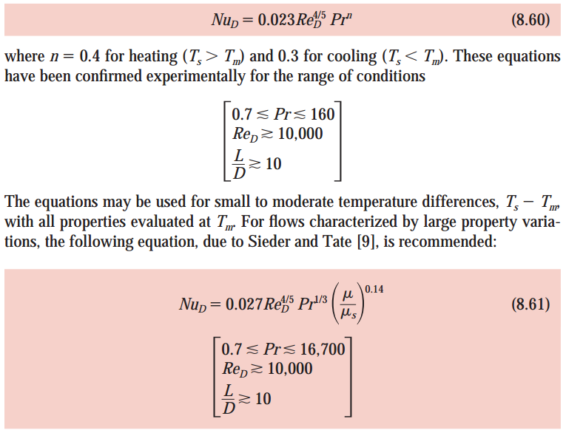
Cont’d …
Convection Correlations: Turbulent Flow in Circular Tubes
From the Chilton–Colburn:
The Dittus–Boelter equation:
AAiT
School of Mechanical and Industrial Engineering - SMiE

Slide 23
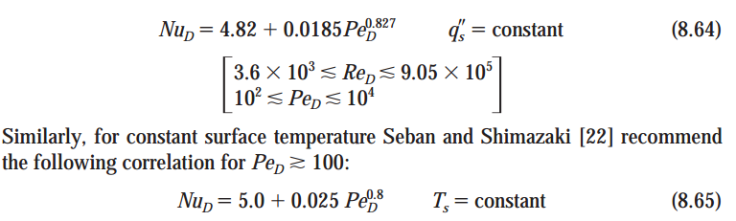
Cont’d …
The above correlations are used to a good approximation for both the uniform surface temperature and heat flux conditions.
For fully developed turbulent flow in smooth circular tubes with constant surface heat flux, Skupinski et al. recommend a correlation of the form:
AAiT
School of Mechanical and Industrial Engineering - SMiE

Slide 24
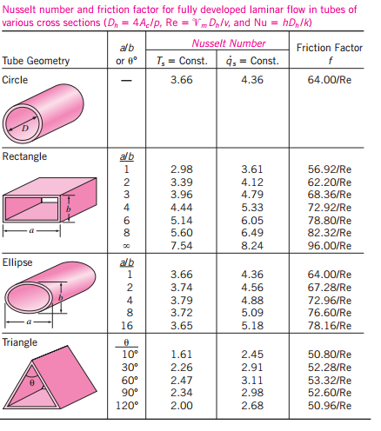
Cont’d …
Convection Correlations: Noncircular Tubes
AAiT
School of Mechanical and Industrial Engineering - SMiE

Slide 25
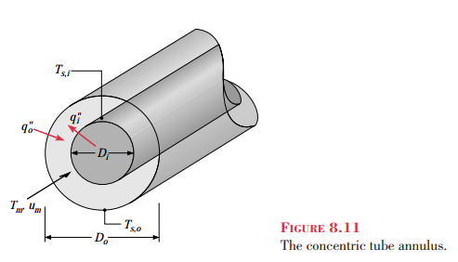

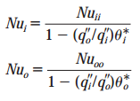

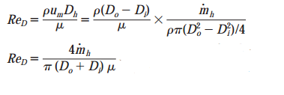

Cont’d …
Convection Correlations: Concentric Tube Annulus
AAiT
School of Mechanical and Industrial Engineering - SMiE

Slide 26
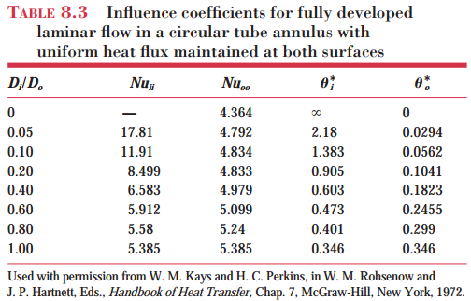
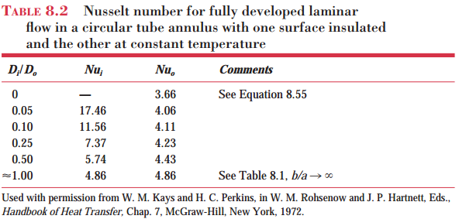
Cont’d …
AAiT
School of Mechanical and Industrial Engineering - SMiE

Slide 27
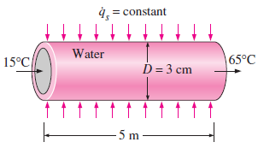
Example 1
1. Water is to be heated from 15°C to 65°C as it flows through a 3-cm-internal-diameter 5-m-long tube. The tube is equipped with an electric resistance heater that provides uniform heating throughout the surface of the tube. The outer surface of the heater is well insulated, so that in steady operation all the heat generated in the heater is transferred to the water in the tube. If the system is to provide hot water at a rate of 10 L/min, determine the power rating of the resistance heater. Also, estimate the inner surface temperature of the pipe at the exit.
AAiT
School of Mechanical and Industrial Engineering - SMiE

Slide 28
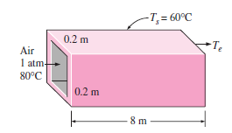
Example 2
2. Hot air at atmospheric pressure and 80°C enters an 8–m-long uninsulated square duct of cross section 0.2 m x 0.2 m that passes through the attic of a house at a rate of 0.15 m3/s. The duct is observed to be nearly isothermal at 60°C. Determine the exit temperature of the air and the rate of heat loss from the duct to the attic space.
AAiT
School of Mechanical and Industrial Engineering - SMiE

Slide 29
Thank You
Questions are Welcomed!

