Slide 1
Introduction to Power Systems(ECEG-3176)
Introduction

Slide 2
Evolution of Electric Power Systems
An electric power system is a network of electrical components deployed to supply, transfer, store, and use electric power
The first complete electric power system was built by Thomas Edison- the historic Pearl Street Station in New York City which began operation in September 1882.
Comprising a generator, cable, fuse, meter and loads.
It was dc system:-steam engine driven dc generator
59 customers in 1.5 km radius
Load: incandescent lamps
Underground cable system, 110 v.

Slide 3
Cont’d…
Within a few years similar systems were in operation in most large cities throughout the world.
With the development of motors by Frank Sprague in 1884, motor loads were added to such systems.
By 1886, the limitations of dc systems were becoming increasingly apparent. They could deliver power only a short distance from the generators.

Slide 4
Cont’d…
L. Gaulard and J.D. Gibbs of Paris, France developed transformer and ac transmission.
In 1886, William Stanley developed and tested a commercially practical transformer and ac distribution system for 150 lamps at Great Barrington, Massachusetts.
In 1889, the first ac transmission line in North America was put in to operation. It was a single phase line transmitting power at 4,000 V over a distance of 21 km.

Slide 5
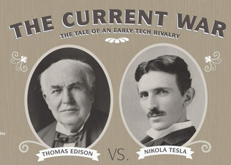
Cont’d…
With the development of poly phase systems by Nikola Tesla, the ac system became even more attractive.
In the 1890s, there was considerable controversy over whether the electric utility industry should be standardized on dc or ac.
There were passionate arguments between Edison, who advocate dc, and Nikola Tesla, who favored ac.

Slide 6
Cont’d…
By the turn of the century, the ac system had won out over the dc system for the following reasons:
Voltage levels can be easily transformed in ac systems, thus providing the flexibility for use of different voltages for generation, transmission and consumption.
AC generators are much simpler than dc generators.
AC motors are much simpler and cheaper than dc motors.

Slide 7
Cont’d…
The first three phase line in North America went in to operation in 1893 , a 2300V, 12km line.
In the early period of ac power transmission, frequency was not standardized.
Many different frequencies were in use: 25, 50, 60, 125 and 133 Hz.
60 Hz was adopted as standard in North America and many other countries use 50 Hz.

Slide 8
Cont’d…
The increasing need for transmitting larger amounts of power over longer distances created an incentive to use progressively higher voltage levels.
To avoid the proliferation of an unlimited number of voltages, the industry has standardized voltage levels.
With the development of mercury arc valves in the early 1950s, high voltage dc (HVDC) transmission systems became economical in special situations.
The cross over point beyond which dc transmission may become a competitive alternative to ac transmission is around 500 km for over head lines and 50 km for underground or submarine cables.

Slide 9
Cont’d…
HVDC transmission also provides an asynchronous link between systems where ac interconnection would be impractical because of system stability considerations or because nominal frequencies of the systems are different.
The first modern commercial application of HVDC transmission occurred in 1954 when the Swedish mainland and the island of Gotland were interconnected by a 96 km submarine cable.

Slide 10
Cont’d…
With the advent of thyristor valve converters, HVDC transmission became even more attractive.
The first application of an HVDC system using thyristor valves was at Eel River in 1972.
With the cost and size of conversion equipment decreasing and its reliability increasing, there has been a steady increase in the use of HVDC transmission.

Slide 11
Sources of Energy
The major sources of primary energy are:
Fossil fuels: coal, natural gas and oil
Water power: Hydroelectric power
Nuclear power: fission and fusion
Solar energy: heat radiation from the sun
Geothermal energy: thermal springs due to inner strata of earth at a very high temperature
Wind power: wind turbines
Tidal power: tides of ocean

Slide 12
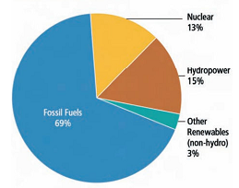
Cont’d…
Share of global electricity

Slide 13
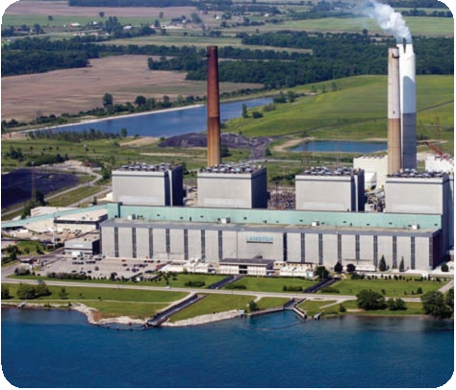
Cont’d…
Fossil fuel thermal power plant

Slide 14
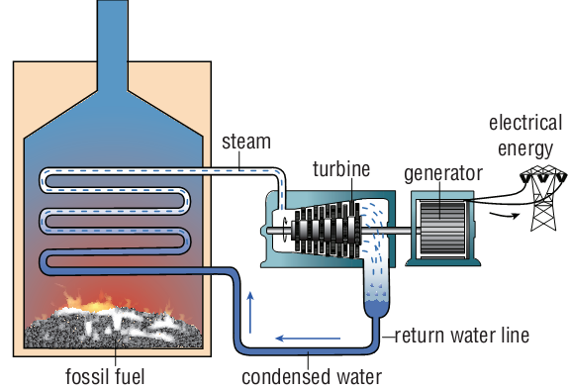
Cont’d…
Cross-section of a fossil fuel-fired thermal power plant

Slide 15
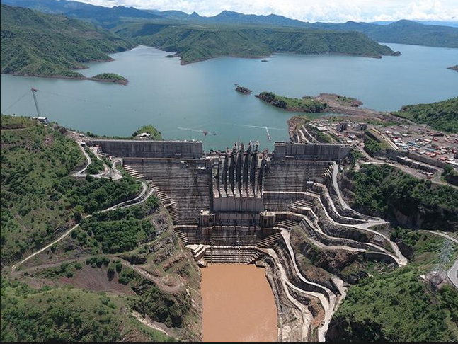
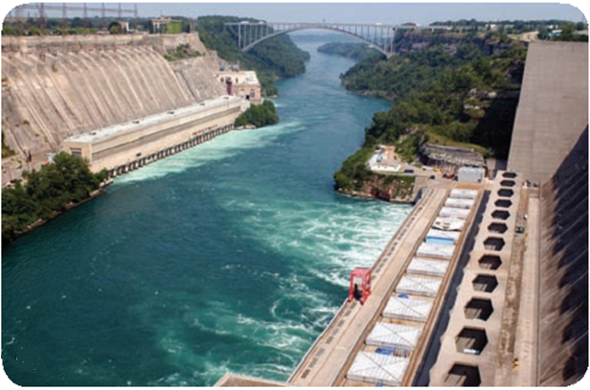
Cont’d…
Hydro-electric power plant
Gilgel Gibe III Dam

Slide 16
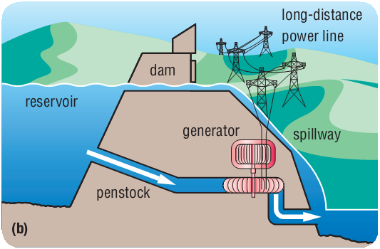
Cont’d…
Cross-section of a hydro-electric power plant

Slide 17
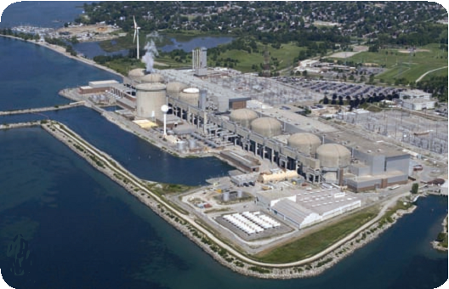
Nuclear power plant

Slide 18
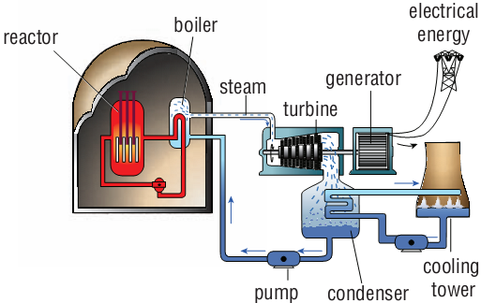
Cont’d…
Cross-section of a nuclear power plant

Slide 19
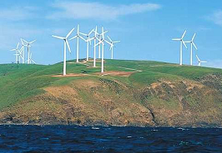
Cont’d…
Wind power plant

Slide 20

Cont’d…
Solar

Slide 21
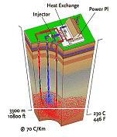
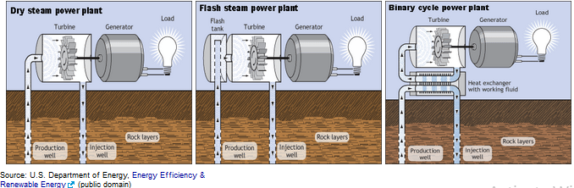
Cont’d…
Geothermal power plant

Slide 22
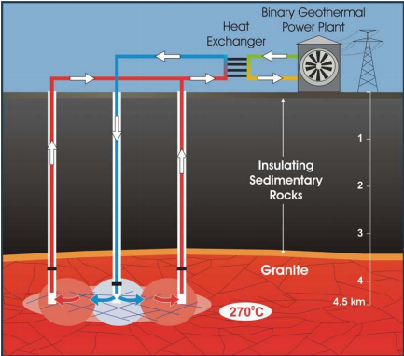
Cont’d…

Slide 23
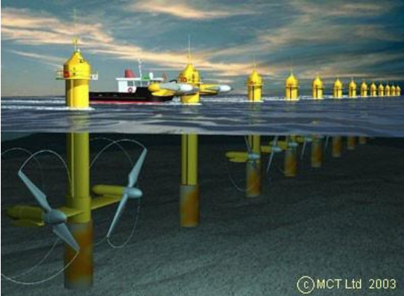
Cont’d…
Tidal power plant

Slide 24
AC and DC transmission
Comparison of AC and DC Transmission
Electric Power can either be transmitted by means of AC or DC
Advantages of DC Transmission:
Power transmission by means of DC requires only two conductors as compared to three conductors required for AC.
There is no inductance, capacitance, phase displacement and surge problem in DC transmission.
Due to absence of inductance, the voltage drop in DC transmission is less than the AC transmission for same load and receiving end voltage.
A DC transmission line has less Corona and hence efficiency is improved.
In DC transmission, there is no stability and synchronization problem.

Slide 25
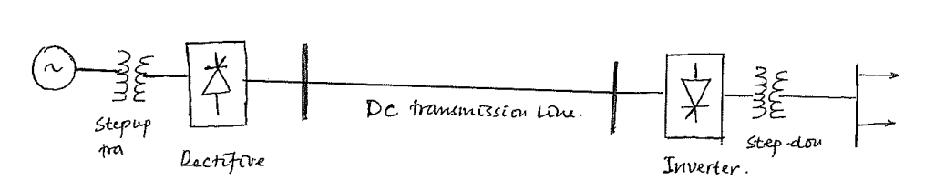
Cont’d…
Disadvantages of DC Transmission:
DC Power generation is difficult due to commutation problem.
Transformer does not work for DC and therefore voltage level of DC cannot be changed for power transmission.
DC Switches and Circuit Breakers have their own limitations

Slide 26
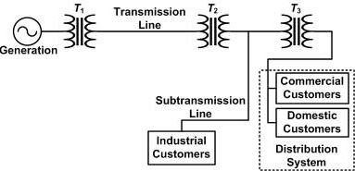
Cont’d…
Advantages of AC Transmission:
AC power can be generated at high voltage. The maximum voltage at which Electrical Power is generated in India is at 21 kV.
AC voltage can be stepped up for power transmission at high voltage.
Disadvantages of DC Transmission:
AC transmission requires more conductor material as compared to DC transmission.
The construction of AC transmission line is more complicated as compared to DC transmission line.
Due to Skin Effect in AC transmission, the effective resistance of conductor increases.

Slide 27
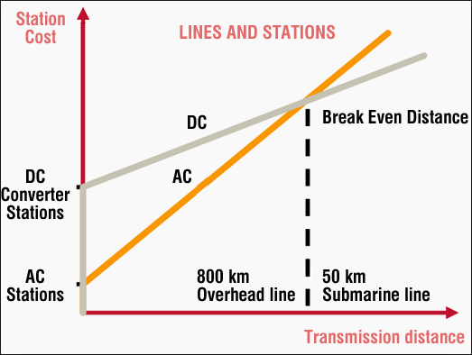
Cont’d…
Cost comparison of HVDC and HVAC overhead transmission lines

Slide 28
3 phase vs Single phase systems
Advantages of a three phase system over a single phase power system
The rating, i.e. the output of a three-phase machine is nearly 1.5 times the rating (output) of a single phase machine of the same size
In single phase circuits, the power delivered is pulsating. Whereas, in the polyphase system, the power delivered is almost constant when the loads are in balanced condition
Single Phase induction motors are not self starting as it does not have starting torque, where as Three phase induction motors are self starting.
3 Phase system requires less copper and aluminium for the transmission system in comparison to a single phase transmission system.

Slide 29
Cont’d…
In 3 phase motor, the frequency of vibrations is less as compared to single phase motor because in single phase the power transferred is a function of current and varies constantly
3 Phase system requires less copper and aluminium for the transmission system in comparison to a single phase transmission system.
Disadvantages of 3 phase system over single phase
Unbalanced loading ( can cause voltage fluctuations )
Complex System (requires symmetrical components for analysis and operation )
Phase Sequence needed to be kept in mind while making connections

Slide 30
Structure of the Power System
Electrical systems vary in size and structural components.
However, they all have the same basic characteristics.
Generation system
Transmission system
Sub-transmission system
Distribution system

Slide 31
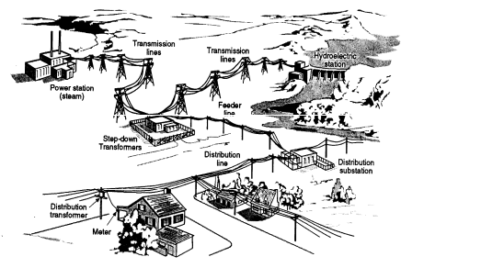
Cont’d…

Slide 32
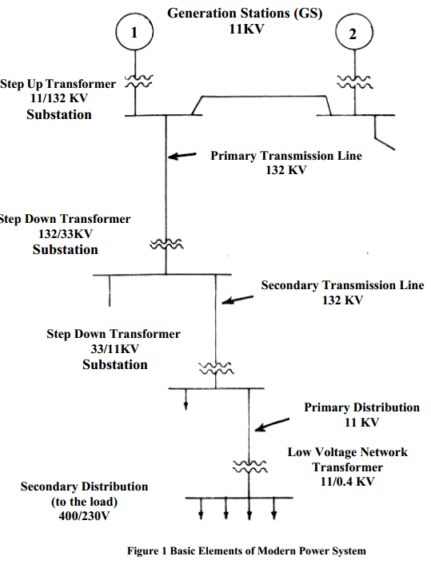
Cont’d…

Slide 33
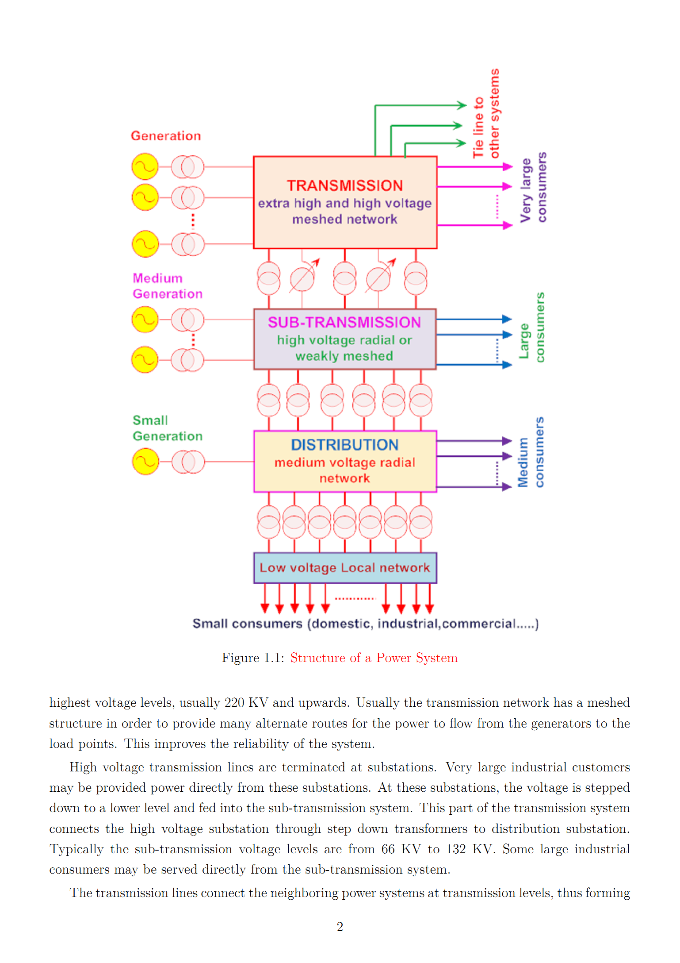

Slide 34
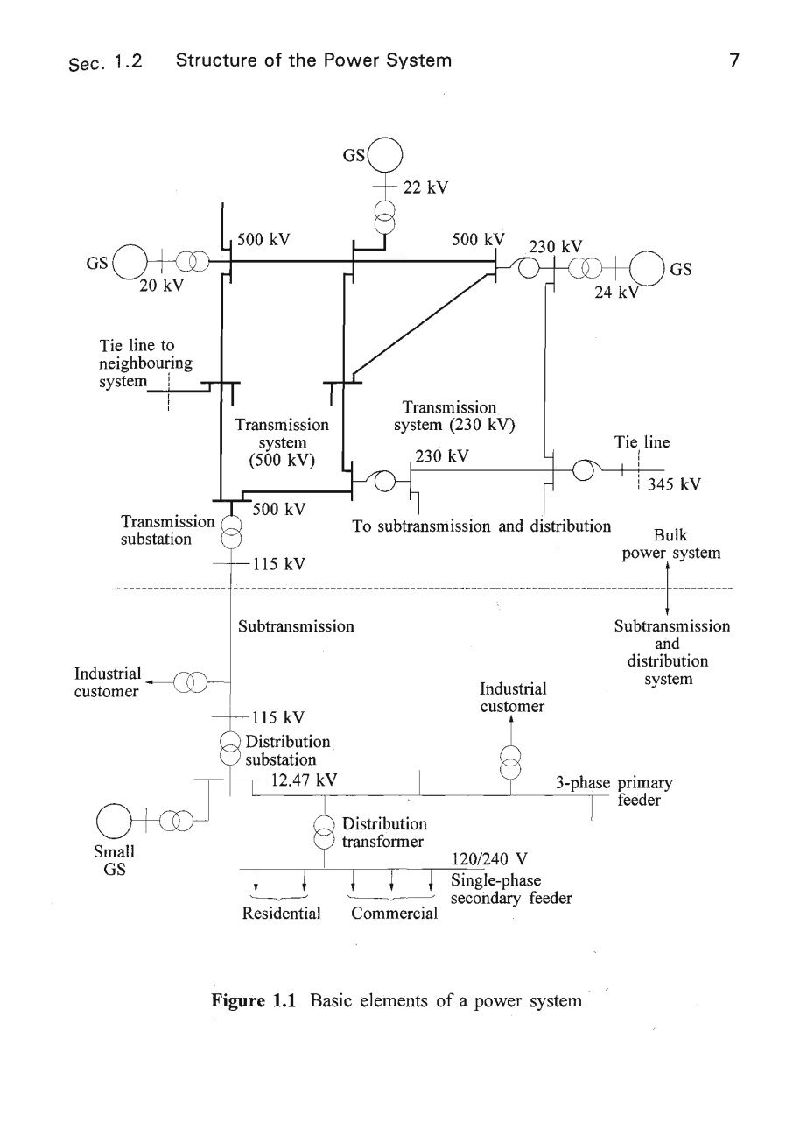

Slide 35
