Slide 1
Introduction to Power Systems
Chapter 3: Transmission Line Parameters

Slide 2
Transmission Line Design Considerations
An overhead transmission line consists of :
      Conductors
      Insulators
      Support structures
      Shield wires
The transmission towers are usually made of steel and are solidly erected with a concrete base. The three-phase conductors are supported by the towers through insulators.

Slide 3
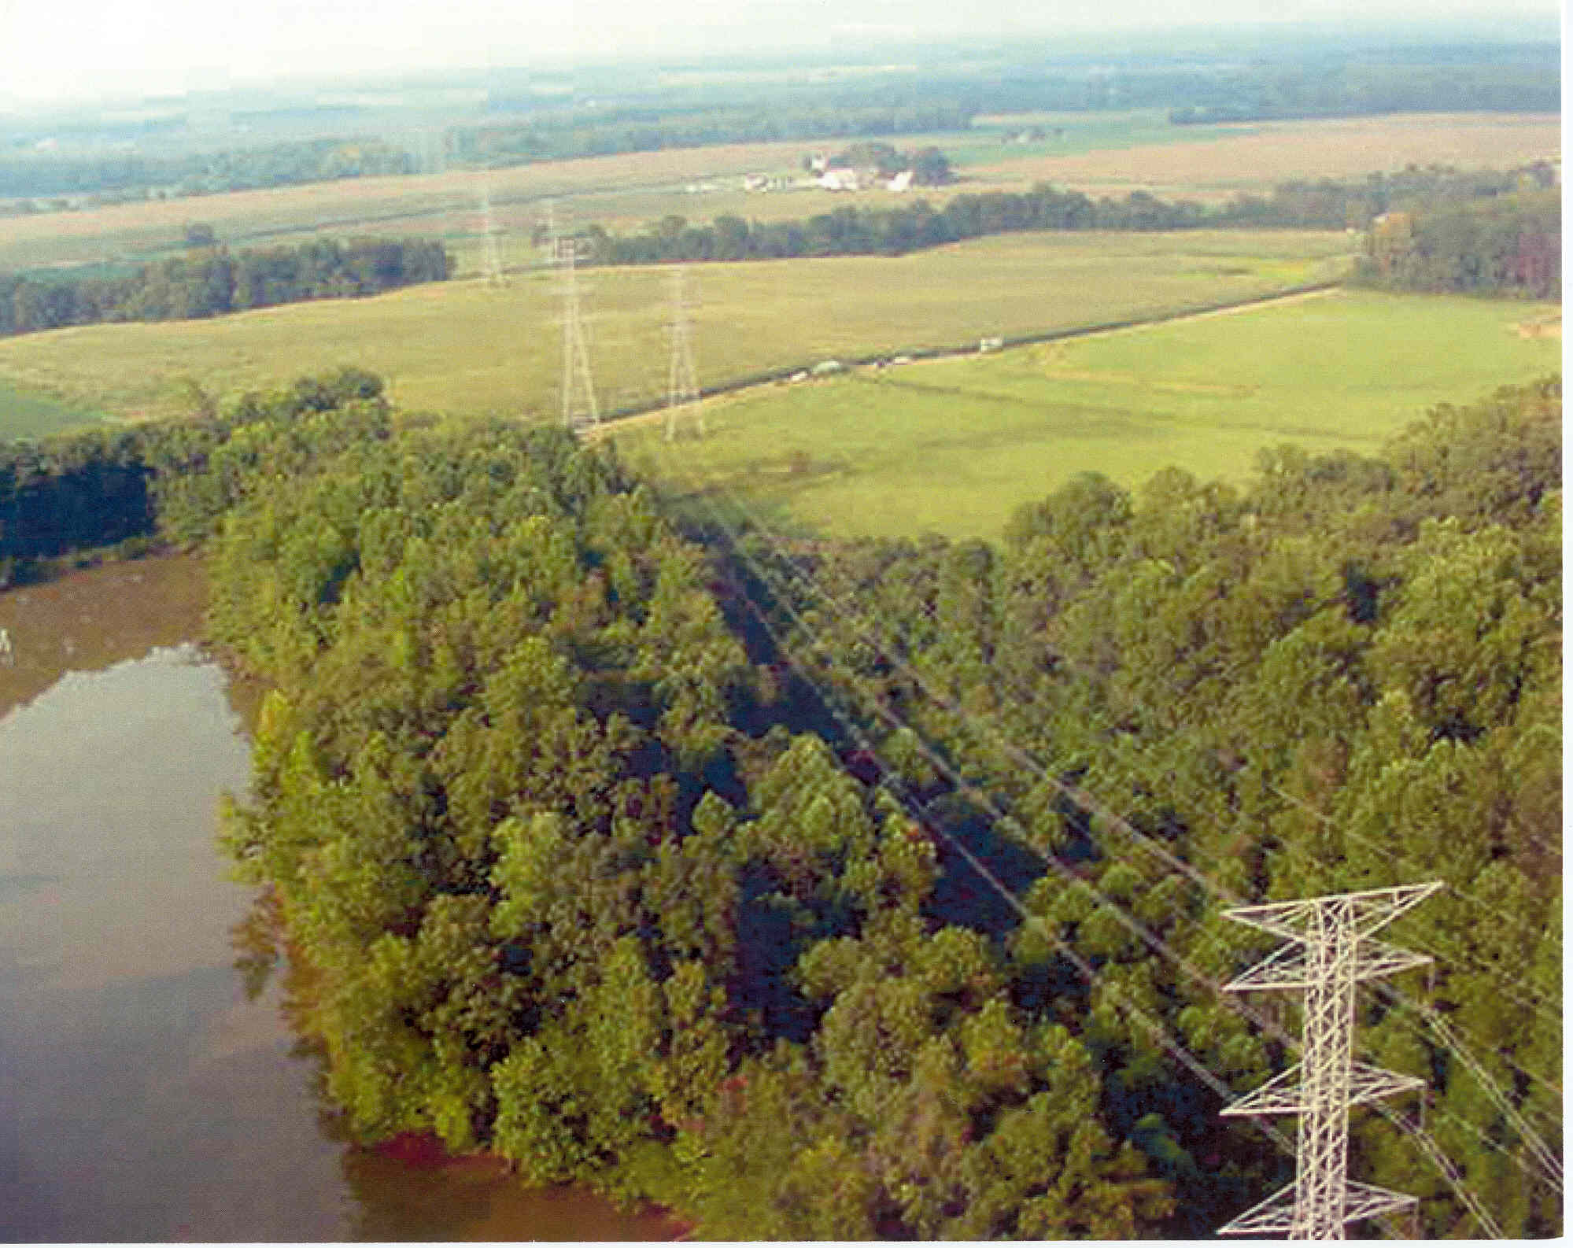

Slide 4
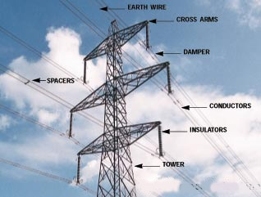

Slide 5
Conductors
The conductors are usually made of aluminum or its alloys.
Aluminum is preferred over copper as an aluminum conductor is lighter in weight and cheaper in cost than copper conductor of the same resistance.
The conductors are not straight wires but strands of wire twisted together to form a single conductor to give it higher tensile strength. One of the most common conductors is aluminum conductor, steel reinforced (ACSR).

Slide 6
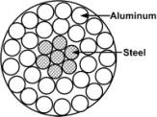
The central core is formed with strands of steel while two layers of aluminum strands are put in the outer layer.
The other type of conductors that are in use are all aluminum conductor (AAC), all aluminum alloy conductor (AAAC), aluminum conductor, alloy reinforced (ACAR).

Slide 7
EHV lines often have more than one conductor per phase.
These conductors are called a bundle.
Bundle conductors have a lower electric field strength at the conductor surfaces, thereby controlling corona.
They also have a smaller series reactance.

Slide 8
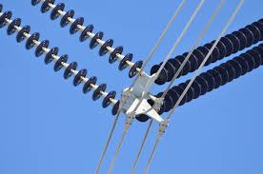
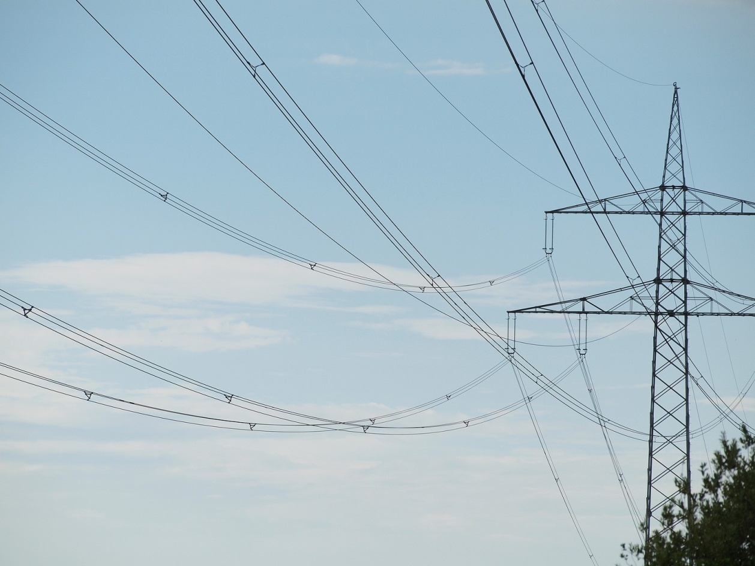

Slide 9
Insulators
Towers are at ground potential, the lines must be insulated from the tower structure.
An insulator is a device intended to give flexible or rigid support to the conductors or equipment and to insulate these conductors or equipment from ground.

Slide 10
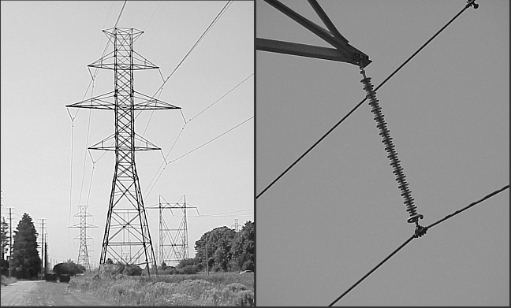

Slide 11
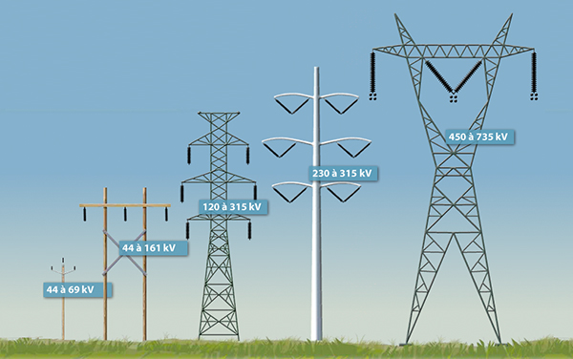
      Support structures
Transmission lines employ a variety of support structures.

Slide 12
      Shield wires
Shield wire located above conductors protect the conductors from lightening.
These are usually high- or extra-high strength steel, Alumo-weld , or ACSR with much smaller cross section than the phase conductors.
Shield wires are grounded to the tower.

Slide 13
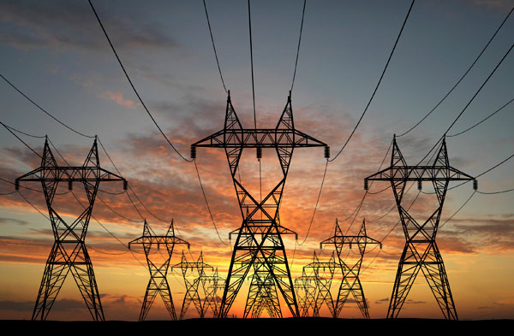

Slide 14
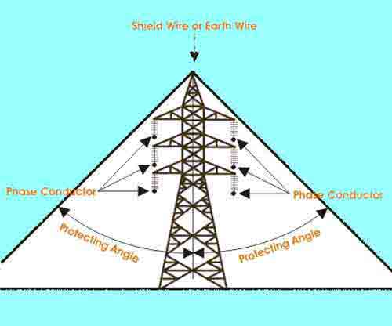

Slide 15
The decision to build new transmission is based on power system planning studies to meet future system requirements of load growth and new generation.
The points of interconnection of each new line to the system, as well as the power and voltage ratings of each, are selected based on these studies.
Thereafter, transmission line design is based on optimization of:
          Electrical
          Mechanical
          Environmental
          economic factors.

Slide 16
      Electrical factors
            Conductors:
              size, type, number of bundle per phase
              Thermal capacity: normal, emergency, overload, short circuit currents
            Insulators:
              No. of insulator discs
              Arrangement of strings: vertical or V-shaped
              Clearance: phase to phase, phase to tower.
            Shield wires: no., type and location of shield wires, footing resistance of towers,…

Slide 17
      Mechanical Factors
Mechanical design focuses on strength of the conductors , insulator strings and support structures.
Conductors must be strong enough to support a specified thickness of ice and a specified wind in addition to their own weight.
Suspension insulator strings must be strong enough to support the phase conductors with ice and wind loadings from tower to tower (span length).
Towers support phase conductors, shield wires with ice and wind loadings.

Slide 18
      Environmental factors
Environmental factors includes land usage and visual impact.
When a line route is selected, the impact on local communities and population centers, land values, access to property, wild life and use of public parks ,…, must all be considered.

Slide 19
      Economic Factors
The optimum line design meets all the technical design criteria at lowest possible overall cost, which includes the total installed cost of the line as well as the cost of line losses over the operating life of the line.

Slide 20
Transmission Line Parameters
A transmission line has four parameters:
      Series Resistance
      Series Inductance
      Shunt Capacitance
      Shunt Conductance

Slide 21
Conductance exists between conductors or between conductors and the ground. It is due to:
      The leakage current at the insulators (dirt, salt,…)
      Corona discharge between lines
It is neglected due to:
      Leakage currents at insulators and the power loss due to corona are negligible.
      It is quite variable. There is no good way of taking it into account.

Slide 22

Line Resistance
It is very well known that the dc resistance of a wire is given by
where ρ is the resistivity of the wire in Ω - m, l is the length in meter and A is the cross sectional area in m² .
Unfortunately the resistance of an overhead conductor is not the same as that given by the above expression.

Slide 23
When alternating current flows through a conductor, the current density is not uniform over the entire cross section but is somewhat higher at the surface.
This is called the skin effect and this makes the ac resistance a little more than the dc resistance.
Moreover in a stranded conductor, the length of each strand is more than the length of the composite conductor.
This also increases the value of the dc resistance.

Slide 24

Finally the temperature also affects the resistivity of conductors.
However, the temperature rise in metallic conductors is almost linear in the practical range of operation and is given by
where R₁ and R₂ are resistances at temperatures t₁ and t₂ respectively and T is a constant that depends on the conductor material and its conductivity.

Slide 25
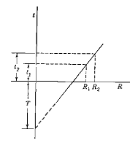

Since, the resistance of a conductor cannot be determined accurately, it is best to determine it from the data supplied by the manufacturer.
The effective (ac) resistance of a conductor is:

Slide 26
Inductance
Inductance of a Straight Conductor
From the knowledge of high school physics we know that a current carrying conductor produces a magnetic field around it.
The magnetic flux lines are concentric circles with their direction specified by Maxwell's right hand thumb rule ( i.e., if the thumb of the right hand points towards the flow of current then the fingers of the fisted hand point towards the flux lines ).

Slide 27

The sinusoidal variation in the current produces a sinusoidal variation in the flux.
The relation between the inductance, flux linkage and the phasor current is then expressed as
where L is the inductance in Henry, λ is the flux linkage in Weber-turns and I is the phasor current in Ampere.

Slide 28
The inductance of a magnetic circuit that has a constant permeability μ can be obtained by determining the following:
Magnetic field intensity H, from Ampere’s law
Magnetic flux density B (B = μH)
Flux linkages λ
Inductance from flux linkages per ampere (L = λ/I )

Slide 29
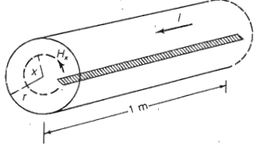
Internal Inductance
Consider a straight round (cylindrical) conductor, the cross-section of which is shown below.
The conductor has a radius of r and carries a current I.

Slide 30

Ampere's law states that the magneto-motive force (mmf) in ampere-turns around a closed path is equal to the net current in amperes enclosed by the path. We then get the following expression:
where H is the magnetic field intensity in At/m, s is the distance along the path in meter and I is the current in ampere.
Let us denote the field intensity at a distance x from the center of the conductor by H_{x}.

Slide 31


It is to be noted that H_{x}is constant at all points that are at a distance x from the center of the conductor.
Therefore H_{x} is constant over the concentric circular path with a radius of x and is tangent to it.
Denoting the current enclosed by I_{x} we can then write
If we now assume that the current density is uniform over the entire conductor, we can write

Slide 32


Assuming a relative permeability of 1, the flux density at a distance of x from the center of the conductor is given by
Where
  µ₀ is the permeability of the free space and is given by 4π X 10⁻⁷ H/m.

Slide 33

The flux inside (or outside) the conductor is in the circumferential direction .
The two directions that are perpendicular to the flux are radial and axial .
Let us consider an elementary area that has a dimension of dx m along the radial direction and 1 m along the axial direction.
Therefore the area perpendicular to the flux at all angular positions is dx X 1 m² . Let the flux along the circular strip be denoted by dφ _{x} and this is given by .

Slide 34

Note that the entire conductor cross section does not enclose the above flux.
The ratio of the cross sectional area inside the circle of radius x to the total cross section of the conductor can be thought about as fractional turn that links the flux dφ _{x}.
Therefore the flux linkage is

Slide 35



Integrating over the range of x , i.e., from zero to r , we get the internal flux linkage as
Then, we get the internal inductance per unit length as
It is interesting to note that the internal inductance is independent of the conductor radius.

Slide 36
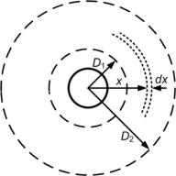
External Inductance
Let us consider an isolated straight conductor as shown below.
The conductor carries a current I .

Slide 37


Assume that the tubular element at a distance x from the center of the conductor has a field intensity H_{x} .
Since the circle with a radius of x encloses the entire current, the mmf around the element is given by
and hence the flux density at a radius x become

Slide 38


The entire current I is linked by the flux at any point outside the conductor.
Since, the distance x is greater than the radius of the conductor, the flux linkage dλ_{x} is equal to the flux dϕ_{x}.
Therefore, for 1 m length of the conductor we get
The external flux linkage between any two points D₁ and D₂, external to the conductor is

Slide 39


We can then write the external inductance due to the flux linkage between any two points outside the conductor as
The total flux λ_{p} linking the conductor out to external point P at a distance D is the sum of the internal flux linkage and the external flux linkage, from D₁ = r to D₂=D.

Slide 40
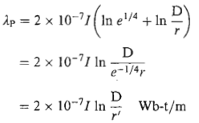


Using the identity
Where
The total inductance L_{p} due to both internal and external flux linkages out to distance D is

Slide 41
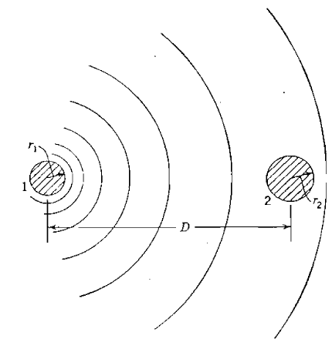
Inductance of a Single-Phase Two-Wire Line

Slide 42
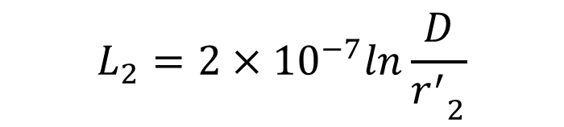
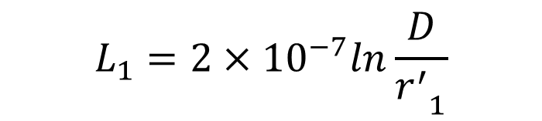
The inductance of the circuit due to current in conductor 1 only
The inductance of the circuit due to current in conductor 2 only
$$L_{1}=2×{10}^{−7}ln\frac{D}{{r_{}^{′}}_{1}^{}}$$
$$L_{2}=2×{10}^{−7}ln\frac{D}{{r_{}^{′}}_{2}^{}}$$

Slide 43
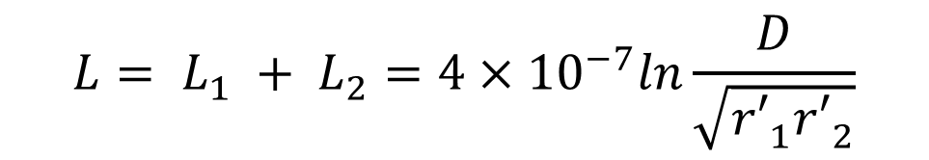


For the complete circuit (Loop inductance of the circuit)
If ${r′}_{1 }= {r′}_{2}=r′$
$${L= L}_{1} + L_{2}=4×{10}^{−7}ln\frac{D}{\sqrt{{{r′}_{1}^{}r′}_{2}^{}}}$$
$$L=4×{10}^{−7}ln\frac{D}{r′}$$

Slide 44
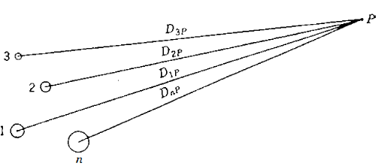
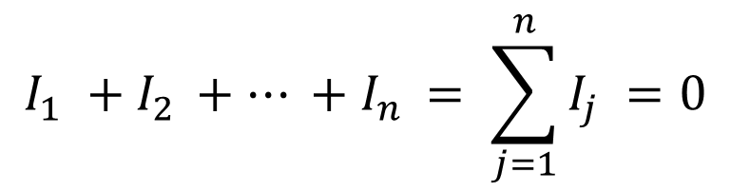
Flux Linkage of One Conductor in a Group
$$I_{1} +I_{2 }+… +I_{n }= \sum_{j=1}^{n}{I_{j} }=0$$

Slide 45
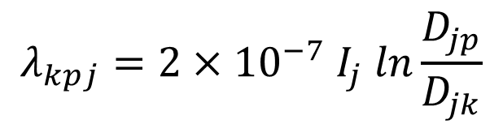
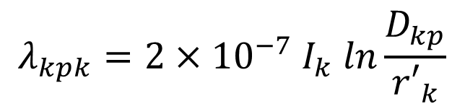
Flux linkage of conductor k due to current in conductor k:
Flux linkage of conductor k due to current in conductor k:
$$λ_{kpk}=2×{10}^{−7} I_{k} ln\frac{D_{kp}}{{r′}_{k}}$$
$$λ_{kpj}=2×{10}^{−7} I_{j} ln\frac{D_{jp}}{D_{jk}}$$

Slide 46


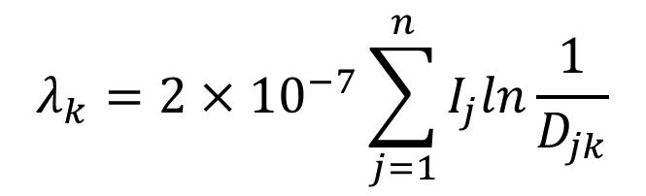
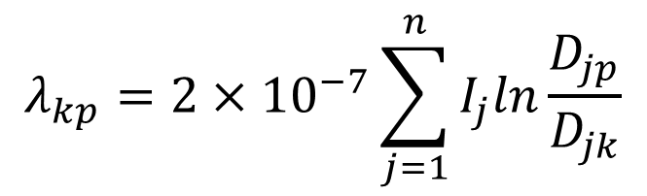
The flux linkages with conductor k due to the currents in all conductors of the group except the flux beyond point p:
If p$→∞$
$${λ_{kp}= λ}_{kp1}+λ_{kp2}+λ_{kp3}+…+λ_{kpn}$$
$$λ_{kp}=2×{10}^{−7}\sum_{j=1}^{n}{I_{j}ln\frac{D_{jp}}{D_{jk}}}$$
$${Where: D}_{kk}={r′}_{k}$$
$$λ_{k}=2×{10}^{−7}\sum_{j=1}^{n}{I_{j}ln\frac{1}{D_{jk}}}$$

Slide 47
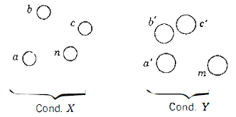
Inductance of Composite Conductor Lines
All the strands are identical and share the current equally.

Slide 48
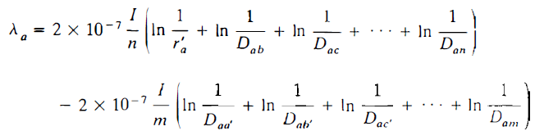


Flux linkages of filament a in conductor X.

Slide 49


Similarly, the inductance of filament b:
The average inductance of the filaments of conductor X:

Slide 50

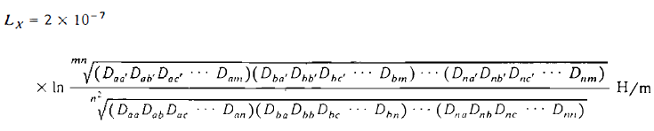

The inductance of conductor X:

Slide 51


$D_{m}$ is called Geometric Mean Distance (GMD or Mutual GMD).
$D_{s}$ is called Geometric Mean Radius (GMR or Self GMD).
The inductance of the line is:

Slide 52
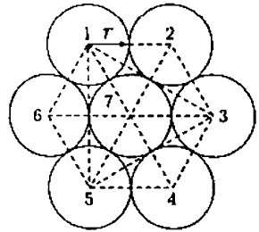
Example:
A stranded conductor consists of seven identical strands each having a radius r as shown below. Determine the GMR of the conductor in terms of r.

Slide 53
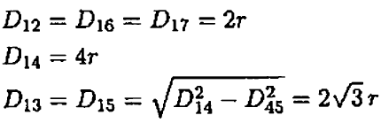

Solution

Slide 54
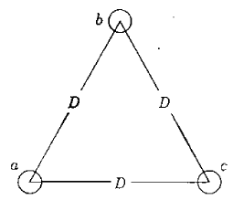
Inductance of Three Phase Lines with Equilateral Spacing
Balanced three phase currents.

Slide 55





Slide 56
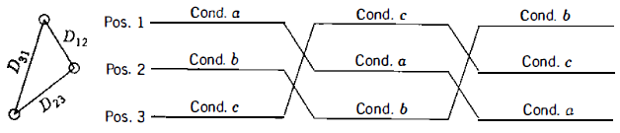

Inductance of Three Phase Lines with Unsymmetrical Spacing
Flux linkages of a in position 1:

Slide 57



Flux linkages of a in position 2:
Flux linkages of a in position 3:
The average value of the flux linkages of a:

Slide 58
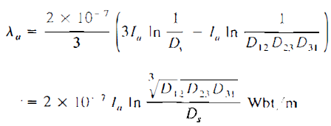


The average inductance per phase is:
Where:

Slide 59

Inductance Calculation for Bundle Conductors
Advantages of using bundle conductors
  Reduced corona loss and interference with communication lines
  Reduced Reactance
To compute D_{eq}, the distance from the center of one bundle to the center of another bundle is sufficiently accurate for D_{ab}, D_{bc} and D_{ca}.

Slide 60



For a two bundle conductor
For a three bundle conductor
For a four bundle conductor

Slide 61
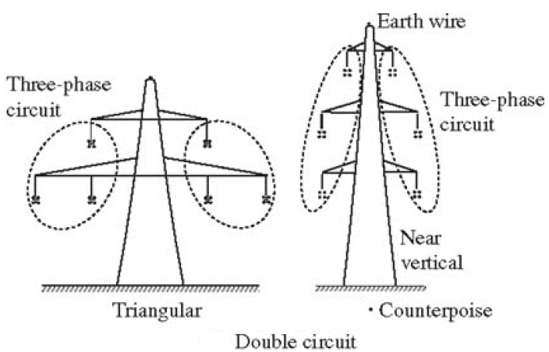
Inductance of Three Phase Double Circuit Lines

Slide 62
A three phase double circuit line consists of two identical three phase circuits.
The circuits are operated with a₁-a₂, b₁-b₂, and c₁-c₂ in parallel.
Because of geometrical differences between conductors, voltage drop due to line inductance will be unbalanced.
To achieve balance, each phase conductor must be transposed within its group and with respect to the parallel three phase line.

Slide 63
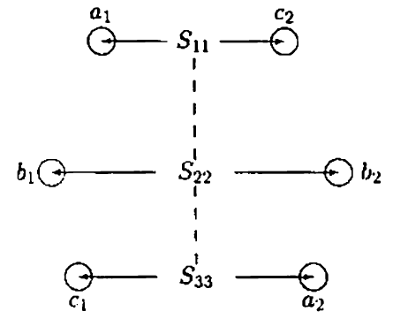
Transposed double circuit line.

Slide 64
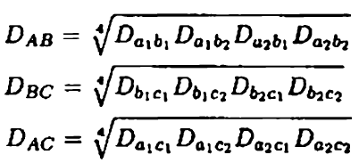

The method of GMD can be used to find the inductance per phase.
To do this, the identical phases are grouped together.
The GMD between each phase group:
The equivalent GMD per phase is then:

Slide 65
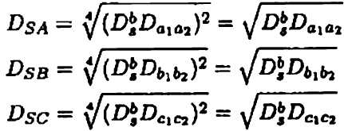


Similarly, the GMR of each phase group is:
The equivalent GMR for calculating the per phase inductance is:
The inductance per phase in millihenries per kilometer is:

Slide 66
Capacitance
Shunt admittance of a transmission line consists of conductance and capacitive reactance.
As we have discussed previously the conductance is usually neglected because its contribution to the shunt admittance is very small.
Capacitance of a transmission line is the result of the potential difference between the conductors.
It causes them to be charged in the same manner as the plates of a capacitor when there is a potential difference between them.

Slide 67
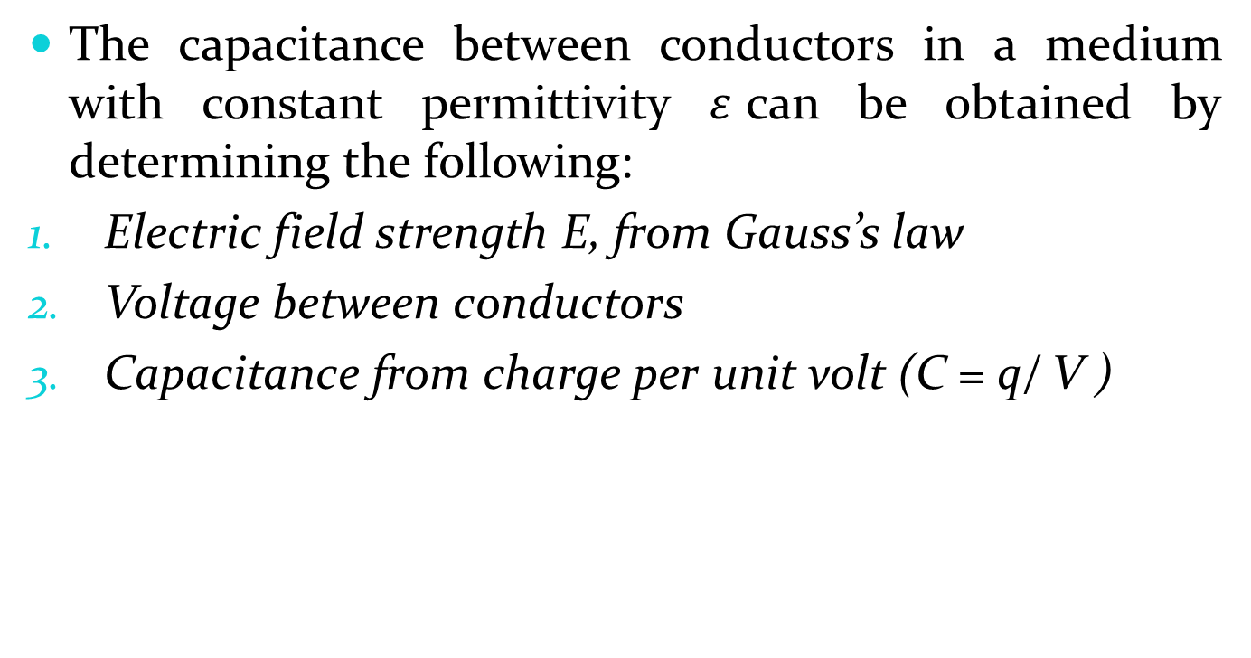
The capacitance between conductors in a medium with constant permittivity $ε$can be obtained by determining the following:
Electric field strength E, from Gauss’s law
Voltage between conductors
Capacitance from charge per unit volt (C = q/ V )

Slide 68

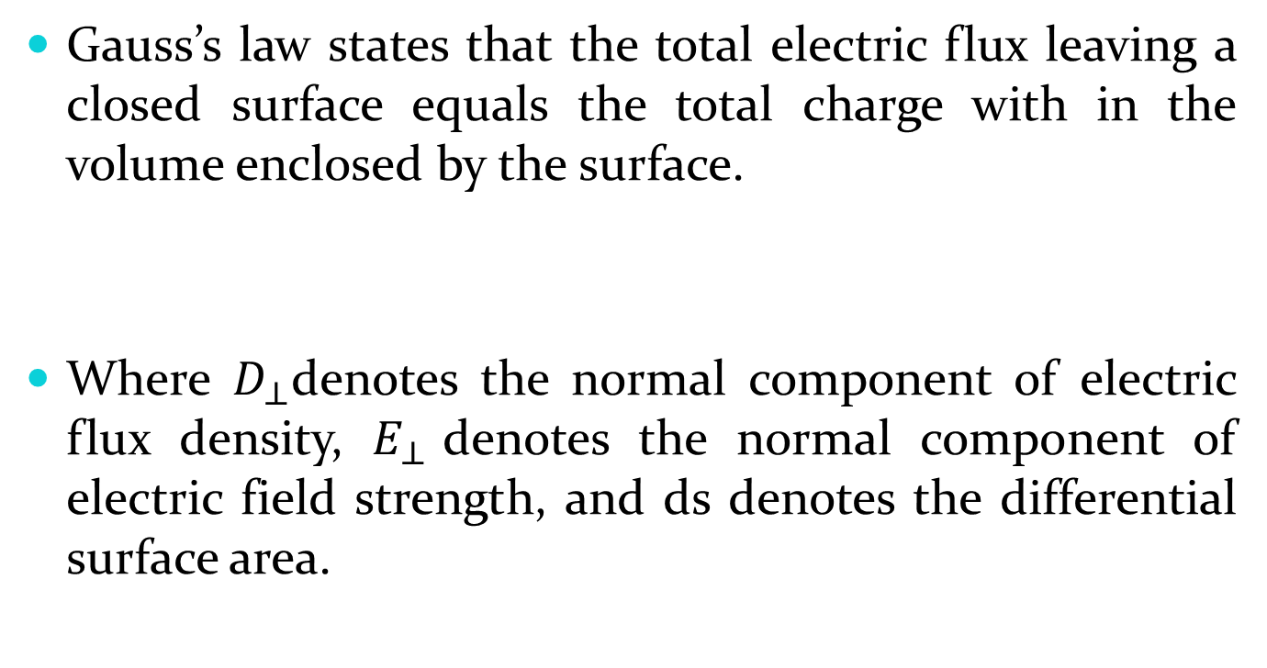
Gauss’s law states that the total electric flux leaving a closed surface equals the total charge with in the volume enclosed by the surface.
Where $D_{⊥}$denotes the normal component of electric flux density, $E_{⊥}$denotes the normal component of electric field strength, and ds denotes the differential surface area.

Slide 69
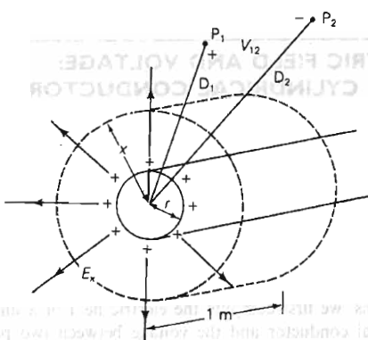

Slide 70
Assumptions:
The line is sufficiently long that end effects are neglected.
It is a perfect conductor (zero resistivity).
Uniform distribution of charge on the surface. The uniformly distributed charge on the wire is equivalent to a charge concentrated at the center of the wire for calculating flux external to the wire

Slide 71



At x distance from the center of the conductor:
The potential difference between two pints P1 and P2 at distances D1 and D2 from the center of the conductor.

Slide 72
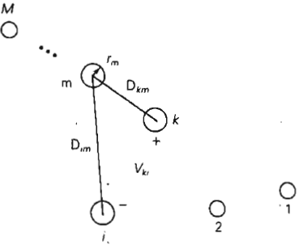
For array of M solid cylindrical conductors

Slide 73


The voltage between conductors k and i due to the charge q_{m} acting alone
Using superposition, the voltage between the conductors k and i due to all the charges

Slide 74

Capacitance of single phase two wire line
r_{a}
r_{b}
a
b
D
$V_{ab}=\frac{q_{a}}{2πε}ln\frac{D}{r_{a}}+\frac{q_{b}}{2πε}ln\frac{r_{b}}{D}$ V
$$V_{ab}=\frac{q_{a}}{2πε}\left(ln\frac{D}{r_{a}}−ln\frac{r_{b}}{D}\right)\text{V}$$
$V_{ab}=\frac{q_{a}}{2πε}ln\frac{D^{2}}{r_{a}r_{b}}$ V
$C_{ab}=\frac{q_{a}}{V_{ab}}=\frac{2πε}{ln⁡(\frac{D^{2}}{r_{a}r_{b}})}$ F/m

Slide 75
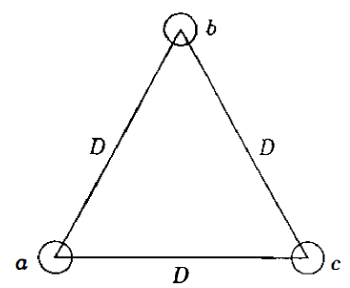
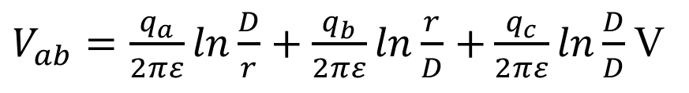

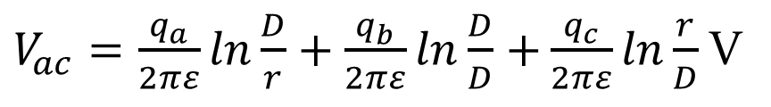
Capacitance of a Three-phase Line with Equilateral Spacing
I f there are no other charges in the vicinity , the sum of the charges on the three conductors is zero. (For balanced voltages)
$$q_{a}+q_{b}+q_{c}=0$$
$V_{ab}=\frac{q_{a}}{2πε}ln\frac{D}{r}+\frac{q_{b}}{2πε}ln\frac{r}{D}$ $+\frac{q_{c}}{2πε}ln\frac{D}{D}$ V
$V_{ac}=\frac{q_{a}}{2πε}ln\frac{D}{r}+\frac{q_{b}}{2πε}ln\frac{D}{D}$ $+\frac{q_{c}}{2πε}ln\frac{r}{D}$ V

Slide 76
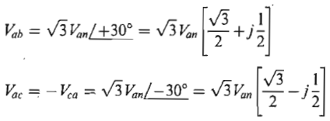



Slide 77


The capacitance-to-neutral per line length is:
Due to symmetry:

Slide 78
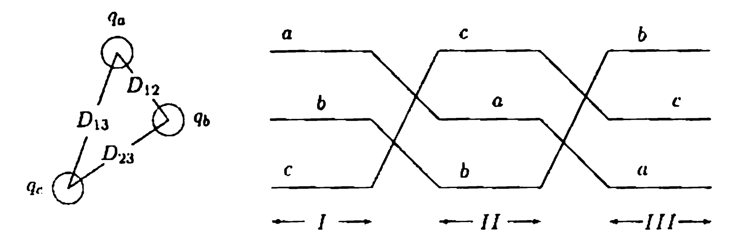

Capacitance of a Three-phase Line with Unsymmetrical Spacing
Since we have a balanced three phase system:
Assume that the line is transposed.
$$q_{a}+q_{b}+q_{c}=0$$

Slide 79



For section I of the line:
For section II of the line:
For section III of the line:

Slide 80
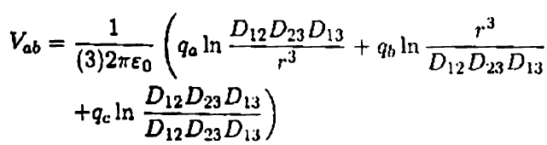
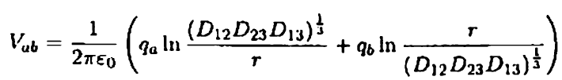


The average v_{ab} is:
$$D_{eq}=$$

Slide 81



Similarly,
Adding the two, we have:

Slide 82



Since,
The capacitance per phase to neutral is:
The capacitance to neutral in μF/km is:

Slide 83


Effect of Bundling
Two bundle three phase line:
Assume that the conductors in each bundle, which are in parallel, share the charges equally.
Also assume that the phase spacings are much larger than the bundle spacings.
$$q_{a}+q_{b}+q_{c}=0$$

Slide 84


This equation is the same as the equation of v_{ab} when the line is without bundle, except that D_{aa} and D_{bb} are replaced by $\sqrt{rd}$.

Slide 85


Therefore, for a transposed line, derivation of the capacitance would yield:
Where: ${D_{}^{b}}_{sc}^{}=\sqrt{rd}$ for a two bundle line.
Similarly:
          ${D_{}^{b}}_{sc}^{}=\sqrt[3]{rd^{2}}$ for a three bundle line
          ${D_{}^{b}}_{sc}^{}=\sqrt[4]{rd^{3}\sqrt{2}}$ for a four bundle line
$$C_{an}=\frac{2πε}{ln⁡({D_{eq}}/{{D_{}^{b}}_{sc}^{}})}F/m$$

Slide 86


Capacitance of Three Phase Double Circuit Line
The expression for GMD is the same as was found for inductance calculation.
The GMR_{C} of each phase group is Similar to the GMR_{L}, with the exception that ${D_{}^{b}}_{sc}^{}$ is used instead of ${D_{}^{b}}_{s.}^{}$

