Slide 1
Introduction to Power Systems
Chapter 4: Characteristics and performance of power transmission lines

Slide 2





Representation of Transmission Lines
Transmission lines are normally operated with a balanced three phase load.
The analysis can therefore proceed on a per phase basis.
$$I_{S}$$
$$I_{R}$$
Two Port Network
$$\left[\begin{matrix}A & B \\ C & D\end{matrix}\right]$$
$$V_{S}$$
$$V_{R}$$

Slide 3
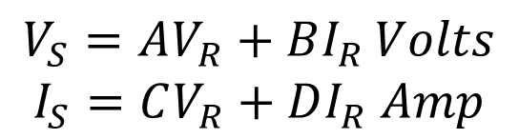
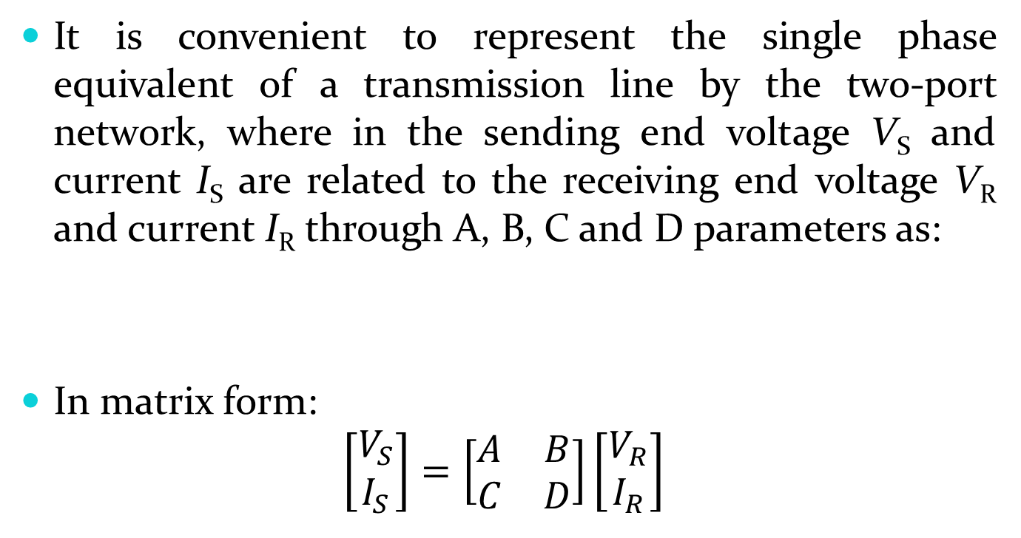
It is convenient to represent the single phase equivalent of a transmission line by the two-port network, where in the sending end voltage V_{S} and current I_{S} are related to the receiving end voltage V_{R} and current I_{R} through A, B, C and D parameters as:
In matrix form:
$$\left[\begin{aligned}V_{S} \\ I_{S}\end{aligned}\right]=\left[\begin{matrix}A & B \\ C & D\end{matrix}\right]\left[\begin{aligned}V_{R} \\ I_{R}\end{aligned}\right]$$
$$V_{S}=AV_{R}+BI_{R }Volts$$
$$I_{S}=CV_{R}+DI_{R} Amp$$

Slide 4

A, B, C and D are the parameters that depend on the line parameters R, L, C and G.
The ABCD parameters are, in general complex numbers.
A and D are dimensionless.
B has units of Ohms and D has units of Siemens.
The following identity holds true for ABCD constants:
For symmetrical network A and D are equal.
$$AD−BC=1$$

Slide 5
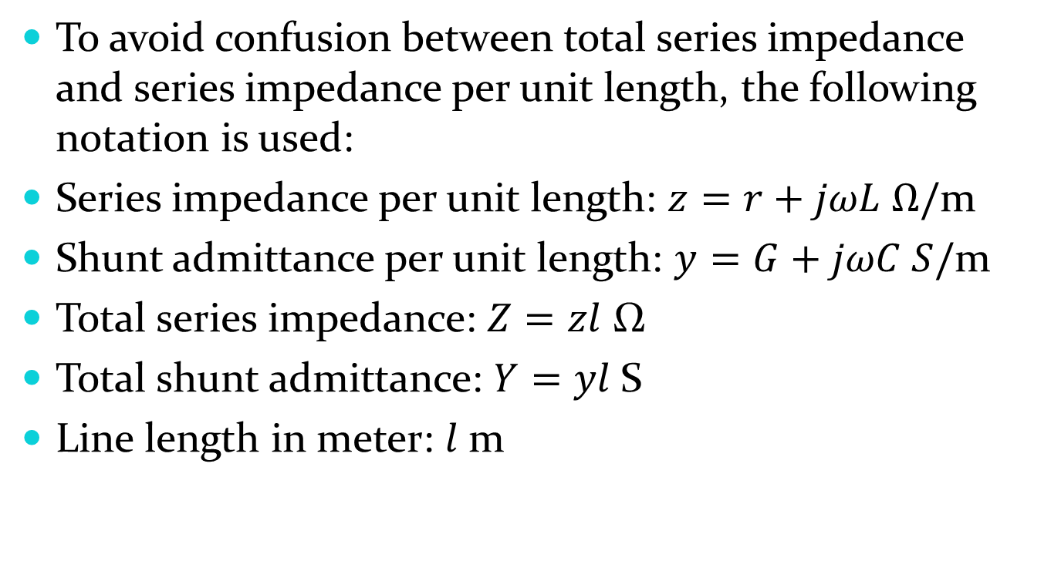
To avoid confusion between total series impedance and series impedance per unit length, the following notation is used:
Series impedance per unit length: $z=r+jωL Ω/$m
Shunt admittance per unit length: $y=G+jωC S/$m
Total series impedance: $Z=zl$ Ω
Total shunt admittance: $Y=yl$S
Line length in meter: $l$m

Slide 6
The parameters of transmission lines which are discussed in chapter three are uniformly distributed along the lines.
For lines of short and medium length we can use lamped parameters with good accuracy.
For long transmission lines the parameters must be taken as distributed parameters.
Because approximating the uniformly distributed parameters of long lines to lamped parameters results considerable error.

Slide 7
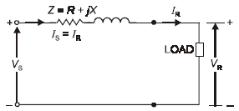
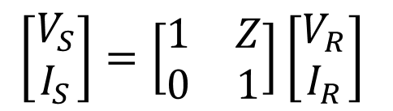
Short Transmission Line (< 80km)
Capacitance may be ignored with out much error if the lines are less than 80 km long or if the voltage is not over 66 kV.
$$\left[\begin{aligned}V_{S} \\ I_{S}\end{aligned}\right]=\left[\begin{matrix}1 & Z \\ 0 & 1\end{matrix}\right]\left[\begin{aligned}V_{R} \\ I_{R}\end{aligned}\right]$$

Slide 8
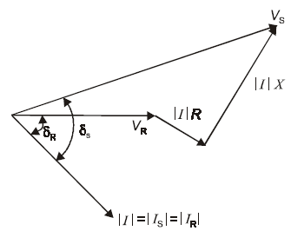
The phasor diagram for the short line is shown below for lagging current.

Slide 9
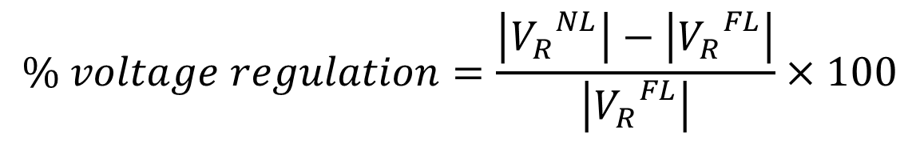
Voltage Regulation
Voltage regulation of transmission lines may be defined as the percentage change in voltage at the receiving end of the line expressed as percentage of full load voltage in going from no-load to full-load.
Where:
$$\% voltage regulation=\frac{\left|{V_{R}}_{}^{NL}\right|−\left|{V_{R}}_{}^{FL}\right|}{\left|{V_{R}}_{}^{FL}\right|}×100$$
$\left|{V_{R}}_{}^{NL}\right|$= magnitude of no-load receiving end voltage
$\left|{V_{R}}_{}^{FL}\right|$= magnitude of full-load receiving end voltage

Slide 10
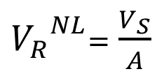

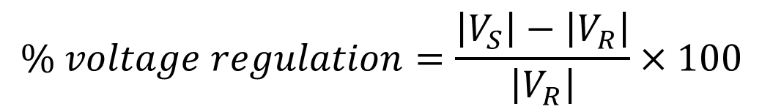
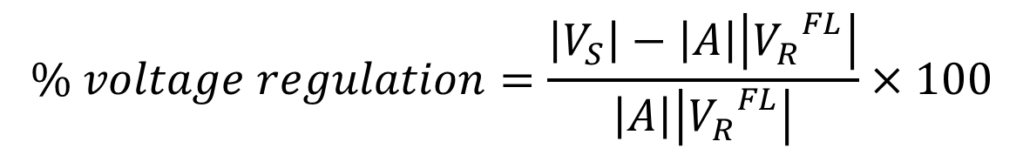
At no load, $I_{R}=0, V_{R}={{ V}_{R}}_{}^{NL}$ and:
Therefore,
For a short line $\left|A\right|=1, \left|{V_{R}}_{}^{FL}\right|=V_{R}$
${V_{R}}_{}^{NL}$= $\frac{V_{S}}{A}$
$$\% voltage regulation=\frac{\left|V_{S}\right|−\left|A\right|\left|{V_{R}}_{}^{FL}\right|}{\left|A\right|\left|{V_{R}}_{}^{FL}\right|}×100$$
$$\% voltage regulation=\frac{\left|V_{S}\right|−\left|V_{R}\right|}{\left|V_{R}\right|}×100$$

Slide 11
Medium Transmission Line
(80 km < l < 240km)
Transmission lines more than 80 km long and below 250 km in length are treated as medium lines, and the line charging current becomes appreciable and the shunt capacitance must be considered.
Medium lines can be represented sufficiently well by R, L and C as lumped parameters with:
  Half the capacitance to neutral of the line lumped at each end of the equivalent circuit (π-model) or
  Half of the series impedance lumped at each side of the line (T- model).

Slide 12
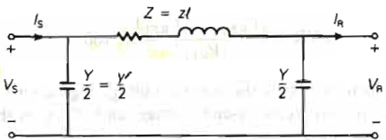
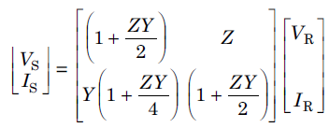
Nominal π-model

Slide 13
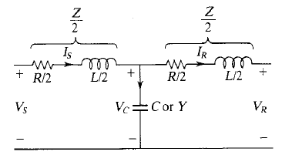
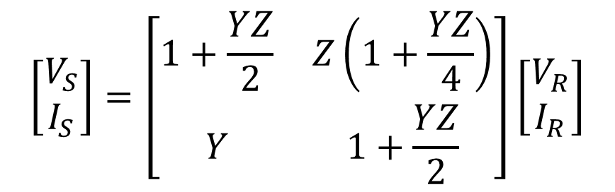
T-model
$$\left[\begin{matrix}V_{S} \\ I_{S}\end{matrix}\right]=\left[\begin{matrix}1+\frac{YZ}{2} & Z\left(1+\frac{YZ}{4}\right) \\ Y & 1+\frac{YZ}{2}\end{matrix}\right]\left[\begin{matrix}V_{R} \\ I_{R}\end{matrix}\right]$$

Slide 14
Long Transmission Line (> 250 km)
I(x+Δx)
I(x)
I_{S}
+
+
+
+
I_{R}
Gen.
V_{S}
V(x+Δx)
V(x)
V_{R}
Load
_
_
_
_
dx
x

Slide 15
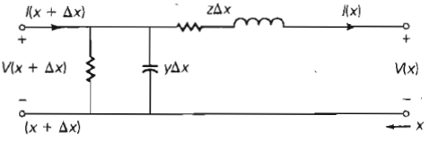


Writing KVL equation for the circuit:

Slide 16



Taking the limit as Δx approaches zero:
Similarly, writing KCL equation for the circuit:
Taking the limit as Δx approaches zero:

Slide 17
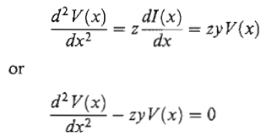
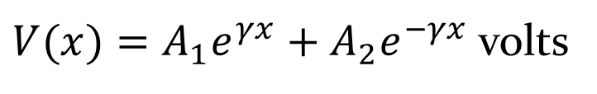
If we differentiate again the above equation:
This equation is a linear, second order, homogeneous differential equation with one unknown, V(x).
By inspection, its solution is:
$V(x)=A_{1}e^{γx}+A_{2}e^{−γx}$ volts

Slide 18

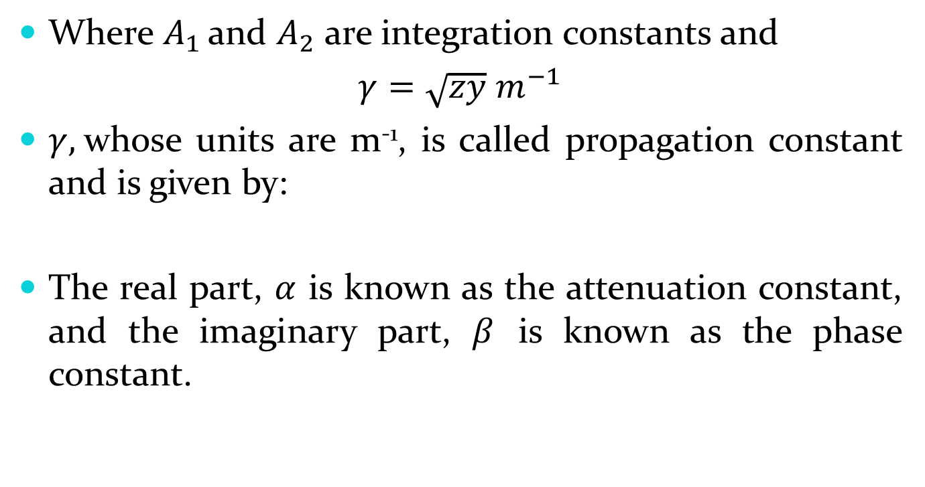
Where $A_{1 }$and $A_{2}$are integration constants and
$γ=\sqrt{zy} m^{−1}$
$γ,$whose units are m⁻¹, is called propagation constant and is given by:
The real part, $α$ is known as the attenuation constant, and the imaginary part, $β$ is known as the phase constant.
$$γ=α+jβ=\sqrt{zy}$$

Slide 19
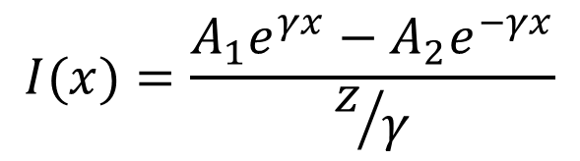
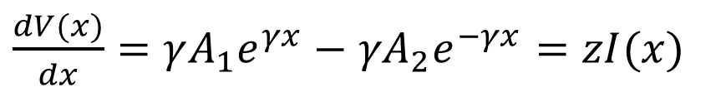
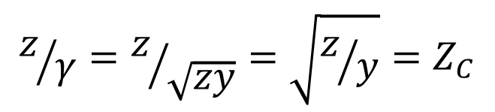
For the current:
Solving for I(x):
$\frac{dV(x)}{dx}=γA_{1}e^{γx}−$ ${γA}_{2}e^{−γx}=zI(x)$
$$I(x)=\frac{A_{1}e^{γx}−A_{2}e^{−γx}}{z/γ}$$
$$z/γ=z/{\sqrt{zy}}=\sqrt{z/y}=Z_{C}$$

Slide 20
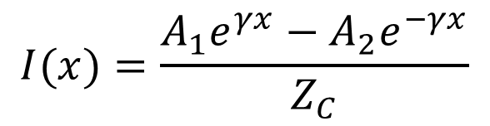
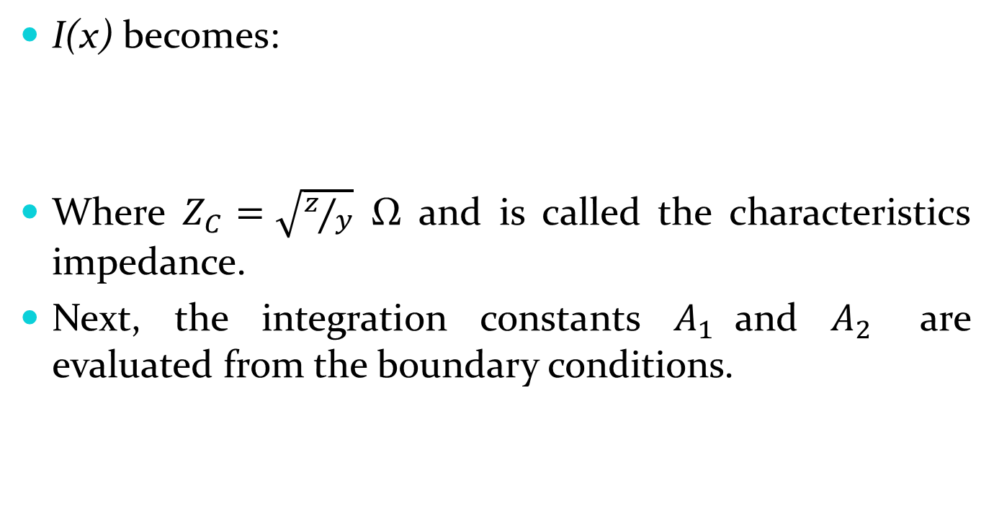
I(x) becomes:
Where $Z_{C}=\sqrt{z/y}$ Ω and is called the characteristics impedance.
Next, the integration constants $A_{1 }$and $A_{2}$ are evaluated from the boundary conditions.
$$I(x)=\frac{A_{1}e^{γx}−A_{2}e^{−γx}}{Z_{C}}$$

Slide 21

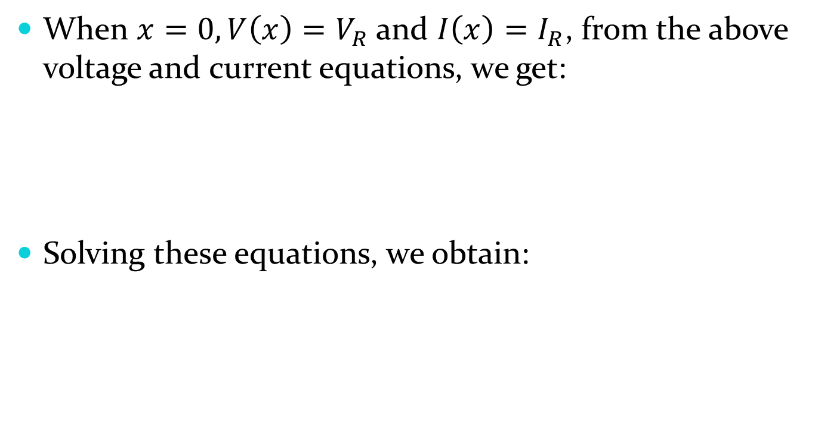


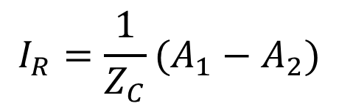
When $x=0, V\left(x\right)=V_{R}$ and $I\left(x\right)=I_{R}$, from the above voltage and current equations, we get:
Solving these equations, we obtain:
$$V_{R}=A_{1}+A_{2}$$
$$I_{R}={\frac{1}{Z_{C}}(A}_{1}−A_{2})$$
$$A_{1}=\frac{V_{R}+Z_{C}I_{R}}{2}$$
$$A_{2}=\frac{V_{R}−Z_{C}I_{R}}{2}$$

Slide 22
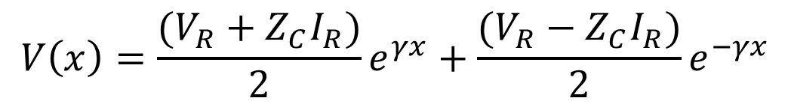

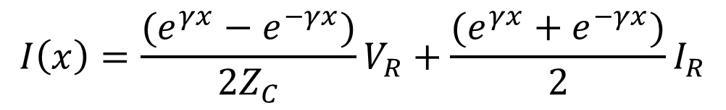
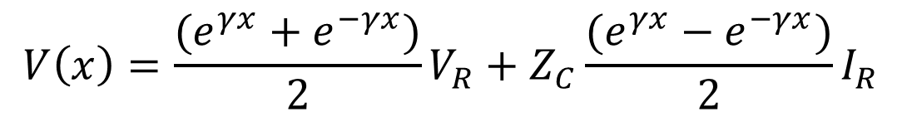
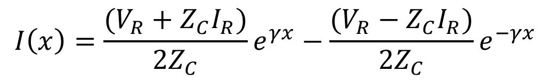
Substituting the values of $A_{1}$ and $A_{2}$ into the voltage and current equations, we obtain:
The equations can be rearranged as follows:
$$V\left(x\right)=\frac{(V_{R}+Z_{C}I_{R})}{2}e^{γx}+\frac{(V_{R}−Z_{C}I_{R})}{2}e^{−γx}$$
$$I\left(x\right)=\frac{(V_{R}+Z_{C}I_{R})}{2Z_{C}}e^{γx}−\frac{(V_{R}−Z_{C}I_{R})}{2Z_{C}}e^{−γx}$$
$$V\left(x\right)=\frac{(e^{γx}+e^{−γx})}{2}V_{R}+Z_{C}\frac{(e^{γx}−e^{−γx})}{2}I_{R}$$
$$I\left(x\right)=\frac{(e^{γx}−e^{−γx})}{2Z_{C}}V_{R}+\frac{(e^{γx}+e^{−γx})}{2}I_{R}$$

Slide 23

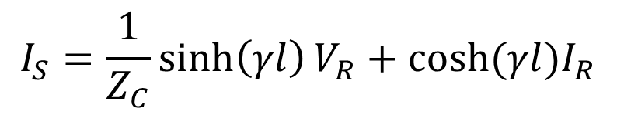

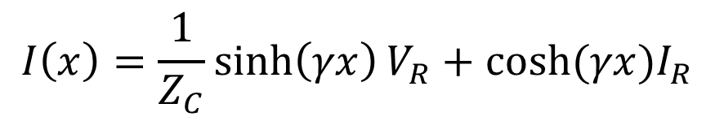
Our interest is in the relation between the sending end and the receiving end of the line.
Therefore, when $x=l, V\left(l\right)=V_{S}$and $I\left(l\right)=I_{S}$. The result is:
$$V\left(x\right)=\cosh\left(γx\right)V_{R}+Z_{C}sinh⁡(γx)I_{R}$$
$$I\left(x\right)=\frac{1}{Z_{C}}sinh\left(γx\right)V_{R}+cosh⁡(γx)I_{R}$$
$$V_{S}=\cosh\left(γl\right)V_{R}+Z_{C}sinh⁡(γl)I_{R}$$
$$I_{S}=\frac{1}{Z_{C}}sinh\left(γl\right)V_{R}+cosh⁡(γl)I_{R}$$

Slide 24




Therefore, ABCD constants are:
$$A=cosh⁡(γl)$$
$$B=Z_{C}sinh⁡(γl)$$
$$C=\frac{1}{Z_{C}}sinh⁡(γl)$$
$$D=cosh⁡(γl)$$

Slide 25
The Equivalent Circuit of a Long Line
The nominal-π circuit does not represent a transmission line exactly because it does not account for the parameters of the line being uniformly distributed.
The discrepancy between the nominal-π and the actual line becomes larger as the length of line increases.

Slide 26

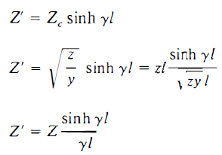
It is possible, however, to find the equivalent circuit of a long transmission line and to represent the line accurately, in so far as ends of the line are concerned, by a network of lumped parameters.

Slide 27

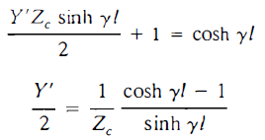

Using the identity:

Slide 28
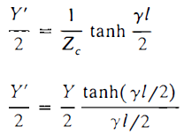
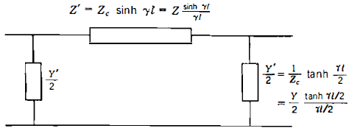

Slide 29
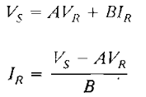
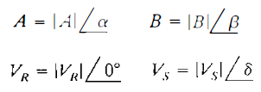
Power Flow through Transmission Lines
Equations for power can be derived in terms of ABCD constants.
The equations apply to any network of two ports.
Letting:

Slide 30


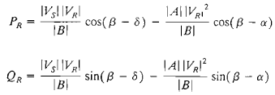
We obtain:
The complex power at the receiving end is:
The real and reactive power at the receiving end are:

Slide 31
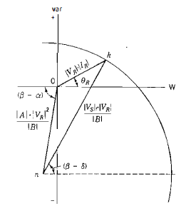
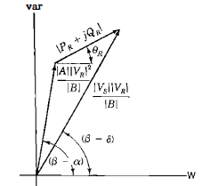
Phasor diagrams:

Slide 32
Examination of the phasor diagrams shows that there is a limit to the power that can be transmitted to the receiving end of the line for specified magnitudes of sending- and receiving-end voltages.
An increase in power delivered means that the point k will move along the circle until the angle (β-δ) is zero; that is, more power will be delivered until β = δ.
Further increase in δ results in less power received.

Slide 33

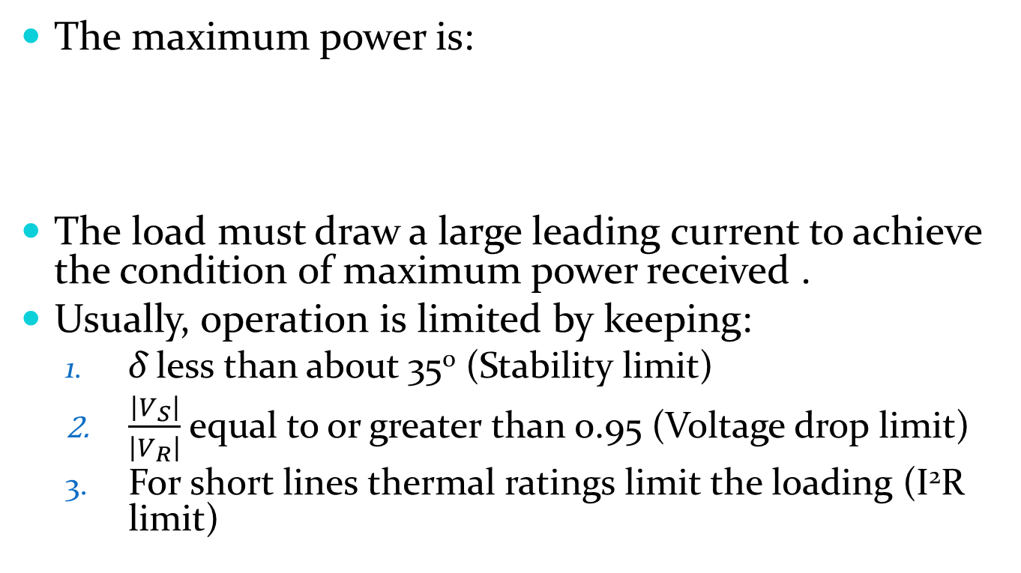
The maximum power is:
The load must draw a large leading current to achieve the condition of maximum power received .
Usually, operation is limited by keeping:
  δ less than about 35⁰ (Stability limit)
  $\frac{\left|V_{S}\right|}{\left|V_{R}\right|}$ equal to or greater than 0.95 (Voltage drop limit)
  For short lines thermal ratings limit the loading (I²R limit)

Slide 34
Reactive Compensation of Transmission Lines
The performance of transmission lines, especially those of medium length and longer, can be improved by reactive compensation of a series or parallel type.
Series compensation consists of a capacitor bank placed in series with each phase conductor of the line.
Shunt compensation refers to the placement of inductors from each line to neutral to reduce partially or completely the shunt susceptance of a high-voltage line, which is particularly important at light loads when the voltage at the receiving end may otherwise become very high.

Slide 35
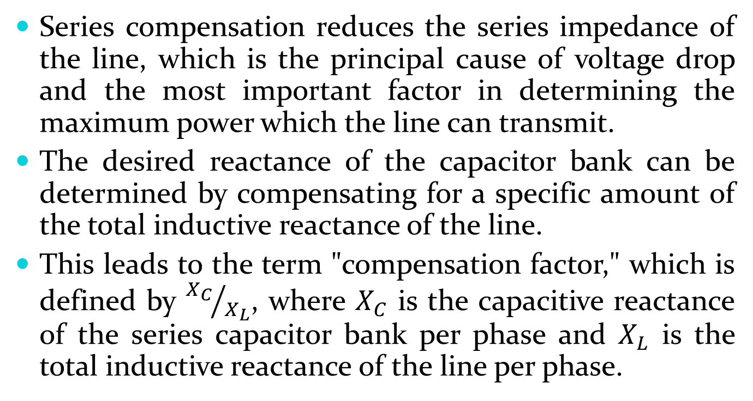
Series compensation reduces the series impedance of the line, which is the principal cause of voltage drop and the most important factor in determining the maximum power which the line can transmit.
The desired reactance of the capacitor bank can be determined by compensating for a specific amount of the total inductive reactance of the line.
This leads to the term "compensation factor," which is defined by ${X_{C}}/{X_{L}}$, where $X_{C}$ is the capacitive reactance of the series capacitor bank per phase and $X_{L}$ is the total inductive reactance of the line per phase.

Slide 36
When the nominal-π circuit is used to represent the line and capacitor bank and if only the sending- and receiving-end conditions of the line are of interest, the physical location of the capacitor bank along the line is not taken in to account.
However, when the operating conditions along the line are of interest, the physical location of the capacitor bank must be taken into account.

Slide 37
This can be accomplished most easily by determining ABCD constants of the portions of line on each side of the capacitor bank and by representing the capacitor bank by its ABCD constants.
The equivalent constants of the combination (actually referred to as a cascaded connection) of line – capacitor - line can then be determined.

Slide 38
Ferranti Effect
During light load or no-load condition, receiving end voltage is greater than sending end voltage in long transmission line or cable.
This happens due to very high line charging current.
This phenomenon is known as ferranti effect.
A chrged open circuit line draws significant amount of current due to capacitive effect of the line.
This is more in high voltage long transmission lines.

