Slide 1
Chapter Five
Insulators

Slide 2
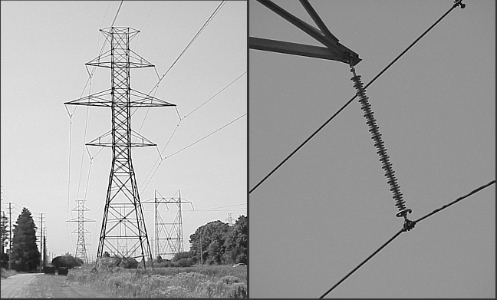

Slide 3
Definition
An insulator is a device intended to give flexible or rigid support to electric conductors or equipment and to insulate these conductors or equipment from ground or from other conductors or equipment.
Overhead transmission lines are supported on the towers. Since towers are at ground potential, the lines must be insulated from the tower structure.

Slide 4
Desirable Properties
High mechanical strength in order to withstand conductor load, wind load, etc.
High electrical resistance of insulator material in order to avoid leakage currents to earth.
High relative permittivity of insulator material in order that dielectric strength is high.
The insulator material should be non-pores, free from impurities and cracks other wise the permittivity will be lowered.
High ratio of puncture strength to flashover.

Slide 5
Materials
        Porcelain
        Toughened Glass
        Polymeric composite
    Choice of insulator material is governed by availability, price and ease of maintenance.
    Porcelain is most widely used insulator material as it is cheap.

Slide 6
Ratings of Insulators
Insulators are rated by three voltages:
Working Voltage (Rated Voltage): is the voltage at which an insulator is designed to bear the steady state voltage stress. If the line voltage is V_{LL} ,the working voltage is V_{LL}/√3
Flashover Voltage: is the voltage at which flashover occurs through air surrounding insulator.
Puncture Voltage: is the voltage at which the insulator break through between conductor and pin.

Slide 7
Flashover voltage is higher than working voltage and less than the puncture voltage of the insulator.
A safety factor is defined as a ratio of flashover voltage to working voltage.
Safety factor = Flashover Voltage/Working Voltage

Slide 8
Testing of Insulators
Flashover Tests:
  50 % dry impulse flashover test
  Dry flashover and dry one-minute test
  Wet flashover and one-minute rain test
Sample Tests:
  Temperature cycle test
  Mechanical test

Slide 9
  Electro-mechanical test
  Puncture test
  Porosity test
Routine Tests:
  Electrical routine test
  Mechanical routine test

Slide 10
Types of Insulators
There are several types of insulators but the most commonly used are:
  pin type
  suspension type
  strain insulator and
  shackle insulator

Slide 11
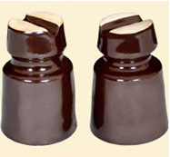
Pin Type Insulators
As the name suggests, the pin
type insulator is secured to the cross arm on the pole.
There is a groove on the upper end of the insulator for housing the conductor.
The conductor passes through this groove and is bound by the annealed wire of the same material as the conductor.

Slide 12
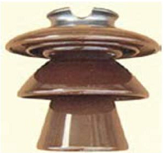
Pin type insulators are used for transmission and distribution of electric power at voltages up to 33 kV.
Beyond operating voltage of 33 kV, the pin type insulators become too bulky and hence uneconomical.
A single pin type insulator is used to transmit voltages up to 11 kV (kilovolts) and higher voltages require two-, three- or four piece pin insulators.

Slide 13
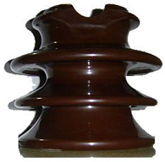
They are not economically feasible for 33 kV and
higher transmission lines.
Pin type insulators are secured with steel or lead bolts onto transmission poles.
These are typically used for straight-running transmission lines.

Slide 14
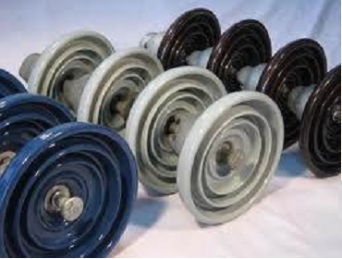
  Suspension Type Insulators
  For high voltages (>33 kV), it is a usual practice to use suspension type insulators consist of a number of porcelain discs connected in series by metal links in the form of a string.

Slide 15
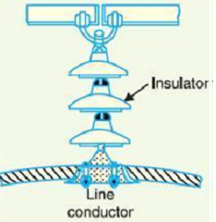
The conductor is suspended at the bottom end of this string while the other end of the string is secured to the cross-arm of the tower.
Each unit or disc is designed for low voltage, say 11 kV.
The number of discs in series would obviously depend upon the working voltage.
For instance, if the working voltage is 66 kV, then six discs in series will be provided on the string.

Slide 16
Advantages of suspension type insulators
Suspension type insulators are cheaper than pin type insulators for voltages beyond 33 KV.
Each unit or disc of suspension type insulator is designed for low voltage, usually 11 kV. Depending upon the working voltage, the desired number of discs can be connected in series.

Slide 17
If any one disc is damaged, the whole string does not become useless because the damaged disc can be replaced by the sound one.
The suspension arrangement provides greater flexibility to the line. The connection at the cross arm is such that insulator string is free to swing in any direction and can take up the position where mechanical stresses are minimum.

Slide 18
In case of increased demand on the transmission line, it is found more satisfactory to supply the greater demand by raising the line voltage than to provide another set of conductors. The additional insulation required for the raised voltage can be easily obtained in the suspension arrangement by adding the desired number of discs.
The suspension type insulators are generally used with steel towers. As the conductors run below the earthed cross-arm of the tower, therefore, this arrangement provides partial protection from lightning.

Slide 19
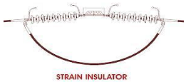
Strain Type Insulators
When there is a dead end of the line or there is corner or sharp curve, the line is subjected to greater tension.
In order to relieve the line of excessive tension, strain
insulators are used.
For low voltage lines (< 11 kV), shackle insulators are used as strain insulators.

Slide 20
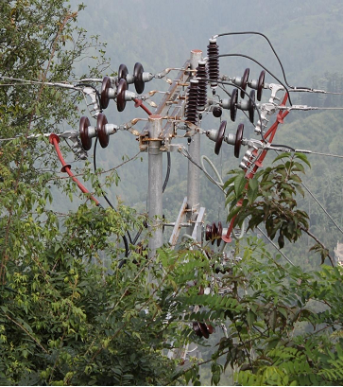

Slide 21
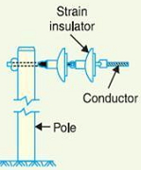
However, for the high voltage transmission lines, strain insulator consists of an assembly of suspension insulators.
The discs of strain insulators are used in the vertical plane. When the tension in lines is exceedingly high, at long river spans, two or more strings are used in
parallel.

Slide 22
Strain type insulators are horizontally suspended suspension insulators.
They are used to handle mechanical stresses and take the pressure off a conductor at the end of a transmission line, at a sharp corner or curve or over long river crossings.
Strain insulators are typically used for higher voltage transmissions.

Slide 23
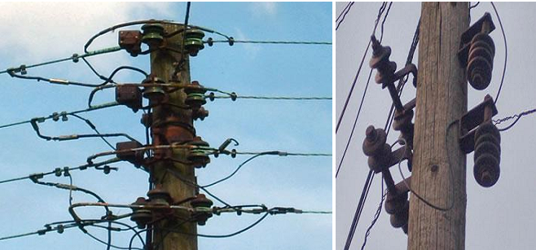
Shackle Type Insulators
Shackle type insulators, similar to strain type insulators, are used on sharp curves, end poles and in section poles.

Slide 24
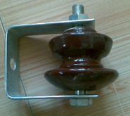
These insulators are single, round porcelain parts that are mounted horizontally or vertically.
In early days, the shackle insulators were used as strain insulators.
But now a days, they are frequently used for low voltage distribution lines.
They can be directly fixed to the pole with a bolt or to the cross arm.

Slide 25
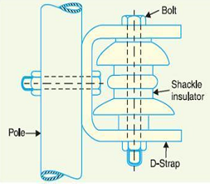
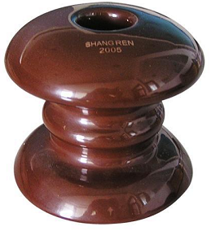

Slide 26
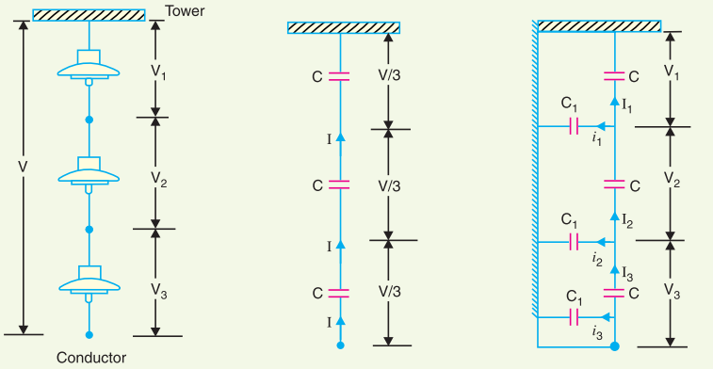
Voltage Distribution across Suspension Insulators

Slide 27
The following points may be noted regarding the potential distribution over a string of suspension insulators:
The voltage impressed on a string of suspension insulators does not distribute itself uniformly across the individual discs due to the presence of shunt capacitance.
The disc nearest to the conductor has maximum voltage across it. As we move towards the cross-arm, the voltage across each disc goes on decreasing.

Slide 28
The disc nearest to the conductor is under maximum electrical stress and is likely to be punctured. Therefore, means must be provided to equalize the potential across each unit.
If the voltage impressed across the string is dc, then voltage across each unit would be the same. It is because insulator capacitances are ineffective for dc.

Slide 29
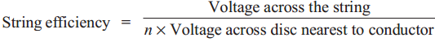
String Efficiency
Where n is the total number of discs in the string.
The greater the string efficiency, the more uniform is the voltage distribution.

Slide 30
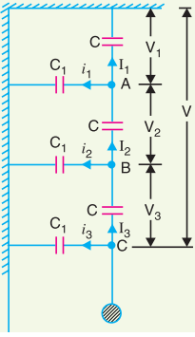
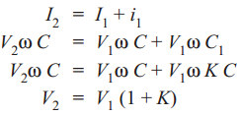
Mathematical Expression
Let:
  3-disc string
  Self (mutual) capacitance = C
  Shunt capacitance (C₁) = KC (fraction of C)

Slide 31
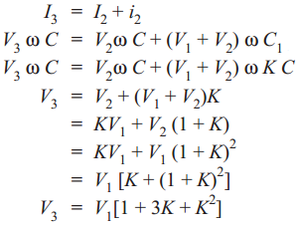

Slide 32
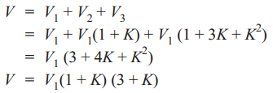
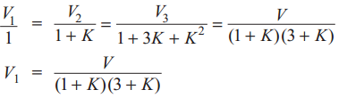

Voltage between conductor and earth (tower):

Slide 33
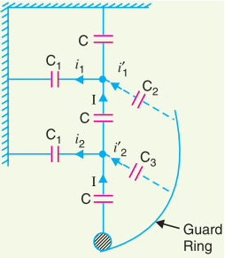
Methods to Improve String Efficiency
By using longer cross arms (Reducing the value of K)
By grading the insulator (Capacitance grading)
By using a guard ring

