Slide 1
Chapter Six
Corona and Radio Interference

Slide 2
Introduction
The literal meaning of Corona is “a bright circle seen around the sun or the moon.”
This term is borrowed to describe partial discharge that developed in the presence of high electric field.
When an alternating potential difference is applied across two conductors whose spacing is large in comparison with the diameter, then the air surrounding the conductor is subjected to electro-static stress.

Slide 3
This stress is maximum at the surface of the conductor and then decreases in inverse proportion to the distance from the center of the conductor.
If this potential difference is gradually increased, a point will be reached when a faint luminous glow of violet color will make its appearance and at the same time a hissing noise will be heard.
This phenomenon is called corona and is accompanied by the formation of ozone, as is indicated by the characteristic odor of this gas.

Slide 4
If the potential difference is further increased, the glow and the noise will increase in intensity until eventually a spark-over will take place.
Corona is accompanied by power loss, which is in the form of heat, light, sound and chemical action.
In case of AC systems, current flow due to corona is non-sinusoidal and in practice this non-sinusoidal current and non-sinusoidal voltage drop by corona may be more important than the power loss.

Slide 5
The effect of corona can be summarized as follows:
It is accompanied by power loss.
A luminous violet glow is observed around the conductor.
This glow is much brighter over rough and dirty surfaces of the conductor.
It produces a hissing noise.
It produces ozone gas which can be readily detected by its characteristic odor.

Slide 6
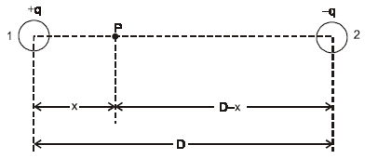
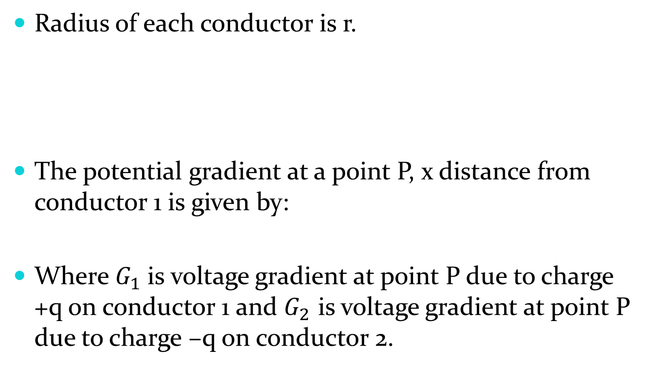

Potential Gradient for a Single Phase Line
Radius of each conductor is r.
The potential gradient at a point P, x distance from conductor 1 is given by:
Where${ G}_{1}$is voltage gradient at point P due to charge +q on conductor 1 and $G_{2}$ is voltage gradient at point P due to charge –q on conductor 2.
$$G=G_{1}−G_{2}$$

Slide 7
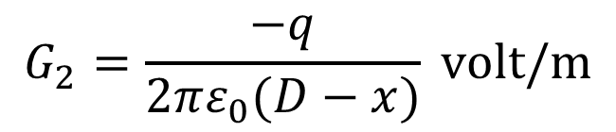
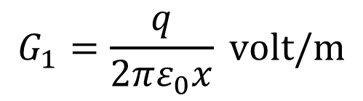
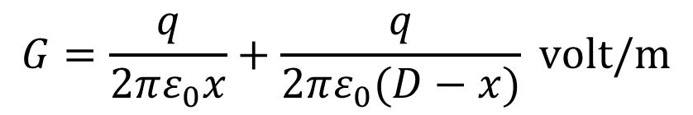
We know that:
Therefore,
$$G_{1}=\frac{q}{2πε_{0}x} volt/m$$
$$G_{2}=\frac{−q}{2πε_{0}(D−x)} volt/m$$
$$G=\frac{q}{2πε_{0}x}+\frac{q}{2πε_{0}(D−x)} volt/m$$

Slide 8
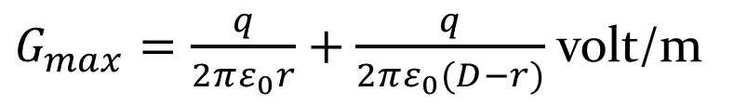
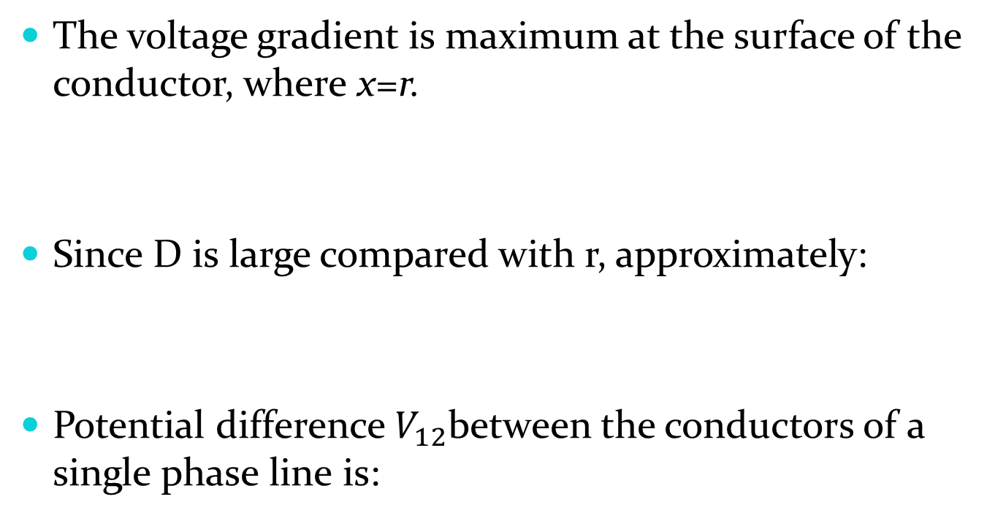
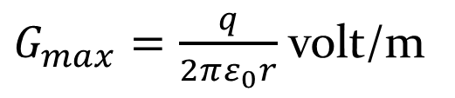
The voltage gradient is maximum at the surface of the conductor, where x=r.
Since D is large compared with r, approximately:
Potential difference${ V}_{12}$between the conductors of a single phase line is:
$G_{max}=\frac{q}{2πε_{0}r}+\frac{q}{2πε_{0}(D−r)}$ volt/m
$G_{max}=\frac{q}{2πε_{0}r}$ volt/m

Slide 9
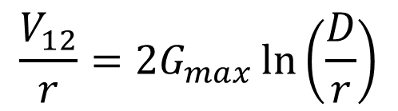
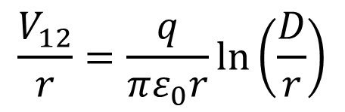


$$V_{12}=\frac{q}{πε_{0}}\ln\left(\frac{D}{r}\right)$$
Therefore:
$$\frac{V_{12}}{r}=\frac{q}{πε_{0}r}\ln\left(\frac{D}{r}\right)$$
$$\frac{V_{12}}{r}=2G_{max}\ln\left(\frac{D}{r}\right)$$
$$G_{max}=\frac{V_{12}}{2r\ln\left(\frac{D}{r}\right)}$$

Slide 10
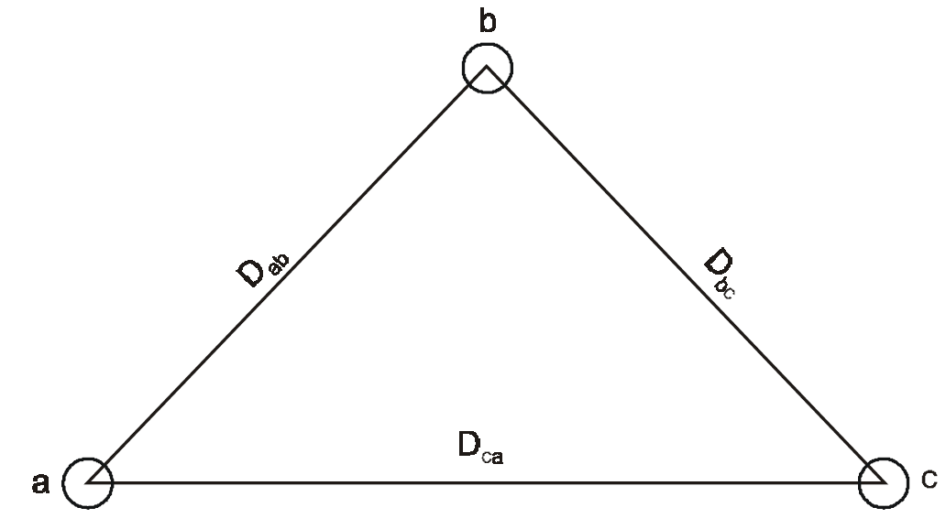




Potential Gradient for a Three Phase Line
Let G_{a}, G_{b} and G_{c} denote the voltage gradients at the surfaces of the conductors in phases a, b and c respectively.
$$\frac{q_{a}}{2πε_{0}}=r.G_{a}$$
$$\frac{q_{b}}{2πε_{0}}=r.G_{b}$$
$$\frac{q_{c}}{2πε_{0}}=r.G_{c}$$
$$q_{a}+q_{b}+q_{c}=0$$

Slide 11
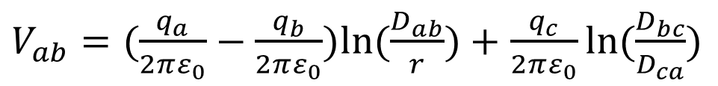

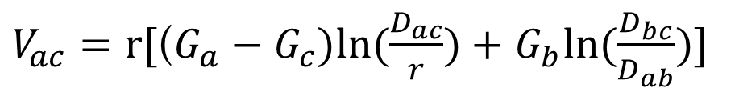
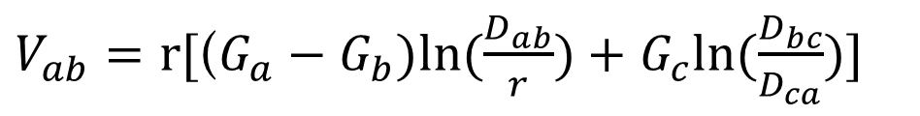
The voltage $V_{ab}$ is given by:
Similarly:
$V_{ab}=(\frac{q_{a}}{2πε_{0}}−\frac{q_{b}}{2πε_{0}})ln⁡(\frac{D_{ab}}{r})+$ $\frac{q_{c}}{2πε_{0}}ln⁡(\frac{D_{bc}}{D_{ca}})$
$V_{ab}=r[$($G_{a}−G_{b})ln⁡(\frac{D_{ab}}{r})+$ $G_{c}ln⁡(\frac{D_{bc}}{D_{ca}})]$
$V_{ac}=r[$($G_{a}−G_{c})ln⁡(\frac{D_{ac}}{r})+$ $G_{b}ln⁡(\frac{D_{bc}}{D_{ab}})]$

Slide 12
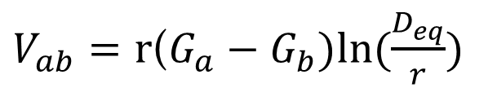



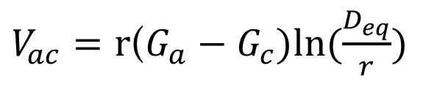
$$3V_{an}=V_{ab}+V_{ac}$$
For a transposed line:
But:
$V_{ab}=r$($G_{a}−G_{b})ln⁡(\frac{D_{eq}}{r})$
$V_{ac}=r$($G_{a}−G_{c})ln⁡(\frac{D_{eq}}{r})$
$$q_{a}+q_{b}+q_{c}=0$$
$$2πε_{0}rG_{a}+2πε_{0}rG_{b}+2πε_{0}rG_{c}=0$$
$$G_{a}+G_{b}+G_{c}=0$$

Slide 13

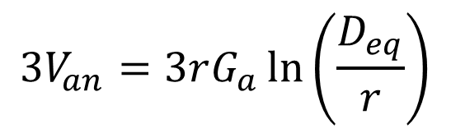


Therefore:
$$3V_{an}=3rG_{a}\ln\left(\frac{D_{eq}}{r}\right)$$
$$G_{a}=\frac{V_{an}}{rln\left(\frac{D_{eq}}{r}\right)}$$
$$G_{b}=\frac{V_{bn}}{rln\left(\frac{D_{eq}}{r}\right)}$$
$$G_{c}=\frac{V_{cn}}{rln\left(\frac{D_{eq}}{r}\right)}$$

Slide 14
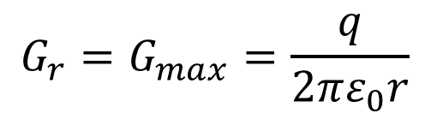

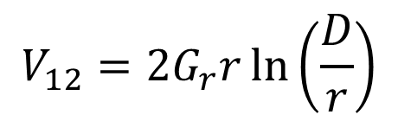
Disruptive Critical Voltage for a Single Phase Transmission Line
The minimum voltage at which complete disruption of air occurs and corona starts is called the disruptive critical voltage.
The potential gradient corresponding to this value of the voltage is called disruptive critical voltage gradient.
$$V_{12}=\frac{q}{πε_{0}}\ln\left(\frac{D}{r}\right)$$
$$G_{r}=G_{max}=\frac{q}{2πε_{0}r}$$
$$V_{12}=2G_{r}r\ln\left(\frac{D}{r}\right)$$

Slide 15
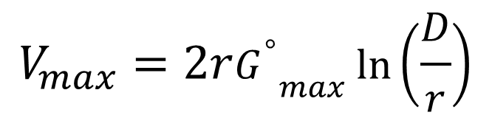

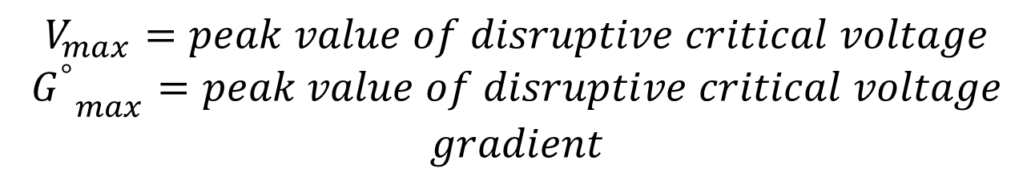
The breakdown strength of air at a pressure of $760 mm of Hg$ and temperature of $25 ℃$ is $30{kV}/{cm}$(peak).
Let:
Then:
$$V_{max}=peak value of disruptive critical voltage$$
$${G_{}^{°}}_{max}^{}=peak value of disruptive critical voltage$$
$$gradient$$
$$V_{max}=2r{G_{}^{°}}_{max}^{}\ln\left(\frac{D}{r}\right)$$

Slide 16
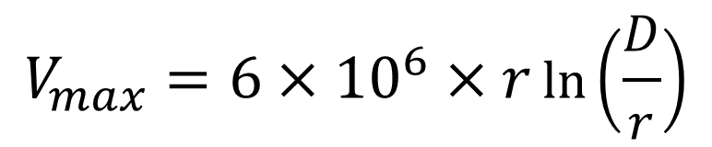

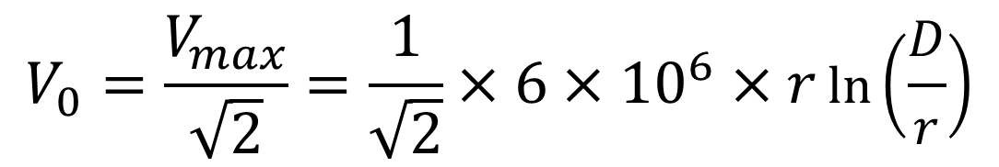
But:
Therefore:
The R.M.S. value of the disruptive critical voltage for single phase line is given by:
$${G_{}^{°}}_{max}^{}=3×{10}^{6}V/m$$
$$V_{max}=6×{10}^{6}×r\ln\left(\frac{D}{r}\right)$$
$$V_{0}=\frac{V_{max}}{\sqrt{2}}=\frac{1}{\sqrt{2}}×6×{10}^{6}×r\ln\left(\frac{D}{r}\right)$$

Slide 17


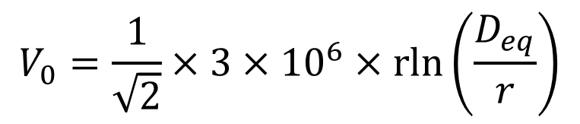
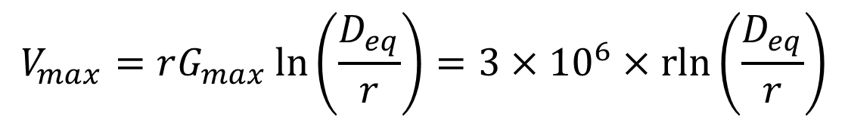

Disruptive Critical Voltage for a Three Phase Transmission Line
Let:
If $G_{r}=G_{max}$, then $V_{n}=V_{max}$.
The R.M.S. value of the disruptive critical voltage for three phase line is given by:
$$V_{n}=\left|V_{an}\right|=\left|V_{bn}\right|=\left|V_{cn}\right|$$
$$V_{n}=rG_{r}\ln\left(\frac{D_{eq}}{r}\right)$$
$$V_{max}=rG_{max}\ln\left(\frac{D_{eq}}{r}\right)=3×{10}^{6}×\operatorname{rln}\left(\frac{D_{eq}}{r}\right)$$
$$V_{0}=\frac{1}{\sqrt{2}}×3×{10}^{6}×\operatorname{rln}\left(\frac{D_{eq}}{r}\right)$$

Slide 18
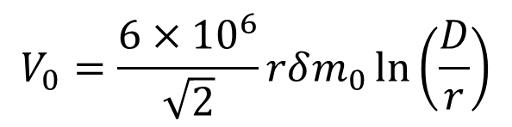
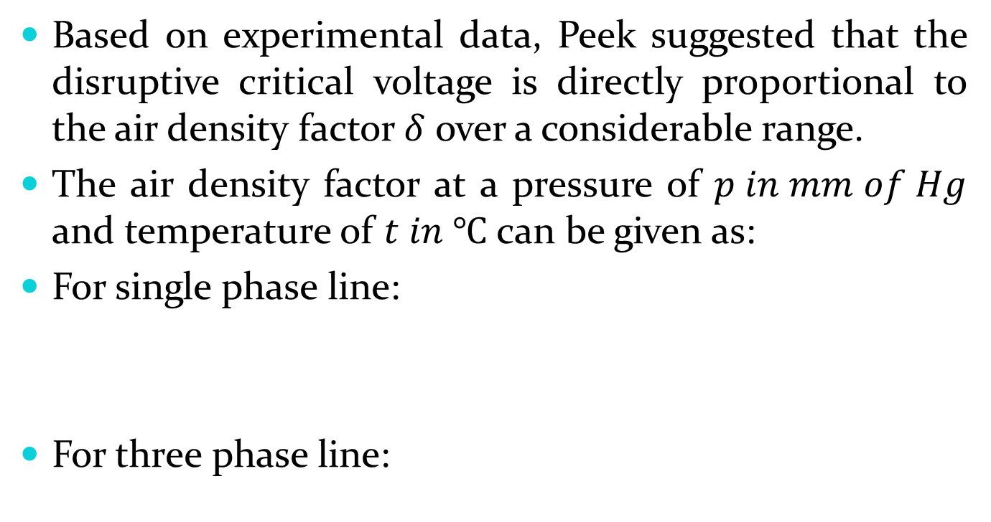

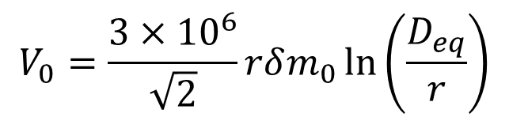
Formula for Disruptive Critical Voltage Suggested by F.W.Peek
Based on experimental data, Peek suggested that the disruptive critical voltage is directly proportional to the air density factor $δ$ over a considerable range.
The air density factor at a pressure of $p in mm of Hg$ and temperature of $t in ℃$ can be given as:
For single phase line:
For three phase line:
$$δ=\frac{0.392p}{(273+t)}$$
$$V_{0}=\frac{6×{10}^{6}}{\sqrt{2}}rδm_{0}\ln\left(\frac{D}{r}\right)$$
$$V_{0}=\frac{3×{10}^{6}}{\sqrt{2}}rδm_{0}\ln\left(\frac{D_{eq}}{r}\right)$$

Slide 19
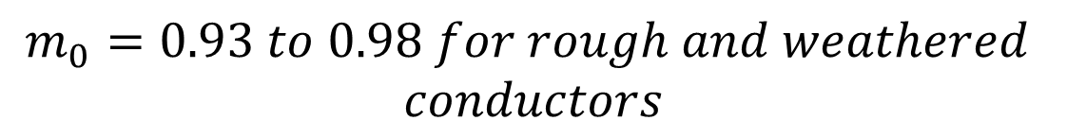
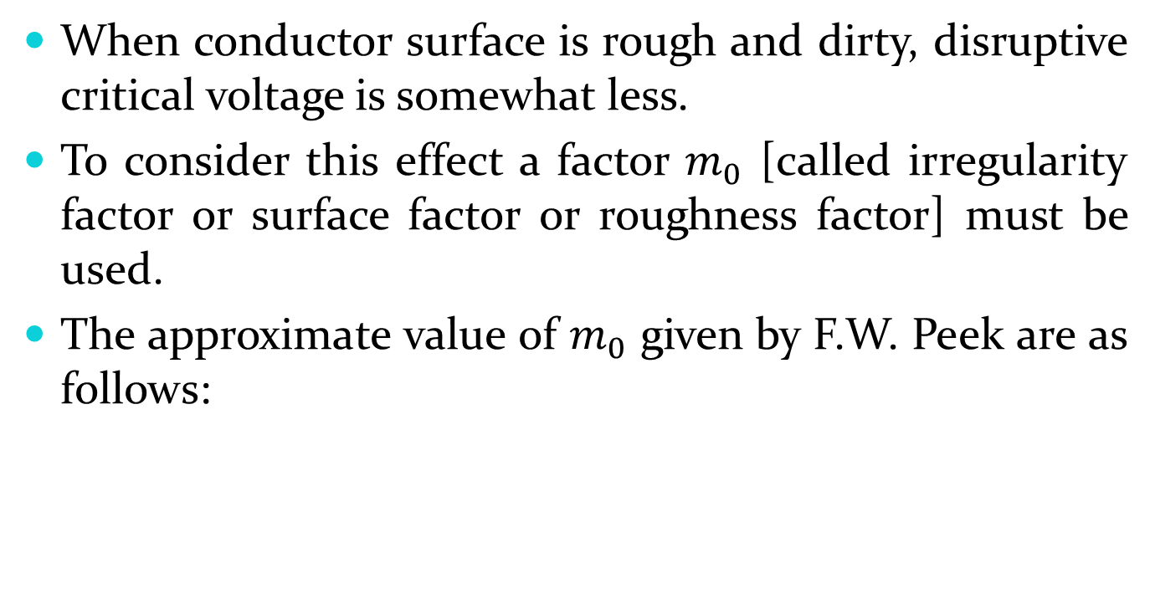
When conductor surface is rough and dirty, disruptive critical voltage is somewhat less.
To consider this effect a factor $m_{0}$ [called irregularity factor or surface factor or roughness factor] must be used.
The approximate value of $m_{0}$ given by F.W. Peek are as follows:
$$m_{0}=1.0 for smooth, polished conductors$$
$$m_{0}=0.93 to 0.98 for rough and weathered$$
$$conductors$$
$$m_{0}=0.80 to 0.87 for stranded conductors$$

Slide 20
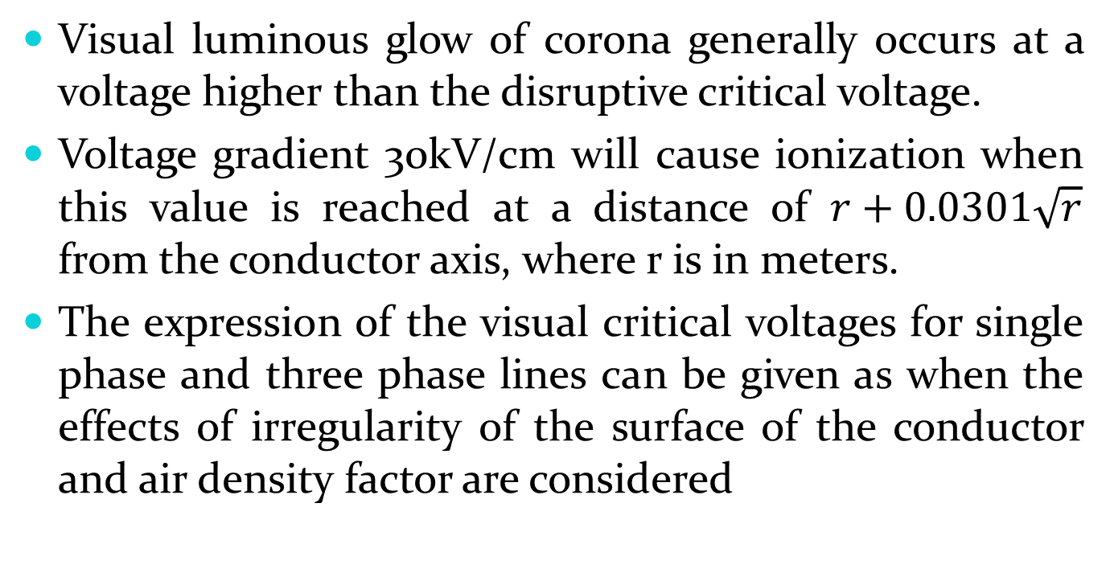
Visual Critical Voltage
Visual luminous glow of corona generally occurs at a voltage higher than the disruptive critical voltage.
Voltage gradient 30kV/cm will cause ionization when this value is reached at a distance of $r+0.0301\sqrt{r}$ from the conductor axis, where r is in meters.
The expression of the visual critical voltages for single phase and three phase lines can be given as when the effects of irregularity of the surface of the conductor and air density factor are considered

Slide 21
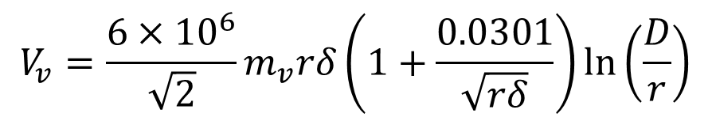
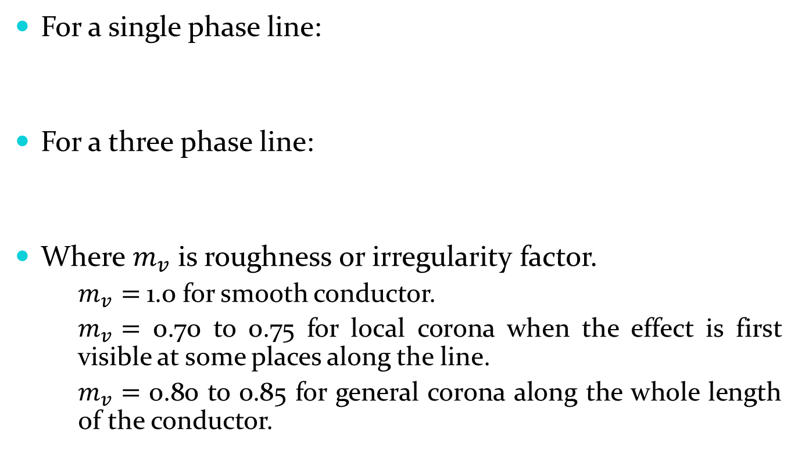
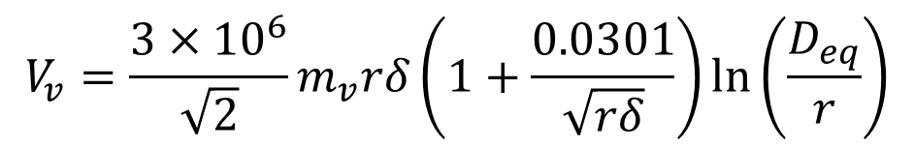
For a single phase line:
For a three phase line:
Where $m_{v}$ is roughness or irregularity factor.
$m_{v}=$ 1.0 for smooth conductor.
$m_{v}=$ 0.70 to 0.75 for local corona when the effect is first visible at some places along the line.
$m_{v}=$ 0.80 to 0.85 for general corona along the whole length of the conductor.
$$V_{v}=\frac{6×{10}^{6}}{\sqrt{2}}m_{v}rδ\left(1+\frac{0.0301}{\sqrt{rδ}}\right)\ln\left(\frac{D}{r}\right)$$
$$V_{v}=\frac{3×{10}^{6}}{\sqrt{2}}m_{v}rδ\left(1+\frac{0.0301}{\sqrt{rδ}}\right)\ln\left(\frac{D_{eq}}{r}\right)$$

Slide 22
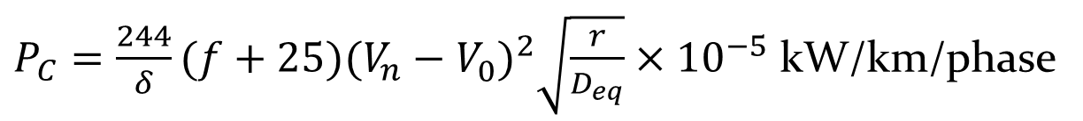
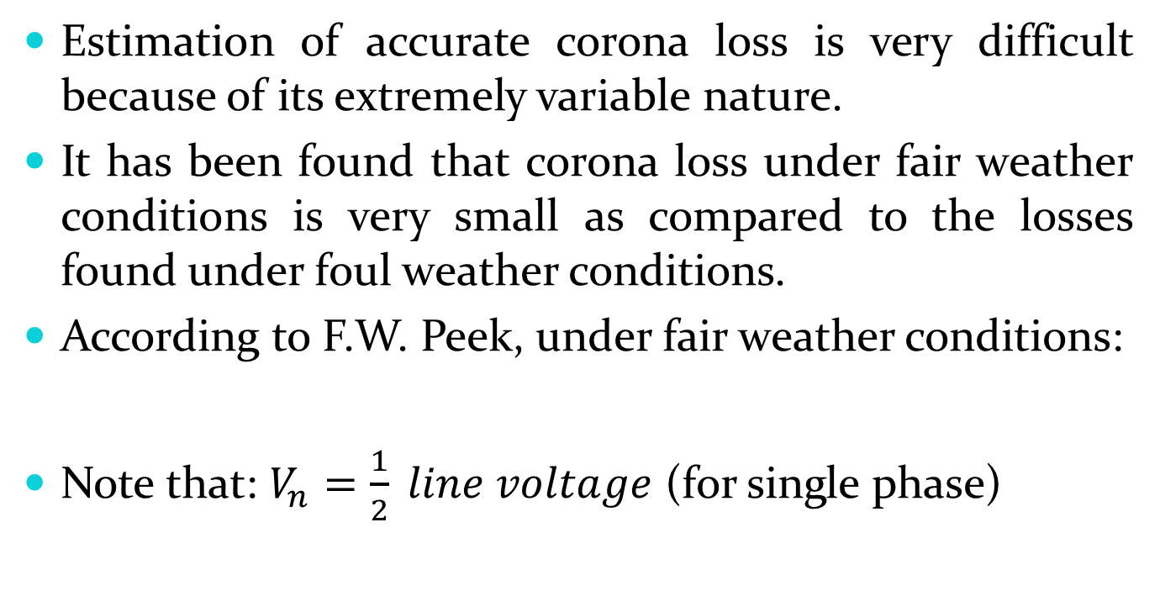

Corona Power Loss
Estimation of accurate corona loss is very difficult because of its extremely variable nature.
It has been found that corona loss under fair weather conditions is very small as compared to the losses found under foul weather conditions.
According to F.W. Peek, under fair weather conditions:
Note that: $V_{n}=\frac{1}{2} line voltage$ (for single phase)
$P_{C}=\frac{244}{δ}(f+25){(V_{n}^{}−V_{0}^{})}^{2}\sqrt{\frac{r}{D_{eq}}}×{10}^{−5}$ kW/km/phase
$V_{n}=\frac{1}{\sqrt{3}} line voltage$ (for three phase)

Slide 23





Where:
$$P_{C}=corona power loss$$
$$f=supply frequency (Hz)$$
$$δ=air density factor$$
$$V_{n}=rms line to neutral voltage in kV$$
$$V_{0}=rms disruptive critical voltage per phase in kV$$
$$r=radius of conductor (meters)$$
$$D_{eq}=spacing\left(equivalent spacing\right) between$$
$$conductors (meters)$$

Slide 24


Peek’s formula for corona loss is valid when corona losses are predominant and the ratio $\frac{V_{n}}{V_{0}}$ is greater than 1.8.
When this ratio is less than 1.8, the following formula known as Peterson’s formula, gives better results:
The factor $F$ is called the corona loss function and it varies with the ratio $\frac{V_{n}}{V_{0}}$.
$P_{C}=2.1f {\left(\frac{V_{n}}{\log_{10}\left(\frac{D_{eq}}{r}\right)}\right)}^{2}×{10}^{−5}×F$ kW/km/phase

Slide 25


Where:
$$P_{C}=corona power loss$$
$$f=supply frequency (Hz)$$
$$V_{n}=rms line to neutral voltage in kV$$
$$r=radius of conductor (meters)$$
$$D_{eq}=spacing\left(equivalent spacing\right) between$$
$$conductors (meters)$$

Slide 26

Effect of Corona on Line Design
Transmission lines are designed in such a way that the corona loss is small enough in fair weather condition because it reduces the efficiency of the lines.
If disruptive critical voltage of about 10% more than the operating voltage, then it is acceptable even though some corona loss will take place under foul weather condition.
An increase in $D_{eq}$ and $r$ increases the disruptive critical voltage, thus reduces the corona loss but increases the cost.

Slide 27
Reading Assignment
Advantages and disadvantages of corona in transmission lines
Factors affecting corona loss
Methods to reduce corona loss
Radio interference

