Slide 1


Addis Ababa University
Addis Ababa Institute of Technology
School of Mechanical & Industrial Engineering
Applications of Heat Exchangers
Prepared by: Dawit M.
Office: 314 - C
E-mail: dwtmus@gmail.com

Slide 2
Outline
  Introduction
  Objectives
  Heat Exchangers for Liquid to Liquid Applications
    Plate Heat Exchangers (Compact)
    Shell and Tube Heat Exchangers
  Heat Exchangers for Liquid to Gas Applications
    Bank of Tubes in Cross Flow
    COLASIT Heat Exchangers
    Compact Heat Exchangers
  Heat Exchangers for Gas to Gas Applications
    Compact Heat Exchangers
  Applications in Thermal Power Stations and Marine Engineering
  Accessories of Heat Exchangers:
    Anti – Plugging Systems for Sea Water
    Anit – Fouling Systems
AAiT
School of Mechanical and Industrial Engineering - SMiE

Slide 3
Introduction
This topic elucidates the application of different types of heat exchangers in various process industries and plants.
The application of heat exchangers in bio-process, chemo-process, power generation and cogeneration industries varies over a wide range, from the thermal treatment of fluids to perform cooling and heating processes, as demanded by a particular application.
Heat exchangers are also integral part of gas conditioning systems.
AAiT
School of Mechanical and Industrial Engineering - SMiE

Slide 4
Objectives
After completion of this lecture on heat exchangers’ applications, student will be able to have a good understanding on types of heat exchange systems used in:
  Liquid to liquid (L/L) heat exchange applications
  Liquid to gas (L/G) heat exchange applications
  Gas to gas (G/G) heat exchange applications
  And
  Auxiliaries/Accessories of heat exchangers
AAiT
School of Mechanical and Industrial Engineering - SMiE

Slide 5
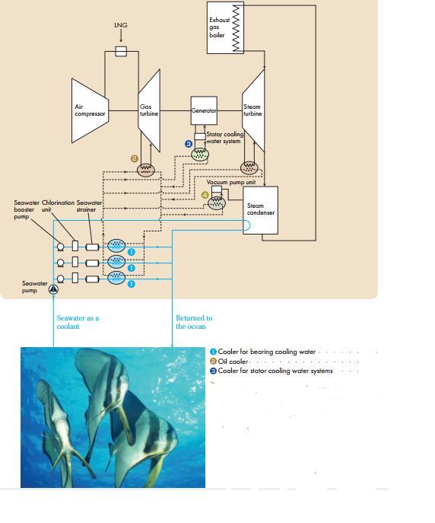
1. Heat Exchangers for Liquid to Liquid Applications
AAiT
School of Mechanical and Industrial Engineering - SMiE

Slide 6
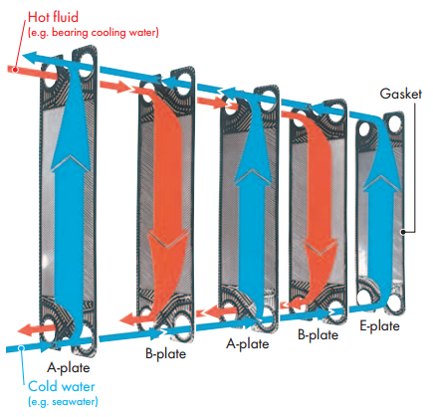
1.1 L/L Heat Exchange in Plate Heat Exchanger
The mechanism of efficient heat transfer:
Hot fluid (e.g. lub oil) and cold fluid (e.g. sea water) are flowed through four specified portholes at the four corners of each heat exchanger plate.
These heat transfer plates are made of press formed thin sheet of metal with high corrosion resistance (stainless steel or titanium).
The hot fluid flows in opposite direction to the cold fluid, and heat transfer is performed
AAiT
School of Mechanical and Industrial Engineering - SMiE

Slide 7
Cont’d …
Features of this heat exchanger:
A high heat transfer coefficient: three to five times that of tubular heat exchangers)
Excellent heat transfer allows the hot fluid to be cooled close to cold fluid: even to only 1⁰C
Flexibility of heat transfer area: the number of plates can be increased or decreased according to the required duty
Usable with sea water: made from corrosion resistant metals like titanium
Easy to open and inspect
AAiT
School of Mechanical and Industrial Engineering - SMiE

Slide 8
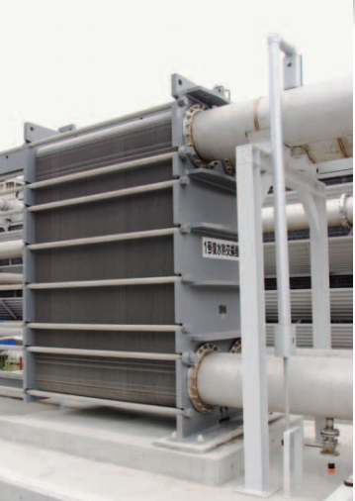
Cont’d …
Few applications in thermal power station and marine engineering:
Cooler for bearing cooling water
Oil cooler
Cooler for Stator Cooling Water Systems
AAiT
School of Mechanical and Industrial Engineering - SMiE

Slide 9
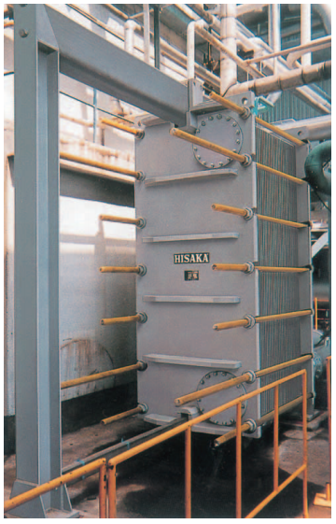
Cooler for Bearing Cooling Water
Application:
This cooler is designed for cooling system which collects all the cooling water for every system within the entire power station/water jacket circulating water of the engine and cylinder head, and cools it with sea water as a cooling medium.
Another cooling medium used to cool the cooling water can be water from cooling tower or river depending on plant location.
AAiT
School of Mechanical and Industrial Engineering - SMiE

Slide 10
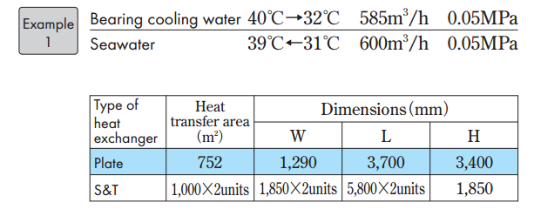
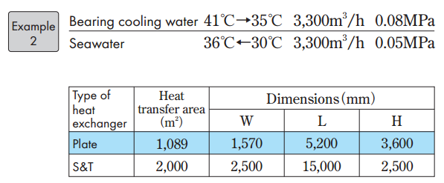
Cont’d …
Examples of operating conditions:
It should be noted that Shell and Tube Heat Exchangers perform L/L heat exchange
AAiT
School of Mechanical and Industrial Engineering - SMiE

Slide 11
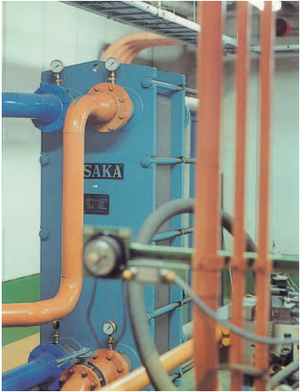
Oil Cooler
Application:
This cooler is designed to cool lubricating oil for bearing of steam, gas turbines, ship engines.
These heat exchangers are proven devices that have long track of use in ships and individual power stations.
Note:
Titanium plates can be used for low quality cooling water with high chlorine ion concentration.
AAiT
School of Mechanical and Industrial Engineering - SMiE

Slide 12
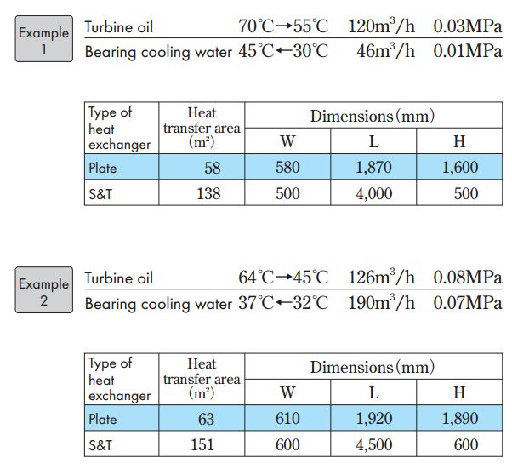
Cont’d …
Examples of operating conditions:
It should be noted that Shell and Tube Heat Exchangers perform L/L heat exchange
AAiT
School of Mechanical and Industrial Engineering - SMiE

Slide 13
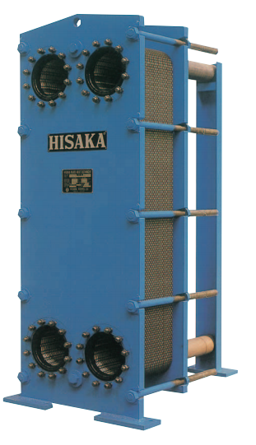
Cooler for Stator Cooling Water Systems
Application:
Stator cooling water systems are used to cool stator coils of large – capacity turbine generators. Cooling water circulates through stator coils to remove the heat generated by the rotating stator coils. The cooler is designed to cool the stator cooling water.
AAiT
School of Mechanical and Industrial Engineering - SMiE

Slide 14
Heat Exchanger Auxiliaries
1. Anti-Plugging System for Sea Water
2. Anti–Fouling Systems
AAiT
School of Mechanical and Industrial Engineering - SMiE

Slide 15
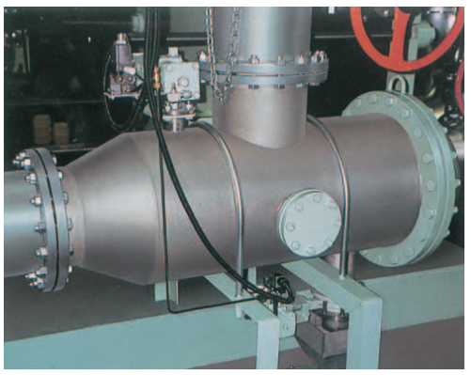

Anti-Plugging System for Sea Water
Application:
This system is designed to remove any debris such as sea – weed, shellfish and contaminants contained in sea water so that they don't enter the heat exchanger, pre venting the channel inlet from plugging.
Working Principle:
By changing the sea water flow direction in the strainer element, discharge the debris through back flushing valve.
AAiT
School of Mechanical and Industrial Engineering - SMiE

Slide 16
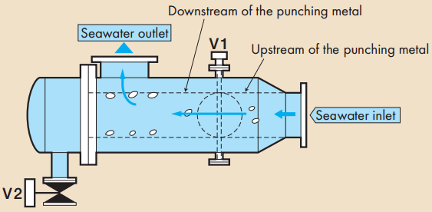
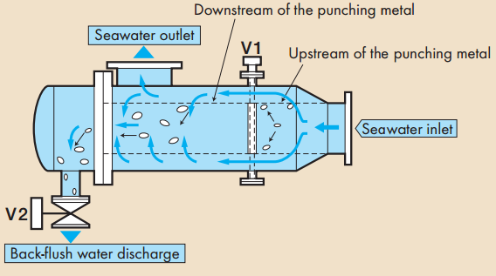
Cleaning Process
Normal Operation:
V1 fully opened and V2 fully closed
Cleaning Operation:
V1 fully closed and V2 fully opened
AAiT
School of Mechanical and Industrial Engineering - SMiE

Slide 17
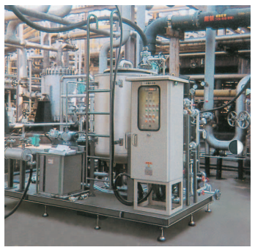
Anti–Fouling Systems
Applications:
Film-like fouling caused by microbes in sea water and deposition of shellfish may contaminate the heat transfer surfaces resulting in reduced heat transfer performance of heat exchanger and blockage of the plate channels.
This anti-fouling system can be installed to prevent such trouble.
Working Principle:
Hot water circulation can raise the ambient temperature to kill fungi and young shell fish. This mechanism allows antifouling of the heat transfer surface by retention of hot water in the plate type heat exchanger.
AAiT
School of Mechanical and Industrial Engineering - SMiE

Slide 18
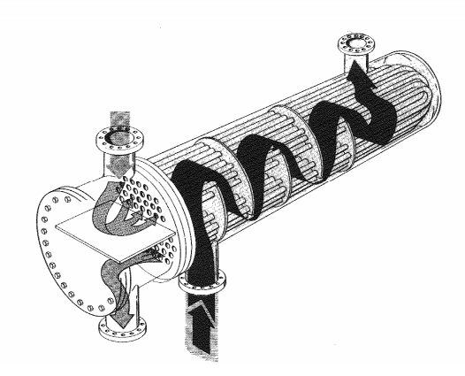
1.2. Shell and Tube Heat Exchangers
Type 1: Removable Bundle, Out Side Packed Head.
This design allows for easily removal, inspection and cleaning of the shell circuit and shell interior.
Applications:
Flammable or Toxic liquids in the tube circuit
Good for high fouling liquids in the tube circuit
Type 2: Removable Bundle, U – Tube Type.
Suitable for severe requirements with maximum thermal expansion capacity. Because each tube expand and contract independently, this design is suitable for larger thermal shock applications.
Applications:
Oil, chemical and water heating applications
Excellent in steam to liquid applications
AAiT
School of Mechanical and Industrial Engineering - SMiE

Slide 19
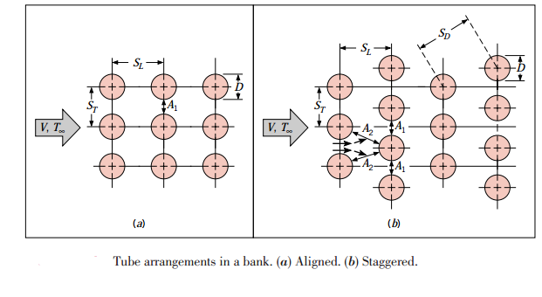
2. Liquid to Gas Heat Exchangers – Cross Flow H.E
2.1. Bank of Tubes in Cross Flow – Cross Flow Heat Exchanger
Liquid flows in the tube side and gas will pass in cross flow over it.
The tube rows of a bank are either staggered or aligned in the direction of the fluid velocity V.
Applications:
Super heaters
Condensate Heaters…
AAiT
School of Mechanical and Industrial Engineering - SMiE

Slide 20
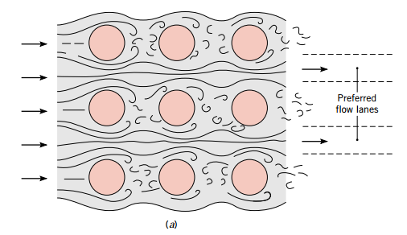
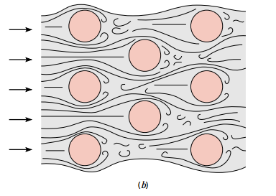
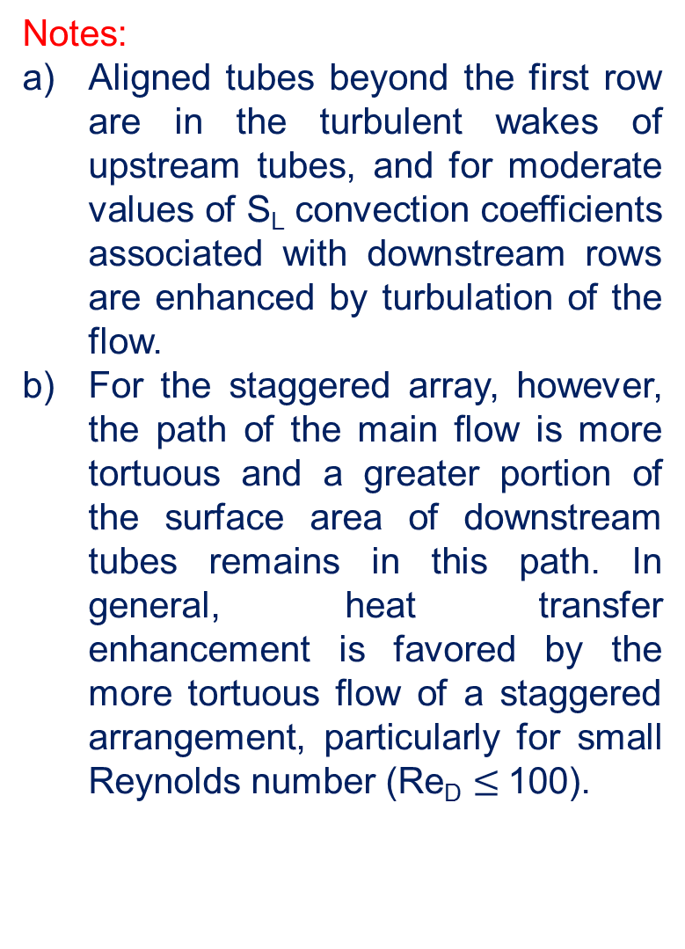
2. Liquid to Gas Heat Exchangers – Cross Flow H.E
Notes:
Aligned tubes beyond the first row are in the turbulent wakes of upstream tubes, and for moderate values of S_{L} convection coefficients associated with downstream rows are enhanced by turbulation of the flow.
For the staggered array, however, the path of the main flow is more tortuous and a greater portion of the surface area of downstream tubes remains in this path. In general, heat transfer enhancement is favored by the more tortuous flow of a staggered arrangement, particularly for small Reynolds number (Re_{D} $≤$100).
Application
AAiT
School of Mechanical and Industrial Engineering - SMiE

Slide 21
2.2. COLASIT – L/G Heat Exchanger
COLASIT - Heat Exchanger for aggressive air, gases and vapor
There are no corrosion problems with the COLASIT heat exchanger made entirely of plastic.
COLASIT heat exchangers are cleaned by means of pressurized water or, if necessary, by use of chemical detergents. The high degree of corrosion resistance allows chemical cleaning of the COLASIT heat exchanger.
Applications:
heat recovery processes from aggressive waste air, in electro-plating in the chemical industry, in the electronics industry etc.
cooling aggressive waste gases upstream of scrubbers and subsequent heating, for example in drying processes, in chemical metal treatment,
as a condenser for vapor in the chemical and pharmaceutical industries, in drying processes etc.
AAiT
School of Mechanical and Industrial Engineering - SMiE

Slide 22
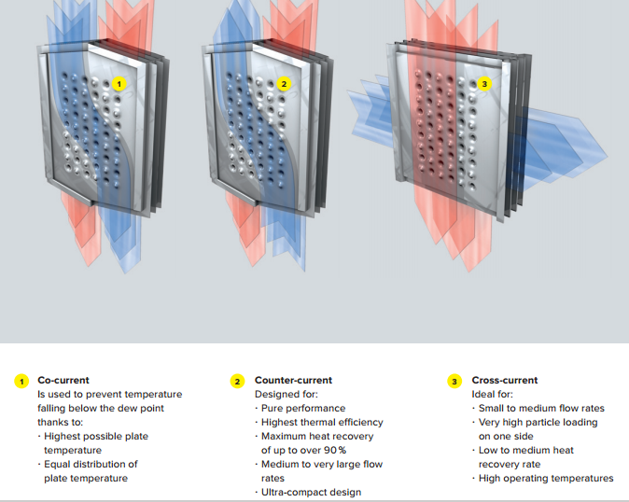
3. Heat Exchangers for Gas/Gas Applications
3.1. Compact Heat Exchangers
Plate Heat Exchangers are applicable here but if the gas in one side is characterized by very small convection coefficient, compact designs are required to accomplish >700 m²/m³ of the heat exchanger.
AAiT
School of Mechanical and Industrial Engineering - SMiE

Slide 23
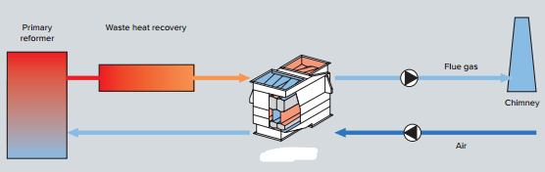
Cont’d …
Applications:
High pressure flue gas/air heat exchanger (air preheater)
Syngas cooling and conditioning (Natural cooling)
AAiT
School of Mechanical and Industrial Engineering - SMiE

Slide 24
Thank You
Questions are Welcomed!

