Slide 1

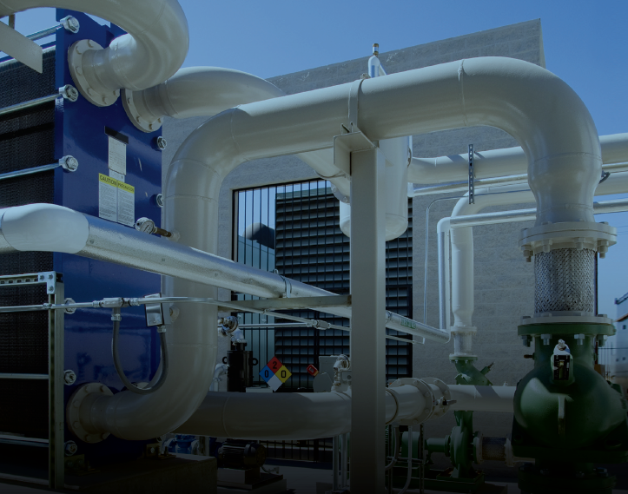
Addis Ababa University
Addis Ababa Institute of Technology
School of Mechanical & Industrial Engineering
Introduction to Thermo-Fluid Systems Design
Prepared by: Dawit M. (M.Sc.)
Office: 314 - C
E-mail: dwtmus@gmail.com

Slide 2
Outline
About the Course
About the Instructor & Contact Info
Introduction
Prerequisites
Learning Outcomes
Course Contents and References
Mode of Evaluation
Course Policies
Introduction
Design of Thermo – Fluid Systems
General Steps in Design
Applications
AAiT
School of Mechanical and Industrial Engineering - SMiE

Slide 3
About the Course
Course title: Thermo - Fluid Systems Design
Course code: MEng 5372
Program: Regular, B.Sc. in Mechanical Engineering
Credit Hours: 3
ECTS: 5
Contact Hours: 2 lecture, 2 tutorial, 1 lab, 5 Home study (HS)
Target Group: Year V (Thermal Stream, UG)
AAiT
School of Mechanical and Industrial Engineering - SMiE

Slide 4
About the Instructor
Instructor: Mr. Dawit Mussie
Qualifications: B.Sc. in Mechanical Engineering
M.Sc. in Thermal Engineering
Office: 314-C (Mechanical Floor)
Consultation hours: 2:30pm-:4:30pm on Monday
10:00am-12:00pm on Wednesday
E-mail: dwtmus@gmail.com (comments, suggestions, questions … are welcome)
Student Representative: Yitayal - 0923273245
AAiT
School of Mechanical and Industrial Engineering - SMiE

Slide 5
Introduction
Design courses and projects in contemporary undergraduate curricula have focused mainly on topics in solid mechanics. This has left graduating junior engineers with limited knowledge and experience in the design of components and systems in the thermo-fluids sciences. ABB Automation in their handbook on Energy Efficient Design of Auxiliary Systems in Fossil-Fuel Power Plants has mentioned that this lack of training in thermo-fluids systems design will limit our ability to produce high-performance systems. This deficiency in contemporary undergraduate curricula has resulted in an urgent need for course materials that underline the application of fundamental concepts in the design of thermo-fluids components and systems.
Owing to the urgent need for course materials in this area, this textbook has been developed to bridge the gap between the fundamental concepts of fluid mechanics, heat transfer, and thermodynamics and the practical design of thermo-fluids components and systems. To achieve this goal, this textbook is focused on the design of internal fluid flow systems, heat exchangers, and thermal power generations and utilizations.
AAiT
School of Mechanical and Industrial Engineering - SMiE

Slide 6
Prerequisite Knowledge
This requires prerequisite knowledge of:
internal fluid flow
conduction heat transfer
convection heat transfer with emphasis on forced convection in tubes and over cylinders
analysis of constant area fins
thermodynamic power cycles, in particular, the Rankine and Brayton cycles.
Courses: Thermodynamics I & II, Heat Transfer, Fluid Mechanics I & II
The fundamental concepts are used as tools in an exhaustive design process to solve various practical problems presented in the sections.
AAiT
School of Mechanical and Industrial Engineering - SMiE

Slide 7
Learning Outcomes
After completion of this course, student will be able:
To learn techniques for formulating and solving thermal and fluid problems with emphasis on using an integrated and just-in-time teaching strategy.
To prepare themselves for competence in the workplace through cooperative group works and extensive computer-based teaching and learning.
To be prepared for advanced courses in thermal and fluid sciences.
Choose a pump/fan, fluid mover to perform adequate fluid flow rate.
Design a series piping/duct system network, design and analyze a parallel or series piping/duct system network.
Develop a realistic thermal-fluid design of heating/cooling system including heat exchangers, solar water heating systems and work on individual components of a composite system.
AAiT
School of Mechanical and Industrial Engineering - SMiE

Slide 8
Course Contents and References
1. Introduction
2. Air – Duct Systems
Introduction
Applications
What is Duct? (Duct Defined)
Duct Classifications
Duct Materials
Duct Shapes
Pressures in Duct
Pressure Losses in Ducts
Air – Duct Systems Design
General Rules for Duct Design
Commonly Used Duct Design Methods
Performance of Air Duct Systems
System Balancing and Optimizations
Fans and Fan Laws
Interaction Between Fan and Duct System (Fan Laws)
Fan Selection
Duct Leakage
Duct Work Sectional Losses (Charts)
3. Liquid Pumping Systems
Pipe Flow Review
Laminar and Turbulent Flows
Losses (minor and major)
Energy Grade Line and Hydraulic Grade Line in Conduit Flow
Concept of Equivalent Length
Fluid Power Transmission through Pipes
Piping Network
Water Supply Design for High Rise Buildings
Pump Types and Pump Selection
4. Design of Heat Exchangers – Kern’s Method
Process (Thermal) Design of Shell and Tube HEXs
AAiT
School of Mechanical and Industrial Engineering - SMiE

Slide 9
Cont’d …
5. Application of Heat Exchangers
Liquid – Liquid Heat Exchange
Liquid – Gas Heat Exchange
Gas – Gas Heat Exchange
Auxiliaries (Anti – Plugging and Anti Fouling Systems)
6. Solar Thermal Systems
Solar Water Heating Systems
Steady State and Transient Models
Solar Air Heating Systems
Steady State and Transient Models
Solar Thermal Power Plants
Solar Desalination
Text Book and References
Text Book:
André G. McDonald, Hugh L. Magande, Introduction to Thermo – Fluid Systems Design, A John Wiley & Sons, Ltd., Publication, 2012
References:
Yunus Çengel, Heat and Mass Transfer: A Practical Approach, 3rd Edition, McGraw-Hill, Co., 2007 and White, Fluid Mechanics, 6th Edition, McGraw-Hill, Co., 2008
Yunus Çengel and John Cimbala, Fluid Mechanics: Fundamentals and Applications, McGraw-Hill, Co., 2006
Frank Incropera, David Dewitt, Theodore Bergman, Adrienne Lavine, Introduction to Heat Transfer, 5th Edition, John Wiley & Sons, 2007
Stephen Turns, Thermal-Fluid Sciences: An Integrated Approach, Cambridge University Press, 2006
AAiT
School of Mechanical and Industrial Engineering - SMiE

Slide 10
Mode of Evaluation
Graded Contents
Project I and II | 20%
Mid Exam | 30%
Final Exam | 50%
Total | 100%
[To be graded, A (maximum, pass) - F (minimum, fail)]
AAiT
School of Mechanical and Industrial Engineering - SMiE

Slide 11
Course Policies
Attendance will be noted throughout. 75% class attendance is mandatory to get a grade in this course or to sit for final exam.
Collaborative discussion on homework is encouraged, but each student must do his/her own work and submit papers as per the due date.
Deadlines must be respected. Late work WILL NOT be accepted.
Cheating is a very bad habit and any form of cheating on assignments and exams has strict punishments by the school academic commission.
Students are welcomed to meet the instructor for discussion or for any good need in the subject matter, in class or outside the class (office).
AAiT
School of Mechanical and Industrial Engineering - SMiE

Slide 12
Introduction
AAiT
School of Mechanical and Industrial Engineering - SMiE

Slide 13
Design of Thermo – Fluid Systems
Engineering Design — Definition
Process of devising a system, subsystem, component, or process to meet desired needs.
Types of Design in Thermo-Fluid Science
Process Design: The manipulation of physical and/or chemical processes to meet desired needs.
Example: (a) Introduce boiling or condensation to increase heat transfer rates.
System Design: The process of defining the components and their assembly to function to meet a specified requirement.
Examples: (a) Steam turbine power plant system consisting of turbines, pumps,
pipes, and heat exchangers.
(b) Hot water heating system, complete with boilers.
Subsystem Design: The process of defining and assembling a small group of components to do a specified function.
Example: Pump/piping system of a large power plant. The pump/piping
system is a subsystem of the larger power plant system used to transport water
to and from the boiler or steam generator.
Component Design: Development of a piece of equipment or device.
AAiT
School of Mechanical and Industrial Engineering - SMiE

Slide 14
Cont’d …
Difference between Design and Analysis
Analysis: Application of fundamental principles to a well-defined problem. All supporting information is normally provided, and one closed-ended solution is possible.
Design: Application of fundamental principles to an open problem. All supporting information may not be available and assumptions may need to be made. Several alternatives may be possible, no single correct answer exists.
Classification of Design
(i) Modification of an existing device for
(a) cost reduction;
(b) improved performance and/or efficiency;
(c) reduced mean time between “breakdowns”;
(d) satisfy government codes and standards;
(e) satisfy customer/client preferences.
(ii) Selection of existing components for the design of a subsystem or a complete
system.
(iii) Creation of a new device or system.
AAiT
School of Mechanical and Industrial Engineering - SMiE

Slide 15
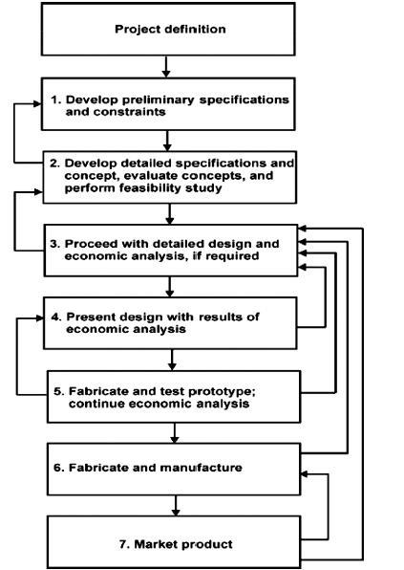
General Steps in Design
AAiT
School of Mechanical and Industrial Engineering - SMiE

Slide 16
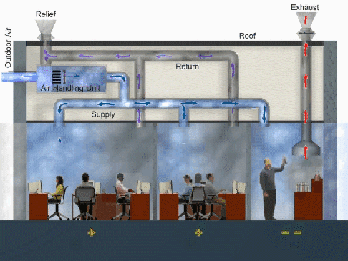
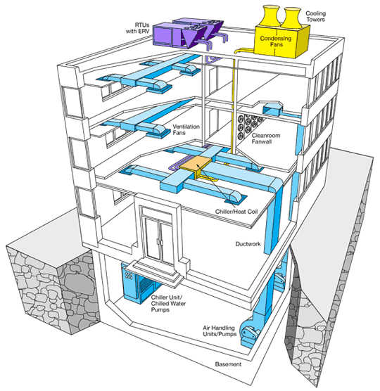
Applications
AAiT
School of Mechanical and Industrial Engineering - SMiE

Slide 17
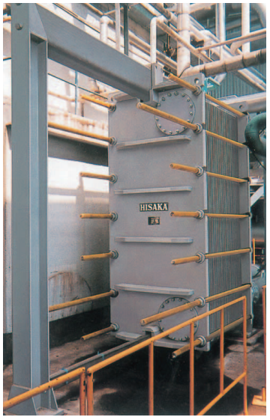
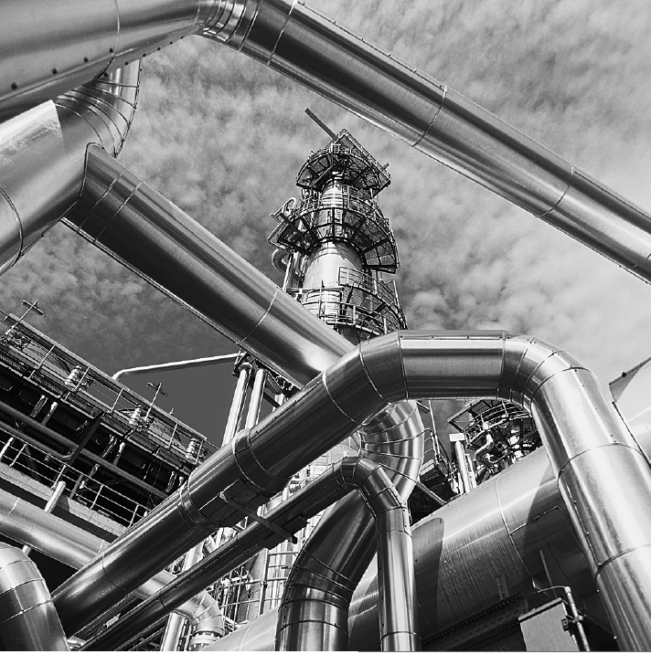
Cont’d …
AAiT
School of Mechanical and Industrial Engineering - SMiE

Slide 18
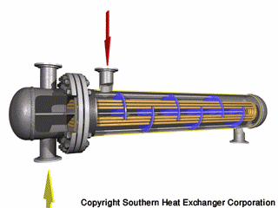
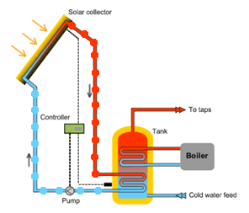
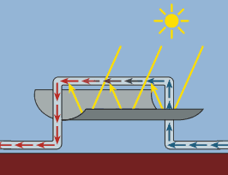
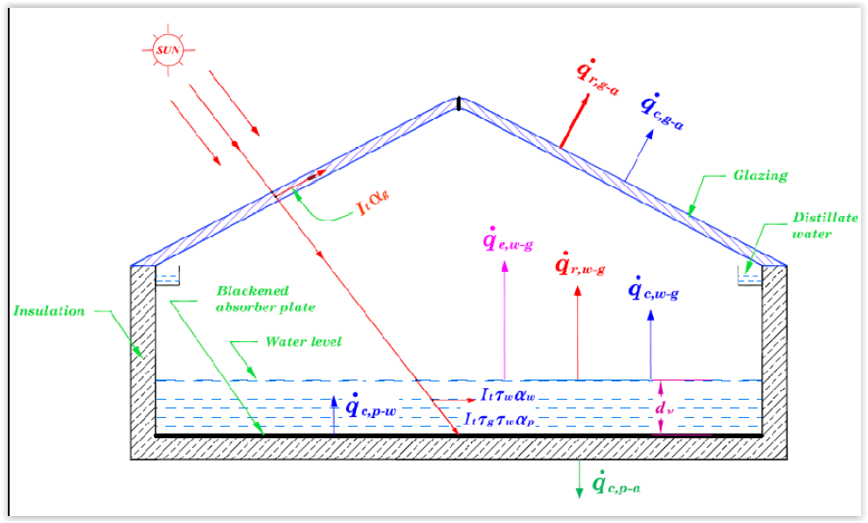
Cont’d …
AAiT
School of Mechanical and Industrial Engineering - SMiE

Slide 19
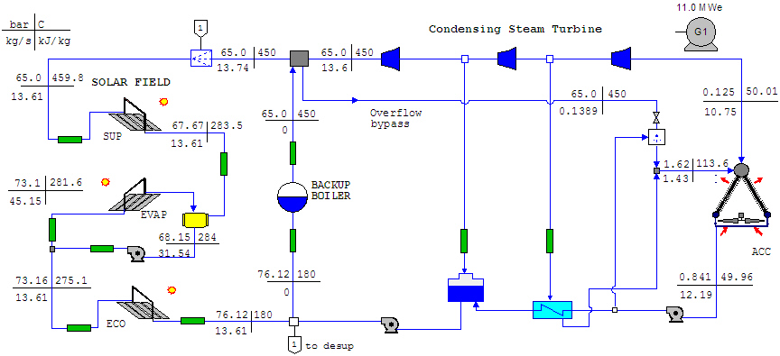
Cont’d …
AAiT
School of Mechanical and Industrial Engineering - SMiE

Slide 20
Thank You
Questions please …

