Slide 1
Pipe flow systems : Part-2
Dr.Yilma T.

Slide 2
Energy line and hydraulic grade line in conduit flow
The plot of the sum of pressure head and dynamic head along the flow path is known as energy line. This refers to the total available energy of the system at the location.
The line will drop due to losses. For example in straight constant area pipe the line will slope proportional to the head drop per m length. There will be sudden drop if there are minor losses due to expansions, fittings etc.

Slide 3
Cont…
Hydraulic grade line is the plot of pressure head along the flow path. Hydraulic grade line will be at a lower level and the difference between the ordinates will equal the dynamic head, i.e., u^2/2g.
This line will drop sharply if velocity increases and will slope upwards if velocity decreases. This line will also drop due to frictional losses. Flow will be governed by hydraulic grade line.
Introduction of a pump in the line will push up both the lines.

Slide 4
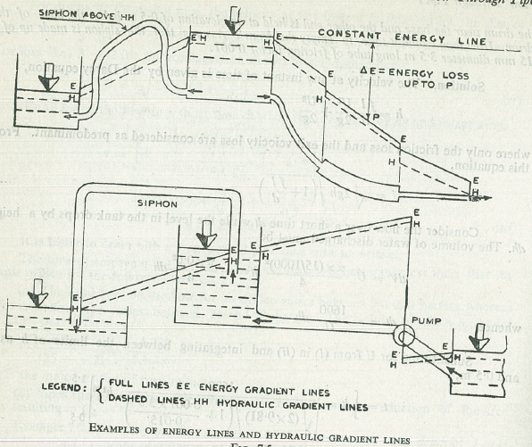
It has been stated that flow through pipe transition is accompanied by a loss in energy. The total energy line therefore drops for flow through a transition.
The hydraulic gradient line may drop or rise depending upon the change in velocity

Slide 5
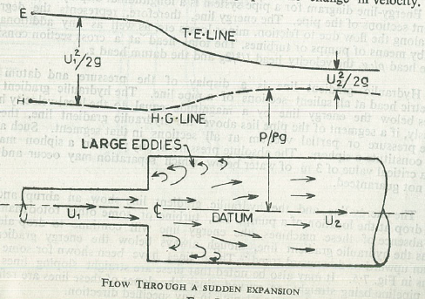
Cont..
Typical plots for flow through sudden expansion and contraction are depicted below

Slide 6
Example :
A pump takes in water from a level 5 m below its center line and delivers it at a height of 30 m above the centre line, the rate of flow being 3 m3/hr. The diameter of the pipe line all through is 50 mm (ID). The fittings introduce losses equal to 10 m length of pipe in addition to the actual length of 45 m of pipe used. Determine the head to be developed by the pump. The head to be developed will equal the static head, friction head and the dynamic head.

Slide 7
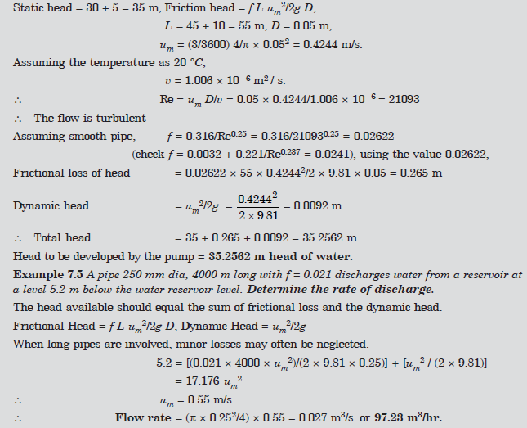

Slide 8
Concept of equivalent length
For calculation of minor losses it is more convenient to express the pressure drop in fittings, expansion–contraction and at entry in terms of a length of pipe which will at that discharge rate lead to the same pressure drop. This length is known as equivalent length, Le. From the relation knowing C, f and D.
As a number of fittings at various positions may be involved causing minor losses in a pipe system, this is a convenient way to estimate minor losses.

Slide 9
Concept of equivalent pipe or equivalent length
When pipes of different friction factors are connected in series (or in parallel) it is convenient to express the losses in terms of one of the pipes. The friction loss hf for pipe 1 with L1 and f1 is given by

Slide 10
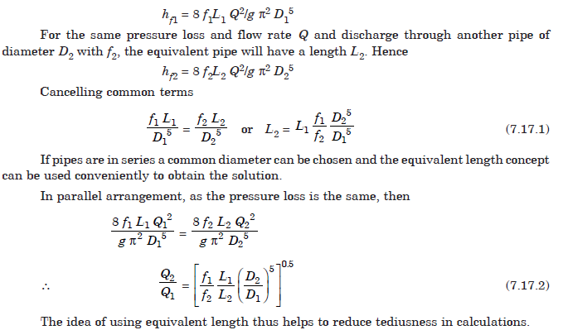

Slide 11
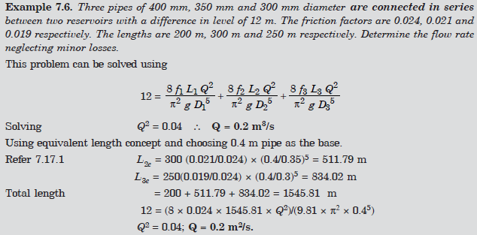

Slide 12
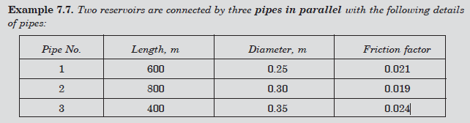
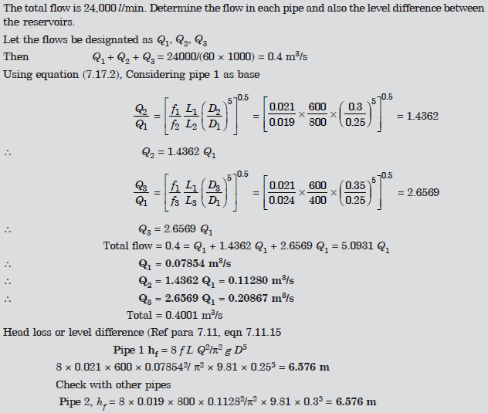

Slide 13
Fluid power transmission through pipes
High head and medium head hydal plants convey water from a high level to the power house through pressure pipe called penstock pipes. The choices of the pipe diameter depends on the expected efficiency of transmission and also on the economical aspect of the cost of pipe.
Higher efficiencies can be obtained by the use of larger diameter pipes, but this will prove to be costly.
It is desirable to maximise the power transmitted as compared to an attempt to increase efficiency. Applications are also there in hydraulic drives and control equipment.

Slide 14
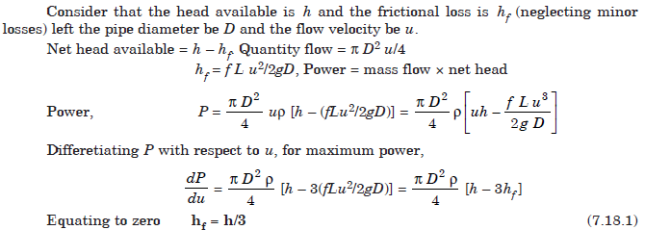

Slide 15
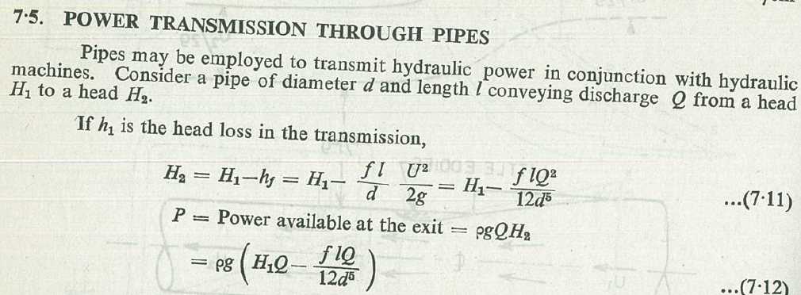
Condition for Maximum Power Transmission

Slide 19
Condition for Maximum Power Transmission
For maximum power generation frictional loss will equal one third of available head and the corresponding transmission efficiency is 66.67%.
If the available rate of flow is known the velocity and then the diameter can be determined or if the diameter is fixed the flow rate can be obtained. The friction factor for the pipe can be fixed as this is nearly constant above a certain value of Reynolds number.
For maximum power when flow rate is specified, pipe diameter is fixed and when diameter is specified the flow rate will be fixed.

Slide 20
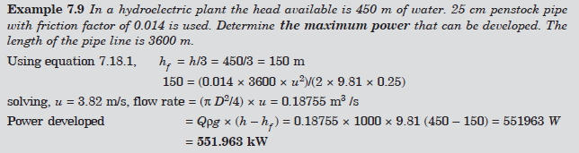

Slide 21
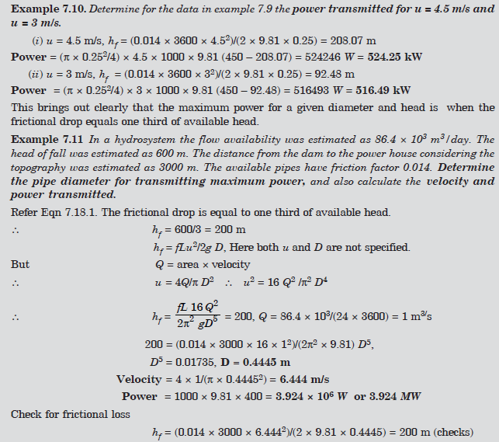

Slide 22


Network of pipes
Complex connections of pipes are used in city water supply as well as in industrial systems. Some of these are discussed in the para.
Pipes in Series—Electrical Analogy
Series flow problem can also be solved by use of resistance network. Consider head loss equation below. For given pipe specification the equation can be simplified as :
For flow in series Q is the same through all pipes. This leads to the relation
Note: The dimension for R is .

Slide 23
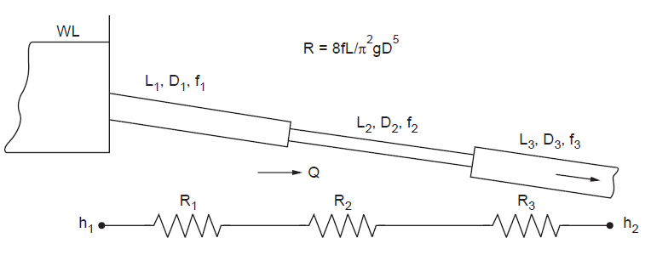
Equivalent circuit for series flow
The R values for the pipe can be calculated. As the total head is also known Q can be evaluated. The length L should include minor losses in terms of equivalent lengths.
The circuit is shown in Fig.

Slide 25
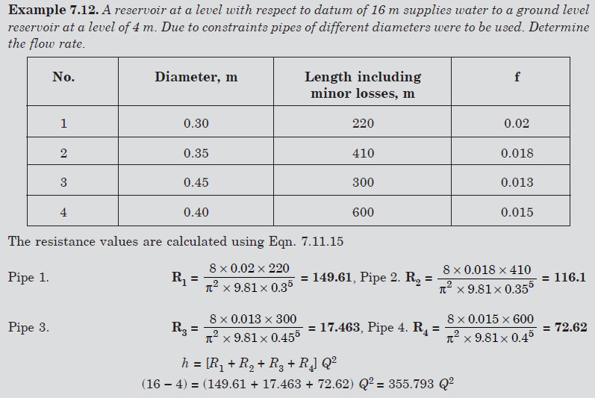

Slide 26
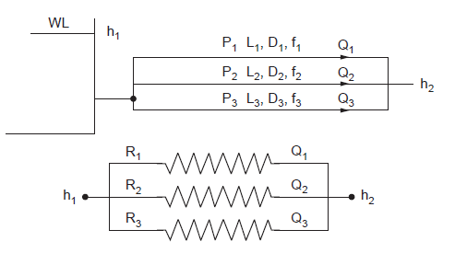

Pipes in Parallel
Such a system is shown in fig below
Case (i) The head drop between locations 1 and 2 are specified: The total flow can be determined using

Slide 27
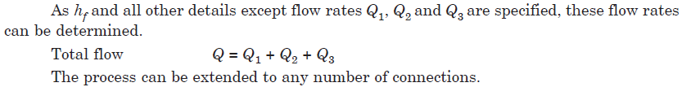
Pipes in Parallel
Case (ii) Total flow and pipe details specified. One of the methods uses the following steps:
1. Assume by proper judgement the flow rate in pipe 1 as Q1.
2. Determine the frictional loss.
3. Using the value find Q2 and Q3.
4. Divide the total Q in the proportion Q1 : Q2 : Q3 to obtain the actual flow rates.

Slide 28
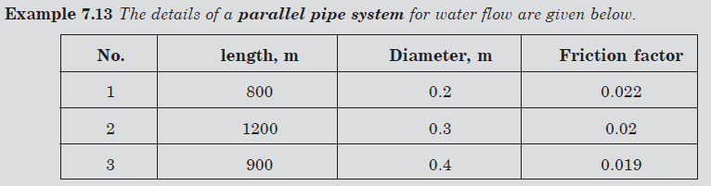
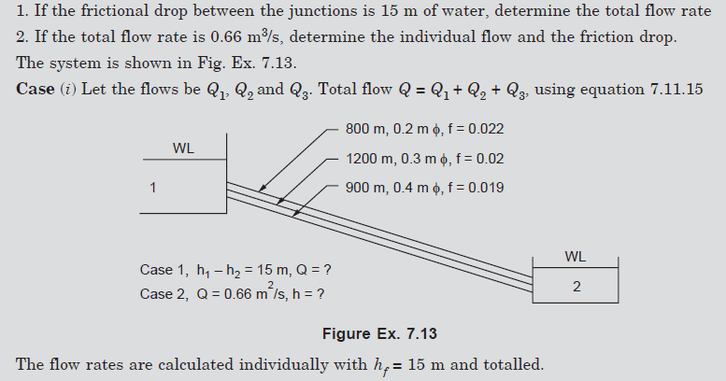

Slide 29
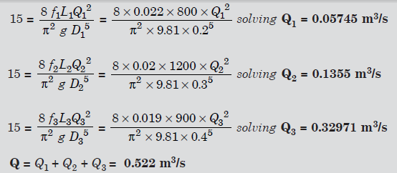
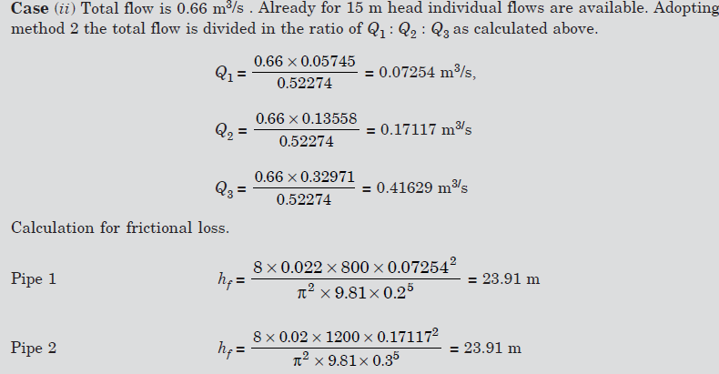

Slide 30
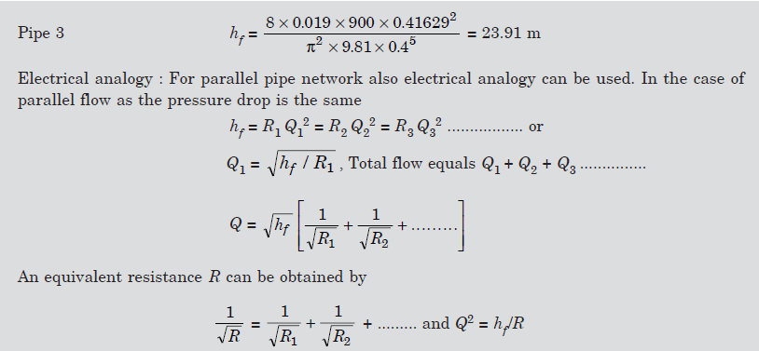

Slide 31
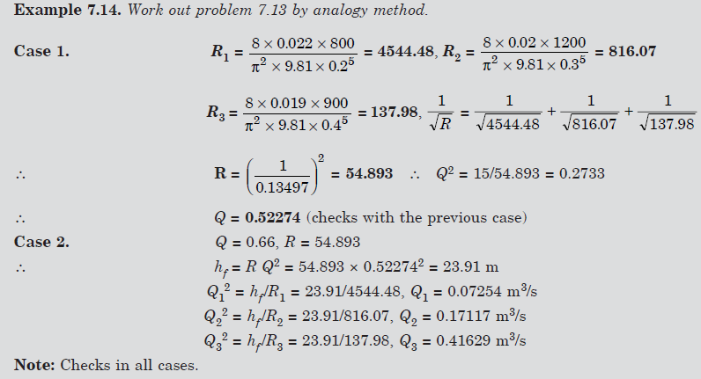

Slide 32
Branching Pipes
The simplest case is a three reservoir system interconnected by three pipes, Fig below. The conditions to be satisfied are
(i) The net flow at any junction should be zero due to continuity principle.
(ii) The Darcy-Weisbach equation should be satisfied for each pipe. If flows are Q1, Q2, Q3 , then the algebraic sum of Q1 + Q2 + Q3 = 0.
If one of the flow rate is specified the solution is direct. If none are specified, trial solution becomes necessary. The flow may be from the higher reservoir to the others or it may be from both high level reservoirs to the low level one. The hydraulic grade line controls the situation. If the head at the junction is above both the lower reservoirs, both of these will receive the flow. If the head at the junction is below the middle one, the total flow will be received by the lowest level reservoir.

Slide 33
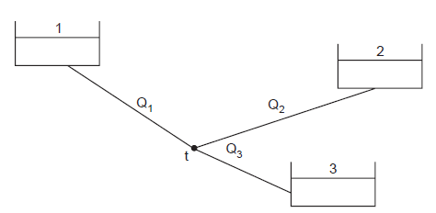

Slide 34
Branching Pipes
The method of solution requires iteration.
(i) A value for the head at the junction is assumed and the flow rates are calculated from pipe details.
(ii) The sum of these (algebraic) should be zero. But at the first attempt, the sum may have a positive value or negative value.
(iii) If it is positive, inflow to the junction is more. So increase the value of head assumed at the junction.
(iv) If it is negative, the outflow is more. So reduce the value of head assumed. Such iteration can be also programmed for P.C.

Slide 35
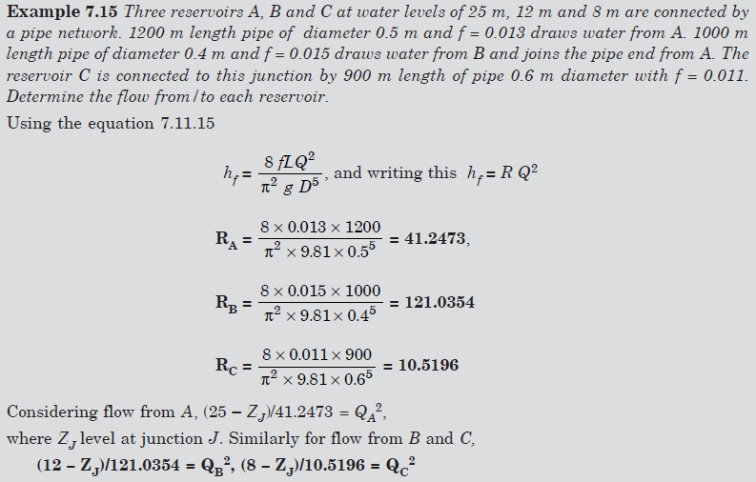

Slide 36
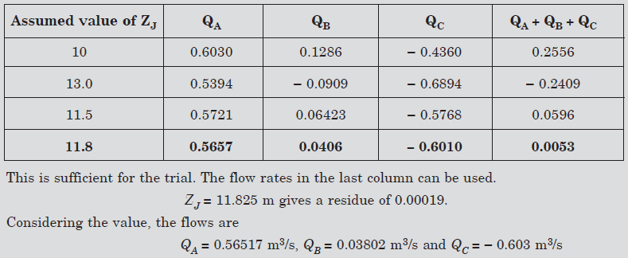

Slide 37
Water supply system design for High rise buildings
Document Ethiopian Building Code standard for Plumbing services
Velocities general
Flow Velocities for water systems

