Slide 1
Pump Types and Pump Selection

Slide 2
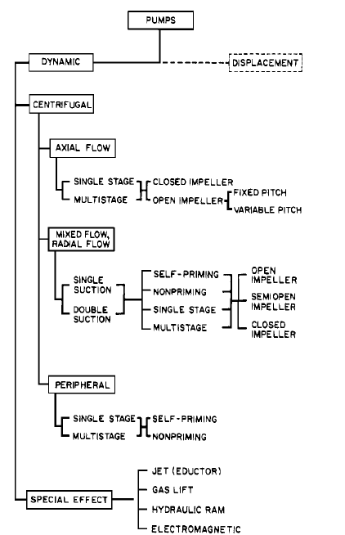

Slide 3
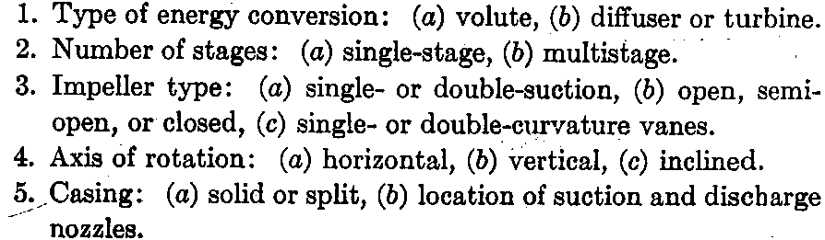
Types
Centrifugal Pump

Slide 4
Types of Pumps and application areas
Reciprocating pumps (plunger or diaphragm type) for liquid chemical metering and injection applications (small capacity)
Centrifugal pumps - for wide variety of hydraulic head and over a wide range of capacity requirements, for low to medium capacity with medium to high pressure.
Axial flow pumps: for low hydraulic head and high flow conditions
Vertical turbine pumps: require much less space and self-priming but more head room.

Slide 5
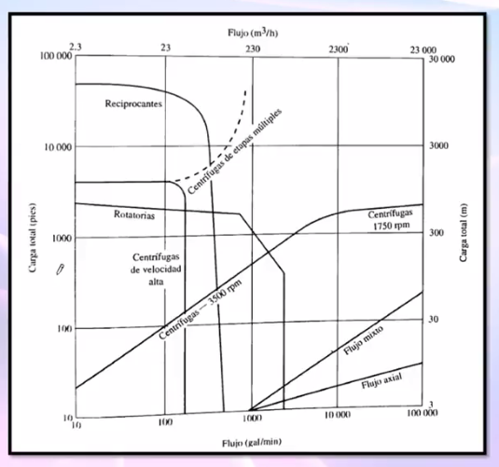

Slide 6
Coverage chart for centrifugal pumps
A coverage chart (see Figure 4-2) makes it possible to do a preliminary pump selection by looking at a wide range of pump casing sizes for a specific impeller speed. This chart helps narrow down the choice of pumps that will satisfy the system requirements.
Pump size= Discharge diameter X Inlet diameter - maximum impeller diameter

Slide 7
Figure 4-2 Typical pump capacity coverage chart.
Pump size= Discharge diameter X Inlet diameter X maximum impeller diameter

Slide 8
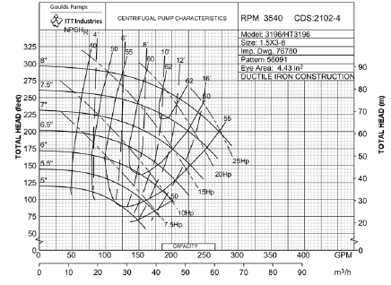
Pump performance curve of centrifugal pumps
Operating point
This figure shows a typical vendor-supplied pump performance curves for a centrifugal pump where clear water is the pumping liquid.
In selecting the pump, suppliers try to match the system curve supplied by the user with a pump curve that satisfies these needs as closely as possible.
The operating point is where the system curve and pump performance curve intersect

Slide 9
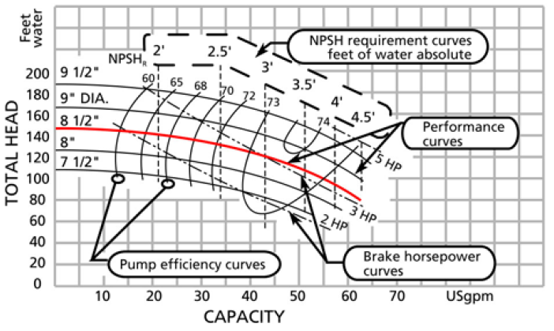

Slide 10
Efficiency Curves
The pump's efficiency varies throughout its operating range. This information is essential for calculating the motor power.
The B.E.P. (best efficiency point) is the point of highest efficiency of the pump. All points to the right or left of the B.E.P have a lower efficiency.
The impeller is subject to axial and radial forces, which get greater the further away the operating point is from the B.E.P.
These forces manifest themselves as vibration depending on the speed and construction of the pump. The point where the forces and vibration levels are minimal is at the B.E.P.
In selecting a pump, one of the concerns is to optimize pumping efficiency.
It is good practice to examine several performance charts at different speeds to see if one model satisfies the requirements more efficiently than another.
Whenever possible the lowest pump speed should be selected, as this will save wear and tear on the rotating parts.

Slide 11
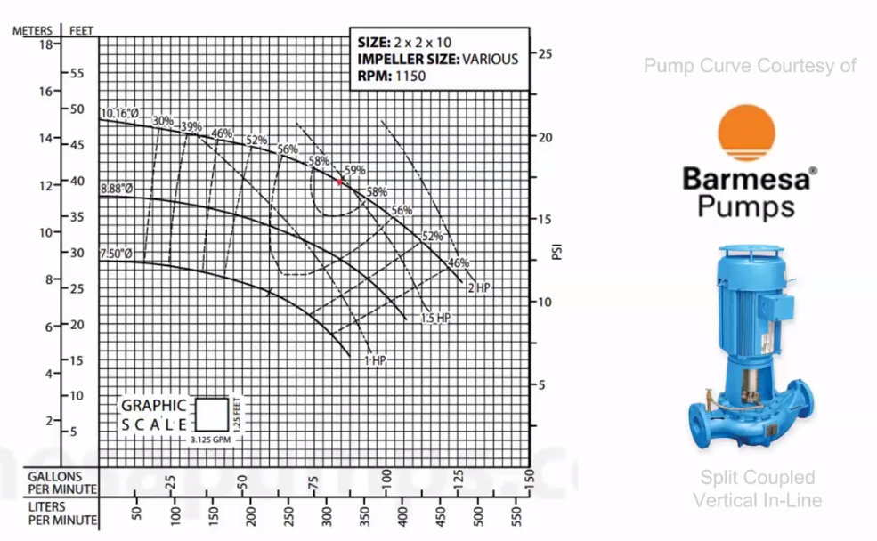
Example –performance curve of a commercial pump

Slide 12
Cont…
The BEP is affected when the selected pump is oversized. The reason is that the flow of oversized pumps must be controlled with different methods, such as a throttle valve or a by-pass line. These provide additional resistance by increasing the friction. As a result the system curve shifts to the left and intersects the pump curve at another point. The BEP is now also lower. In other words, the pump efficiency is reduced because the output flow is reduced but power consumption is not.
Inefficiencies of oversized pumps can be overcome by, for example, the installation of VSDs, two-speed drives, lower rpm, smaller impeller or trimmed impeller
Summery
Oversized pump
Requires flow control (throttle valve or by-pass line)
Provides additional head
System curve shifts to left
Pump efficiency is reduced
Solutions if pump already purchased
VSDs or two-speed drives
Lower RPM
Smaller or trimmed impeller

Slide 13
Controlling Flow: speed variation
A centrifugal pump’s rotating impeller generates head. The impeller’s peripheral velocity is directly related to shaft rotational speed. Therefore varying the rotational speed has a direct effect on the performance of the pump.
The pump performance parameters (flow rate, head, power) will change with varying rotating speeds. To safely control a pump at different speeds it is therefore important to understand the relationships between the two. The equations that explain these relationships are known as the “Affinity Laws”(will be discussed in the coming slides):
Flow rate (Q) is proportional to the rotating speed (N)
Head (H) is proportional to the square of the rotating speed
Power (P) is proportional to the cube of the rotating speed
As can be seen from the above laws, doubling the rotating speed of the centrifugal pump will increase the power consumption by 8 times. Conversely a small reduction in speed will result in a very large reduction in power consumption. This forms the basis for energy conservation in centrifugal pumps with varying flow requirements.

Slide 14
Variable Speed Drives (VSD)
Controlling the pump speed is the most efficient way to control the flow, because when the pump’s speed is reduced, the power consumption is also reduced.
The most commonly used method to reduce pump speed is Variable Speed Drive (VSD).
VSDs allow pump speed adjustments over a continuous range, avoiding the need to jump from speed to speed as with multiple-speed pumps. VSDs control pump speeds use two types of systems:
Mechanical VSDs include hydraulic clutches, fluid couplings, and adjustable belts and pulleys.
Electrical VSDs include eddy current clutches, wound-rotor motor controllers, and variable frequency drives (VFDs). VFDs are the most popular and adjust the electrical frequency of the power supplied to a motor to change the motor’s rotational speed.

Slide 15
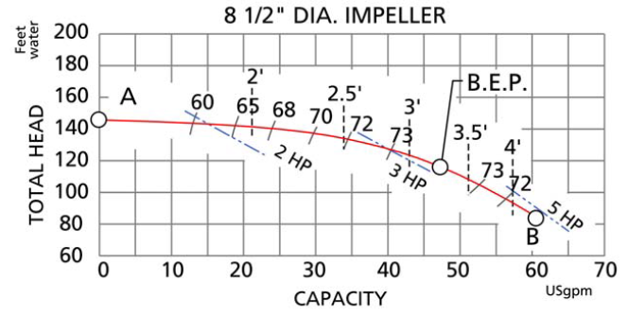
At some point in the pump selection process, the impeller diameter is selected.
For an existing pump, the diameter of the impeller is known. For a new pump, our calculations of Total Head for a given flow rate will have determined the impeller diameter to select according to the performance curve.
This figure shows only the information relevant to the 8 1/2" impeller performance curve.
Figure 3-3

Slide 16
The plot starts at zero flow. The head at this point corresponds to the shut-off head of the pump, point A in Figure 3-3.Starting at this point, the head decreases until it reaches its minimum at point B.
This point is sometimes called the run-out point and represents the maximum flow of the pump. Beyond this, the pump cannot operate. The pump's range of operation is from point A to B.

Slide 17
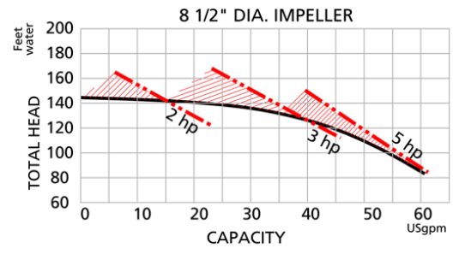
Horsepower Curves
The horsepower curves are shown on the chart and give the power required to operate the pump within a certain range. For example (see Figure 3-4), all points on the performance curve to the left of the 2 hp curve will be attainable with a 2 hp motor. All points to the left of 3 hp curve and to the right of the 2 hp curve will be attainable with a 3 hp motor. The horsepower can be calculated with the Total Head, flow and efficiency at the operating point.
Note that the horsepower curves shown on the performance curves are valid for water only.
Figure 3-4 Coverage area of horsepower curves.

Slide 18
Break Horsepower
The BHP required to drive a pump at a specific duty point is:
These values can be determined from the pump specification and the pump curve.

Slide 19
Example
Spec. calls for 675 gpm at 95 ft. head. Performance curve shows 86%. Pump effluent liquid is ethylene glycol at Sp. Gr. of 1.08.
= 20.3
Would select a 25 hp Driver

Slide 20
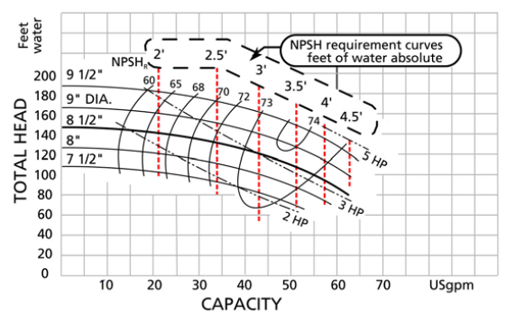
N.P.S.H. Requirement Curves
The pump manufacturer specifies a minimum requirement on the N.P.S.H. in order for the pump to operate at its design capacity. These are the vertical dashed lines in Figure.
The N.P.S.H. required becomes higher as flow increases, and lower as flow decreases. This essentially means that more pressure head is required at the pump suction for high flows than low flows.
N.P.S.H. is a head term and therefore independent of the fluid density and is in absolute fluid column height.
N.P.S.H required curves

Slide 21
NPSH Definition
NPSH defined as the combination of atmospheric pressure and static suction head that causes liquid to flow through the suction piping and finally enter the eye of the impeller.
Two Kinds of NPSH
Net positive suction head.
NPSH_{R}. – required by pump at duty point, found on the pump performance curve.
NPSH_{A}. – Available in the system and must be determined by calculation
Important !
For the pump to perform properly, the NPSH_{R} (required), must be less than the NPSH_{A} (available)

Slide 22
NPSH_{A}
P_{A} = atmospheric pressure or pressure in tank (psia);
P_{V} = vapor pressure of liquid at maximum pumping temperature;
Sp. Gr. = specific gravity at pumping temperature;
H_{E} = elevation head (ft); and
H_{F} = friction loss in suction line (ft).
Refer to following pages for example calculations.
Values for vapor pressure (P_{V}) and atmospheric pressure (P_{A}) found in pump handbooks. (see attached)

Slide 23
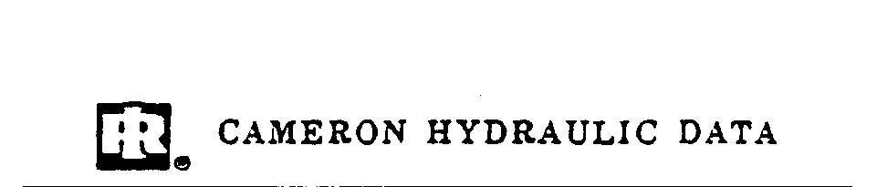
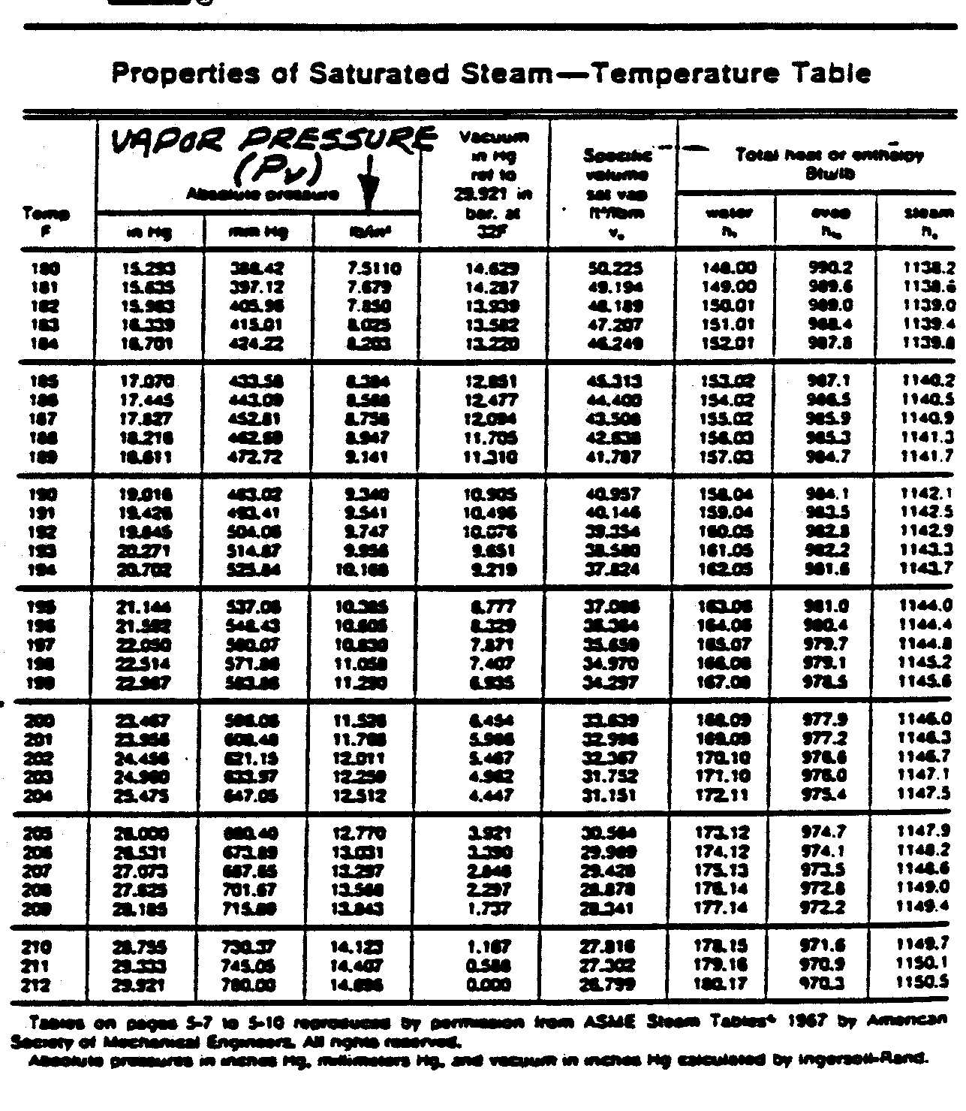

Slide 24
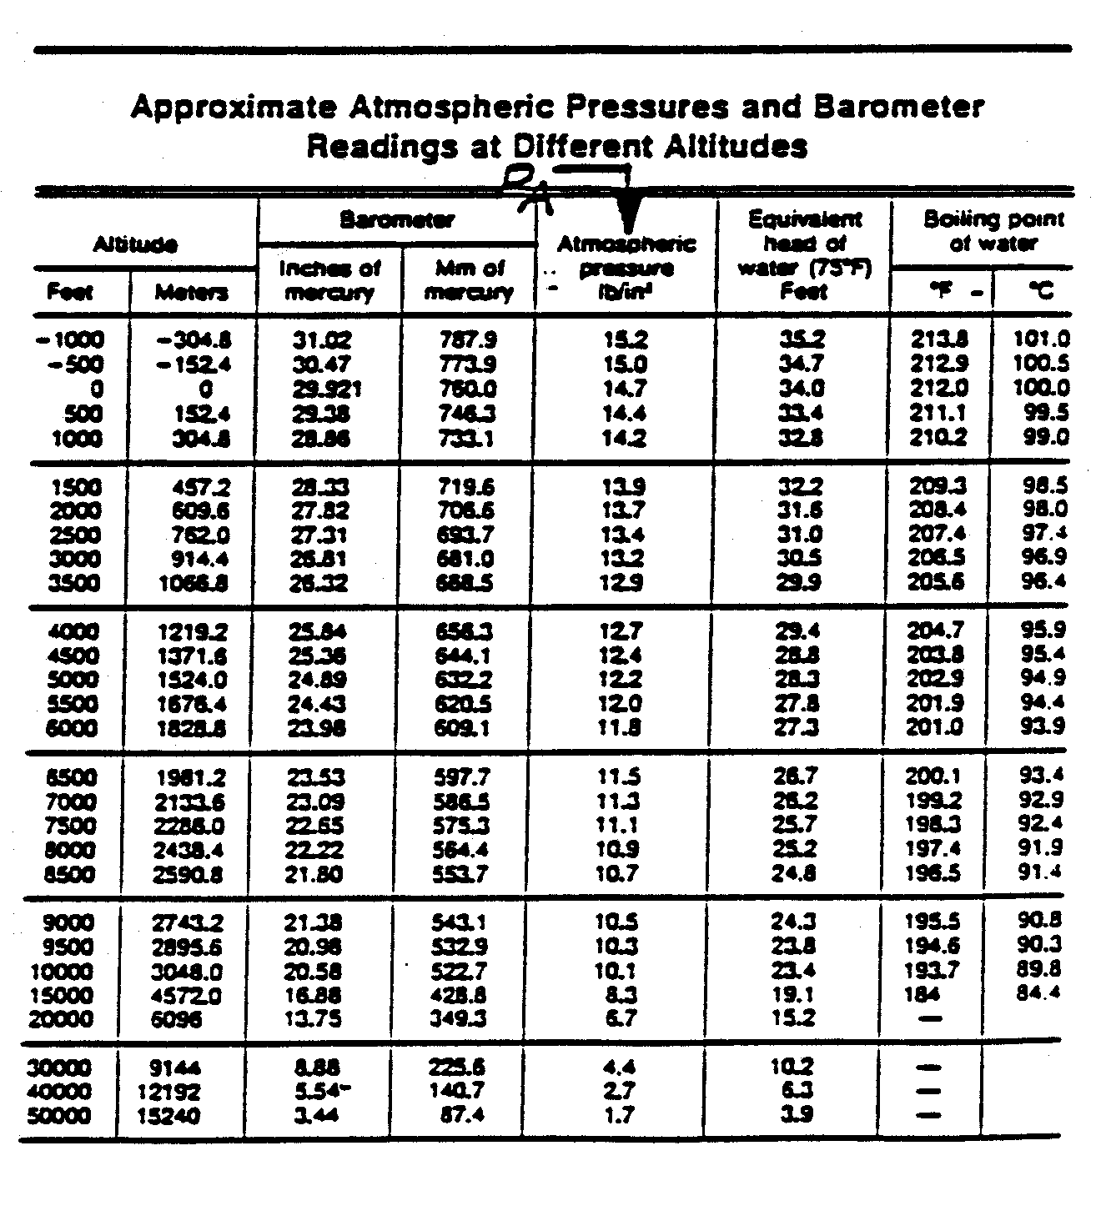

Slide 25
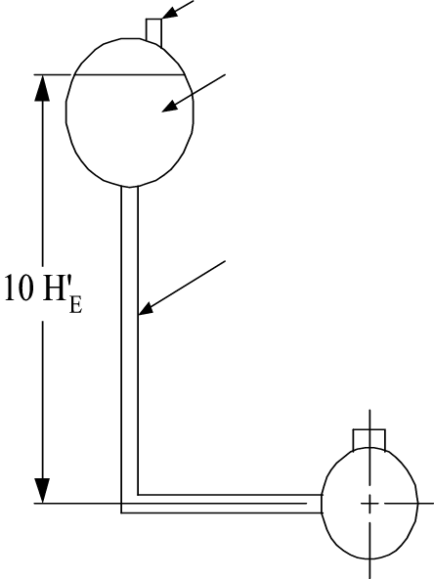
NPSH_{A} Example #1
vent
Atmospheric pressure (P_{A}) = 14.7 psia
Water at 90°F SP.GR. = .99 P_{V} = 0.69 psia
NPSH_{A} = 2.31 (P_{A}-P_{V}) + (H_{E}-H_{F})
SP.GR.
= 2.31 (14.7-0.69) + (10-1.5)
0.99
= 32.7 + 10 –1.5
= 41.2 ft NPSH_{A}
GOOD !
Should be no problem to select a pump to perform satisfactorily.
Friction loss in suction line H_{F} = 1 ^{½} ft.

Slide 26
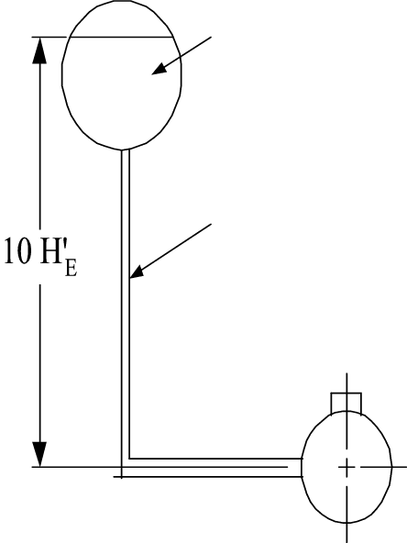
NPSH_{A} Example #2
Tank not vent
Deaerator system
Tank pressure (P_{A}) = 18.9 psia
Water at 225°F Sp.Gr. = 0.95 P_{V} = 18.9 psia
NPSH_{A} = 2.31 (P_{A}-P_{V}) + (H_{E}-H_{F})
SP.GR.
= 2.31 (18.9-18.9) + (10-1.5)
0.953
= 0 + 10 – 1.5
= 8.5 ft NPSH_{A}
Fair !
Select a pump that requires less than
8.5’ NPSH_{A} a duty point
Friction loss in suction line H_{F} = 1 ^{½} ft.

Slide 27
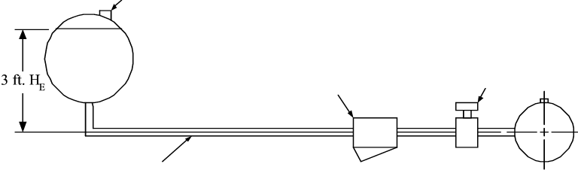
NPSA_{A} Example #3
Vent
Water at 210°F Sp.Gr. = .96 P_{V} = 14.1 psia
Atmospheric pressure (P_{A}) = 14.7 psia
Strainer
Gate Value
Friction loss in suction pipe with strainer and gate valve H_{F} = 1½ ft.

Slide 28
NPSH_{A} Example #3 - continued
Bad !
It will be difficult to select a pump for satisfactory operation the NPSH_{A} could be increased by raising the tank (H_{E}). If the pump requires 7 ft. NPSH_{R}, tank should be raised approximately 6 ft. add to give 7.9 ft NPSH_{A} even more if possible

Slide 29
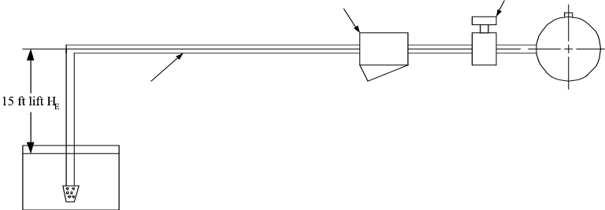
NPSH_{A} Example #4
Gate Value
Atmospheric pressure (P_{A}) = 14.7 psia
Strainer
Friction loss in suction pipe with strainer and gate valve H_{F} = 1½ ft.
Water at 90°F Sp. Gr.
= 0.99 P_{V} = 0.69 psia
Foot value
In selection the pump it would be necessary to see that the NPSH_{R} required did not exceed 13 to 14 ft at the duty point, otherwise noise and cavitation would occur at the pump

Slide 30
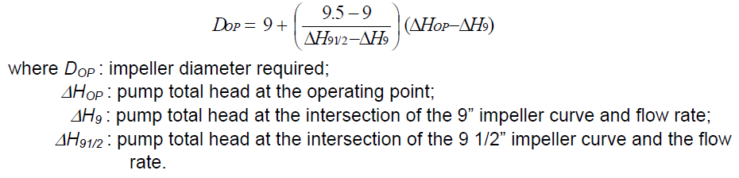
Impeller diameter selection
Quite often, the operating point is located between two curves on the performance chart. We can calculate the impeller size required by linear interpolation. For example, if the operating point falls between the 9" and 9 1/2" impeller curve (see Figure 4-7), the following equation will give the correct size:

Slide 31
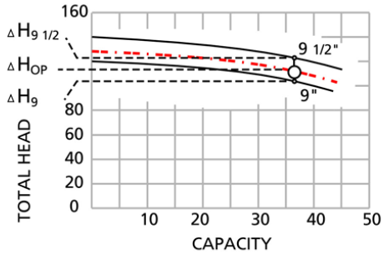
Figure 4-7 Interpolating impeller diameter

Slide 32
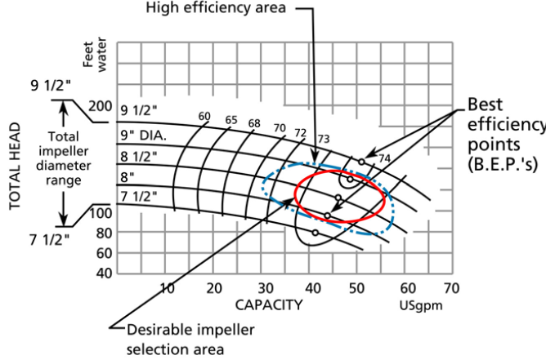
It is good practice to select (when possible) a pump with an impeller that can be increased in size, permitting a future increase in head and capacity. Or alternatively, an impeller which can be reduced in size. As a guide, select a pump with an impeller size no greater than between 1/3 and 2/3 of the impeller range for that casing with an operating point in the high efficiency area (see Figure 4-8).
It is also important not to go too far right or left from the B.E.P.. A guideline is to locate the operating point between 110% and 80% of the B.E.P. flow rate with an operating point in the desirable impeller selection area (see Figure 4-8).
Figure 4-8 Desirable pump selection area.

Slide 33
System curve
The system curve is a plot of the Total Head vs. the flow for a given system. The higher the flow, the greater the head required (see Figure 4-9). The shape of the system curve depends on the type of system being considered.
The system curve is superimposed on the pump performance chart. The Total Static head is constant and the friction head, equipment head and velocity head are flow dependent.
The calculation of Total Head at different flow rates produces a plot of Total Head vs. flow that is called the system curve.

Slide 34
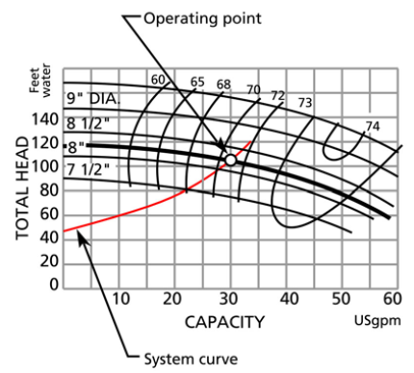
System curve
The operating point is the point on the system curve corresponding to the flow and head required. It is also the point where the system curve intersects the performance curve.
The design system curve is usually calculated with extra flow capacity in mind. It is good practice to plot the system curve for higher flow rates than the design flow rate, since flow demand may change and extra capacity may be required.
Figure 4-9 Superposition of system curve
and pump performance curve

Slide 35
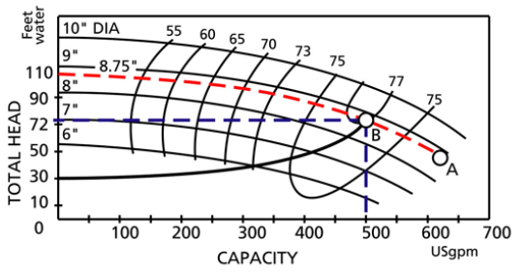
Operating point
First, determine the right pump size by using the coverage chart (see Figure 4-2). Locate the head and flow coordinate (operating point) on the chart.
This will identify the casing size and pump speed. Locate the correct performance curve chart for this pump casing size and again identify the operating point.
The operating point characterizes the actual flow rate and the head gain across that pump.

Slide 36
Determine the impeller size. The impeller size will be approximately 8.75". The dashed line represents the performance curve of the pump. The pump can only operate on its performance curve.
The system can only be run somewhere on the system curve. The intersection of these two defines the operating point which is the only point that the pump and system can operate

Slide 37
How does the pump get to the operating point from the moment it is switched on?
There are two methods which can be used to start a pump.
method 1 : the discharge valve is closed, whereas with
method 2 : the discharge valve is open.
The term discharge valve refers to the manual valve located close to the pump outlet flange.

Slide 38
Method 1 (discharge valve closed)
Pumps are often started with the discharge valve closed. Immediately after the pump is started, the head rises to point D (see Figure 4-11). The system curve at this moment is vertical. By gradually opening the discharge valve to its full open position, point D will move down the performance curve to point C, where the discharge valve should be fully open. The system curve's shape is progressively modified as the operating point is moved towards point C. This is a typical way of starting large pumps and should be the preferred method for any pump operating at more than 500 GPM.

Slide 39
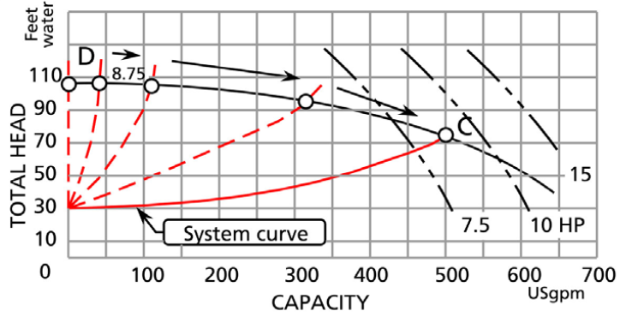
Figure 4-11 Starting the pump with discharge valve closed.

Slide 40
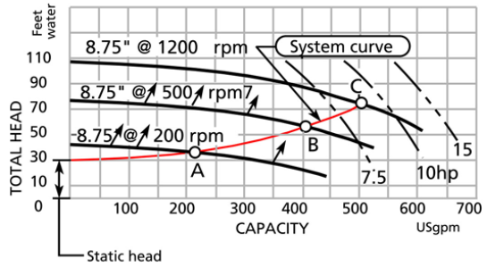
Method 2 (discharge valve open)
The alternate method is to start with the discharge valve open.
When the pump is just starting the initial RPM is low; the pump produces little head and flow.
As the pump accelerates, it will intersect the system curve at point A at 200 RPM, point B at 500 RPM and finally point C at the normal rotational speed of the pump and motor. This happens very quickly since the motor will reach its full operating speed in a few seconds. The disadvantage of starting with this method is that high initial velocity can produce a severe water hammer, shaking pipes and equipment.
Figure 4-12 Starting the pump with discharge valve
open.

Slide 41
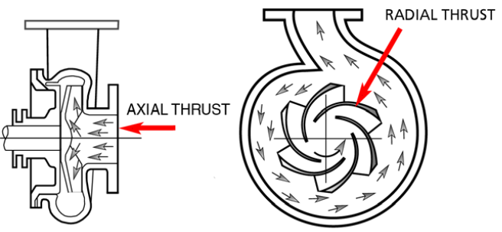
Pump operation to the right or left of the best efficiency point (B.E.P.)
The impeller is subjected to axial and radial forces. The level of the radial force depends on the pressure within the casing and is taken up by the drive shaft bearings.
Figure 4-14 The forces on the impeller.
There

Slide 42
Consequences of operating to the right or left of the B.E.P.
To the right of the B.E.P., or at high flows
Operating at the far right of the curve, near run-out point of the pump (point B, Figure 4-4) should be avoided. As flow increases, so does the N.P.S.H. required, and therefore cavitation is more likely to occur.

Slide 43
To the left of the B.E.P. or at low flows
Operation of centrifugal pumps at reduced capacity leads to a number of unfavorable results that may take place separately or simultaneously, and should be anticipated and circumvented. Some of these are:
Operating at less than best efficiency
On occasion, reduced flows may be required by the process. This can be
accommodated by a variable speed drive, or by using several pumps. One or
more pumps can then be shut down to provide the reduced flow.
• Higher bearing load
If a pump is of a single volute design, it will be subjected to higher radial thrust,
which will increase the load on the radial bearing. Therefore, the bearing life
would be expected to diminish.

Slide 44
Temperature rise
As capacity is reduced, the temperature of the pumped liquid increases. To
avoid exceeding permissible limits, a minimum flow by-pass is required.
• Internal re-circulation
At certain flows below the best efficiency, all centrifugal pumps are subjected
to internal re-circulation, in both the suction and the discharge area of the
impeller. This can cause hydraulic surging and damage to the impeller metal, similar to that caused by classic cavitation, but taking place in a different area of the impeller.

Slide 45
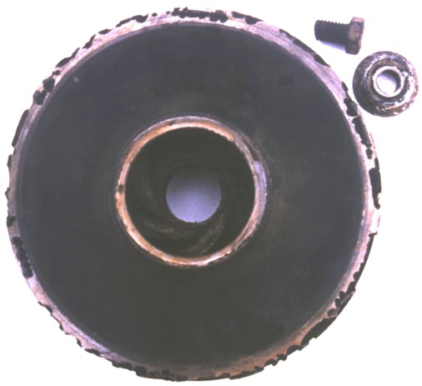
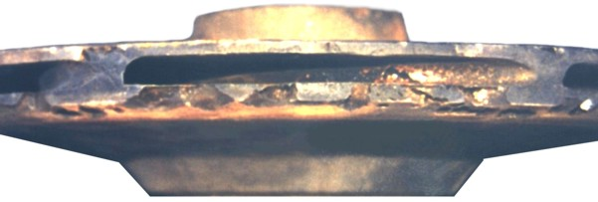
Damage Caused by Recirculation Cavitation
Damage to the outside of the impeller, on the outer periphery.

Slide 46
Pump-shut-off head
The shut-off head is the Total Head that the pump can deliver at zero flow (see Figure 4-19).
The shut-off head is important for 2 reasons.
1. In certain systems (admittedly unusual), the pump discharge line may have to run at a much higher elevation than the final discharge point. The fluid must first reach the higher elevation in the system. If the shut-off head is smaller than the static head corresponding to the high point, then flow will not be established in the system.
2. During start-up and checkout of the pump, a quick way to determine if the pump has the potential capacity to deliver the head and flow required, is to measure the shut-off head. This value can be compared to the shut-off head predicted by the performance curve of the pump.

Slide 47
Figure 4-18 Discharge pipe coming from
a higher elevation into the discharge
tank.

Slide 48
Figure 4-19 Location of pump shut-off head on the
performance curve.

Slide 49
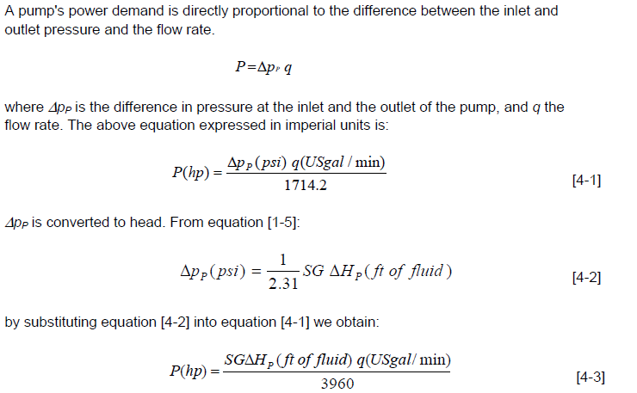
PUMP POWER

Slide 50

Equation [4-3] would be true if the pump were 100% efficient. Pump efficiency data are available from the pump manufacturer. All manufacturers test their pumps for various flows, heads and impeller sizes. The resulting efficiency data are mapped on the pump performance curve. The true power required at the pump shaft is:
where η is the pump efficiency. If the pump efficiency is 60%, then the value of η is 0.6.
It is good practice to design the pump base in such a way that the selected motor will stand on spacer blocks, being high enough that the next largest motor frame can be installed when the blocks are removed. This will allow the installation of a larger motor without a major disturbance if it should be required.

Slide 51

Affinity laws
The affinity laws are derived from a dimensionless analysis of three important parameters that describe pump performance: flow, total head and power.
The analysis is based on the reduced impeller being geometrically similar and operated at dynamically similar conditions or equal specific speed. The affinity laws were developed using the law of similitudes which provide 3 basic relationships.
Flow vs. diameter and speed

Slide 52
Affinity Laws
On occasion you may find it necessary to determine the performance of a pump at a different operating speed the affinity laws are used in making these calculations.
Q₁ = capacity
H₁ = Head (feet) at N₁ – rpm
Q₂ = capacity
H₂ = Head (feet) at N₂ – rpm

Slide 53
Example
Given pump at 600 gpm, 80 ft head, 15.1 BHP at 1750 rpm, what is comparable point at 1550 rpm?
Q₁= 600 H₁= 80 BHP₁= 15.1 N₁= 1750
Q₂= ? H₂= ? BHP₂= ? N₂= 1550
H₂ = H₁ × (N₂/N₁)² = 80 (1550/1750)² = 62.8 ft.
BHP₂ = BHP₁(N₂/N₁)³ = 15.1 (1550/1750)³ = 10.5 BHP

Slide 54
Example - continued
Other points from the 1750 rpm curve can be converted in a similar manner to plot an expected curve at the new rpm.
There are also similar equations to determine expected performance when changing the impeller diameter with rpm remaining constant. These can be shown by replacing N₁ and N₂ with D₁ and D₂ in the above equations. The use with different diameters would be the same as above

Slide 55
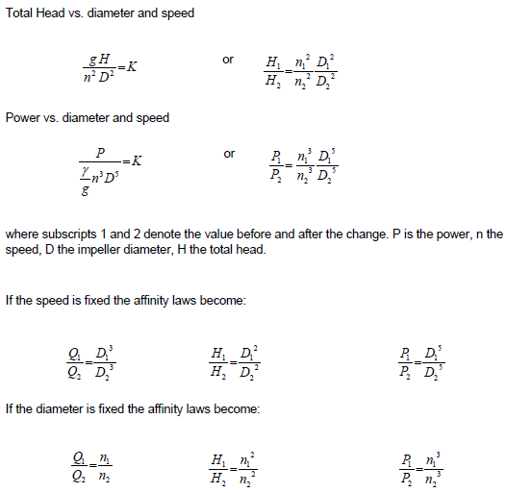

Slide 56
The process of arriving at the affinity laws assumes that the two operating points that are being compared are at the same efficiency. The relationship between two operating points, say 1 and 2, depends on the shape of the system curve (see Figure 4-20). The points that lie on system curve A will all be approximately at the same efficiency. Whereas the points that lie on system curve B are not. The affinity laws do not apply to points that belong to system curve B. System curve B describes a system with a relatively high static head vs. system curve A which has a low static head.

Slide 57
Figure 4-20 Limitation on the use of the affinity laws.

Slide 58

Diameter reduction To reduce costs pump casings are designed to accommodate several different impellers. Also, a variety of operating requirements can be met by changing the
outside diameter of a given radial impeller. Euler’s equation shows that the head should be proportional to (nD)^2 provided that the exit velocity triangles remain the same before and after cutting. This is the usual assumption and leads to:

Slide 59
Which apply only to a given impeller with altered D and constant efficiency but not a geometrically similar series of impellers.
If that is the case then the affinity laws can be used to predict the performance of the pump at different diameters for the same speed or different speed for the same diameter

Slide 60
Sizing things up ….
Head is independent of fluid density.
For fluids other than water, it should be determined if the fluid is Newtonian. Many pure fluids are Newtonian (see the table on rheological properties of fluids in Appendix A as a starting point). If the fluid is non-Newtonian, depending on the severity of its departure from Newtonian behavior, a centrifugal pump may not be an appropriate pumping device. If the fluid is Newtonian but with a different viscosity than water, apply the correction factors to the performance curve suggested by the pump manufacturer (see reference 1 and 2).

Slide 61
Cont..
Select a pump size and speed in such a way that the impeller is not close to its maximum size (i.e. within 2/3’s of it’s total range) in order to allow for a future increase in capacity. Locate the operating point somewhere between 110% and 80% of the B.E.P. flow.
During the selection process, if the operating point falls between two performance curves, by interpolation calculate the exact impeller size required to intersect the operating point. Impeller size is easily machined down to the correct diameter.
Determine the total static head corresponding to the highest point of the system and make sure that it is less than the pump shut-off head.
Finally, beware using the affinity laws for calculating a new pump diameter or speed for systems that have a high static head, the affinity laws apply only between two points that are at the same efficiency.

Slide 62
Centrifugal pumps in series - high head / low flow applications
Putting your centrifugal pumps in series, or connected along a single line, will let you add the head from each together and meet your high head, low flow system requirements.
This is because the fluid pressure increases as the continuous flow passes through each pump, much like how a multi-stage pump works. For example, if two of the same pumps are in series, the combined performance curve will have double the head of a single pump for a given flow rate.
For two different pumps, the head will still be added together on the combined pump curve, but the curve will most likely have a piecewise discontinuity (meaning to curve with protusions as pictured in in the 2nd pump curve below

Slide 63
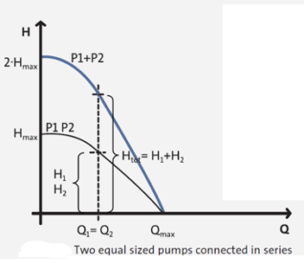
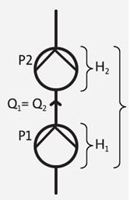
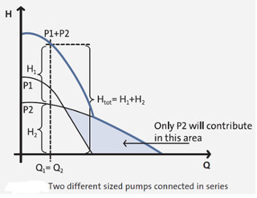

Slide 64
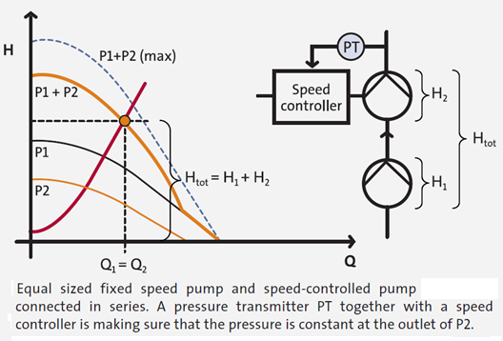
Pumps in series with control - constant, high pressure applications
In situations where a high, constant pressure is required, consider adding speed control to the final pump in a series. This configuration achieves the high pressure that is needed, while keeping a low flow, because the fixed-speed pump feeds into the speed-controlled pump, which adjusts its output with a pressure transmitter to add only enough head to maintain a constant pressure.

Slide 65
Pumps in parallel - low head / high flow, or low head / varied flow applications
Putting your pumps in parallel, or connected to any number of line branches so that each handles a division of the flow, will help you reach a low head, high flow operating point that a single pump cannot supply. Additionally, this system configuration gives you flexibility by permitting the switching of parallel pumps on or off in order to adjust to variable flow conditions.
Going back to our pump curves, the combined curve for parallel pumps is created from the addition of the flow capacities of each pump. Two of the same pumps will result in double the flow while two different pumps will result in the addition of the flows

Slide 66
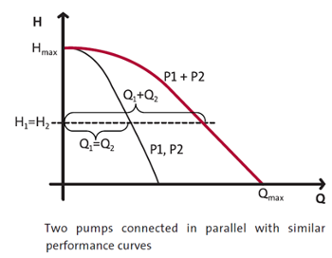
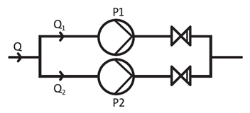
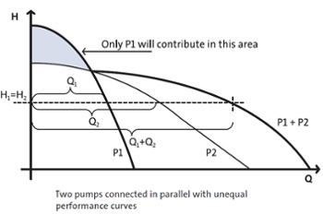

Slide 67
Pumps in parallel with control - low head / varied flow applications
In cases where a variable flow and high efficiency is required, consider adding speed control to each pump to achieve good performance and to operate pumps closer to their best efficiency point.
In this configuration, two scenarios can occur: either one pump can fully run while the other adds flow when needed, or both pumps can run at reduced speed and adjust as needed.
Running a pump at full speed causes you to move past the BEP on the right side, lowering efficiency and causing potential issues. With two controlled pumps operating at partial capacity, you can still have control over the flow while running each pump closer or to the left of its BEP, resulting in a more efficient operation. Overall, this configuration offers a wide range of operating conditions and opportunities for better efficiencies in order to meet your variable flow needs.

Slide 68
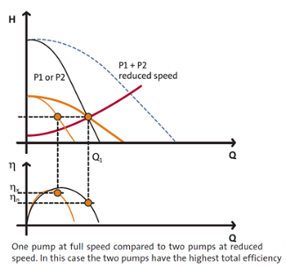
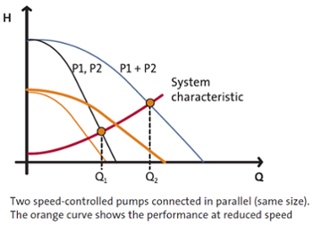

Slide 69
PROBLEMS IN PUMP OPERATION

Slide 70
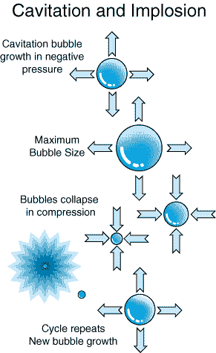
Cavatition
The formation of and Immediate Implosion of Vapor Bubbles within a liquid
Two types of cavitation
Suction
Recirculation

Slide 71
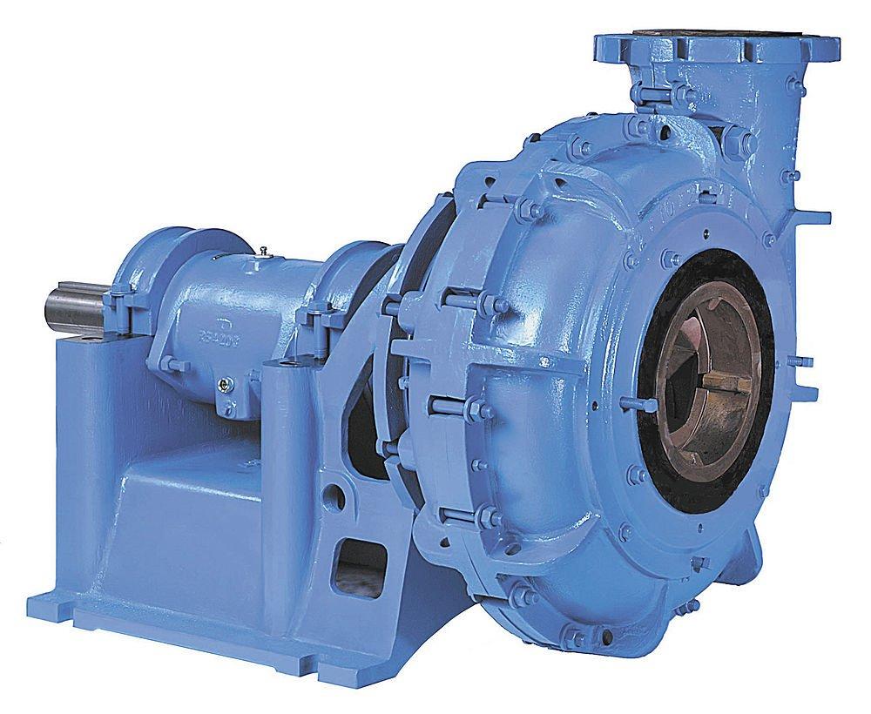
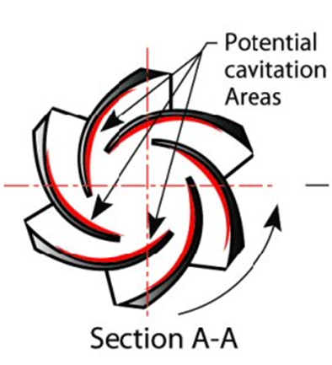
Suction Cavitation - caused by inadequate suction p.
Pump Suction

Slide 72
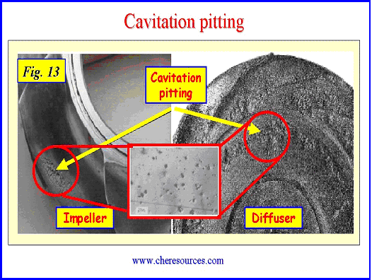
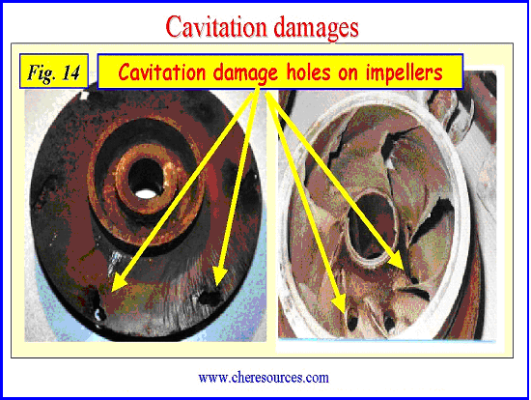

Slide 73
To Avoid Suction Cavitation

Slide 74
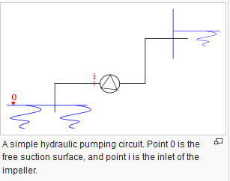


NPSH
NPSH_{AV} or NPSH_{A} :Actual pressure of the fluid in suction eye of the pump
USING B. E ELIMINATE VELOCITY TERM

Slide 75
NPSH_{req} : Minimum pressure needed in the suction eye of the pump in order to prevent cavitation (presented by Manufacturer on Pump Data Sheet)

Slide 76
Target 1: To reduce the NPSH_{req}
Target 2: To increase the NPSH_{A}

Slide 77
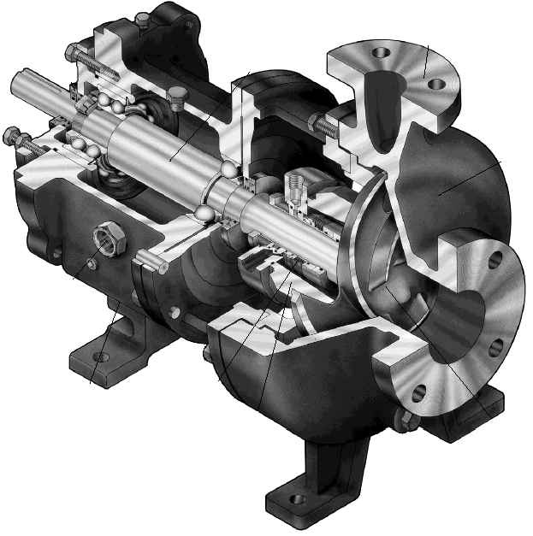
Recirculation Cavitation - is caused by low flow through the pump this occurs at suction or discharge of the pump.
Pump Discharge
Pump Suction

Slide 78
Damage Caused by Recirculation Cavitation
Damage to the outside of the impeller, on the outer periphery.

