Slide 1
Course Title: Structure of English II
Course Code: MTLa 321
Instructor: Shegaw Wedaj (PhD)

Slide 2
Unit One: Introduction
1. What is Language?
Structural Linguistics
Generative Linguistics
components of language- Sound Component
-Grammar component
-Meaning component

Slide 3
2. What is Linguistics?
branches of linguistics -phonetics and phonology
-morphology and syntax
-semantics and pragmatics

Slide 4
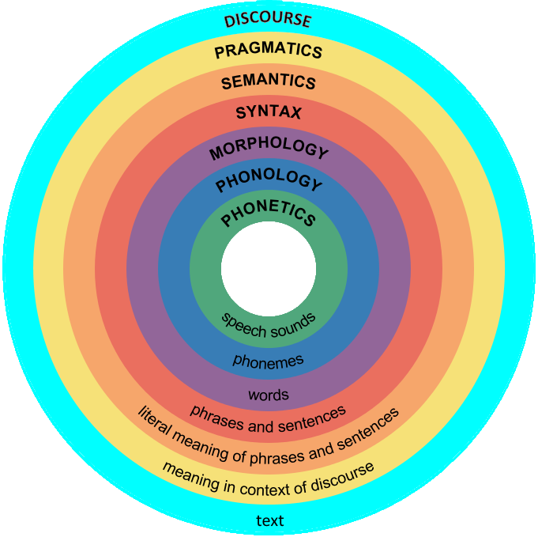
3. What is the relation between language and linguistics?

Slide 5
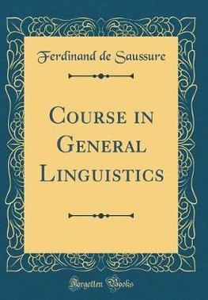
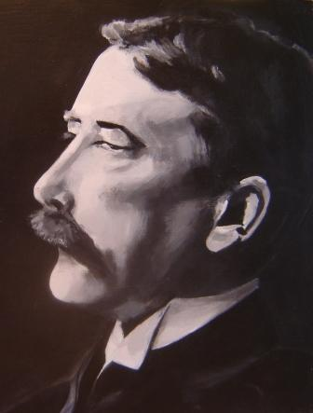
Structural Linguistics
(1857– 1913)
1916
Language = structural system of signs

Slide 6
Structural linguistics Cnt’d.
What is Language?
-Language-a structural system of signs;
-Sign =linguistic element
-Structure =product of hierarchical combination of signs;
-System: Syntagmatic vs paradigmatic relation

Slide 7
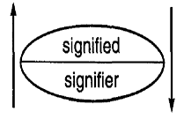
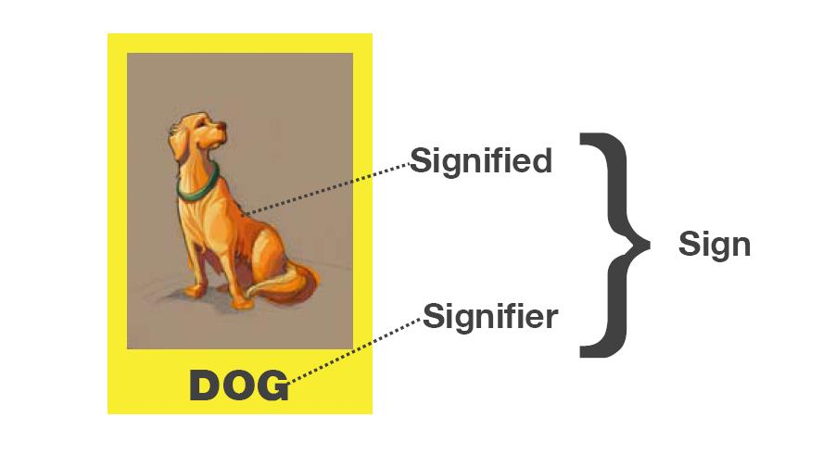
Structural linguistics Cnt’d.
Language as Sign;
What is a linguistic sign?
A linguistic sign is the association of a sound and a meaning.
Dyadic View of Sign =
Language as an arbitrary;
English= dog
Spanish= un perro
German= ein hund
French= le chien

Slide 8
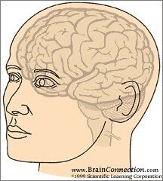
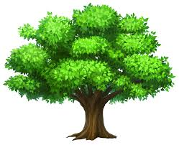
Triadic view of sign (Peirce’s model)
Concept
Refers
S
Symbolizes
[tri]
Symbol Referent
Semiotic Triangle
Sign=tree
Causal Relation
Causal Relation
…….Arbitrary Relation………

Slide 9
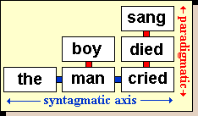
Language as a relational system of signs:
Paradigmatic vs. sytagmatic:
Substitution vs. Co-occurrence:
Same vs. Different categories

Slide 10
Structural linguistics Cnt’d
2. What aspect of Language is acquired?
Learning is knowing a new behavior and changing the behavior.
Language is a verbal behavior.
Learning a new structure of sign (word) is learning a new behavior and changing the previous behavior.
Learning is knowing a new sign/structural system.

Slide 11
Structural linguistics Cnt’d.
3. How are the structural system of signs acquired?
Claim: Learning happens when a correct response is demonstrated following the presentation of a stimulus;
Assumption: Organisms can be conditioned to respond in desired ways, given the correct degree of reinforcement.

Slide 12
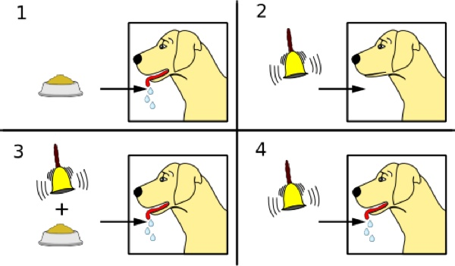
Structural linguistics Cnt’d.
Pavlov’s experiment

Slide 13
Structural linguistics Cnt’d.
Pavlov established stimulus-response pattern =the sound of the bell is the stimulus and salivation is the response;
Psychologists called it classical conditioning;

Slide 14
Structural linguistics Cnt’d.
Scholars expanded it in to operant conditioning
Skinner -stimulus-response-reinforcement;
-response becomes habit in the future;
Watson and Skinner applied the concept in SLA;
The language learner is an organism whose behavior is conditioned;
The behavior/language is verbal behavior;

Slide 15
Structural linguistics Cnt’d.
Language is analyzed into smaller units (signs)
(sounds-feature/words-morphemes/phrases-words/sentences-phrases)
contrasted with another (paradigmatic) (features/sounds/morphemes/words/phrases/sentences)
and added up to form the whole (syntagmatic).
(features-sounds-morphemes-words-phrases-sentences)

Slide 16
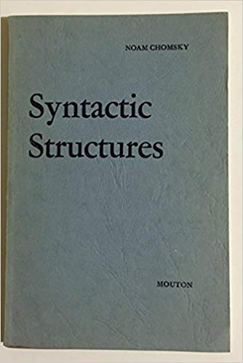
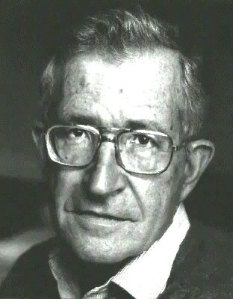
Generative Linguistics
1957
(1928-)

Slide 17
Generative Linguistics Cont’d.
1. What is language for Generativists?
Language -a set of innate rules.
competence vs. performance.
Chomsky adds a cognitive dimension to the linguistic system;
Competence – linguistic system + native speaker's knowledge;

Slide 18
Generative Linguistics Cont’d.
  Poverty of the Stimulus
The arguments for Generative linguistics start with-poverty of the stimulus argument:
-States that children are not exposed to rich enough data within their linguistic environment to acquire every feature of their language.
-However, children have come to produce new, complex and rich enough structures of their language;
-There must be human innate knowledge of language (UG)

Slide 19

Generative Linguistics Cont’d.
Claim: speaker-hearers’ competence in their native language is an innate knowledge that the human species is genetically endowed with.
Assumption: human mind consists of different compartments one of which is the language faculty/ LAD.
Language Faculty/LAD

Slide 20
in the faculty/LAD there is universal grammar (UG);
UG---Principles and parameters are innate/common for all;
Principles explain similarities across lgs;
parameters explain d/ces among lgs;

Slide 21
Principles -Phrase Structure
=the phrases of all languages consist of heads and possible complements;
parameter- Head initial and Head final
= Some languages are head initial and some are head final;
Eg. English =head + complement
-The man [killed (head) the lion (com)]VP.
Amharic =Complement + head-
-ሰውየው [አንበሳውን (com)ገደለው (head)]VP

Slide 22
Principle -Pronoun Subject
= Pronouns of all languages function as subjects;
Parameter- Pro-drop and non pro-drop
=some languages are pro-drop and some are non pro-drop;
Eg. -English- He killed the lion. (non pro-drop)
-Amharic- ___አንበሳውን ገደለው:: (Pro-drop )

Slide 23
2. What aspect of language is acquired?
What is acquired/learnt? =rules of the target language;
what are the rules of a target language?=parameter settings (head first/head final)
principles and parameter options are innate;
parameter settings are triggered by input/learnt.
Languages have few rules for basic sentence structures (PSRs), and a limited set of transformational rules (TRs)
( movement, insertion) for deriving other structures.

Slide 24
3. How do children acquire language?
through cognitive process
=finite rules/parametric options are triggered by limited input.
Acquisition of a specific language -a process of selecting among the limited parametric options that matches the linguistic input.

Slide 25
Grammar/Language system
Phonology
Lexicon
Syntactic
Semantic
It is obvious that words are ‘made up of’ sounds (or at least that they contain sounds) and that sentences are ‘made of’ words, and sentences must be meaningful.

Slide 26
+
3. Semantic Component
Sem. Rep.
1. Lexicon
Syntactic
Represen
4. Phonological Component
Pho. Rep.
2. Syntax

Slide 27
Grammatical Components of Language Morphology and Syntax
1 What is morphology?
-THE STRUCTURE OF WORDS
-the formation of words
eg. Workers—is formed from --work+er+s;
-analysis of words
eg. Workers—is analyzed in to --work-er-s;

Slide 28
1.1 Concepts of Words
Lexicon/lexeme/word
Lexicon-mental dictionary
Lexeme- Basic abstract unit of a word that could be realized in different grammatical forms;
eg. write in writes, wrote, written.
A lexeme may also be part of another lexeme, e.g. writer, is a lexeme which is part of the lexeme write;

Slide 29
Word- the physical realization of lexemes in contexts of use;
Eg. Write =They write/he writes/wrote/is writing/has written/
=Write/writes/wrote/written/writing/writer/writers
=WRITE/WRITER

Slide 30
1.2 Word Classes
=Lexical/content/open vs. Grammatical/function/closed words
Eg. Book/go/the/of/and/quickly/tall
Open word classes:
Closed word classes:
The focus of morphology: Open word classes
Classification of open word classes:

Slide 31
1.3 Criteria for Determining word category/class/parts of speech
Semantics-N-name entity/object/,
V-action/sense,
Adj-describe nouns,
Adv-describe verbs
Morphology-N-pl/possessive,
V-tense,
Adj-comp/sup,
Adv-ly
Syntax/distribution-N-takes Art/Adj,
V-aux,
Adj/Adv-degree words

Slide 32
1.4 Types of words
=Simple/compound/complex words
Eg. Teach/blackboard/blackboards/teachers/teaching/reexaminers
Simple words:
Complex words:
Naming parts of complex words:

Slide 33
1.5 The Concepts of Morpheme
Types of Morphemes
=Status: Free vs. Bound
=Function: Derivational vs. Inflectional
=Position: prefix/sufix/infix/circumfix

Slide 34
1.6 The difference between Inflectional and Derivational Morphemes
Productivity
Productivity=derivationals are less productive than inflectionals;
Eg. the derivational morpheme=en goes with weak-en, deep-en, white-en, but not with*yellow-en, *ugly-en, *slow-en
The inflectional morpheme=er-goes with relatively many adjectives to make comparative

Slide 35
2. Order of occurrence=first/last
-derivationals occur first, but inflectionals last;
Eg. reexaminers
3. Affixation property=prefix/suffix
Eg. reexaminers
4. Requirement in syntax= inflectionals are required, but derivationals are not required by syntax.
Eg. They are happy/unhappy //He is happy/unhappy
They work //He works
5. Role in changing meaning and/or word class=change/no change
Eg. workers

Slide 36
Exercise 1: look at the following words.
a. reactivated
b. Hospitalization
c. Fingers
d. Misleadingly
e. Discouraged
Identify the morphemes
Label each of them as derivational or inflectional morpheme

Slide 37
1.7 The difference between Morpheme /morph /allomorph
Morpheme (meaning)-the smallest meaningful unit of a language;
Morph (form)-a physical representation of a morpheme in a language;
Allomorph (other form)-variants/realizations/manifestations of a morpheme;

Slide 38
1.8 The relationship between Morpheme and morph
1. Allomorphic =one meaning but different forms
Eg. a. indefinite article: an orange/ a building
b. plural morpheme: cat-s [s] { dog-s [z] { judg-es [iz]
[z] after voiced consonants and vowels: beds, knees
[s] after voiceless consonants: tulips, parents
[Iz] after sibilants: horses, bushes
c. past tense [d] after voiced consonants and vowels: rubbed,
judged, entered
[t] after voiceless consonants: stopped, kicked,
laughed
[Id] after [t, d]: wanted, decided

Slide 39
2. Homomorphs =one form/ different meanings in different contexts
Eg. Tall=tall-er/teach=teach-er
3. Portmanteau morph=one form/different meanings in the same context
Eg. He teaches=s/es=tense/person/number
4. Zero morph=there is meaning but no form/there is change in meaning but no change in form;
Eg fish-sg=fish-pl/sheep-sg=sheep-pl /cut-pres=cut-past=cut-past parti

Slide 40
5. Suppletion =irregular' relation between the base and the new words.
be = am/is/was/been/being/were/are
go =went/gone
good =better/best
6. Ablaut =Morpheme internal changes/the word changes internally
English: sing, sang, sung, /man, men,/ goose geese

Slide 41
Allomorphic Conditions=causes for variation
1. Phonetic/phonological conditions= Allomorphic =pl/past/indefiniteness
2. Lexical/morphological conditions=ox-oxen/child-children
3. Grammatical conditions/caused by grammar change=Not very common in English
Definiteness in Amharic=u in masculine/wa-in feminine

Slide 42
Determining allomorphs and morphemes
1. Complementary distributions=Allomorphs=work-t/mend-ed/clean-d
2. In contrastive distributions =Morphemes=work-s/work-ed

Slide 43
Determining the underlying form of the allomorphs
Plural----------s] after voiced consonants and vowels
----------[z] after voiceless consonants
-----------[iz] after sibilants
1. Which form is the underlying form?=wider distribution
2. what motivates the change?=ease of articulation

Slide 44
Exercise 2: Consider the following nouns in Zulu (a language in South Africa)
umfazi “married woman”
abafazi “married women”
umfani “boy”
abafani “boys”
umzali “parent”
abazali “parents”
umfundisi “teacher”
abafundisi “teachers”
a. What is the morpheme meaning “singular” in Zulu?
b. What is the morpheme meaning “plural” in Zulu?
c. List the Zulu bases to which the singular and plural morphemes are attached, and give their meanings.

Slide 45
Look at the following data from Swahili:
Swahili English
Mtoto child
watoto children
mtu person
watu persons
kisu knife
visu knives
kikapu basket
vikapu baskets
Identify the singular and plural morphemes.
Do the singular and plural morphemes have allomorphs?
If yes, what is context of the allomorphs?

Slide 46
2.1.3 The difference between Root /Base /Stem
1. Root –the most basic morpheme of a word; it is the irreducible part of a word;
-This means any morpheme, excluding affixes;
Eg. Re-search-er-s=search is the root;
=Number of Roots =Number of words in a given data (the words are not compound);

Slide 47
2. Base -an element, which is ready to take any affix that can be derivational or inflectional.
Eg. Re-search-er-s=search is root and base for (re-)=research;
Research is base for (-er)=researcher;
Researcher is base for (-s)=researchers;
=Number of Bases =number of affixes in a given word/data;

Slide 48
3. Stem -an element, which is ready to take an inflectional morpheme;
Eg. Researcher is stem for (-s)=researchers;
=Number of stem =number of inflectional affixes in a given data;
=All roots are bases;
=all stems are bases;
=bases are stems only in the case of inflectional affixes;

Slide 49
Exercise: identify the roots, bases and stems in the following words;
Workers
unkindness
reactivated

Slide 50
2.1.4 Hierarchical/Internal structure of words
=the base and result of derivational morphemes;
Lexicon =(kind, un-, -ness)
Eg. Unkindness
un- needs a base with Adj category
Un- derives Adj word class with negative meaning
-ness needs a base with an Adj word class
-ness derives N word class;

Slide 51
N=unkindness
Adj Aff
Aff Adj -ness
un- kind

Slide 52
2.1.5 Word formation processes
Word formation=Lexeme formation=Addition of new words on the lexicon
Major word formation processes:
Derivation/Affixation
Compounding
Other processes

Slide 53
1. Derivation
-is an affixal process that forms a word with a meaning and/or category that is different from its base.
-Derived words become independent items;
Eg. V + able ----A =work-able, manage-able
V +ment----N =enjoy-ment, manage-ment
N +ize-----V =hospital-ize, crystal-ize
A +ness----N =happy-ness, kind-ness
Un +A---A =un-fair, un-clear
Dis + V----V =dis-respect, dis-qualify

Slide 54
Prefixes =change meaning
Learners will be able to infer the meaning of a word if they know the meaning of the prefix.
Prefix Meaning Word class Example
Non negation/opposite Noun nonviolence
Adjective nonviolent
Un reverse action Verb untie/undo
opposite quality Adjective unhappy
Re repeat action Verb rewrite
Noun reunion

Slide 55
Suffixes =change word class
Suffix meaning word class Word class changed to Example
-ity quality/state Adjective Noun popular-ity
-ous having quality Noun Adjective fame-ous
al connected with Noun Adjective institution-al
-able can be Verb Adjective print-able
-ize to become Adjective Verb capital-ize

Slide 56
2. Compounding- a process which forms new words not from bound affixes, but from two or more independent words.
2.1 Formation of compound words: the words which are parts of the compound can be free morphemes, words derived by affixation or even words derived by compounding.
Free + free =Eg. Girlfriend, Blackbird
free + complex word = eg. air conditioner, looking glass
free +compound/complex =eg. lifeguard chair, watchmaker

Slide 57
2.2 Category of compound words: is determined by the rightmost part of the compound (known as the head of the compound).
a. Noun head
N+N---N = fire + engine = type of engine, not type of fire
A +N---N =green +house =---------------------------------------
V+N---N =jump+suit =-------------------------------------------
b. Verb head
N +V---V =spoon+feed = type of feeding, not type of spoon
A +V---V =dry+clean =type of leaning, not type of dry
V +V---V =break +dance =type of dancing, not type of breaking
c. Adjective head
N +A---A =sky +blue =type of blue, not type of sky
A +A---A =red +hot =type of hot, not type of red

Slide 58
2.3 Types of Compounds=compound can be categorized into two based on the basis of the meaning relation between the components of the compound.
2.3.1 Endocentric- compound words in which one member identifies the general class to which the meaning of the entire word belongs.
Eg. Dog food, steam boat, air plane=the meaning of the compound is same as the meaning of the rightmost/head of the compound=type of food/type of boat/type of plane
2.3.2 Exocentric-a compound whose meaning does not follow from its parts;
Eg. Walkman/walkmans, pickpocket

Slide 59
3. Other word formation processes
3.1 Coinage -the process of creating totally new words;
-it involves the extension of name of a product from specific reference to a more general one;
Eg. Xerox=copying machine=brand name for the company
-Kodak=film=brand name for a company that produces film, camera and other photographic equipments;
3.2 Clipping -the process of shortening a longer word;
-it involves the shortening of a polysyllabic word by deleting one or more syllables;
Eg. Lab-laboratory, machine-machinery, auto-automobile

Slide 60
3.3 Blending -the process of creating new words by taking parts of different words;
Eg. -Brunch -breakfast and lunch,
-Motel= -motor and hotel, bed and parking
-telethon= long television show -television and marathon
3.4 Conversion/Zero derivation-the process of the extension use of one word from its original grammatical category to another category as well.
Eg. Must (V) – you must attend class regularly;
-must (N)-class attendance is a must
Survey (V/N), poor (A/N), water (V/N)
3.5 Back formation-process of creating words by taking off part of the word perceived as affix.
Eg. Edit-editor, distruct-distruction,

Slide 61
3.6 Reduplication -the process of forming new words by doubling an entire free morpheme (total reduplication) or part of the word (partial reduplication);
-This process is not common in English;
-Other languages use this process to create new words:
Eg. Indonesian language=rumah-house=rumah rumah-houses; ibu-mother=ibu ibu-mothers
Amharic=nech-nechach; tilk-tililik
3.7 Borrowing -new words enter a language through borrowing from other languages;
Eg piano-from Italian

Slide 62
3.8 Acronyms vs Abbreviations
–words created from the initial letters of several words.
-Acronym involves taking initial letters of two or more words and pronouncing those as single word;
Eg. UNESCO-United Nations Educational, Scientific and Cultural Organization
AIDS-Acquired Immune Deficiency Syndrome,
NATO-North Atlantic Treaty Organization
Abbreviations - involves taking initial letters of two or more words and naming each letter, not read as a word;
Eg. USA

