Slide 1
Course Introduction
Cadastral Surveying - Laad 333

Slide 2
Course Description
Definition and benefit of cadastral survey
Planning procedure for cadastral surveying
Data capturing techniques
Content of cadastral map
Property formation procedures
Property description methods

Slide 3
Course Objectives:
Describe basic principles, data collection and processing, and application of cadastral surveying
Identify the advantage and disadvantages of data capturing techniques
Prepare a cadastre map
Write a property description for a given a area
Practice on data collection and mapping

Slide 4
List of Lectures
Introduction to Cadastre
Cadastral surveying procedures
Date capturing tech: GPS ,Total Station
Data capturing tech: photo and image
Cadastral Map
Property Formation: Subdivision Survey
Property Formation: Amalgamation and Re-allotment
Property Description: Mates and bounds
Property Description: Block-and-lot system and Coordinates

Slide 5
Project Work
Planning and Reconnaissance
Control establishment - Total Station
Detail measurement
Buildings - total station
Roads, parcels and spot elevation (contouring) - RTK GPS
Data downloading and preparation
Mapping
Printing

Slide 6
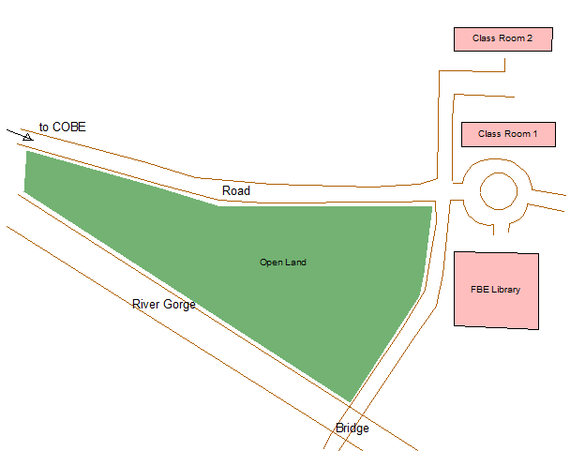
Project Area

Slide 7
Detail Measurement includes
Electric Poles
Open land and river gorge
Road edges
Building corners
Spot elevation for topographic mapping

Slide 8
Software
Leica Geo Office: for data downloading and preparation
ArcGIS: for mapping

Slide 9
List of Field Practice and Computer Lab
Control point establishment -Total Station (Filed)
Detail measurement – RTK (Field)
Detail measurement – Total Station (Field)
Data Downloading and Processing (LAB)
Cadastral Mapping

Slide 10
Assessment Method
Project work with continuous individual assessment, presentation, report 30%
Quiz 10%
Final Exam 60%

Slide 11
Required reference book
Ghilani C. D. & Wolf P. R. (2007) Elementary Surveying: An introduction to Geomatics.12th edition, Pearson Prentice Hall
Course Lecture Material

