Slide 1
Lecture – 3 Data Capturing Techniques
Cadastral Survey – Chapter 3

Slide 2
Data Capturing Techniques
Traditional methods
Compass and tape
Total station
GPS
Aerial Photographs
Satellite image
GIS-GPS equipments

Slide 3
Traditional methods
Varies one region to the other.
Simple method for measuring parcel boundaries and for area estimation.
Common examples would be to use ‘kada’, ‘tilm’, and the rope method.
Areas are determined using simple mathematical methods (areas of rectangles and triangles) with assumptions on parcel shape.

Slide 4
Compass and tape
The standard surveyor’s compass is a hand-held device which shows the bearing of a line relative to magnetic north. Reads bearing to 0.5°
Tape: 30 m, 50 m, 100m
Linen, Fiber Glass, Steel
Error source: inaccuracy in the length of the tape, temperature, tension, slope, sag, Mean sea level.

Slide 5
Total Station
Total station instruments, combine three basic components:
an electronic distance measuring (EDM) instrument
an electronic angle measuring component, and
a computer or microprocessor-into one integral unit.

Slide 6
What Total Station Does?
Can observe horizontal and vertical angles, as well as slope distances from a single setup.
From these data they can instantaneously compute horizontal and vertical distance components, elevations and coordinates of points sighted and display the results on a display (type LCD).
Can also store the data, either on board or in external data collectors connected to their communication ports.

Slide 7
Function of Total Station
Averaging of multiple angle and distance measurements
Correcting electronically observed distances for prism constant, atmospheric pressure and temp.
Making curvature and refraction correction
Reducing slope distance to Horiz and Verti comp
Calculating point elevation
Computing coordinates from horizontal angle and distance

Slide 8
Traversing

Slide 9
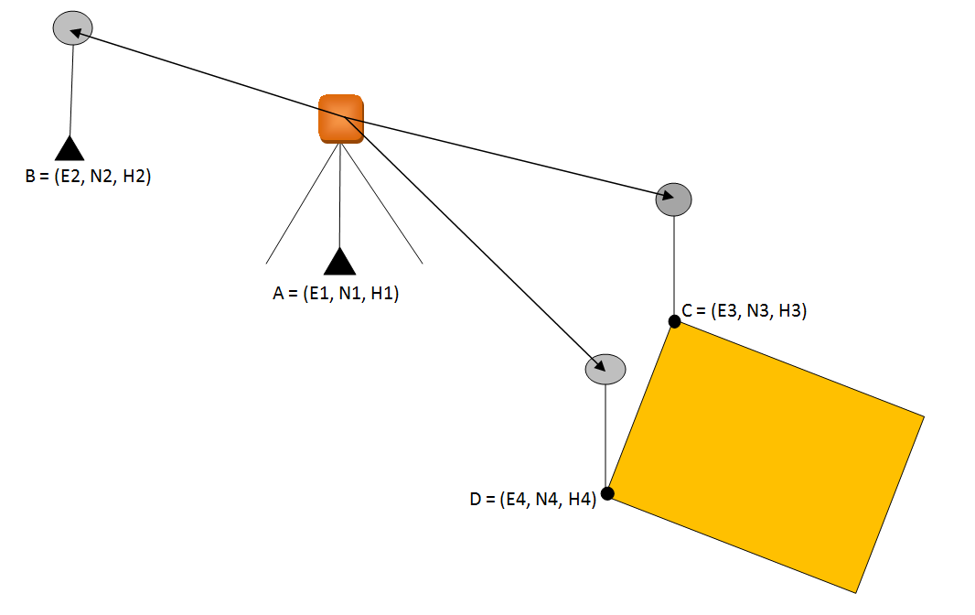
Detail Measurement

Slide 10
Expected accuracy
Leica TPS1200+ model has a superb accuracy of 1 mm + 1.5 ppm for a range of 3 km.
And it has a choice of accuracy for angle from 1 to 5 seconds.

Slide 11
GPS for Cadastre
RTK GPS, can be used depending on the project requirements, location, and other factors.
The RTK surveying, however, seems to be the most suitable method, especially in unobstructed areas.
Inaccessible locations or obstructed areas can be surveyed with integrated systems such as GPS/total station.

Slide 12
Advantages of GPS
There are several advantages of using GPS for cadastral surveying. The most important one is that inter-visibility between the points is not required with GPS means that extensive traversing is eliminated
The accuracy obtained with GPS is consistent over the entire network
Also, with GPS, one reference station can support an unlimited number of rover receivers

Slide 13
GPS Positioning
Point positioning: employs one GPS receiver that measures the code pseudoranges to determine the user’s position instantaneously, as long as four or more satellites are visible at the receiver
Relative positioning: employs two GPS receivers simultaneously tracking the same satellites.

Slide 14
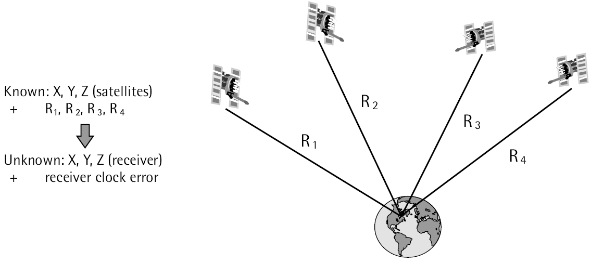
Point positioning
The receiver gets the coordinates of the satellites from the navigation message while the pseudorange are determined from C/A code

Slide 15
Relative Positioning
The key point of relative positioning is to keep the coordinates of the reference station fixed.
Carrier phase or pseudorange observables
provide a post processing (post mission) or real time solutions
GPS relative positioning provides a higher accuracy (cm level)
Depending on whether carrier phase or pseudorange measurements
Two satellite contain more or less similar errors or biases.
The shorter the distance between the two receivers, the more similar the errors are.
The similar errors will be removed or reduced.

Slide 16
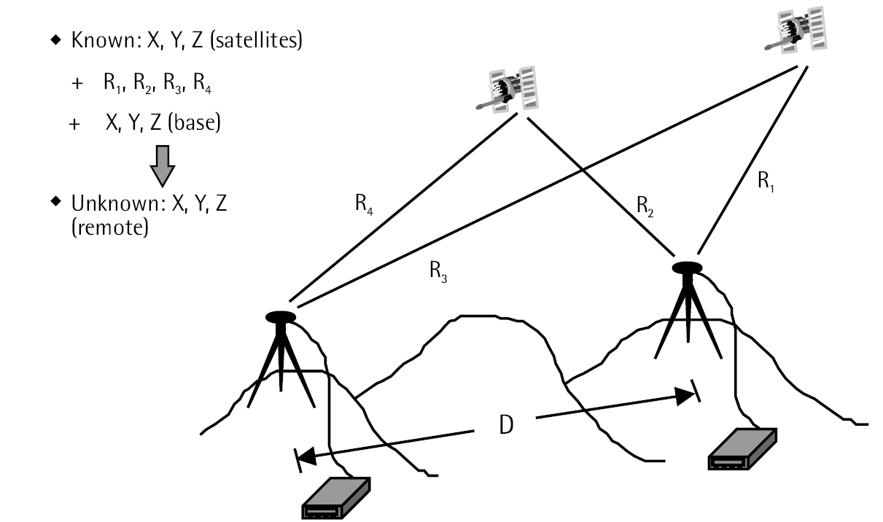

Slide 17
Static GPS
Based on the carrier phase measurements.
One receiver called the base receiver being located on an existing control station, while the remaining receivers called the roving receivers occupy stations with unknown coordinates.
Occupation time: <10 km – 30 m, > 10 km - 1 hr, >15 km - 2 hr, >100 km - 4 hr
Resolving the ambiguity parameters would be a key issue to ensure a high-precision positioning.
Recording interval of 15 or 20 seconds
Accuracy -- 5mm+1ppm

Slide 18
Rapid Static GPS
One receiver always remains on a control station while the others are moved progressively from one unknown point to the next during the entire observation session.
The observation time or the occupation time for rapid static surveying is relatively small.
Collects data for about 2 to 10min depending on the distance to the base and the satellite geometry.
Collecting and downloading the GPS data is processed.

Slide 19
Stop and go GPS
The data is usually collected at 1-to-2 seconds recording rate for a period of 30 seconds per each stop.
The survey starts by first determining the initial integer ambiguity parameters, a process known as receiver initialization.
Once the initialization is performed successfully, centimeter-level positioning accuracy can be obtained instantaneously.
A special case of Stop and Go GPS surveying is known as kinematic GPS surveying. Both methods are the same in principle. However; the latter one requires no stop at unknown stations.

Slide 20
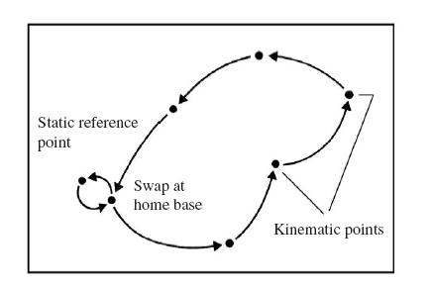
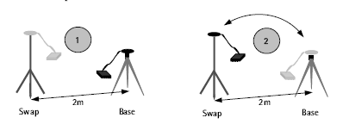
antenna swapping
determination of a start baseline with a static survey prior to kinematic operations,
short observation on a known baseline, and
antenna swapping -- static initialization

Slide 21
RTK GPS
This methods are required that are independent of static initialization techniques, and that include the capacity to recover cycle slips and/or to resolve ambiguities during motion.
These techniques are referred to as ambiguity solution on the way, or on the fly
Only with such methods at hand can kinematic surveying be purely or truly kinematic.

Slide 22
Suitable methods for ambiguity resolution while the receiver is moving are
code/carrier combination using the extra wide laning technique, and
ambiguity search functions for six or more satellites.
Methods for cycle slip recovery in true kinematic mode are
use of redundant satellites (≥ 4 four satellites),
use of dual frequency data, and
use of code/carrier combination

Slide 23
On the fly procedure
The base and rover measurements are combined in the double differenced mode and an initial adjustment by, for example, the least squares, is then performed.
The outcome of this initial adjustment is an initial rover position along with estimates (real values) for the ambiguity parameters and their uncertainty values, or the covariance matrix.
The covariance matrix can be represented geometrically to form a region, known as the confidence region, around the estimated real-value ambiguity parameters

Slide 24
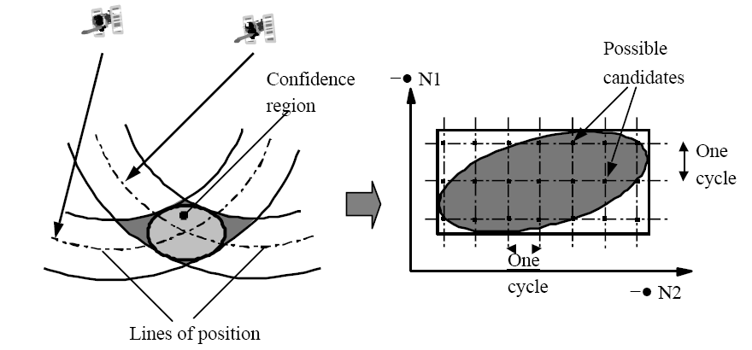

Slide 25
Based on statistical evaluation, only one point is selected as the most likely candidate for the integer ambiguity parameters.
Once the ambiguities are correctly resolved, a final adjustment is performed to obtain the rover coordinates at centimeter-level accuracy.
It should be pointed out that the OTF technique, although designed mainly for resolving the ambiguity parameters in real time, could also be used in the non-realtime mode.

Slide 26
Next time
LECTURE 4 – Data Capturing Techniques cont’d
Satellite images
Aerial Photographs

