Slide 1
Lecture 5 Cadastral Maps
Cadastral Survey

Slide 2
A cadastral mapping components
Geodetic control network
Current, accurate, base map layer (ideally, pho­togrammetrically derived tied to the geodetic control)
Cadastral overlays delineating all real property parcels
A unique parcel identifier assigned to each parcel
A series of parcel data files containing parcel identi­fiers, ownership and assessment data
Additional overlays of interest to the assessor such as municipal boundaries, zoning, and flood plains

Slide 3
City maps categorized into three:
The city base map is the original map of the city prepared from actual field surveying or photogrammetric plots. It contains complete planimetric and vertical information and may consist of several overlays.
Derived maps are basically similar in content to the city base map but are usually at smaller scales; they are derived from the base map and use a certain generalization in presentation.
Thematic maps include maps not listed in category 1 or 2. Usually, they are single-factor maps providing, on a reference background, quantitative or qualitative information on the phenomenon in question.

Slide 4
Data source - Spatial
Aerial Images
Satellite Images
Ground measurement by total station
Ground measurement by GPS
Existing analog maps

Slide 5
Data Source – Non Spatial
Legal documents: Ownership, Taxation, Land value, Parcel-identifiers, Street addresses, Buildings type, House numbers, Land use,
Field observation
Sample
Questioner
Report
Census Figures

Slide 6
Layers of Cadastral MAP
Topographic layers
Vegetation layers
Road layers
Transportation layers: Air strip, Public transport lines, Terminals,
Utility layers
Built-Up area layer: Blocks, Parcels, Buildings, Fences
Jurisdiction layers: Administrative/town boundary, District boundary if there is Kebele

Slide 7
Scale of Cadastral Maps
Cadastral maps are a series of large scale maps showing property boundaries, building and structures on the land and major natural features and provide cartographic land survey and land ownership records.
It facilitates the administration of lands which assists in the valuation and taxation of land.

Slide 8
Standard scale for cadastral maps
Scale ranges | Typical standard scales
1:500 to 1:5000 | 1:500 1:1000 1:2000
1:5 000 to 1:13 000 | 1:5 000 1:7 500 1:10 000
1:13 000 to 1:33 000 | 1:15 000 1:20 000 1:25 000
1:33 000 to 1:83 000 | 1:50 000 1:75 000
1:83 000 to 1:183 000 | 1:100 000 1:150 000
1:183 000 to 1:433 000 | 1:200 000 1:250 000
1:433 000 to 1:1 082 000 | 1:500 000 1:1 000 000
> 1:1 082 000 | 1:2 500 000 1:7 500 000

Slide 9
Accuracy of Geo-spatial Data
Accuracy of map data is the degree toward which any given feature(s) on a map conforms to its true position on the ground
Horizontal Accuracy /positional according the National Mapping - EMA = -/+ 30cm (at the scale of 1:2,000)
Vertical Accuracy- EMA standard is = 0.25 or ¼ of the contour interval – 1:500 -0.5m, 1:1000m -1m, 1:5000 - 2m, 5m.
Temporal accuracy time of the data
Content accuracy of the cadastral data is also important. Content accuracy has to do with the correctness and completeness of the attribute data associated with the points, lines, and polygons that comprise the cadastral database.

Slide 10
Designing a Cartographic Map
Map Layout
Map layouts can be portrait or landscape according to the shape of the area.
The placement of the map should be such that it does not interfere on the other map
Map Title
The map title should be set in large bold text to stand out from other annotation on the map.
It should be placed in such a way as not to be confused with other map text.
The lettering size can be adjusted to suit the map size and to accommodate long titles.
Orientation
As a general rule, orientation should be north-south with north at the top of the page.
Show a north arrow

Slide 11
Map Extent
Information should be shown up to the neat line of the map,
Plan the scale of your cadastral map having in mind the way to represent clearly the smallest property;
Map Sheet Size
A uniform size for map sheets facilitates handling and storage of maps.
75x75 cm, 80x60 cm, 80x64 cm, A0,A1, A2, A3, A4
North Arrow
Use a north arrow consistent in size, colour and style
Place it above the scale bar
Scale Bar
A scale bar
Representative fraction e.g. 1:50 000 is essential in addition to scale bar

Slide 12
Legend
All features on a map must be explained in the legend
The map legend should be clearly separated from the map.
Logos
Place logos of the respected municipal towns in the map legend area.
Avoid reducing logos to such an extent that they are illegible.
Sheet Number/Parcel numbering
A parcel identification system provides a method for referencing land parcels, or data associated with
parcels, using a number or code instead of a complete legal description. The correlation of maps and
individual property records requires that all parcel files be indexed using a uniform parcel identifier.
Index map
Separate any index map clearly from the main map.
Use sparse labelling, but sufficient for orientation.
Use a north arrow (if necessary) and a scale bar.

Slide 13
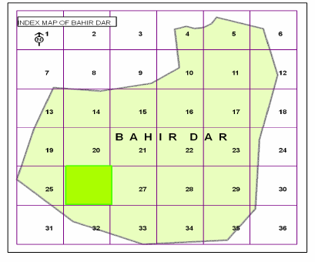
Example of Index Map

Slide 14
Projections and Coordinate Systems
Projection – Universal Transverse Mercator ,
Reference Ellipsoid - Clarke1880,
Local Geodetic Datum – Adindan
Unit – Meters,
Parameters
a) UTM Grid Zone - 37,
b) Central Meridian - 39º E,
c) False Easting – 500,000 m E
d) False Northing – 0 m N
e) Scale Factor - 0.999

Slide 15
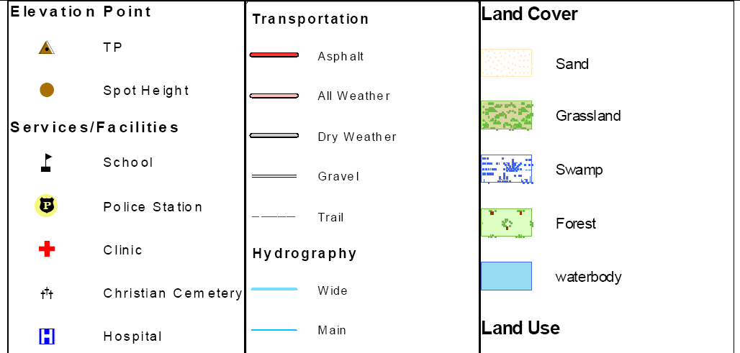
Cartographic Symbolization

Slide 16
