Slide 1
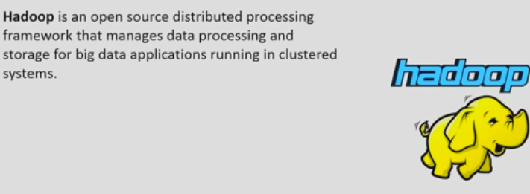
Chapter -2 Introduction to HADOOP

Slide 2
contents
What is Hadoop
A Brief History of Hadoop
Difference between RDBMS and Hadoop
Hadoop cluster
Hadoop EcoSystem projects
Hadoop distributions

Slide 3
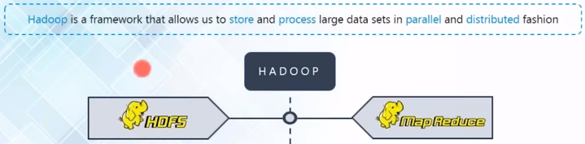


What is Hadoop

Slide 4
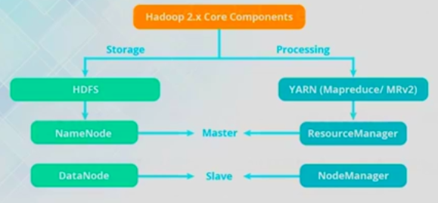
What is Hadoop

Slide 5
A Brief History of Hadoop
Hadoop was created by Doug Cutting, the creator of Apache Lucene, the widely used text search library.
Hadoop has its origins in Apache Nutch, an open source web search engine, itself a part of the Lucene project.
2004—Initial versions of what is now Hadoop Distributed Filesystem and MapReduce implemented by Doug Cutting and Mike Cafarella.

Slide 6
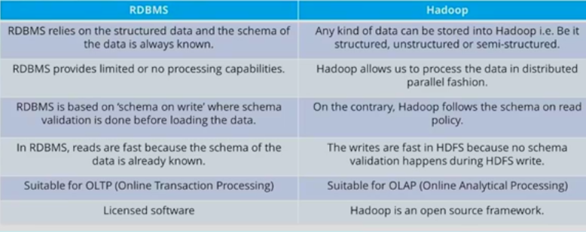
RDBMS vs HADOOP

Slide 7
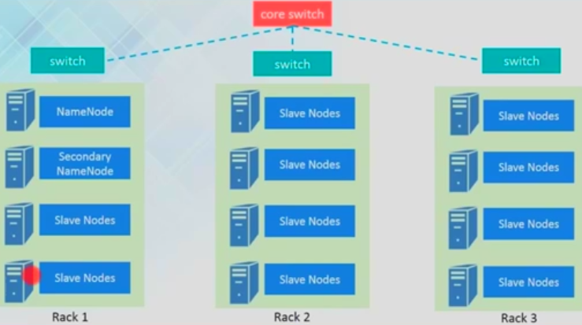
Hadoop cluster

Slide 8
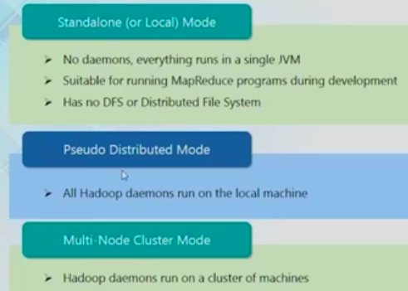
Hadoop cluster modes

Slide 9
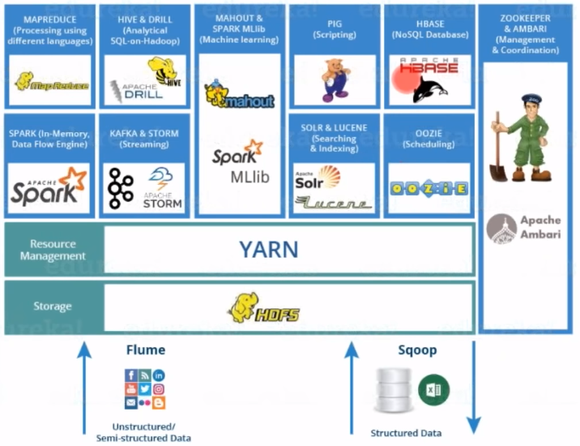
HADOOP Eco System/ Architecture

Slide 10
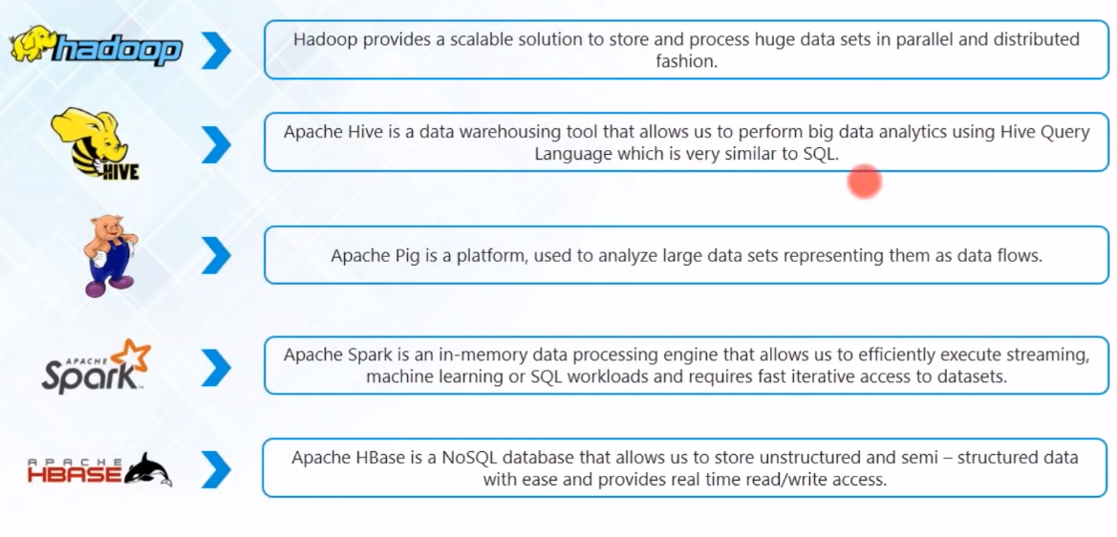
HADOOP projects

Slide 11
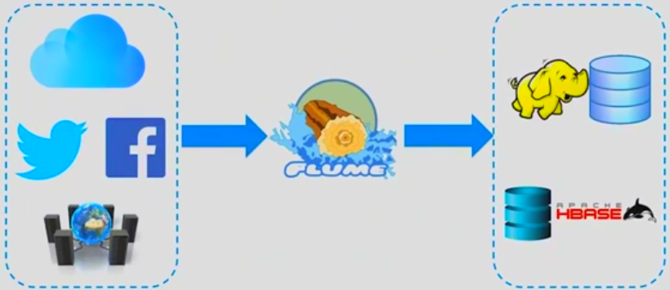
APACHE FLUME

Slide 12
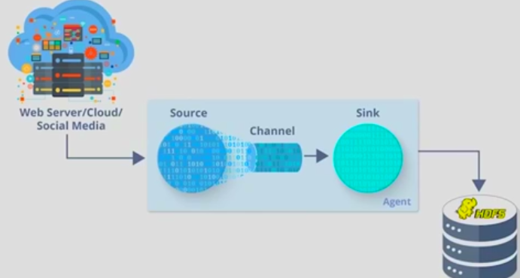
APACHE FLUME

Slide 13

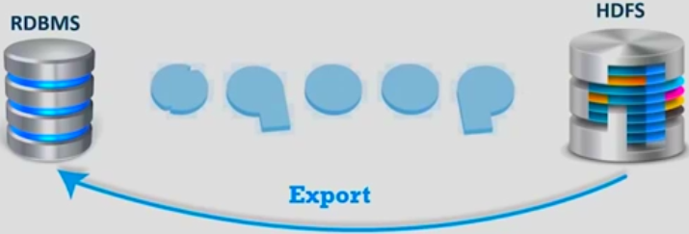
SQOOP[SQL+HADOOP]

Slide 14
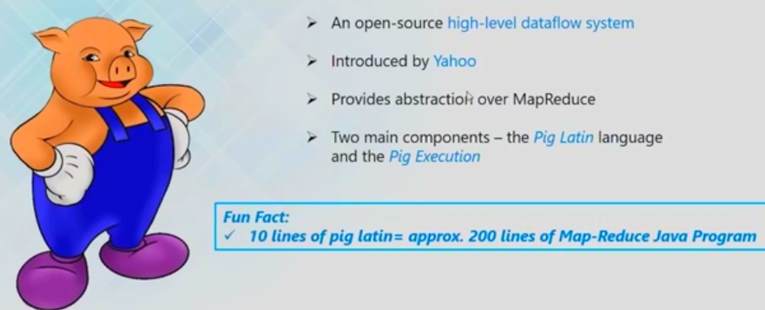
APACHE PIG

Slide 15
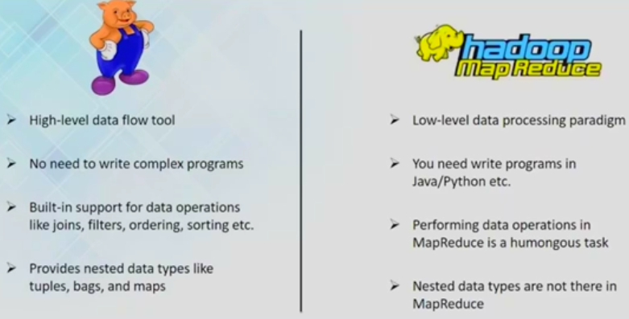
APACHE PIG

Slide 16
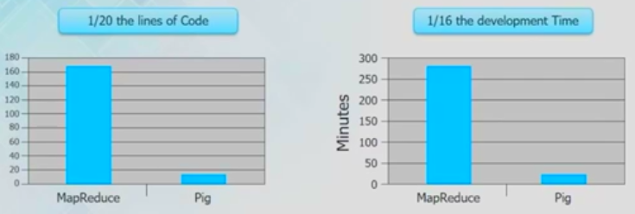
APACHE PIG

Slide 17
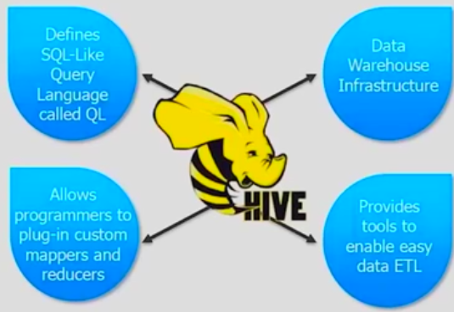
APACHE HIVE

Slide 18
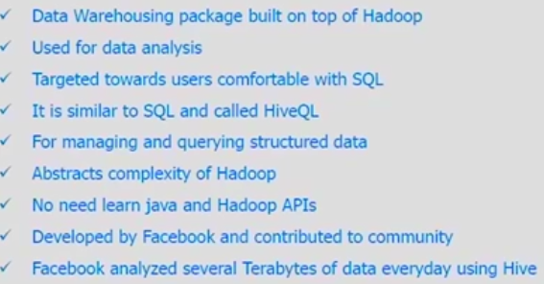
APACHE HIVE

Slide 19
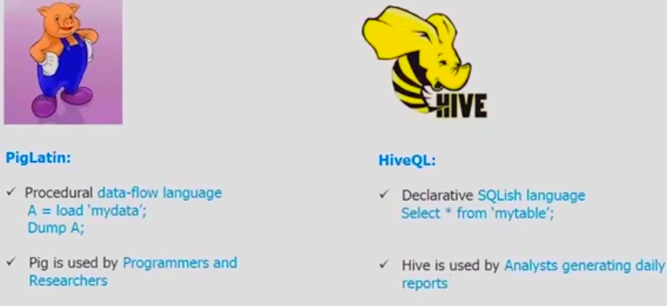
APACHE HIVE

Slide 20
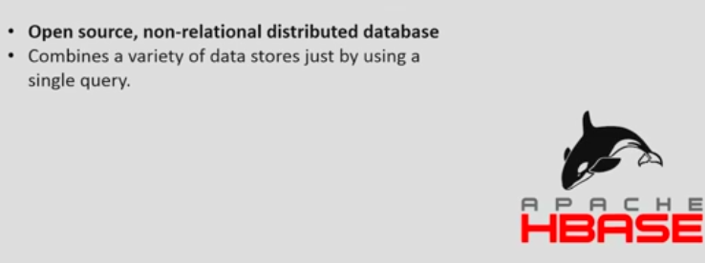
APACHE HBASE

Slide 21
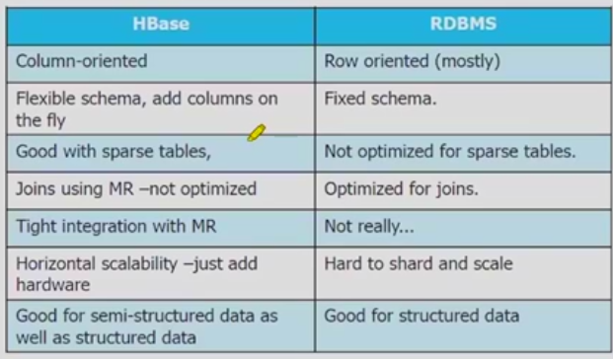
HBASE

Slide 22

NOSQL data bases

Slide 23

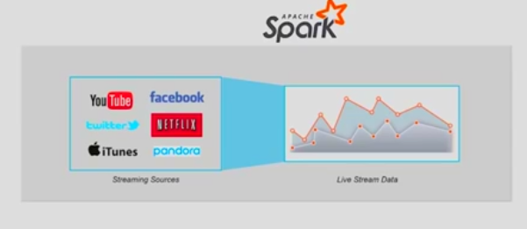
APACHE SPARK

Slide 24
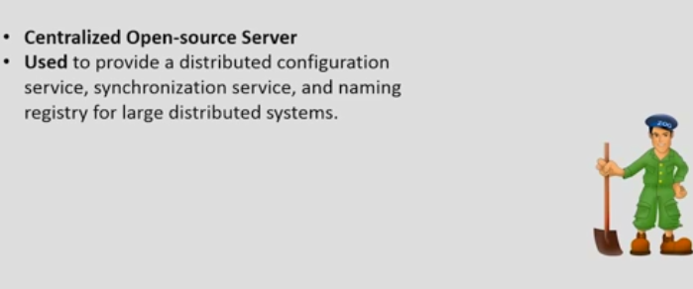
ZOO KEEPER

Slide 25
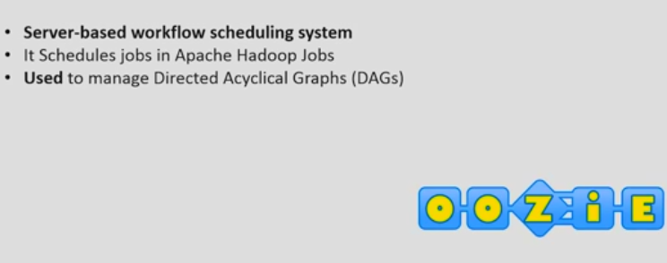
OOZIE

Slide 26
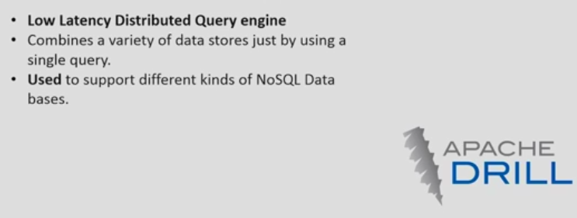
APACHE DRILL

Slide 27
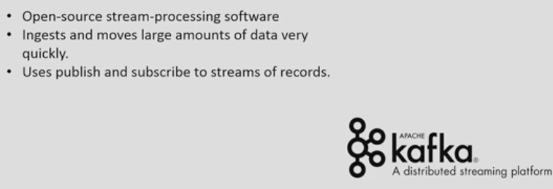
APACHE KAFKA

Slide 28
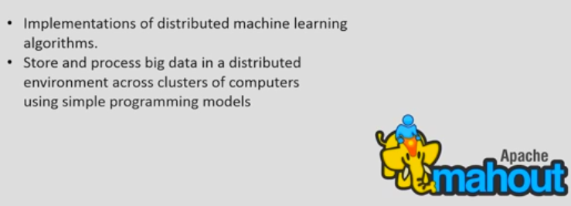
APACHE MAHOUT

Slide 29
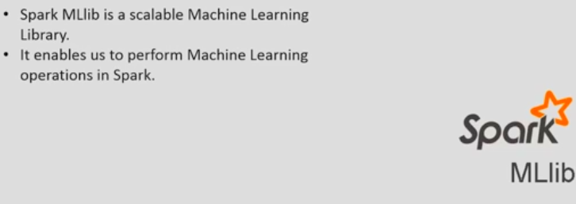
SPARK MLib

Slide 30
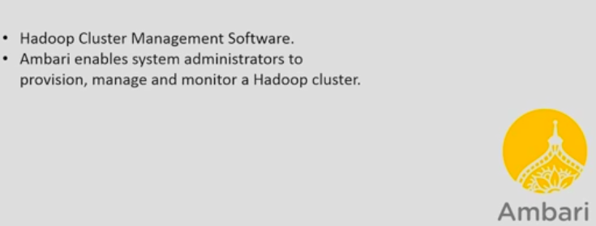
Apache ambari

Slide 31
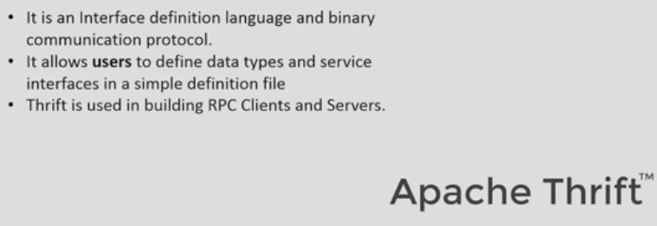
Apache thrift

Slide 32
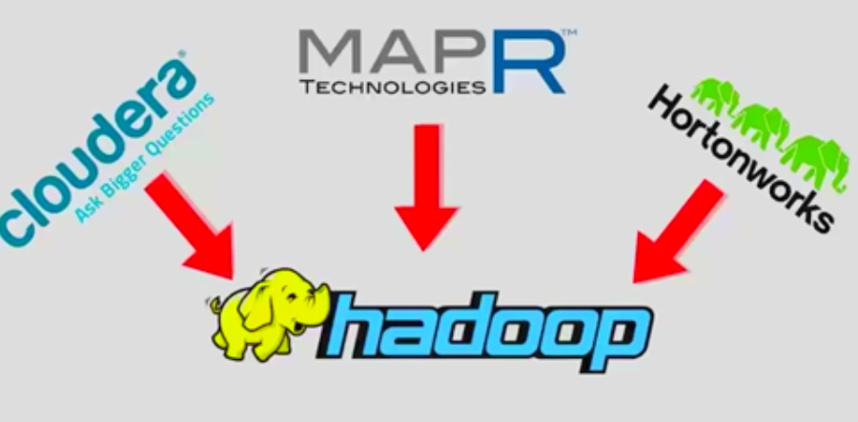
HADOOP DISTRIBUTIONS

Slide 33
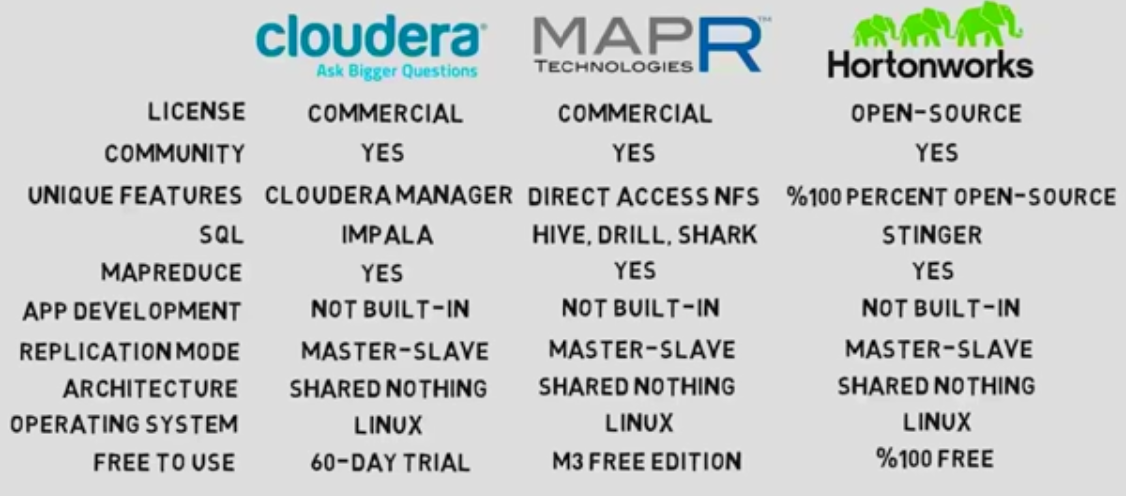
HADOOP DISTRIBUTIONS

Slide 34
Introduction to HADOOP
ANY QUESTIONS / DOUBTS
???

