Slide 1
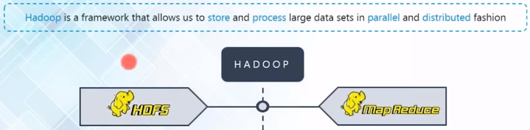

Chapter -3
HADOOP Distributed file system

Slide 2
contents
HDFS-Overview
HDFS architecture
NameNode and DataNodes
Secondary name node
Fault tolerance using data replication
HDFS blocks
Write mechanism
Read mechanism
HDFS configuration files

Slide 3
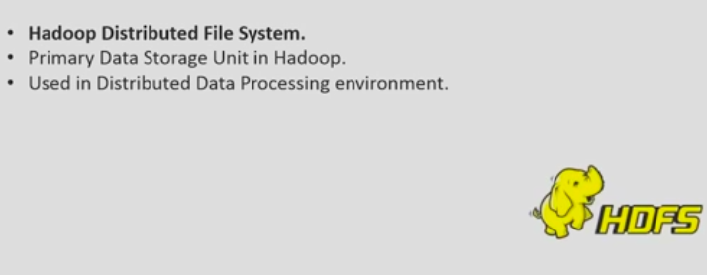
HDFS

Slide 4
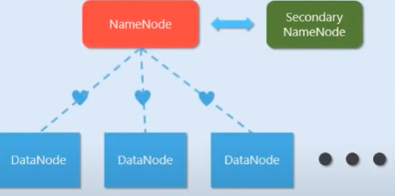
HDFS ARCHITECTURE

Slide 5
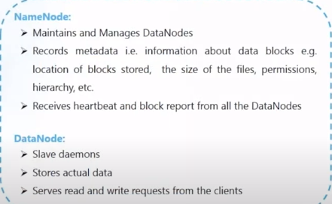
Name node and Data node

Slide 6
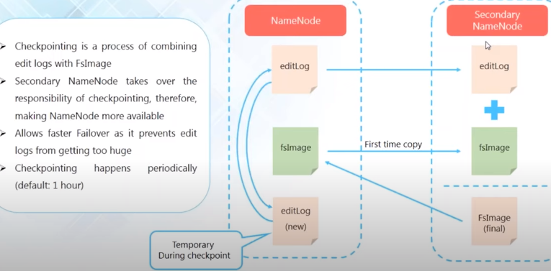
Secondary Name node & check pointing

Slide 7
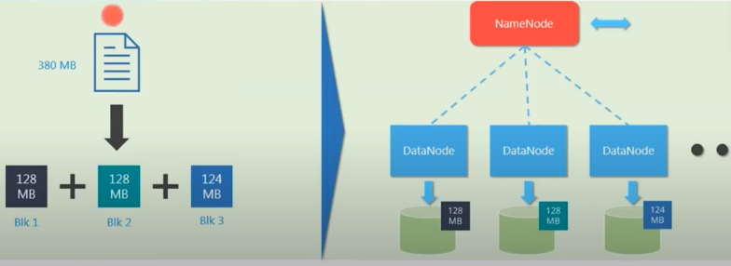
HDFS Blocks

Slide 8
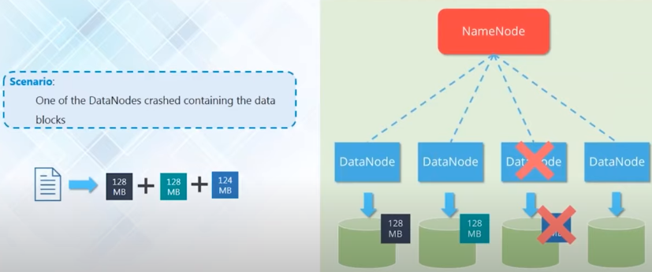
Fault tolerance

Slide 9
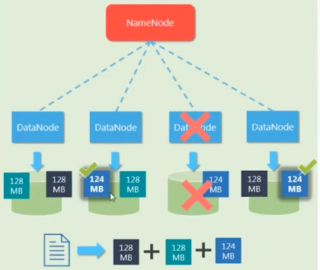

Fault tolerance

Slide 10
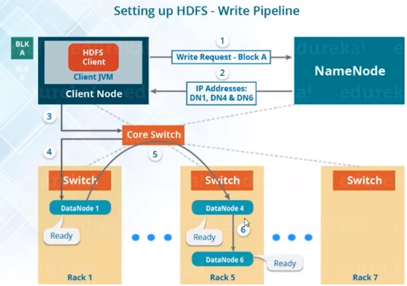

HDFS write mechanism- pipeline setup

Slide 11
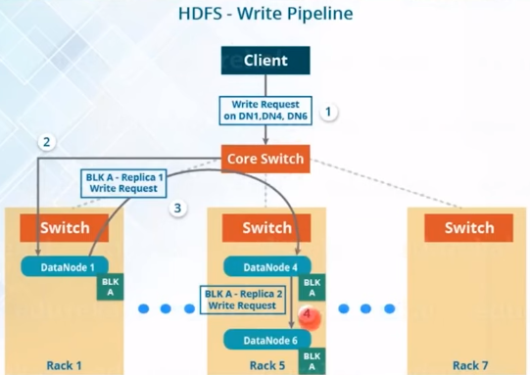
HDFS write mechanism- write block

Slide 12
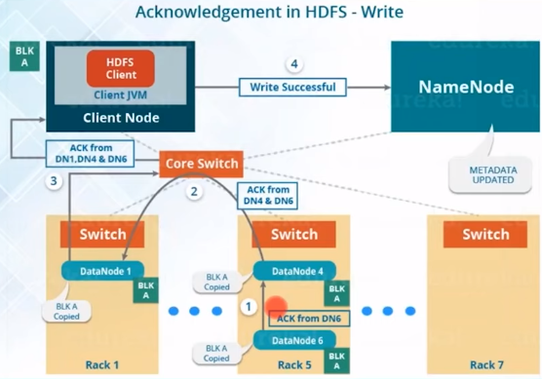
HDFS write mechanism- acknowledgement

Slide 13
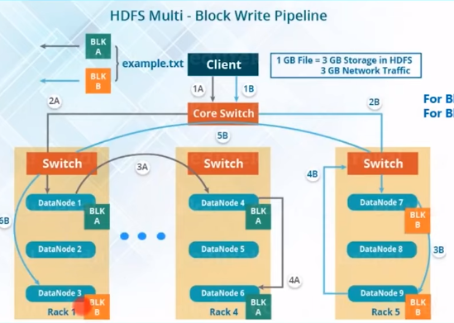

HDFS multi block write mechanism

Slide 14
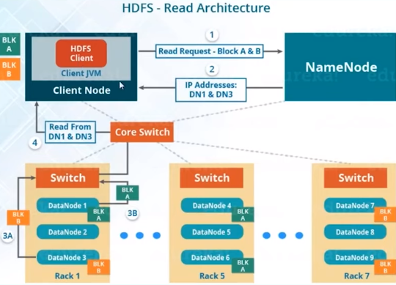
HDFS read mechanism

Slide 15
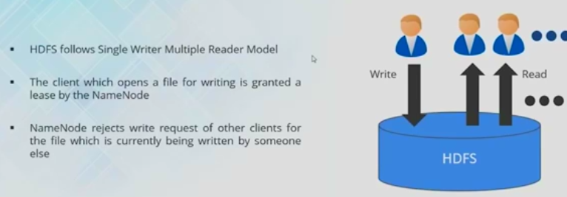
HDFS read –write mechanism

Slide 16
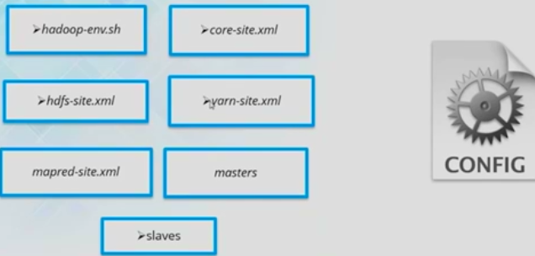
HDFS configuration files

Slide 17
HDFS
ANY QUESTIONS / DOUBTS
???

