Slide 1
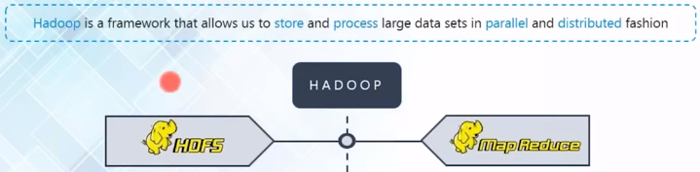

Chapter -2
MAP REDUCE

Slide 2
contents
What is map reduce
Story of map reduce
Map reduce example- word count program
Mapper code
Reducer code
Driver code

Slide 3
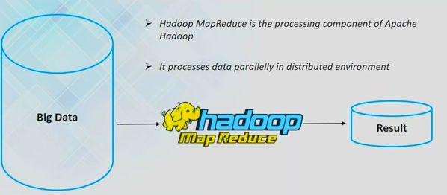
What is MAP REDUCE

Slide 4
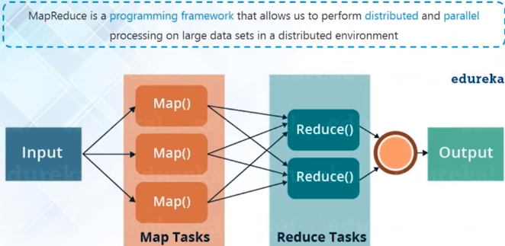
Map reduce
What is map reduce and why it is so popular
Map reduce big picture: map and reduce
Map reduce process and terminology
Map reduce components failures and recovery

Slide 5
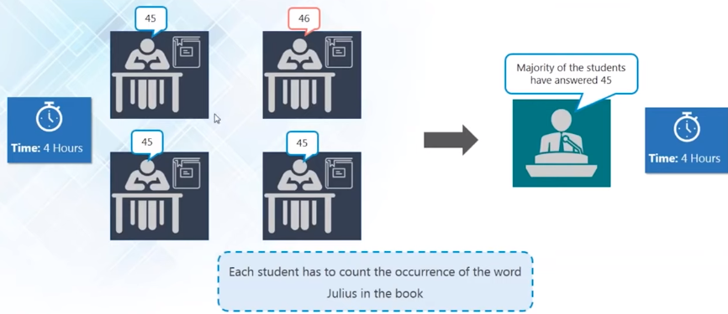
Story of map reduce

Slide 6
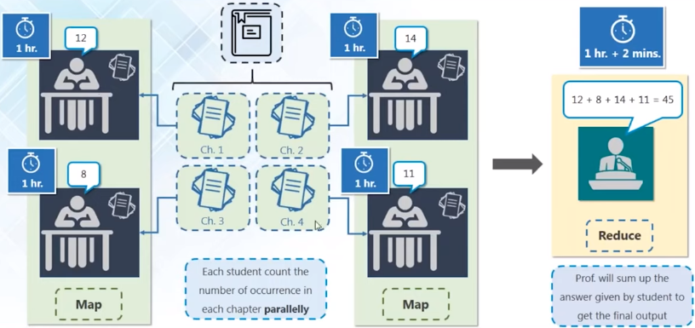
Story of map reduce

Slide 7
What is map reduce

Slide 8
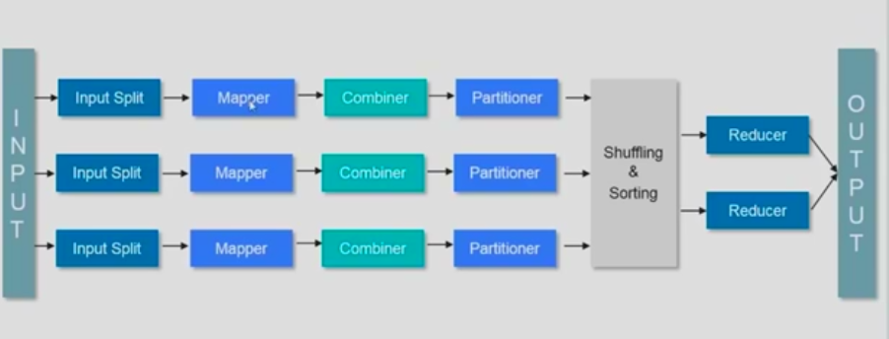
What is map reduce

Slide 9
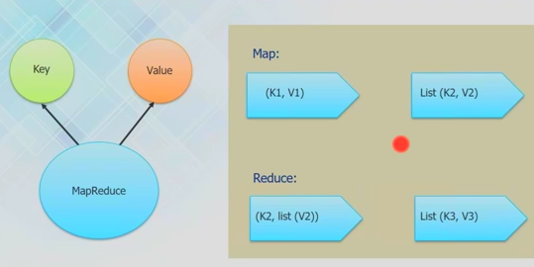
What is map reduce

Slide 10
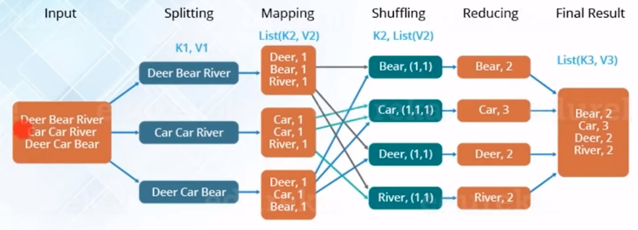
map reduce example- word count program

Slide 11
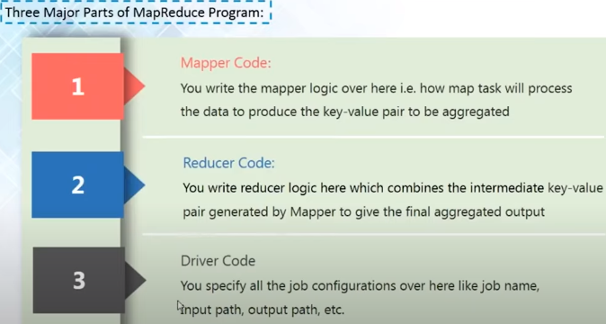
map reduce example- word count program

Slide 12
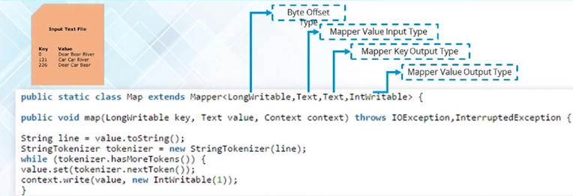
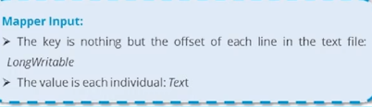

Mapper code

Slide 13
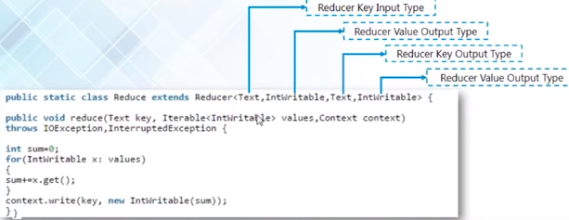
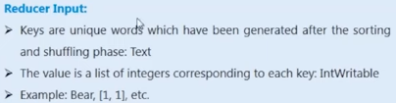
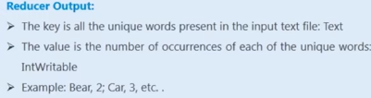
Reducer code

Slide 14
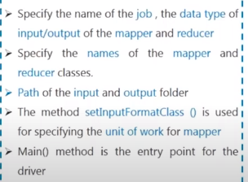
driver code

Slide 15
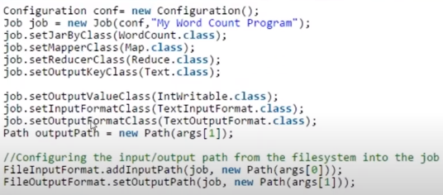
driver code

Slide 16
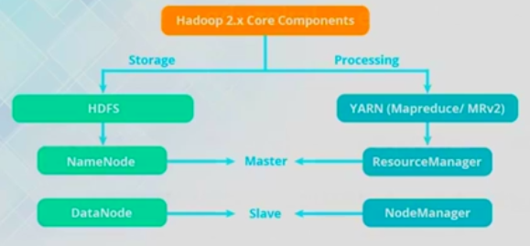
YARN

Slide 17
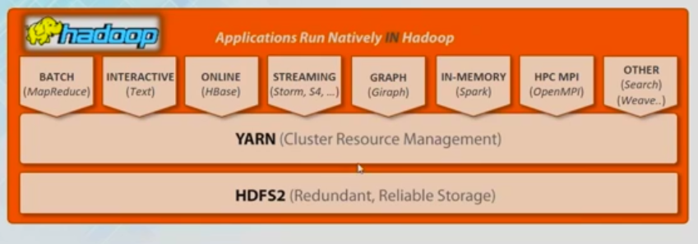
YARN

Slide 18
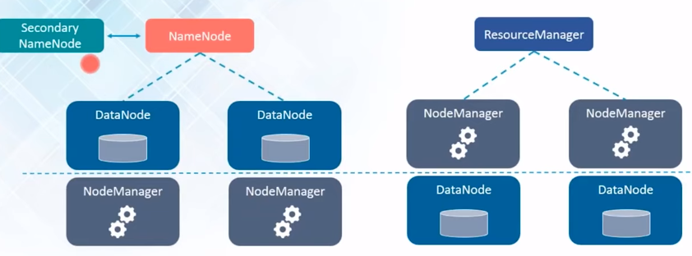
YARN

Slide 19
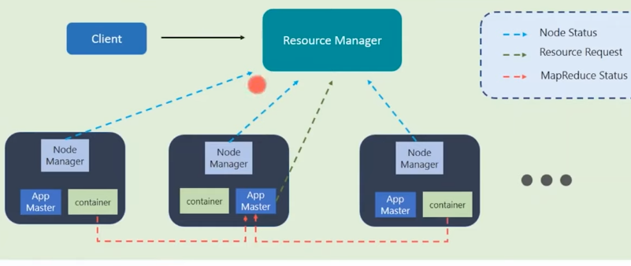
YARN

Slide 20
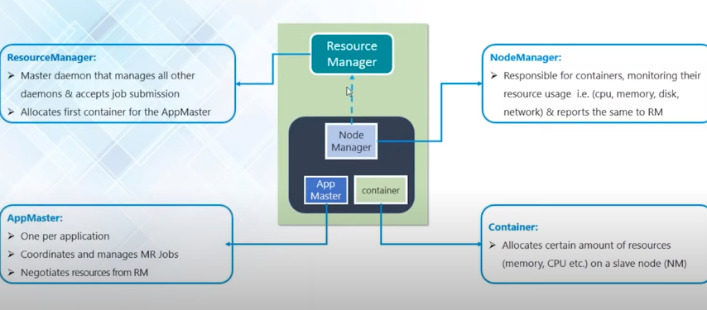
YARN

Slide 21
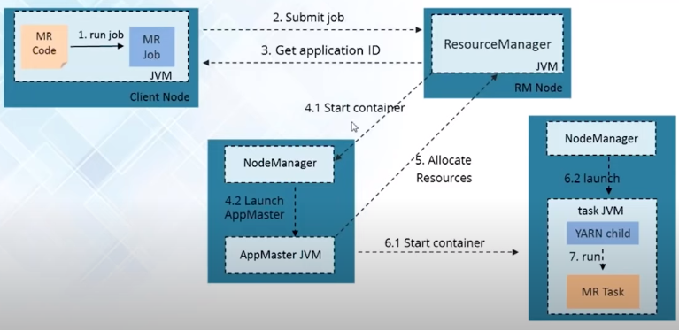
Map reduce work flow

Slide 22
Map reduce
ANY QUESTIONS / DOUBTS
???

