Slide 1
3. DATA BASE OF WILDLIFE MANAGEMENT
3.1 The need for inventory and monitoring in wildlife management
Regular monitoring the habitats of wildlife from time to time is required to understand the management problems and to analyze the effects of human impacts on wildlife and on the habitat.
Wildlife management involves controlling the number, distribution, and abundance of wildlife either directly by manipulating wildlife themselves or their habitat indirectly.
Management decision such as liberalize hunting regulations, planting food patches or control -burn shrubs fields requires some knowledge of the target population and/ or of its habitat.
Acquiring information necessary to make correct decisions is part of the wildlife manager’s job.

Slide 2
Managers must collect some time and budget to measure the abundance of animals, their reproductive success, the quantity and quality of habitat or whatever population and habitat characteristics for best management decisions based on the goal or objectives of management.
The development of tourist areas is also based on this information. Also detailed studies of habitat, boundaries are based on such information.
In general, management wants to answer three types of questions about species in protected areas.

Slide 3
To know the type and number of wildlife communities in a protected area (PAs), their distribution, and predator prey relationship or in more related studies, one can make study on habitat utilization.
What species of communities occur in the protected areas?
Where and in what number?
This is inventory, it is an enumeration of resources found in an area in the from stock taking (checking what species are there in a given area).
2. To know population trend overtime (monitoring): study of population dynamics (changing in population size, structure, i.e. status of population in PAs, decreasing, increasing, stable).

Slide 4
This is useful for management decision and conservation polices.
It requires the periodic estimates of absolute population size and age and sex structure (example Male, female ratio, proportion of calves, yearlings and sub adults, number and distributions, conditions and dynamics).
What is population trends overtime? this is monitoring refers to change of species of time i .e, decrease or increase.
3. Distribution and movements. Data on seasonal patterns of movement and vegetation type as well as basic migratory routs and areas of high species diversity.
This information is used to define the boundaries of new PAs or alterations to the existing database for wildlife management.

Slide 5
It may be to determine the importance of a site, the population size of a site, the habitat requirements of a species, the reason for a species decline, or whether habitat management has been successful, or to understand the population dynamics.
No form of wildlife management whether it is cropping or culling or hunting quotas, the development of tourism or demarcation of boundaries is possible without reliable information on number, population dynamics and movement of wild animals concerned.

Slide 6
Q. Why inventory and monitoring?
To determine the list of resources species found in an area
To determine the causal factor for population dynamics
To determine the habitat requirement of a species
To establish a distribution maps on temporary basses. E.g. for dry season or wet season
To monitor population change over time
To monitor seasonal movements of animals
Establish cropping or hunting quota for economic or social benefit planning in relation to Consumptive utilization of the resources

Slide 7
Infrastructures development in an area of protected areas, e.g. tourism, roads, dams as sources of water and boundary.
Preparation for management plan
For scientific and other related studies.
To measure stability of ecosystem.
To evaluate management effectiveness of the protected areas.
To monitor climatic condition of an area.

Slide 8
What are the means of ecological monitoring?
1. Ground monitoring: Monitoring from the ground
2. Aerial monitoring: Monitoring from air craft
3. Satellite monitoring: Monitoring through satellite imageries
Ground monitoring is more effective, because:
It gives fine details of the ground
It gives the actual ground truth
It can be used to check the effectiveness of ‘remote data”
It can also be used to check and interpret aerial and satellite data
It is more efficient in terms of expenses

Slide 9
3.2 Introduction to Counting animals
Any research program for the management and conservation of wildlife require information on the number of animals.
The type of information falls into three main categories
Total number of animals:
This is an estimation of the total number of animals in the protected areas (National parks, reserve or the study area forming part of the general ecological description of the area.
Theses studies are also needed for the determination of prey /predatory relationships, and more for studies of habitat utilization of a species.

Slide 10
b) The size and structure of populations:
The study of population dynamics is essential for understanding the ecological status of a particular population within Park, reserves as well as deciding on management and conservation polices.
This studies requires periodic estimates of the absolute size of population and of its age and sex structure (e.g. male ,female ratios, proportions of calves, yearlings and sub adults).
c) Distribution and movement:
data on seasonal patterns of movement, and vegetation type utilizations are necessary to identify key grazing and watering areas as well as migratory routes and areas of high species density and diversity.

Slide 11
This information is used to define the boundaries of new park and to define alteration of existing boundaries.
Also important for the development of tourist areas.
Detailed studies of habitat utilization overlap and competition requires very precise information of this type.
Techniques/methods of censusing wildlife population
Census is a total or sample count of wildlife population of a species in an area.
Census zone is the whole area (E.g., National Parks, Game reserves, cattle ranches or the whole study area) in the wildlife population to be estimated.

Slide 12
Sample zone is the portion of the census zone
Sample unit is a number of which is chosen at random to be searched
Population total is the number of wildlife population of a sample unit.
Total count in total count the whole population of a species in an area is counted.
Good for counting conspicuous larger mammals
Advantage
Provides account of all individuals and information on distribution
Data on age and sex structure can be collected at the sometime.
Disadvantage
Impractical for larger areas, difficult to cover larger areas
Difficult to assess whether individuals have been missed or counted twice

Slide 13
Sample count a portion of the total area is counted to estimate a number of populations of a species of an area (only part of an area is searched for wildlife).
3.2.1 Direct count method
a) Ground sample count include counting on foot and from vehicle
b) Aerial sample, count counting of wild animals from aircraft
It is fundamental for counting larger mammals.
3.2.2 Indirect count Method
Majority of the wildlife observations is based on indirect evidences of animals in their natural habitats.

Slide 14
Only rarely that we may get sufficient data by direct observations in the wild.
Tracks /Spores/ Footprints
Droppings/Fecal/ pellets
Diggings/burrows
Calls/Vocalization, Feeding sign, nest counting

Slide 15
A. Population Estimation
Line-transect count:
This is one of the most widely used methods in wildlife census.
During this process, the investigators have to fix the study transects, consisting of fixed length (eg. 1 km, 2 km, 4 km, 5 km, etc) and width (eg. 1 m, 5 m, 10 m, 50 m, 100 m on both sides of the transect), based on the habitat type and the animal to be observed.
If the study animal is small in size, transect width should be small, so as to make a close observation.
On the other hand, if the study organism is large in size, transect width should be large enough to expect at least few of the organisms within the transect coverage.

Slide 16
Several transects are to be observed, so as to make a better coverage of the area.
Random selection of transect is the ideal so as to eliminate bias.
For example, roadside or a lakeside transect alone may result in biased data.
During counting, in addition to the total number of individuals, sex and age categories are to be recognized.
Individual identification, herd/troupe identity is also useful to arrive at conclusions on populations/herd size, etc.

Slide 17
2. Pellet count: Pellets are animal droppings.
Each species of animal has its own specific type of pellets/droppings, which can easily be identified by an experienced Wildlife Ecologist/Wildlife Biologist.
Each species of animal has its own average rate of defecation, every day.
If new pellets in the study transects are counted systematically, one can easily come to know the approximate density of the wildlife populations.
3. Minimum Number Alive Method:
This is one of the most commonly used methods for assessing rodent populations in the study area.

Slide 18
If the investigators trap rodents using suitable traps, baited with a preferred food for few weeks, it can be assumed that there is equal chance for all individuals of them to be trapped on any of the trapping days.
If all individuals trapped are marked and released, new individuals trapped every day can be counted, until the last few
trapping days, when no more new individuals are available for trapping in the area as shown in the table below.
The assumption is that all individuals of the species in the area are trapped and counted in the group of ‘new capture’.

Slide 19
Trapping session | Capture | New capture | Marked and released
Week 1 | 75 | 75 | 0
Week 2 | 85 | 60 | 25
Week 3 | 90 | 45 | 45
Week 4 | 95 | 40 | 55
Week 5 | 90 | 40 | 50
Week 6 | 85 | 35 | 50
Week 7 | 70 | 5 | 65
Week 8 | 75 | 0 | 75
Week 9 | 68 | 0 | 68
Total New |  | 300

Slide 20
4. Capture-Mark-Recapture (CMR) Technique:
This is another commonly used method to estimate populations of insects and small mammals.
A 100 x 100 m² grid can be marked for this method in the study area.
This grid can be divided in to 100 equal sized units (each of 10 x 10 m²), to set suitably baited traps.
There should be a minimum two trapping sessions for this method.
During the first trapping session few individuals of the study species may be trapped (P1).
All of them are to be marked and essential body measurements are to be collected and released in the same site of collection.

Slide 21
All of them are to be marked and essential body measurements are to be collected and released in the same site of collection.
Sufficient time should be allotted between the first and second trapping sessions, for a proper mingling of the trapped ones with other members in the population.
During the second trapping also a limited number of individuals of the study species (P2) would be trapped, out of which few (P3) may be the ones trapped in the first trapping session.

Slide 22
From this data, the approximate population of the study species in the grid can be estimated using the following formula:
P1 = P3
N P2 therefore N= P1 P2
P3
Where N= total population estimate of the species in the study area.
Number of marked and released individuals in the first trapping/netting = P1 = 50
Number of trapped individuals in the second trapping/netting = P2 = 60
No. of marked individuals released after the first trapping and recaptured during the second trapping = P3 = 10
The total population estimate =50 x 60 = 300
10

Slide 23
Means to present populations are:
1. Density,
2. Abundance, and
3. Diversity Indices.
Density is the number of individuals of the species per unit area (eg. per ha/per m²/km², etc).
Abundance is the number of individuals of the species in the total area.
Usually used biodiversity indices (indexes) are Shannon-Weaver index, H’ and Simpson’s Diversity index, D.
Similarity index (Simpson’s Similarity Index, SI) denotes the similarity of different study areas/habitats with respect to the number of species common to the different study areas/habitats.

Slide 24
B. Eco-behavioural observations
Wildlife is better studied by behavioural observations.
Behavioural patterns can be studied by direct observations and by indirect evidences. Example: Feeding behaviour.
Direct observation on feeding is possible in the case of diurnal animals, whereas in the case of nocturnal animals most of the data are gathered through indirect evidences.
Faeces are excellent tools for wildlife Biologists/Ecologists.
Undigested particles in a carnivore/herbivore dropping can be isolated and analyzed under a stereo microscope to identify the food organisms responsible for the scat.

Slide 25
Radio-location telemetry/Biotelemetry:
Biotelemetry is the technique of obtaining information about an animal through tracking radio signals from a devise fixed on the animal.
Wildlife telemetry studies have facilitated acquisition of detailed information on many aspects of wildlife ecology such as habitat association, home range, survivorship and mortality, migration timing and routes of migration of a variety of species of animals.
The secretive nature and the difficult habitat terrains make conventional observations of many species of wildlife difficult, and hence necessitate biotelemetry studies.

Slide 26
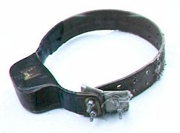
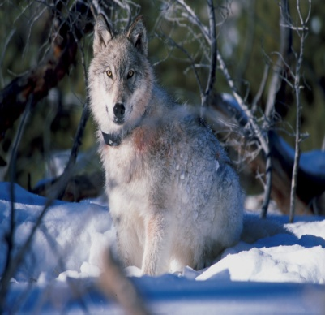
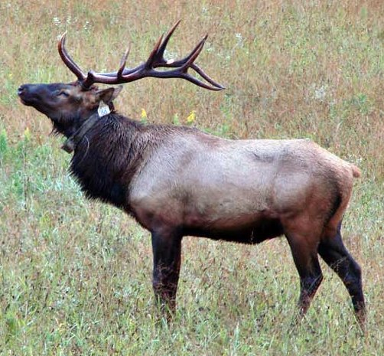
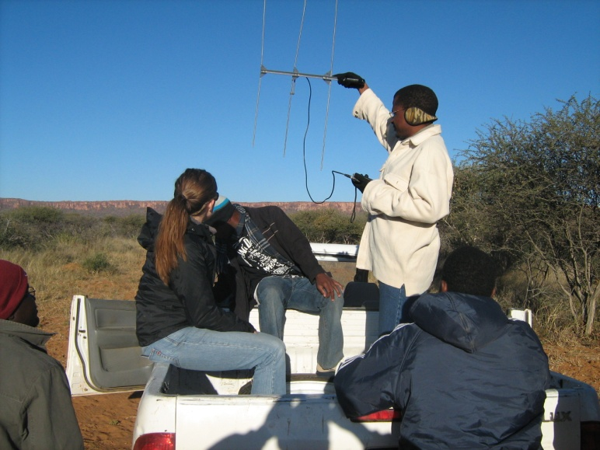
Tracking systems are composed of two major radio- signaling and tracking units, viz., the transmitter and the receiver.

Slide 27
Camera trapping
Camera trap – is a remotely activated camera that is equipped with a motion sensor or an infrared, or uses a light beam as a trigger.
Camera trapping is a method for capturing wild animals on film when researchers are not present, and has been used in ecological research for decades.
It is set in the field and captures the picture of an organism when it pass across the area.
Helps to study nocturnal animals.

Slide 28
Helps in detection of rare species, estimation of population size and species richness, as well as research on habitat use of certain wildlife species.
Camera traps are useful in determining behavioral and activity patterns of animals.
Camera traps are also helpful in quantifying the number of different species in an area.

Slide 29
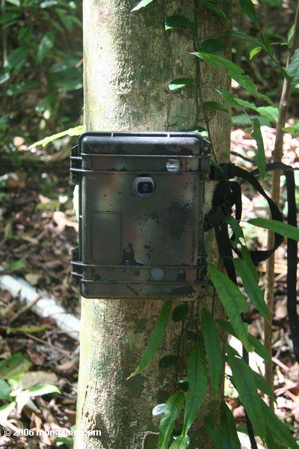
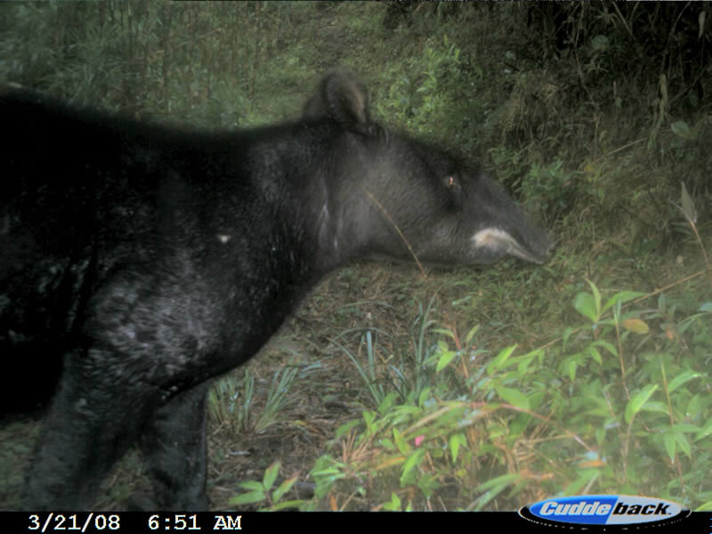
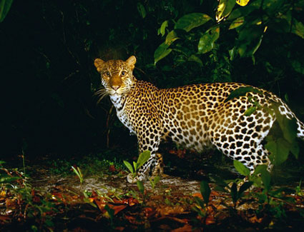

Slide 30
4. WILDLIFE HABITATS
Habitat is any kind of biotic community, or set of biotic communities in which an animal or population lives"
Habitat is the range of environments in which a species occurs.
For any species we can define 'habitat' as "any physical place where an organism lives and most progeny can be raised successfully.
OR "any part of the earth where the species live either temporarily or permanently“
4.1 Evolution of Habitat Preferences
To understand the evolution of habitat preference we can start by recognizing that animals cannot live everywhere and that natural selection will favour the development of sensory systems, which can recognize suitable habitats.

Slide 31
In reality we find animals do not occupy their entire range even though they can disperse into the unoccupied range.
They choose to live in certain area and at some specific time.
On principle states that Natural selection will favour individuals that use the specific habitats in which most progeny can be raised successfully.
Individuals that choose the poorer, marginal, habitats will not raise as many progeny and consequently be selected against.
Therefore habitat can firstly be viewed from Natural Selection point of view.
Secondly, habitat preference can be viewed from the animal's adaptation point of view.

Slide 32
Animal adaptations can be classified from its: (a) Anatomical
(b) Physiological and
(c) Behavioral (innate/learned)
(a) Anatomical adaptation in animals:
Body size e.g. long leg, neck, pointed snout, body coloration, feathers (dense/sparse) horn formation etc in relation to forest, plain, woodland, or water
(b) Physiological adaptation in animals:
Digestive and reproductive system (e.g. simple digestive system and therefore simple food for carnivores etc.)
Development of sensory organs (e.g. acute eye sight, sense of smell for forest dwelling animals etc)
Resistance to diseases

Slide 33
(c) Behavioural adaptations in animals:
Small vs. large social groups, mating system, feeding habits, defense mechanisms (hippo), breeding strategy (e.g. Big bang and repetitive breeding)
An adaptation fits an animal for survival and reproduction within a particular environment or within a limited range of environments.
Consequently the animal is less fit to operate in other environmental settings, which it is not adapted.
For example we don't expect to find ducks in deserts, fish out of water, waterbucks and hippos in areas devoid of water etc.
Adaptations that fits an animal to its natural associated environment also limits the animal to that environment:

Slide 34
Some animals are highly SPECIALIZED i.e. adapted to a narrow range of environment with specialized requirements.
Specialized animals are quite sensitive to environmental changes in the sense they cannot adjust to changes.
Because of specialization we find such species (specialized) to be rare, endangered or extinct e.g. Klipspringers, Cheetahs, Rock hyraxes.
The Ethiopian wolf, Canis simensis is a habitat specialist, seen only in the high altitude Afro-alpine habitats in Ethiopia, where they depend mostly on the giant mole rats for their food.
Hence, it is essential to maintain habitats of such endemic species, even though the habitat is less diverse.

Slide 35
Habitat association of wild animals depends mainly on the food preferences of each of the species.
On the other hand GENERALIZED species are those adapted to a wide range of environments that permit them to have large geographical and ecological ranges e.g. Elephant, Zebra, Buffalo.
4.2 Management Implications in Animals' Adaptations to Habitat
Misunderstanding of animal adaptation has lead to the following failures in wildlife management:
(a) Management of animals in captivity: Animals have been lost while on holding grounds or guarantee stations due to neglect of their natural habitat requirements.

Slide 36
(b) Domestication of wild animals: Some experiments to domesticate wild animals failed due to neglect of their habitat requirements.
Lack of natural environmental requirements to specialized animals lead to death or reproductive failure.
(c) Transplanting wild animals and release of pen-raised animals: Transplanting and release of pen - raised animals failed in many areas due to neglect of their adaptations.

Slide 37
4.3 Wildlife Habitat Requirements
Wildlife habitat requirement that can be studied and measured include: -
(i) Nutritional and (ii) Structural
i)Nutritional:
Wildlife habitat nutritional aspects include feeding habits and nutritional needs.
Food is important to all living things.
Measurement of animal’s general physical condition includes size, vigor and health that are controlled by the quality and quantity of food.
Good nutrition leads to increased growth and natality rate, good health and reduced mortality.

Slide 38
Food components:
Food provides animals with water, nutrients and energy.
Water is important for digestion, metabolism, carrying off body waste and evaporative cooling.
Other sources of water to animals besides that contained in their food include:
Free water = surface water, succulent vegetation (food), dew, and Metabolic water (obtained in metabolizes of fats)
Wildlife responds to water deprivation by exploring water sources: - e.g.- Elephants digging riverbeds - migrating to water sources, - feeding on different food sources.

Slide 39
Variability in water requirements
Water requirement is mainly governed by:
i) Weather conditions e.g. in hot weather they take more water for cooling and compensation of evaporated water.
ii) Seasonal patterns of animals physiological function: e.g. reproduction energy; migration,
iii) Species of animals: Water requirement vary greatly among species.
Animal Adaptations to Arid Environment:
a) Nocturnal or Fossorial Habits.
Animals confine activities to times and places with lower temperatures and high humidity to avoid the demand for evaporative cooling.

Slide 40
b) Concentrating Excreta. Produce dry feces, powerful kidneys to concentrate urine.
c) Labile body temperature. Animals allow their body temperature to rise during the heat of the day thus reducing water requirement for evaporative cooling.
d) Morphology: large body size and abundant insulation that is common on the back of the animal lead to less evaporation.
f) Use of metabolic water. i.e. oxidation of fats and carbohydrates.
g) Water Storage: Ruminants store water in their rumen.
h) Mobility: Visiting watering points through daily movements e.g. Sand grouses, buffalos
i) Reproduction patterns: Synchronizing reproductive season to avoid the dry period.

Slide 41
3.5 Habitat Evaluation Methods
Wildlife manager mostly evaluate habitats to determine the quantity and quality of available resource for a particular species.
To evaluate habitat we can measure habitat features that relates specifically to the presence; number or health of the animals.
Evaluation can also be based on trend analysis to determine whether a habitat has improved, declined or remained unchanged.
(a) How to decide habitat features to measure:
i) Consider time and available funding sources.
ii) Consider the organisms to focus on rather than considering the whole ecosystem.
It may be wise to focus on selected species e.g. dominant species

Slide 42
iii) Have basic knowledge of the interrelations of the species with its environment throughout the animal cycle (e.g. migratory species) including knowledge of their natural history.
(b) Habitat evaluation based on habitat factors/factors
Habitat factor can be used as variable to evaluate habitat condition.
Habitat factors/features to measures aimed to evaluate habitat trends can be classified as
(i) MAJOR or MACRO and (ii) MICRO
(i) MAJOR or MACRO features will include:
Size (area) of the habitat,
Vegetation cover –vegetation map, vegetation communities
Water bodies etc.,
Geomorphology –soils, drainage

Slide 43
MACRO Habitat features can be measured using remote sensing. and GIS techniques
Remote sensing is a time serving method for collecting wildlife habitat data.
It includes satellite imagery (land sat), infrared aerial photos.
Habitat size and shape can be determined from satellite digital analysis or interpretation of aerial photographs.
(i) Colour infrared photographs are valuable for vegetation analysis.
The color tones along with size, shape, pattern, shadow, and texture are useful for identifying plant communities and growth forms.
Also colour infrared photographs indicate the site of water bodies, degree of burn and levels of recovery.

Slide 44
Maps and GIS technology: Survey maps where available can provide data on location of physical habitat features such as streams, roads, mountains, and other infrastructures.
(ii) MICRO habitat factors/features include – Plant species, Composition of food; Water chemistry
Evaluation of habitat using MICRO Habitat features
(a). Aquatic Habitat
This involves measuring water column to include:
1) Stream width, depth, and light intensity.
2) Water chemistry = chemical analysis of lakes and stream water eg. to determine degree of pollution.
3) Turbidity

Slide 45
(b.) Terrestrial habitats (Analysis of habitat features)
Monitoring plant species composition and distribution
Monitor disturbances that affect species utilizing the area. Such disturbances will include: Fire, Fence posts, buildings, dams, water holes, overgrazing, mining, and agriculture.
Studying and Evaluating Wildlife nutrition.
Evaluating habitat on basis of wildlife nutrition will involve methods for determining and evaluating food production, availability, utilization, quality and its contribution in rangeland.

Slide 46
Evaluating food Production (Quantity and Quality) for Herbivores:
i) Forage Surveys to determine quantity can be achieved by various methods used in sampling vegetation and measurement data
e.g. frequency of occurrence, density, cover biomass etc. Sampling methods will includes among others: - Quadrat, plot less, step point, line intercept, point intercept, Clipping, PCQ - Point Centered Quarter etc.

Slide 47
ii) Forage quality can be evaluated directly by measuring degree of use and or by analyzing nutrient contents in different plant species.
Direct measurement on degree of utilization for different spp. in a particular habitats can at times be misleading if the area is over stocked or where the variety of plant spp. minimal.
In all cases animals will be compelled to utilize the suitable food resources even if they were least palatable and of poor nutritional quality.
On the other hand measurement of nutrient contents in different plant species and comparing with availability will provide better quantitative assessment.
Consequently to measure forage quality Proximate Analysis method is applied.
Proximate analysis is a method for partitioning food into five components reported in percentage of dry matter.

Slide 48
5. FEEDING AND PREDATOR – PREY INTERACTIONS
Feeding is the most important activity of all organisms in nature, for which they spend most of their active time.
Feeding involves activities concerned with finding food, manipulation of the food and then the actual process of eating.
Eating is involved with the feeding apparatus or the mouth organs including the teeth in higher animals.
In the case of unicellular organisms such as amoeba, the pseudopodial movements help to engulf food.

Slide 49
Among ciliates, ciliary movements are responsible for bringing food closer and ultimately engulfing it.
The ciliary feeding involves filtering minute organisms from the current of water drawn through cilia.
Among coelenterates, tentacular movements perform this function.

Slide 50
In the case of higher organisms, special body organs perform each function, starting from searching for prey, entangling, killing, chewing, engulfing, and so on.
Animals are clever in trapping their food organisms.
For example, spider webs are species-specific, in which the prey organisms such as small insects are trapped accidentally.
The animal world is so fascinating, particularly so with the feeding related behaviours.
There are also animals like human beings, (e.g. rodents: rats and squirrels) capable of hoarding food when available in plenty for the use when food is scarce.

Slide 51
5.1 Foraging as a major activity of animals
In natural habitats, all animals spend most of their active time in foraging and in feeding activities.
Feeding related activities constitute majority of the active time of both diurnal and nocturnal animals.
Animal migration from one part of the world to another during adverse environmental conditions is also related to the availability and searching for food.
During the winter season when availability of food and feeding time are limited, birds migrate to environmentally safe areas, where food is available in plenty as well as where more time is available for foraging.
Food and water are most important requirements for survival of organisms.

Slide 52
Food and water are not readily available in all cases and in all habitat types, and hence animals are forced to wander considerable distances over time in search of these most essential life requirements.
This makes animals busy in their activity schedule. Case studies have revealed that up to 80% of the active time is spent by animals in food related activities.
Food as a source of Energy and Nutrients to animals
Besides water, food is the source of nutrients and energy to animals.
Nutrients in food support growth and maintenance of body structure while energy serves as fuel for metabolic processes.

Slide 53
Food Nutrients includes: Proteins, carbohydrates and fats (fatty acids), vitamins, and minerals.
Protein is a good general index to food quality but the value of food may be limited by other factors such as palatability, digestibility, toxicity and deficiencies in essential elements (vitamins & minerals).
Wildlife fulfils their nutrient requirement by using great variety of food -cf.- domestic animals.

Slide 54
5.2. Variability in food requirements in wildlife
Amount and quality of food required by wildlife may vary among species and within species.
For example: between sexes; among age classes; variations with the physiological function and season of the year (Wet/Dry), and geographical locations.
a)Variations in Food Requirement Among Species:
Different species require varying amount and quality of food as can be seen in the food chain or trophic levels.
Carnivores are opportunistic feeders adapted to catch certain type of prey but generally feeding on any species that is available and vulnerable.

Slide 55
Carnivore food (raw meat) provides high quality diet.
It is easily digested, contains high concentration of nutrients.
For these reasons carnivores have simple digestive tract.
Consequently a nutritional problem in wild carnivores is a matter of quantity and availability rather than quality.
Herbivores exists on comparatively crude foods mainly carbohydrates with low concentration of proteins and other nutrients.
They feed on different plant species and parts (buds, leaves, flowers, root fruits).
Because their food is coarse, less digestible and taken in large volumes they grind it; feed continuously and anatomically they have larger, longer and complex digestive tract.
Nutrients are more concentrated in certain parts than others e.g. Seeds, fruits, root, buds etc

Slide 56
(a) Hierarchy of herbivores’ food classes includes.
i) Preferred and high quality foods
Easily digestible,
Rich with nutrients.
ii) Emergency food - less preferred and usually of mediocre quality.
Become important when all preferred food have been used.
Sustain population through a critical period of food shortage.
iii. Starvation food:
Food of very inadequate quality.
Eaten when other food are absent
Habitat can't support the number of animals present.

Slide 57
Many herbivores have evolved special digestive organs and systems e.g. Rumino-reticula section for physical and chemical digestion, Ceca (caecum) in birds, and Microbial digestion.
b) Variation In Food Requirements Within Species:
i) Variation between sexes:
Males and females of some species usually exhibit similar but not necessarily the same feeding habits e.g. female lion (lioness) by their hunting behaviour are able to catch larger prey than males.
Most male birds of prey are larger than females thus capable of catching larger preys.

Slide 58
In other cases males are separated from females in a large part of the year leading to use of separate food resources in their home range.
In all cases, the existence of sexual dimorphism permits the sexes to use different food resources reducing intersexual competition for food
ii) Variations in Food Requirements among Age Classes.
Young animals have higher requirement for nutrients thus they feed more continuously than adults.

Slide 59
5.3 Predation
Predation can be defined as the phenomenon of individuals of one species eating individuals of another species.
This does not include the behaviour of detritivores and scavengers, eating carcasses.
Predation need not always be the one involved in carnivores killing and eating herbivores.
It can also be the involvement of herbivores eating vegetation. Broadly, predation can be classified in to four types.
1) Herbivory: Herbivory deals with the eating of green plants, fruits or seeds by plant eating animals.

Slide 60
In this case, plants are not necessarily killed by the herbivore. Even though seed predators (granivores) and fruit eaters (frugivores) often kill seeds, some seeds require passage through the mammalian digestive system for germination (e.g seeds of certain species of Acacia passing through the intestine of impala).
2. Parasitism: Parasitism relates to the behaviour of parasitising one species by another.
The parasite need not kill the host always; but it happens in rare cases.
3. Carnivory: This is the classical concept of predation, where the predator kills and eats the prey animal.

Slide 61
4. Cannibalism: Cannibalism is a special case of predation in which the predator and prey are of the same species.
Cannibalism may be seen in special circumstances, when there is considerable food shortage, particularly in captivity.
Predator – Prey interactions - behaviour
The behavioural activities of predators and their prey are important in studying predator-prey interactions.
This include
i. The behaviour of predators in response to changes in the density of prey,
ii. The behaviour of predators in response to changes in the density of the predator species itself,

Slide 62
iii. Response of predators in response to the differences in the degree of clumping of prey and
iv. The behaviour of the prey species.
In areas where predators are absent or experimentally removed, the prey population is expected to increase considerably for certain period, until they deplete as a result of shortage of own food.
The populations of prey also regulate predator population.
In areas where prey population is less, predator populations can not increase beyond certain limits.
When food supply is limited, predator populations can not increase constantly.
The carrying capacity of any organism in its natural habitats is regulated by ecological factors of the habitat.

Slide 63
Food is a major limiting factor in controlling populations of any species.
It is also one of the major factors limiting the distribution patterns of organisms. Thus, predator populations are responsible for controlling prey populations and vice-versa.
The response of predators to different prey densities depends on
i. the feeding behaivour of individual predators, which is called the functional response and
ii. the response of the predator population through reproduction, immigration and emigration, which is called the numerical response.

Slide 64
If there are two prey types, A & B in the habitat, A being rare and B common, predators will concentrate on B and ignore A.
Predators may change their search from B to A (switching) when B becomes rare as a result of predation, thus switching from one prey to the other based on the more abundant prey species in the area.
The success with which predators catch prey depends on the density of the predator population.
Predators usually react to the presence of other individuals of their own species by dispersing.
When the density of the predator species increases in the habitat, the efficiency to search and find out food reduces.

Slide 65
Mammal and bird predators are usually territorial and evict other individuals from the area when the space is fully occupied.
Predators concentrate their search (appetitive behaviour) in patches of high prey density; thus having a regulating effect on the prey population.
As prey density increases, more predators survive and reproduce.
These two effects (survival and fecundity) result in an increase of the predator population, which in turn eats more prey.

Slide 66
Lotka-Volterra Model of Predator-prey Interactions
The Lotka-Volterra equations state that the prey population grows exponentially and that reproduction in the predator population is a function of the number of prey consumed.
These equations show that when the predator population increases, the prey population decreases to a point, at which the trend is reversed.
The prey increases, following an increase in the predator population. The two populations rise and fall, oscillating.
As the predator population increases, it will consume a progressively larger number of prey until the prey population begins to decline.
In turn, the abundance of prey influences the reproductive rate of the predator population.

Slide 67
In time, the number of predators overshoots the availability of prey, and the predator population declines to a point where the reproduction of prey more than balances its losses through predation.
The population of the prey then increases, which is followed by an increase in the population of predators.
The cycle may continue indefinitely provided all other ecological factors remain suitable for both the prey and the predator populations

Slide 68
A schematic representation of predator – prey interactions showing various food webs in natural ecosystems. 1. Tiger as predator and sambar deer as prey, 2. Birds of prey as predating on and rats, 3. Jungle cat as predator and rabbit as prey, 4. Rat as predating on vegetative matters, and 5. Large fish depends on smaller fish.

Slide 69
Food as a factor responsible for distribution of animals
Distribution of organisms in natural habitats is governed by the availability of food items.
Animals restrict their movements through areas where preferred food items are available in plenty.
This is also revealed by the habitat selection by animals. For example, carnivores are more abundant in areas where herbivorous prey animals are seen in plenty.
The Ethiopian wolf habitat in the Afro-alpine habitat in the Bale Mountains is abundant with their preferred prey, the giant mole rat.
Endemic species usually depend up on less variety of food items; thus, they form endemic to a limited area where their preferred food items are seen.

Slide 70
This is disadvantageous for the species concerned as chances of their survival on a long-term basis is difficult, unless their habitat is specially conserved with protective measures.
Animals with wider distribution patterns show a better adaptive nature with a variety of food items on which they depend upon.
This behaviour helps them to have wider areas of distribution, which is also advantageous for their survival.

Slide 71
5.4 Studying wildlife nutrition
Studies of nutrition in wild animals include:-
1) Food habit investigations;
2) Feeding and digestion trials; and
3) Nutritional disorders
Food habits and preferences
Several methods exist but each has limitations with regard to species behaviour, season of the year, expertise and costs.
Methods for studying food habits and preference includes:
i) Feeding site observations
This involves direct observation in the field but can have the following limitations:

Slide 72
Some species are secretive thus not observable. Also the eaten food resource is not observable as at time it is completely utilized and no evidence left, some observable food items may be overestimated.
ii) Inspection (or Observation) of digestive tract:
Collect animals and observe food items present in the mouth, esophagus, crop or stomach, and rumen.
Limitation:- Animal are collected or killed; - Some food resources are completely digested.
iii) Fecal analysis - Examination of feces:
Undigested food will remain in the feces while the digestible food is underestimated.
The technique will require microscopic analysis and proper identification of feces to spp.

Slide 73
iv) Materials Regurgitated
For example some birds of prey regurgitate food on their nests in the process of feeding their young.
Inspection of regurgitated materials on such nests can reveal the kind of food items eaten by such birds.
For the case of mammals Esophageal/Fistulation can be done.
v) Food remains and signs.
Some predators (lion, leopard, hyenas) signs can be inspected including partially eaten carcasses found in their habitat.
Preference trials: Animals in captivity may be presented with two or more food items.
The item eaten mostly is rated as preferred. In the field one can follow the animal and note the items mostly eaten.

