Slide 1
6. TRANSLOCATION, INTRODUCTION AND REINTRODUCTION OF ANIMALS
Translocation of animals means moving or transferring animals from one area/location to another.
Translocated animals may be exotic or endemic species.
Translocation in wildlife conservation is the capture, transport and release or introduction of species, from one location to another.
It contrasts with reintroduction, a term which is generally used to denote the introduction into the wild of species from captive stock.

Slide 2
Translocation is an effective management strategy in conservation biology.
It decreases the risk of extinction by increasing the range of a species, increasing the numbers in a critical population, or establishing new populations thus reducing the risk of extinction.
This improves the level of biodiversity in the ecosystem.
Translocation may be expensive and is often subject to public analysis, particularly when the species involved is charismatic or perceived as dangerous (for example wolf reintroduction).
Translocation as a tool is used to reduce the risk of a catastrophe to a species with a single population, to improve genetic heterogeneity of separated populations of a species, to aid the natural recovery of a species or re-establish a species where barriers might prevent it from doing so naturally.

Slide 3
It is also used to move ecological features out of the way of development.
Translocation is an effective conservation tool but its use either on its own or in conjunction with other conservation solutions needs rigorous justification.
Feasibility assessment should include a balance of the conservation benefits against the costs and risks of both the translocation and alternative conservation actions.
Risks in a translocation are multiple, affecting in many ways the focal species, their associated communities and ecosystem functions in both source and destination areas; there are also risks around human concerns.

Slide 4
Any proposed translocation should have a comprehensive risk assessment with a level of effort appropriate to the situation.
Where risk is high and/or uncertainty remains about risks and their impacts, a translocation should not proceed.
Translocations can be classified as
i) Introductions into areas outside the historical distribution of the species
ii) Reintroductions within the species’ distribution range either as reintroductions to areas where the species has died out or translocations to boost declining populations

Slide 5
Objectives:
Conservation through relocation of threatened species
Arrest declining population
Control problem/competitive species
Control Diseases
Restocking population i.e. Re-establish populations in areas where they have gone extinct
Breeding in captivity, farming/ranching
Economic
Recreational

Slide 6
Risks
Biological –hybridization
Species loss through the process
Introduction of exotics
Disease transmission
Lack of knowledge and expertise –Technical know-how
Failure to manage and monitor the animals before and after
Introduction is the intentional movement and release of an organism outside its indigenous range.
Reintroduction is the deliberate release of a species into the wild, from captivity or relocated from other areas where the species survives.

Slide 7
A species that needs reintroduction is usually one whose existence has become threatened or endangered in the wild.
Because reintroduction may involve returning native species to localities where they had been extirpated, some prefer the term "reestablishment".
Reintroduction and translocation are both important tools for population and species management.
Translocation moves wild-caught animals from one natural location to another, while Reintroduction moves captive-born animals into their natural historical range.
Much of the behavioral research required to obtain reproduction will also be critical for reintroduction, which depends on the development of behaviorally competent individuals.

Slide 8
More behavioral research to select the best candidates and prepare them for the very different challenges that await them in nature will be essential also.
Behaviorists will again play a crucial role in post-release monitoring to determine the behavioral deficiencies that limit the success of reintroductions.
There may be no other conservation action where the skills of behavioral researchers are more essential than reintroduction." In situ conservation means "on site".
In-situ conservation is the conservation of species diversity within normal and natural habitats and ecosystems.
The challenge in using in-situ methods is to expand our vision of protected areas to include multiple use and extractive reserves to develop new models for conservation.

Slide 9
In-Situ conservation uses innovative proposals such as damaged ecosystems to preserve rare, endangered, and threatened species and to expand the range of options available for economic development.
Ex-situ conservation means literally, "off-site conservation".
It is the process of protecting an endangered species of plant or animal outside of its natural habitat.
Capturing and relocating part of a population from a threatened habitat and placing it in a new location where it may have a better chance of survival is one example.
Ex-situ conservation should only be used when In-Situ conservation impossible.

Slide 10
7. Ecological principles in wildlife management planning and conservation
Megadiversity countries and hotspots: Few number of countries situated mainly in the tropics possess a large fraction of the world's species diversity, and introduced the concept of "megadiversity countries".
McNeely et al. (1990) used country-species lists of vertebrates, swallo tail butterflies and higher plants and identified 12 megadiversity countries: Mexico, Colombia, Ecuador, Peru, Brazil, Zaire, Madagascar, China, India, Malaysia, Indonesia and Australia.
These countries together hold upto 70 percent of the global diversity of vertebrtes, swallotail butterflies and higher plants.

Slide 11
Wildlife is not uniformly distributed all over the world or even in the tropics.
There are certain areas with rich diversity than other parts of the world.
Endemism is also not common with all regions. Some areas with specific vegetative and climatic conditions harbour more endemic species when compared to other areas.
Some such areas with large number of endemics are more threatened due to more intensive human activities.
Areas characterized with these three features (viz., species richness, endemism and threat) are identified as hotspots for conservation priorities.
There are 34 such hotspots (including the highlands of Ethiopia) so far identified.

Slide 12
Although 'hot-spots' occupy a tiny fragment of the land, they are the exclusive show room of one fifth of the world's plant species.
During the past few decades of developmental era, we have altered even such 'hot-spots' in different parts of the world.
Keystone species, umbrella species and flagship species concepts:
Certain species of animals or plants may be considered as more important for conservation efforts in any area.
This is based on the relative importance of few such species, which may have an overall control or dependence of other species or the ecosystem in general.

Slide 13
Keystone species: is a plant or animal that plays a unique and crucial role in the way an ecosystem functions.
In abundance there may be only few, but in effect they may be supporting several other species in the ecosystem.
For example, consider the case of Ficus in a tropical ecosystem.
Even if they are not seen in large numbers, a remarkably large number of birds and insects in addition to mammals may directly depend upon them during the flowering and fruiting seasons of long duration. I
In other words, a species, which is not seen in large abundance in a natural habitat, may form a key element in hosting and feeding a variety of organisms in the habitat.

Slide 14
The principle involved is conservation of specific species to support biodiversity in the area.
It is not only their effects as fed upon or feed upon, they are also responsible for maintaining a physical environment wherein diversity is protected and organisms are dispersed appropriately.
Keystone species can be cited from all habitat types and from all ecosystems.
The impacts of keystone species on its community or ecosystem are large than can be expected from their abundance.
Such impacts may be easily revealed when such species or the individuals of them are altogether eliminated from the ecosystem.

Slide 15
Umbrella species are species selected for making conservation-related decisions, typically because protecting these species indirectly protects the many other species that make up the ecological community of its habitat.
There are several organisms, which have a wider range of habitat use. Eg. Elephant , tiger
Under the cover of few such species, several of the species in the area would get protection.
Such major species, which are responsible for conservation of the area and indirectly responsible for conservation of several other species from the threat of extinction, are known as umbrella species.
The concept of conservation activities with reference to any one such species is the umbrella species concept.

Slide 16
The umbrella species concept is aimed not only to conserve a single species, but also to conserve a variety of other species as a chain response of conservation initiatives.
Umbrella species are also responsible for natural control of several organisms in their habitats on which they depend upon directly and indirectly.
For example, tiger is responsible for the control of populations of larger herbivores, which in turn is responsible for the growth, development and control of herbs, shrubs and grasses in the area.
Flagship species: is a species selected to act as an icon or symbol for a defined habitat, issue, campaign or environmental cause.

Slide 17
there are several species of organisms, which are more attractive than others to laymen as well as to the general public.
The features, which may be responsible for such special attraction of an organism, can be borrowed for conservation slogan or to develop a conservation motto, which will be impressive and can be passed on through millions of people all over the world.
Such organisms can be a large animal or a smaller one; it can be a plant or an animal, but a special feature of it should be attractive by which the public should appreciate.
For example, animals such as panda, cheetah, tiger, rhino, elephant, mandrill, etc. would form excellent flagship species among animals.

Slide 18
Such species can also serve as indicator species, as they can be observed carefully on a long-term basis and their population fluctuations can be assessed so as to reveal the environmental quality, from time to time.
In case, there is need for conservation of any area, a prominent species of that area can be considered as a flagship species.
For example, the Ethiopian wolf forms one of the flagship species of Ethiopia, for the conservation of which the Bale Mountains National Park has been established.

Slide 19
Sustainable use of wildlife resources:
Sustainable use of wildlife resources is the use of organisms, their populations or natural ecosystems at a rate within its optimum capacity for renewal without affecting the populations and the ecosystems of which they are part and parcel.
It should be in a manner compatible with conservation of the diversity on a long-term basis.
Indiscriminate extraction of the resource depletes it, eventually resulting in the elimination of the resource, as a result of which the associated ecosystems would also deplete on a long term basis without giving a chance for rejuvenation.
Sustainable development is possible only through the judicious use of natural resources without destruction, so as to make available for the future generations.

Slide 20
In-situ Gene banks: a new category of protected area: Conservation of genetic resources is the ultimate objective of conservation efforts.
It is now realized that conservation is most effectively carried out if the resources are conserved in the natural habitat itself rather than transferring and re-establishing in other areas (ex-situ).
Only in essential situations that relocation of organisms is advised. So, whatever is the ultimate objective of the type of conservation programme, conservation of organisms and their habitats in their natural set up is to be achieved.
In-situ gene banks are sites where wild gene pools of value for plant and animal breeding, new domestication and biotechnology (including genetic engineering) are protected and maintained in their natural habitats.

Slide 21
‘Gene pool’ denotes the total number of genes responsible for different characters of an organism present in a group of interbreeding plants or animals.
It is the sum total of genes in a population.
The gene pool in a population can be conserved only if the entire population is conserved in the natural habitat.
This means several species present in such a community would be benefited, and the ultimate result will be not only conservation of the gene pool of one population, but the gene pools of several interdependent populations in that habitat.

Slide 22
Botanical garden and zoo as ex-situ centres of conservation and education:
Botanic gardens and zoos act as ex-situ centres of conservation and nature education.
When a species is threatened with extinction as a result of human interactions in its natural habitats, such a population can be translocated into a botanic garden (plant) or a zoo (animal).
They can be managed in such areas under human control and when their populations increase in good numbers, they can be relocated in to suitable natural habitats.
When zoo reared animals are relocated in to natural habitats, care must be taken until they get familiarized with the environment where they are introduced.

Slide 23
8. THREATS TO WILDLIFE
Although Ethiopia has a rich diversity of species, growing human pressure during the last century has caused considerable destruction to different habitats.
Many of the national parks and other wildlife conservation areas have been severely damaged by nearby communities and/or business developments.
Wildlife species continue to decline at an alarming rate because of several factors:
Impact of ever increasing human population
Expansion of human settlement and land cleared for agriculture
Lack of conductive mechanisms for public participation in wildlife conservation processes

Slide 24
Illegal hunting
Overgrazing resulting from livestock encroachment
Inadequate financial and logistic support for all conservation areas
Insufficient current data on wildlife resources
Inadequate law-enforcement mechanisms
Low public awareness of the value of wildlife
Lack of institutional capacity
Inadequate land use policy

Slide 25
8.1. Habitat destruction
Habitat destruction is defined as the complete elimination of a localized or regional ecosystem leading to the total loss of its former biological function
Habitat destruction occurs when a natural habitat, such as a forest or wetland, is altered so dramatically that it no longer supports the species it originally sustained.
Plant and animal populations are destroyed or displaced, leading to a loss of biodiversity.
Globally, agriculture is the biggest cause of habitat destruction.
Other human activities, such as mining, clear-cut logging, and urban sprawl, also destroy or severely degrade habitats.

Slide 26
In developing nations, where most habitat loss is now occurring, the drivers of environmental change have shifted fundamentally in recent decades.
Instead of being caused mostly by small-scale farmers and rural residents, habitat loss, especially in the tropics, is now substantially driven by globalization promoting intensive agriculture and other industrial activities.
When this occurs, three interrelated processes take place:
a reduction in the total amount of the original vegetation (i.e. habitat loss);
subdivision of the remaining vegetation into fragments, remnants or patches (i.e. habitat fragmentation); and introduction of new forms of land-use to replace vegetation that is lost.

Slide 27
These three processes are closely intertwined such that it is often difficult to separate the relative effect of each on the species or community of concern.
Species show many kinds of responses to habitat fragmentation: some are advantaged and increase in abundance, while others decline and become locally extinct.
Understanding these diverse patterns, and the processes underlying them, is an essential foundation for conservation. Those managing fragmented required for a single individual or breeding unit, or for a self-sustaining population.
Some species persist in fragmented landscapes by incorporating multiple fragments in their territory or daily foraging movements.

Slide 28
The loss and fragmentation of habitat make it difficult for migratory species to find places to rest and feed along their migration routes.
Habitat degradation: Pollution, invasive species and disruption of ecosystem processes (such as changing the intensity of fires in an ecosystem) are some of the ways habitats can become so degraded that they no longer support native wildlife.

Slide 29
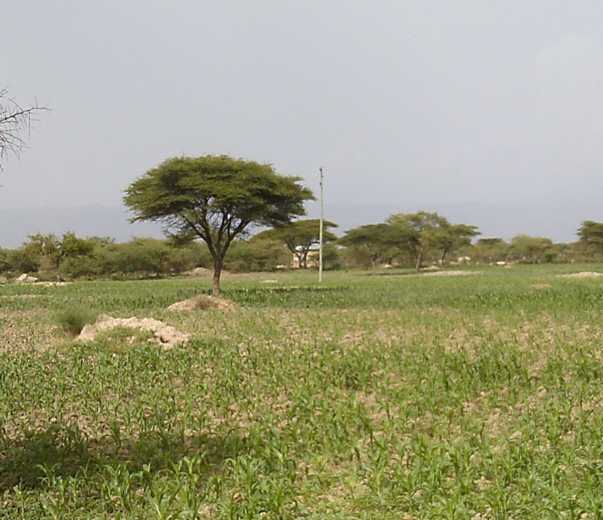

Slide 30
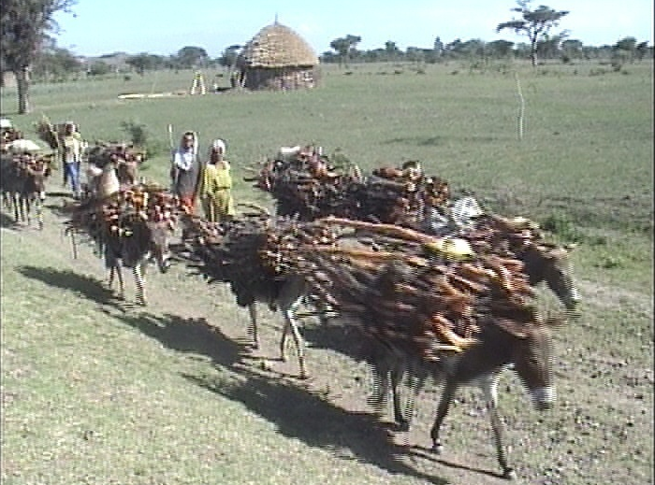
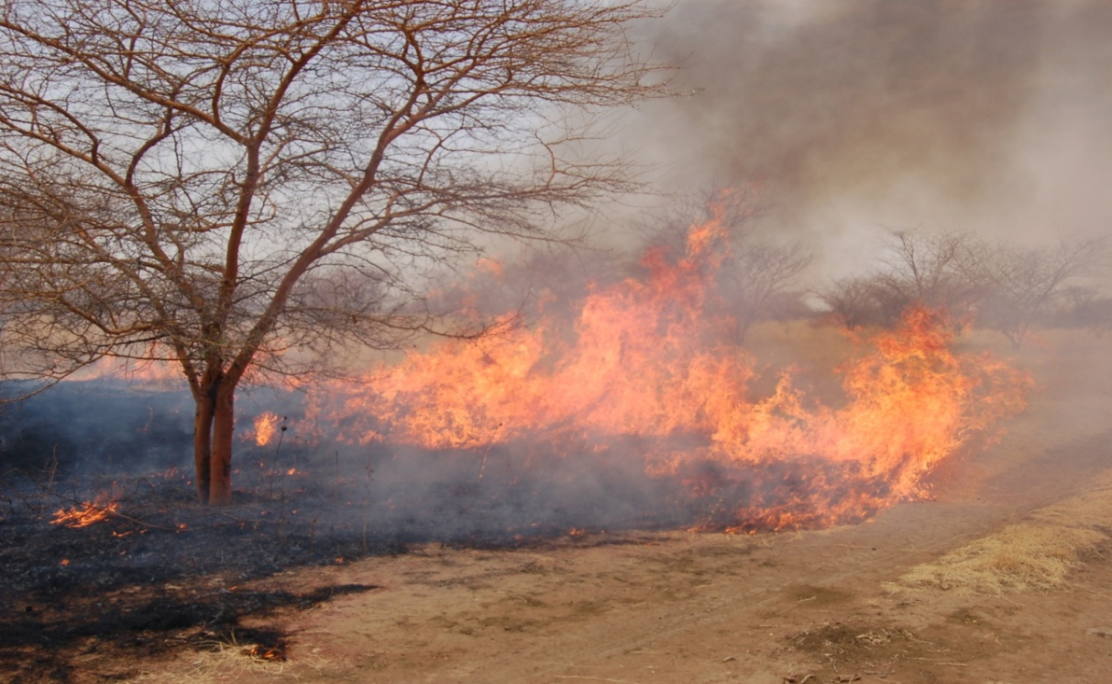

Slide 31
8.3. Poaching/Illegal hunting
Poaching has been defined as the illegal hunting, killing or capturing of wild animals.
Poaching is one of the most serious threats to the survival of animal populations.
It is considered to have a detrimental effect on biodiversity both within and outside protected areas as wildlife populations decline, species are depleted locally, and the functionality of ecosystems is disturbed.
Illegal trapping, poaching, and other demands for wildlife are a huge problem throughout the world.

Slide 32
Many species are sought for their use as valuable products.
Snakes are sought for their skins, elephants for their ivory tusks, rhino for their horn and birds for their feathers.
Wildlife are also trapped or taken from wild populations to be sold or bred in the pet trade.
The worldwide demand for pets and medicinal products drives the illegal trade of wildlife, especially rare species.
In many parts of the world, people kill wildlife for food or to protect their food source.

Slide 33
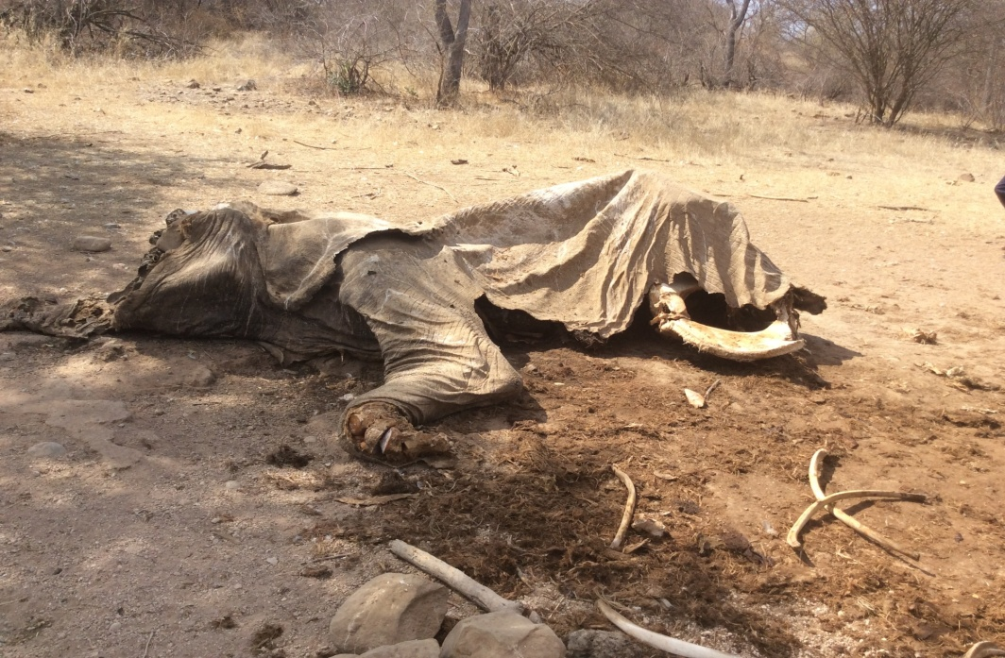
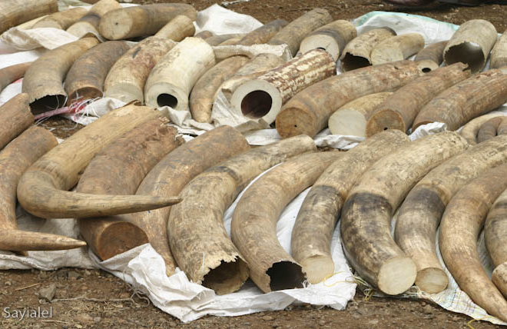

Slide 34
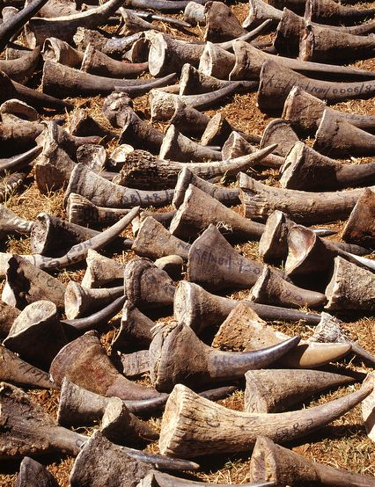
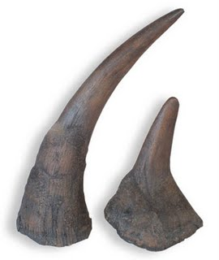

Slide 35
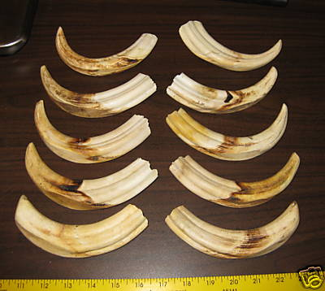

Slide 36
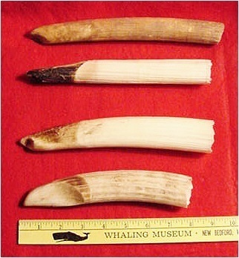
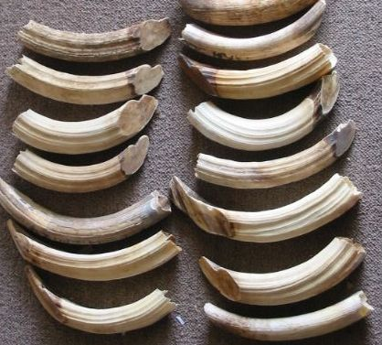

Slide 37
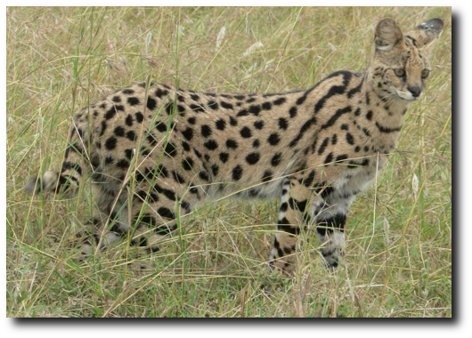
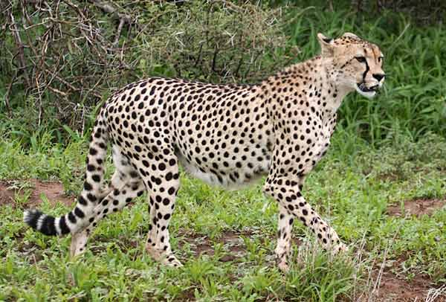
For their skin

Slide 39
8.4. Pollution
Pollution is man-made waste or by-products that are released into the environment.
Pollutants can change ecosystems and can have severe effects on people, wildlife and the natural environment.
Many organisms ingest or absorb harmful toxins that ultimately get passed along through the food chain. Persistent pollutants, like DDT, PCBs, and heavy metals bio-accumulate (are stored in fat) in predators.
All of the effects, especially over the long-term, are unknown. In many species bio-accumulation can be associated with reduced reproduction or death.
For example, the widespread and heavy use of persistent pesticides (DDT and DDE) in the 1950’s caused severe declines in many species of raptors.

Slide 40
At the time, the effects of DDT on wildlife and the environment were unknown.
It was quickly absorbed into soils and the environment and it was found to persist for a very long time.
It caused egg shells to thin by inhibiting the production of calcium, which reduced their rate of reproduction.
DDT is highly toxic to fish. It accumulates and gets concentrated through the food chain.
When they were consumed by fish-eating raptors the DDT contributed to their decline.
Since then, many pollutants have been banned in the U.S.; however, trace amounts are still found in many raptors and large fish.

Slide 41
Non-point source pollution can also have major impacts, but it is hard to measure because it comes from all across our landscape.
When the rain falls and washes our roads clean, for example, the runoff carries car oil, metals, sediment, trace toxins, and litter (and even heat) down the storm drains and into nearby streams and rivers.
It washes fertilizers, pesticides, pet waste and grass clippings from our lawns; farm fields give up soil, nutrients, and chemicals too.
Fish spawning habitat may become smothered with silt.
The extra nutrients and higher temperatures can cause oxygen-stealing blooms of algae and eutrophication in water bodies.

Slide 42
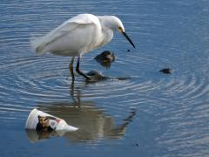
Even the road salt that helps keep us safe in winter will accumulate in wetlands, causing problems for amphibians, aquatic animals, and plants.
On the plus side, non-point source pollution is one threat we can all do something about, with a little care and education.
Litter and trash pollute many of our lakes, rivers, estuaries, and oceans.

Slide 43
Persistent marine debris, such as plastic bags and bottle caps, balloons, discarded fishing line, and medical waste threatens many forms of marine life.
Such items may snare drown, or restrict the movement of marine life or may be ingested and ultimately lead to the death of that animal.
Such debris may take several hundred years to break down, thereby threatening wildlife for many years.
Another form of pollution is noise pollution.
Whales’ primary means of communication, navigation, locating food, locating mates, and avoiding predators and other threats is through their sense of hearing, which is much more highly developed than that of humans.

Slide 44
Noise pollution created by ship traffic or offshore construction may negatively impact whales by disrupting their normal behavior.
Active sonar, such as that used by the Navy, also threatens marine mammals by disrupting navigation, foraging and communication abilities.
There have been instances of whale stranding and death caused by acoustic trauma.
This may be due to a fatal injury within the structure of the ear, or may result from the distressed animal surfacing too rapidly and developing nitrogen bubbles within their blood (decompression sickness).

Slide 45
8.5. Introduction of Exotic Species
Exotic species (invasive species) area species either accidentally or deliberately introduced by human actions in to places beyond its natural geographical range.
Exotic species are species that were introduced to North America that reduce biodiversity of native species.
Many exotics were accidentally introduced during the colonial times when many plants (from other continents) were used as packing materials on ships.
Exotic species can affect native populations of wildlife by displacing them or altering their habitat.
Most exotics are able to quickly adapt to our environment.

Slide 46
For example, house cats are not native and can have devastating effects on bird populations.
Surveys have shown that only 35% of the known 77 million pet cats are kept indoors (American Bird Conservancy).
Feral cats compete with native predators, reproduce quickly, and transmit disease.
It is estimated that hundreds of millions of birds and billions of small mammals are killed by feral cats each year (American Bird Conservancy).
Cats are opportunistic and kill a variety of birds.
Common birds like Cardinals and endangered birds like the Piping plover all can fall prey to feral cats.

Slide 47
8.6. Climate change
Climate Change or global warming is the overall increase in average temperatures on Earth.
The rate of warming has increased dramatically due to the increased outputs of greenhouse gases (particularly carbon dioxide) since the industrial revolution.
Its effects on wildlife are dramatic.
Entire populations will be effected.
Many species are already in jeopardy of becoming extinct, like the Polar bear.
Other species will have to adapt to a warmer planet.
It is believed that many ecosystems will shift north.

Slide 48
Climate change may also significantly alter the chemical balance of the seas, off-shore currents, and plankton distribution and abundance, thereby affecting migration routes of marine species and impacting the entire food web.

Slide 49
9. WILDLIFE-HUMAN CONFLICTS AND CONTROL METHODS
Vermin: Wild animals that cause damage to cultivated crops, livestock and human
Pest: Animals that cause harm directly or indirectly to mankind and his/her properties
9.1 Wildlife damages
Wildlife damages are negative values of wildlife to mankind.
A wildlife manager may be called upon to attend to such damages.
On the other hand, wildlife damage can be viewed as conflicts between wildlife and their environment.

Slide 50
Also we can say that damage is described as harm or injury that causes loss of value and they arise naturally or from man’s activities.
By the nature of damage, they are in many cases not quantified when presented by many publics.
In attending to wildlife damages, a wildlife manager, first and far most ought to assess them before instituting control measures.
In the other hand Wildlife conflicts are negative values of wildlife to mankind.
The conflicts arise from damage caused by wildlife and a wildlife manager may be called upon to attend to such damages.

Slide 51
On the other hand, wildlife damage can be viewed as conflicts between wildlife and their environment.
All in all there are evident that there is crisis looming the continent of Africa, as the relationship between wild animals and human being which otherwise could have been cordial is deteriorating as days go by.
Problem animals can be classified in to two.
I: Species that require large areas e.g. Elephants
II: Species that require small areas

Slide 52
9.2 Identification and Assessment of Wildlife Damage:
i) Identify the type of damage e.g. Crop raiding, fouling, infrastructure, predation, lose of human life
ii) Identify the animal causing damage: e.g. Elephants, Lions, Birds, Crocodiles, Baboons, Rodents
iii) Identify the time damage is caused: e.g. Day, Night, Year round
iv) Describe the magnitude of the damage –Full description on the state of the damage at its qualification

Slide 53
9.3 Forms of wildlife Damage/conflicts
Wildlife damages can be classified in different forms ranging from the type or kind of harm or injury caused to the system or organism affected.
The forms of damage described here are a mix of both the kind of harm/injury resulting from the wildlife, as well as the systems affected.
a. Crop Damage:
This is negative effect of wildlife on crops production.
The damage can either be from direct feeding to mechanical damage.
Mechanical damage include among others: trampling, debarking, and breaking the whole or part of plant.

Slide 54
Wild animals are responsible for crop damage in rural areas.
During foraging activities, wild animals also forage in villages around forests.
Crop damage by various species of primates, deer, wild boar, porcupine, elephants and birds are well known.
Poor farmers can not withstand such problems if their crop is raided by wild animals.
Small carnivores raid poultry farms; tigers and leopards lift cattle and other domestic animals in villages nearby forest areas.
Foresters experience wildlife damage to seeds and seedlings of crop species, or bark damage to growing trees.
Elephants and various species of artiodactyles have the behaviour of debarking trees to substitute their mineral requirements.

Slide 55
b. Predation on livestock
Predators (carnivores, birds of prey, crocodiles) preying livestock, man, and poultry
c. Injuries to human
Wild animals make direct or accidental attack to human leading to injuries (e.g. Buffalo and elephants) and/or loss of life.
d. Disease transmission:
Some wildlife species act as host of pathogenic parasites that can be transmitted to other animals.
In other extent wildlife species may accidentally be carriers of pathogens from one site to the other.

Slide 56
e. Pollution:
Wild animals especially birds pollute human habitations through fouling, noise etc.
f. Deformation of infrastructures:
Wild animals destroy and/or damage infrastructures such as houses, vessels, roads, communication media, utilities, households etc.
Summary Of Conflicts/Damages:

Slide 57
TYPE OF DAMAGE | MODE OF DAMAGE | DAMAGE CAUSED TO
1.. Crop raiding | Direct consumption Indirect damage e.g. trampling | Cash and food crops e.g. maize, wheat, sugar cane etc.
2. Livestock predation | Preying and killing | Domestic animals e.g. cows, goats etc.
3. Diseases transmission | Zoonotic (e.g. communicable) | Livestock and human beings
4. Injury/loss of life | Killing, injury or eating | Human beings
5. Destruction of infrastructure | Demolition Nesting Collisions | Buildings, Roads Vessels e.g aircrafts Communication equipment
6. Destruction of habitats | Debarking Uprooting | Ecosystem
7. Pollution | Noise Smell Fouling | Human beings Habitat

Slide 58
ANIMAL DAMAGE CONTROL METHODS
i) Biological control
Introduction of competitive exotics
Use decoy organisms
Habitat management –Buffer zone
Public education: Train peoples the effect of their activities e.g. feeling animals
ii) Mechanical Control
Barriers –Use of Canals, moats, ditches, fences, barbed wires, electrical, construction of trenches, wire strands, grating
Scaring method: models, alarm, chasing etc
Shooting and Trapping

Slide 59
iii) Chemical control
Poisoning, Repellents, Exploders, anti-fertility compounds, hormones

Slide 60
10. ETHIOPIAN WILDLIFE
10.1. History of wildlife development in Ethiopia
The conservation of Ethiopia’s unique biodiversity had a varied history.
The effort towards conservation had been for the first time started during the reign of Emperor Zerea Yacob (1434-1468) following the loss of forest covers on Wachacha Mountain near Addis Ababa.
This effort was resource-oriented tree planting activity that gave rise to the legal establishment of Menagasha forest in 1958, representing the oldest conservation areas in the continent and still existing today.

Slide 61
The first attempt of protecting wildlife was made by Emperor Menelik II.
The Emperor declared the first wildlife conservation law in 1909 to stop indiscriminate hunting of large mammals.
Because wildlife were considered as infinite sources of food and other materials, there had been severe damage especially of large mammals.
The law prohibited killing of wildlife, particularly elephants, without the permission of hunting authorities who were appointed by the Emperor.
But there was no responsible authority or institution regarding wildlife.

Slide 62
Eventually, the Ethiopian wildlife Conservation Authority (EWCA) was established pursuant to proclamation No. 581/2007.
Since its inception, EWCA has been dedicated on the active participation of the community surrounding the park and other protected areas for wildlife conservation.

Slide 63
10.2. Diversity of Ethiopia’s wildlife
Ethiopia is rich in biodiversity resources.
This made the country as one of the most biologically diverse countries of the world.
This believed to be as a result of large diversity of ecological conditions determined by topographic variation.
Most of the areas in the country are characterized by extensive highlands and contain the largest extent of Afro-alpine habitats in Africa.

Slide 64
No | Class | Number species | Number of Endemics species
1 | Mammals | 320 | 55
2 | Aves | 918 | 19
3 | Reptiles | 240 | 15
4 | Amphibians | 71 | 30
5 | Fishes | 180 | 40

Slide 65
10.3. Protected Wildlife Areas of Ethiopia
Ethiopia’s Protected Area System is larger than the global average, covering 14% of its landmass.
But there are still unique ecosystems that are not represented.
Currently, there are 8 reserves, 18 controlled hunting areas, 3 sanctuaries and 24 National Parks in the country.
Protected areas under the control of the federal government (EWCA) are 11 National Parks and 2 Sanctuaries.

Slide 66
Wildlife conservation areas in Ethiopia fall in to two groups:
Principal wildlife conservation areas: which include national parks and sanctuaries, are areas where conservation has been active for some time and where a certain degree of infustructure development has been reached.
Secondary wildlife conservation areas: which include wildlife reserves and controlled hunting areas, areas where no development activity has taken place, and where management has been limited to the control of activities by hunting companies.

Slide 67
1. NATIONAL PARKS
No | Name of the National parks | Location | Year established | Area In km2
1 | Awash | Oromiya & Afar(F) | 1958 | 756
2 | Simian Mountains | Amhara R. S(F) | 1959 | 412
3 | Alatish | Amhara R. S(F) | 1997 | 2666
4 | Bahir Dar Blue Nile river Millennium | Amhara R.S | 2008 | 4729
5 | Borena saynt | Amhara R.S | 2001 | 4325
6 | Bale Mountains | Oromiya R.S(F) | 1962 | 2200
7 | Abijata lakes | Oromiya R.S(F) | 1963 | 887
8 | Omo | S.N.N.P R.S(F) | 1959 | 3566
9 | Nech sar | S.N.N.P R.S(F) | 1966 | 514

Slide 68
10 | Mago | S.N.N.P R.S | 1974 | 1942
11 | Chebera Churchura | S.N.N.P R.S | 1997 | 1190
12 | Maze | S.N.N.P R.S | 1997 | 202
13 | Yangudi-rassa | Afar R.S(F) | 1969 | 4731
14 | Gambela | Gambela R.S(F) | 1966 | 5061
15 | Geraile | Somali R.S (F) | 1998 | 3558
16 | Dati Wolel | Oromia R.S | 1998 | 431
17 | Yabello | Oromia R.S | 1978 | 2500
18 | Gibe Sheleko | S.N.N.P R.S | 2001 | 248
19 | Loka Abaya | S.N.N.P R.S | 2001 | 500
20 | Kafeta Shiraro | Tigray R.S(F) | 1999 | 5000

Slide 69
21 | Bakusa | Amhara R.S (R) | 2000
22 | Borena/Yabelo | Oromia R.S (R) | 1978 | 1000
23 | Alidege | Oromia R.S & AfarR.S(F) | 2006 | 1099
24 | Bejmiz | Benishangul Gumz R.S | 2006 | 1685
Note: ‘ R.S ’ stands for Regional State. ‘ (F) ’ stands for Administering by Federal government

Slide 70
2. WILDLIFE SANCTUARIES
No | Name of the Sanctuaries | Location | Year established | Area In km2
1 | Babile elephant | Oromiya & Somali R.(F) | 1962 | 69873
2 | Senkele | Oromiya & S.N.N.P R.S(F) | 1964 | 54
3 | Deara | Oromiya R.S (R) | 1986 | 19.4

Slide 71
3. COMMUNITY CONSERVATION AREAS
No | Name of the Community Conservation areas | Location | Year of establishment (E.C) | Area In km2
1 | Simien Gibe | S.N.N.P R.S | 2001 | 49
2 | Garameba | S.N.N.P R.S | 2001 | 25
3 | Guassa | Amhara R.S |  | 78

