Slide 1

Welcome to the course
Chemical Engineering Equipment Design, CBEg 4201

Slide 2
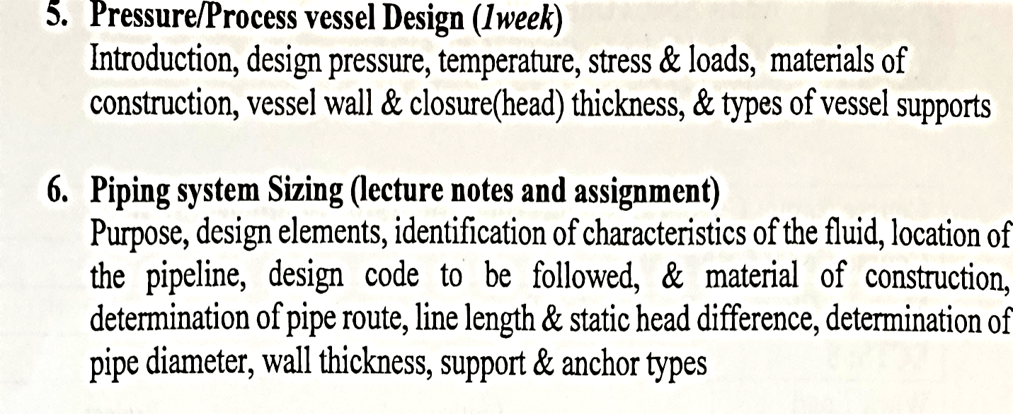
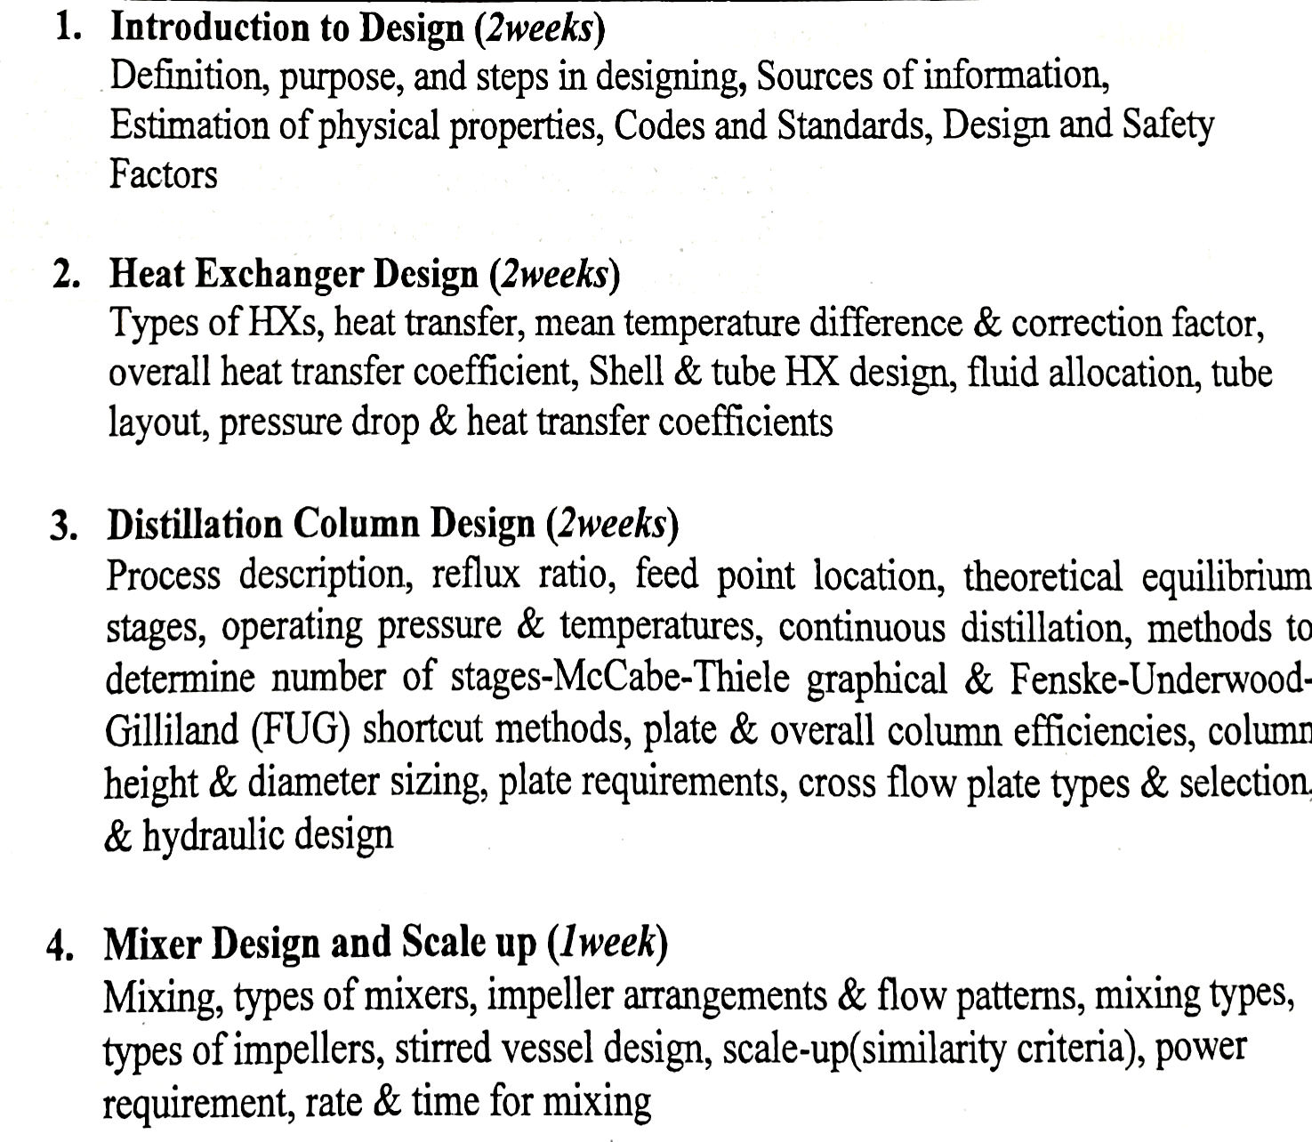
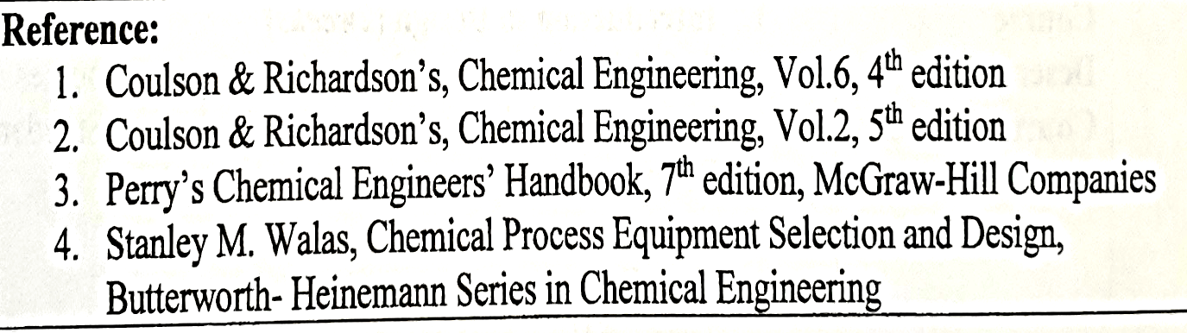
Course outline
Assessment weight | %
Project work | 50
Assignment | 15-20
Final exam | 30-35
Attendance | 80

Slide 3
Chapter one
Introduction to design
Lecture 1
© Kalid Hussien

Slide 4
What is design?
Design is a creative activity of synthesis and putting together of ideas to achieve a desired purpose in the presence of constraints.
The designer starts with a specific objective in mind, a need, and by developing and evaluating possible designs, arrives at what he/she considers the best way of achieving that objective
It is a process which passes into different stages before it is realized into existence.

Slide 5
What are the desired purposes/objectives?
It may be a better chair, a new bridge, a toilet seat paper ..
To produce a purchased raw material
To convert a waste by-product
To create a completely new material (synthetic fibers, food, bioprocessing)
To find a new way of producing an existing product ( anew catalyst)
To exploit a new technology (genetic engineering)
To exploit a new material of construction (high temperature or high pressure operation, specialty polymers)

Slide 6
The design process
Engineers are concerned with the application of technology to satisfy human needs
The essence of engineering is characterized by the design process, in which resources are transformed in the best way possible into needed devices or systems.
This transformation starts with the recognition of some need and progresses to the physical implementation which satisfies this need. The device or system which results may be simple or extremely complex

Slide 7
In general, Engineering design can be of two kinds.
  Something completely new may result
  or the design may produce an improved form of something already in existence
In outlining the design process, two approaches are possible
  One way is to look at the life cycle of the product itself from conception to retirement. This is usually referred to as the morphology of the design process
  The second method of describing the design process involves a detailed examination of the designer's actions as the person goes about identifying and solving his/her problem and it is called the anatomy of design

Slide 8
Morphology of design process
Needs analysis
Feasibility study
Preliminary design
Detailed design
Distribution
Consumption
Retirement

Slide 9
Anatomy of the design process
  Problem statement and needs formulation
  Information collection
  Modeling
  Value statement
  Synthesis of alternatives
  Analysis and testing
  Evaluation
  Decision
  Optimization
  Iteration
  Communication

Slide 10
Point of origin/clients for a design project
  The creation of a design begins with the recognition of a need
  This may occur in several ways
    It may be from observation
    Often they originate in a research labs of chemists, biochemists, and engineers who seek to satisfy the desires of customers for chemicals with improved properties for many applications
    The initial primitive statement of need may be merely an expression of opinion.
    When new markets are discovered
  Who would be potential customers
  …..

Slide 11
The needs analysis, concludes with a specification which provides the starting point for the feasibility study
Each case given below shows a primitive need statement (i), and a specification in shortened, qualitative form (ii).
1. (i) An airport is congested.
(ii) A rapid transit link is required to a nearby airport with specification of number of people to be carried in a given time, amount of freight and baggage in a given time, and speed of passage.
2. (i) A building must be comfortable to work in.
(ii) Heating, ventilation, and air conditioning are required. Specify permissible limits of temperature, humidity, velocity, and fresh air makeup.
3. (i) National fossil fuel supplies are running low.
(ii) Alternative forms of energy supply are required. Specify amount and where they are needed, and any restrictions of space, time, or

Slide 12
Needs Analysis and Refinement
Example 1
Problem: The community needs water. Define
(i) Community.
How large is it? Where is it located? How is the population distributed?
(ii) Needs.
Does everybody need it? Is it for washing? For drinking? For irrigation? For recreation? For display? How much is needed and for how long? Who will pay for it? When is it needed?
(iii) Water.
What kind of water?
In this way, one question leads to another until the problem has been completely formulated. Notice how the analysis involves the removal of uncertainty from the information supplied in the primitive statement

Slide 13
Needs Analysis …….
Example 2
Problem: Design a worldwide communications system?
Example 3
Problem: the factory needs heat transfer equipment?
Example 4
Problem: The fruit must be packaged/picked ?

Slide 14
Other examples
A Client asks you to design a tool for picking avocado from avocado tree with available materials.
A toilet seat paper
A substitution for imported shoe cream
What is the first thing you do?

Slide 15






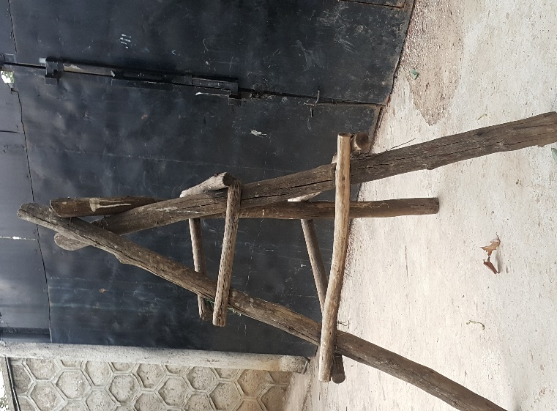

Slide 16
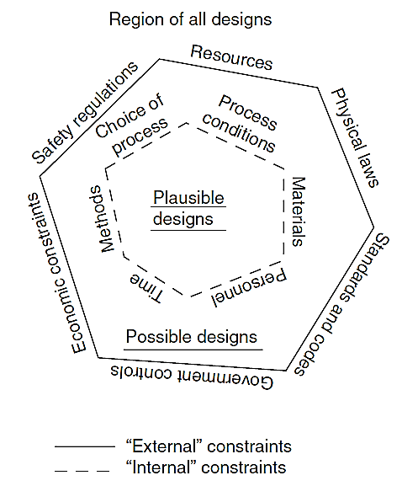
Design constraints
What did you see/understand from this figure ?

Slide 17
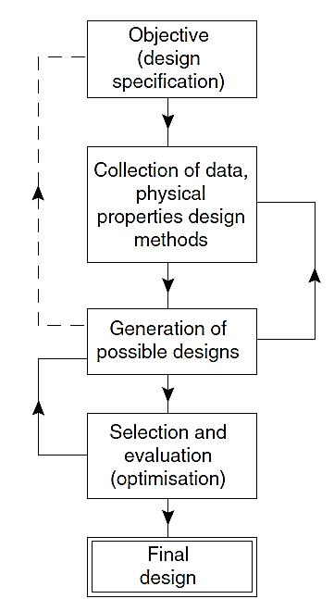
Design process

Slide 18
Chemical process equipment design
In a chemical plant many different process operations are performed,
  Mixing
  conveying
  Reaction
  separation: distillation, absorption, screening,….
  Heat transfer
Need and Criteria to design an equipment
must perform its intended function properly, must operate safely, must be an economic design, should operate with minimum maintenance and repair & with minimum operating costs and utilities requirements, usually required to operate satisfactorily under conditions of both increased and reduced capacity, must operate for the expected life of the plant, must be capable of construction and operation

Slide 19
What does a complete design include?
A complete design includes consideration of all aspects of the equipment specification for the item to be built and operated.
Mechanical design, construction material, fabrication requirements, operational details, safety features, versatility, economic considerations….
Complete design report must be prepared giving details of all relevant design calculations and the data used, and assumptions/restrictions inherent in the design method.
Full design specification sheet and detailed(scaled) engineering drawing are prepared with sufficient details, so the item can be costed and constructed accurately.

Slide 20

Tips
Get started anyway
Survey appropriate literature for useful background information and details of available design methods
Make necessary assumptions/estimates
Don’t expect the design method always to be completely rigorous, many designs are based upon empirical correlations and experience/rules of thumb
Design engineer must be updated with new design methods and improvements
Petrochemicals Notebook, Chemical Engineering Progress

Slide 21
Design Information and Data
Information on manufacturing processes, equipment parameters, materials of construction, costs and physical properties of process materials are needed at all stages of design.
The needed accuracy of the data depends on the:
  level of design
  reliability of the design method
  sensitivity to the particular property
Sources of Information on manufacturing processes:
Encyclopedia of Chemical Technology edited by Kirk and Othmer (2003),
Ullman’s Encyclopedia of Industrial Technology (2002)
Encyclopedia of manufacturing processes by McKetta (2001),
Shreve’s books later updated by Austin and Basta (1998),
Comyns lists of manufacturing processes with references (1993)
Too numerous specialized text books
Internet sources-university libraries
    http://www.thermopedia.com/
    http://vle-calc.com/

Slide 22
Sources of Physical Properties:
International Critical Tables - Chemical Abstracts
Engineering Sciences Data Unit - Engineering Index
Journal of Chemical Engineering Data
Engineering information
Sources of data on costs: cost indices
Process Engineering journal
Chemical Engineering journal, CPE plant cost index
Sources of data on materials of construction
handbooks, catalogues, national codes, manufacturers’ literature, Perry
Comprehensive review of materials used in CPI –book by Evans(1974)

Slide 23
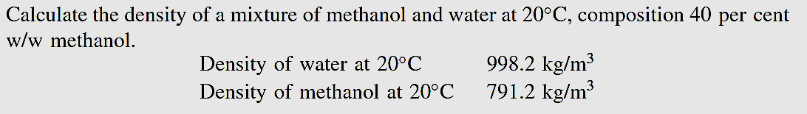
Estimation of Physical Properties
Different methods are available
Group Contribution
  https://checalc.com/solved/property_joback.html
Equation Oriented techniques
Examples
1. Density (liquid)

Slide 24
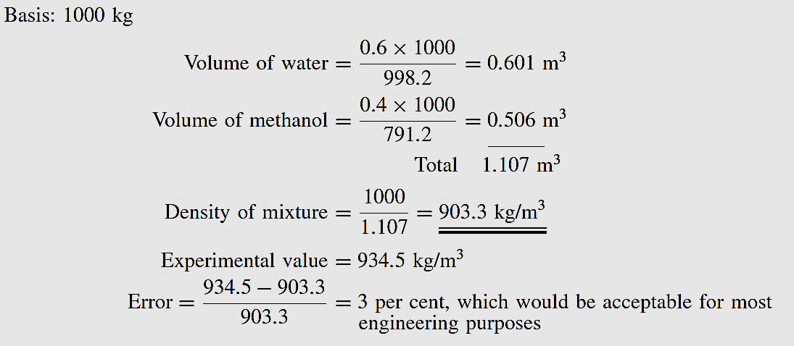
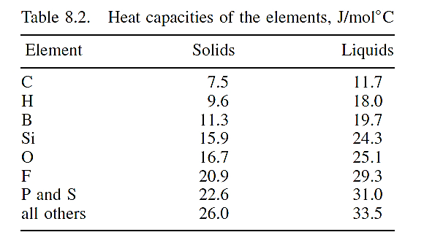
2. Specific heat capacity (Solid)

Slide 25
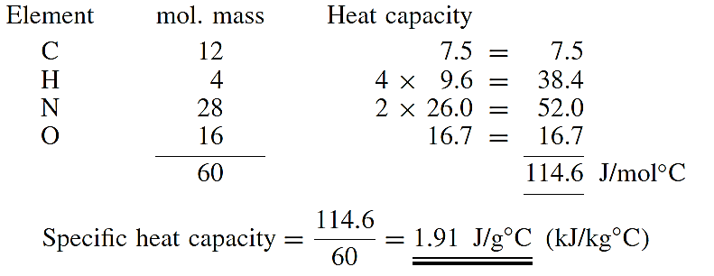
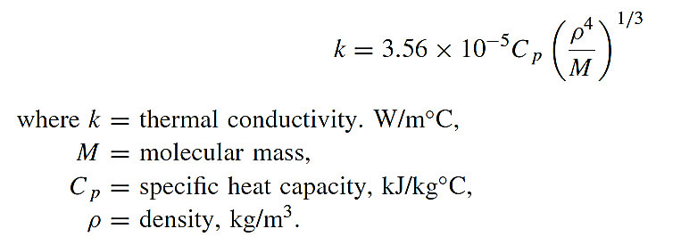
3. Thermal Conductivity (Weber equation for organic liquids)

Slide 26
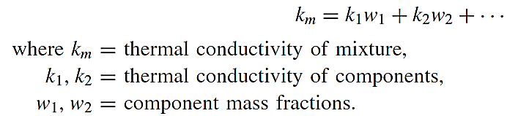
For mixtures made up of non-polar components (Bretsznajder Equation):
4. Phase Equilibrium Data (correlations for liquid phase activity coefficients, γ_{i})
Separation processes: transfer of components from one phase to another
Distillation : vapor-liquid
Absorption: gas-liquid
Extraction: liquid-liquid
Phase equilibria: theoretical limit of separation

Slide 27
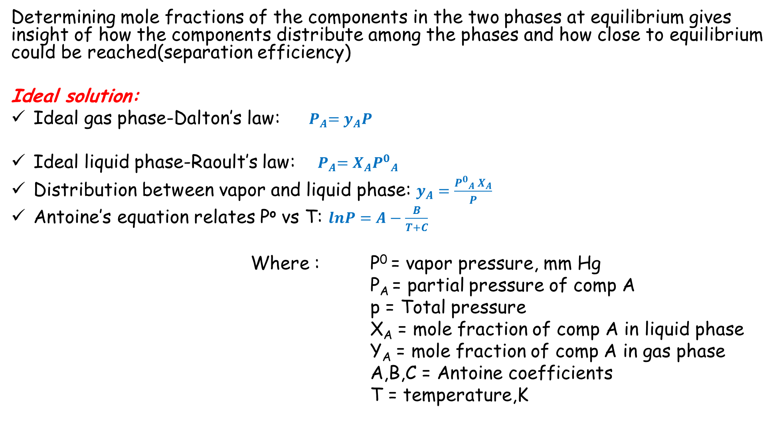
Determining mole fractions of the components in the two phases at equilibrium gives insight of how the components distribute among the phases and how close to equilibrium could be reached(separation efficiency)
Ideal solution:
Ideal gas phase-Dalton’s law: ${ P}_{A}=y_{A}P$
Ideal liquid phase-Raoult’s law: ${ P}_{A}=X_{A}{P^{0}}_{A}$
Distribution between vapor and liquid phase: $y_{A}=\frac{{P^{0}}_{A} X_{A}}{P}$
Antoine’s equation relates Pº vs T: $lnP=A−\frac{B}{T+C}$
Where : P⁰ = vapor pressure, mm Hg
P_{A} = partial pressure of comp A
p = Total pressure
X_{A} = mole fraction of comp A in liquid phase
Y_{A} = mole fraction of comp A in gas phase
A,B,C = Antoine coefficients
T = temperature,K

Slide 28

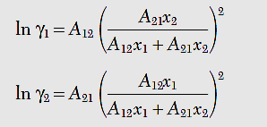

Non-ideal solution:
Raoult’s law with correction for non-ideal liquid phases:
$P_{A}=γ_{A}{P^{0}}_{A}X_{A}$P_{A}
Estimation of activity coefficients for a 2-component(binary) system:
1. Margules equation:
2. Van Laar equation:

Slide 29
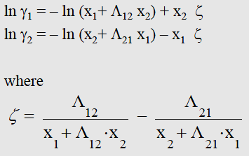
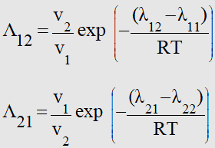
Wilson equation:
Parameter values are available through different databases and books
--J Gmehling, H. Onken, W. Arlt: Vapor-Liquid Equilibrium Data Collection, Dechema Chemistry Data Series, Frankfurt a/M.
www.ddbst.com/ddb.html
Perry chemical engineers handbook

Slide 30
Ex: A liquid mixture at a temperature of 50ºC consists of 60mol% methanol and the rest is water. Calculate the gas composition in equilibrium with the liquid using the Wilson equations. The gas phase may be considered ideal and at the same temperature as the liquid.
Antoine’s constants for log₁₀ , Pº (mmHg) & T (ºC)
Wilson parameters(cal/mol)
Component | Molar volume (ml/mol) | A | B | C | Temp. interval
Methanol(1) | 40.73 | 8.081 | 1582.3 | 239.73 | 25-56ºC
Water(2) | 18.07 | 8.0713 | 1730.6 | 233.43 | 1-100ºC
i | j | λij-λii
1 | 2 | 107.38
2 | 1 | 469.55

Slide 31
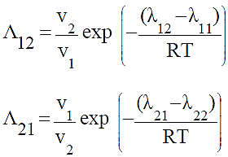

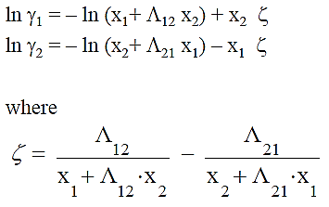
P_{A}= γ_{A}Pº_{A}x_{A}
Λ₁₂ = 0.375, Λ₂₁ = 1.084, ξ = -0.532,
γ₁ = 1.078, γ₂ = 1.31,
Pº₁ = 416.87, Pº₂ = 93.33
P₁ = 269.63, P₂ = 48.9
y₁ = 84.6%, y₂ = 15.4%

Slide 32
Assignment #1 Vapor-Liquid equilibrium(VLE)
Calculate the composition(mole fraction) of the vapor in equilibrium with a binary liquid mixture of acetone-water at 70ºC and with the following mole fractions of acetone x₁ =[0.1:0.1:0.9] using
Margules equation
Van Laar equation
Wilson equation
Plot the results in a diagram to compare the results.

Slide 33

Constants for molar volume calculation | Acetone(1) | Water(2)
Tc,deg k | 508.10 | 647.30
Pc, bar | 47.01 | 220.48
ω | 0.31 | 0.34
ZRA | 0.2477 | 0.2338
Antoine Equation Parameters (P in mmHg, T in °C)
Component | A | B | C | T_{min} | T_{max}
Acetone(1) | 7.6313 | 1566.69 | 273.419 | 57 | 205
water (2) | 8.07131 | 1730.63 | 233.426 | 1 | 100
Parameters for model equations
V = (RT_{c}/P_{c})Z_{RA} ^{[1 + (1-Tr)^(2/7)]}
Margules | Â₁₂ 1.5751 | Â₂₁ 0.8693
Van Laar | A ₁₂ 1.5916 | A ₂₁ 1.0074
Wilson | ʎ₁₂-ʎ₁₁(cal/mol) 344.33 | ʎ₂₁-ʎ₂₂(cal/mol) 1482.21

