Slide 1
Codes and standards
Chapter 1
Lecture 2
©Kalid Hussien

Slide 2
What is Standard?
A standard can be defined as a set of technical definitions and guidelines
“how to" instructions for designers and manufacturers.
They serve as a common language to defining quality and establishing safety criteria for the products.
Examples- ASTM, ISO, API, MSs, ES etc.

Slide 3
What is Code ?
A code is a standard that has been adopted by one or more governmental bodies and can been forced by law or
When it has been incorporated into a business contract
Requirements are mandatory only if said Code is law in your country
If not, Code will server as generally accepted guidelines for design, fabrication, construction and installation
    Examples- ASME Code , BS, DIN, IS e.t.c

Slide 4

milieu

Slide 5
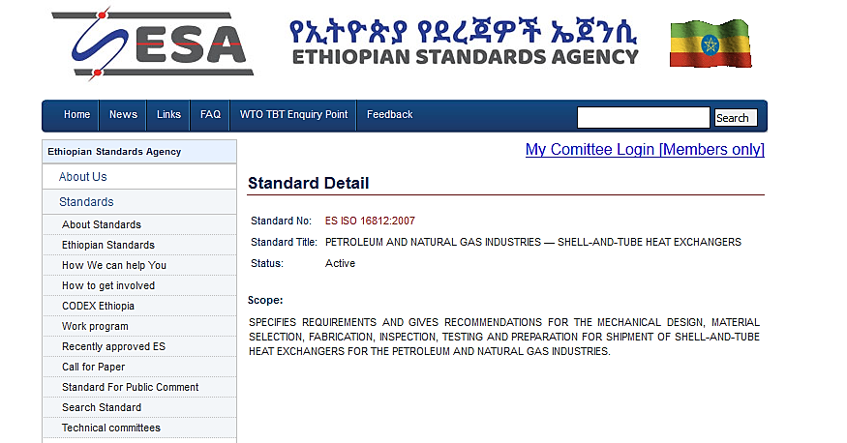

Slide 6
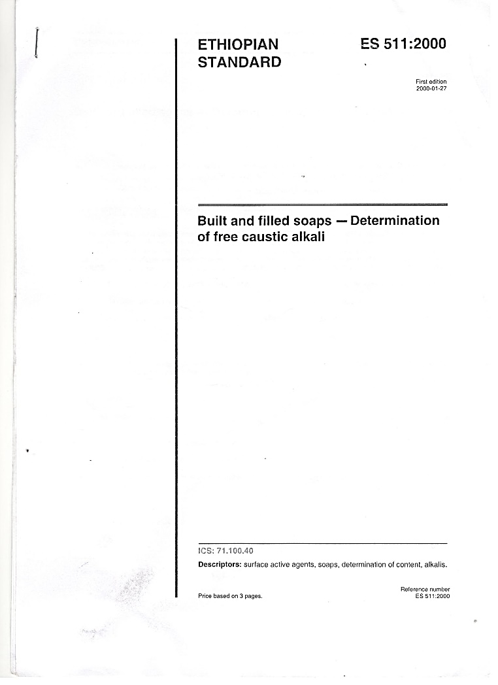
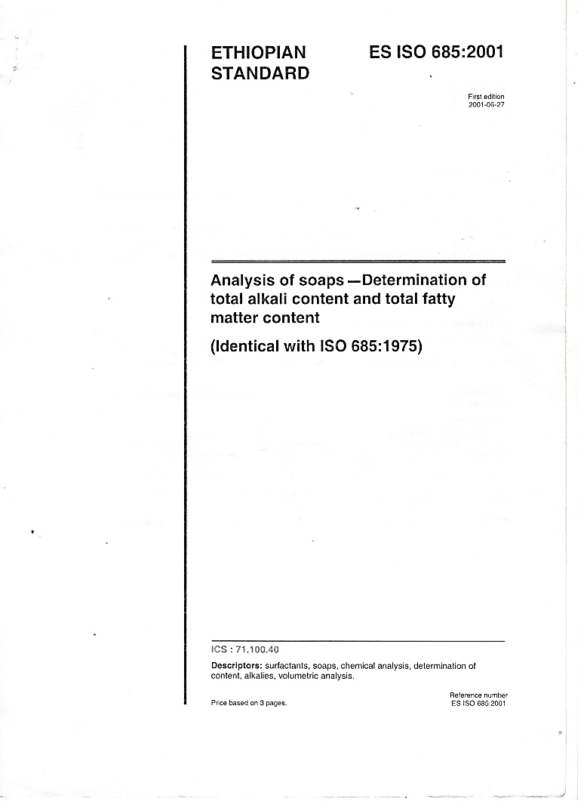
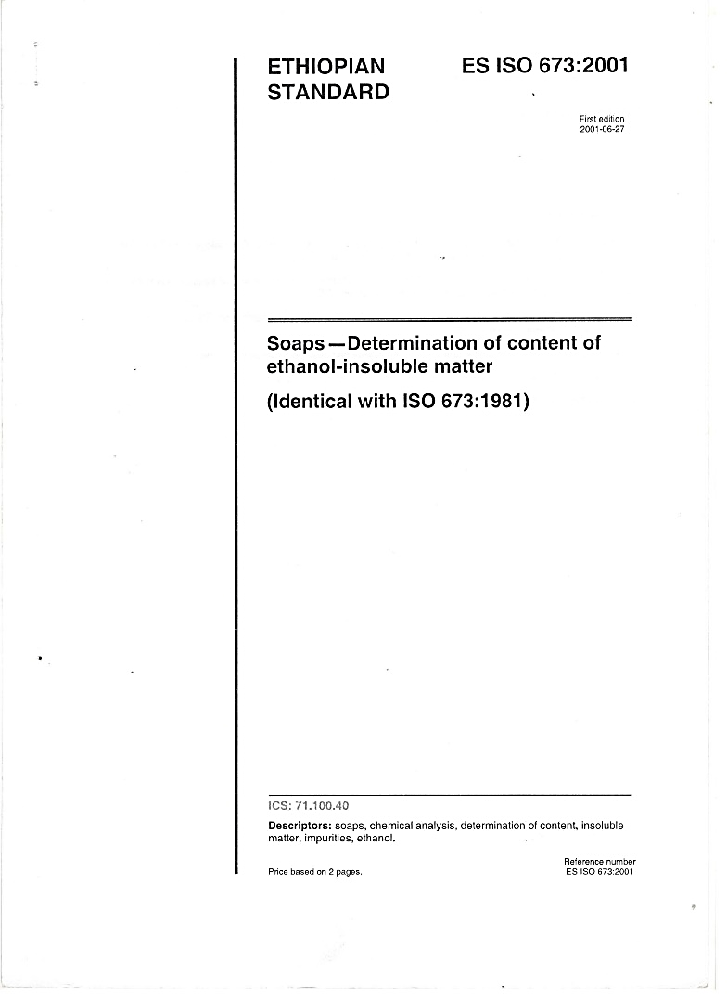
Examples of Ethiopian standards

Slide 7
Why Code is required ?
Provide a set of rules that specify the minimum acceptable level of safety &quality for manufactured, fabricated or constructed objects.
Also refer out to standards or specifications for specific details on additional requirements not specified in the Code itself.

Slide 8
Why Standard is required ?
Standards are documents that establish engineering or technical requirements for products, practices, methods or operations.
Build confidence about quality in users
Lower the cost of production as requirements are standardize

Slide 9
What is Specification ?
Specifications provide specific /additional requirements for materials, components or services beyond the code or standard requirements
Often generated by private companies to address additional requirements applicable to a specific product or application
Why Specification required?
  Allow purchaser to include special requirements as per design and service condition- Must meet requirements
        Examples- Product specification

Slide 10
Participants and contributor's in developing codes and standards
Consaltants
Operators
Designers
Codes and standards
Academia
Contractors
Regulatory agencies
Manufacturers
The committee continually meets to revise and update on advancement in the technology
Understanding and awareness on d/f codes and standards is created through seminar, workshop and other platforms

Slide 11
Code & Standard grouping
System Design Code
        -ASME B31 series (piping), ASME Section XIII (Boiler and Pressure Vessel)
Material Standard
    —ASTM, ASME Section II
Dimensional Standard
        —ASME B16 series (Standardization of Valves, Flanges, Fittings, and Gaskets)

Slide 12
System Design Code Covers
Requirements for materials
Types of Components
Design requirements
Fabrication, assembly, Installation requirements
Inspection and testing requirements

Slide 13
Material standard covers
Manufacturing process
Chemical Property
Mechanical Property
Heat treatment requirements
Mechanical testing requirements
Non-destructive Testing and inspection requirements

Slide 14
Material standard covers
Acceptable tolerance for imperfection
Defect repair and acceptance
Marking requirements
Supplementary requirements
General requirements

Slide 15
Dimension standard cover
Different standard for different components gives product specific requirements in general
Standard Sizes
Inside and outside diameters
Wall thickness (schedule no.)
Pressure Temperature ratings

Slide 16
Dimension standard cover
Bolting dimensions
Threading requirements
Gasket thickness & finishing requirements
End types for pipe
Permissible variance in dimensions

