Slide 1
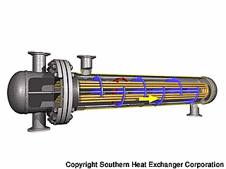
Heat Exchanger Design
Chapter two
Lecture 3

Slide 2
Applications of heat exchangers
Heat exchangers are practical devices used to transfer energy from one ﬂuid to another
To get fluid streams to the right temperature for the next process (reactions often require feeds at high temp).
To condense vapors
To evaporate liquids
To recover heat to use elsewhere
To reject low-grade heat
To drive a power cycle

Slide 3
Categories of heat exchangers
In general, industrial heat exchangers have been classified according to
Construction
    Tubular heat exchangers- (double pipe, shell and tube, coiled tube )
    Plate heat exchangers (PHEs)- (gasketed, brazed, welded)
    Extended surface heat exchangers- (tube-fin, plate-fin)
    Regenerators- (fixed matrix, rotary matrix)
Transfer processes
    Indirect contact type - (direct transfer type, storage type, fluidized bed)
    Direct contact type - (cooling towers)

Slide 4
Degrees of surface compactness
Flow arrangements
    Parallel flow
    Counter flow
    Cross flow
Pass arrangements
    single pass or
    multi pass
Phase of the process fluids
    Gas–Liquid
    Liquid–Liquid
    Gas–Gas
Heat transfer mechanisms
    single-phase
    two-phase

Slide 5
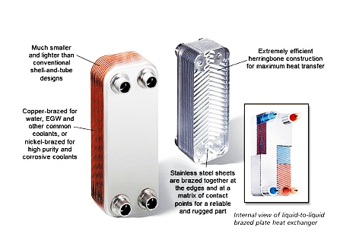
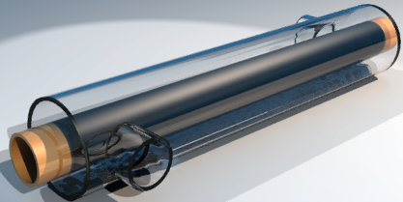
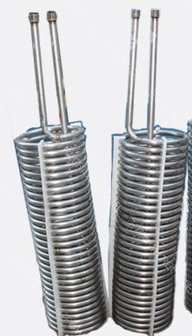
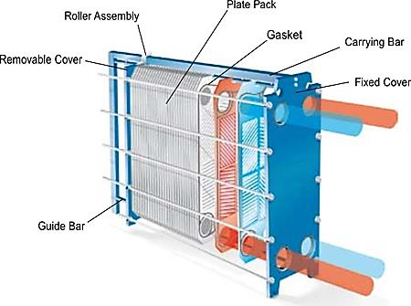
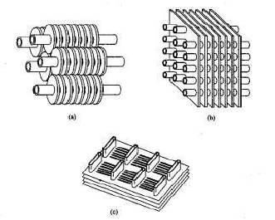

Slide 6
Shell and tube heat exchangers
Widely known and understood since it is the most common type
The configuration gives a large surface area in a small volume
Good mechanical layout a good shape for pressure operation
Uses well established fabrication techniques and design procedure
Most versatile in terms of types of service
Can be constructed from a wide range of material

Slide 7
  Fixed tube sheet
Advantage
It’s low cost b/c of simple construction
Tube can be cleaned mechanically after removal of the channel cover or head
Leakage of shell side is minimized since there is no flanged joints
Disadvantage
Since the bundle is fixed to the shell and cannot be removed the outside of the tube cannot be cleaned mechanically therefore it’s application is limited to clean service on the shell side

Slide 8
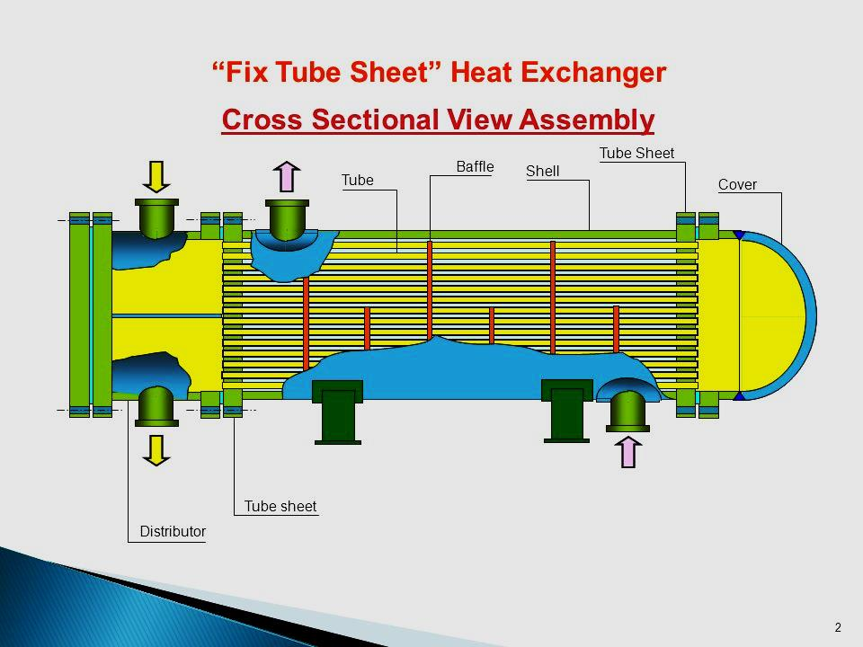
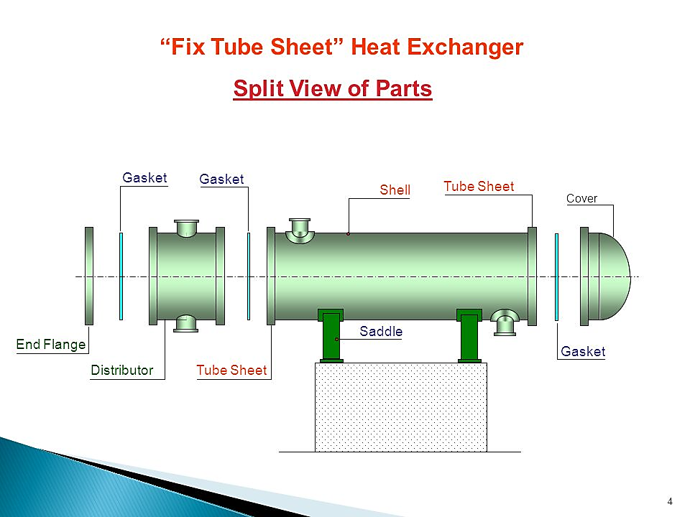

Slide 9
2) U-tube exchanger
The tubes in this exchangers are bent like a shape of U and there is only one tube sheet in a u – tube exchanger
Advantage
b/c one end is free the bundle can expand or contract in response to stress
Out side of the tube can be cleaned
disadvantage
Inside tube can not be cleaned effectively
It should not be used for service with dirty fluid inside tubes

Slide 10
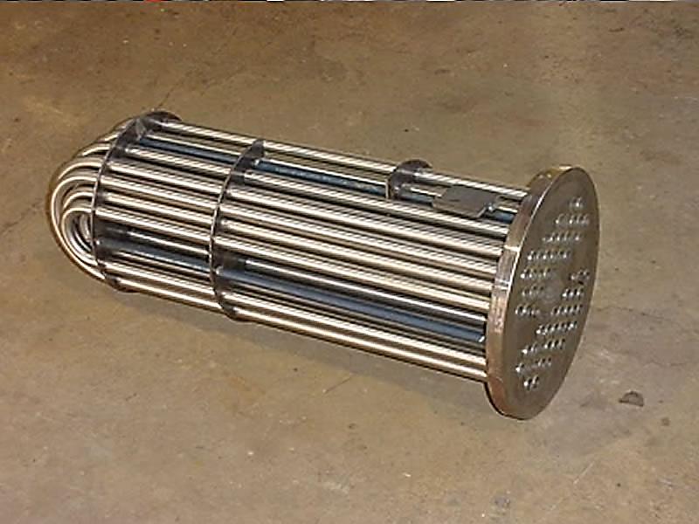
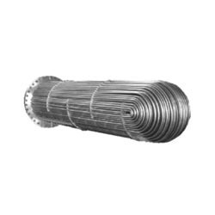

Slide 11
3) Floating head type
It is the most versatile type of STHE and also high price
One tube sheet is fixed relative to the shell and the other is free to float within the shell, this permits free expansion of the tube bundle as well as cleaning of both the inside and outside of the tubes
It can be used for service where both the shell side and the tube side fluids are dirty (e.g. in petroleum refinery)

Slide 12
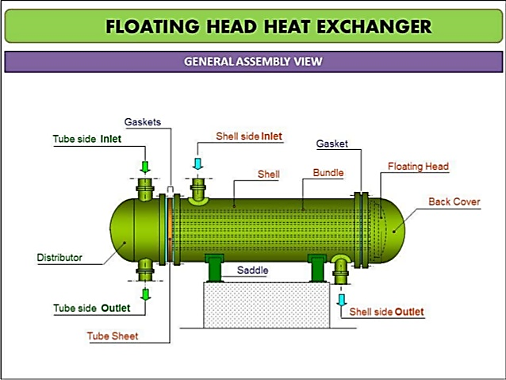

Slide 13
Components of STHE
Shell
Shell cover
Tubes
Channels
Channel cover
Tube sheet
Baffles
Nozzles
tie – rod and spacers
Pass partition plates
Impingement plates
Longitudinal baffle
Spacing strips
Supports
foundation

Slide 14
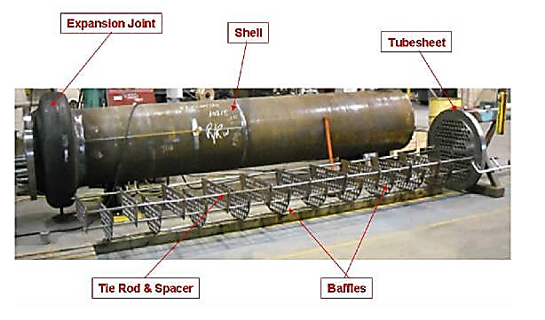
Component continue….

Slide 15
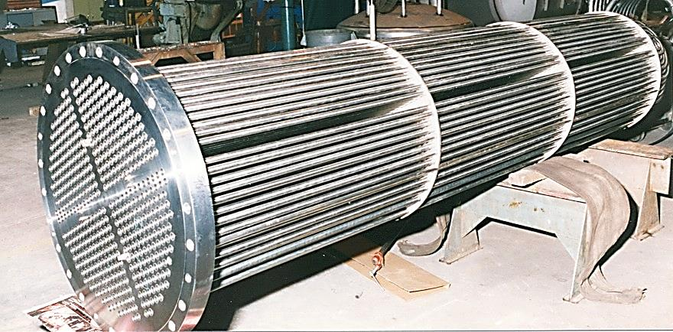

Slide 16
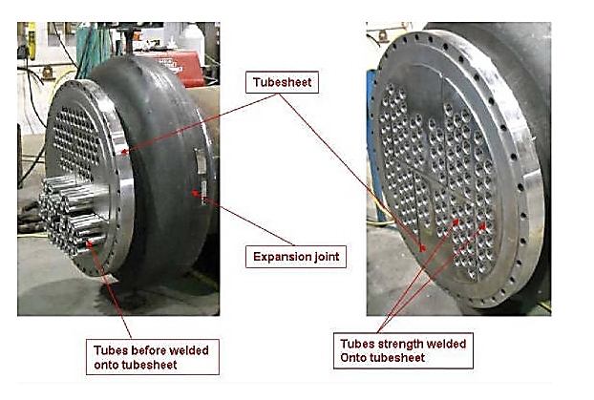

Slide 17
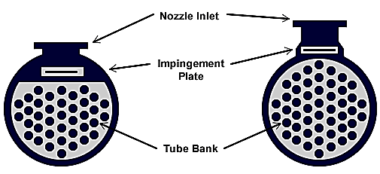

Slide 18
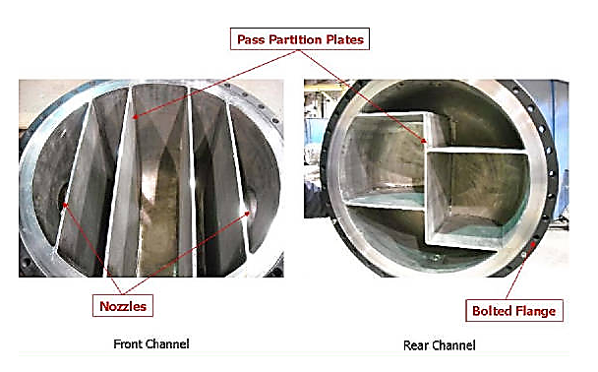

Slide 19
Components of STHE(TEMA standards)
A STHE is divided into three parts:
The front head, the shell, and the rear head.
Type and naming of the heat exchanger is designed by three letters
TEMA nomenclature for the various construction possibilities
The TEMA (tubular exchanger manufacturers association) standards covers three classes of exchangers
  Class R:- covers exchangers for generally Sevier duties of petroleum related industries
  Class C:- covers exchangers for moderate duties in commercial & general purpose applications
  Class B:- covers exchangers for use in the chemical process industries
The first letter describes the stationary head type [A,B,C,D,N]
The second letter refers to the shell type [E,F,G,H,J,K,X]
The third letter shows the rear head type [L,M,N,P,S,T,U,W]
Example : TYPE AES refers to Split-ring floating head exchanger with removable channel and cover

Slide 20
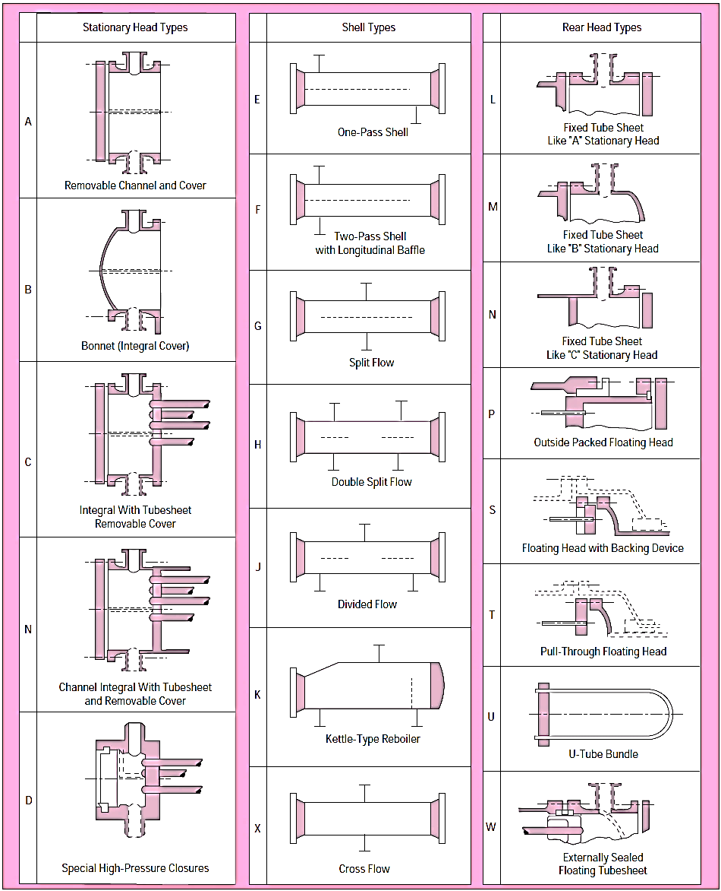

Slide 22
Shell
Shell is the container for the shell fluid and the tube bundle is placed inside the shell.
Shell diameter should be selected in such a way to give a close fit of the tube bundle.
The clearance between the tube bundle and inner shell wall depends on the type of exchanger
Shells are usually fabricated from standard steel pipe with satisfactory corrosion allowance.
The shell thickness of 9.5mm for the shell ID of 305-610 mm can be satisfactorily used up to 2070 kpa of operating pressure

Slide 23
Tube
The most efficient condition for heat transfer is to have the maximum number of tubes in the shell to increase turbulence.
The tube thickness should be enough to withstand the internal pressure along with the adequate corrosion allowance.
The tube length of 1.8, 2.4, 3.6, 4.8, 6.1 and 7.3 meter are preferably used.
Longer tube reduces shell diameter at the expense of higher shell pressure drop.
Stainless steel, admiralty brass, copper, bronze and alloys of copper-nickel are the commonly used tube materials

Slide 24
Tube pitch, tube-layout and tube-count
Tube pitch is the shortest center to center distance between the adjacent tubes.
The tubes are generally placed in square or triangular patterns (pitch)
The number of tubes that can be accommodated in a given shell ID is called tube count.
The tube count depends on the factors like shell ID, OD of tube, tube pitch, tube layout, number of tube passes, type of heat exchanger and design pressure.

Slide 25
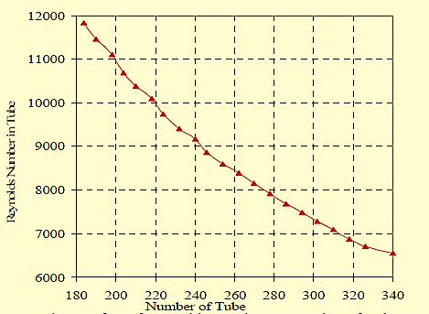
Number of Tubes Vs Reynolds Number
Reynold No
No of tubes

Slide 26
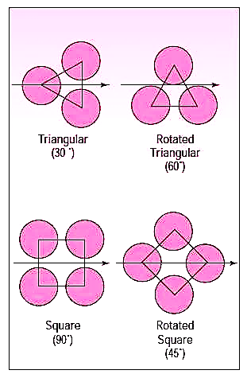
Tube arrangement
Triangular
Square
Rotated triangular and
square arrangement

Slide 27
Tube passes
A pass is when liquid flows all the way across from one end to the other of the exchanger.
The number of passes is chosen to get the required tube side fluid velocity to obtain greater heat transfer co-efficient and also to reduce scale formation
An exchanger with one shell pass and two tube passes is a 1-2 exchanger.
The tube passes vary from 1 to 16. The tube passes of 1, 2 and 4 are common in application
The partition built into exchanger head known as partition plate (also called pass partition) is used to direct the tube side flow

Slide 28
Tube pass …….
At any time halve the number of tubes present in a shell will handle the entire flow.
A large number of tube passes are used to increase the tube side fluid velocity and heat transfer coefficient and minimize fouling.
This can only be done when there is enough pumping power since the increased velocity and additional turns increases the pressure drop significantly.

Slide 29
Tube Outside Diameter
From the heat transfer viewpoint, smaller-diameter tubes yield higher heat transfer coefficients and result in a more compact exchanger.
However, larger-diameter tubes are easier to clean and more rugged.
For mechanical cleaning, the smallest practical size is 19.05 mm.
For chemical cleaning, smaller sizes can be used.
Small tube diameters (8 to 15mm) are preferred for greater area to volume density but are limited for the purposes of cleaning.
Large tube diameters are often required for condensers and boilers.
The most common plain tube sizes have 15.88,19.05, and 25.40 mm tube outside diameters.

Slide 30
Tube length
Tube length affects the cost and operation of heat exchangers.
Longer the tube length (for any given surface area), Fewer tubes are needed, requiring less complicated header plate with fewer holes drilled.
Shell diameter decreases resulting in lower cost.
Mechanical cleaning is limited to tubes 6 meter and shorter, although standard exchangers can be built with tubes up to 12.2 meter.
Shell-diameter-to-tube-length ratio should be within limits of 1/5 to 1/15
Maximum tube length is dictated by
  Architectural layouts
  Transportation (to about 30m.)
  Structural stability

Slide 31
Tube Length ………….
Thermal expansion of tubes needs to be taken into account for heat exchangers operating at elevated temperatures.
Tube elongation due to thermal expansion causes:
  Header plate deformation
  Shell wall deformation near the header plate
Fatigue strength of the tube, header plate and shell joint needs to be considered when using
  Longer tubes
  High operating tube side temperatures
  Cyclic thermal loads

Slide 32
Baffles
Baffles are used to increase the fluid velocity by diverting the flow across the tube bundle to obtain higher transfer coefficient
The distance between adjacent baffles is called baffle-spacing
The baffle spacing of 0.2 to 1 times of the inside shell diameter is commonly used
Baffles are held in positioned by means of baffle spacers
Closer baffle spacing gives greater transfer coefficient by inducing higher turbulence
The pressure drop is more with closer baffle spacing.

Slide 33
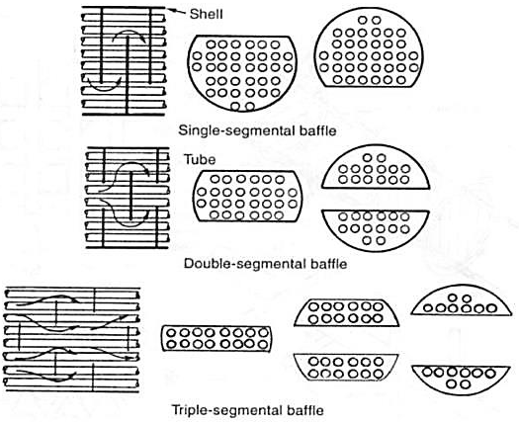
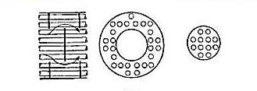
Baffle types

Slide 34
Fluid allocation in STHE
Factor | Tube-side | Shell-side
Corrosion | More corrosive fluid | Less corrosive fluids
Fouling | Fluids with high fouling and scaling | Low fouling and scaling
Fluid temperature | High temperature | Low temperature
Operating pressure | Fluids with low pressure drop | Fluids with high pressure drop
Viscosity | Less viscous fluid | More viscous fluid
Stream flow rate | High flow rate | Low flow rate

Slide 35
Heat exchanger selection criteria
Application/service fluid
Operating pressures & temperatures
Fouling characteristics of the fluids
Available utilities
Temperature driving force
Plot plan & layout constraints
Accessibility for cleaning and maintenance

Slide 36
Selection continue …
Considerations for future expansions
Mechanical considerations such as:
  material of construction
  thermal stresses (during startup, shutdown; process upset and clean out conditions)
  impingement protection
Total cost of the equipment which includes
  Purchase cost
  Installation cost
  Operating cost
  Maintenance cost

Slide 37
Choice of heat exchanger type for intended applications
Application | Remark
Low viscosity fluid | For high temperature/pressure, use STHE or double-pipe heat exchangers. Use PHE or LHE for low temperature/pressure applications.
Low viscosity fluid to steam | Use STHE in carbon steel
Medium viscosity fluid | Use PHE or with high solid content, use SPHE.
High viscosity | PHE offers the advantages of good flow distribution. For viscosities, the SPHE is preferred
fluid Fouling liquids | Use STHE with removable tube bundle, SPHE or PHE is preferred due to good flow distribution. Use PHE is easy access is of importance
Slurries-suspensions and pulps | SPHE offers the best characteristics. Also consider free flow PHE or wider gap PHE. Or scraped surface heat exchangers
Heat sensitive liquid | PHE fulfills the requirement best. Also consider SPHE
Cooling with air | Extended surface types like tube- fin heat exchangers or PFHE
Gas or air under pressure | Use STHE with Extended surface on the gas side brazed plate heat exchangers made of stainless steel or nickel alloy
Cryogenic application | Brazed aluminum plate-fin exchangers. coiled tube exchangers or PCHE
Vapor condensation | Surface condensers or STHE in carbon steel are preferred also consider SPHE or brazed plate heat exchangers
Vapor/gas partial condensation | Choose SPHE
Refrigeration and air conditioning application | Finned tube heat exchangers, special type of PHEs, brazed PHE up to 200 ⁰C
Air-Air or Gas-Gas application | Regenerators and plate-fin heat exchangers. Also consider STHE.
Vicious products, aseptic products, jam, food and meat processing, heat sensitive products and particulate laden products | Scraped surface heat exchangers
Note: STHE, shell and tube heat exchangers: PHE, Gasketed plate heat exchangers; SPHE, spiral plate heat exchangers: LHE, lamella heat exchangers; PCHE, printed circuit heat exchangers: CTHE, coiled tube heat exchangers: PFHE, plate fin heat exchangers

Slide 38
Requirement of heat exchangers
High thermal effectiveness
Pressure drop as low as possible
High quality products and safe operation
Material compatibility with process fluids
Convenient size, easy for installation, reliable in use
Easy for maintenance and serving
Light in weight but strong in construction to withstand the operational
and vibrations especially heat exchangers for military applications
Simplicity of manufacture
Low cost
Possibility of effecting repair to maintenance problems

Slide 39
Thermal Design Considerations
The primary inputs of thermal design of heat exchangers
  The flow rates of both hot and cold streams
  their terminal temperatures
  and fluid properties

Slide 40
Thermal Design Considerations ……….
Thermal design of a shell and tube heat exchanger typically includes
  determination of heat transfer area
  number of tubes
  tube length and diameter
  tube layout
  number of shell and tube passes
  type of heat exchanger (fixed tube sheet, removable tube bundle etc)
  tube pitch
  number of baffles, its type and size
  shell and tube side pressure drop etc.

Slide 41
General design consideration
Kern’s Method
        This method was based on experimental work on commercial exchangers with standard tolerances and will give a reasonably satisfactory prediction of the heat-transfer coefficient for standard designs.
Bell’s method
        This method is designed to predict the local heat transfer coefficient and pressure drop by incorporating the effect of leak and by-passing inside the shell and also can be used to investigate the effect of constructional tolerance and the use of seal strip

Slide 42
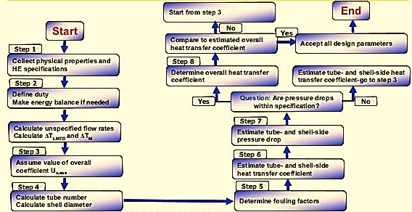
Kern’s Method

Slide 43
Major Steps in Design
Initial Decisions.
Tube side Thermal Analysis.
Thermal analysis for Shell side flow.
Overall Heat Transfer coefficient.
Hydraulic Analysis of Tube side.
Hydraulic Analysis of Shell side.
Spatial allocation of fluid.
Determination of flow velocity.
Initial guess for number of tubes.
Correction for standard tube diameter.
Effect of number of tubes on tube length….

Slide 45
Optimum heat exchanger design
Many of the considerations that enter into selecting the optimum exchanger are often difficult to evaluate quantitatively.
Such considerations, for example, might involve
    Heat sensitivity of the material being handled,
    Fouling characteristics as functions of the surface temperature and fluid velocity.
Other considerations might involve factors unrelated to performance of the unit itself, such as
    Ease of cleaning and maintenance,
    Complexity of fabrication
    Layout and available space

Slide 46
The optimum piece of heat transfer equipment for a given job can be selected only after considering initial costs, operating cost, available utilities, and maintenance costs.
The two process variables that have the greatest effect on the size (cost) of a heat exchanger are the allowable pressure drops of streams and the mean temperature difference between the two streams.
Other important variables include
    physical properties of the streams
    location of fluids in an exchanger
    piping arrangement of the fluids

Slide 47
Pressure drop
Selection of optimum pressure drops involves consideration of the overall process.
  higher pressure drops result in smaller exchangers, investment savings are realized only at the expense of operating costs.
  Only by considering the relationship between operating costs and investment can the most economical pressure drop be determined.
Reasonable pressure drops for various pressure levels are listed below. Designs for smaller pressure drops are often uneconomical because of the large surface area (investment) required.
Pressure Level | Reasonable P
Subatmospheric | I/10 absolute pressure
6.9 to 69 kpa gauge | 1/2 operating gauge-pressure
69kpa gauge and higher | 34.5kpa or higher

Slide 48
In some instances, velocities of 3.04 to 4.5 m/sec help to reduce fouling, but at such velocities the pressure drop may have to be from 69 to 207 Kpa.
For shell-and-tube and air-cooled exchangers pressure drop vanes with the flow as below:
1. Shell side
a. Turbulent flow (Re> 300)
Pressure drop proportional to 2.0 power of flow
b. Laminar flow (Re <300)
Pressure drop proportional to 1.0 power of flow
2. Tube side
a. Turbulent flow (Re> 2100)
Pressure drop proportional to 1.8 power of flow
b. Laminar flow (Re <2100)
Pressure drop proportional to 1.0 power of flow

Slide 49
Mean temperature difference
Process-fluid inlet and outlet temperatures and utility fluid-temperature levels are usually selected in the early stages of a process design.
consideration should be given to the effect of mean temperature difference on heat-exchanger investment because the temperature level of the heat-transfer-medium has a great effect on the heat-transfer area required.
Although there are no specific rules for determining the best temperature approach, the following recommendations are made regarding terminal temperature differences for various types of heat exchangers

Slide 50
The greater temperature difference should be at least 10 ⁰C.
The lesser temperature difference should be at least 5 ⁰C. When heat is being exchanged between two process streams, the lesser temperature difference should be at least 10 ⁰C.
In cooling a process stream with water, the outlet-water temperature should not exceed the outlet process-stream temperature if a single body having one shell pass—but more than one tube pass—is used.
When cooling or condensing a fluid, the inlet coolant temperature should not be less than 5 ⁰C above the freezing point of the highest freezing component of the fluid.

Slide 51
For cooling reactors, a reactor stability study should determine the maximum allowable temperature difference between reaction and coolant to permit control of the reaction. A temperature difference of 10 to 15 ⁰C is common.
A 20 ⁰C approach to the design air-temperature is the minimum for air-cooled exchangers. Economic justification of units with smaller approaches requires careful study.
When condensing in the presence of inert, the outlet coolant temperature should be at least 5⁰C below the dew point of the process streams.

Slide 52
Flow arrangement
There is a distinct thermal advantage to counter flow, except when one fluid is isothermal.
In co-current flow the hot fluid cannot be cooled below the cold-fluid outlet temperature; thus, the ability of co-current flow to recover heat is limited.
Co-current flow works better, as when
  cooling viscous fluids, because a higher heat-transfer coefficient maybe obtained.
  there is a possibility that the temperature of the warmer fluid may reach its freezing point.

Slide 53
Location of fluid
To determine which should be the shell side and which the tube side fluid consider these factors:
Corrosion. Fewer costly alloy or clad components are needed if the corrosive fluid is inside the tubes.
Fouling. This can be minimized by placing the fouling fluid in the tubes to allow better velocity control; increased velocities tend to reduce fouling. Straight tubes can be physically cleaned without removing the tube bundle; chemical cleaning can usually be done better on the tube- side. Finned tubes on square pitch sometimes are easier to clean physically; chemical cleaning is usually not as effective on the shell side because of bypassing.
Temperature. For high-temperature services requiring expensive alloy materials, fewer alloy components are needed when the hot fluid is placed on the tube side.

Slide 54
Pressure. Placing a high-pressure stream in the tubes will require fewer (more costly) high-pressure components.
Pressure drop. For the same pressure drop, higher heat-transfer coefficients are obtained on the tube side. A fluid with a low allowable pressure drop should generally be placed on the tube side.
Viscosity. Higher heat-transfer rates are generally obtained by placing a viscous fluid on the shell side.
Toxic and lethal fluids. Generally, the toxic fluid should he placed on the tube side with tubes welded to the tube sheet to minimize the possibility of leakage. ASME (American Society of Mechanical Engineers) code requirements for lethal service must be followed.
Flow rate. Placing the fluid with the lower flow rate on the shell side usually results in a more economical design. Turbulence exists on the shell side at much lower velocities than on the tube side.

