Slide 1
Chapter Three
Distillation column design
©Solomon bogale

Slide 2
Introduction
DISTILLATION PROCESSES
Distillation is the process of converting liquid into its vapours by heating and reconverting it again into liquid by condensing the vapours. It is method of separating substances which differ in their vapour pressures(relative volatility).
The distillation process is carried out in an apparatus which consists of
Still, in which volatile material is boiled.
(b) Condenser, in which vapours are condensed.
(c) Receiver, in which distillate is collected.

Slide 3
TYPES OF DISTILLATION PROCESSES
The following are the various types of distillations:
Simple distillation
Distillation under reduced pressure
Fractional distillation
Steam distillation
Destructive distillation

Slide 4
TYPES OF DISTILLATION COLUMNS
Batch and Continuous Columns
One way of classifying distillation column type is to look at how they are operated. Thus we have: batch and continuous columns.
Batch Columns
In batch operation, the feed to the column is introduced batch-wise. That is, the column is charged with a 'batch' and then the distillation process is carried out. When the desired task is achieved, a next batch of feed is introduced.
Continuous Columns
In contrast, continuous columns process a continuous feed stream. No interruptions occur unless there is a problem with the column or surrounding process units. They are capable of handling high throughputs and are the most common of the two types. We shall concentrate only on this class of columns.

Slide 5
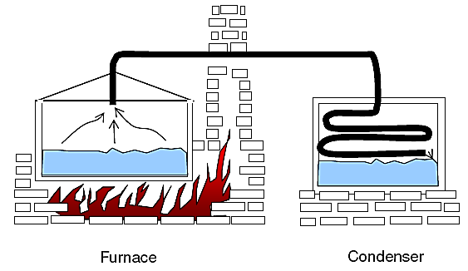
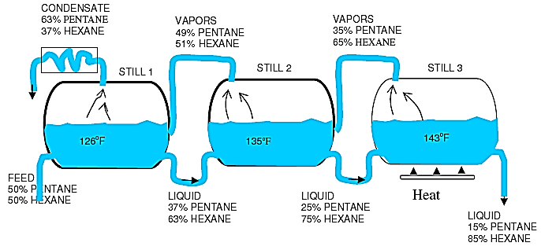
Still Distillation in Series
Batch Still Distillation Process

Slide 6
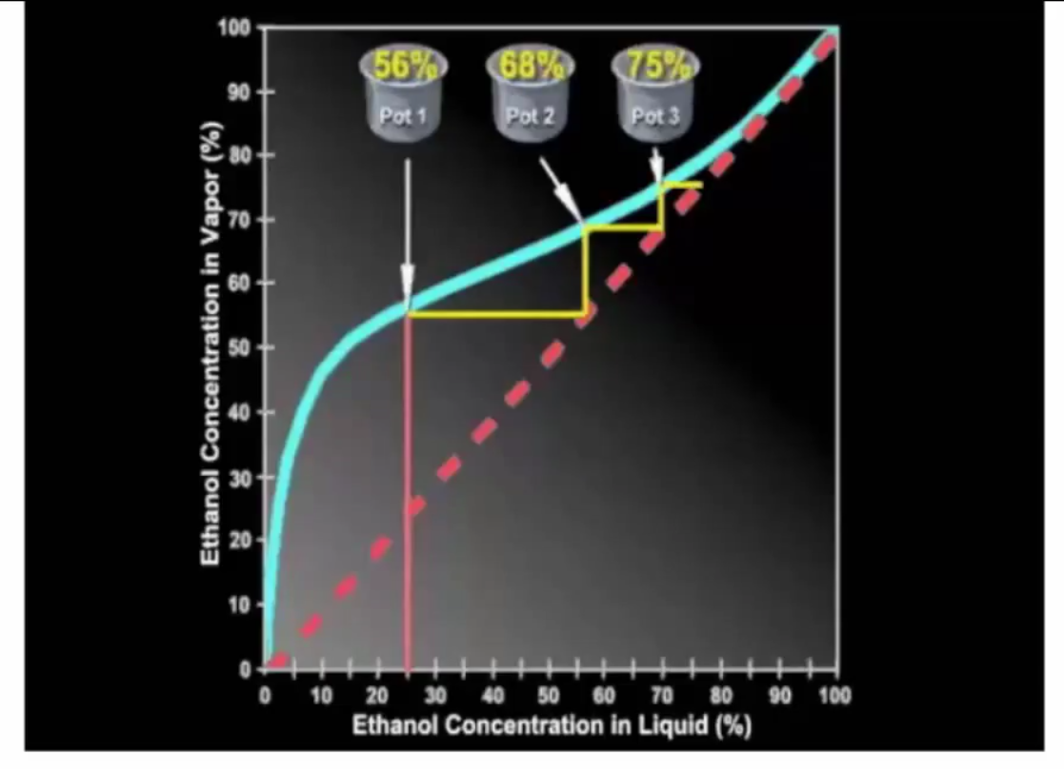

Slide 7
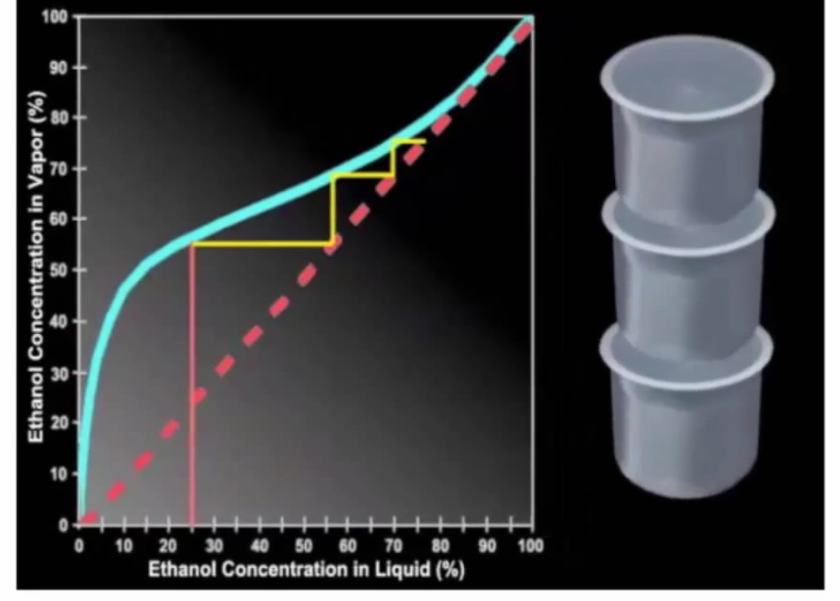

Slide 8
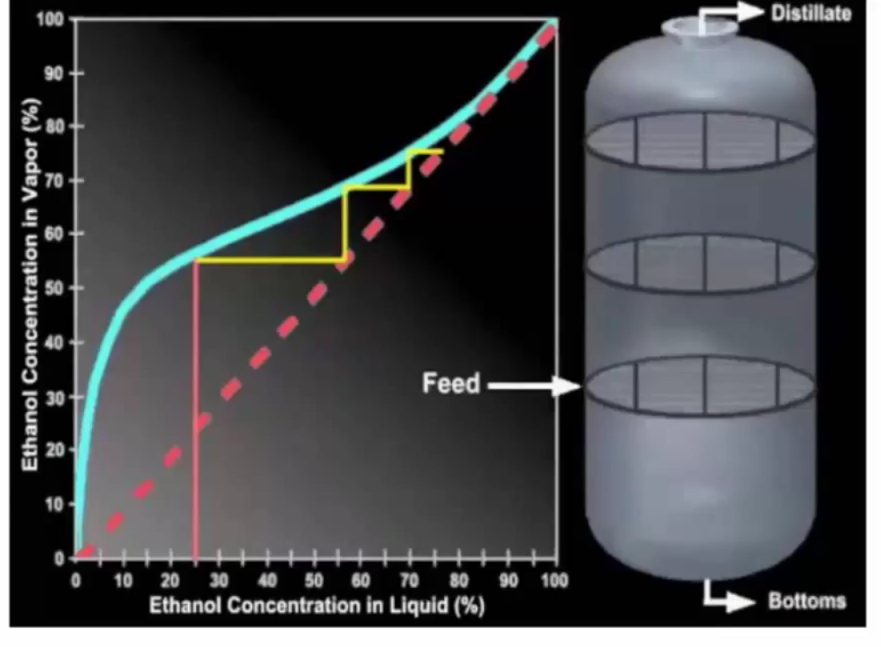

Slide 9
Boil and Cool 4 times
Finish
Boiling a liquid with Xa of 0.2 produces a vapour with Ya of 0.57
Boiling a liquid with Xa of 0.57 produces a vapour with Ya of 0.82
1
2
3
4
Boiling a liquid with Xa of 0.81 produces a vapour with Ya of 0.93
Boiling a liquid with Xa of 0.93 produces a vapour with Ya of 0.98
Start

Slide 10
Alternatively use T-x-y Diagram

Slide 11
How to separate a binary mixture – Pot still
Boil the mixture, condense the vapour and collect the distillate. Repeat the procedure until the desired purity is obtained.

Slide 12
Each still is a step on the x-y curve
Step off each stage using the x=y line gives the same result
Each step is an ideal stage in distillation
4 ideal stages to go from 20% Meth to 95% Meth
4
3
2
1

Slide 13
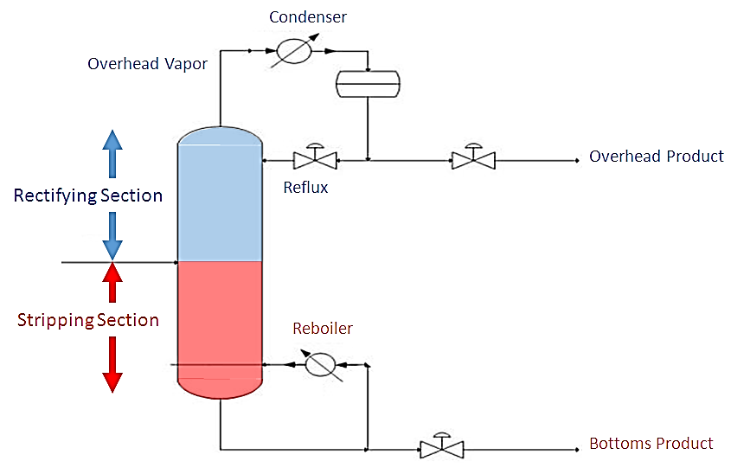
Different Parts of Distillation

Slide 16
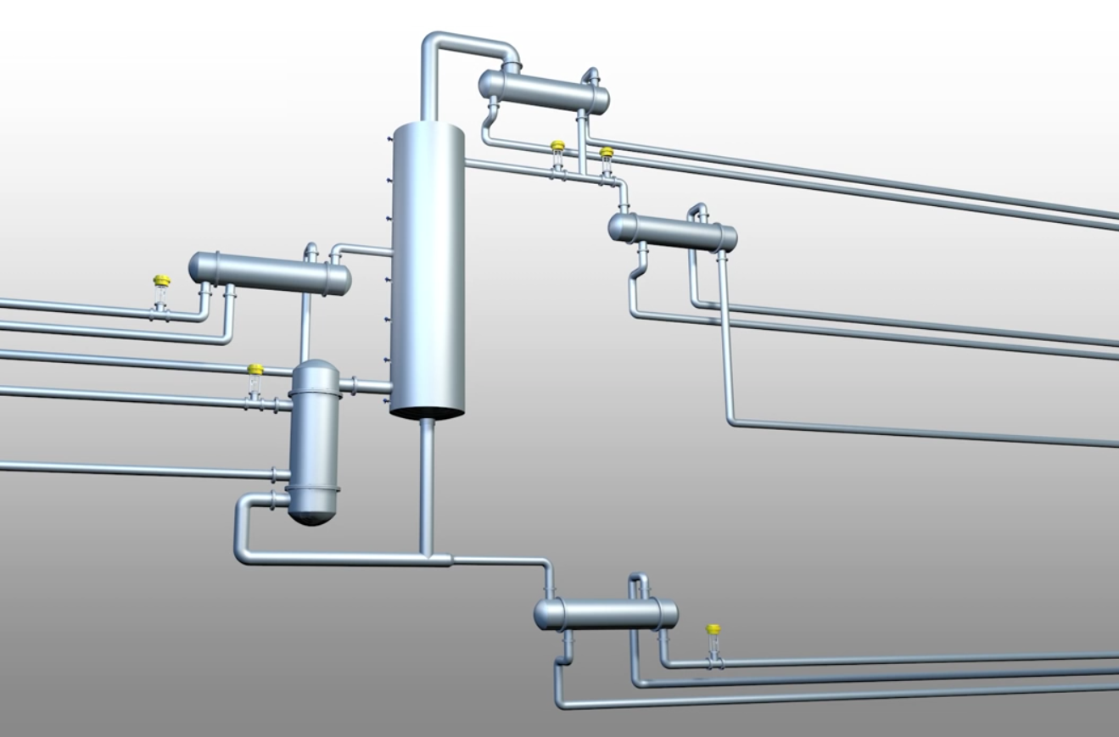

Slide 17
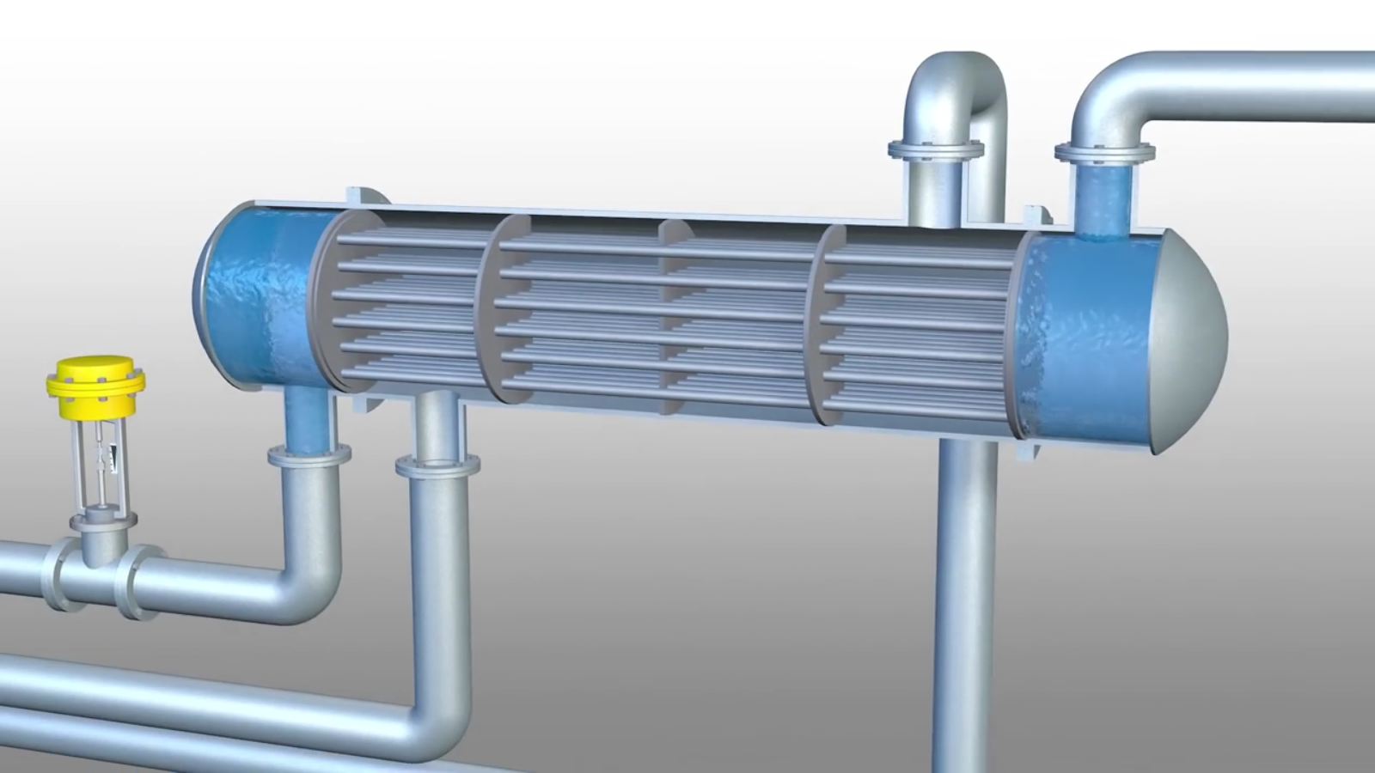

Slide 18
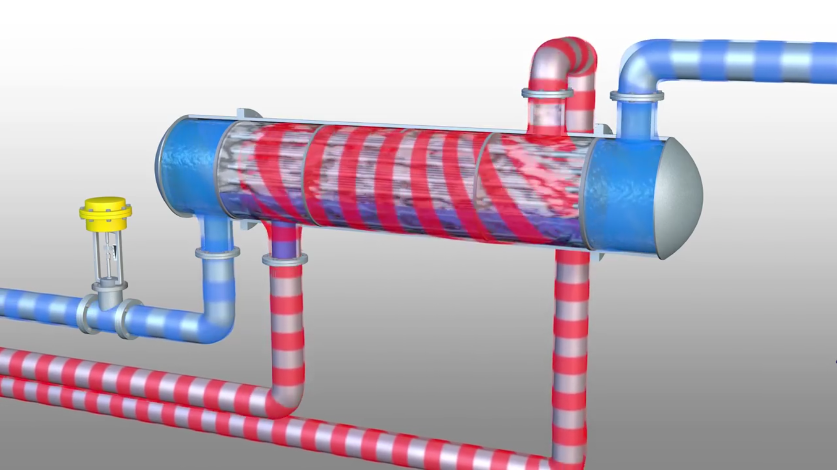

Slide 19
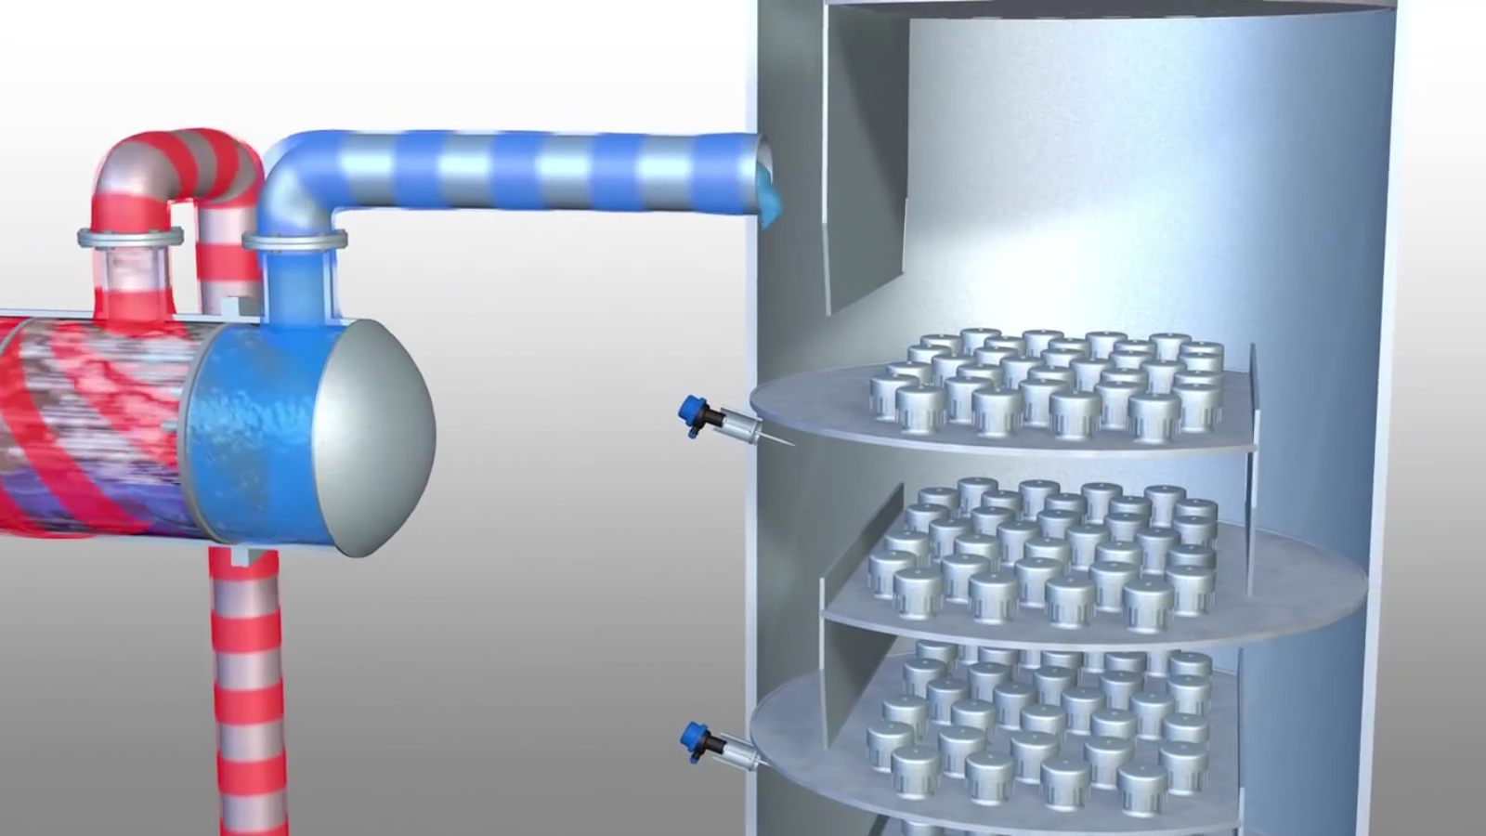

Slide 20
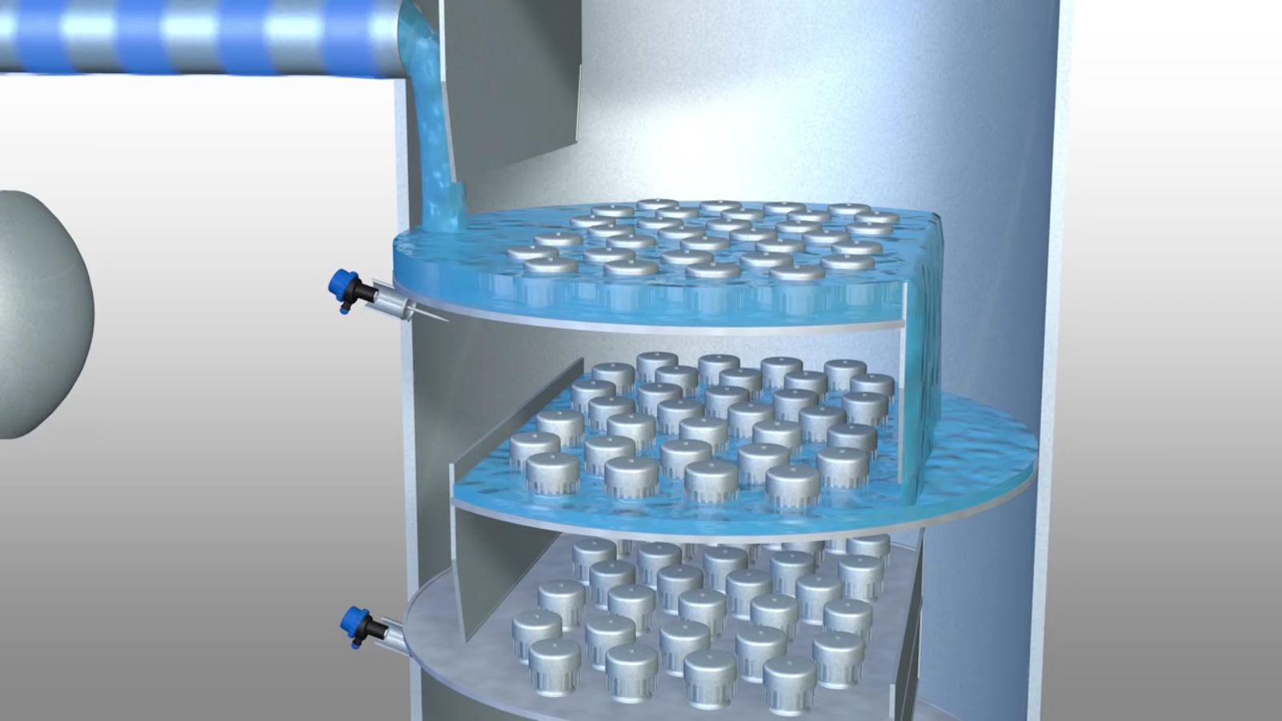

Slide 21
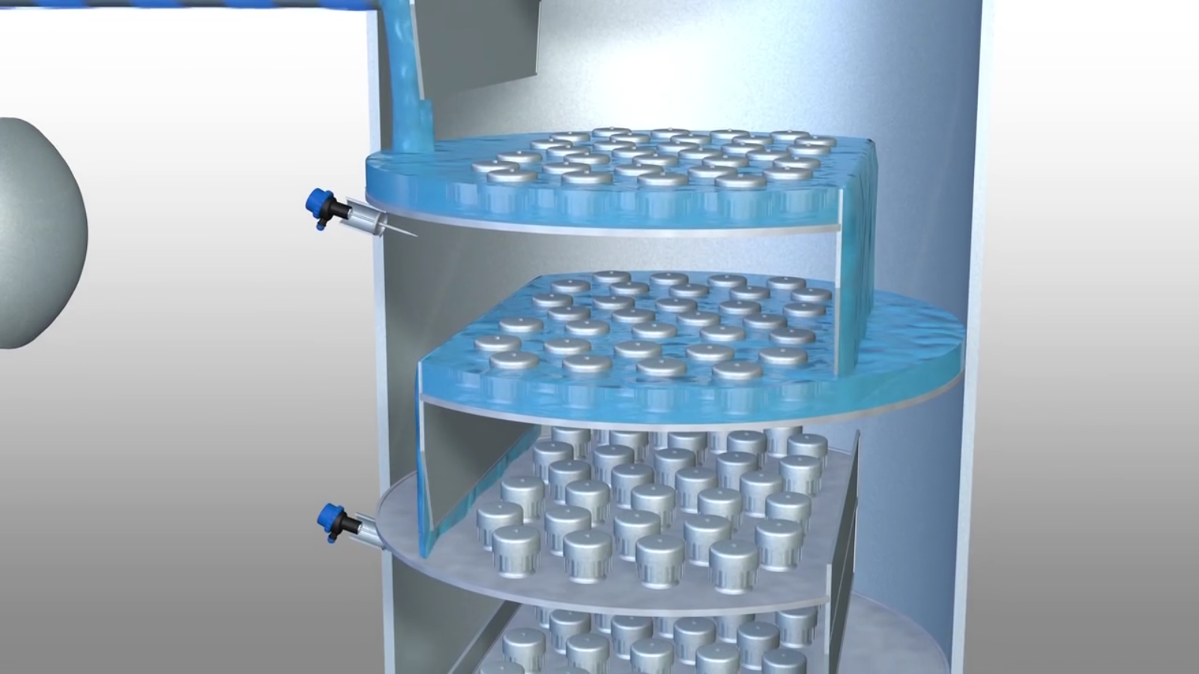

Slide 22
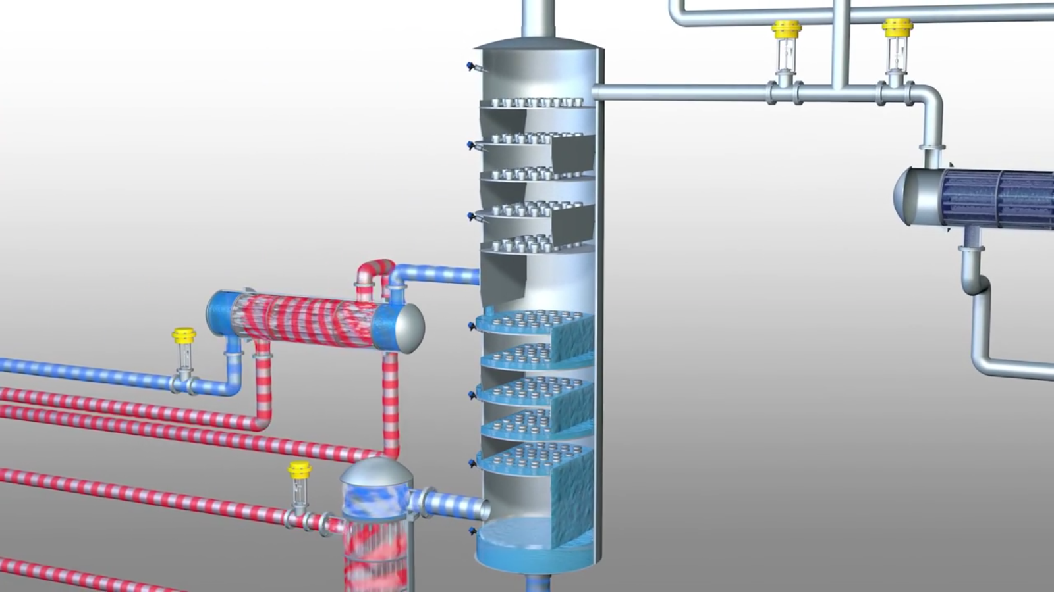

Slide 23
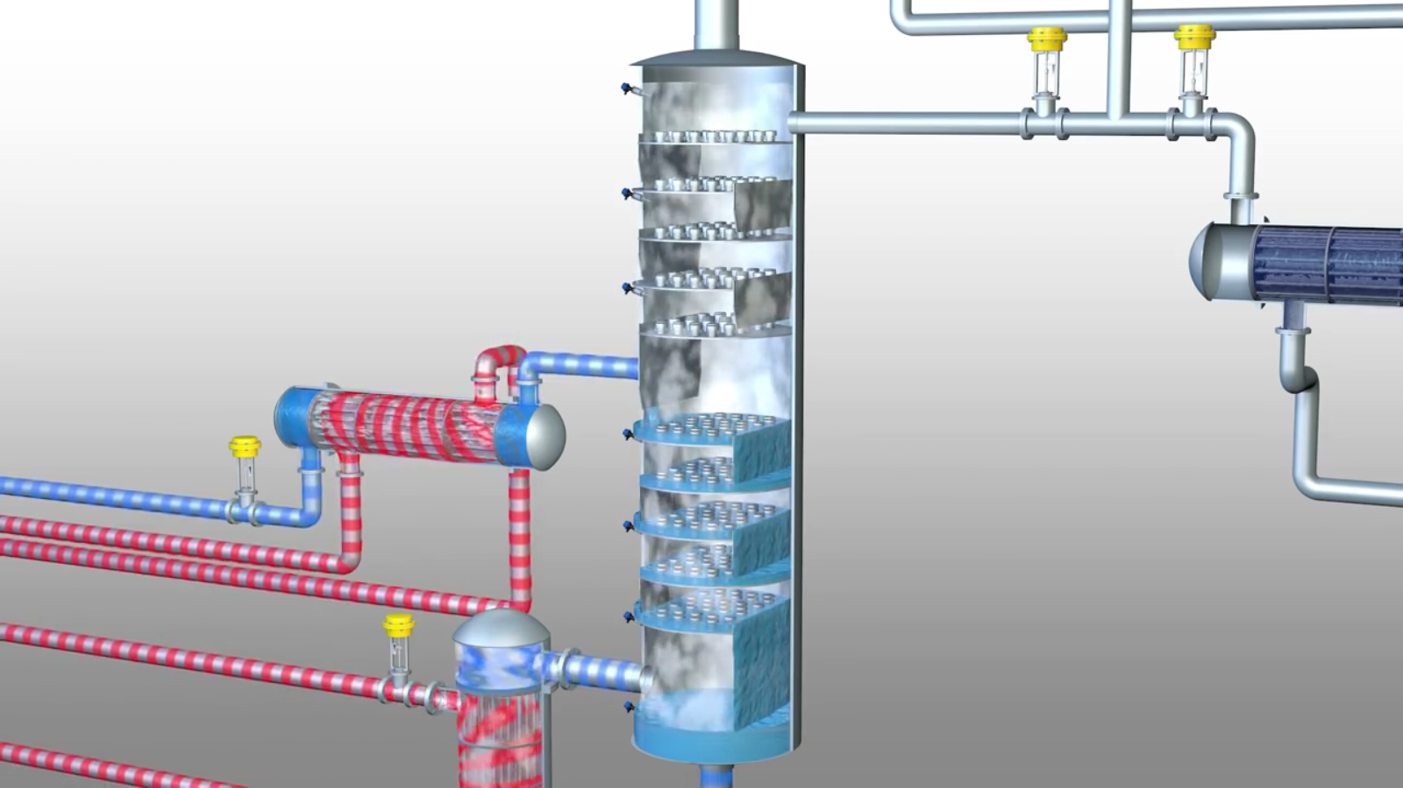

Slide 24
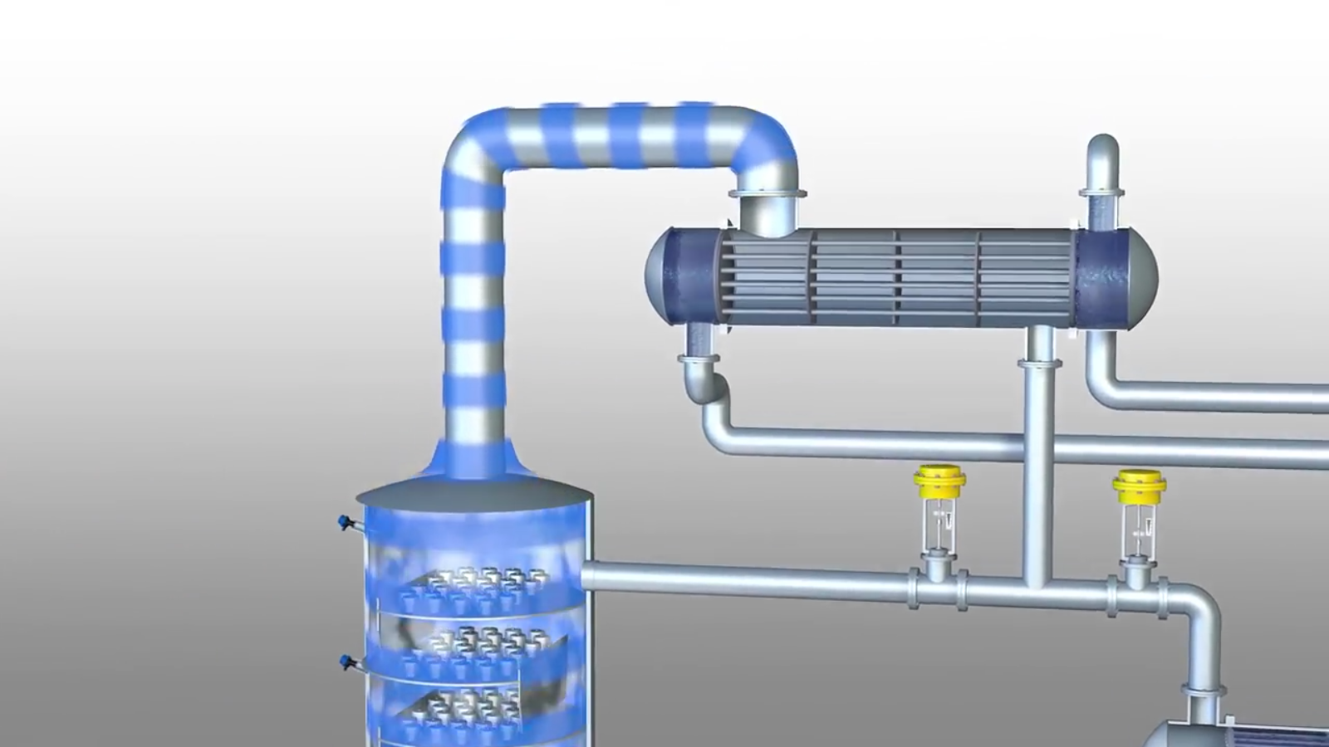

Slide 25
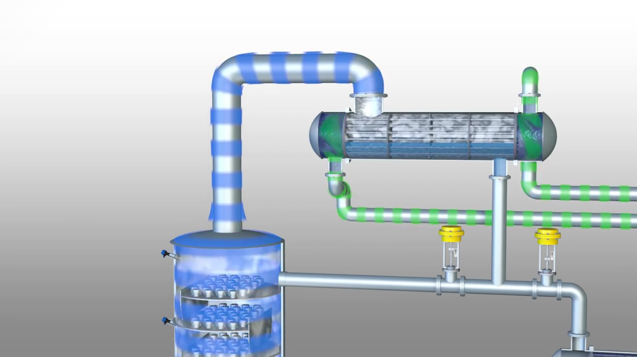

Slide 26
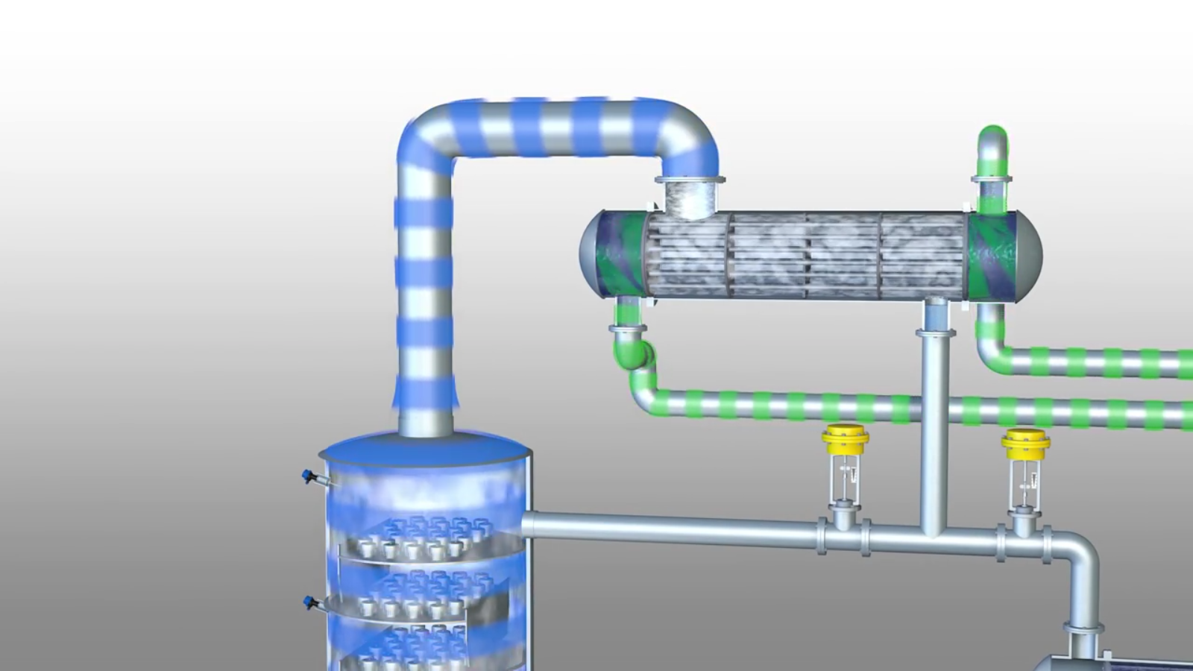

Slide 27
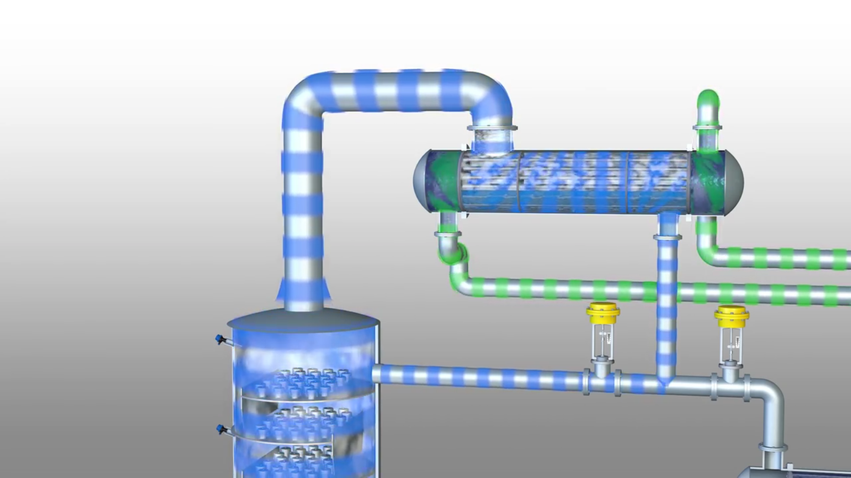

Slide 28
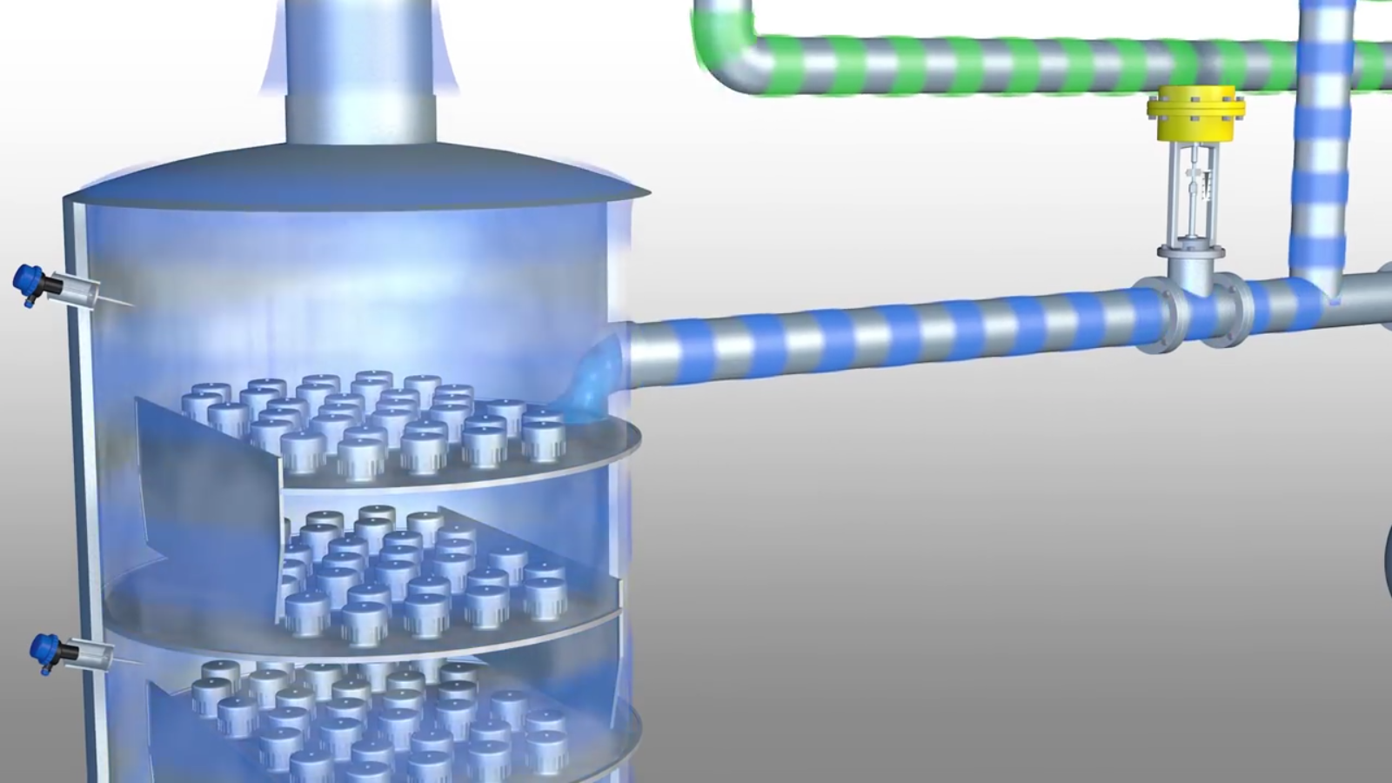

Slide 29
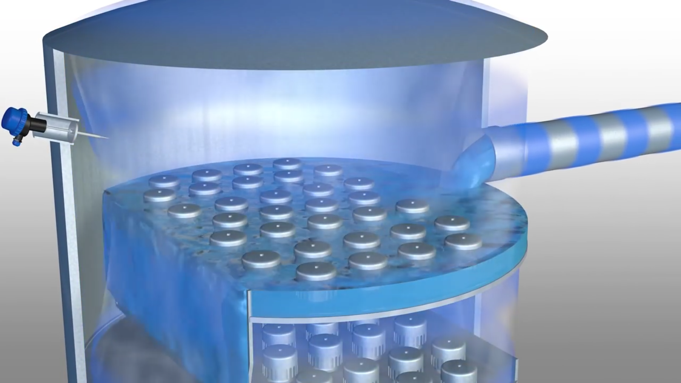

Slide 30
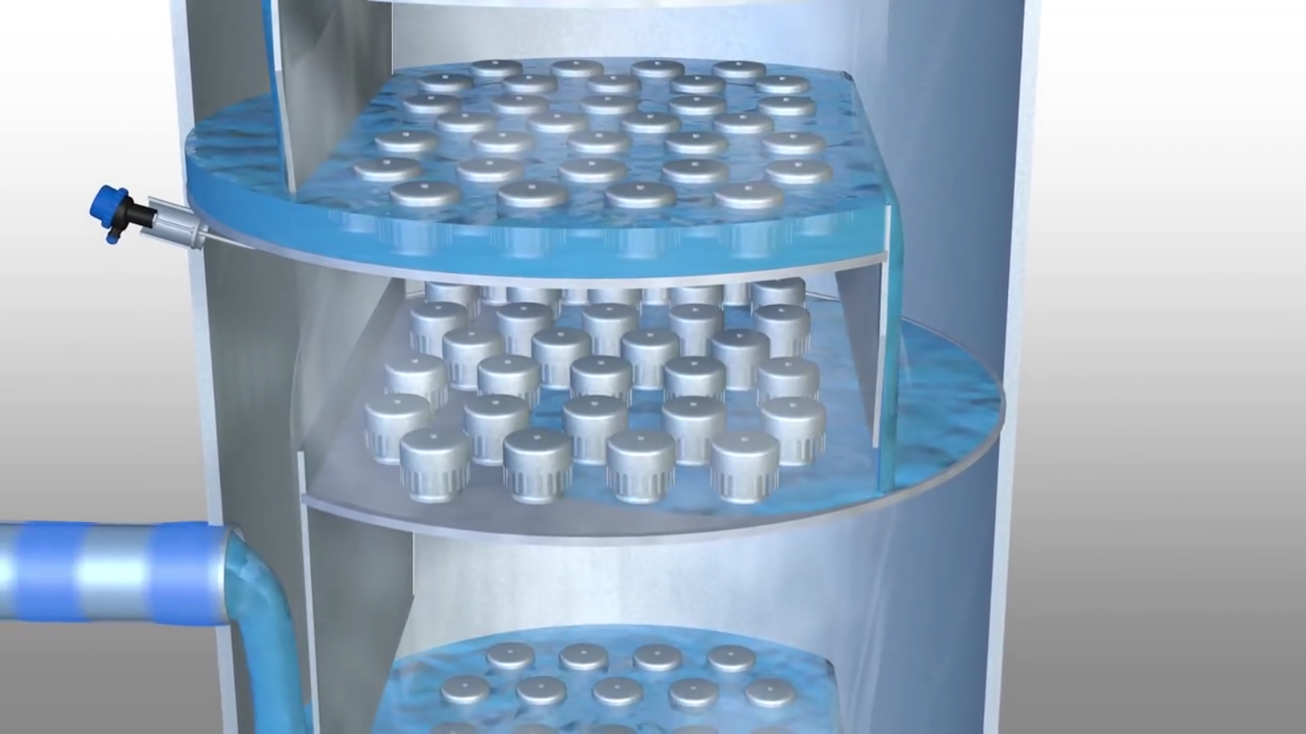

Slide 31
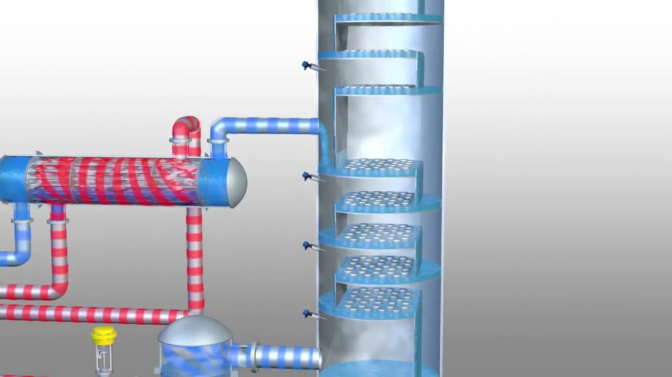

Slide 32
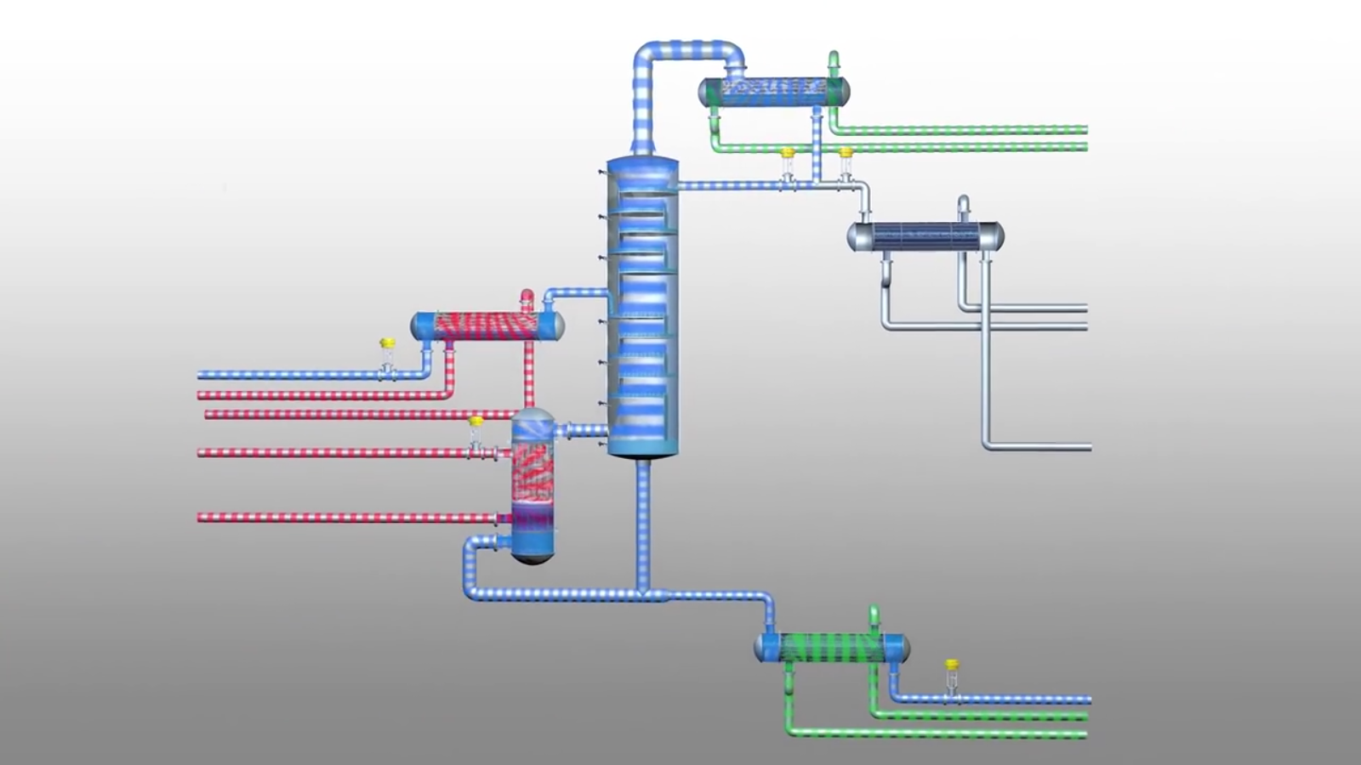

Slide 33
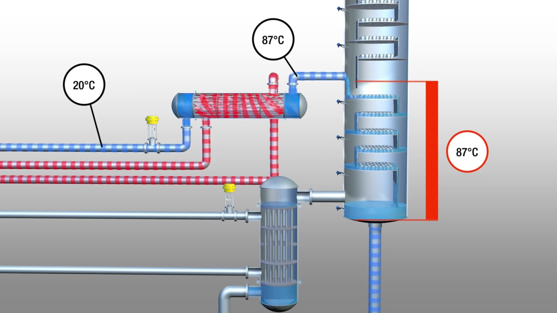

Slide 34
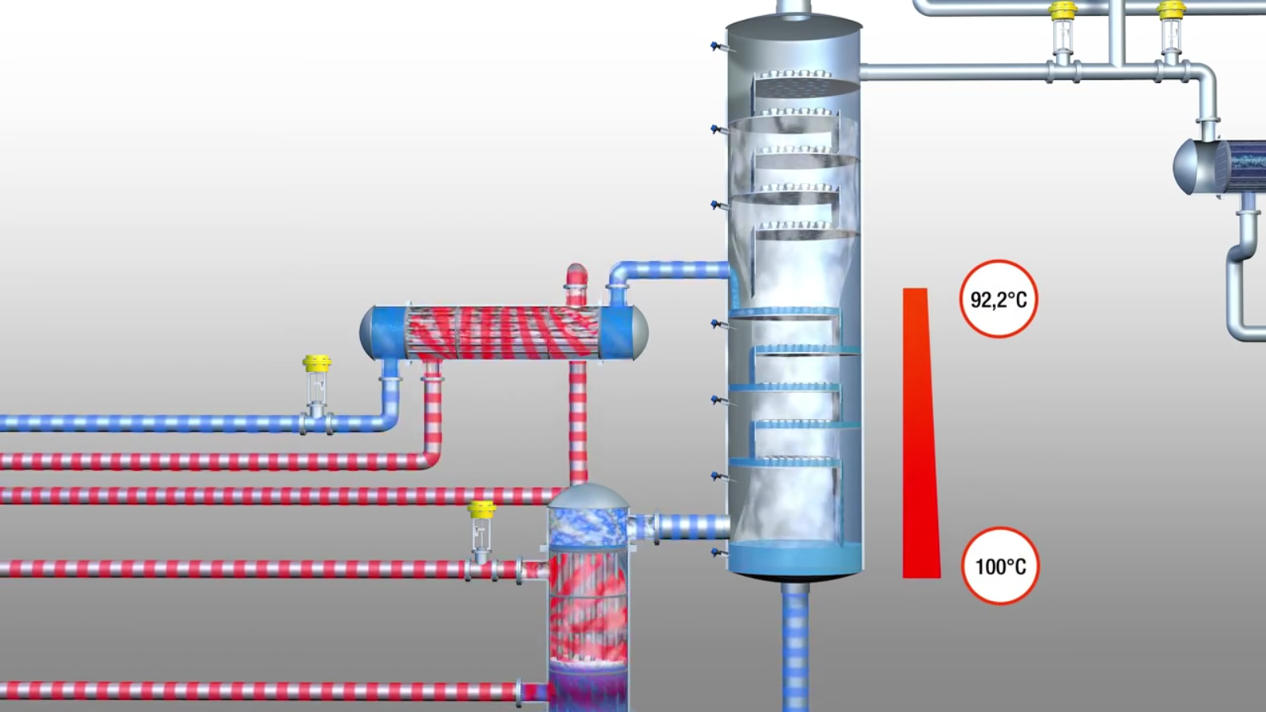

Slide 35
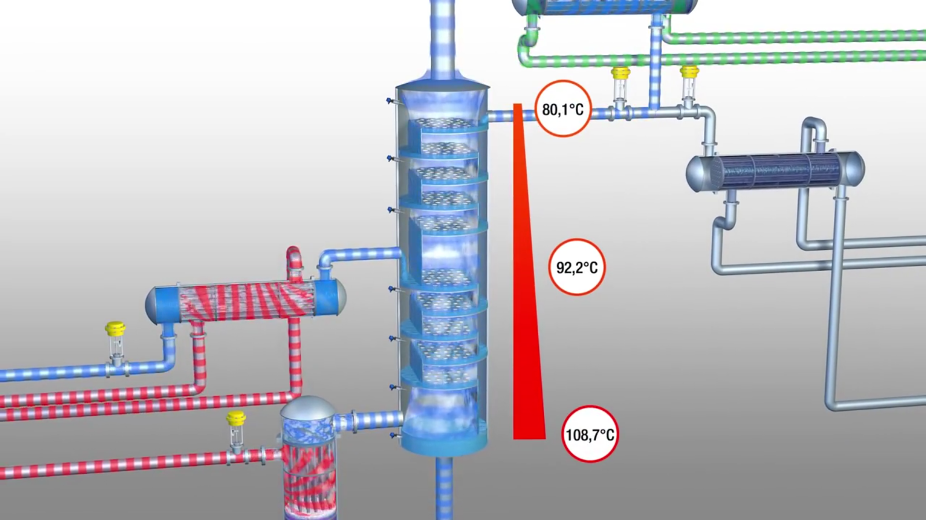

Slide 36
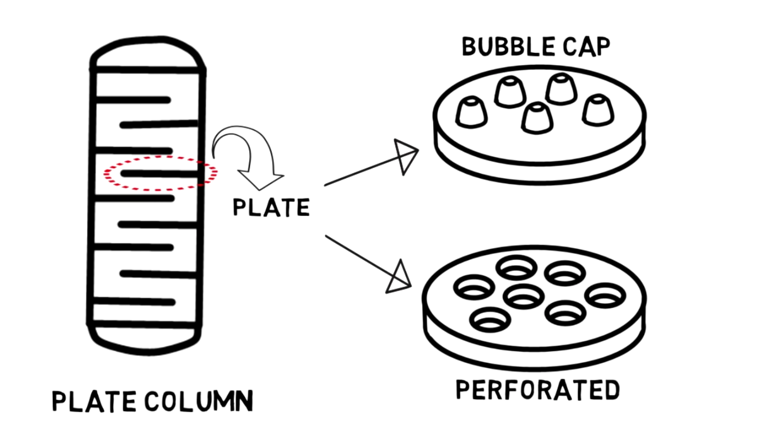

Slide 37
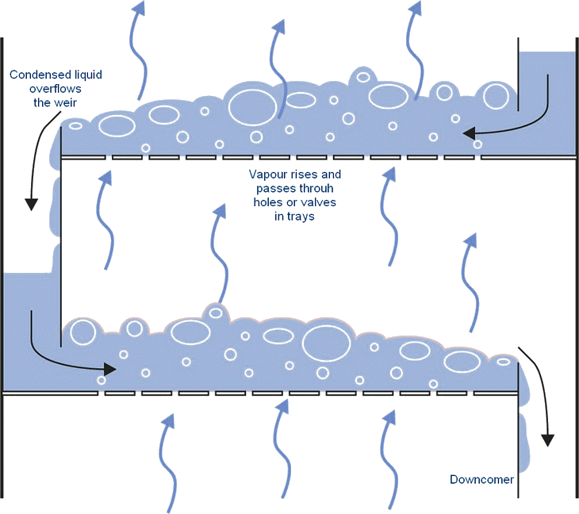

Slide 38
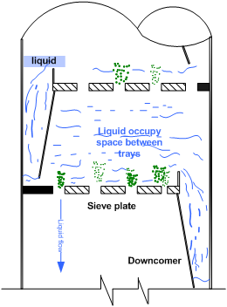
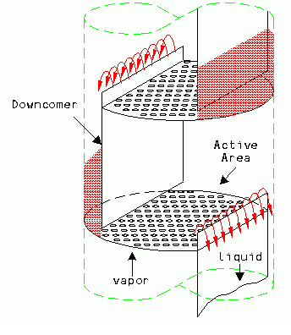

Slide 39
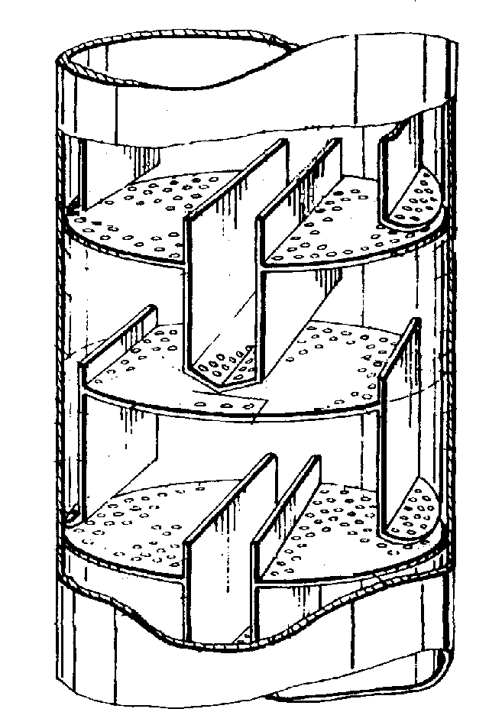
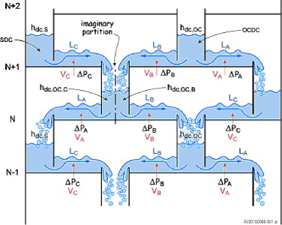

Slide 40
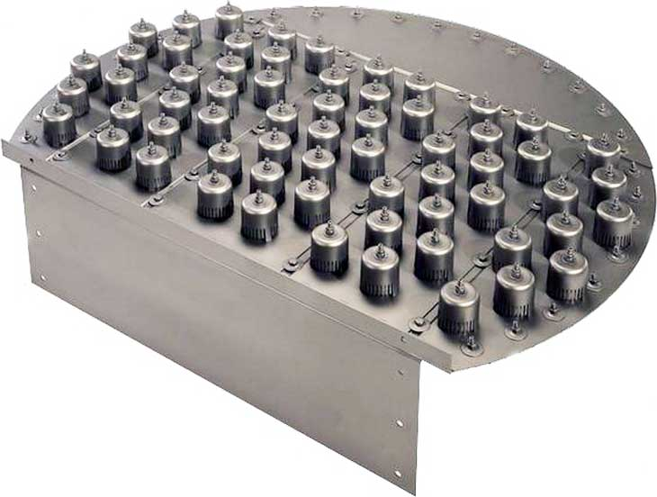

Slide 41
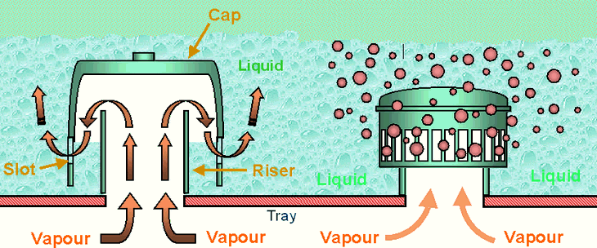

Slide 42
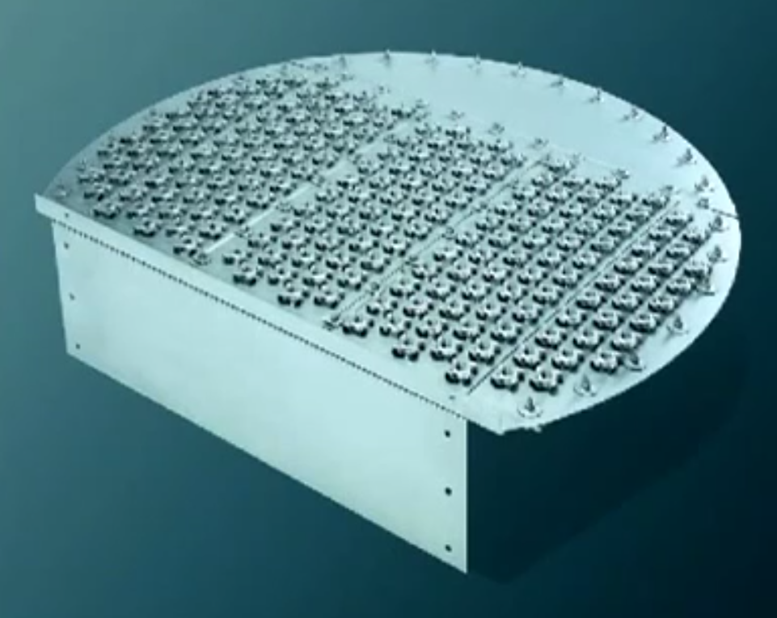

Slide 43
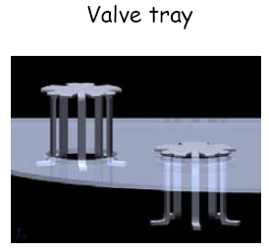

Slide 44
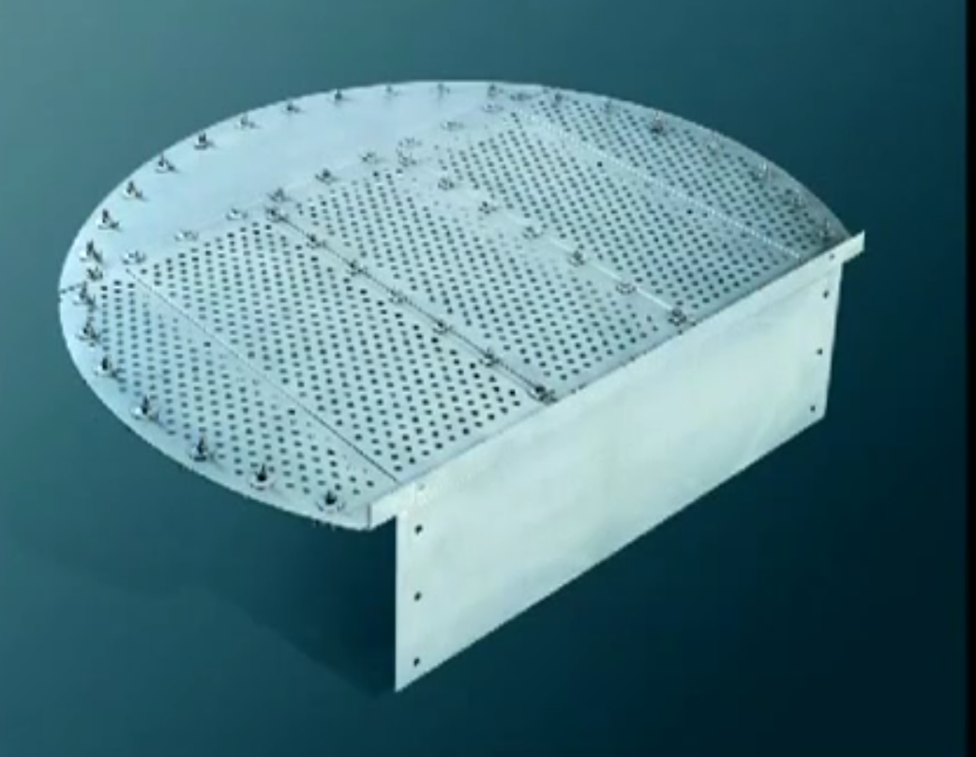

Slide 45
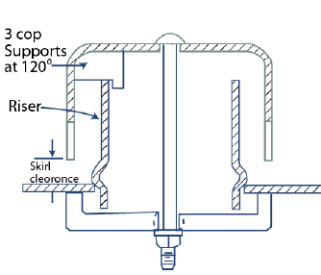
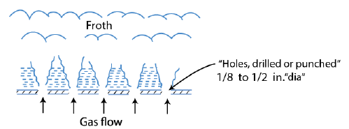
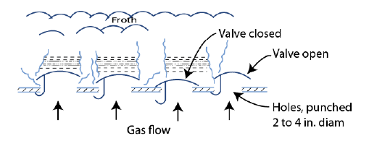
Sieve tray
Bubble caps
Valve tray

Slide 46
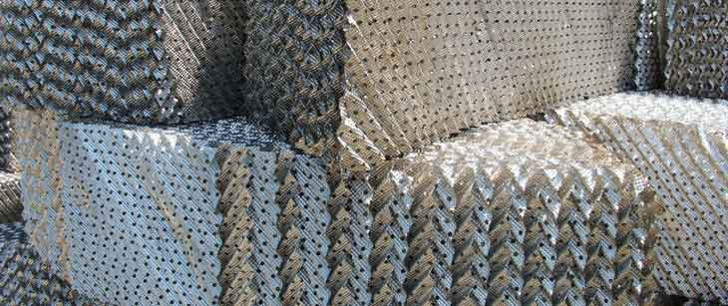

Slide 47
VAPOUR LIQUID EQUILIBRIA
Distillation columns are designed based on the boiling point properties of the components in the mixtures being separated. Thus the sizes, particularly the height, of distillation columns are determined by the vapour liquid equilibrium (VLE) data for the mixtures.

Slide 48
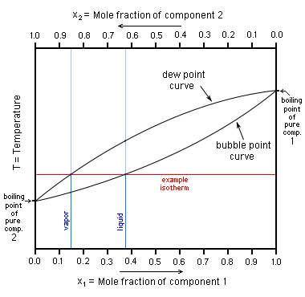
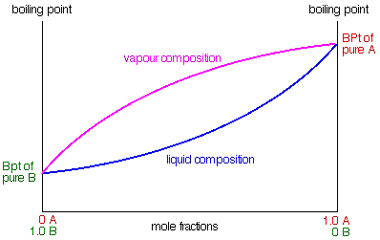
Binary boiling point diagram (T-xy)
The boiling point diagram shows how the equilibrium compositions of the components in a liquid mixture vary with temperature at a fixed pressure.

Slide 49
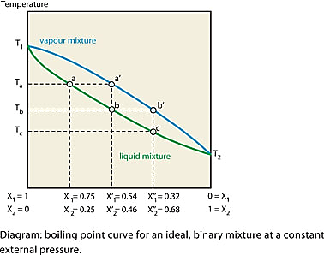

Slide 50
DISTILLATION PRINCIPLES
The dew-point is the temperature at which the saturated vapour starts to condense.
The bubble-point is the temperature at which the liquid starts to boil.
The region above the dew-point curve shows the equilibrium composition of the superheated vapour while the region below the bubble-point curve shows the equilibrium composition of the subcooled liquid.

Slide 51
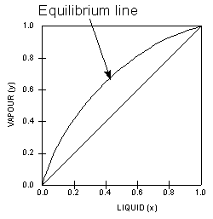
VAPOUR LIQUID EQUILIBRIA
Vapour-Liquid-Equilibrium (VLE) Curves
Constant pressure VLE data is obtained from boiling point diagrams. VLE data of binary mixtures is often presented as a plot, as shown in the figure on the right. The VLE plot expresses the bubble-point and the dew-point of a binary mixture at constant pressure. The curved line is called the equilibrium line and describes the compositions of the liquid and vapour in equilibrium at some fixed pressure.

Slide 52
110
0.67
100
0.46
0.15
0.46
0.67
0.28
0.15
0.28

Slide 53
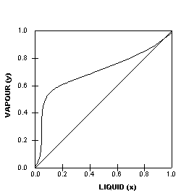
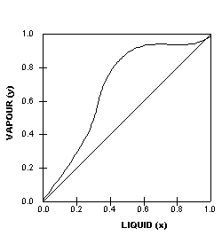
VAPOUR LIQUID EQUILIBRIA
This particular VLE plot shows a binary mixture that has a uniform vapour-liquid equilibrium that is relatively easy to separate. The next two VLE plots below on the other hand, shows non-ideal systems which will present more difficult separations. We can tell from the shapes of the curves and this will be explained further later on.

Slide 54
VAPOUR LIQUID EQUILIBRIA
The most intriguing VLE curves are generated by azeotropic systems. An azeotrope is a liquid mixture which when vaporised, produces the same composition as the liquid. The two VLE plots below, show two different azeotropic systems, one with a minimum boiling point and one with a maximum boiling point. In both plots, the equilibrium curves cross the diagonal lines, and this are azeotropic points where the azeotropes occur. In other words azeotropic systems give rise to VLE plots where the equilibrium curves crosses the diagonals.

Slide 55
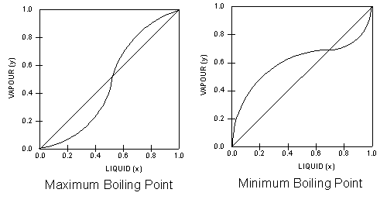
VAPOUR LIQUID EQUILIBRIA
Note the shapes of the respective equilibrium lines in relation to the diagonal lines that bisect the VLE plots.

Slide 56
VAPOUR LIQUID EQUILIBRIA
Both plots are however, obtained from homogenous azeotropic systems. An azeotrope that contains one liquid phase in contact with vapour is called a homogenous azeotrope. A homogenous azeotrope cannot be separated by conventional distillation. However, vacumn distillation may be used as the lower pressures can shift the azeotropic point.Alternatively, an additional substance may added to shift the azeotropic point to a more ‘favourable’ position.
When this additional component appears in appreciable amounts at the top of the column, the operation is called azeotropic distillation.
When the additional component appears mostly at the bottom of the column, the operation is called extractive distillation

Slide 57
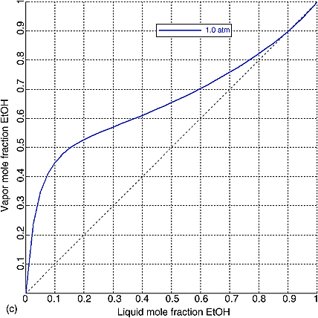
VLE diagram

Slide 58
DISTILLATION COLUMN DESIGN
As mentioned, distillation columns are designed using VLE data for the mixtures to be separated. The vapour-liquid equilibrium characteristics (indicated by the shape of the equilibrium curve) of the mixture will determine the number of stages, and hence the number of trays, required for the separation. This is illustrated clearly by applying the McCabe-Thiele method to design a binary column.

Slide 59
DISTILLATION COLUMN DESIGN
McCABE-THIELE DESIGN METHOD
The McCabe-Thiele approach is a graphical one, and uses the VLE plot to determine the theoretical number of stages required to effect the separation of a binary mixture. It assumes constant molar overflow and this implies that:
molal heats of vaporization of the components are roughly the same
heat effects (heats of solution, heat losses to and from column, etc.) are negligible
for every mole of vapor condensed, 1 mole of liquid is vaporized

Slide 60
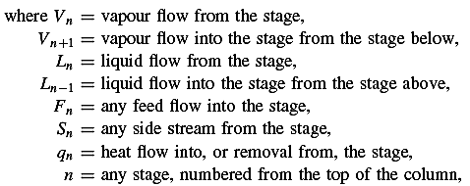
Stage by stage design
calculation of a distillation Tower

Slide 61
In an equilibrium stage (theoretical plate) the liquid and vapour streams leaving the stage are taken to be in equilibrium, and their compositions are determined by the vapour liquid equilibrium relationship for the system .
The performance of real stages is related to an equilibrium stage by the concept of plate efficiencies for plate contactors, and “height of an equivalent theoretical plate” for packed columns.
In addition to the equations arising from the material and energy balances over a
stage, and the equilibrium relationships, there will be a fourth relationship, the summation equation for the liquid and vapour compositions:
For now McCabe Thiele approach

Slide 62
Material balance
Total flows
For component
Energy balance
total stream enthalpies
Above feed
where L = the constant liquid flow in the rectifying section = the reflux flow, L₀,

Slide 63
Analogous equations can be written for the stripping section,
At constant pressure, the stage temperatures will be functions of the vapour and liquid compositions only (dew and bubble points) and the specific enthalpies will therefore also be functions of composition
V’ = is the constant vapour flow in the stripping section.
Below feed

Slide 64
slopes
They are referred to as operating lines, and give the relationship between the liquid and vapour compositions between stages.
Equations are conveniently solved by the graphical method developed by McCabe and Thiele (1925).

Slide 65
McCabe-Thiele Graphical Method

Slide 66
The top and bottom operating lines intersect the diagonal at x_{d} and x_{b} respectively;
The point of intersection of the two operating lines is dependent on the phase condition of the feed. The line on which the intersection occurs is called the q line. The q line is found as follows:

Slide 67
DISTILLATION COLUMN DESIGN
Depending on the state of the feed, the feed lines will have different slopes. For example,
q = 0 (saturated vapour)
q = 1 (saturated liquid)
0 < q < 1 (mix of liquid and vapour)
q > 1 (subcooled liquid)
q < 0 (superheated vapour)
The q-lines for the various feed conditions are shown in the diagram on the left.

Slide 68
Possible Feed Conditions
Partially vaporized
Sub-cooled liquid
Bubble point liquid
Dew point vapor
Super-heated vapor

Slide 69
Material and energy balance on the feed plate
q can also be considered as the number of moles of saturated liquid produced on the feed plate by each mole of feed added to the tower.

Slide 70
Minimum Reflux Ratio
minimum reflux occurs where the top operating line
just touches the equilibrium curve at the point where the q line cuts the curve.

Slide 71
Optimal Feed Stage

Slide 72
How to determine each stage temperature
From VLE diagram by projecting from y-x to
T-xy

Slide 73
Inlet Temp. of distillate
to the condenser
Outlet Temp. of distillate
from the condenser

Slide 82
Sieve plate

Slide 83
Design procedure

Slide 84
Step #1: Determine the number of theoretical plate and vapor and liquid flow-rates separately both in top and bottom sections.
Step #2: Obtain the physical properties of the system
Step #3: Select a trial plate spacing
Step #4: Estimate the column diameter based on flooding considerations
Step #5: Decide the liquid flow arrangement (reverse, single-pass, or multiple-pass). A guideline is provided in Figure 11.28 ([3] page 568).
Step #6: Make a provisional tray layout including downcomer area, active area, perforated area, hole area and size, weir height, weir length
Step #7: Check the weeping rate, if not satisfactory go back to
step #6 and reselect tray layout
Step #8: Check the plate pressure drop, if too high return to step #6
Step #9: Check downcomer back-up, if too high go back to step #6 or #3
Step #10: Decide plate layout including calming zones and unperforated areas and check hole pitch, if unsatisfactory return to step #6
Step #11: Recalculate the percentage of flooding based upon selected tower diameter
Step #12: Check for entrainment, if too high then return to step #4
Step #13: Optimize design: repeat steps #3 to #9 to find smallest diameter and plate spacing acceptable to get the lowest cost for the specified application
Step #14: Finalize design: draw up the plate specification and sketch the layout
Design procedure

Slide 85
Design problem
Design a continuous distillation column (plate) to recover acetone from a 50-50 mole % acetone-water mixture available at 30°C. The feed stream flow rate is 25,000 kg/h. The top product should contain at least 95 mole% acetone and the bottom product should contain <1 % acetone by mole. Consider reboiler as equivalent to one stage. This column is operated at atmospheric pressure (top tray). Column efficiency of 60% and pressure drop per plate of 1.25 kPa may be assumed. You can take the minimum liquid flow as 70% of the maximum rate both above and below the feed plate. The vapor liquid equilibrium (VLE) data for the acetone-water system at atmospheric pressure is provided in the Table below.
Data given:
Latent heat of water= 41,360 J/mol; latent heat of acetone= 28,410 J/mol Specific heat of water=75.3 J/mol°C (mean); Specific heat of acetone 128 J/mol°C (mean)

Slide 87
VLE data for the acetone-water system at 1 atm.
𝑥= Mole fraction of acetone in liquid; 𝑦= Mole fraction of acetone in vapor; BP: Bubble point
Bubble point of feed (from the data shown in table) = 59.95°C
Latent heat of the feed = 28,410×0.5 + 41,360×(1 - 0.5) = 34,885 J/mol
Specific heat of the feed = (128×0.5) + 75.3× (1 - 0.5)= 101.75 J/mol °C
Heat required to vaporize 1 mole of the given feed = (59.95 - 30) ×101.75 + 34,885=37933 J

Slide 89
(Assuming constant molar overflow)

Slide 91
Step #2:
Estimation of physical properties

Slide 93
Step #3: Plate spacing
Plate spacing of 600 mm is considered for the first trial to calculate capacity parameter (𝐶_{𝑠𝑏}) for the estimation of maximum allowable vapor velocity through the net plate area. The suggested plate spacing is 600 mm for column diameter>1.5 m.
Step #4: Column diameter

Slide 98
0.12
0.033

Slide 100
( Nominal diameter )
Note
Use the higher value of the tower diameter for the uniformity between sections, if the difference is not greater than 20%. Higher area than the design area can be taken care by reducing the perforated area.
The nearest recommended shell (nominal diameter 2400 mm) fabricated from carbon steel or stainless steel sheet in IS 2844-1964: ID 2403 mm with minimum wall thickness: 8 mm for carbon steel) and 6 mm for stainless steel.

Slide 101
Step #5: Selection of liquid-flow arrangement
0.012
0.007

Slide 104
For the first trial,
consider hole diameter: D_{ℎ}=12 mm (1/2 inch). The plate thickness = hole diameter is selected for the first trial.

Slide 105
Sieve tray weeping
Weeping occurs at low vapor/gas flow rates. The upward vapor flow through the plate perforations prevents the liquid from leaking through the tray perforation. At low vapor flow rates, liquid start to leak/rain through the perforation (called weeping).
When none of the liquid reaches the downcomer at extreme weeping condition at very low vapor flow rate, it is called dumping. The weeping tendency increases with increasing fractional hole area and liquid flow rates.
The vapor velocity at the weep point (where liquid leakage through holes starts) is the minimum value for stable operation. For a chosen hole area, the minimum operating vapor flow velocity (𝑈_{𝑚𝑖𝑛,𝑜𝑝}) at minimum flow rate for stable operation should be above weep point vapor velocity.

Slide 106
Weir height
The height of the weir determines the volume of liquid
on the plate and is an important factor in determining
the plate efficiency.
A high weir will increase the plate efficiency but at the
expense of a higher plate pressure drop.
For columns operating above atmospheric pressure
the weir heights will normally be between 40 mm to 90 mm;
40 to 50 mm is recommended.
For vacuum operation lower weir heights are used to
reduce the pressure drop; 6 to 12 mm is recommended.

Slide 107
Liquid
flow rate
weir
length

Slide 108
Weir height h_{w} = 40mm is considered

Slide 112
Perforation area per tray
95º
Therefore, the minimum operating velocity both in top and bottom sections are above the weep point velocity.

Slide 113
Residual gas pressure head (𝒉_{𝒓}):
The residual pressure drop results mainly from the surface tension as the gas releases from a perforation.

Slide 114
0.88

Slide 115
Step # 9: Downcomer backup liquid and downcomer residence time
Downcomer design [back-up]
The downcomer area and plate spacing must be such that the level of the liquid and froth in the downcomer is well below the top of the outlet weir on the plate above. If the level rises above the outlet weir the column will flood.
The back-up of liquid in the downcomer is caused by the pressure drop over the plate (the downcomer in effect forms one leg of a U-tube) and the resistance to flow in the downcomer itself
where h_{ap} is height of the bottom edge of the apron above the plate. This height is normally set at 5 to 10 mm below the outlet weir height
Downcomer residence time
Sufficient residence time must be allowed in the downcomer for the entrained vapour to
disengage from the liquid stream; to prevent heavily “aerated” liquid being carried under
the downcomer. The value of 𝑡_{𝑑𝑟𝑡}>3 s is suggested.

Slide 118
Where L_{wd} = liquid flow rate in downcomer, kg/s,
A_{m} = either the downcomer area A_{d} or the clearance area under the downcomer A_{ap}; whichever is the smaller, m².
h_{b} = downcomer back-up,
measured from plate surface, mm,
h_{dc} = head loss in the downcomer, mm.
No flooding

Slide 119
Sufficient time for the vapor to disengage and clear liquid will go through the down comer to the plate below

Slide 120
For equilateral
triangular pitch
Pitch

Slide 122
The actual flooding is below the design flooding value of 80%.
Usually, Ψ<0.1 is desirable. below this figure the effect
on efficiency will be small. However, the optimum design value may be above this.

Slide 124
Desirable

