Slide 1


Donkey paired with ox for ploughing

Slide 2
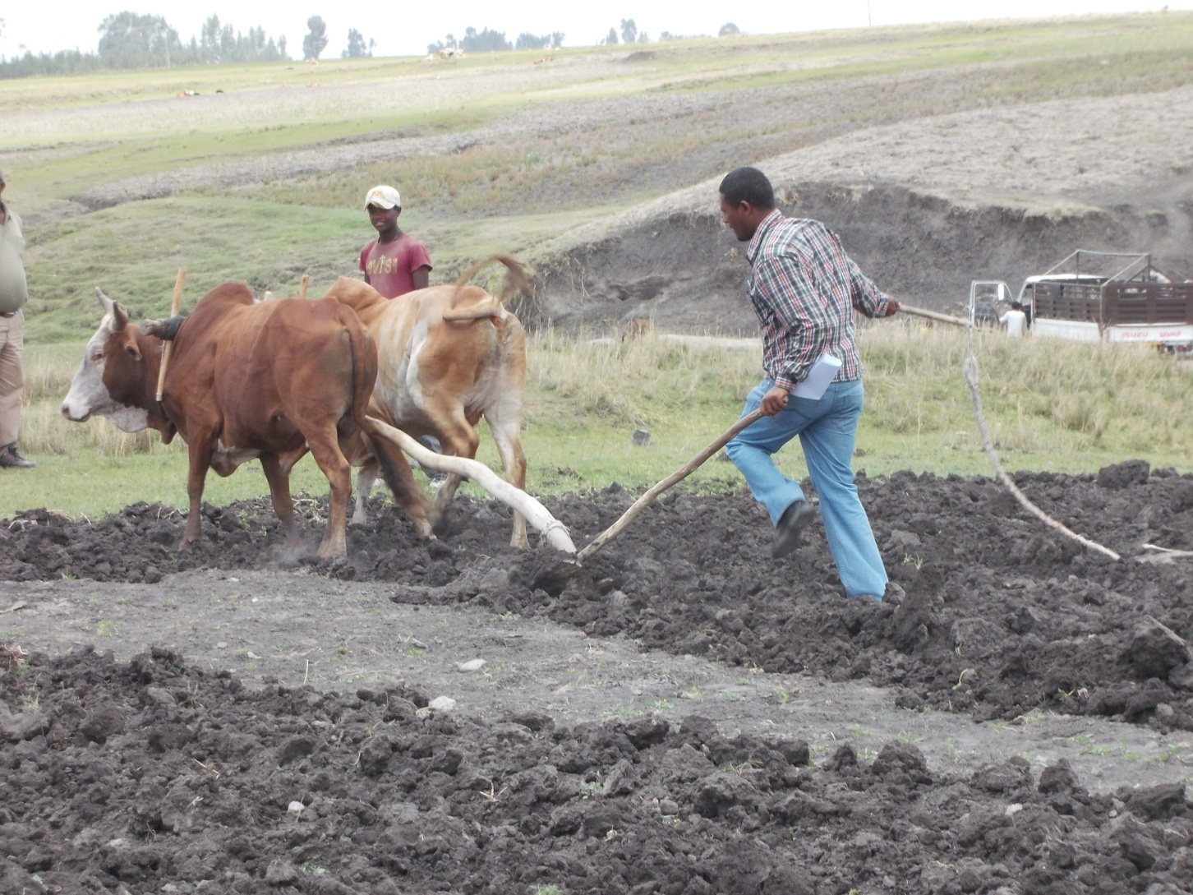

Slide 3
Health problems associated with work
Apart from general ailments draft animals are prone to specific diseases associated with work like yoke galls, back sores, horn injuries, luxation of patella, hoof injuries, cancer and various skin diseases.
Theses health problems occur due to improper management. Some of the conditions which predispose draft animals to specific health problems include:

Slide 4
  When draft animals are first made to work for long periods injuries are liable to occur during the first weeks of work in oxen before the skin has become hardened to the inevitable friction. Such friction is exaggerated if an inexperienced animal is used for work due to unsteady friction.
  When there is excessive pressure exerted by the weight of the load for prolonged periods on the hump or back.

Slide 5
    In this case the tissues beneath the skin may be deprived of their blood supply resulting in deeper wounds or injuries due to tissue necrosis.
Inadequate padding under the harness
Excessive and unbalanced load on the back of pack animals
Injuries may also occur due to bruising caused by the rough surface of the harness
Hoof injuries may result when draft animals re made to work on hard surfaces

Slide 6
Injuries may also occur when animals are bitten by inexperienced operator during training
Using a single harness for different animals. This is due to injury arising from improper fitting of the harness and transmission of certain skin diseases.

Slide 7
Health management practices to prevent specific health problems associated with work
  Initial work periods should be short
  The skin that makes contact with the harness should be kept clean
  The harness should have a broad and smooth bearing surface
  The skin should be greased when animals are used for traction are made to work during the rain
  Draft animals need to be shod if they are used on hard surfaces

Slide 8
  Proper wound management whenever it occurs
  Avoid use of too young animals for work particularly bulls
  Avoid use of the same harness for different animals i.e. harnesses should be individually made to avoid transmission of skin diseases

Slide 9
Care and management of draft animal
Although draft animal management and husbandry is almost the same as for other animals, there are special features that make their management slightly to be different. These include:
  Draft animals have to able to work when they might be the least able to do so i.e. at the end of the dry season when feed resources are scarce
  Husbandry practices such as vaccination and mating of draft cows need to be timed considering work requirements

Slide 10
  Wok can cause stress and predispose animals to further health problems. Draft animals are vulnerable to illness than other animals kept for other forms of production.
  Draft animals need to be easily handled and get used to human beings i.e. there should be good companionship between the animal and the operator/farmer
  Veterinary service is required at specific times for instance in case of injuries

Slide 11
Management of work oxen
Age of a bullock for work
  Indigenous bullocks of about 4 years of age are the best for work. Animals of exotic and crossbreeds may be ready for work even at earlier ages.
  Advantage of using bullocks at the indicated (optimum) age:
      At this age bullocks are strong enough to work well and also will have several years of working life
      Reduces the risk of yoke injuries and growth retardation which is a common problem when oxen are used at early ages
      Too old animals are difficult to train

Slide 12
Selection of work oxen
Working oxen can be selected
  steady animals with short legs
  strong muscles under a fine short haired coat
  powerful short neck
  strong healthy bulls with a good spirit but still manageable

Slide 13
Training of work oxen
Training for tillage could be started at 2 to 4 years of age. Training period normally lasts between 3 to 4 weeks.
However, the duration may depend on:
  the experience of oxen handlers
  age of the animal
  character and condition of the animal i.e. aggressive and bad tempered animals require longer periods of training

Slide 14
Time and duration of work
Time: working during the coolest parts of the day is preferred. Otherwise oxen will be heat stressed
Duration: Oxen should not be overworked. The duration of work expected from an animal depends on the feed input, body condition and physiological state of the animal i.e. incase of cows
Thus the duration of work should be adjusted considering the above conditions. The recommended average duration of work for good conditioned oxen that are on good state of nutrition for ploughing is about 5 to 6 hours per day.

Slide 15
Avoiding seasonal use of draft oxen
Oxen are intensively used during the cultivation period and become almost idle for the rest of the year. Thus oxen will be under stress at the start of the cultivation period i.e. after long period of rest. Hence seasonality of work need to avoided to prevent oxen from work stress.
This can be done by using oxen in other operations outside the cultivation period e.g. Cart pulling. This will keep oxen trained and exercised year round and reduces the risk of work stress at the start of peak working period.

Slide 16
Care of the feet
Oxen should not be made to plough if the ground is dry, if possible shoeing is preferred
Regular checking and removal of packed clay between the claws as this may result in lameness due pressure. Any damage to the interdigital skin either by stones ,thorns predispose to interdigital collibacllosis.

Slide 17
Stabling areas should be kept clean and dry. Muddy or wet floors where animals are kept during the night increase hoof moisture content and predispose to certain hoof problems.
Wet hooves become soft and liable to physical damage. Moreover, the muddy condition predisposes them to mud fever/pastern dermatitis (hoof disease due to infection with dermatophlus organisms).

Slide 18
Castration of working bulls
Bulls to be used for work should be castrated. Because castrates are more docile than entire males. Castration avoids undesirable aggressive behavior of bulls which is associated with sex hormones.
In most countries of the tropics, Castration is carried out very late often at about 4 years of age. This is advantageous (desirable) for bulls kept for wok. Such animals should be castrated after the animal has developed secondary sexual characteristics of males which are desirable for working bulls.

Slide 19
These include:
  Development of heavy short neck and powerful shoulders
  Strong musculature and well developed hump
  The body characteristics confer strength to the animal and also facilitate the fitting of the yoke.
  However, those animals kept for beef purposes should be started at early ages minimize fat deposition which is mostly regarded as undesirable.

Slide 20
Improving the genetic potential for power output in cattle
Supply of animal power can be improved through enhancing the genetic potential for work capacity.
The strategies to be followed include:
  Selection and breeding of large sized and better performing indigenous cattle. This help to improve the work performance of the indigenous cattle stock
  Crossbreeding indigenous zebu breeds with exotic European breeds.

Slide 21
  F1 crosses Bos indicus (zebu) and Bos Taurus have more power than indigenous bullocks.
  However, studies indicate they are suitable when only properly fed and managed (require higher management input) and are best used in early hours of the morning (because they had lower heat tolerance capacity than zebu breeds).

Slide 22
Management of working Equidae
Care of the feet
  The ability of a working equine chiefly lies in its ability to move. There is an old saying ‘no foot-no horse’.
  Hoof trimming
  In their natural environments, equines have hooves hard enough and with a sufficient rate of growth to compensate for normal wear and tear.

Slide 23
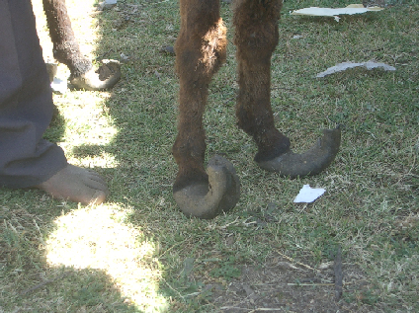
Excessive hoof growth in equidae occurs under two conditions;
  In case of unshod equines which are on soft ground or housed
  In shod animals
Thus, there a need for regular checks up of the feet under these two conditions.

Slide 24
Excessively grown hooves result in difficulty in walking which may finally lead to lameness. (every 6 weeks for horses and every 4-6 weeks in case of mules and donkeys.)
Trimming helps to maintain their normal foot axis and the correct proportions (shape & level) of the hoof.
In case of unshod equidae that are working on hard surfaces, the frequency of hoof trimming is dependent on the normal hoof wear and tear.

Slide 25
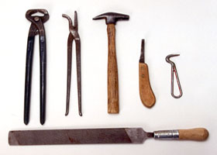
Hoof trimming Tools/Farrier kit
Nippers
Used to remove excessive hoof
wall length
Hoof Knife
- to correct frog
and sole
Hoof Pick
to remove foreign materials
from sole & frog
Hoof Rasp
Used to make hoof wall levelled and smooth /file

Slide 26
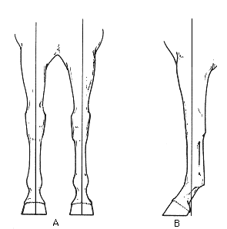
Principles of hoof trimming
Hoof pastern axis (HPA)
Mediolateral balance

Slide 27
Shoeing
Shoeing is a skilled practice and should not be attempted by persons who do not have proper and sufficient experience. It should be done by personnel’s trained for the purpose i.e. farriers
Shoeing is conducted for the following reasons;
  to prevent excessive wear and splitting of hooves if the animal works on harder surfaces than their natural environments

Slide 28
  to prevent from sliding while animals work on smooth or slippery surfaces
  to correct faulty hoof structure and to compliment or correct the gait

Slide 29
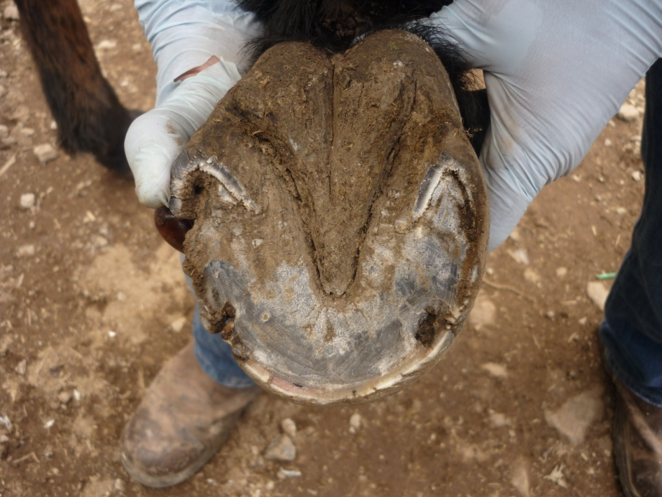
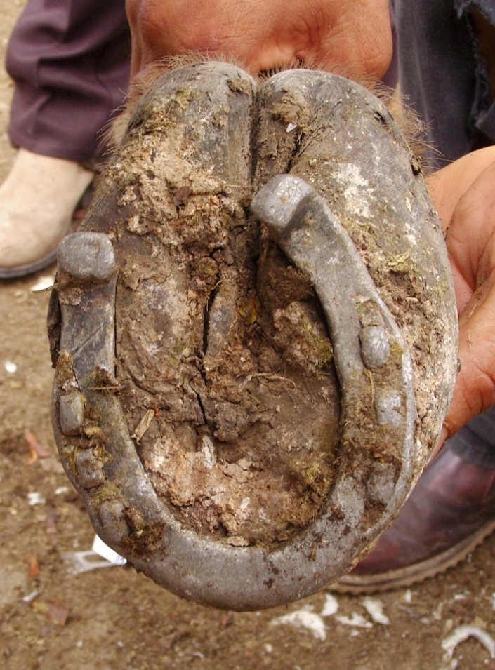
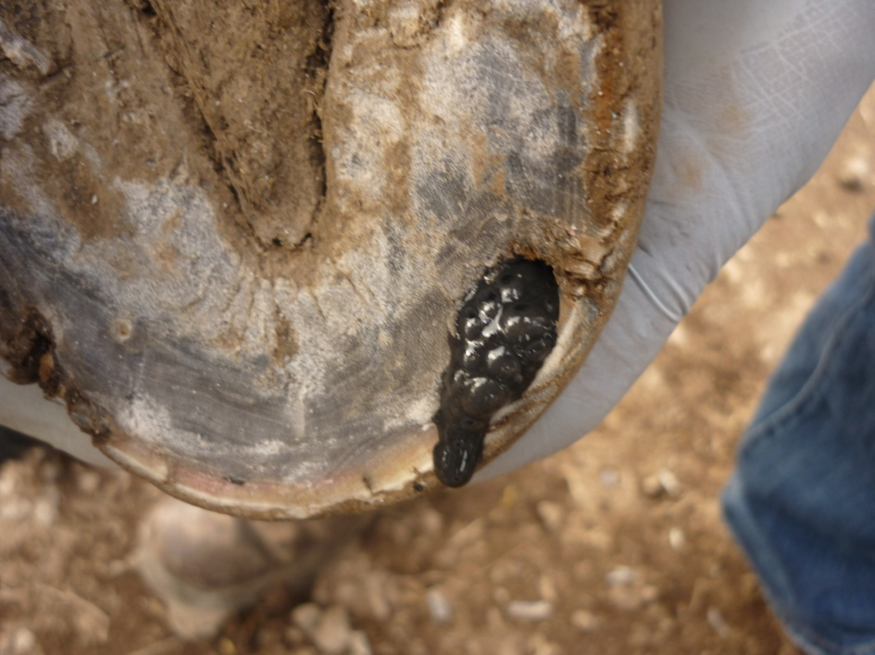
What?
Hoof disease
Notes:
Hoof disease

Slide 30
Maintaining proper hoof moisture
Proper hoof moisture contents is important in the maintenance of good hooves as moist hooves are liable to cracking and splitting.
Factors, which increase hoof moisture content in equidae, include;
  Stabling in deep manure (mud or urine): this also may result in certain hoof diseases such as greasy heel(Mud fever)caused by dermatophylus organisms and thrush (Fusobacterium necrophorum)
  Daily packing of saturated clay in the bottom of the hoof

Slide 31
Stabling areas should be kept dry and clean.
Each day the feet of all stabled equidae should be examined for any abnormality.
Hooves should be cleaned out using hoof pick.
“If you care for your draught animal, you will take good care of its hoofs.”

Slide 32
Grooming
Grooming is a process of cleaning the skin and coat by means of friction and massage. It has certain advantages, which include;
  Removes the internal waste of their body which has been exuded through the pores of the skin, dust, sand ,mud and ectoparasites
  improves blood flow to the skins and superficial muscles and helps the skin to be healthy.

Slide 33
  Allows time to develop trust between animals and owners and gives chance to the owner to see any abnormality on skin
  Grooming should be done regularly and thoroughly.
  Horses on fast and heavy work accompanied by heavy feeding require more frequent grooming than idle or horses on light work

Slide 34
Use of proper harnesses
Harness is a system or a device that is fitted on the working animal. Example yoke, cart, saddle, hobble, bits, straps, halter etc
Harnesses should be individually made and well fitted to each animal.
This helps to prevent spread of certain skin diseases such as mange mites, dermatophyllosis and ringworm.

Slide 35
The harness should also be properly fitted to the animal not to hamper natural movement, breathing or blood circulation and to avoid injuries.
Because abrasions from improperly fitting harnessing device may provide a suitable site for diseases such as Tetanus, lymphangitis (epizootic and ulcerative), cutaneous sporotrichosis and contagious postular dermatitis

Slide 36
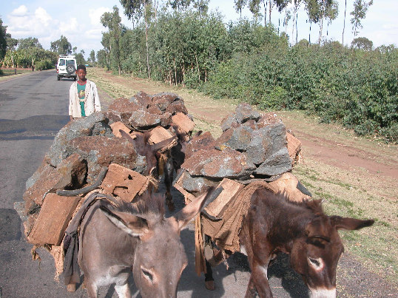

Slide 37
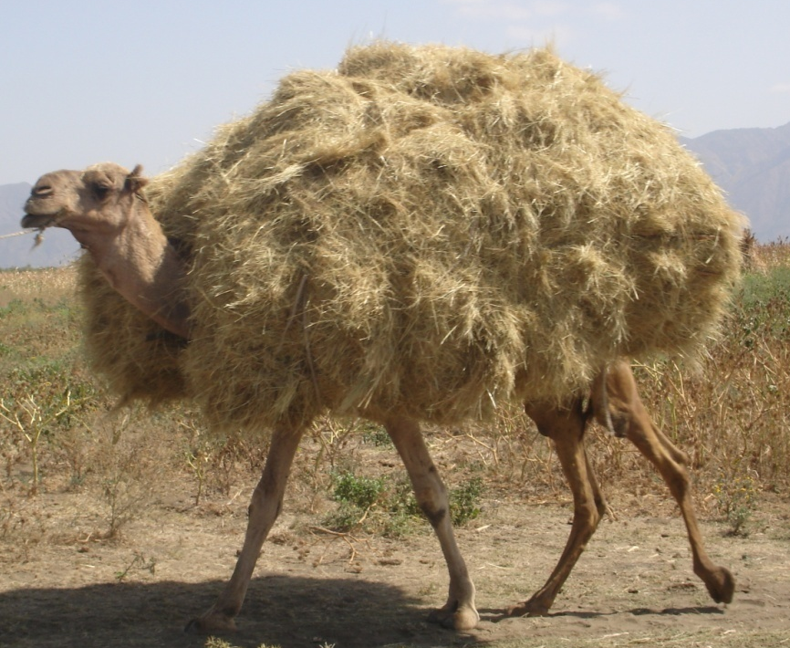
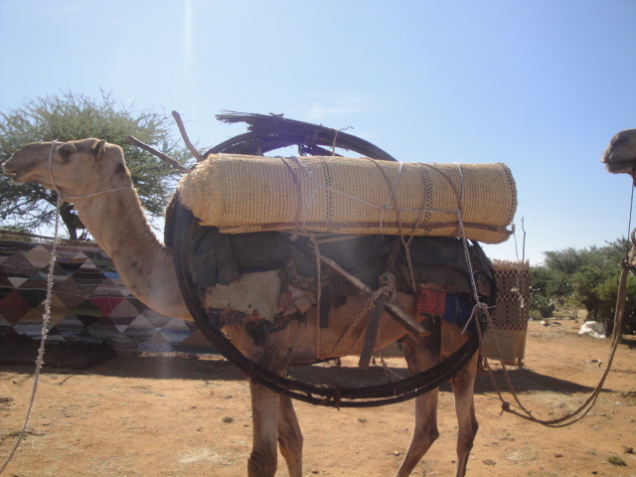
Management
of working camels

Slide 38
Management of draft camels
Camels are good work animals.
They are amenable patient animals that can easily be trained for work.
Despite of this docility, they can be savage and violent under certain physiological conditions and improperly handled

Slide 39
Castration
Castration is an important management practice in camels that are kept for work.
It avoids the undesirable behavior of male camel during the breeding season. During the breeding season un-castrated camels become aggressive and unmanageable. Such behavior is known as rutting.
During rutting, the male changes from a docile phlegmatic animal to a vicious biting and belligerent animal. Due to this behavior entire males to be used for work should be castrated.

Slide 40
Advantages of castrating working camels:
It avoids fighting among male camels during rutting period
  become more docile and easily manageable than entire males.
  avoids the aggressive behavior of masculine characteristics associated with hormonal influence.
Age timing of castration: Generally camels are castrated rather late in most of Eastern Africa. Major reason for this is that selection decision whether to retain an animal for breeding or not is only made when animals approach sexual maturity. It is easier to judge the potential development of a camel at sexual maturity

Slide 41
Males castrated at about 4 year’s age are usually used for slaughter. Because there will be faster rate of hump development until the time of slaughter i.e. about 6 years of age.
If the animal is to be used for pack or draft, castration should be done after the animal has reached full sexual maturity at 7-9 years of age. By this time the hump will not develop any more to the same proportion after castration as those castrated at earlier ages.

Slide 42
Because large sized hump is not required in working camels as that meant for slaughter it would be cumbersome during saddling and loading.
Castration of camels could be carried out in the coolest season of the year. This helps to reduce fly problem and infection which may delay healing.
Castration should be done in camels that are in good body condition for a fast healing process.

Slide 43
Selection of working camels
There are certain body conformations to be considered in selecting working camels.
Commonly observed conformation fault in camels which are undesirable for working camels include:
  Angular deformities of the skeleton especially of the limbs. Such problem is common in very young camels legs : angular deformity of the fetlock
  Hyperflexion of the fetlock due to extreme contraction of the flexor tendons

Slide 44
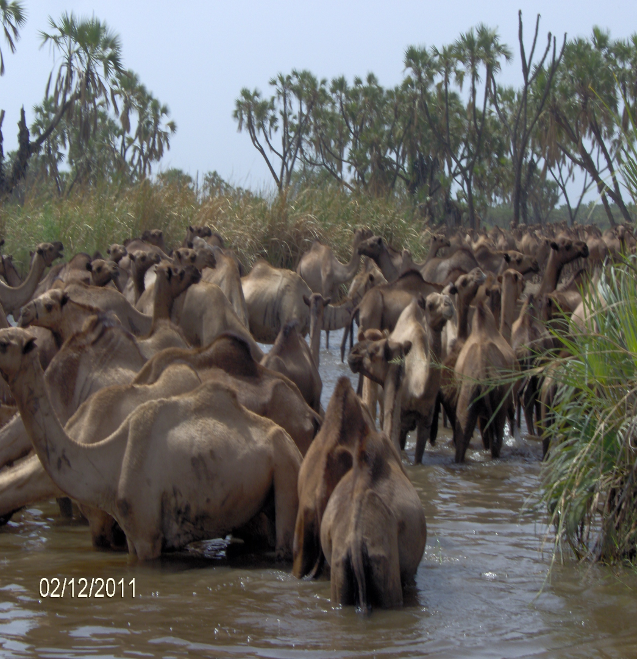
Bruising knees which is most commonly seen in large sized and huge camels
Narrow chest which can be related to nutritional deficiencies during the early post-natal growth stages. Narrow chest can predispose to other problems like bruising elbows which may result in injury impairing the working ability of the animal

Slide 45
Age and average duration for work
Young animals should be trained to handling from the earliest age. Young camels should be first loaded with empty saddles and later with some load on it i.e with gradual increment the load. However, camels should not brought to full work until they are 6 years of age.
The average duration of work in camels should not exceed 6 hours per day. Over working leads to stress.

Slide 46
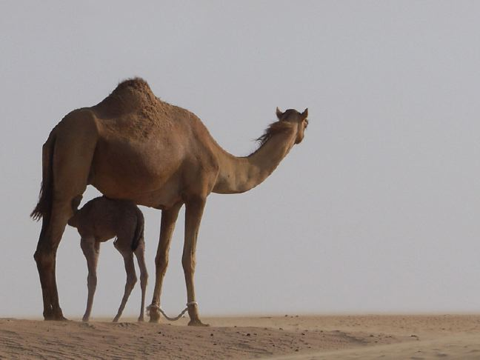
Working camels need to be retired from work for a definite period each year. This is usually during the rainy season when the conditions for work are difficult

Slide 47
Harnessing or packing
In Eastern Africa, camels are mainly used as pack animals. However, the pack saddles used are usually a collection of sticks, ropes and pieces of raw hide.

Slide 48
Back sore is the most common problem due to inappropriate saddling and packing systems. Saddle sore may result in abscess formation or deep wounds that are usually infested by fly larvae.
In the traditional management system wounds take several months to years for healing. This is because camel owners usually do not give rest for working camels until the wound heals which causes the suffering of the animal.

Slide 49
Control and prevention of back sores
improved management through use of comfortable harness or saddle with adequate padding
good sanitation/hygiene of body surface making contact with the harness
proper loading/packing of camels keeping proper balance of the load on the back
avoiding use of camels suffering from back/hump sore until healing occurs
proper management and handling of wounds/abscesses i.e. wound should be properly treated as early as possible

Slide 50
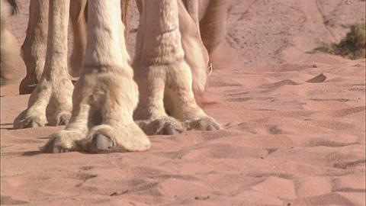
Foot care
In camels deep solar wound is a common problem in the rainy season due to penetration by foreign bodies. This is because humid and wet weather results in excessive wetting of the solar pad. As a result the foot pad becomes soft and susceptible to physical damage resulting wound.
Excessive growth of the solar (foot) pad is also another common foot problem in camels that are kept on soft soil for extremely long period. Such problem may result in lameness.

Slide 51
Control and prevention of foot problems
camels should not be made to work during the wet/rainy season
avoid camels from grazing on areas with rocky or stony surfaces and thorny vegetation during the humid and wet weather conditions
Keep camels on a fairly hard ground surface to maintain the normal rate of foot pad growth

Slide 52
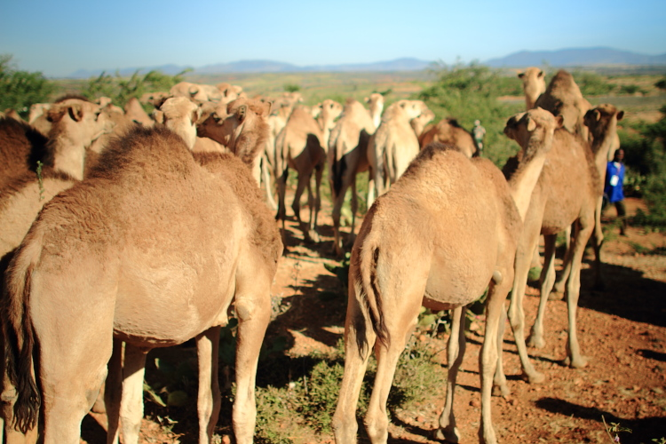
Thank you!!!

