Slide 1
Translation
The flow of genetic information in cells is from DNA to RNA to protein.
Translation (mRNA —> protein) in which the mRNA sequence is decoded (translated) into an amino acid sequence.
The sequence of nucleotides in a gene (DNA) specifies the sequence of nucleotides in a molecule of messenger RNA
The sequence of nucleotides in the mRNA specifies the sequence of amino acids in the polypeptide chain.

Slide 2
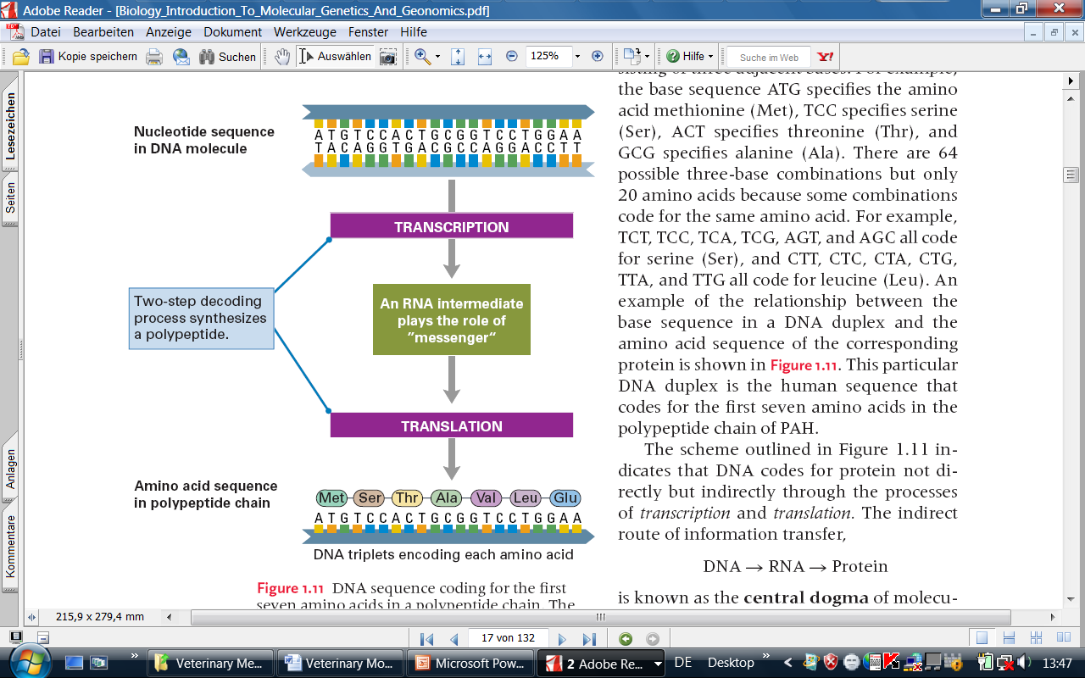
Cont…

Slide 3
What is the correspondence between the mRNA nucleotides and the amino acids of the protein?
Proteins are formed from 20 amino acids in humans
Codons of two nucleotide AA GA CA UA AG GG CG UG AC GC CC UC AU GU CU UU
Codons of one nucleotide A G C U
CAN ONLY ENCODE 4 AMINO ACIDS
CAN ONLY ENCODE 16 AMINO ACIDS

Slide 4
Cont…
Codons of three nucleotides:
AAA AGA ACA AUA AAG AGG ACG AUG
AAC AGC ACC AUC AAU AGU ACU AUU
GAA GGA GCA GUA GAG GGG GCG GUG
GAC GGC GCC GUC GAU GGU GCU GUU
CAA CGA CCA CUA CAG CGG CCG CUG
CAC CGC CCC CUC CAU CGU CCU CUU
UAA UGA UCA UUA UAG UGG UCG UUG
UAC UGC UCC UUC UAU UGU UCU UUU
Allows for 64 potential codons => sufficient!

Slide 5
The Genetic Code
There is a 3 to 1 correspondence between RNA nucleotides and amino acids.
The three nucleotides used to encode one amino acid are called a codon.
The genetic code refers to which codons encode which amino acids.
One start codon (AUG=methionine), and three stop codons (UAA, UAG or UGA)
Non overlapping
Genetic code is universal
The genetic code is degenerate - some codons encode the same amino acid

Slide 6
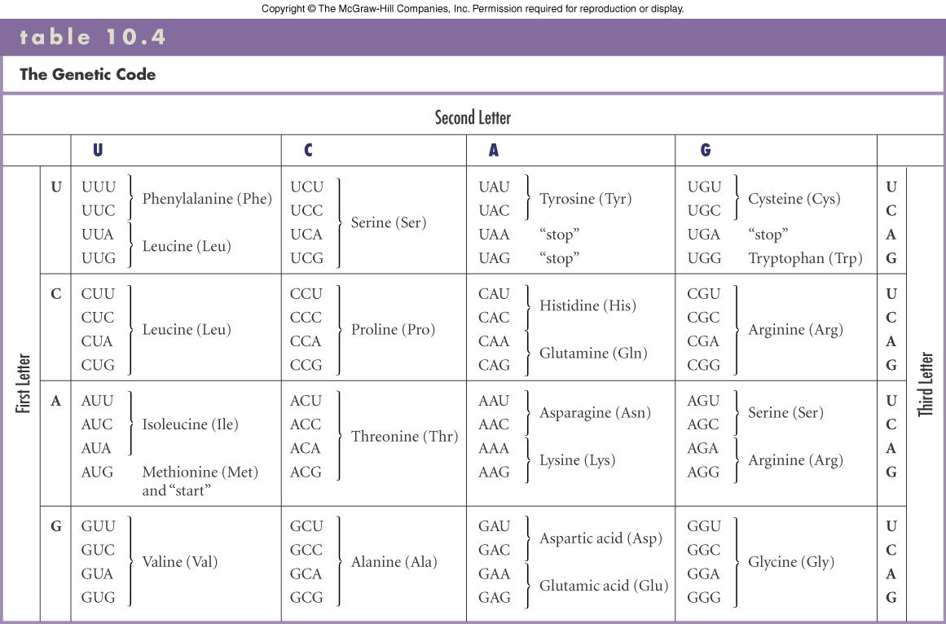
The genetic code

Slide 7
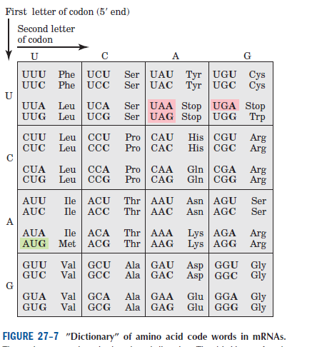

Slide 8
Ribosome
Ribosomes are massive assemblies of proteins and pieces of rRNA that form discrete “small” and “large” subunits.
Prokaryotes:50S+30S=70S Eukaryotes:60S+40S=80S
Ribosomes work free in the cytosol or when membrane bound
i.e. Rough Endoplasmic Reticulum (RER)
Small ribosomal subunit bind mRNA first, then Large subunit

Slide 9
Cont….
Complex has four RNA-lined binding sites
1) mRNA-Site
2) A-Site (aminoacyl-tRNA)
3) P-Site (peptidyl-tRNA )
4) E-Site empty tRNA exits from here!
We call a ribosome a “ribozyme” because it has enzyme-like activity but it is made of RNA at its active site, not protein!
The Proteins associated with it help regulate its shape and activity but are not entirely critical for its activity

Slide 10
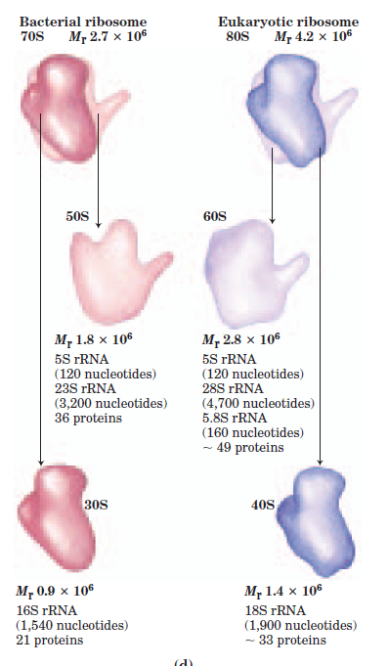

Slide 11
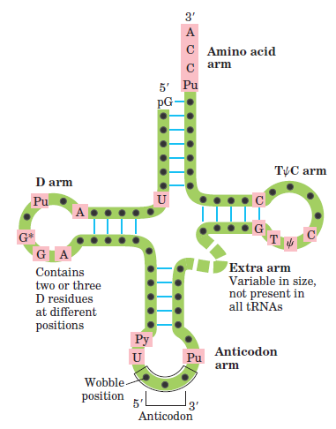
tRNA

Slide 12
Protein Biosynthesis
Takes Place in Five Stages
Activation of amino acids
Initiation
Enlongation
Termination and release
Folding and Posttranslational Processing

Slide 13
Activation of Amino Acids
For the synthesis of a polypeptide with a defined sequence, two fundamental chemical requirements must be met:
(1) the carboxyl group of each amino acid must be activated to facilitate formation of a peptide bond,
(2) a link must be established between each new amino acid and the information in the mRNA that encodes it.

Slide 14
Cont…
Attaching the right amino acid to the right tRNA is critical.
This reaction takes place in the cytosol, not on the ribosome.
Each of the 20 amino acids is covalently attached to a specific tRNA at the expense of ATP energy, using Mg2+ dependent activating enzymes known as aminoacyltRNA synthetases.
When attached to their amino acid (aminoacylated) the tRNAs are said to be “charged.”

Slide 15
Initiation
The mRNA bearing the code for the polypeptide to be made binds to the two smaller ribosomal subunits and to the initiating aminoacyl-tRNA.
The large ribosomal subunit then binds to form an initiation complex.
The initiating aminoacyl-tRNA base pairs with the mRNA codon AUG that signals the beginning of the polypeptide.
This process, which requires GTP, is promoted by cytosolic proteins called initiation factors.

Slide 16
Translation - Initiation
fMet
P
A
Large subunit
E
UAC
5’
GAG...CU-AUG--UUC--CUU--AGU--GGU--AGA--GCU--GUA--UGA-AT GCA...TAAAAAA
3’
Small subunit
mRNA

Slide 17
Elongation
The nascent polypeptide is lengthened by covalent attachment of successive amino acid units
each aminoacid is carried to the ribosome and correctly positioned by its tRNA, which base-pairs to its corresponding codon in the mRNA.
Elongation requires cytosolic proteins known as elongation factors.
The binding of each incoming aminoacyl-tRNA and the movement of the ribosome along the mRNA are facilitated by the hydrolysis of GTP as each residue is added to the growing polypeptide.

Slide 18
Translation - Elongation
Polypeptide
Met
Arg
Phe
Leu
Ser
Gly
Aminoacyl tRNA
P
A
Ribosome
E
UCU
CCA
5’
GAG...CU-AUG--UUC--CUU--AGU--GGU--AGA--GCU--GUA--UGA-AT GCA...TAAAAAA
3’
mRNA

Slide 19
Translation - Elongation
Polypeptide
Met
Phe
Leu
Ser
Gly
Arg
Aminoacyl tRNA
P
A
Ribosome
E
CCA
UCU
5’
GAG...CU-AUG--UUC--CUU--AGU--GGU--AGA--GCU--GUA--UGA-AT GCA...TAAAAAA
3’
mRNA

Slide 20
Translation - Elongation
Polypeptide
Met
Phe
Leu
Ser
Gly
Arg
Ala
P
A
Ribosome
CCA
E
UCU
CGA
5’
GAG...CU-AUG--UUC--CUU--AGU--GGU--AGA--GCU--GUA--UGA-AT GCA...TAAAAAA
3’
mRNA

Slide 21
Translation - Elongation
Polypeptide
Met
Phe
Leu
Ser
Gly
Arg
Ala
P
A
Ribosome
CCA
E
UCU
CGA
5’
GAG...CU-AUG--UUC--CUU--AGU--GGU--AGA--GCU--GUA--UGA-AT GCA...TAAAAAA
3’
mRNA

Slide 22
Termination and Release
Completion of the polypeptide chain is signalled by a termination codon in the mRNA.
The new polypeptide is released from the ribosome, aided by proteins called release factors.
Folding and Posttranslational Processing
In order to achieve its biologically active form, the new polypeptide must fold into its proper three-dimensional conformation.
Before or after folding, the new polypeptide may undergo enzymatic processing, including removal of one or more amino acids (usually from the amino terminus); addition of acetyl, phosphoryl, methyl, carboxyl, or other groups to certain amino acid residues; proteolytic cleavage; and/or attachment of oligosaccharides or prosthetic groups.

Slide 23
Transcription And Translation In Prokaryotes
5’
3’
3’
5’
RNA
Pol.
Ribosome
mRNA
Ribosome
5’

