Slide 1
Genetic engineering/ Gene manipulation or Recombinant DNA Technology
Gene manipulation is the formation of new combinations of heritable material,
  by the insertion of nucleic acid molecules,
  produced by whatever means outside the cell,
  into any virus, bacterial plasmid or other vector system
so as to allow their incorporation into a host organism in which they do not naturally occur,
but in which they are capable of continued propagation.

Slide 2
Requirements
Tool to cut DNA precisely = Restriction enzyme
Tool to join (ligate) DNA to replicon
Cloning vector (= replicon)
Method to transform (bacterial) cells
Cloning strategies
Selection strategies

Slide 3
CLEAVING AND JOINING DNA MOLECULES
1. Cleavage of DNA by mechanical shearing
The DNA molecule is a long thin thread sufficiently rigid to be broken by shear forces in solution, like intense sonication with ultrasound or like high speed stirring in a blender.
Breakage occurs essentially at random with respect to the DNA sequence.

Slide 4
2. Cleavage by non-specific endonucleases
non-specific endonucleases such as DNAase I can be used in order to cut the DNA molecule in an essentially random fashion.
3. Cleavage of DNA with restriction enzymes
Before 1970 there was no method available for cutting a DNA molecule into discrete fragments.
A breakthrough was achieved when it was discovered that host-controlled restriction and modification (= HCRM) involves specific endonucleases (= restriction endonuclease or enzyme).

Slide 5
Cont…
HCRM are most readily observed when bacteriophages are transferred from one bacterial host strain to another.
The phages are said to be restricted by the second host strain.
The phage DNA is degraded soon after injection into a non permissive host by restriction enzymes.
The non-heritable change conferred upon the phage that allows it to be re-plated on a strain without restriction is called modification.
Modification involves methylation of certain bases (A or C) within the recognition sequence of the restriction enzyme.

Slide 6
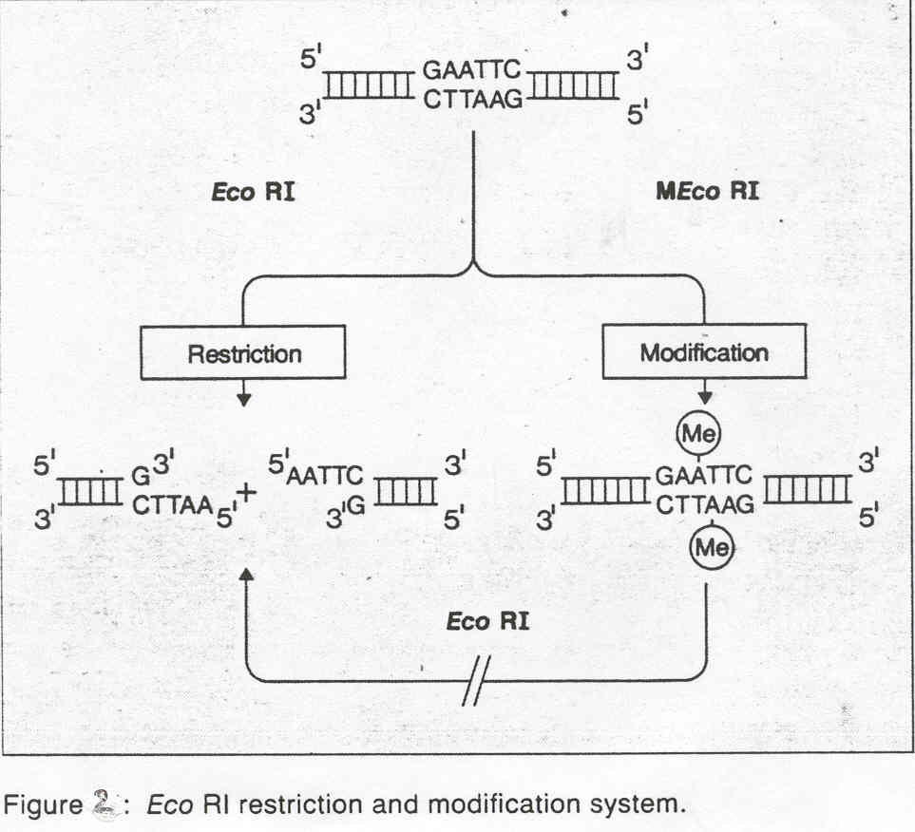
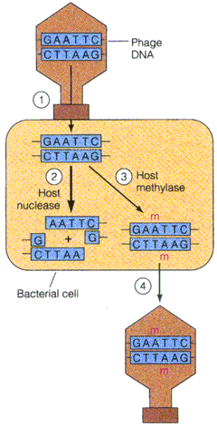

Slide 7
Restriction Endonucleases
Also called restriction enzymes
1962: “molecular scissors” discovered in in bacteria
E. coli bacteria have an enzymatic immune system that recognizes and destroys foreign DNA
3,000 enzymes have been identified, around 200 have unique properties, many are purified and available commercially

Slide 8
Restriction Endonucleases
Named for bacterial genus, species, strain, and type
Example: EcoR1
Genus: Escherichia
Species: coli
Strain: R
Order discovered: 1

Slide 9
Classification of restriction enzymes
There are 3 classes according to the gene organisation and the mode of action:
1.Class or type I restriction enzymes
These are encoded by 3 gene segments expressing the functions for sequence specificity, restriction and methylation.

Slide 10
Cont…
They bind to a specific sequence but cut un-specifically some 100 to 1000 bp in the 3' direction.
The enzyme from E. coli K is an example of a type I restriction enzyme.
The type I restriction enzymes are of limited use in gene manipulation.

Slide 11
2.Class II enzymes
These are expressed from 2 different genes as two single proteins.
They hydrolyse fixed phosphodiester bonds in both DNA strands within or very near the recognition sequence.
Class II restriction enzymes are by far the most important tools for the synthesis of recombinant DNA because of their absolute sequence specificity for both the binding and cleavage reactions.

Slide 12
Class III restriction enzymes
These are also expressed from 2 genes
Type III restriction enzymes recognise specific sequences, but cleave 25 to 27 bp outside of this region in the 3' direction.
Their activity is dependent on magnesium ions and ATP, but not on S-adenosylmethionine.

Slide 13
Recognition Sequences
EcoRI G/AATTC
BamHI G/GATCC
HindIII A/AGCCT
PstI CTGCA/G
PmeI GTTT/AAAC
HincII GTY/RAC
FunII G/AATTC
Features
Palindromic
Length
4 cutters, 6 cutters etc
Site of cleavage
Sticky ends
3’ overhang
5’ overhang
blunt end
Compatibility
Multiple Recognition sequences
Isoschisomers
Type II vs Type III RE

Slide 14
Cont…
Each restriction enzyme always cuts at the same recognition sequence.
Produce the same gel banding pattern (fingerprint)
Many restriction sequences are palindromic.

Slide 15
What is a Palindrome?
A palindrome is anything that reads the same forwards and backwards:
English palindromes: Mom, Dad, Tarzan raised Desi Arnaz rat.
A DNA Palindrome is defined as any double stranded DNA in which reading in the 5’ to 3’ direction in both strands is the same

Slide 16
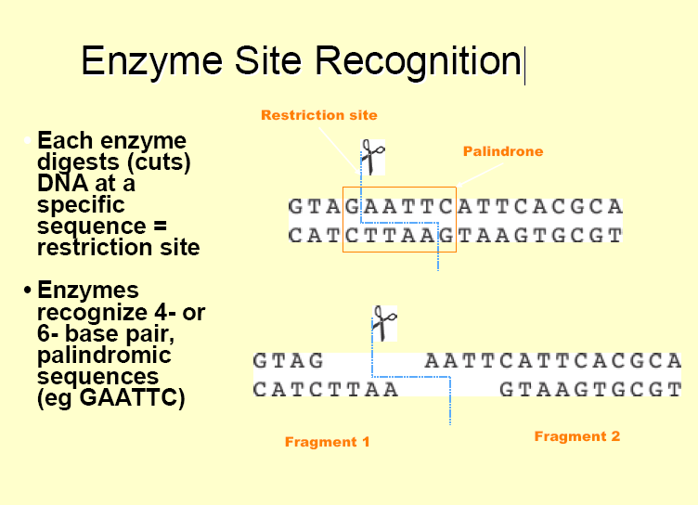

Slide 17


Sticky end cutters
0
Most restriction enzymes make staggered cuts ; staggered cuts
produce single stranded sticky-ends
DNA from different sources can be joined because of sticky-
end overhangs.
5’ P -
- OH 3’
HindIII
- P 5’
3’ OH -
EcoRI

Slide 18


Blunt end cutters
0
Some restriction enzymes cut DNA at opposite bases and leave blunt ended DNA fragments
These are called blunt end cutters
AluI
HaeIII

Slide 19
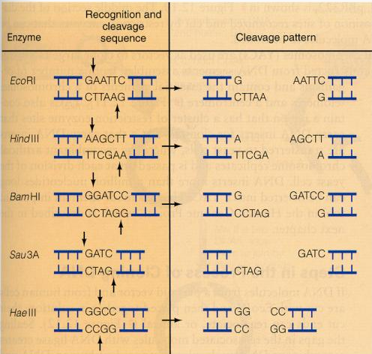

Slide 20
Typical Restriction Digest
0
Sterile, deionized water 16.3 µl
RE 10X Buffer 2.0 µl
Acetylated BSA, 10µg/µl 0.2 µl
DNA, 1µg/µl 1.0 µl
Mix by pipetting, then add:
Restriction Enzyme, 10u/µl 0.5 µl
Final volume 20.0 µl

Slide 21
Joining DNA molecules
There are 5 methods that can be used for joining DNA fragments in vitro:
1.Terminal deoxynucleotidyl transferase synthesises homopolymeric 3' single stranded tails at the ends of the fragments.
Two DNA molecules tailed by complementary bases will anneal spontaneously.

Slide 22
Cont…
2.DNA ligase (from E. coli) joins covalently the annealed cohesive ends produced by certain restriction enzymes.
It needs NAD+ as a co-factor
3.T4 DNA ligase catalyses the phosphodiester bond formation also between blunt ended fragments. Its co-factor is rATP
4.Topoisomerase mediated DNA joining
5.The LIC method (LIC: Ligation independent cloning)

Slide 23
Cloning Vectors
A vector is used to amplify a single molecule of DNA into many copes.
A DNA fragment must be inserted into a cloning vector.
A cloning vector is a DNA molecule that has an origin of replication and is capable of replicating in a bacterial cell.
Most vectors are genetically engineered
plasmids
phages
cosmid vectors
bacterial artificial chromosomes and
yeast artificial chromosomes.

Slide 24
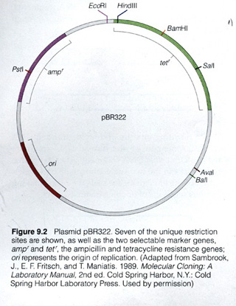
1.Plasmid Cloning Vectors
Plasmids are circular, double-stranded DNA molecules that exist in bacteria and in the nuclei of some eukaryotic cells.
They can replicate independently of the host cell.
The size of plasmids ranges from a few kb to near 100 kb
Can hold up to 10 kb fragments
Plasmids have an origin of replication, antibiotic resistance genes as markers, and several unique restriction sites.
After culture growth, the clone fragment can be recovered easily.
The cells are lysed and the DNA is isolated and purified.
A DNA fragment can be kept indefinitely if mixed with glycerol in a –70 degrees C freezer.

Slide 25
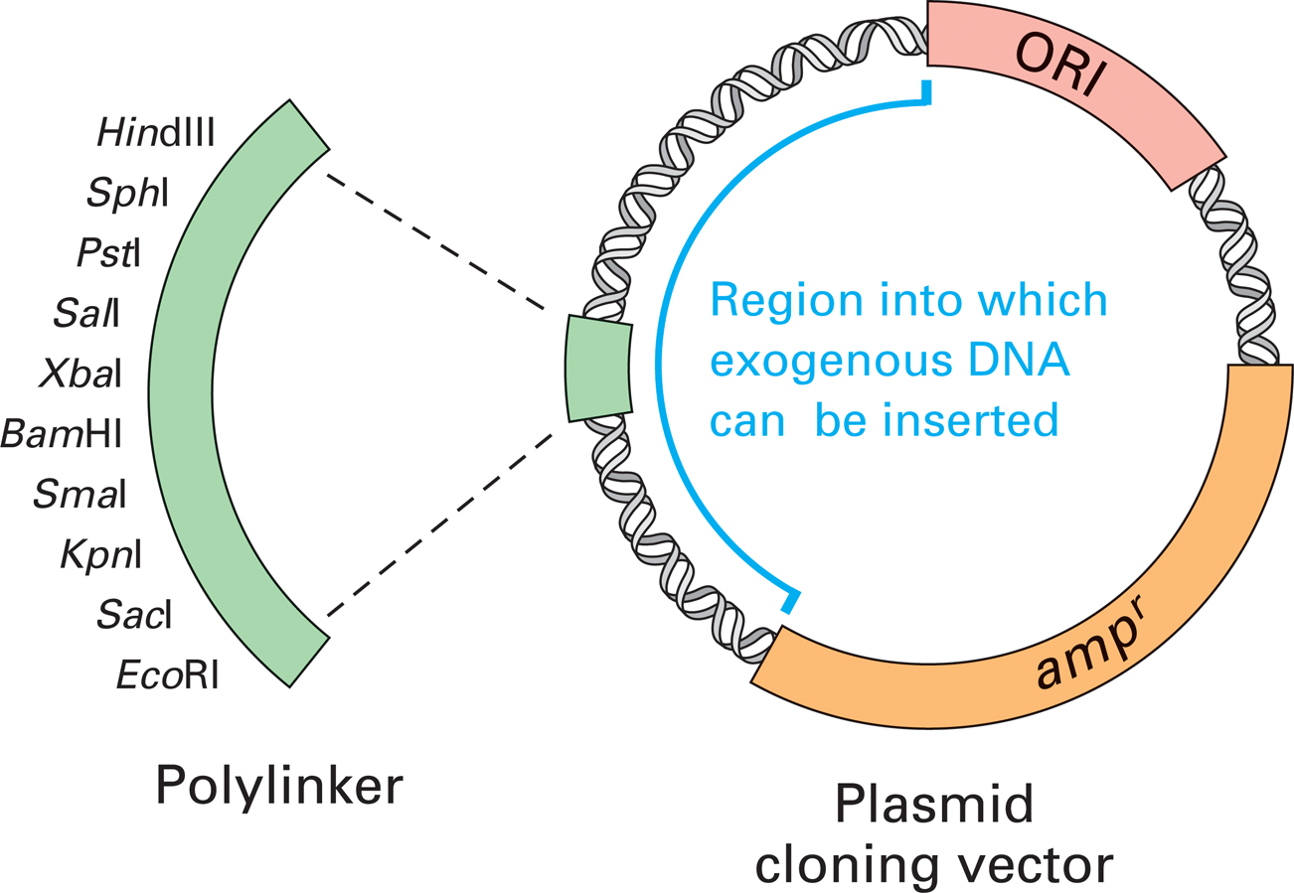
Basic components of a plasmid cloning vector that can replicate within an E. coli cell.
3 important features: Cloning site, Ori-an origin of replication, A selectable marker (amp^{r})

Slide 26
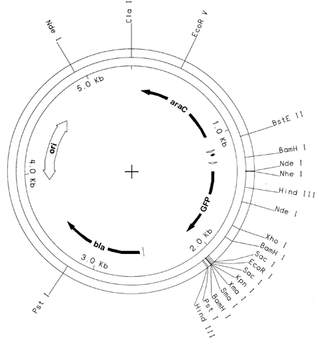
Promotor Site
Origin of Replication
Antibiotic Resistance Gene
Multiple Cloning Site

Slide 27
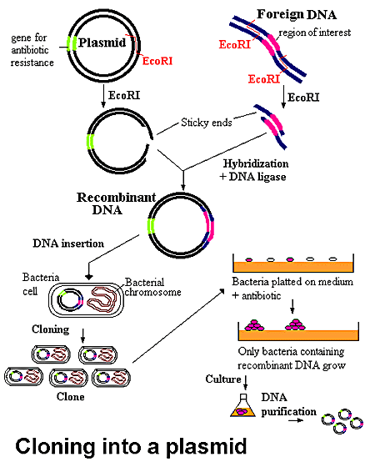
Cloning into a Plasmid

Slide 28
The Major Limitation of Cloning in Plasmids
Upper limit for clone DNA size is 12 kb
Requires the preparation of “competent” host cells
Inefficient for generating genomic libraries as overlapping regions needed to place in proper sequence
Preference for smaller clones to be transformed
If it is an expression vector there are often limitations regarding eukaryotic protein expression

Slide 29
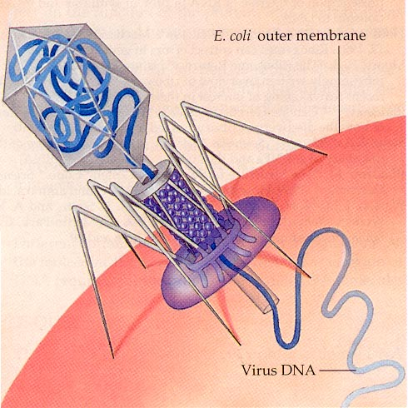
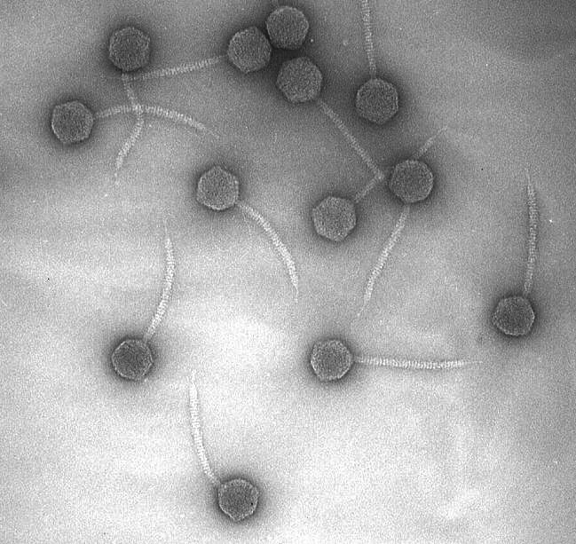
2.Bacteriophage lambda (λ)
A virus that infects bacteria
In 1971 Alan Campbell showed that the central third of the genome was not required for lytic growth.
People started to replace it with E. coli DNA

Slide 30
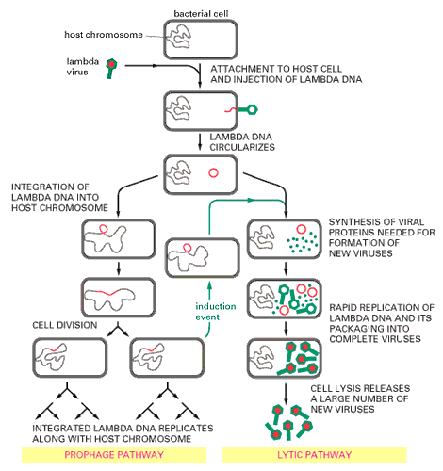
Lambda genome is approximately 49 kb in length.
Only 30 kb is required for lytic growth.
Thus, one could clone 19 kb of “foreign” DNA.
Packaging efficiency 78%-100% of the lambda genome.
Notes:
Legend:
The linear double-stranded DNA lambda genome contains about 50,000 nucleotide pairs and encodes 50-60 different proteins. When the lambda DNA enters the cell the ends join to form a circular DNA molecule. The bacteriophage can multiply in E. coli by a lytic pathway, which destroys the cell, or it can enter a latent prophage state. Damage to a cell carrying a lambda prophage induces the prophage to exit from the host chromosome and shift to lytic growth (green arrows). The entrance and exit of the lambda DNA from the bacterial chromosome are site-specific recombination events.

Slide 31
Cont…
constraint on the amount of DNA that will fit inside it (~ 55kb)
By the early 1970’s we knew that a good portion of lambda was not required
“Junk” DNA
COS site: Cohesive “sticky” ends
Lysis
Head
Replication
ori
Tail
Circularized lambda
Lysogeny

Slide 32
Lysis
COS
Eliminate the non-essential parts of lambda
Can now insert large pieces of DNA (~ 20 kb)
Head
Replication
ori
Tail

Slide 33
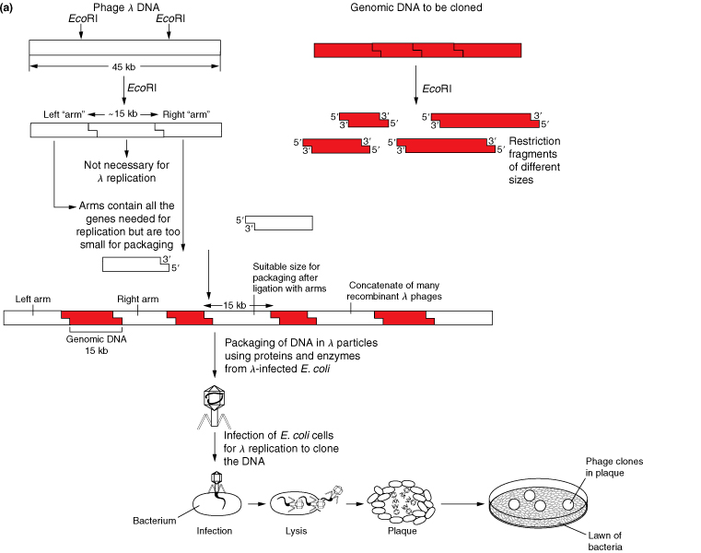

Slide 34
Lambda was great:
Larger insert size
Introducing phage DNA into E.coli by phage infection is much more efficient than transforming E.coli with plasmid DNA
The problem is you Have to work with plaques

Slide 35
3.Cosmid Cloning Vectors
Fragments from 30 to 46 kb can be accommodated by a cosmid vector.
Cosmids combine essential elements of a plasmid and Lambda systems.
Cosmids are extracted from bacteria and mixed with restriction endonucleases.
Cleaved cosmids are mixed with foreign DNA that has been cleaved with the same endonuclease.
Recombinant cosmids are packaged into lambda caspids
Recombinant cosmid is injected into the bacterial cell where the rcosmid arranges into a circle and replicates as a plasmid.
It can be maintained and recovered just as plasmids.

Slide 36
Cont…
Hybrid vectors: plasmids that contain bacteriophage lambda cos sites
DNA is cloned into restriction site, the cosmid packaged into viral particles and these phages used to infect E.coli
Cosmid can replicate in bacterial cell, so infected cells grow into normal colonies
Insert DNA limited by the amount of DNA that can fit into phage capsule
Somewhat unstable, difficult to maintain
ori
21.5 kb
Tet^{R}
cos
EcoRI
Cos site is the only requirement for packaging into phage particle

Slide 37
4.Bacterial Artificial Chromosomes(BACs) and
BACs can hold up to 300 kbs.
The F factor of E.coli is capable of handling large segments of DNA.
Recombinant BACs are introduced into E.coli by electroportation ( a brief high-voltage current).
Once in the cell, the rBAC replicates like an F factor.
Has a set of regulatory genes, OriS, and repE which control F-factor replication, and parA and parB which limit the number of copies to one or two.
A chloramphenicol resistance gene, and a cloning segment.

Slide 38
Cont…
BACs (Bacterial artificial chromosomes)
  Large low copy number plasmids (have ori and selectable marker)
  Can be electroporated into E. coli
  Useful for sequencing genomes, because insert size 100 - 300kb

Slide 39
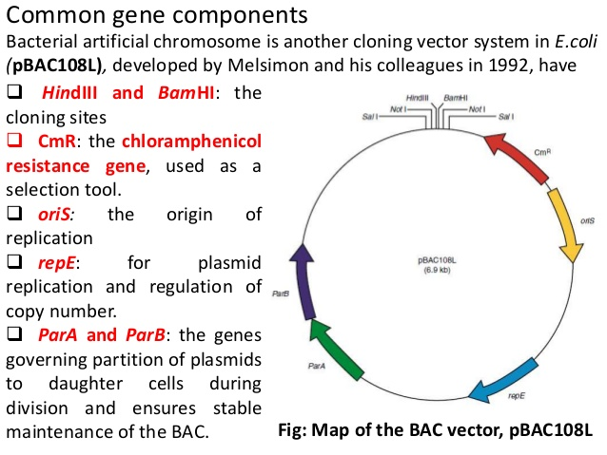

Slide 40
5.Yeast Artificial Chromosomes(YACs)
YACs can hold up to 500 kbs.
YACs are designed to replicate as plasmids in bacteria when no foreign DNA is present.
Once a fragment is inserted, YACs are transferred to cells, they then replicate as eukaryotic chromosomes.
YACs contain: a yeast centromere, two yeast telomeres, a bacterial origin of replication, and bacterial selectable markers.
YAC plasmid→Yeast chromosome
DNA is inserted to a unique restriction site, and cleaves the plasmid with another restriction endonuclease that removes a fragment of DNA and causes the YAC to become linear. Once in the cell, the rYAC replicates as a chromosome, also replicating the foreign DNA.

Slide 41
Cont..
YAC (Yeast Artificial Chromosome)
  Can be grown in E.coli and Yeast
  Miniature chromosome (contains ori, selectable markers, two telomeres, and a centromere
  Can accept 200 kb -1000 kb; useful for sequencing

Slide 42
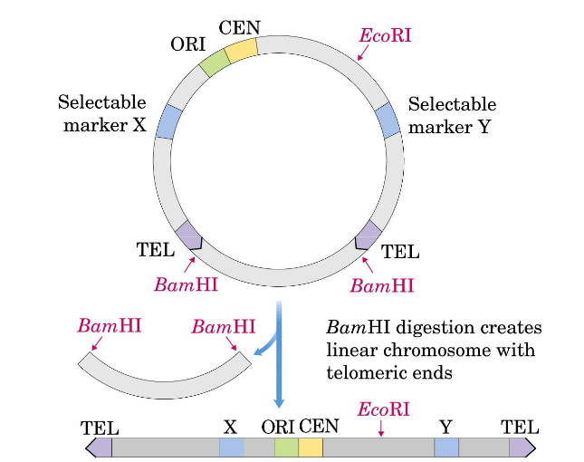
Yeast artificial chromosome vector (YAC)

Slide 43
Transformation
Chemical compétente E.coli
  CaCl₂ treatment
Electro-competent E.coli
In vitro packaging for phage λ
Bio-gun
Micro-injection

Slide 44
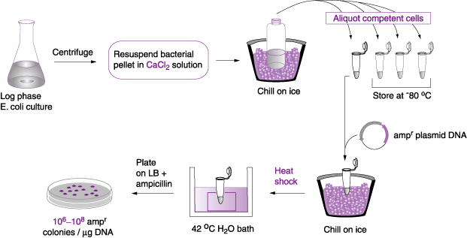
CaCl₂ or chemical compentent

Slide 45
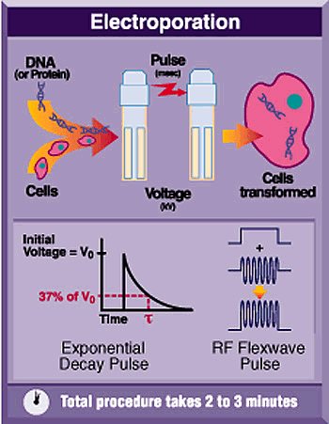
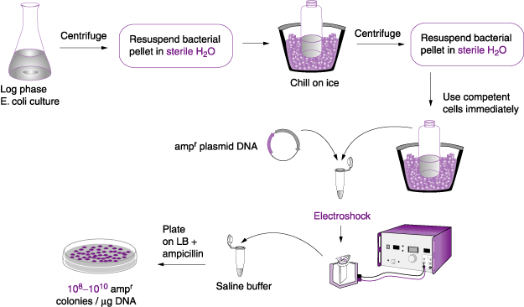
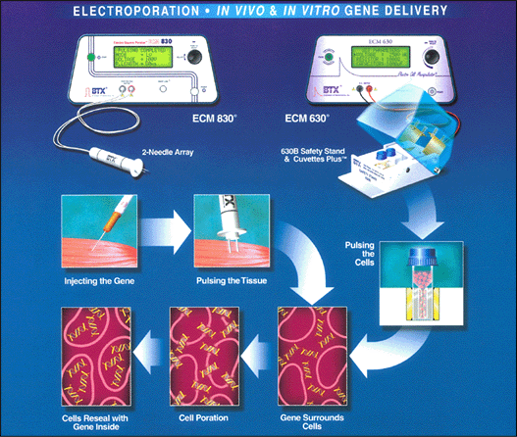
Figure 33
Electro competent

Slide 46
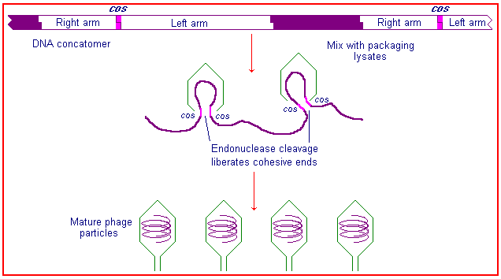
In vitro packaging van phage λ

Slide 47
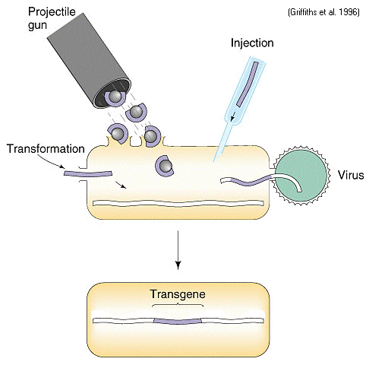
Micro injection

Slide 48
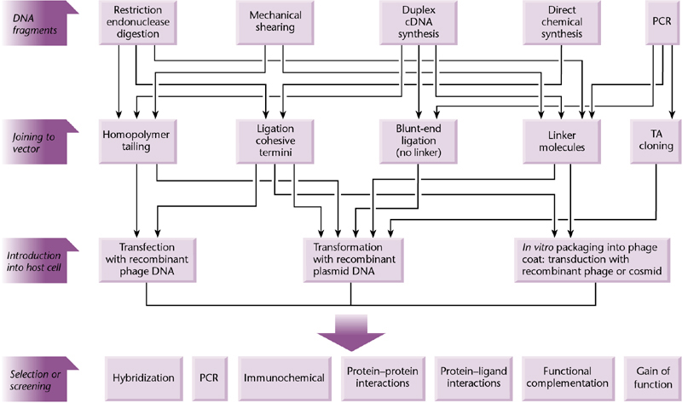
summary of strategies for cloning genes

Slide 49
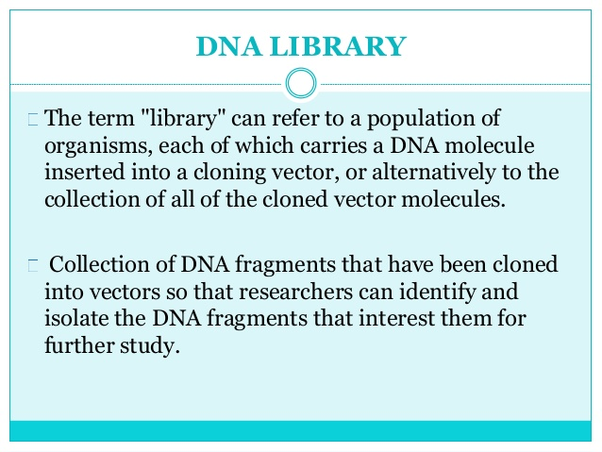

Slide 50
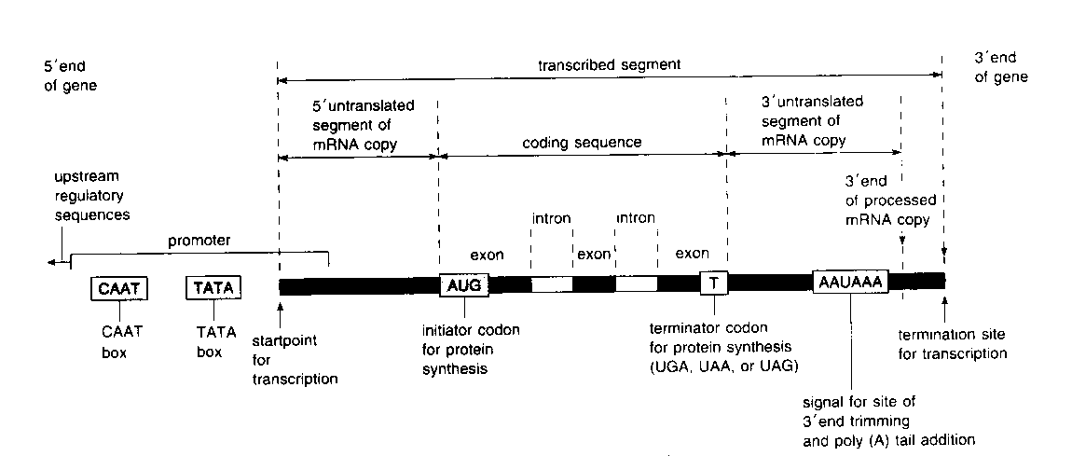
Gene Library construction
Eukaryotic gene organization
enhancers
silencers

Slide 51
1.Genomic Library
2.CDNA Library
Types of DNA liberaries

Slide 52
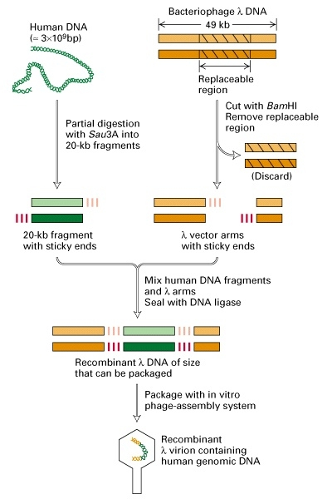
1.Genomic library construction

Slide 53
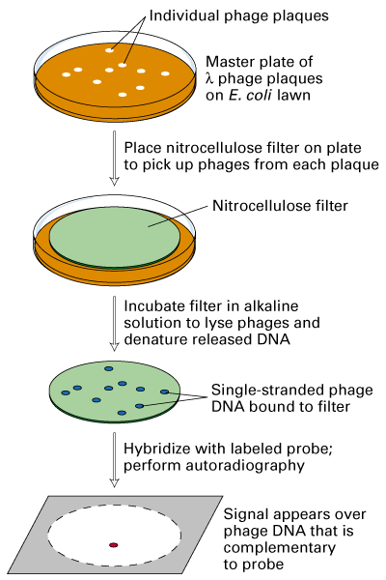
Screening a genomic library using DNA hybridization to a (radio-)labeled DNA probe
Note: a cDNA is commonly (radio-)labeled and used as a DNA probe to screen a genomic library

Slide 54
How many genomic clones must be screened to find your gene?
Theoretically, you will need to screen N clones where N=ln(1-P)/ln(1-f) where P=the probability of finding your gene and f=the average size of the cloned genomic sequence in your vector divided by the total genome size.
How many clones must you screen to find your gene in a human gene library packaged in lambda vector with 99% certainty?
N=ln(1-0.99)/ln(1-20kb/2.8 x 10⁶kb)= 6.4 x 10⁵ clones

Slide 55
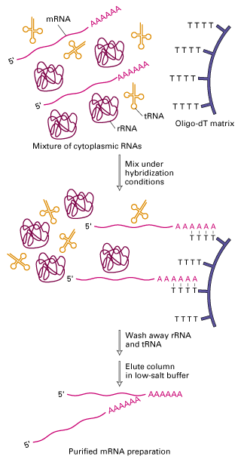
The first step in making a cDNA library: Purification of polyadenylated mRNA using oligo(dT)-cellulose
!
2.cDNA library

Slide 56
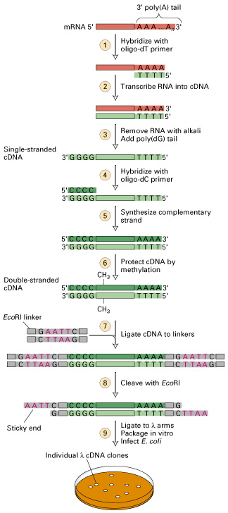
Complementary DNA or cDNA cloning: cDNA library construction
Note: ds cDNAs are typically placed in a cloning vector such as bacteriophage lambda (λ) or a plasmid

Slide 57
There are several possible ways to screen a cDNA library
Using a DNA probe with a homologous sequence (e.g., a homologous cDNA or gene clone from a related species)
Using an oligonucleotide probe based on a known amino acid sequence (requires purification of the protein and some peptide sequencing)
Using an antibody against the protein of interest (note: this requires use of an expression vector)

Slide 58
Screening a cDNA library using DNA hybridization to a (radio-)labeled DNA probe

Slide 59
summary
How to make and screen gene libraries
How to make and screen cDNA libraries
Several different cloning vectors including plasmids, bacteriophage lambda , cosmids, BACS and YACS.

Slide 60
Recombinant DNA Technology:
Steps (1)
DNA extracted from human cells
DNA treated with restriction enzyme, cuts the DNA at specific sites, produce “sticky end”
Bacterial plasmid cut with same enzyme
Plasmid functions as vector and carries human DNA into bacterial cells

Slide 61
Recombinant DNA Technology:
Steps (2)
Fragments of human DNA and plasmid mixed together and join
Plasmids enter the bacterial cells, copy themselves, carry recombinant DNA into bacteria
Bacteria express gene, synthesize the human protein, can be used for treatments, vaccines, or other purposes

Slide 62
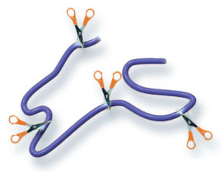
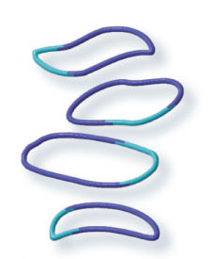
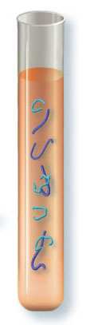
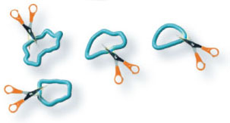
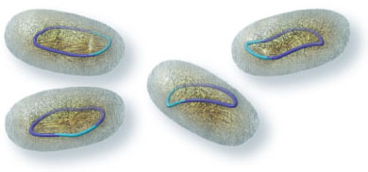
Recombinant DNA Technology
1 Restriction enzymes cut specific base sequences everywhere they occur
in human chromosomes.
4 The result is recombinant DNA molecules with both human and plasmid DNA.
2 The same restriction enzymes cut the same base sequences in plasmid DNA.
3 The plasmid DNA and the human DNA fragments are mixed in a solution with enzymes that link them together.
5 Recombinant DNA inserted into host cells is copied each time the host cells divide.
Stepped Art
p. 104

Slide 63
How Is hGH Produced?
Recombinant DNA technology
Transferred gene for hGH from a human cell DNA to a bacterial cell
Creating a transgenic organism
Transgenic bacterial cell and its descendants manufacture hGH

Slide 64
Other Transgenic Plants and Animals
Production of medically important proteins
Transgenic crops or genetically modified (GM), plants with new characteristics
  Resistance to herbicides, insects, or viral or fungal diseases
  Increase the nutritional value of crops
Pigs for xenotransplants

Slide 65
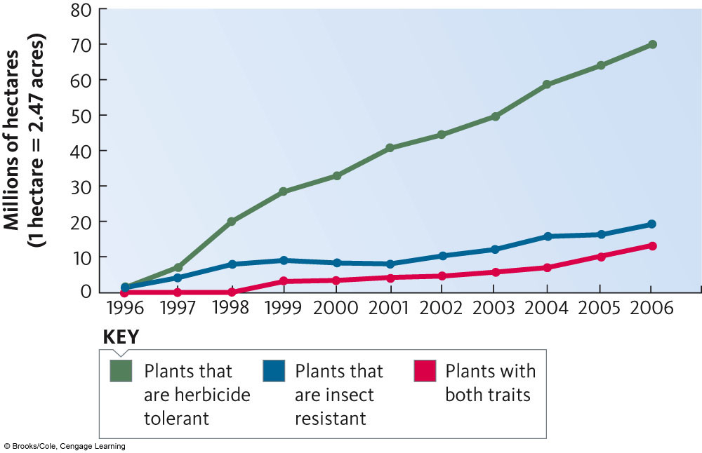
Transgenic Crops

Slide 66
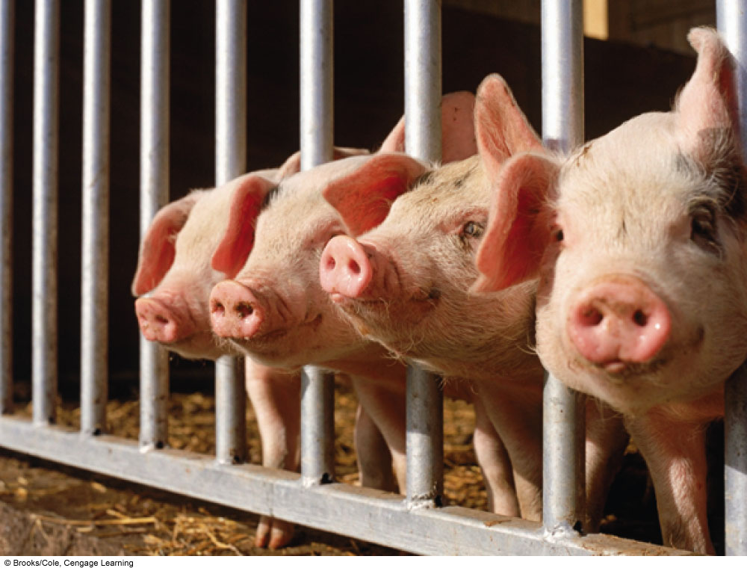
Pigs for Possible Organ Transplant
HLA ( human leukocyte antigen (HLA)) transferred to pig embryos

Slide 67
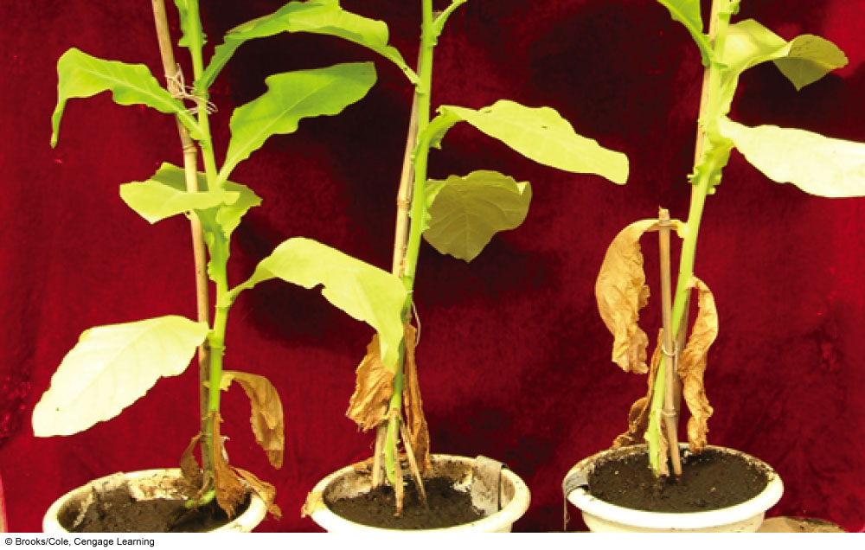
Transgenic Tobacco Produce hGH

Slide 68
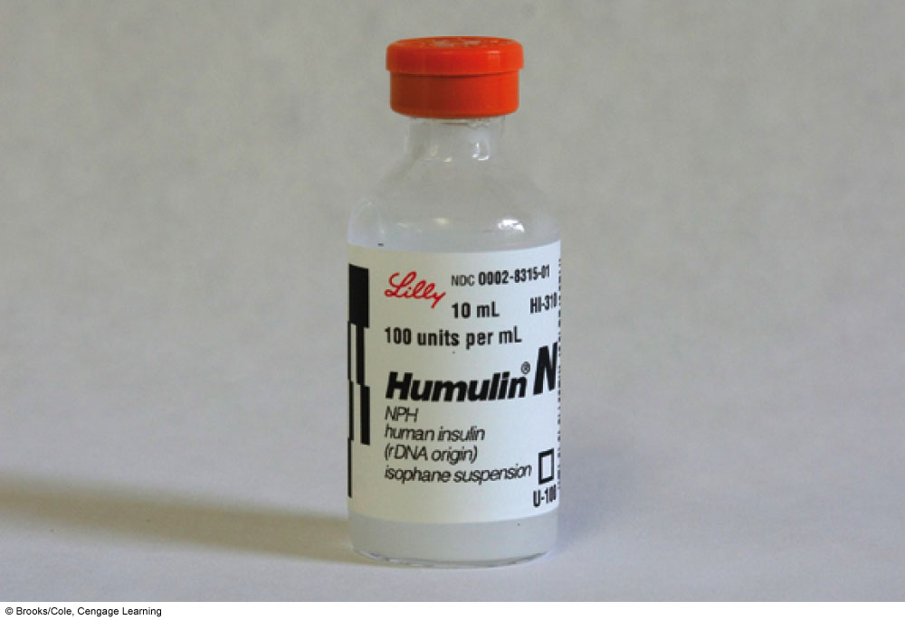
Insulin from Recombinant DNA

Slide 69
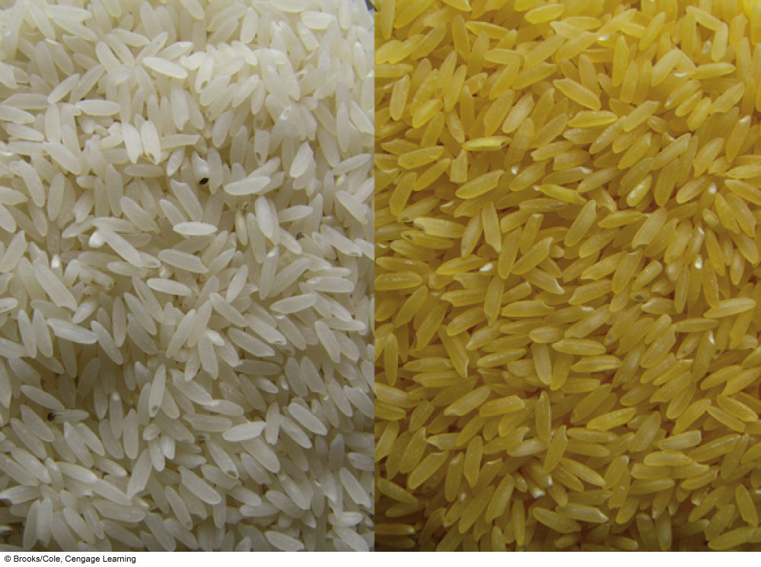
Golden Rice
Genes for beta carotene and bacteria
Produce beta carotene

Slide 70
Are Transgenic Organisms Safe?
Important to address by research and testing
  Health and environmental risks
  Economic and social issues
  Educate public
Potential health risks
Environmental risks, transfer of transgenes to wild plants, and reduction in biodiversity

Slide 71


