Slide 1
DNA Sequencing
DNA sequencing is the process of determining the precise order of nucleotides within a DNA molecule.
It includes any method or technology that is used to determine the order of the four bases—adenine, guanine, cytosine, and thymine—in a strand of DNA.

Slide 2
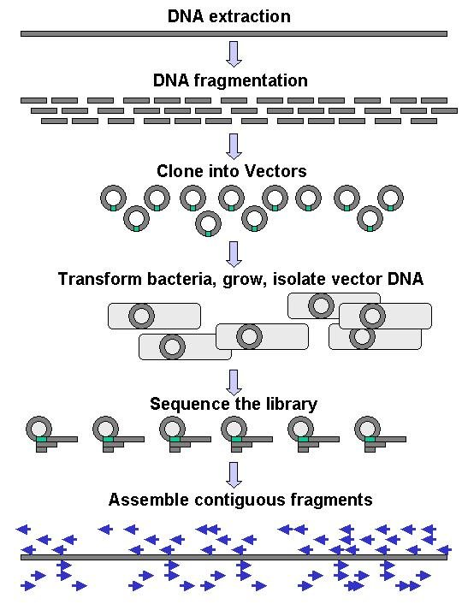
Methods in DNA Sequencing
Large-scale sequencing requires DNA to be broken into fragments
  Cutting (with enzymes)
  Shearing (with mechanical forces)
DNA is duplicated into a vector
Individually sequenced
Assembled electronically
  Shotgun sequencing

Slide 3
There are 2 major methods for sequencing DNA
The enzymatic method developed by Sanger and the chemical method of Gilbert.
Both methods use a similar principle.
They generate large numbers of oligonucleotides that begin at a fixed point and terminate at a specific type of base.
The sequencing reaction consists of 4 different reactions that are performed in parallel.
There is one for each base (A, T, G, and C).
These reactions produce many fragments of different sizes and these are separated in a polyacrylamide gel that can resolve differences as small as 1 nucleotide.
After the 4 reactions are fractionated in the “sequencing gel” the order of nucleotides can be read directly from the gel.

Slide 4
1.The Sanger method uses controlled synthesis of DNA to generate a population of fragments that terminate at specific points.
Dideoxy nucleoside triphosphates (ddNTPs):
Nucleoside analogs that lack the OH group at positions 2 and 3 of the sugar.
When incorporated into the growing DNA strand, the chain can grow no longer (there is no place for the next sugar to attach).

Slide 5
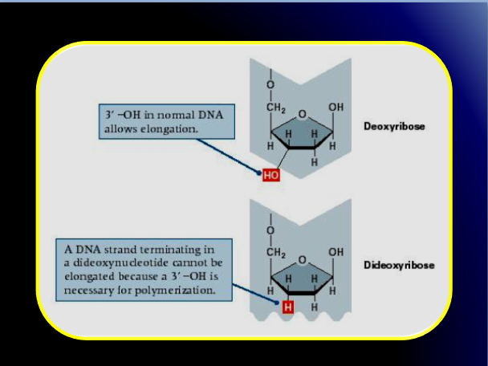

Slide 6
Sanger sequencing
DNA is fragmented
Cloned to a plasmid vector
Cyclic sequencing reaction
Separation by electrophoresis
Readout with fluorescent tags

Slide 7
The sequencing reaction depends on chain termination
Start with a primer that binds to one end of the DNA and is radioactively tagged. It allows you to visualize each band in a gel.
Run 4 DNA synthesis reactions in separate tubes. Each reaction has a surplus of dATP, dTTP, dCTP, and dGTP.
The first reaction also has a small amount of ddGTP, the second reaction has some ddATP, the third ddCTP, and the fourth ddTTP.
In the first tube, the ddGTP stops one of the growing DNA molecules as soon as it is incorporated. Some DNAs grow a little longer before the DDGTP is incorporated, some are a little shorter.
The bottom line is that each tube contains a large population of DNAs of random and different sizes and all end in G.
The same process occurs in the other 3 reactions with ddTTP, ddCTP, and ddATP.

Slide 8
After each of the four reactions is complete, the contents are loaded into a well of a sequencing gel. This is a polyacrylamide gel that is capable of resolving 2 molecules that differ in length by only 1 base pair.
The sequencing gel is dried and covered with an X-ray film to visualize radioactive bands.
To obtain the DNA sequence, you start at the bottom of the gel with the smallest oligo. By counting each successively larger oligonucleotide you can see whether it ends in the G, C, T, or A reaction lanes.
Dideoxynucleotides are chain-elongating inhibitors of DNA polymerase, used in the Sanger method for DNA sequencing.
They are also known as 2',3' dideoxynucleotides, and abbreviated as ddNTPs (ddGTP, ddATP, ddTTP and ddCTP).

Slide 9
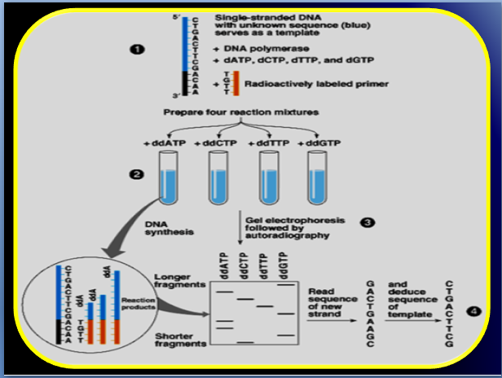

Slide 10
2.Maxam Gilbert sequencing: the chemical method
This method starts with a population of full length DNAs and chops
them up at specific nucleotides.
Think of it as a Sanger reaction going backwards.
1. End label the DNA with P32 to visualize the fragments in a gel
Set up 4 different reactions.
Chemical treatment generates breaks at a small proportion of one or two of the four nucleotide bases in each of four reactions (G, A+G, C, C+T).

Slide 11
Cont…
3.Each reaction modifies one of the 4 bases on the DNA (A, T, C, and G) making it susceptible to cleavage.
Perform other chemical reactions in separate tubes to specifically modify and cleave DNA at each of the other 3 bases.
For example, the purines (A+G) are depurinated using formic acid, the guanines (and to some extent the adenines) are methylated bydimethyl sulfate, and the pyrimidines (C+T) are hydrolysed using hydrazine.
. The modified DNAs may then be cleaved by hot piperidine;(CH2)5NH at the position of the modified base.

Slide 12
5.Add each of the 4 reactions to a sequencing gel and fractionate by size.
Read the sequence by looking at the X-ray film.
The concentration of the modifying chemicals is controlled to introduce on average one modification per DNA molecule.
Thus a series of labeled fragments is generated, from the radio labeled end to the first "cut" site in each molecule.
The fragments in the four reactions are electrophoresed side by side in denaturing acrylamide gels for size separation.

Slide 13
Cont…
To visualize the fragments, the gel is exposed to X-ray film for autoradiography.
yielding a series of dark bands each showing the location of identical radiolabeled DNA molecules.
From presence and absence of certain fragments the sequence may be inferred.

Slide 14
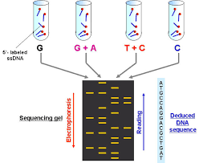

Slide 15
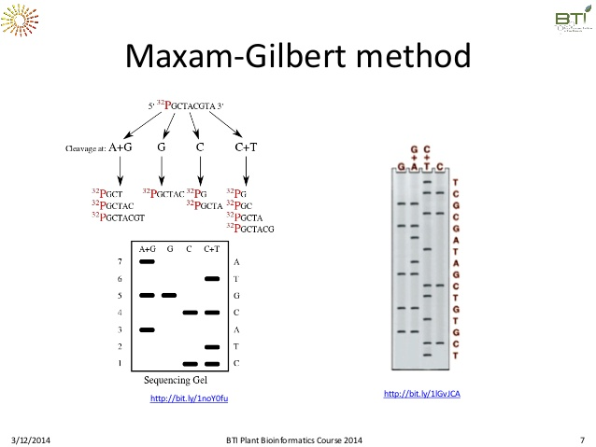

Slide 16
Sanger sequencing VS NGS
Sanger sequencing’ has been the only DNA
NGS has the ability to process millions of sequence reads in parallel rather than 96 at a time (1/6 of the cost)
Objections: fidelity , read length, infrastructure cost, handle large volum of data
.

Slide 17
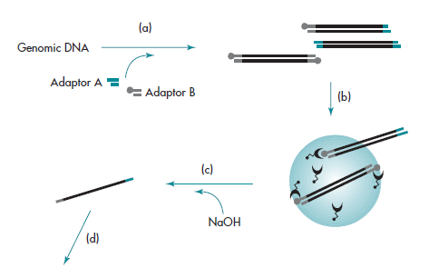
3.Pyrosequencing (Roche / 454)
ds
Bead I.
Streptavidin coated
Library construction
A,B: short DNA oligos fused with
genomic DNA segments
B is biotinilated
Selection of dsDNA: streptavidin-coated magnetic beads
denaturation: AB strands collected
www.454.com
wiki
Notes:
Odaragadthoz kepest komplementer lejon es kesobb felhasznaljuk, golyok kidobodnak

Slide 18
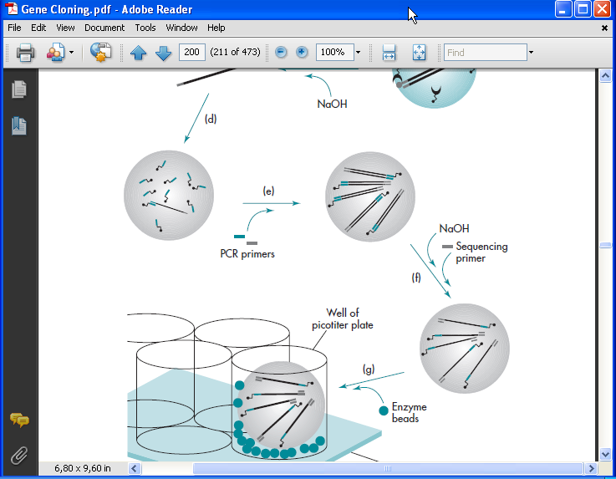
Pyrosequencing (Roche / 454)
Bead II.
Simple agarose beads coated with B oligos
Single sstDNA (singles-stranded template DNA)
with cA and cB oligo immobilized one on a bead
Bead-bound library emulsified (water-in-oil)
PCR reaction:
One strand will be covalently bound to the bead
www.454.com
wiki
Notes:
Lanyok a golyon, fiuk raragadnak, VIZCSEPP|!!!! Egyelore ketszalu dna, egyik szal kovalensen kapcs, a masik csak hibridizacio reven

Slide 19
Pyrosequencing (Roche / 454)
denaturation, one strand is released
Following the selection of DNA-positive beads (enrichment),
Beads+reactants in wells having a diameter of cca 40um
www.454.com
wiki
Notes:
Denaturalas: egy szal maradjon, seq by synthesis, ez csak egy szallal mukodik

Slide 20
Pyrosequencing (Roche / 454)
The reaction:
-addition of dNTP-s:
incorporation releases pyrophosphate
(only one phosphate is needed for the backbone)
-ATP sulfurylase converts PPi to ATP
-luciferase: acts in the presence of ATP
-Unincorporated nucleotides
and ATP are degraded by the apyrase
-400,000 reads in parallel
-multiple consensus incorporations:
>higher signal intensity
>problematic...
www.454.com
wiki
Notes:
Leszakad pirofoszfat (2P), ebbol lesz ATP, feny detektalasa, egyszinu

Slide 21
4.Illumina (Solexa) sequencing
-making DNA library (~300bp fragments)
-ligation of adapters A and B to the fragments
-binding the ssDNA randomly to the flow cell surface
-complementary primers are ligated to the surface
Illumina-Fasteris
Notes:
Denaturalas, a szalak csak hibridizalnak

Slide 22
Illumina (Solexa) sequencing
Bridge amplification:
initiation
On the surface: complementary oligos
GeneCore
Notes:
Itt meg nem szekvenalasi cellal szintetizalunk. Az uj szal kovalensen kapcsolodik az uveghez, az eredeti elvesz

Slide 23
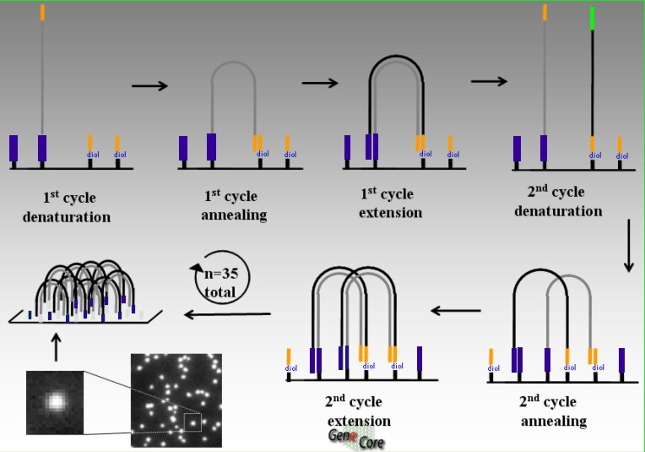
Illumina (Solexa) sequencing
EMBL Gene Core
Notes:
Itt meg mindig nem syekvenalunk, csak soxorositunk, linearisan

Slide 24
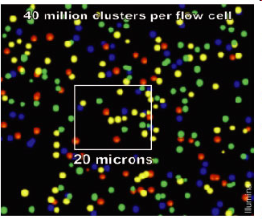
Illumina (Solexa) sequencing
Data aquisition:
sequencing by synthesis:
“reverible terminator” nucleotides
blocked + fluorescently labeled
de-blocking to enable the synthesis
dye cleavage+elimination
wash step+repeat
TGCA
illumina.com
Notes:
Itt a szekvenalas szintezis altal!! Fityego resz levagasaval inditom ujra

Slide 25
Comparison of existing methods

