Slide 1
Anti-Inflammatory Drugs (AIDs)

Slide 2
Learning Objectives
Understand the inflammatory cascades
Know inflammation mediators
Know drugs commonly used in VM to treat inflammation
Know SEs associated with AIDs

Slide 3
Overview
What is Inflammation?
is a useful and normal process that consists of a series of events, including:
vascular changes and
release of chemicals that help to destroy harmful agents at the injury site and repair damaged tissue
Vasodilation increases permeability of blood vessels in the early phase
Accumulation of leukocytes, reduced blood flow, chemical release (histamine, prostaglandin, and bradykinin) and tissue damage in cellular phase

Slide 4
The Inflammatory Cascade
Perceived threat
Infection
Tissue injury
Adaptive immune
system
Innate immune
system
Leukocyte & endothelial cell activation
1
Inflammatory mediators
Inflammation (redness, edema,
warmth, pain, tissue destruction)

Slide 5
Chemical Mediators
Numerous chemical involve to increase leakage of blood and fluid:
Histamines
Prostaglandins
Kinins

Slide 6
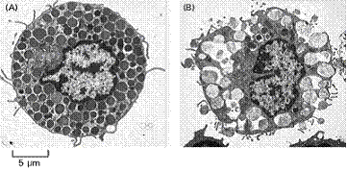
IgE-Mediated Mast Cell Degranulation
Resting Mast Cell
Activated Mast Cell
Histamine
Proteases
Heparin

Slide 7
Histamine
Cimetidine,
ranitidine

Slide 8
Prostaglandins
Found in almost every tissue and body fluid
Causes:
Increase VD at low levels
Increase vascular permeability and pain producing activity of other substances

Slide 9
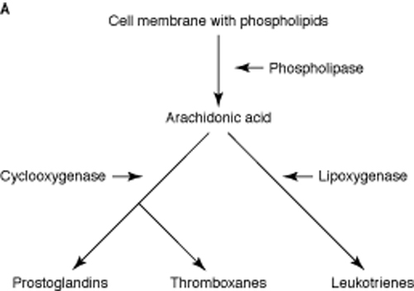




Eicosanoids
Bradykinin
PGD₂, PGF_{2α}, PGI₂
TXA₂
LTC₄, LTD₄, LTE₄

Slide 10
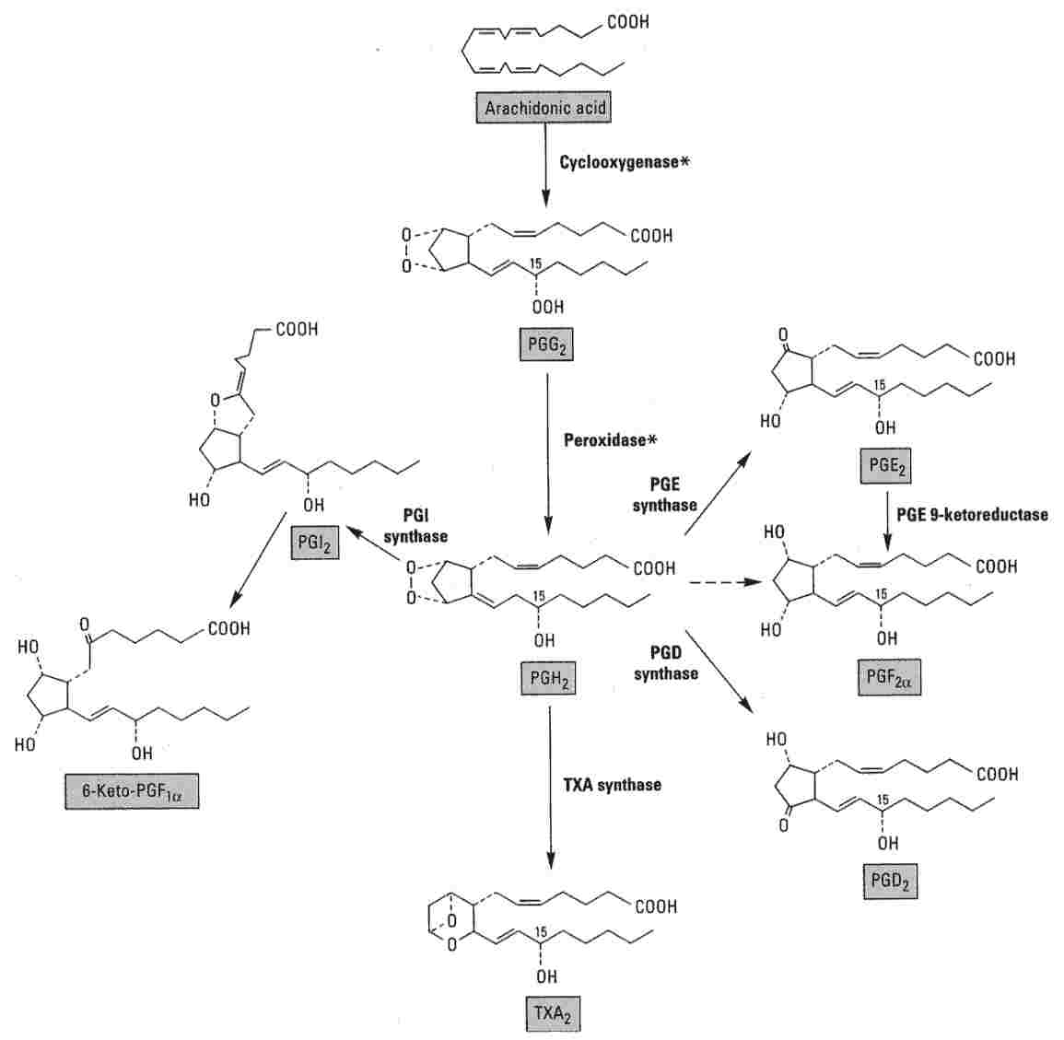
Cyclooxygenase Pathway
C₉₋₁₁
C₁₅
Unstable endoperoxide
C₁₅
Hydroperoxide
Basic and Clinical Pharmacology, 2005
Notes:
A- COX -> Oxidation 1- C9-11 endoperoxide 2- C15 hydroperoxide → PGG2
B- Peroxidase moiety of COX → adds a 15-hydroxyl group : needed for biological activity → PGH2

Slide 11
Anti-Inflammatory Drugs
Steroidal AIDs
Non-steroidal AIDs
Anti-histamines

Slide 12
A- Steroidal Anti-inflammatory Agents
Corticosteroids
are hormones produced by the adrenal cortex
Two groups of corticosteroids used in veterinary medicine:
Glucocorticoids
Mineralocorticoids
Glucocorticoids
Naturally occurring glucocorticoids: cortisol (=hydrocortisone)
Have anti-inflammatory effects due to their inhibition of phospholipase (PLA2)
Raise the concentration of liver glycogen and increase blood glucose levels
Affect carbohydrate, protein, and fat metabolism
Are regulated by negative feedback

Slide 13
The Mighty Corticosteroids
Perceived threat
Infection
Corticosteroids
Tissue injury
Adaptive immune
system
Innate immune
system
Corticosteroids
Leukocyte & endothelial cell activation
Corticosteroids
Inflammatory mediators
Corticosteroids
Inflammation (redness, edema,
warmth, pain, tissue destruction)

Slide 14
Glucocorticoids Regulate Transcription
MOA
GR- glucocorticoid receptor; HSP- heat shock protein; IP- immunophilin; GRE-- glucocorticoid receptor element; IL-intrleukin; TNF-tissue necrosis factor; IF-interferon

Slide 15
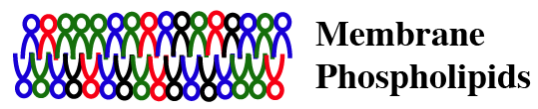
Corticosteroids Inhibit Eicosanoid Production
Corticosteroids
Corticosteroids
inhibit induction
of COX-2 expression
Lipocortin
Phospholipase A₂
Arachidonic acid
Cyclooxygenase (COX)
Lipoxygenase
Leukotrienes
Prostaglandins & Thromboxanes
Inflammatory effects
(esp. in asthma)
Inflammatory effects
Homeostatic
functions

Slide 16
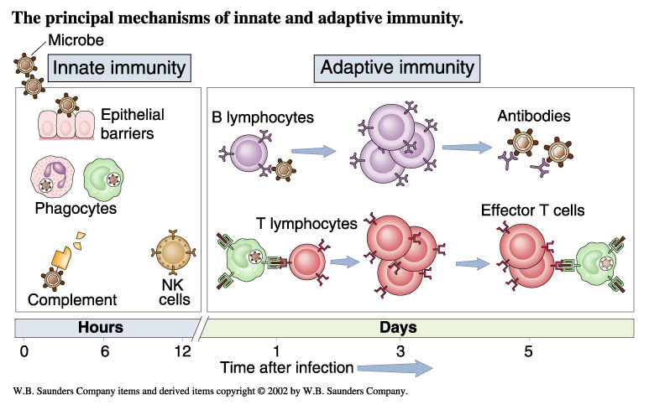
Glucocorticoids Are Powerful Immuno-suppressants
Corticosteroids affect immune function, although less inhibition of humoral arm than cell-mediated arm;
also induce apoptosis in rapidly-dividing leukocytes

Slide 17
Adrenal Suppression with Chronic Systemic use of Glucocorticoids
Hypothalamus
CRH
Anterior
pituitary
prednisone
ACTH
Adrenal cortex
cortisol,
aldosterone
Long term use will inhibit body’s glucocorticoid activity and the body’s ability to produce this substance naturally

Slide 18
Glucocorticoids
May be categorized as
Short-acting (duration of action < 12 hours)
Cortisone and hydrocortisone
Intermediate-acting (duration of action 12–36 hours)
Prednisone, prednisolone, prednisolone sodium succinate, methylprednisolone,
Long-acting (duration of action > 36 hours)
Dexamethasone, betamethasone
May be given orally, parenterally, or topically

Slide 19
Glucocorticoid clinical Use
Benefits:
Reduce inflammation and pain
Relieve pruritus
Reduce scarring by delaying wound healing
Reduce tissue damage
Organ rejection reaction
Drawbacks:
Delay wound healing
Increase risk of infection
May cause GI ulceration and bleeding
Increase the risk of corneal ulceration if corneal damage exists
May induce abortion in some species

Slide 20

Toxicity of Chronic Systemic Glucocorticoids
Fat redistribution
Hypertension
Glucose intolerance
Osteoporosis (prevent with bisphosphonates)
Cataracts
Gastric ulcers (prevent with omeprazole, misoprostol)
Impaired wound healing
Risk of infection
CNS effects, including psychosis
Growth inhibition in young
Cushing’s
syndrome
Notes:
Cushing’s syndrome=excessive production of the hormone ACTH by the pituitary gland

Slide 21
B- Nonsteroidal Anti-inflammatory Drugs (NSAIDs)
They are divided into:
A-Salicylate (e.g. aspirin) and,
B-Non-salicylate (e.g. ibuprofen).

Slide 22
NSAIDs
NSAIDs work by inhibiting cyclooxygenase:
Cox-1 is involved with the stomach and kidneys
Cox-2 is involved with inflammation
NSAIDs are also referred to as prostaglandin inhibitors
NSAIDs have fewer side effects than glucocorticoids
Side effects include:
GI ulceration and bleeding and
bone marrow suppression

Slide 23
Types of NSAIDs
Salicylates
Potent inhibitors of PG synthesis
E.g. Aspirin (acetylsalicylic acid)
Side effects include gastrointestinal problems
Aspirin
Not veterinary licensed
A-Antipyretic action:
Rapidly effective in febrile patient through central effect due to inhibited PGE2 synthesis from hypothalamus in response to pyrogens.
B-Anti-inflammatory effects:
Due to inhibition of PG synthesis.
C-Analgesic effects:
-Effective for low-to-moderate pain (musculoskeletal)
Mechanism of pain relief:
Peripheral: inhibition of PGs in inflamed tissue.
Central: the analgesic site in hypothalamus is closer to antipyretic region.

Slide 24
Types of NSAIDs…cont’d
Pyrazolone derivatives
Inhibit PG synthesis
Phenylbutazone
an analgesic, antipyretic, and anti-inflammatory
Used in equine medicine for musculoskeletal pain
Propionic acid derivatives (the –fen drugs)
Block both cyclooxygenase and lipoxygenase
Carprofen- cats & dogs do not tolerate long term t/t
Ibuprofen- used in dogs (approved for human)
Ketoprofen- injectable & tablet are licensed for cats & dogs
Side effects: GIT problems and possible liver & kidney toxicities

Slide 25
Types of NSAIDs…cont’d
Flunixin meglumine
Inhibits COX
Used in cattle and horses for musculoskeletal and colic (visceral) pain
Is a potent analgesic, antipyretic, and anti-inflammatory
Toxicity: GI upset, limits its use in dogs to 2-3 days.
Paracetamol
Cats lack glucuronyl transferase enzyme, required to metabolize the drug.
Antipyretic & analgesic with poor anti-infilammatory
MOA: do not inhibit COX, but modulate the concentration of PG intermediates.

Slide 26
Types of NSAIDs…cont’d
Cox-2 selective inhibitors
Inhibit cyclooxygenase-2 without interfering with the protective cyclooxygenase-1
E.g. deracoxib and meloxicam
Meloxicam is eliminated as glucuronide conjugates (cats have a deficiency of bilirubin-glucuronoside glucuronsyl transferese enzyme)
Side effect include anorexia, vomiting, and lethargy
Dual-pathway NSAIDs
Block arachidonic acid cycle (both cyclooxygenase and lipoxygenase pathways)
Are analgesics and anti-inflammatories
E.g. tepoxalin, which is a rapidly disintegrating tablet used for osteoarthritis in dogs

Slide 27
C. H₁ Histamine Antagonists
Prototype | Properties | Clinical Uses
Loratadine (Claritin) Fexofenadine (Allegra) | Low affinity for muscarinic receptors, doesn’t cross BBB | Allergic reactions
Diphenhydramine (Benadryl) | Muscarinic antagonist, crosses BBB | Allergic reactions, dystonic rxn to dopamine blockers, OTC sleep aid, antiemetic
However, in the case of severe hypersensitivity reactions, including anaphylaxis, drugs of choice are: Epinephrine (need α₁ vasoconstriction and β₂ bronchodilator) and corticosteroids!

Slide 28
Summary
GC may help to disseminate infectious microorganisms
Use caution when giving high dose of GC to pregnant animals
Use alternate-day dosing at the lowest possible doses to prevent iatrogenic Cushing’s disease
Taper animals off GC to prevent iatrogenic Addison’s disease.

Slide 29
Eicosanoids As Drugs (Additional info )
Drug Name | Analog of | Clinical Use
Epoprostenol | PGI₂ | Pulmonary hypertension
Dinoprostone | PGE₂ | Medical abortion, relax uterine cervix in preparation for induction of labor
Misoprostol | PGE₁ | Peptic ulcer, medical abortion
Alprostadil | PGE₁ | Maintain a patent (open) ductus arteriosus in neonates with certain cardiac malformations until emergency surgery; erectile dysfunction
Carboprost | PGF_{2α} | Labor induction (parturition), luteolysis, abortion
Latanoprost | PGF_{2α} | Glaucoma

Slide 30
Have we met our objectives?
What are you understood about inflammatory cascades?
What are the inflammation mediators?
What are drugs commonly used in vet. Medicine to treat inflammation?
Describe the MOA of GC
What are the SEs associated with AIDs?

Slide 31
Reading materials
Textbook
Rivire JE and Papich MG (2018): Veterinary Pharmacology and therapeutics 10th ed.
OR
Rivire JE and Papich MG (2016): Veterinary Pharmacology and therapeutics 9th ed.

Slide 32
THANK YOU

