Slide 1
Chapter Two
Enzyme Kinetics

Slide 2
contents
Introduction
Nomenclature of Enzymes
How enzymes work?
Commercial Applications of Enzymes
Enzyme Kinetics
Michaelis-Menten Approach
Briggs-Haldane Approach
Evaluation of Kinetic Parameters
Enzyme Reactor with Simple Kinetics
Batch or Steady-State Plug-Flow Reactor
Continuous Stirred-Tank Reactor
Inhibition of Enzyme Reactions
Competitive Inhibition
Noncompetitive Inhibition
Other Influences on Enzyme Activity
Effect of Temperature
Effect of pH

Slide 3
Introduction
Enzymes are biological catalysts that are protein molecules in nature.
Catalysts are substances that increase the rate of chemical reactions without being used up
Produced by living cells (animal, plant, and microorganism) and are absolutely essential as catalysts in biochemical reactions..
A major function of enzymes in a living system is to catalyze the making and breaking of chemical bonds.
The catalytic ability of enzymes is due to its particular protein structure.

Slide 4
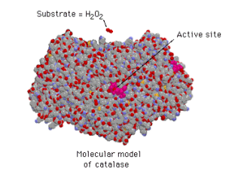
Enzyme structure
Enzymes are proteins
They have a globular shape
A complex 3-D structure
Molecular model of catalase

Slide 5
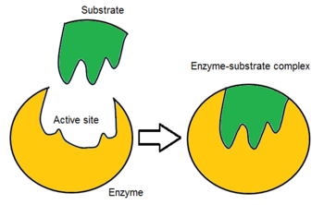
The Active site
One part of an enzyme, is particularly important
The shape and the environment inside the active site permits a chemical reaction to proceed more easily

Slide 6
The substrate
The substrate of an enzyme are the reactants that are activated by the enzyme
Enzymes are specific to their substrates
The specificity is determined by the active site

Slide 7
Nomenclature of Enzymes
Originally enzymes were given non-descriptive names such as:
Rennin curding of milk to start cheese-making process
pepsin hydrolyzes proteins at acidic pH
Name of substrate + ase
lactase lactose → glucose + galactose
Maltase maltose → glucose
Urease urea + H₂O → 2NH3 + CO2
Reaction which is catalyzed + ase
alcohol dehydrogenase ethanol + NAD+ → acetaldehyde + NADH2
glucose isomerase glucose → fructose

Slide 8
cont.…..
This system generated confusion as more enzyme were formed
The new system categorized all enzymes into six major classes.
EC 1.1.1.1
  Enzyme Commission
  First No indicates main class of reaction.
  Second No indicates subclass. Third No indicates sub-subclass.
  Fourth No is serial number of the enzyme in its particular subclass.
Organism of origin is always indicated
Not all enzymes with EC number are active under the same condition

Slide 9
Cont.…..
1. Oxidoreductases - catalyse oxidn - redn reactions.
2. Transferases - catalyse group-transfer reactions.
3. Hydrolases - catalyse hydrolytic reactions.
4. Lyases - catalyse addition groups to double bonds.
5. Isomerases - catalyse isomerisation reactions.
6. Ligases - catalyse condensation of two molecules (coupled with cleavage of ATP, GTP etc.)

Slide 10
Cont.………
Oxidoreductases
oxidases – oxidize, reductases - reduce
Transferases
transaminases – transfer amino groups
Kinases – transfer phosphate groups
Hydrolases
proteases – hydrolyze peptide bonds
Lipases – hydrolyze lipid ester bonds
Lyases
carboxylases – add CO2
hydrolases- add H2O

Slide 11
How enzyme work
Chemical reactions need an initial input of energy = THE ACTIVATION ENERGY
During this part of the reaction the molecules are said to be in a transition state

Slide 12
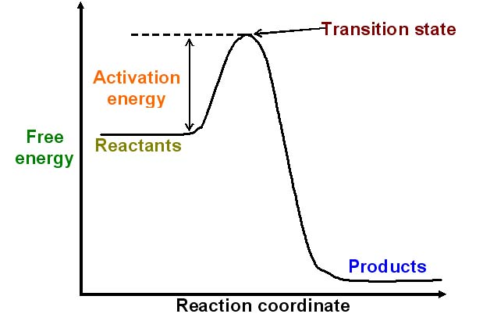
Reaction pathway
© 2007 Paul Billiet ODWS

Slide 13
How can reactions go faster
Increasing the temperature make molecules move faster
Biological systems are very sensitive to temperature changes.
Enzymes can increase the rate of reactions without increasing the temperature.
They do this by lowering the activation energy.
They create a new reaction pathway “a short cut

Slide 14
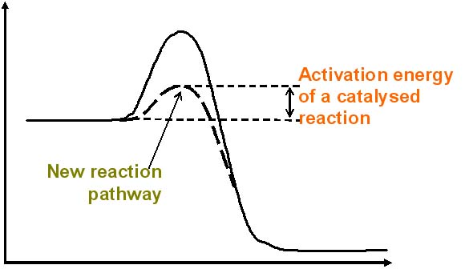
An Enzyme controlled Pathway
© 2007 Paul Billiet ODWS

Slide 15
Enzyme Kinetics
What is kinetics?
is the study of the rate and mechanism in the reactor
Why enzyme kinetics?
Quantitative description of biocatalysis
Understand catalytic mechanism
Find effector inhibitors
Understand regulation of activity

Slide 16
Enzyme Kinetics
Assume that a substrate (S) is converted to a product (P) with the help of an enzyme (E) in a reactor as:
S P
If you measure the concentrations of substrate and product with respect to time, the product concentration will increase and reach a maximum value, whereas the substrate concentration will decrease as shown in the figure below.
E

Slide 17


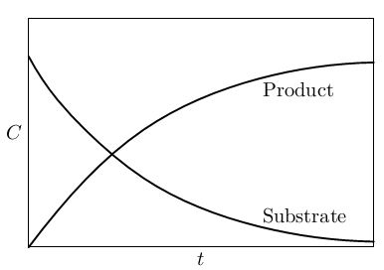
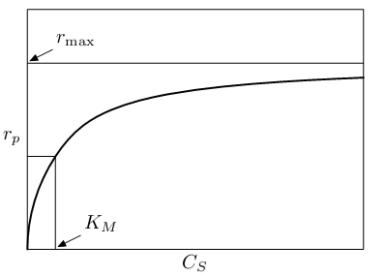


The rate of reaction can be expressed in terms of either the change of the substrate CS or the product concentrations CP as follows:

Slide 18
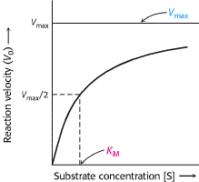
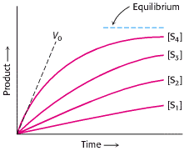
If we measure the initial reaction rate at different levels of substrate and enzyme concentrations, we obtain a series of curves like the one shown in Figure below. From these curves we can conclude the following:

Slide 19
Enzyme kinetics
  The reaction rate is proportional to the substrate concentration (that is, first-order reaction) when the substrate concentration is in the low range.
  The reaction rate does not depend on the substrate concentration when the substrate concentration is high, since the reaction rate changes gradually from first order to zero order as the substrate concentration is increased.
  The maximum reaction rate V_{max} is proportional to the enzyme concentration within the range of the enzyme tested.

Slide 20

Henri observed this behavior in 1902 (Bailey and Ollis, p. 100, 1986) and proposed the rate equation
where V_{max} and K_{M} are kinetic parameters which need to be experimentally determined. The equation expresses the three preceding observations fairly well.
Since the above equation describes the experimental results well, we need to find the kinetic mechanisms which support this equation.
Brown (1902) proposed that an enzyme forms a complex with its substrate.

Slide 21
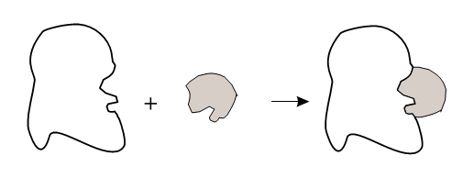
One of the original theories to account for the formation of the enzyme-substrate complex is the “lock and key” theory.
The main concept of this hypothesis is that there is a topographical, structural compatibility between an enzyme and a substrate which optimally favors the recognition of the substrate as shown in Figure below
The reaction rate equation can be derived from the preceding mechanism based on the following assumptions:

Slide 22
The total enzyme concentration stays constant during the reaction, that is:
The amount of an enzyme is very small compared to the amount of substrate. Therefore, the formation of the enzyme-substrate complex does not significantly deplete the substrate.
The product concentration is so low that product inhibition may be considered negligible.

Slide 23
Michaelis-Menten
It is assumed that the product-releasing step, is much slower than the reversible reaction, and the slow step determines the rate, while the other is at equilibrium.
The rapid equilibrium assumption: Assumes a rapid equilibrium between the enzyme and substrate to form an [ES] complex.

Slide 24
If the slower reaction determines the overall rate of reaction, then the rate of product formation:
The concentration of the enzyme-substrate complex [ES], can be related to the substrate concentration [S] and the free-enzyme concentration [E] from the assumption that the first reversible reaction is in equilibrium. Then, the forward reaction is equal to the reverse reaction so that
K₁[E][S]=K₂[ES]

Slide 25
Michaelis-Menten
The equilibrium constant can be expressed by the following equation in a dilute system.
K1
E+S
K2

Slide 26
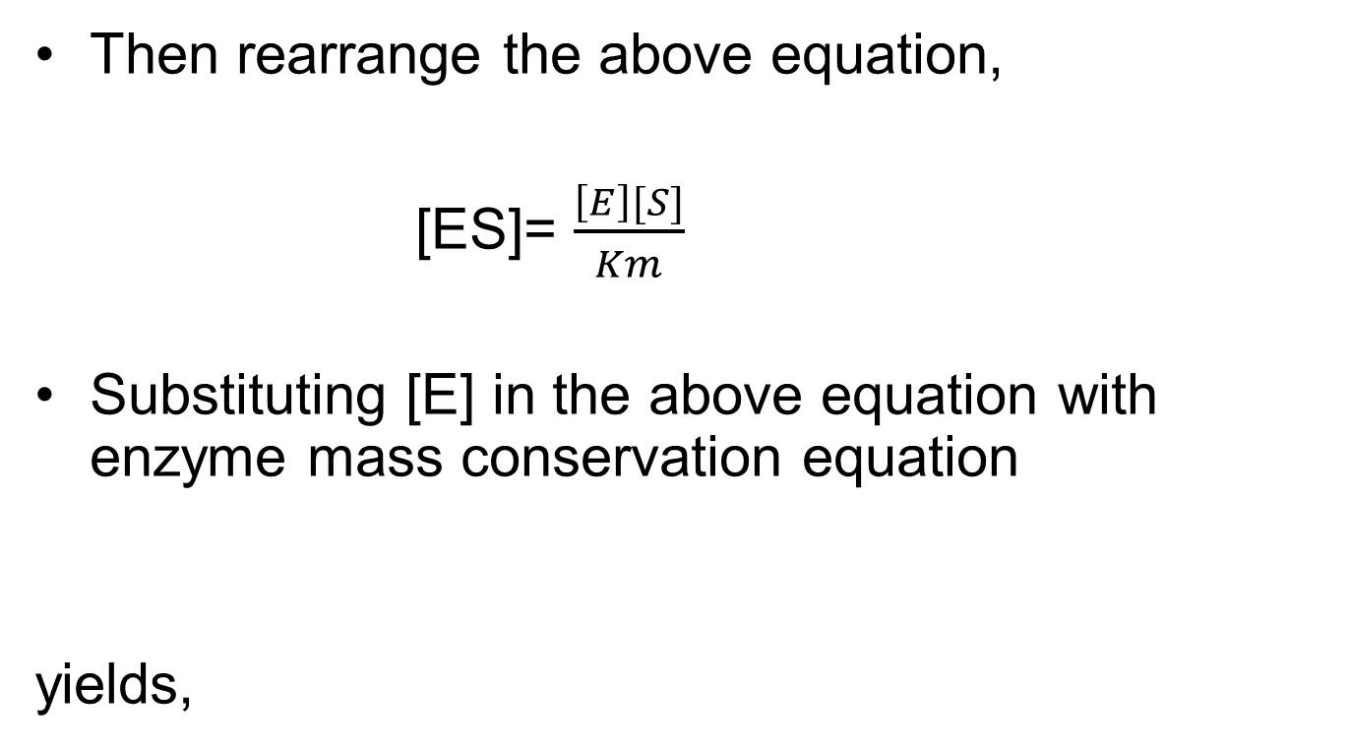
Michaelis-Menten
Then rearrange the above equation,
[ES]= $\frac{\left[E\right][S]}{Km}$
Substituting [E] in the above equation with enzyme mass conservation equation
yields,

Slide 27
Michaelis-Menten
[ES] can be expressed in terms of [S],
Then the rate of production formation v can be expressed in terms of [S],
Where
represents the maximum forward reaction

Slide 28
The significance of KM
KM is often called the Michaelis-Menten constant
The prime reminds us that it was derived by assuming rapid equilibrium in the step of enzyme-substrate complex formation.
Small Km means tight binding; high Km means weak binding
It corresponds to the substrate concentration, giving the half maximum reaction velocity

Slide 29
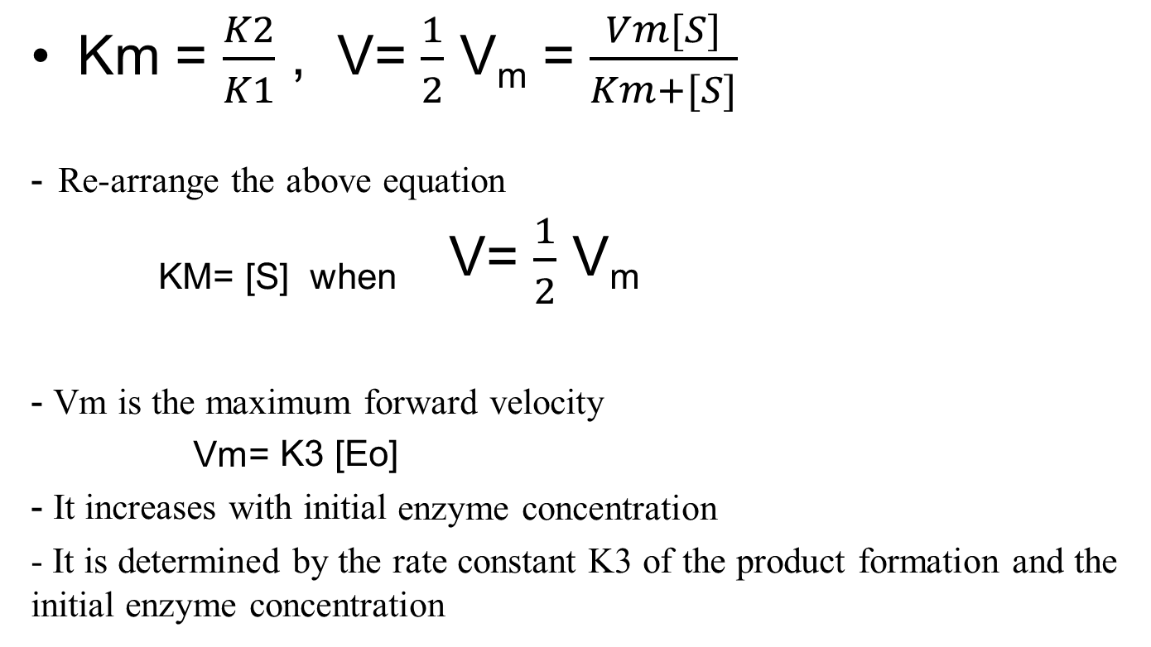
Km = $\frac{K2}{K1}$ , V= $\frac{1}{2}$ V_{m} = $\frac{Vm[S]}{Km+[S]}$
₋ _{Re-arrange the above equation}
_{KM= [S] when} V= $\frac{1}{2}$ V_{m}
- Vm is the maximum forward velocity
_{Vm= K3 [Eo]}
- It increases with initial enzyme concentration
- It is determined by the rate constant K3 of the product formation and the initial enzyme concentration

Slide 30
Briggs-Haldane
The quasi-steady-state assumption:
A system (batch reactor) is used in which the initial substrate concentration [S₀] greatly exceeds the initial enzyme concentration [E₀].
since [E₀] was small,
d[ES]/dt ≈ 0
It is shown that in a closed system the quasi-steady-state hypothesis is valid after a brief transient if [S0]>> [E0].

Slide 31
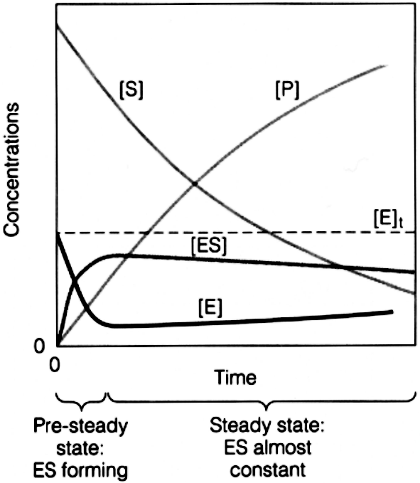
The quasi-steady-state hypothesis is valid after a
brief transient in a batch system if [S0]>> [E0].

Slide 32
Briggs-Haldane
With such assumption, the equation representing the
accumulation of [ES] becomes
Solving this algebraic equation yields

Slide 33
Briggs-Haldane
Substituting the enzyme mass conservation equation
in the above equation yields
Using [S] to represent [ES] yields

Slide 34
Briggs-Haldane
Then the product formation rate becomes
Then
Where
same as that for rapid equilibrium assumption.
Where

Slide 35
Comparison of the Two Approaches
Michaelis-Menten
Briggs-Haldane
Assumption:
d[ES]/dt ≈ 0
Equation:
Maximum forward
reaction rate:
Constant:

Slide 36
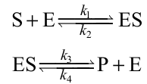
Example 1: When glucose is converted to fructose by glucose isomerase, the slow product formation step is also reversible as:
Derive the rate equation by employing (a) the Michaelis-Menten and (b) the Briggs-Haldane approach. Explain when the rate equation derived by the Briggs-Haldane approach can be simplified to that derived by the Michaelis-Menten approach.

Slide 37



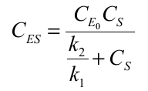
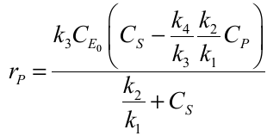
Solution
Michaelis-Menten approach: The rate of product formation is

Slide 38


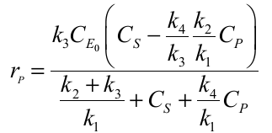
Briggs-Haldane approach: Assume that the change of the complex
concentration with time, dC_{ES}/dt, is negligible. Then,

Slide 39
Recap

Slide 40

What are enzymes?
Biological catalysts made up of proteins

Slide 41
Function of Enzymes
Enzymes speed up the rate of chemical reactions in the body; both breaking down (e.g.: starch into maltose) and building up reactions. (e.g: amino acids into proteins).
Enzymes lower the activation energy required to start a chemical reaction

Slide 42
Characteristics of Enzymes
Enzymes are highly specific in action.
Enzymes remain chemically unchanged at the end of the reaction.
Enzymes are required in minute amounts.

Slide 43
Naming of Enzyme
Substrate + ase
e.g: lactase
The reaction catalyze + ase
e.g: glucose isomerase( glucose- fructose
EC 1.1.1.1
e.g: the six classess

Slide 44
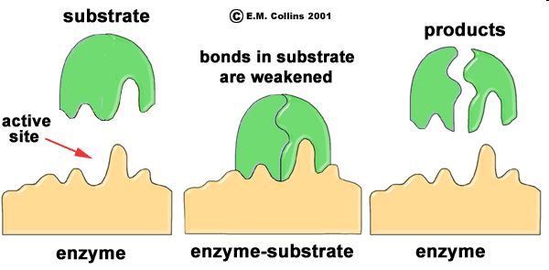
Mode of Action
Substrate fits in the enzyme active site, just like a key fits into a lock.
An enzyme-substrate complex is formed
Chemical reactions occur at the active site and products are formed.

Slide 45
Enzyme kinetics
is the study of the rate and mechanism in the reactor
Michaelis-Menten approach
Briggs-Haldane approach

Slide 46
Comparison of the Two Approaches
Michaelis-Menten
Briggs-Haldane
Assumption:
d[ES]/dt ≈ 0
Equation:
Maximum forward
reaction rate:
Constant:

Slide 47
The theoretical maximal velocity
Vmax is a constant
Vmax is the theoretical maximal rate of the reaction - but it is NEVER achieved in reality
To reach Vmax would require that ALL enzyme molecules are tightly bound with substrate
Vmax is asymptotically approached as substrate is increased

Slide 48
The meaning of KM
Km is a constant; Km is a combination of rate constants describing the formation and breakdown of the ES complex
Km = [S] at ½ Vmax
Km represents the amount of substrate required to bind ½ of the available enzyme (binding constant of the enzyme for substrate)
Small Km means tight binding; high Km means weak binding

Slide 49
Experimentally Determining Rate Parameters for
Michaelis-Menten Type Kinetics.
To determine the rate parameters:
Predict a specific enzyme catalysis system.
Design bioreactor

Slide 50
Determination of Vm and Km from initial-rate experiments.
A batch reactor is charged with known initial concentration of substrate [So] and enzyme [Eo] at specific conditions such as T, pH, and Ionic Strength
The product or substrate concentration is plotted against time.
The initial slope of this curve is estimated.
v=(d[P]/dt) , or = - (d[S]/dt) .
This value v depends on the values of [E0] and [S0].
Many such experiments can be used to generate many pairs of V and [S] data, these data can be plotted as v-[S].

Slide 51
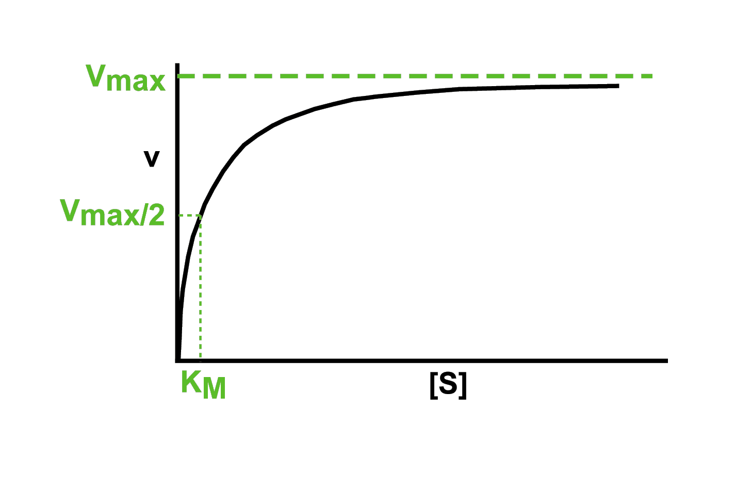

Slide 52
Cont.…
It is an unsatisfactory plot in estimating Vmax and KM because it is difficult to estimate asymptotes accurately and also difficult to test the validity of the kinetic model.
Therefore, the Michaelis-Menten equation is usually rearranged so that the results can be plotted as a straight line.
Some of the better known methods are presented here.

Slide 53
Lineweaver-Burk Plot (Double-Reciprocal Plot)
It is difficult to determine Vmax experimentally
The equation for a hyperbola can be transformed into the equation for a straight line by taking the reciprocal of each side
The formula for a straight line is y = mx + b

Slide 54
Lineweaver-Burk Plot (Double-Reciprocal Plot)
A plot of 1/V versus 1/[S] will give a straight line with slope of KM/Vmax and y intercept of 1/Vmax
Such a plot is known as a Lineweaver-Burk double reciprocal plot

Slide 55
Lineweaver-Burk Plot (Double-Reciprocal Plot)
Linearizing it in double-reciprocal form:

Slide 56
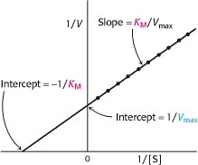
A slope equals to Km/Vm
y-intercept is 1/Vm.
1/v approaches infinity as [S] decreases
.

Slide 57
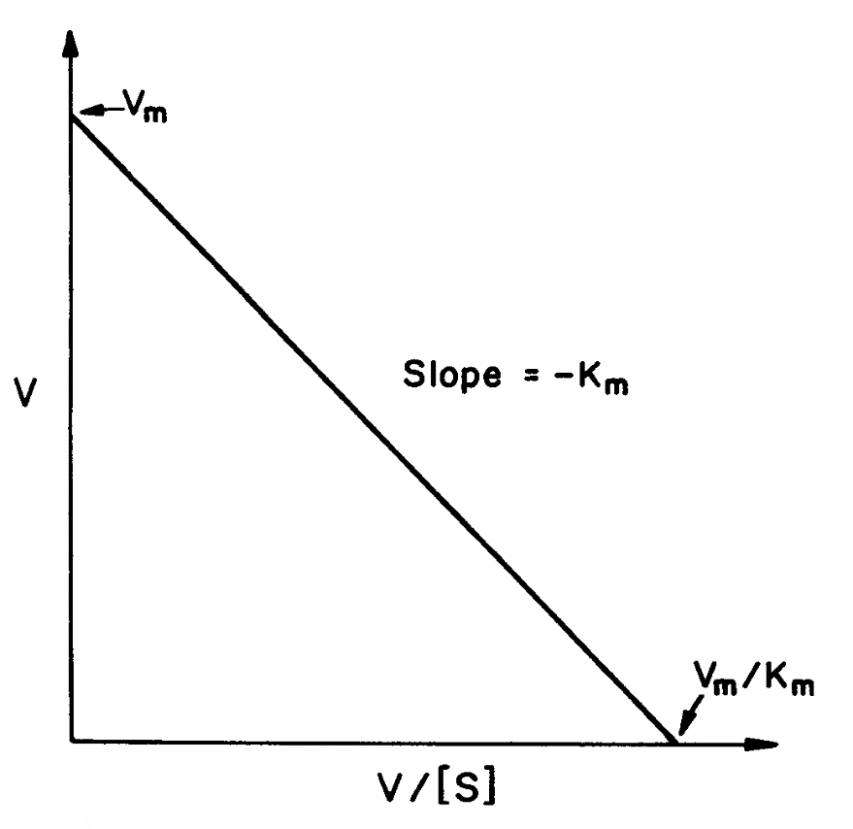
Eadie-Hofstee Plot
The slope is –Km
y-intercept is Vm.

Slide 58
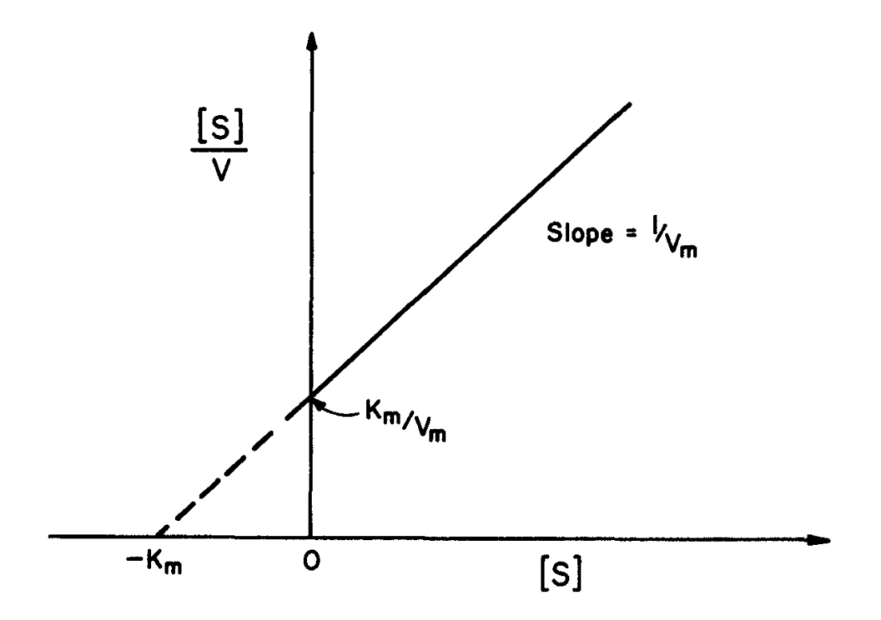
Hanes-Woolf (Langmuir) Plot
The slope is 1/Vm
y-axis intercept is Km/Vm

Slide 59
In conclusion, the values of the Michaelis-Menten kinetic parameters, V_{max} and K_{M}, can be estimated, as follows:
    Make a series of batch runs with different levels of substrate concentration at a constant initial enzyme concentration and measure the change of product or substrate concentration with respect to time.
    Estimate the initial rate of reaction from the C_{S} or C_{P} versus time curves for different initial substrate concentrations.
    Estimate the kinetic parameters by plotting one of the three plots explained in this section.

Slide 60
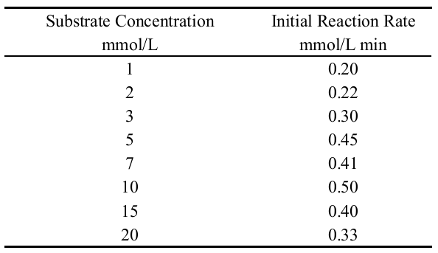
Example2: From a series of batch runs with a constant enzyme concentration, the following initial rate data were obtained as a function of initial substrate concentration.

Slide 61
Evaluate the Michaelis-Menten kinetic parameters by employing the Langmuir plot, the Lineweaver-Burk plot, the Eadie-Hofstee plot, In evaluating the kinetic parameters, do not include data points which deviate systematically from the Michaelis-Menten model and explain the reason for the deviation.
Compare the predictions from each method by plotting r versus C_{S} curves with the data points, and discuss the strengths and weaknesses of each method.

Slide 62
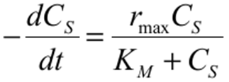
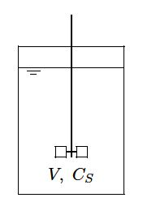
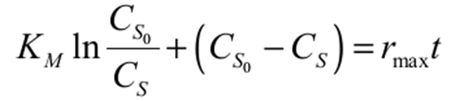
Enzyme Reactor with Simple Kinetics
Batch reactor:
An ideal batch reactor is assumed to be well mixed so that the contents are uniform in composition at all times
Assume that an enzyme reaction is initiated at t = 0 by adding enzyme and the reaction mechanism can be represented by the Michaelis-Menten equation
An equation expressing the change of the substrate concentration with respect to time can be obtained by integrating the above Eq:

Slide 63
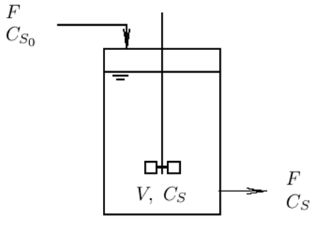
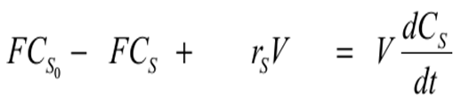
Continuous Stirred-Tank Reactor
Assumption
The reactor contents are well mixed
The concentrations of the various components of the outlet stream are assumed to be the same as the concentrations of these components in the reactor
The substrate balance of a CSTR can be set up, as follows

Slide 64
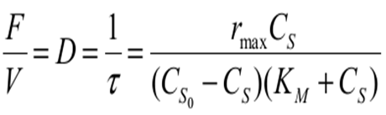
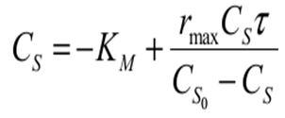
Continuous Stirred-Tank Reactor
Where F is the flow rate and V is the volume of the reactor contents.
For the steady-state CSTR, the substrate concentration of the reactor should be constant.
Where D is known as dilution rate, and is equal to the reciprocal of the residence time (τ)
The above Eq.can be rearranged to give the linear relationship:

