Slide 1
Chapter two
Enzyme kinetics

Slide 2
Table of content
Introduction
Nomenclature of Enzymes
Commercial Applications of Enzymes
Simple Enzyme Kinetics
Michaelis-Menten Approach
Briggs-Haldane Approach
Evaluation of Kinetic Parameters
Enzyme Reactor with Simple Kinetics
Batch or Steady-State Plug-Flow Reactor
Continuous Stirred-Tank Reactor
Inhibition of Enzyme Reactions
Competitive Inhibition
Noncompetitive Inhibition
Other Influences on Enzyme Activity
Effect of Temperature
Effect of pH

Slide 3
Inhibition of enzyme kinetics
Inhibitors are chemicals that reduce the rate of enzymatic reactions
Inhibitors – substance that binds to an enzyme and interferes with its activity
The are usually specific and they work at low concentrations
They block the enzyme but they do not usually destroy it
Many drugs and poisons are inhibitors of enzymes in the nervous system

Slide 4
Need for inhibition
To control the amount of product formed by reaction:
Product may stimulate a biochemical pathway that is needed at certain times (e.g. growth)
Product may be biologically active over a narrow concentration range.
Excess accumulation of products may require too much energy or interfere with other pathway

Slide 5
Enzyme inhibitors
Reversible versus Irreversible
Reversible inhibitors interact with an enzyme via noncovalent associations
Irreversible inhibitors interact with an enzyme via covalent associations
Notes:
Enzyme inhibition may be reversible or irreversible

Slide 6
Reversible enzyme inhibition
Competitive inhibition
Noncompetitive inhibition
Uncompetitive inhibition

Slide 7
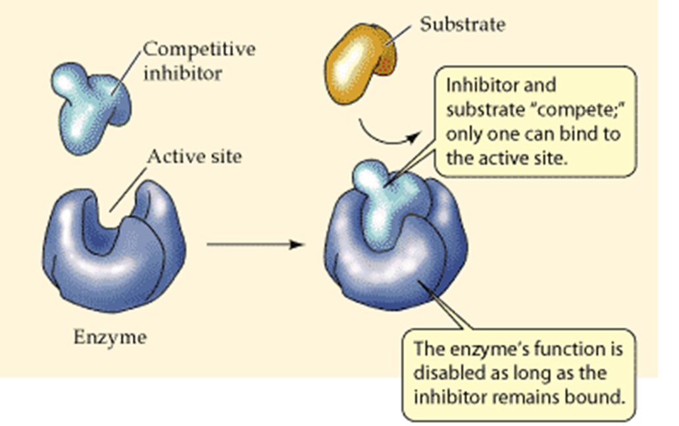
Competitive inhibition
Competitive inhibitor competes with a substrate for the enzyme - substrate binding site
Notes:
- There is a structural similarity between the inhibitor and the substrate

Slide 8
Competitive Inhibition
-Reaction Mechanism
In competitive inhibition, the inhibitor binds only to the free enzyme, not to the ES complex

Slide 9

Competitive inhibition
K1
E + S
Both the substrate and inhibitor compete for binding to the same form of the enzyme: free form
ESI complex is not formed
+
K2
I
KI
EI

Slide 10
Competitive inhibition
The inhibition is most noticeable at low [S] but can be overcome at sufficiently high [S]
- Vmax remains unaffected
Attaining Vmax requires higher [S] in the presence of competitive inhibitor
- Apparent Km is increased

Slide 11
Competitive inhibitors alter the apparent K_{m}, not the V_{max}
V_{max,app} = V_{max}
K_{m,app} > K_{m}

Slide 12
The Lineweaver-Burk plot is diagnostic for competitive inhibition

Slide 13
Relating the Michaelis-Menten equation, the v vs. [S] plot, and the physical picture of competitive inhibition
Inhibitor competes with
substrate, decreasing its apparent affinity: K_{m,app} > K_{m}
K_{m,app} > K_{m}
V_{max,app} = V_{max}
Formation of EI
complex shifts reaction
to the left: K_{m,app} > K_{m}
Formation of EI
complex shifts reaction
to the left: K_{m,app} > K_{m}

Slide 14

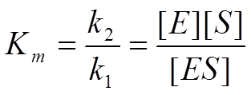
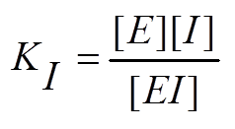

Competitive inhibition
Assume rapid equilibrium and with the definition of

Slide 15
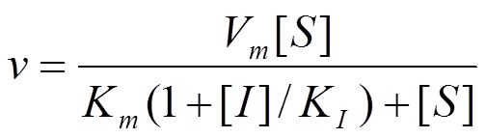
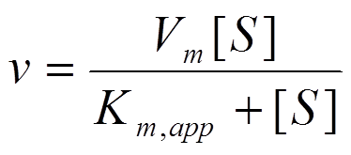

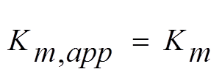


Competitive inhibition
Simplifying
When [I]=0,
Remains that of Michaelis-menten equation
Is increased

Slide 16
Practical case: Methanol poisoning
A wealthy visitor is taken to the emergency room, where he is diagnosed with methanol poisoning. You are contacted by a 3rd year medical student and asked what to do? How would you suggest treating this patient?

Slide 17
Methanol (CH₃OH) is metabolized to formaldehyde and formic acid by alcohol dehydrogenase. You advisethe third year student to get the patient very drunk. Since ethanol (CH₃CH₂OH) competes with methanol for the same binding site on alcohol dehydrogenase, it slows the metabolism of methanol, allowing the toxic metabolites to be disposed of before they build up to dangerous levels. By the way, the patient was very grateful and decided to leave all their worldly possessions to the hospital. Unfortunately, after being released from the hospital, he went to the casinos and lost everything he had.

Slide 18
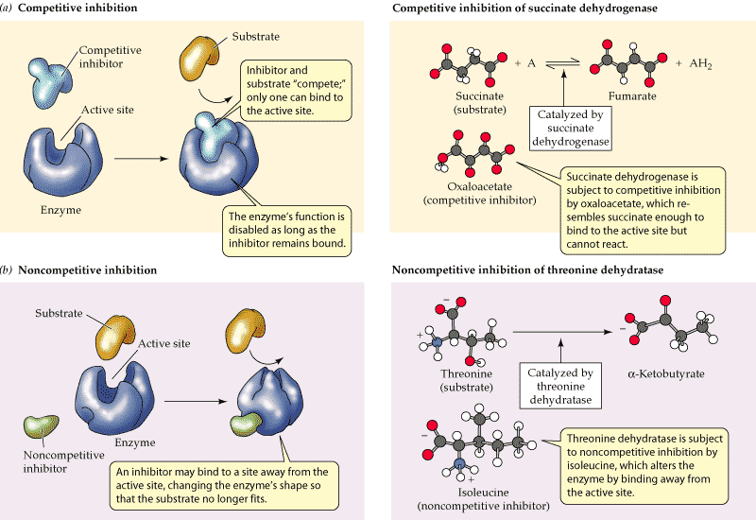
Noncompetitive inhibition

Slide 19

Noncompetitive Inhibition - Reaction Mechanism
In noncompetitive inhibition, the inhibitor binds enzyme irregardless of whether the substrate is bound

Slide 20
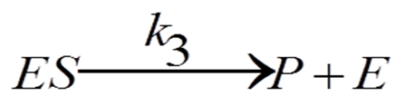
Noncompetitive inhibition
km
E + S
Since noncompetitive inhibitors do not interfere in the binding of the substrate (the dissociation constant of ES and ESI have the same value km)
- Km is not affected
+
+
I
I
kI
kI
km
EI+S
ESI

Slide 21
Noncompetitive inhibition
However, increasing [S] can not abolish the inhibition - (ESI) complex are formed and these are incapable of progressing to reaction products
The effect of a noncompetitive inhibitor is to reduce [ES] that can advance to product
Since Vmax = k3[Eo], and the concentration of competent Eo is diminished by the amount of ESI formed
- Vmax is decreased

Slide 22
Noncompetitive inhibitors decrease the V_{max,app}, but don’t affect the K_{m}
V_{max,app} < V_{max}
K_{m,app} = K_{m}

Slide 23
Why does K_{m,app} = K_{m} for noncompetitive inhibition?
The inhibitor binds
equally well to free
enzyme and the ES
complex, so it doesn’t
alter apparent affinity
of the enzyme for the
substrate

Slide 24
The Lineweaver-Burk plot is diagnostic for noncompetitive inhibition

Slide 25
Relating the Michaelis-Menten equation, the v vs. [S] plot, and the physical picture of noncompetitive inhibition
Inhibitor doesn’t interfere
with substrate binding,
K_{m,app} = K_{m}
Even at high
substrate levels,
inhibitor still binds,
[E]_{t} < [ES]
V_{max,app} < V_{max}
K_{m,app} > K_{m}
V_{max,app} = V_{max}
V_{max,app} < V_{max}
K_{m,app} = K_{m}
Formation of EI
complex shifts reaction
to the left: K_{m,app} > K_{m}

Slide 26
Noncompetitive inhibition
Assume
Rapid equilibrium
Same equilibrium constant of inhibitor binding to E and ES……… KI
Same equilibrium constant of inhibitor binding to E and EI ……….KM

Slide 27
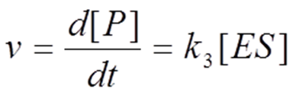
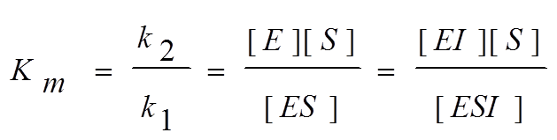
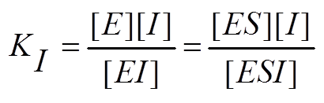

Noncompetitive inhibition

Slide 28
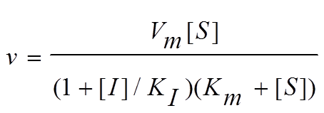
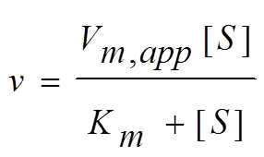




Noncompetitive inhibition
Remains in Michaelis-menten equation
Is reduced
When [I}= 0,

Slide 29
Uncompetitive Inhibition - Reaction Mechanism
In uncompetitive inhibition, the inhibitor binds only to the ES complex, it does not bind to the free enzyme

Slide 30
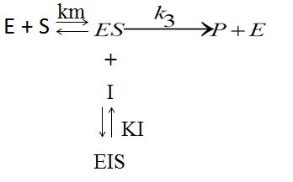
Uncompetitive inhibition
The ES complex dissociates the substrate with a dissociation constant equal to Km, whereas the ESI complex does not dissociate it (i.e. has a Km value equal to zero)
- Km is decreased
Increasing [S] leads to increasing [ESI] (a complex incapable of progressing to reaction products), therefore the inhibition can not be removed
- Vmax is decreased

Slide 31
Uncompetitive inhibitors decrease both the V_{max,app} and the K_{m,app}
V_{max,app} < V_{max}
K_{m,app} < K_{m}
Notice that at low substrate concentrations, uncompetitive inhibitors have little effect on the reaction rate because the lower K_{m,app} of the enzyme offsets the decreased V_{max,app}

Slide 32
Uncompetitive inhibitors decrease both the V_{max,app} and the K_{m,app} of the enzyme
Notice that uncompetitive inhibitors don’t bind to the free enzyme, so there is no EI complex in the reaction mechanism

Slide 33
The Lineweaver-Burk plot is diagnostic for uncompetitive inhibition

Slide 34
Relating the Michaelis-Menten equation, the v vs. [S] plot, and the physical picture of uncompetitive inhibition
Inhibitor
increases
the amount of
enzyme bound
to substrate
K_{m,app} < K_{m}
V_{max,app} < V_{max}
K_{m,app}< K_{m}
Even at high
substrate levels,
inhibitor binds,
[E]_{t} < [ES]
V_{max,app} < V_{max}
Formation of EI
complex shifts reaction
to the left: K_{m,app} > K_{m}

Slide 35
Effect of Temperature
Enzymes have an optimum temperature at which they are most active
The optimum temperature for most human enzymes is normal body temperature, 37 oC
Above optimum temperature, enzymes lose activity due to disruption of intermolecular forces stabilizing the tertiary structure.

Slide 36
0°C
Low temperatures - low Kinetic Energy of enzymes and substrates.
No/Very few enzyme-substrate complexes are formed.
Enzymes are inactivated.

Slide 37
20°C (increasing temperature)
Increasing the temperature will lead to the increase in kinetic energy of enzyme and substrate molecules.
Enzyme and substrate molecules move with increasing speed and collide more frequently with each other.
This increases the rate of enzyme-substrate complex formation This increases the rate of enzyme-substrate complex formation and product formation.
Notes:
Rate of a reaction increases

Slide 38
37°C
As the temperature continues to increase, the rate of enzyme activity also increases until the optimal temperature is reached.
Optimal temperature is the temperature at which the enzyme works best. Rate of product formation is highest!

Slide 39
Beyond Optimal Temperatures
At high temperatures (>60°C), weak bonds within the enzyme molecule are broken
Enzyme loses its shape and its active site.
Loss of shape leads to a loss of function. Enzyme is said to have denatured
Denaturation is the change in 3D structure of an enzyme or any other protein caused by heat or chemicals such as acids or alkali, causing it to lose its function.

Slide 40
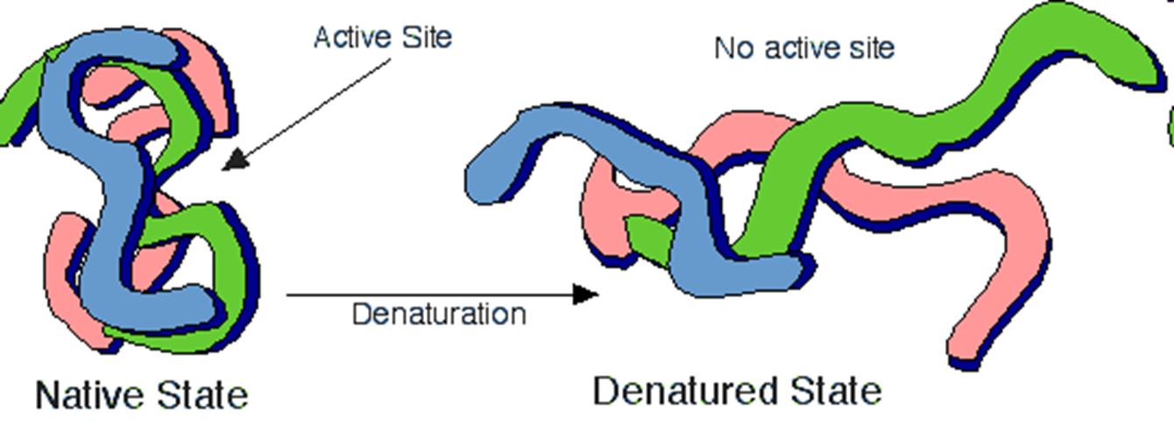
Denaturation
Different enzymes denature at different temperatures. Most enzymes denature at temperatures higher than 60°C. However, there are some enzymes that stay active even at high temperatures like 80°C (Enzymes in the bacteria Thermus aquaticus)
Notes:
Denature=unfold(take on a different shape)

Slide 41
Effect of PH
When the enzyme environment is changed by pH, its tertiary structure is disrupted, altering the active site and causing the enzyme’s activity to decrease.
Enzymes are most active at a pH known as their optimum pH.
At optimum pH, the enzyme maintains its tertiary structure and its active site.

Slide 42
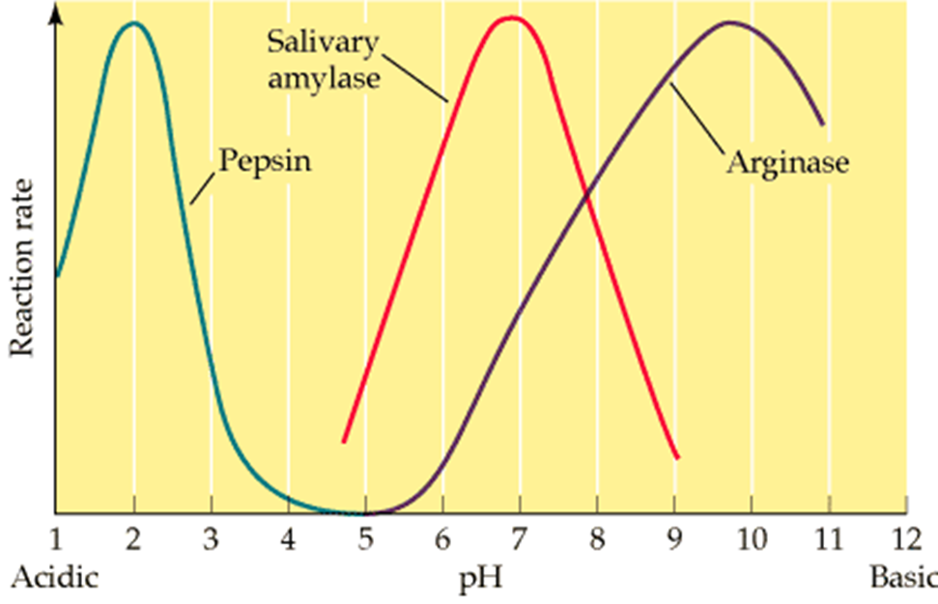
A change in pH can alter the ionization of the R groups of the amino acids. When the charges on the amino acids change, hydrogen bonding within the protein molecule change and the molecule changes shape. The new shape may not be effective.

Slide 44
